Slide 1
Hayward Eden Area Shoreline Resilience Collaborative
Sea Level Rise Community Workshop #2
June 27, 2026
Notes:
Cailin

Slide 2
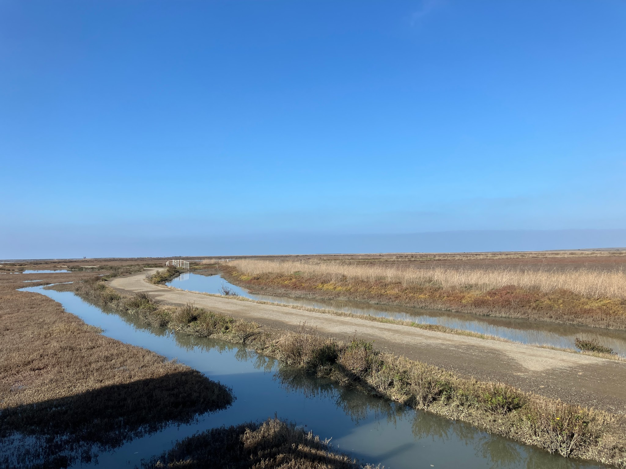
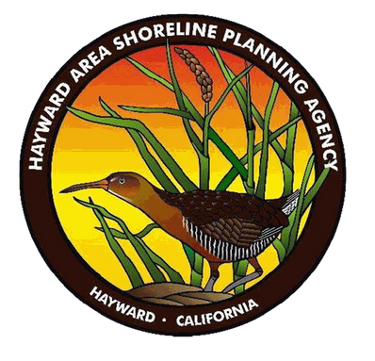
Welcome
Brian Laczko
Hayward Area Recreation & Park District (HARD)
Hayward Area Shoreline Planning Agency (HASPA)
Notes:
Brian

Slide 3
AGENDA
I. Welcome, Goals & Ground Rules
II. Land Acknowledgement
III. Project Overviews
IV. Gallery Walk
V. Closing
VI. Optional visit to view First Mile Project
Notes:
Cailin

Slide 4
GROUND RULES
Engage in active listening
Seek first to understand, not to be understood
Step up, step back. No one or two individuals should dominate the conversation
Engage in your realm of experience and expertise, and respect and engage others in theirs
Take ownership for positive outcomes
No bad ideas – let’s make this a “yes, and…” space
Notes:
Cailin

Slide 5
WORKSHOP GOALS
Build awareness about flood risks and efforts to mitigate these impacts.
Update the community on the latest shoreline adaptation project designs and plans.
Answer questions and get your feedback on your concerns and aspirations for your community.
Notes:
Cailin

Slide 6
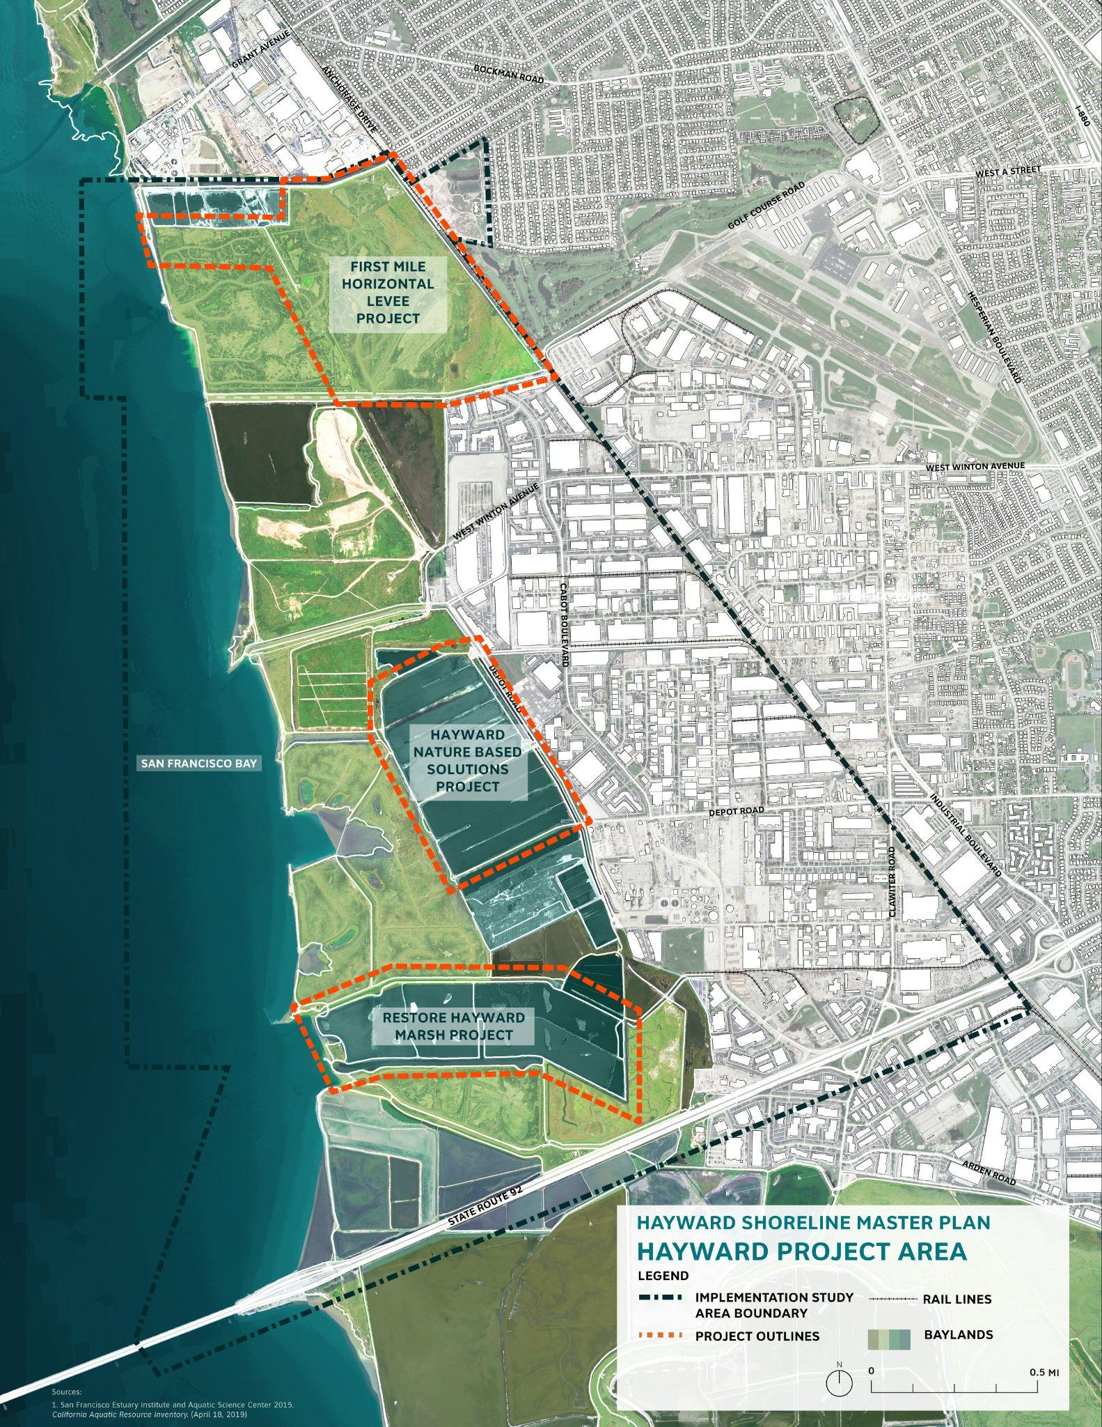
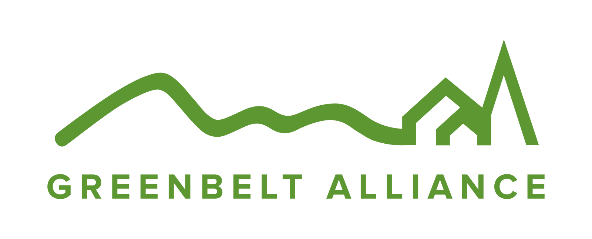




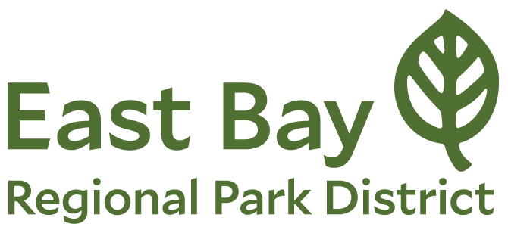

Hayward Eden Area Shoreline
Resilience Collaborative
Notes:
Cailin

Slide 7
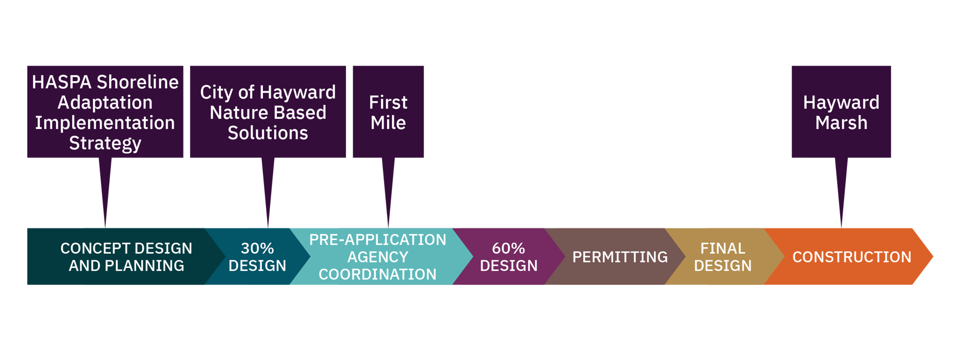
Hayward Eden Area Shoreline
Resilience Collaborative
Notes:
Cailin

Slide 8

Hayward Eden Area Shoreline Resilience Collaborative
Tribal Engagement

Slide 9
Connect Tribal communities to the project planning team in order to:
Create opportunities for Tribal communities to contribute to and learn from the Hayward SLRAP
Identify opportunities for co-benefit elements to include in Hayward SLRAP efforts
Tribal Engagement Goals

Slide 10
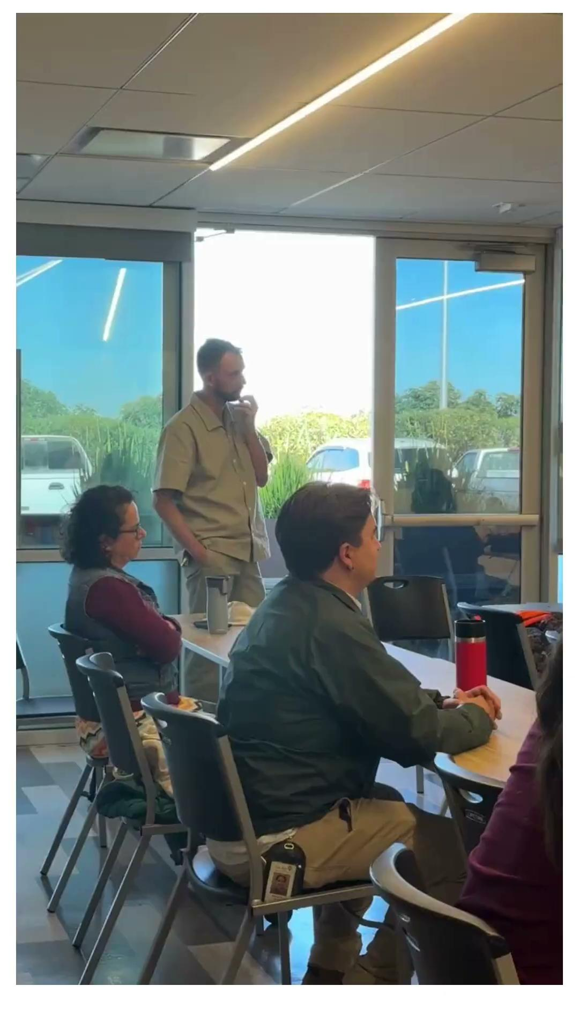
Work completed to date
Confederated Villages of Lisjan Nation (CVL)
11 Meetings with TWP
2 Hayward shoreline site visits
2 meetings with project team(s)
Co-benefit element ideas: tule harvesting, plant palette, education & storytelling
All Tribes
Identify and reach out to all Tribes with ancestry or heritage within the project area (in process)

Slide 11
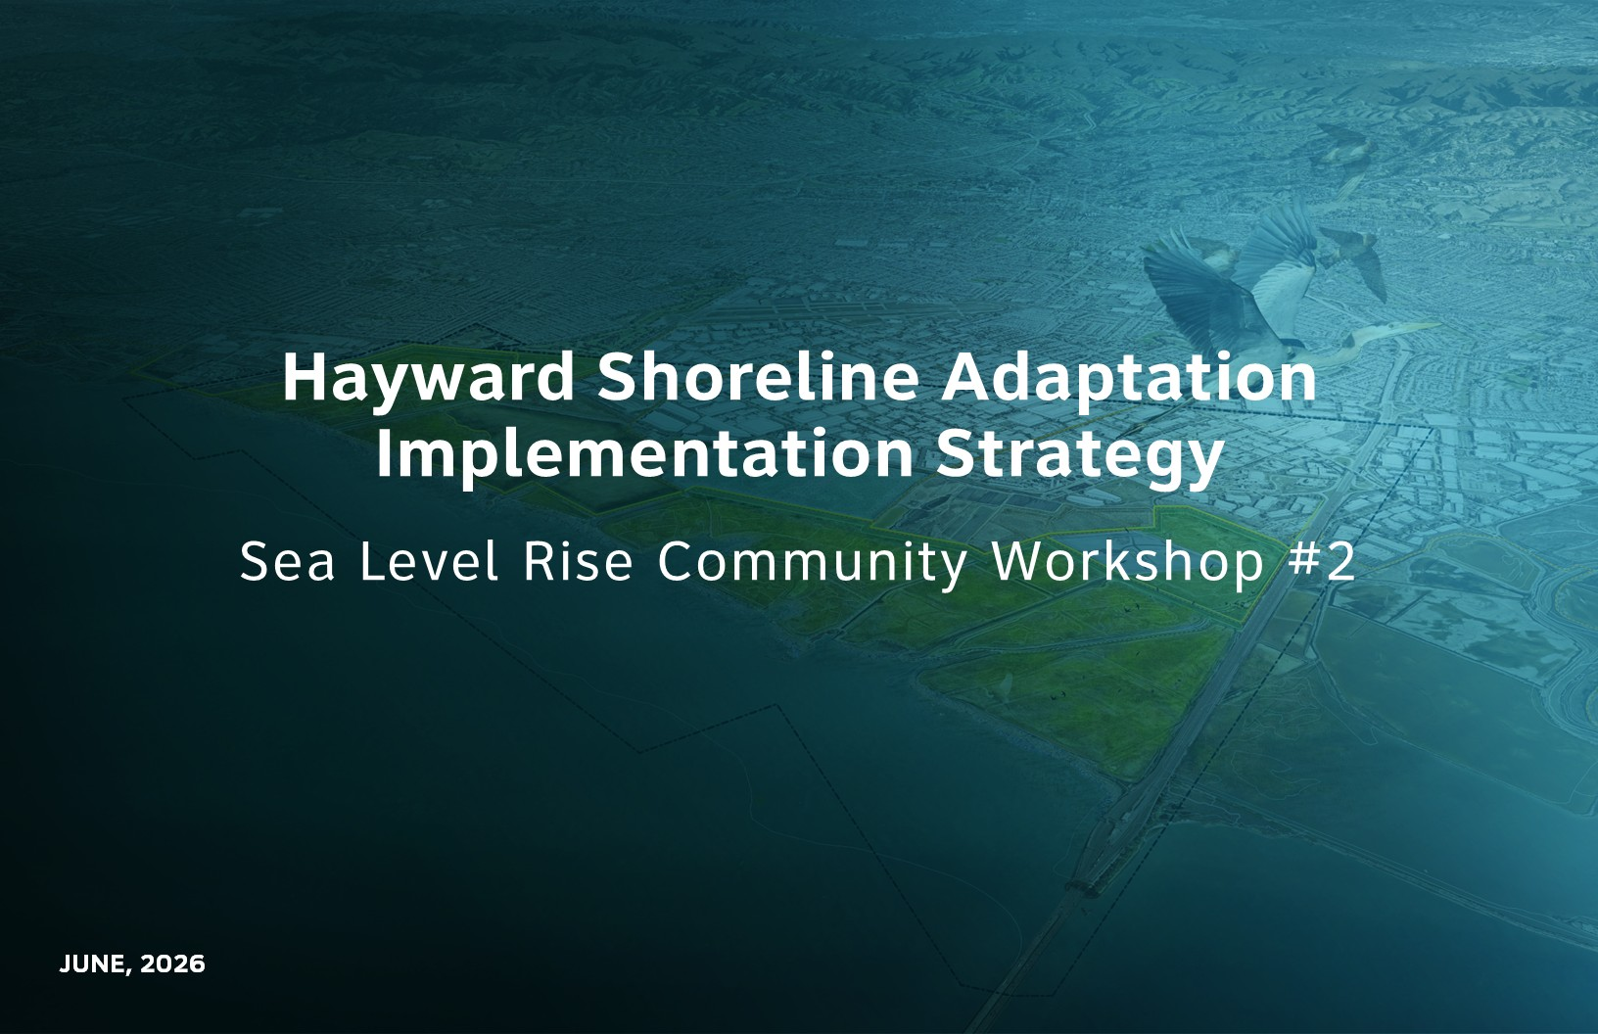

Slide 12
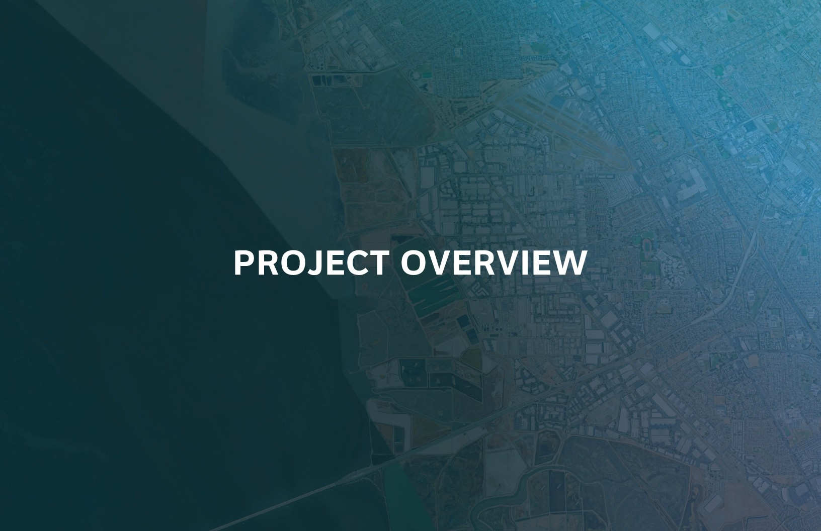

Slide 13
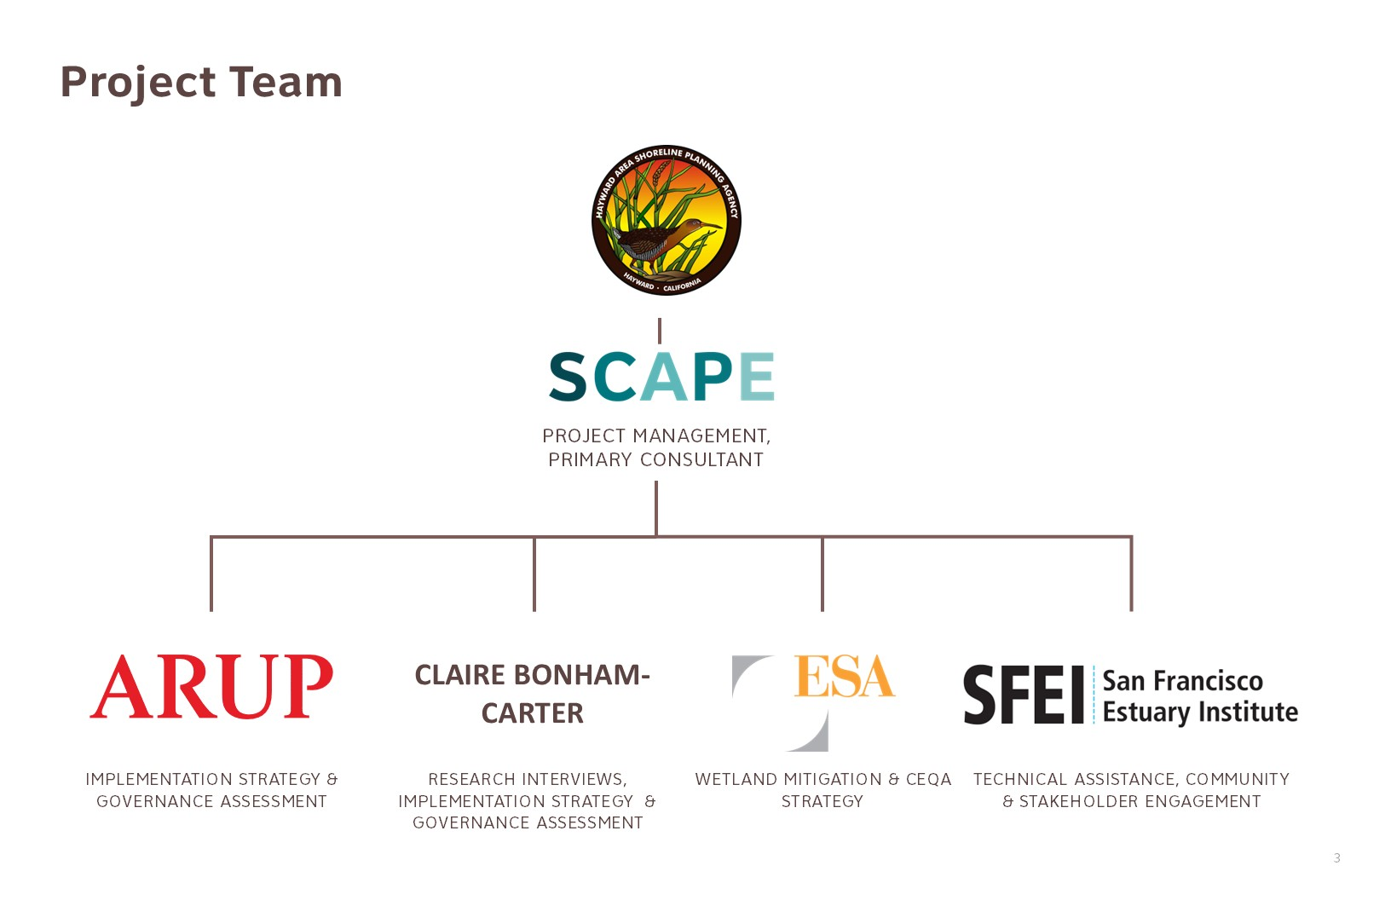

Slide 14
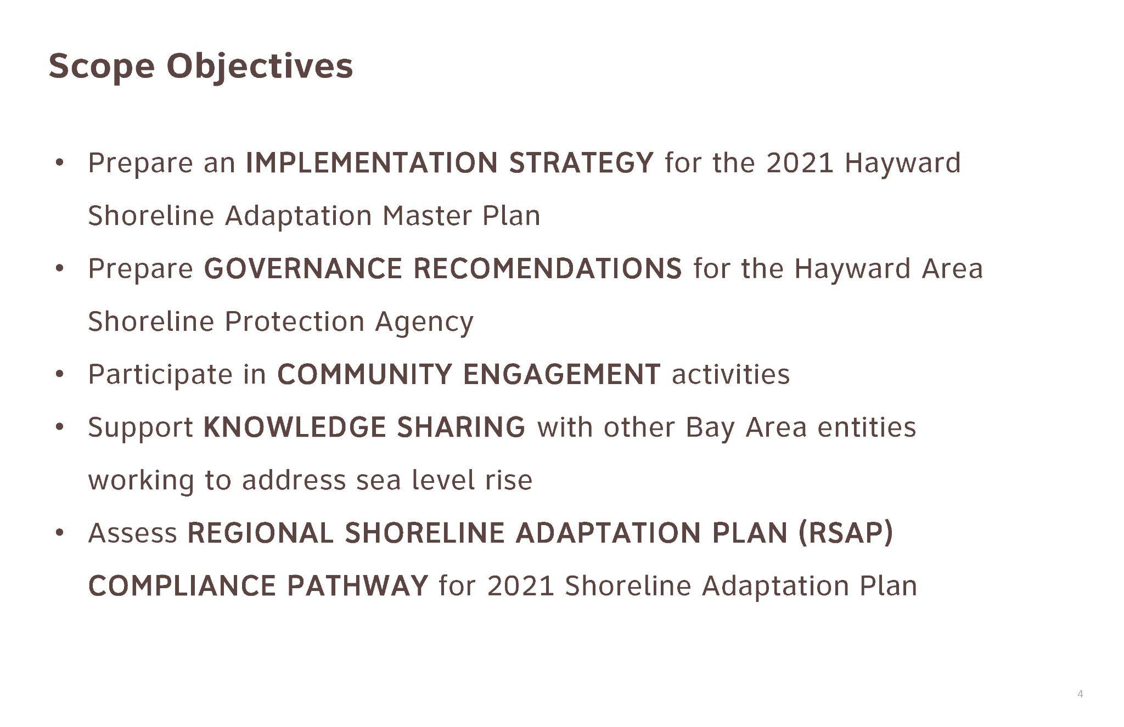

Slide 15
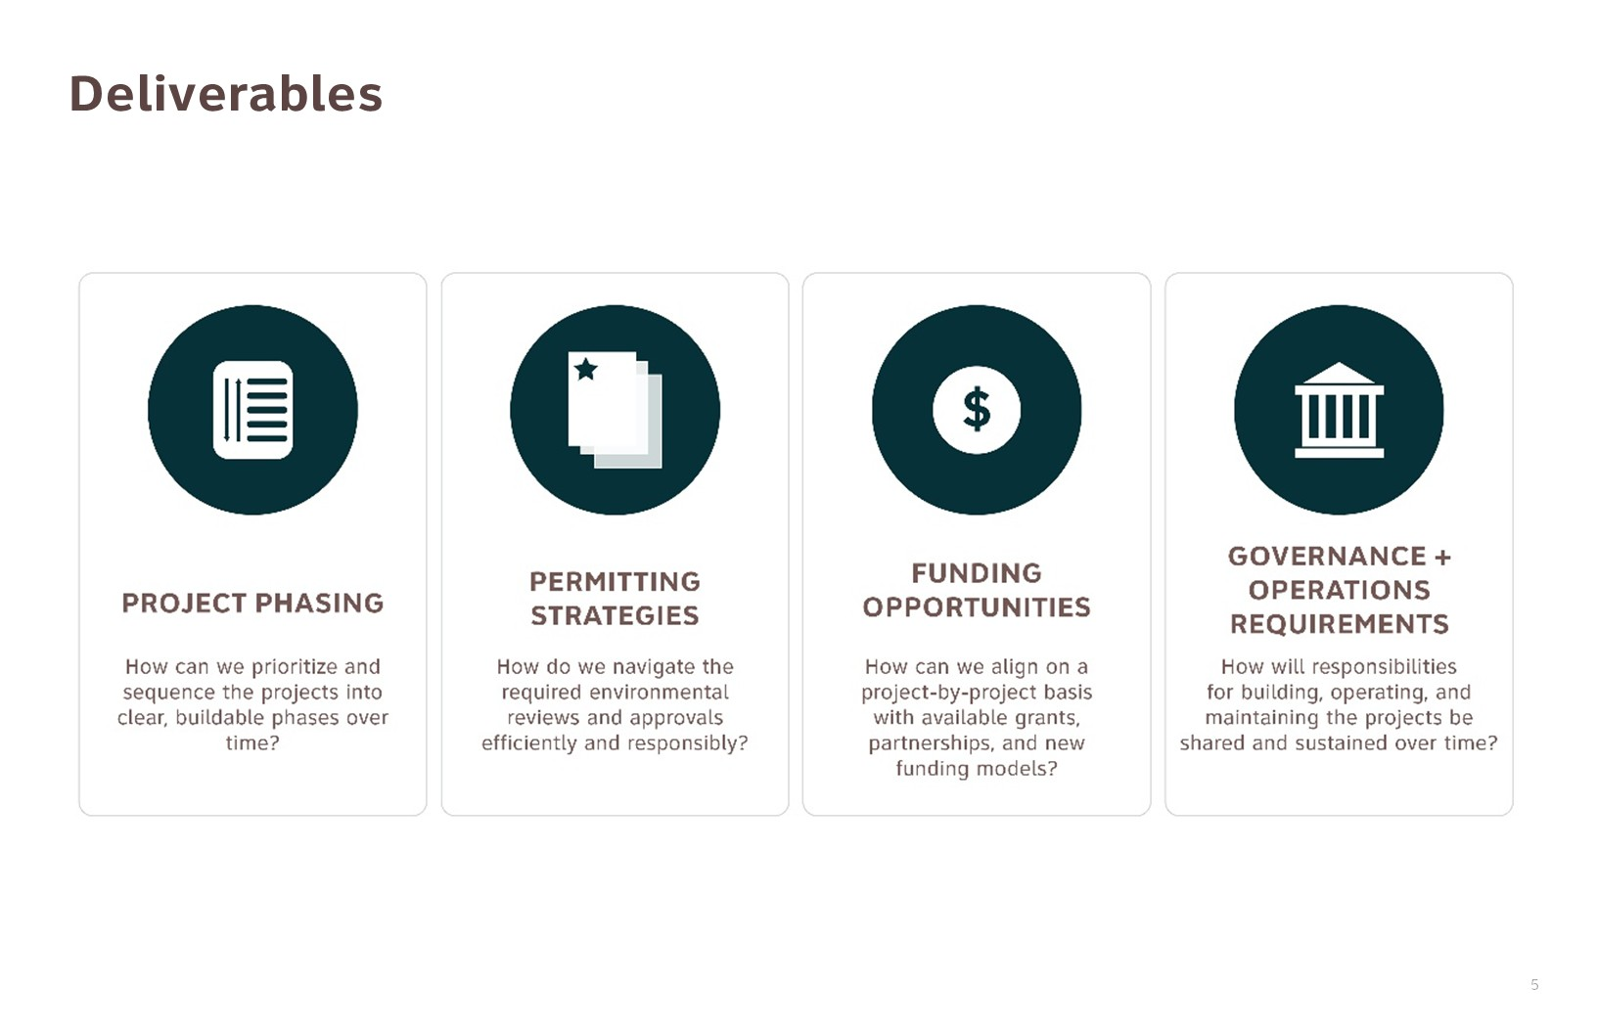

Slide 16
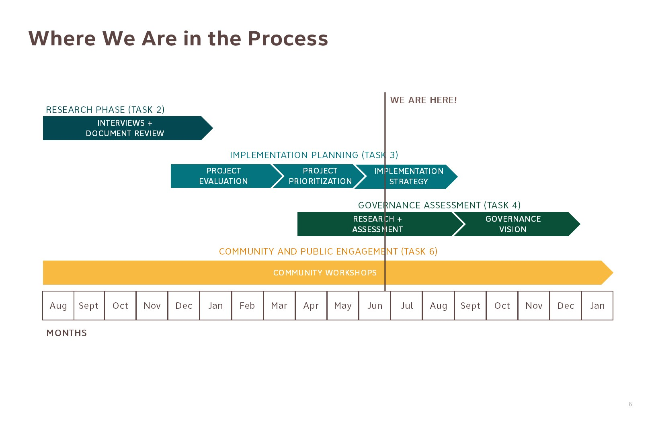

Slide 17
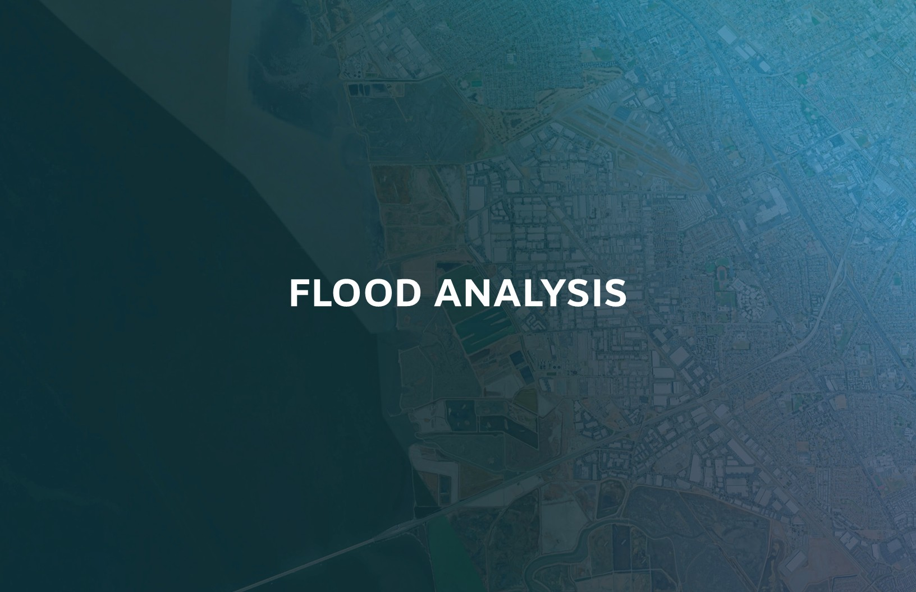

Slide 18
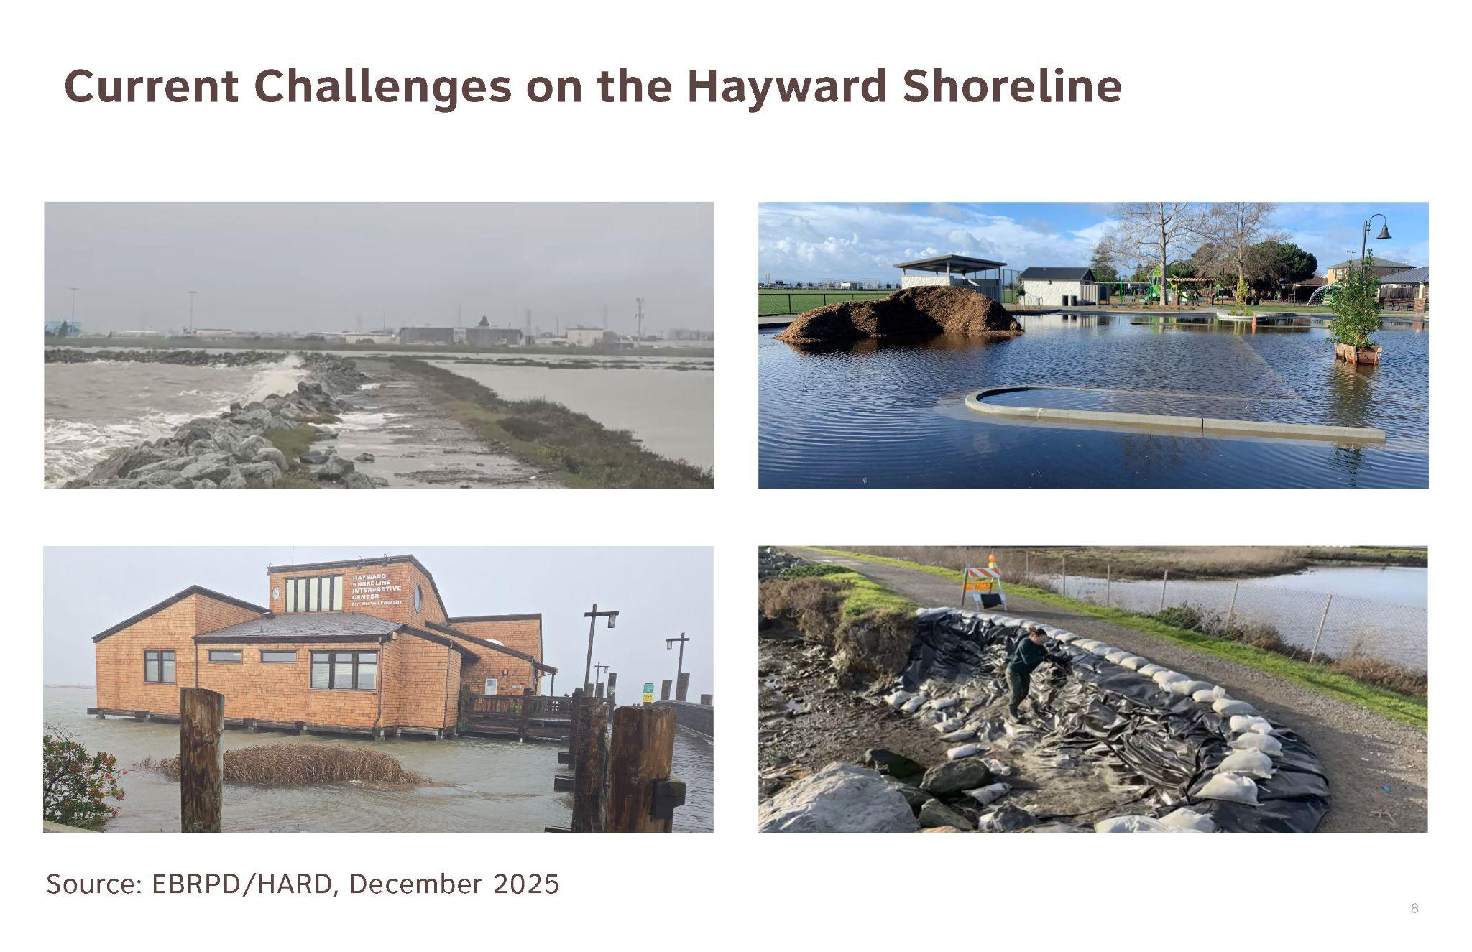
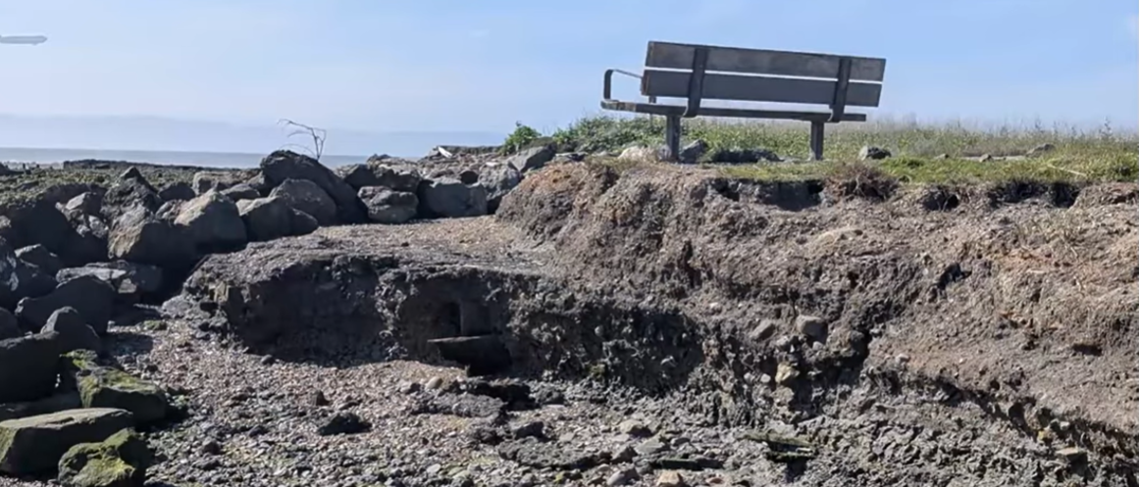

Slide 19
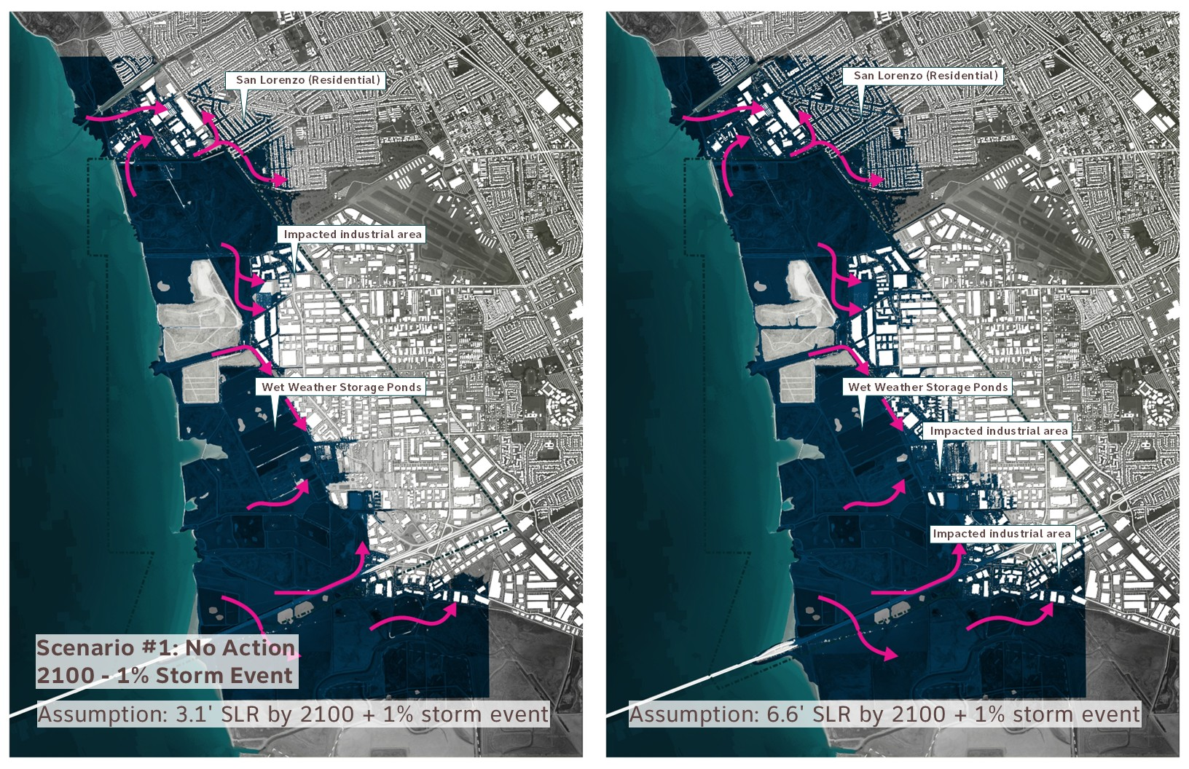

Slide 20
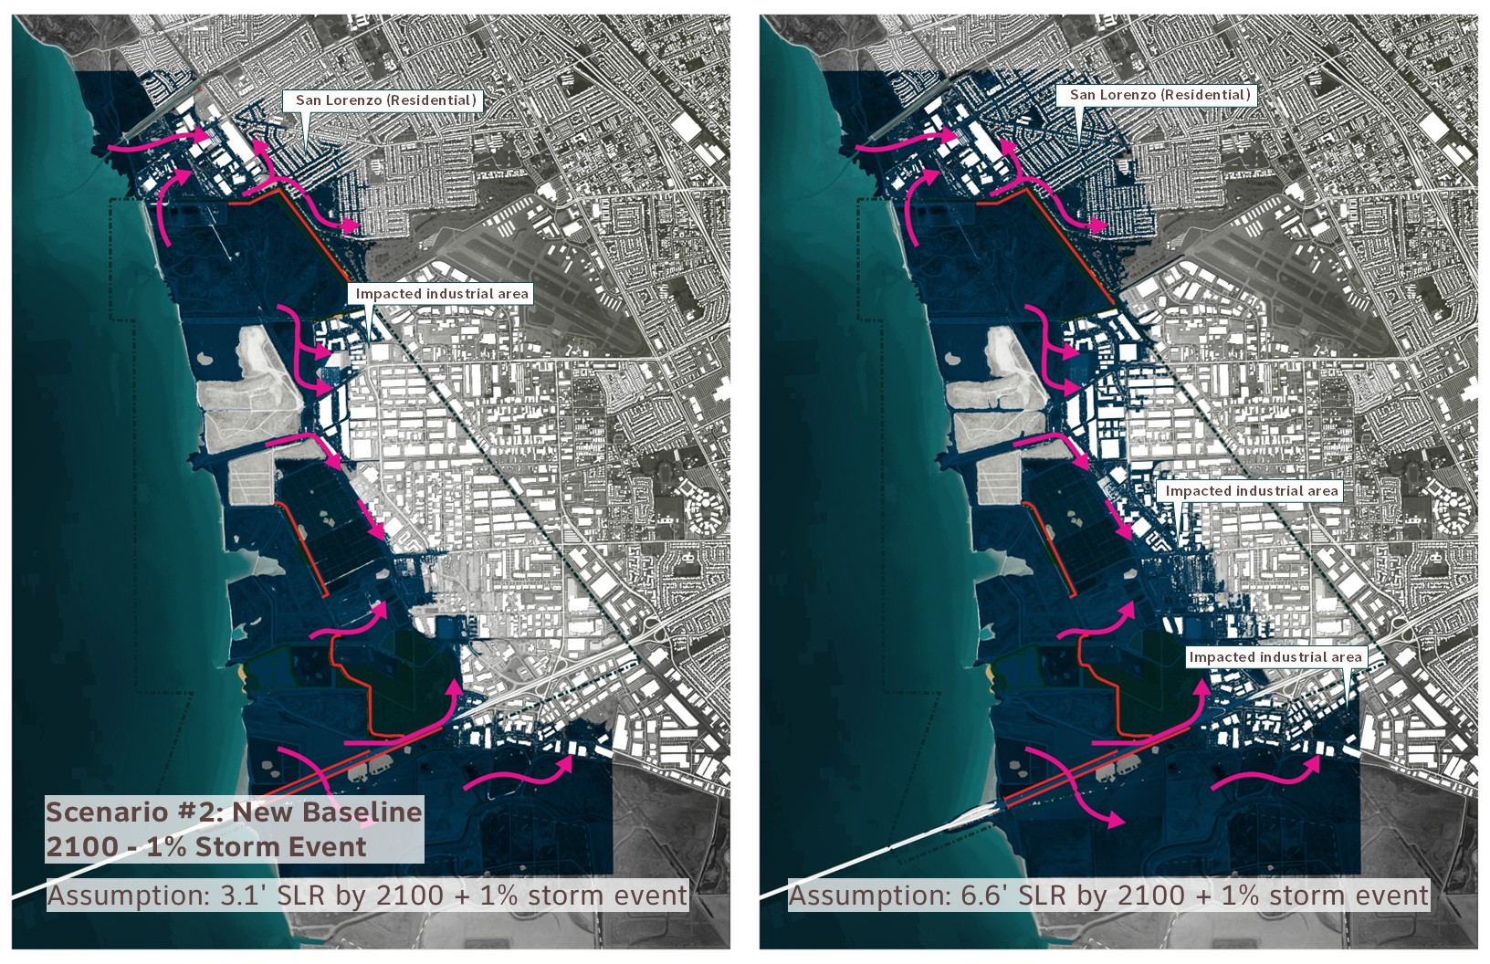

Slide 21
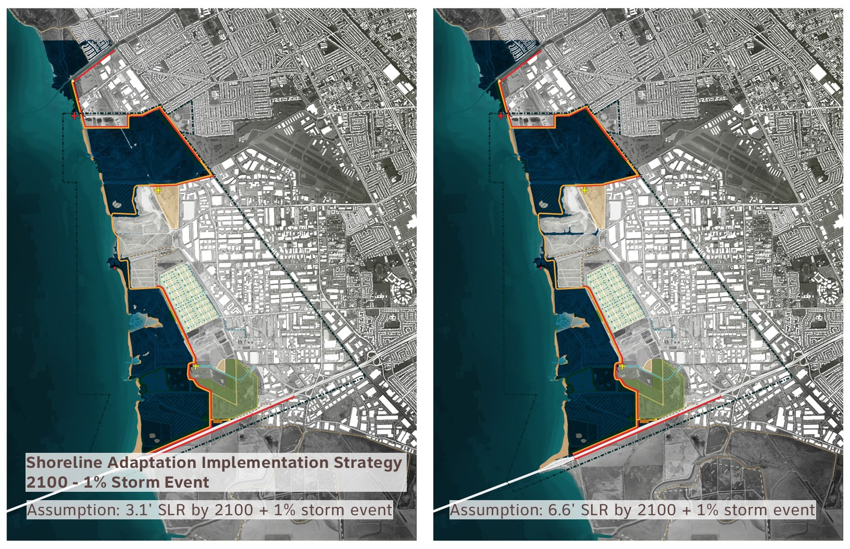

Slide 22
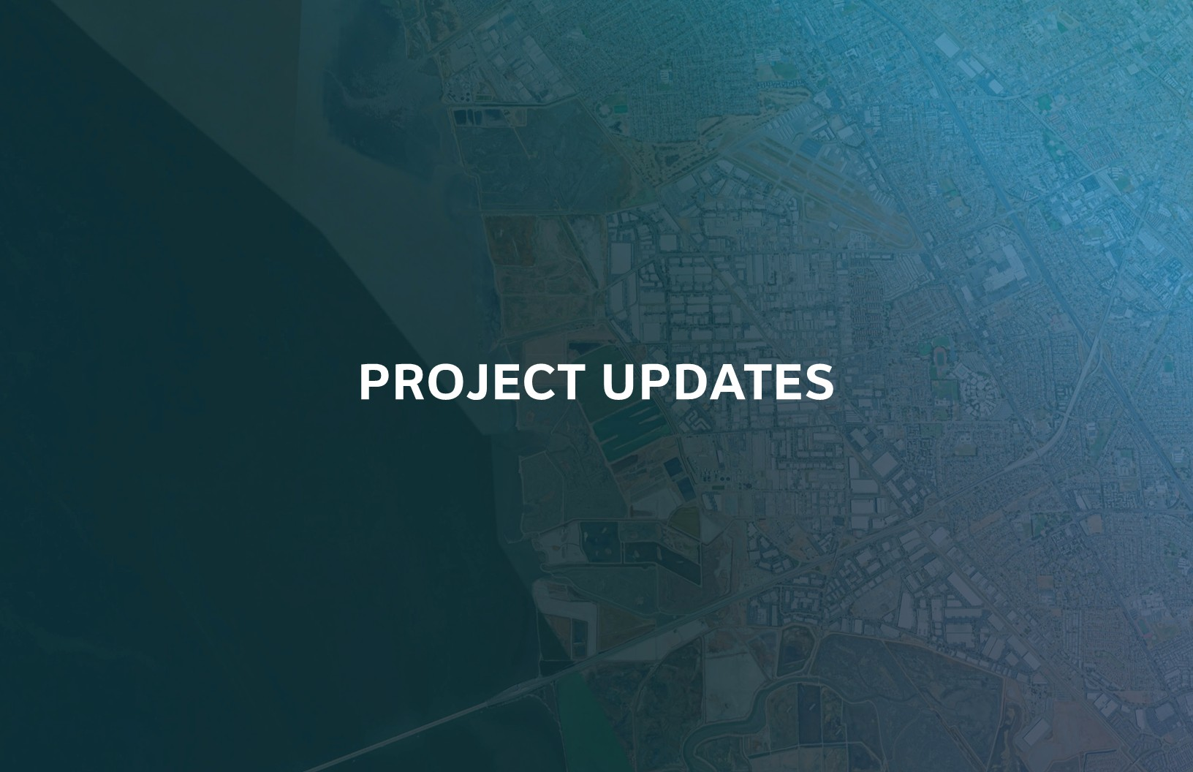

Slide 23
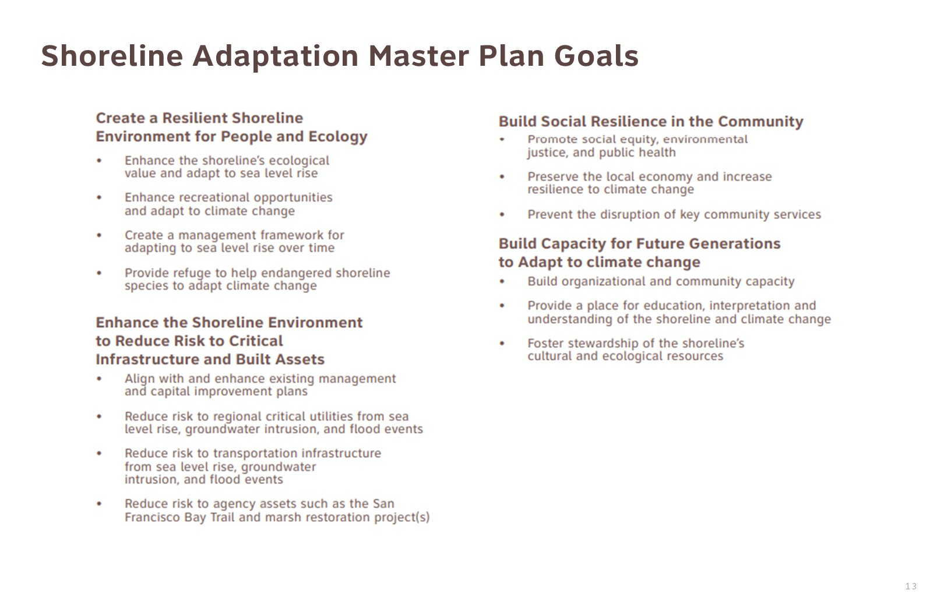

Slide 24
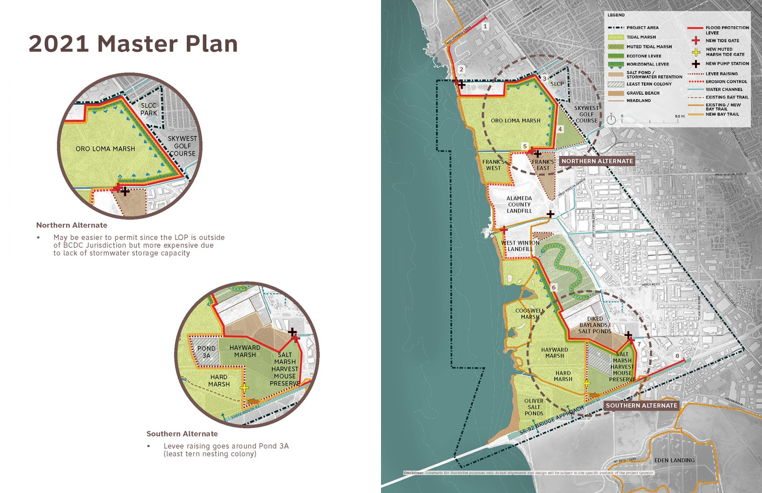

Slide 25
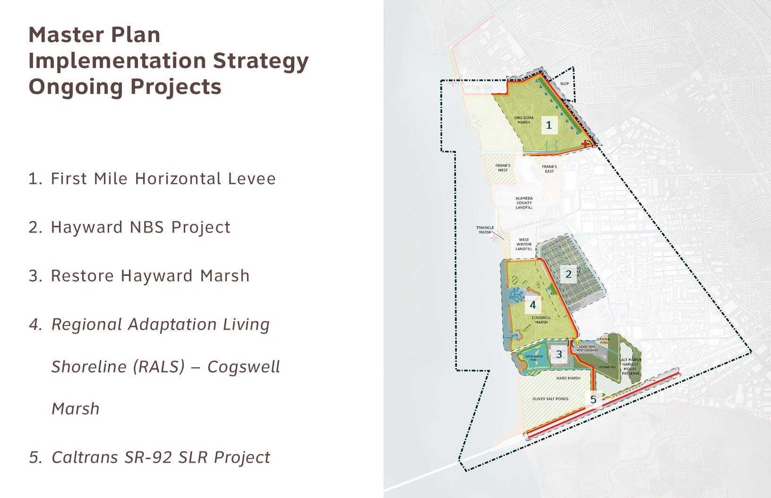

Slide 26
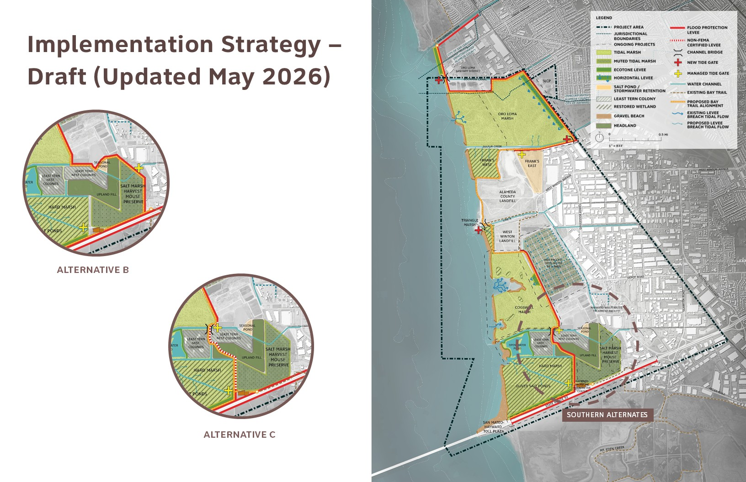

Slide 27
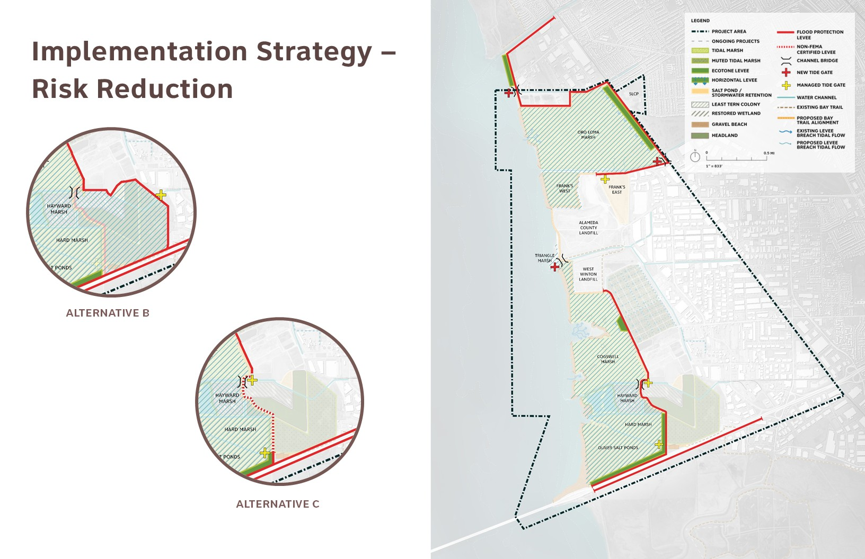

Slide 28
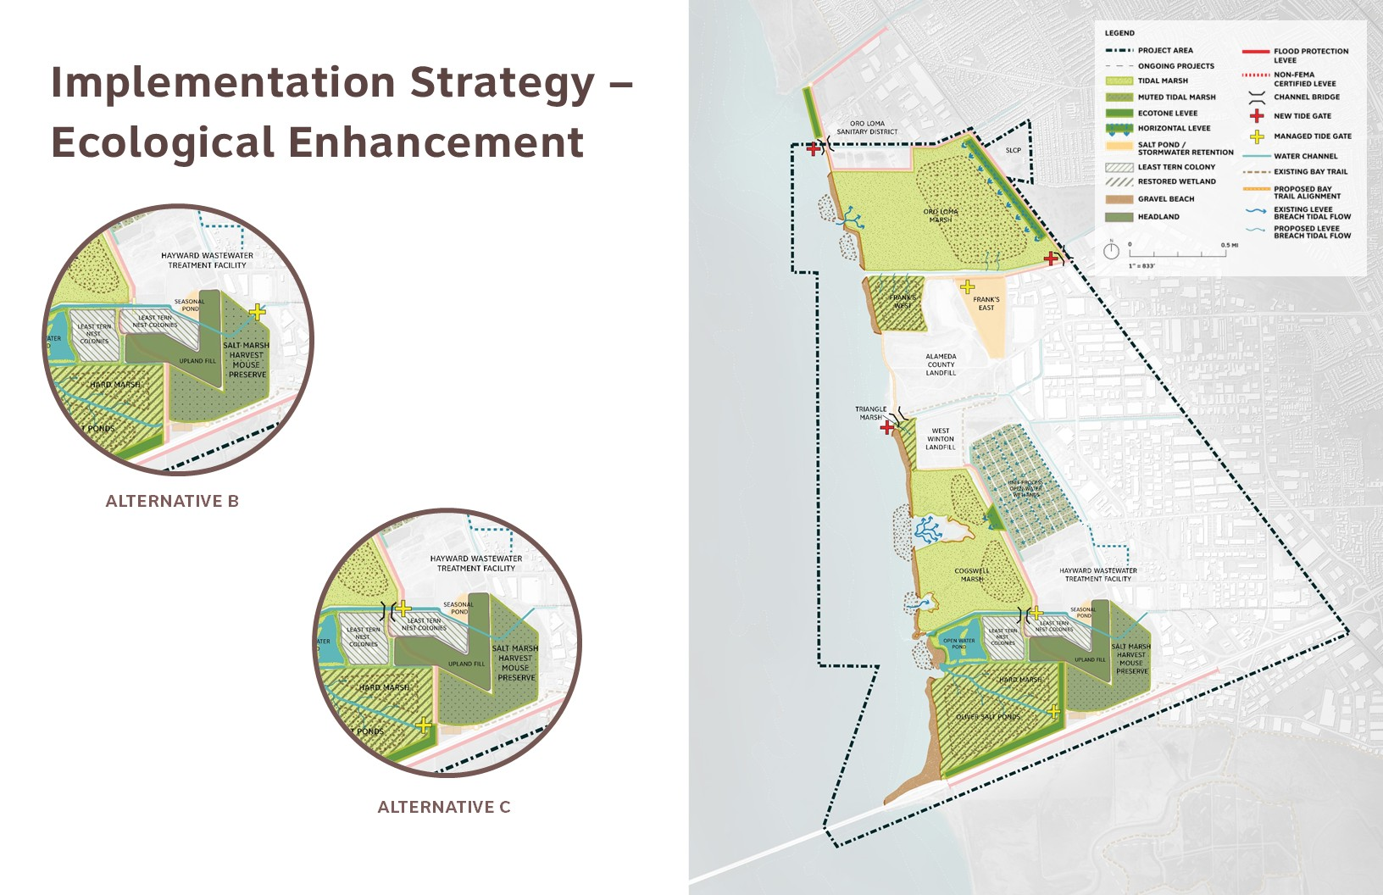

Slide 29
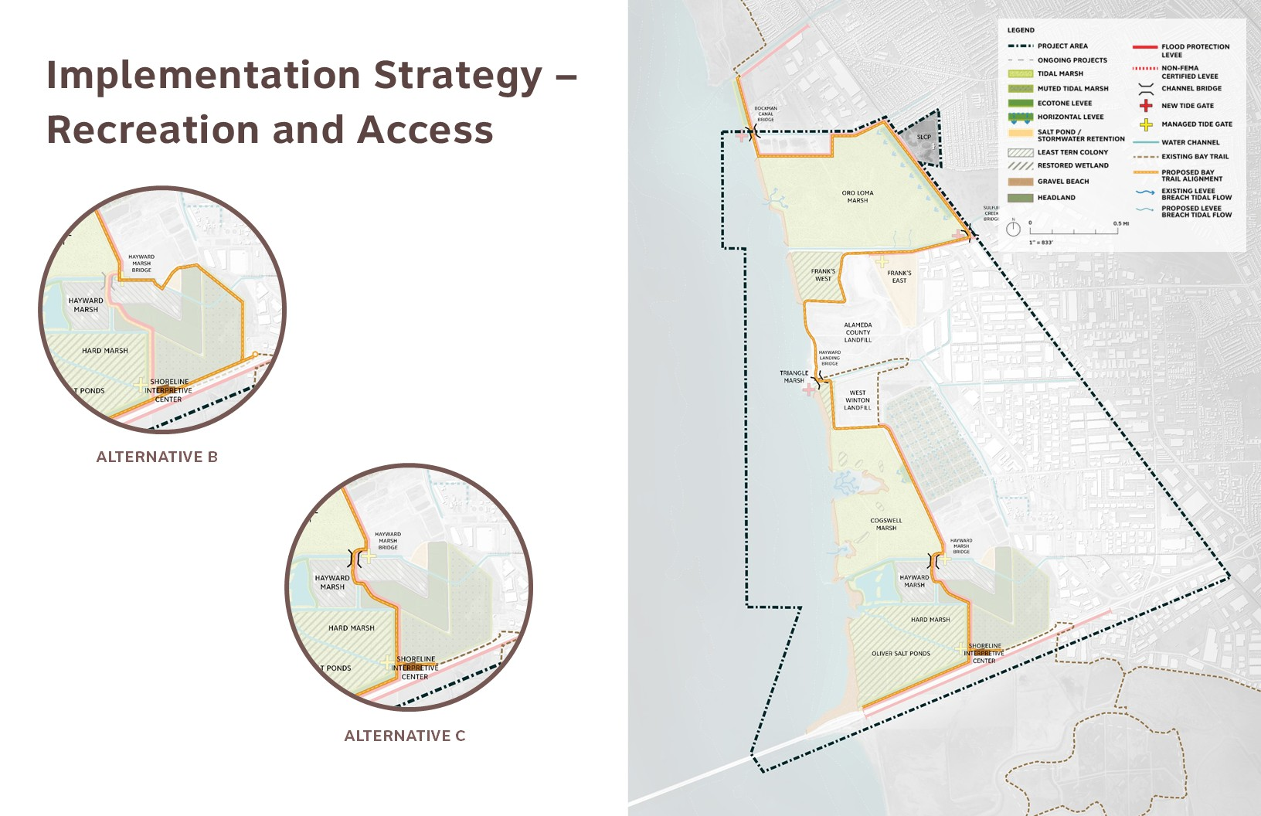

Slide 30
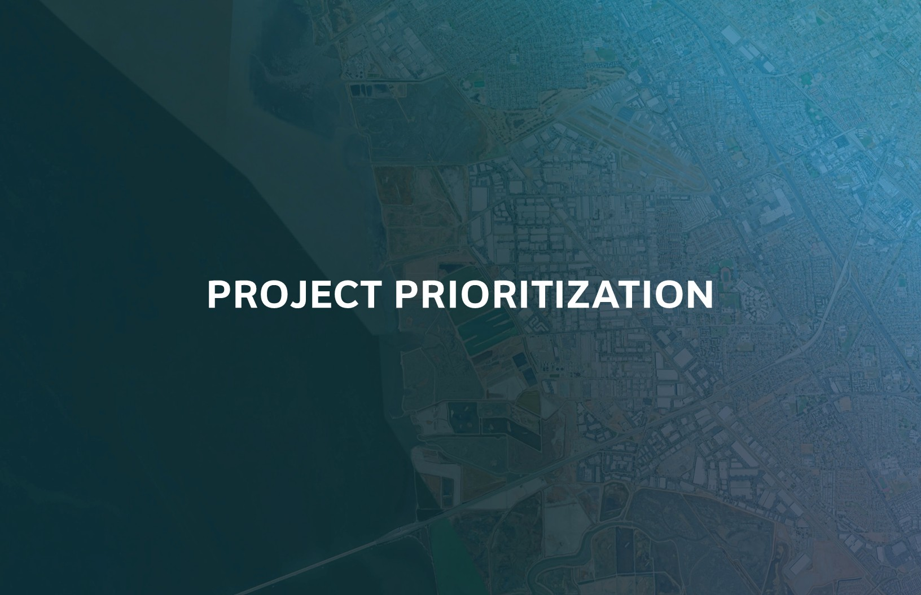

Slide 31
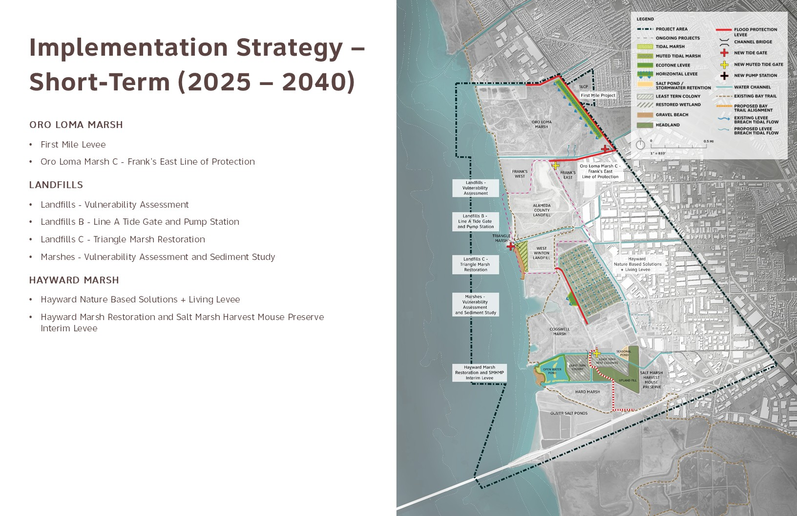

Slide 32
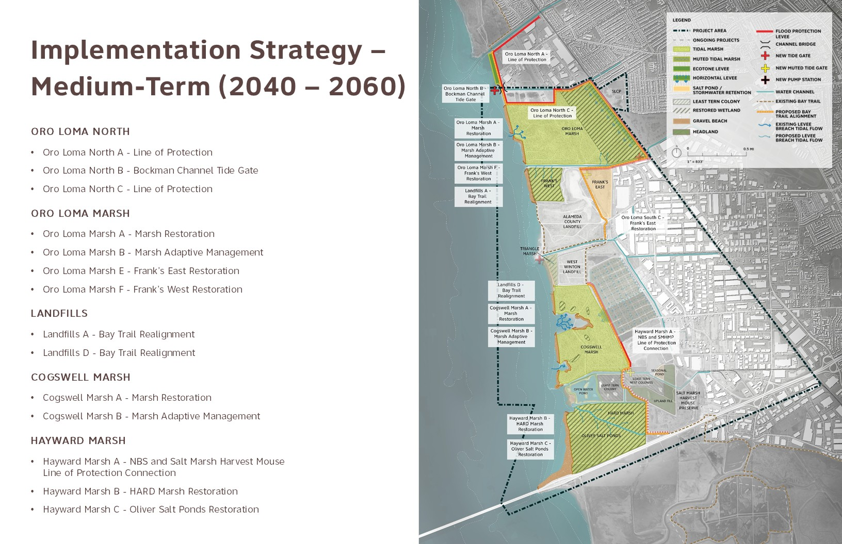

Slide 33
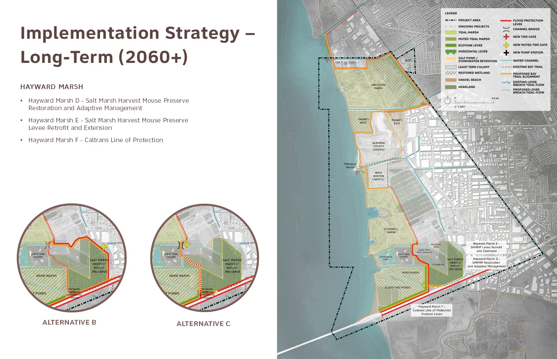

Slide 34
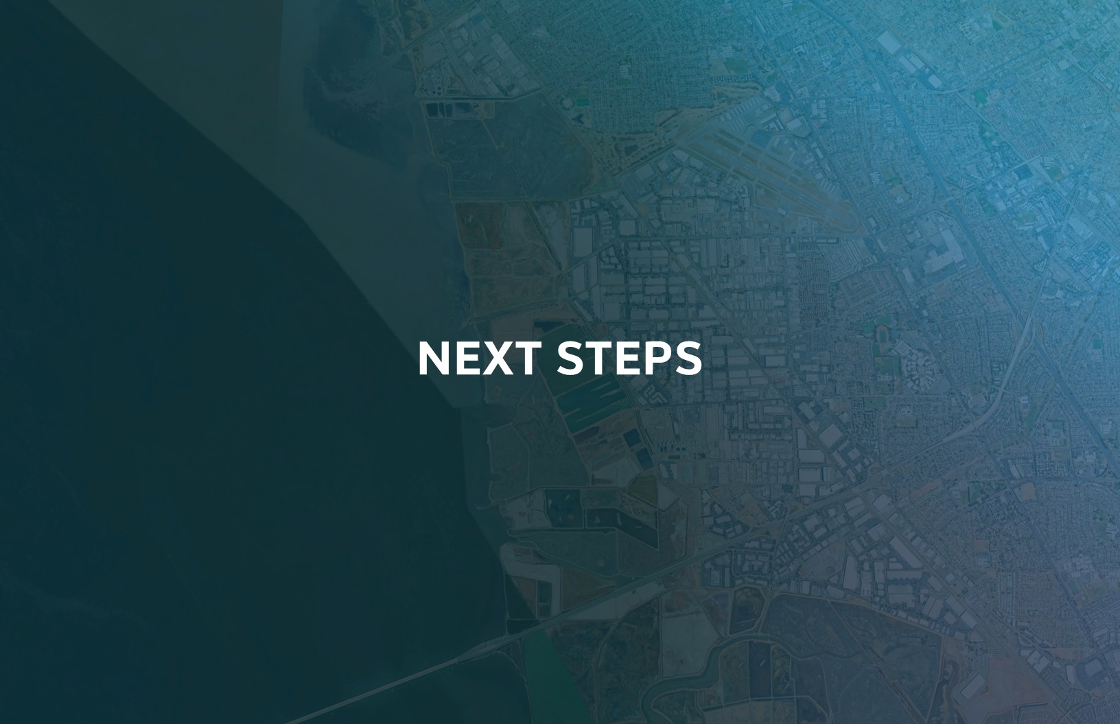

Slide 35
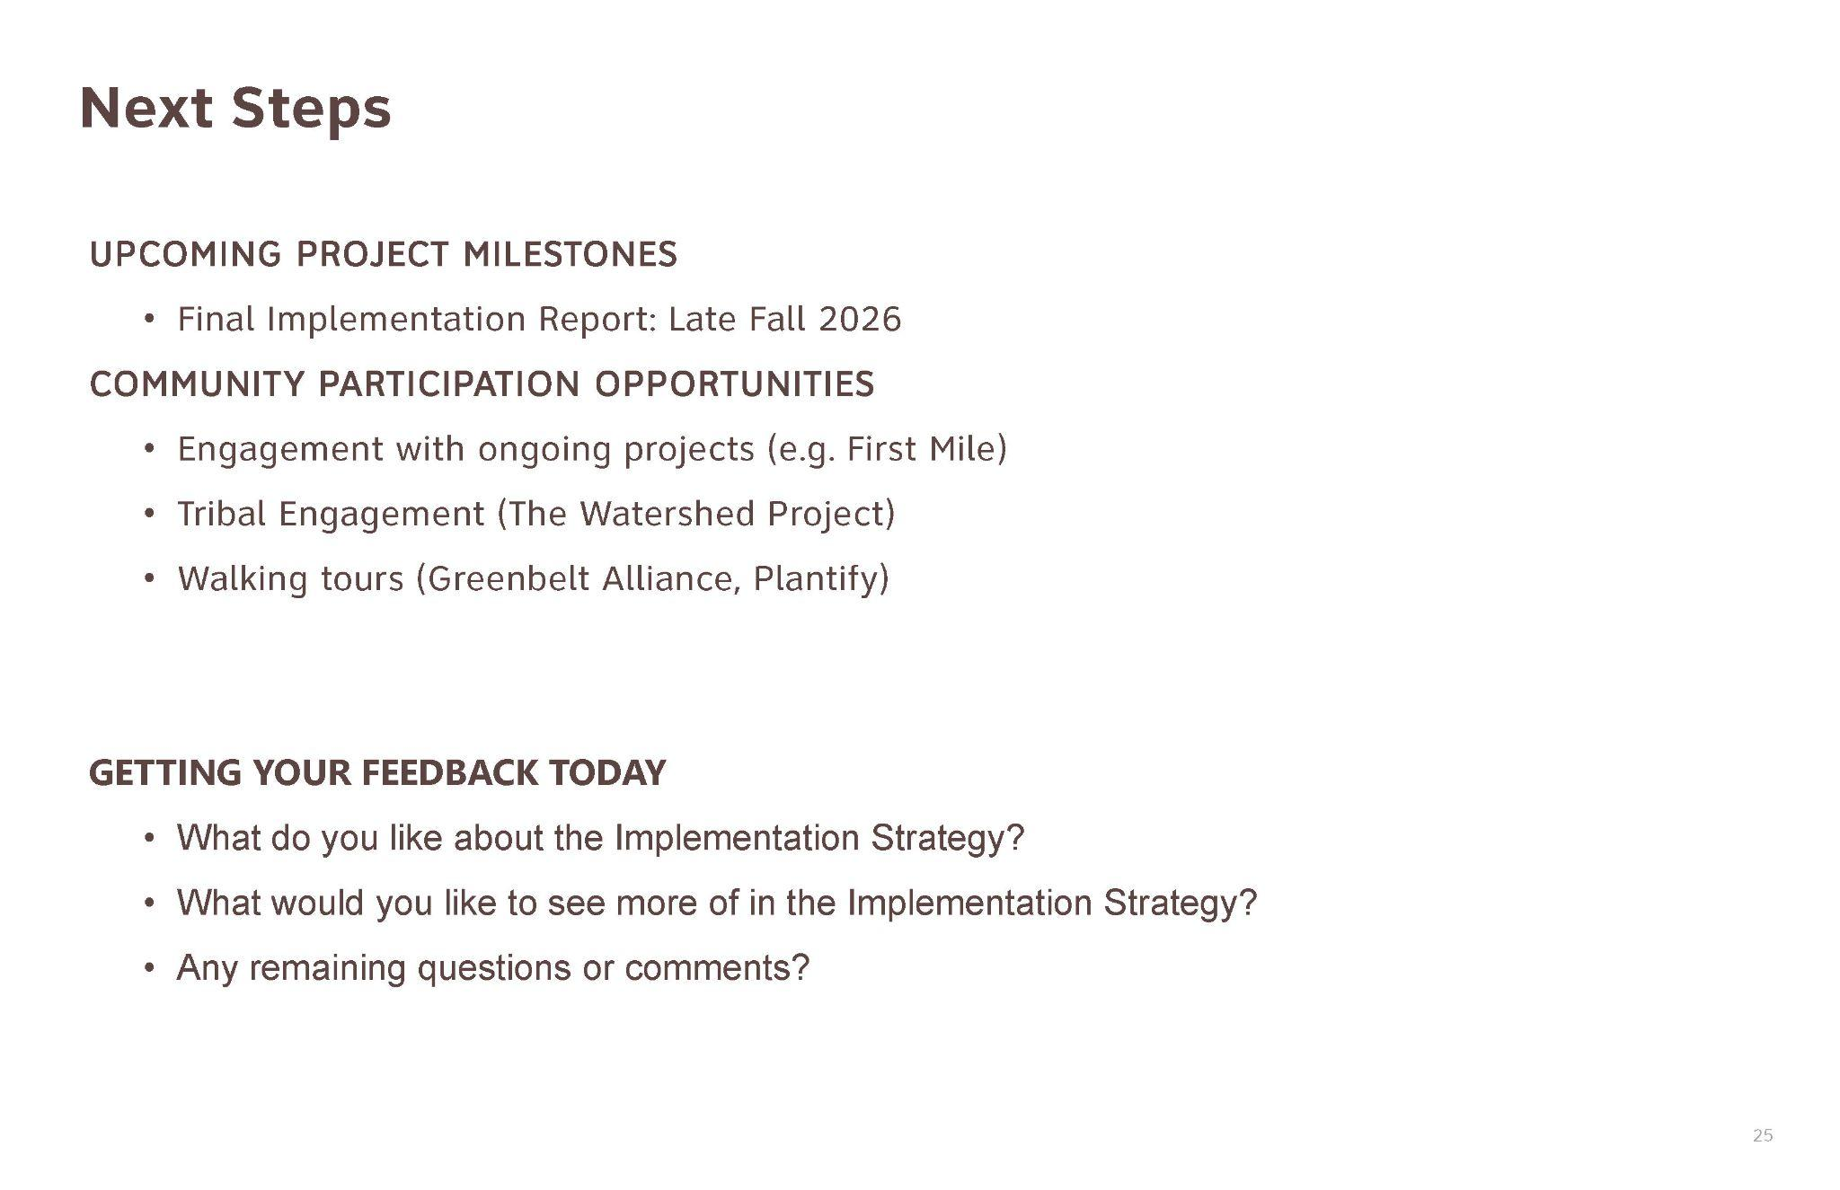

Slide 36
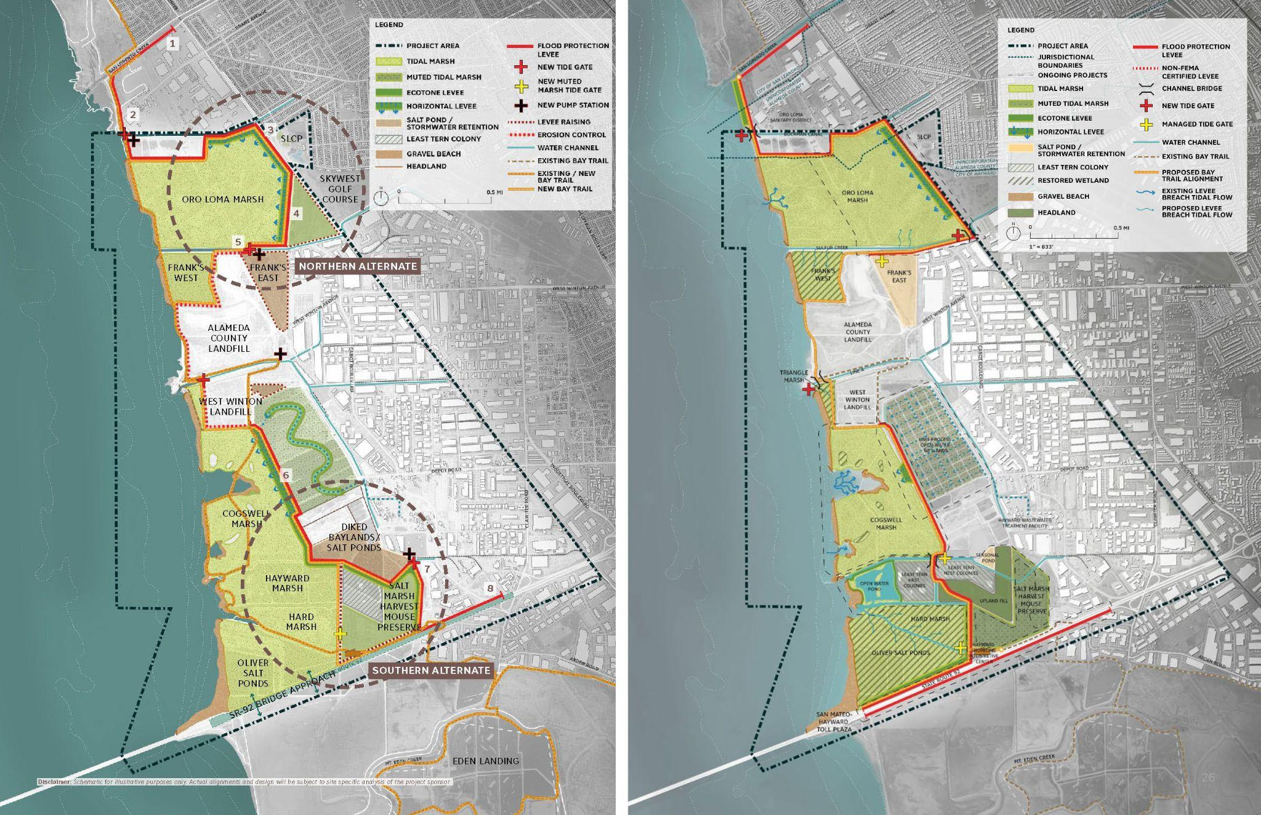
WE WANT TO HEAR FROM YOU!
COME TALK WITH US AT OUR STATION

Slide 37
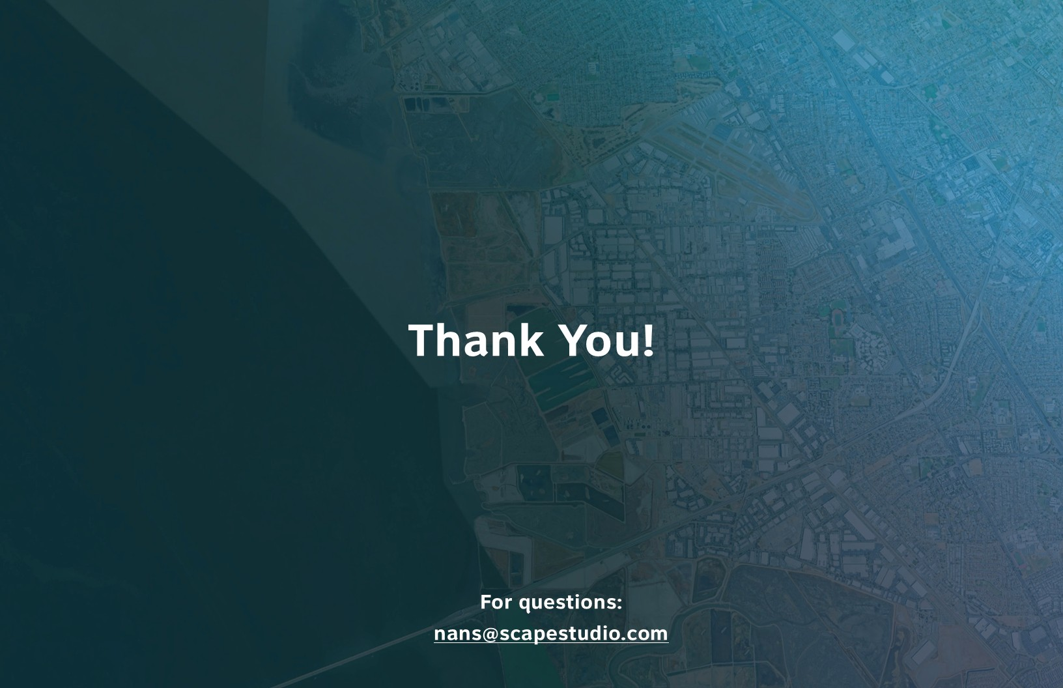

Slide 38
FIRST MILE HORIZONTAL LEVEE
Notes:
Lindsey

Slide 39








First Mile Horizontal Levee | Team Overview

Slide 40
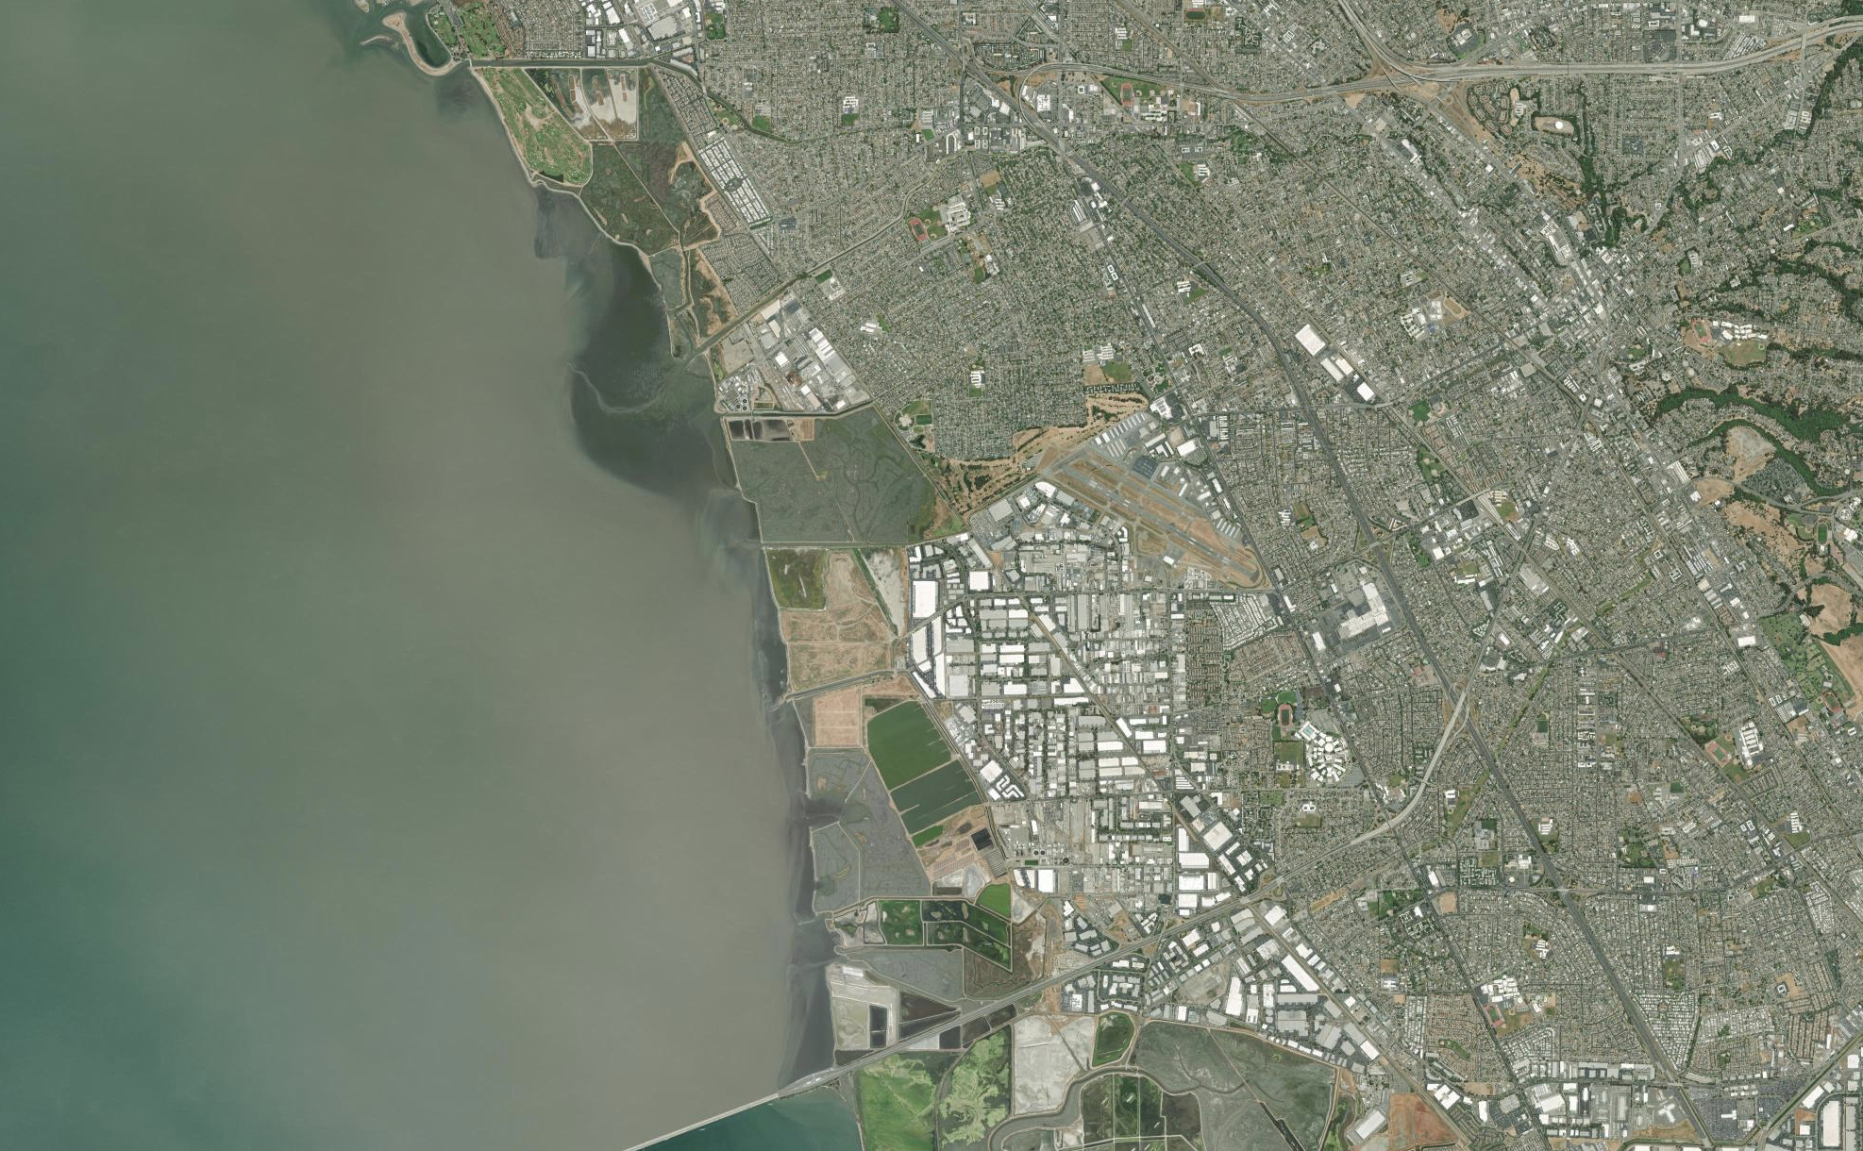

First Mile Horizontal Levee | Site Overview
San Lorenzo Community Center
First Mile Horizontal
Levee Project
Oro Loma Marsh
Hayward NbS Project
‹#›
Basemap provided by Esri

Slide 41
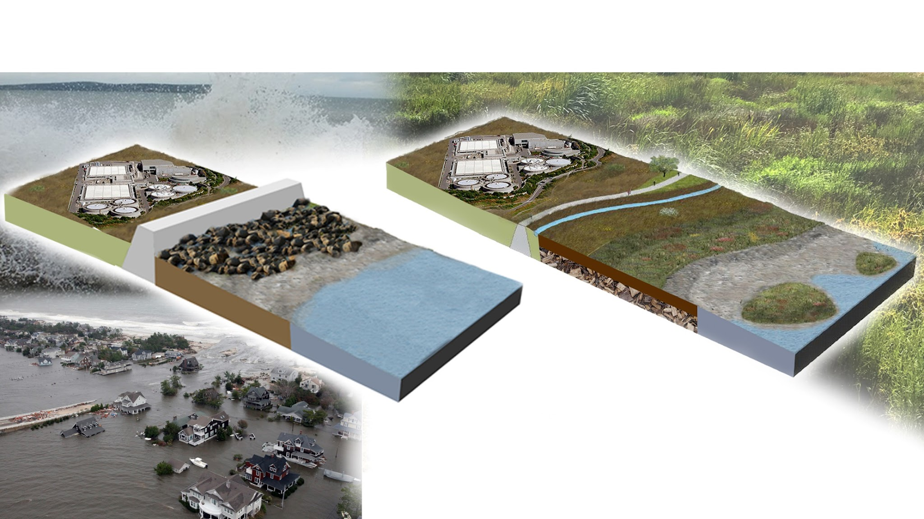
Horizontal Levees
COMMUNITIES &
INFRASTRUCTURE
COMMUNITIES &
INFRASTRUCTURE
TRAIL
LEVEE
TREATMENT AREA
ECOTONE HABITAT
Horizontal levees are a nature-based solution that provides many benefits over traditional levees.
They protect communities from flooding and sea level rise while providing habitat and improving water quality.
Slide credit: A. Stiegler

Slide 42
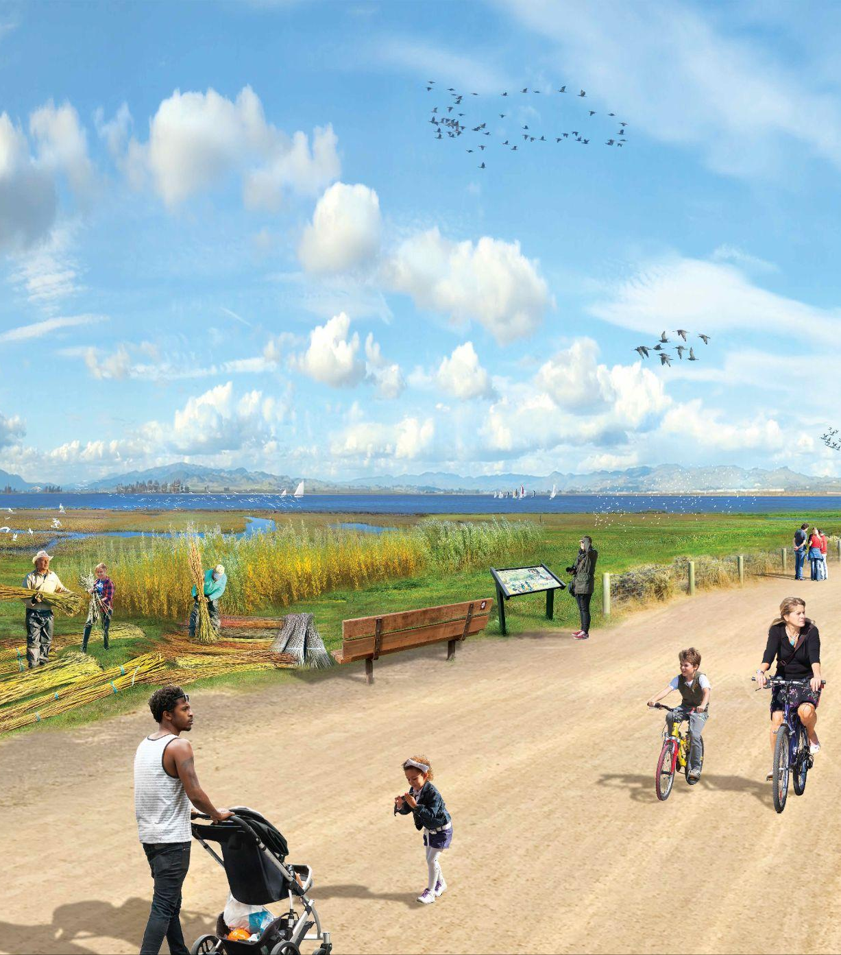
First Mile Horizontal Levee | Project Goals
Improve water quality by reducing nutrient inputs into San Francisco Bay
Create and enhance habitat for wetland-dependent species in the near-term
Facilitate wetland habitat migration as sea levels rise
Protect Hayward and San Lorenzo shoreline communities from sea level rise and improve flood management
Maintain existing utility access
Enhance recreational and social benefits to nearby communities
Artist rendering of the future First Mile Horizontal Levee project.

Slide 43
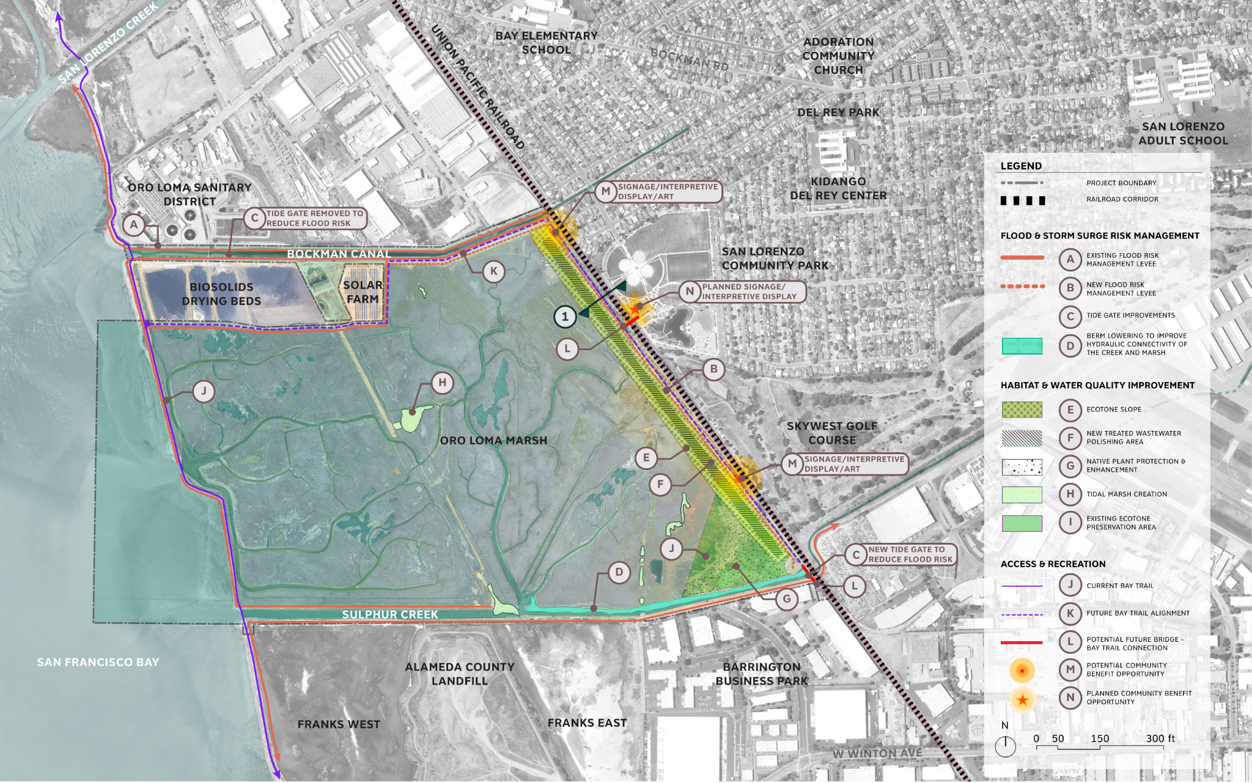
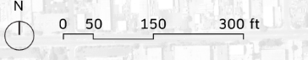
First Mile Horizontal Levee | Future Oro Loma Marsh
Proposed Horizontal Levee
UPDATE PER ANCHOR COMMENTS

Slide 44
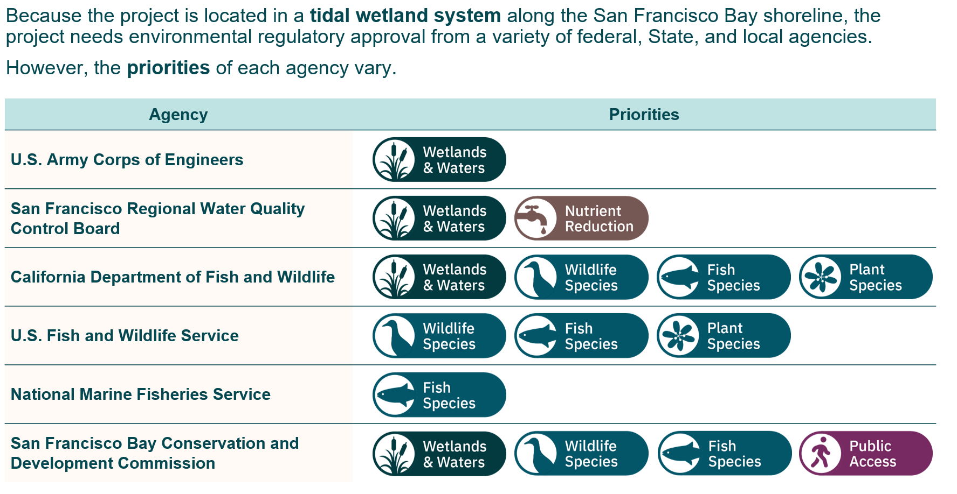
First Mile Horizontal Levee | Regulatory Overview

Slide 45
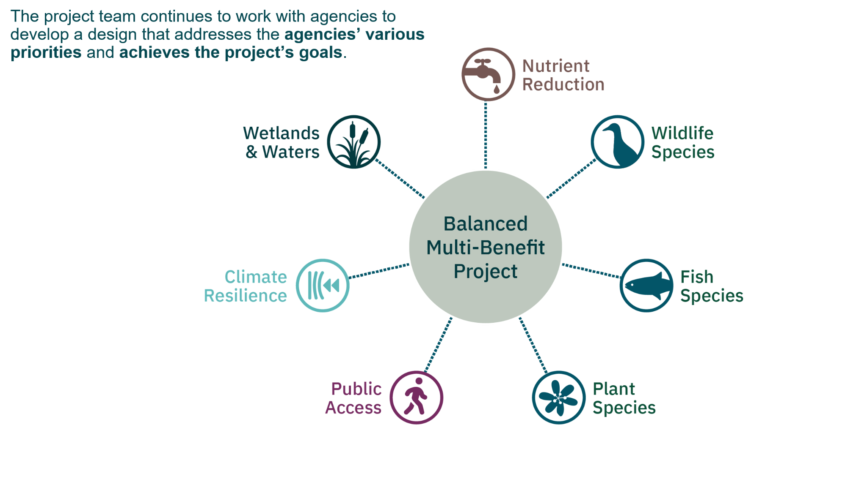
First Mile Horizontal Levee | First of its Kind

Slide 46
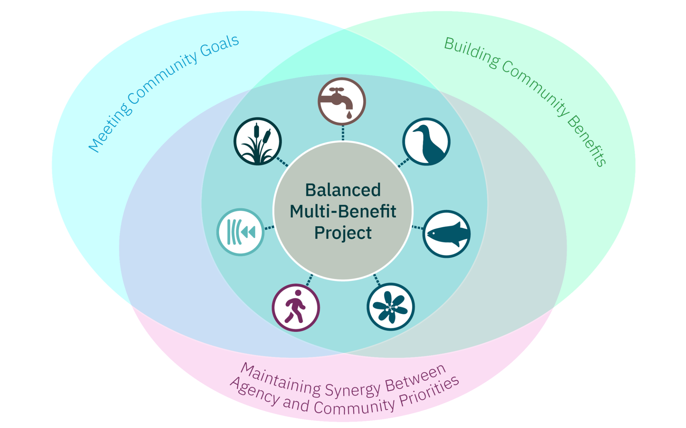
First Mile Horizontal Levee | First of its Kind
ADD COMMUNITY GOALS

Slide 47
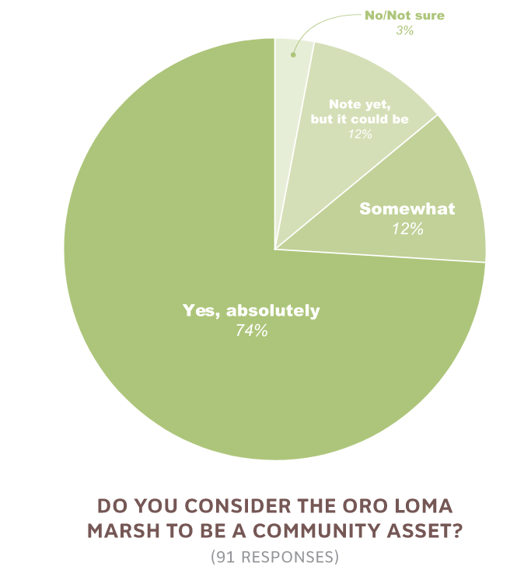



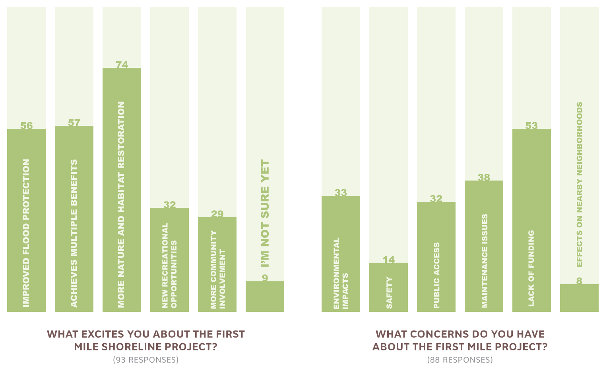
First Mile Horizontal Levee | What we heard from you
Community Meeting 1 + Online Survey
The community wants this project to provide multiple benefits.
protect their community, marsh, trails, and critical infrastructure from flooding
protect and enhance wildlife habitat and native planting
provide safe and accessible bike and pedestrian public access to shoreline
recreational and social benefits -
project thinking about near term & long term community benefits.
highlight synergies between project, agency, community goals
We see many synergies between project, agency, and community goals that we will continue to push forward as the project develops.

Slide 48
First Mile Horizontal Levee
Youth Engagement

Slide 49
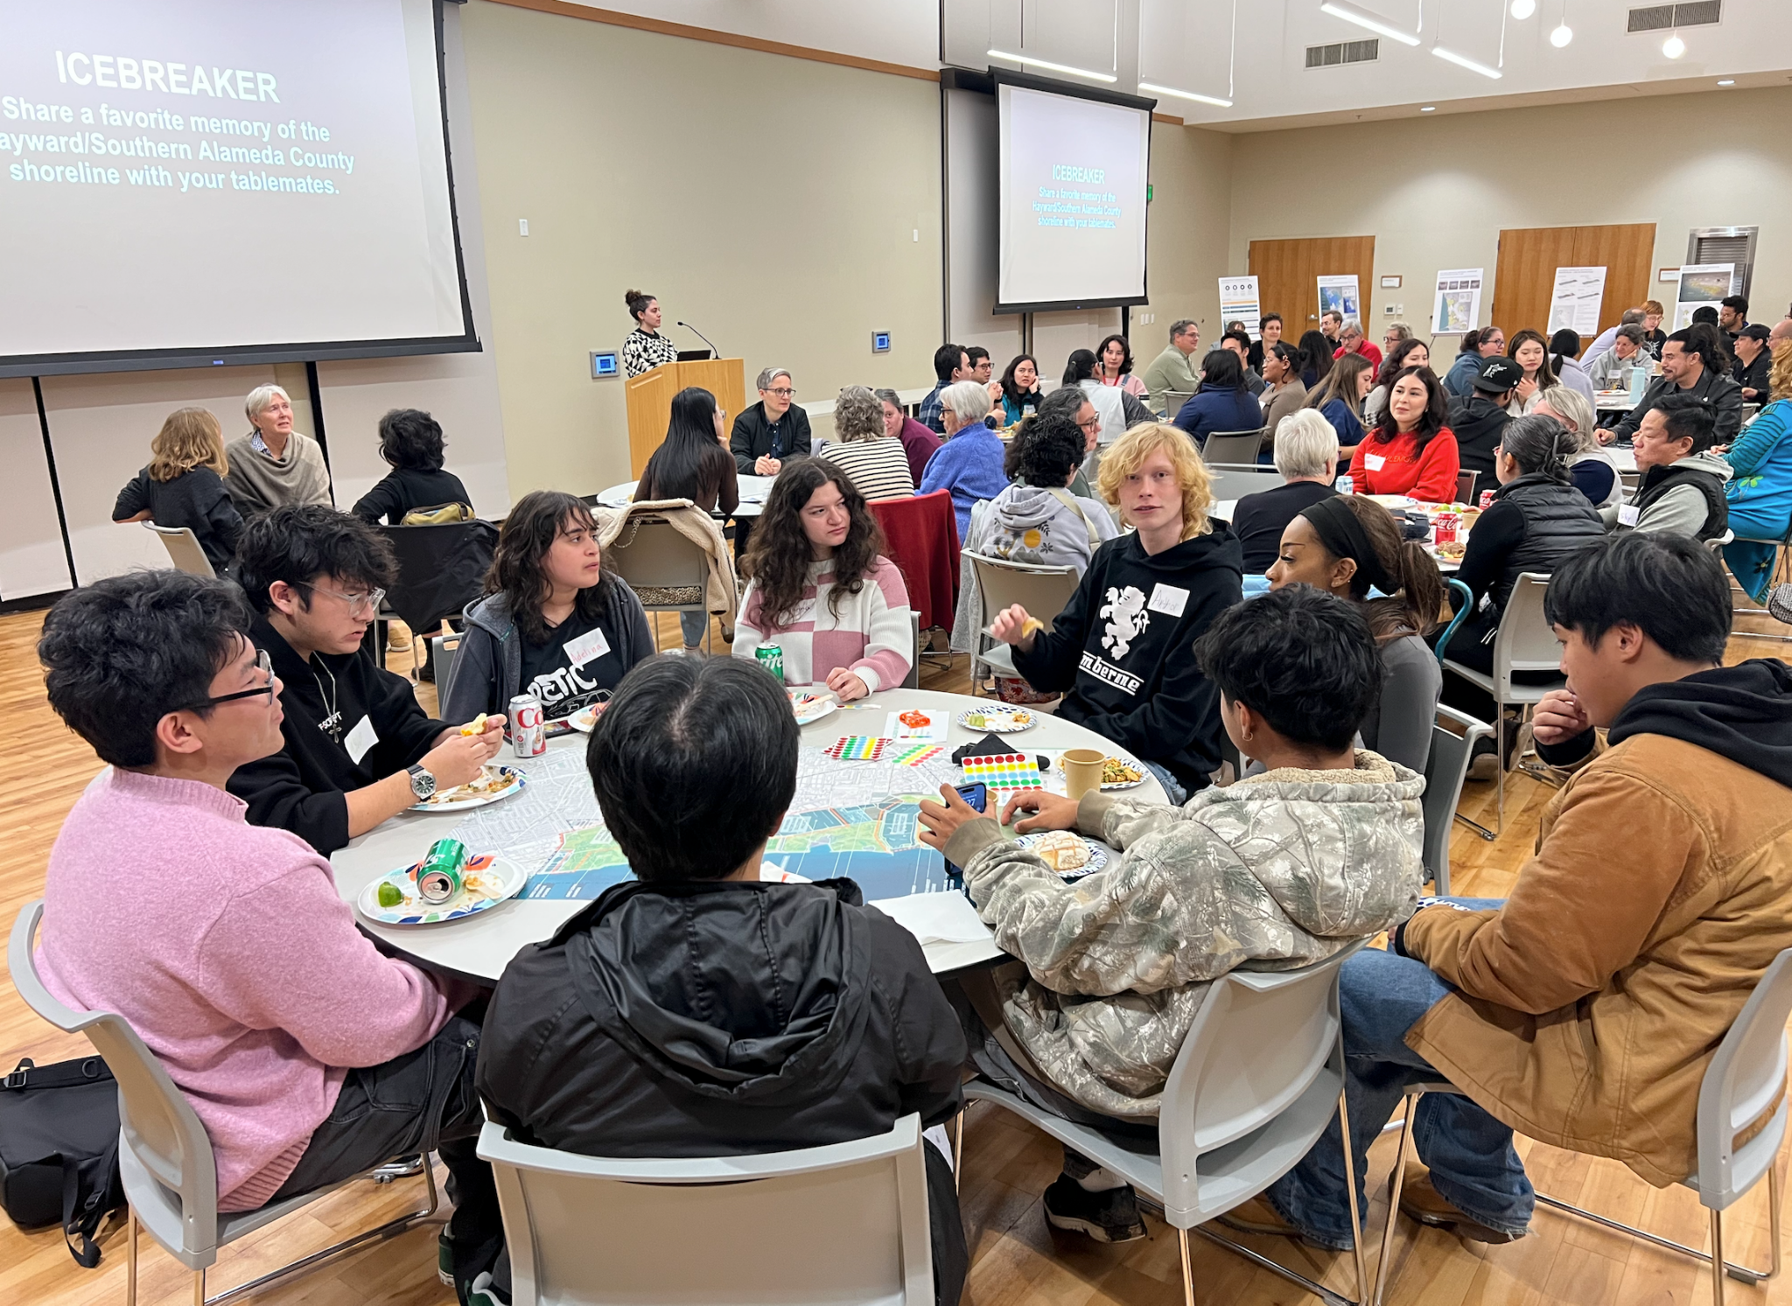
Youth Engagement Process
Chabot students and TEA team interviewed 500 Hayward-Eden Area residents and frequent visitors of the Hayward Shoreline from a wide range of demographics
Asked interviewees about their favorite memories involving the Hayward Shoreline, reasons why they go or do not go to the Hayward Shoreline, cultural practices and family traditions in nature, and visions for the First Mile Horizontal Levee
Chabot students wrote essays and created multimodal representations of their findings and visions for the First Mile Horizontal Levee
Chabot College students participate in First Mile community workshop

Slide 50
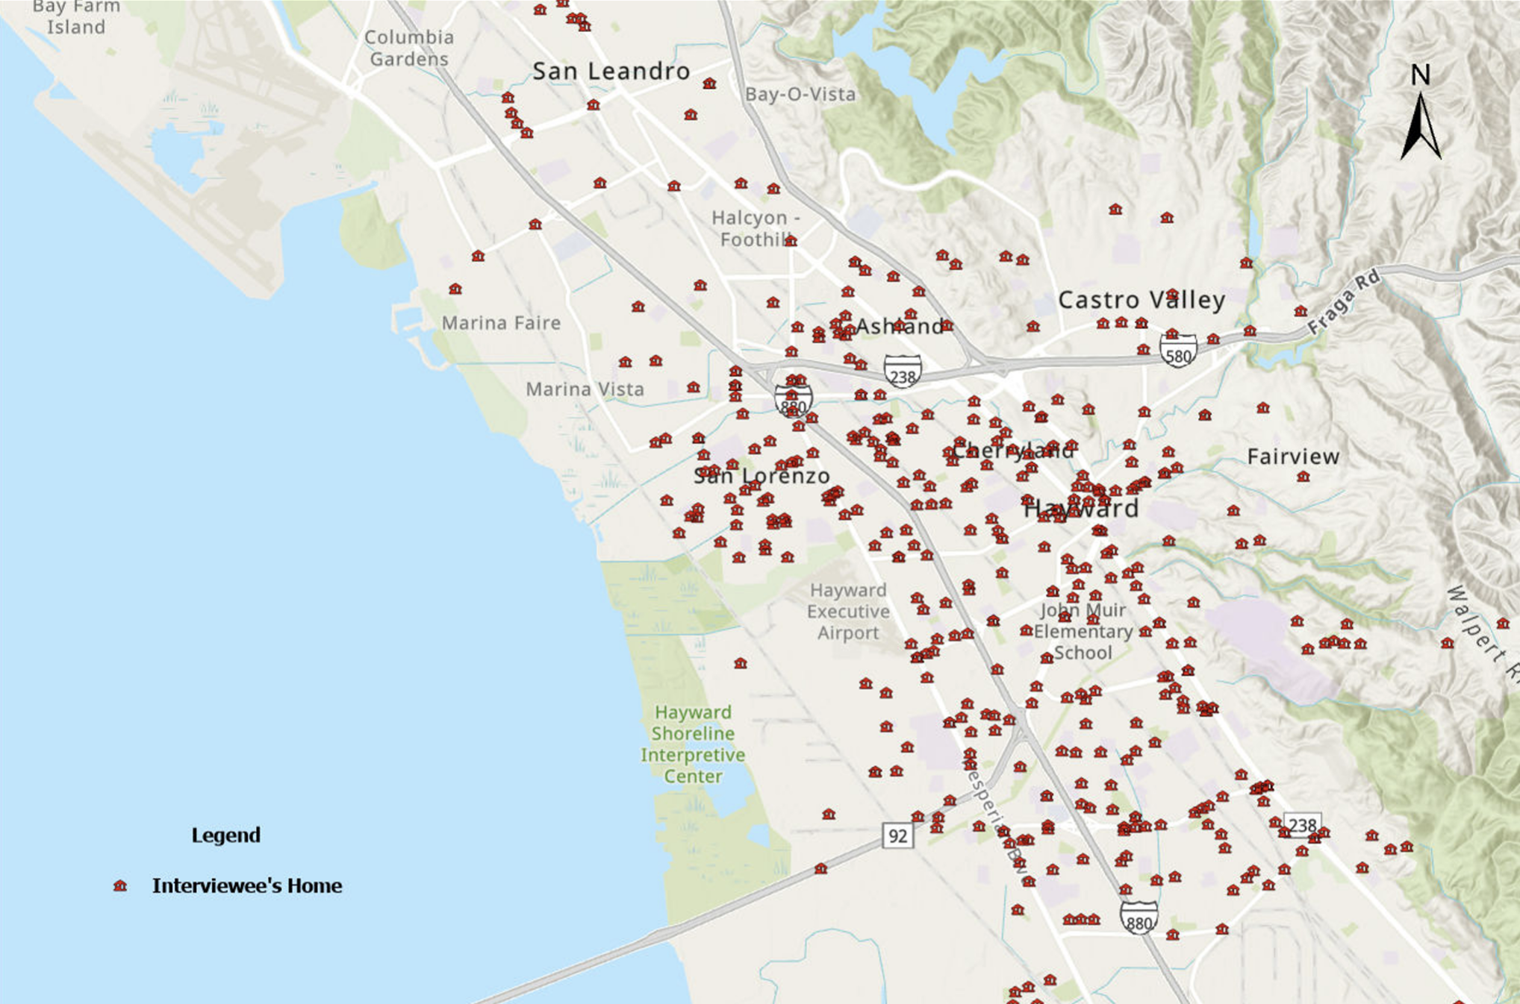
Process
Interviewees are area residents or frequent Hayward Shoreline visitors
Interviews were conducted in languages other than English

Slide 51
Process
354 of 500 (71%) interviewees are from Hayward-Eden Area
Many interviews were conducted at the Hayward Shoreline
First Mile Horizontal
Levee Project
Oro Loma Marsh

Slide 52
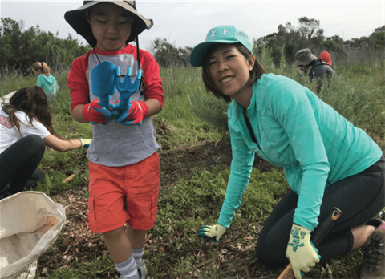
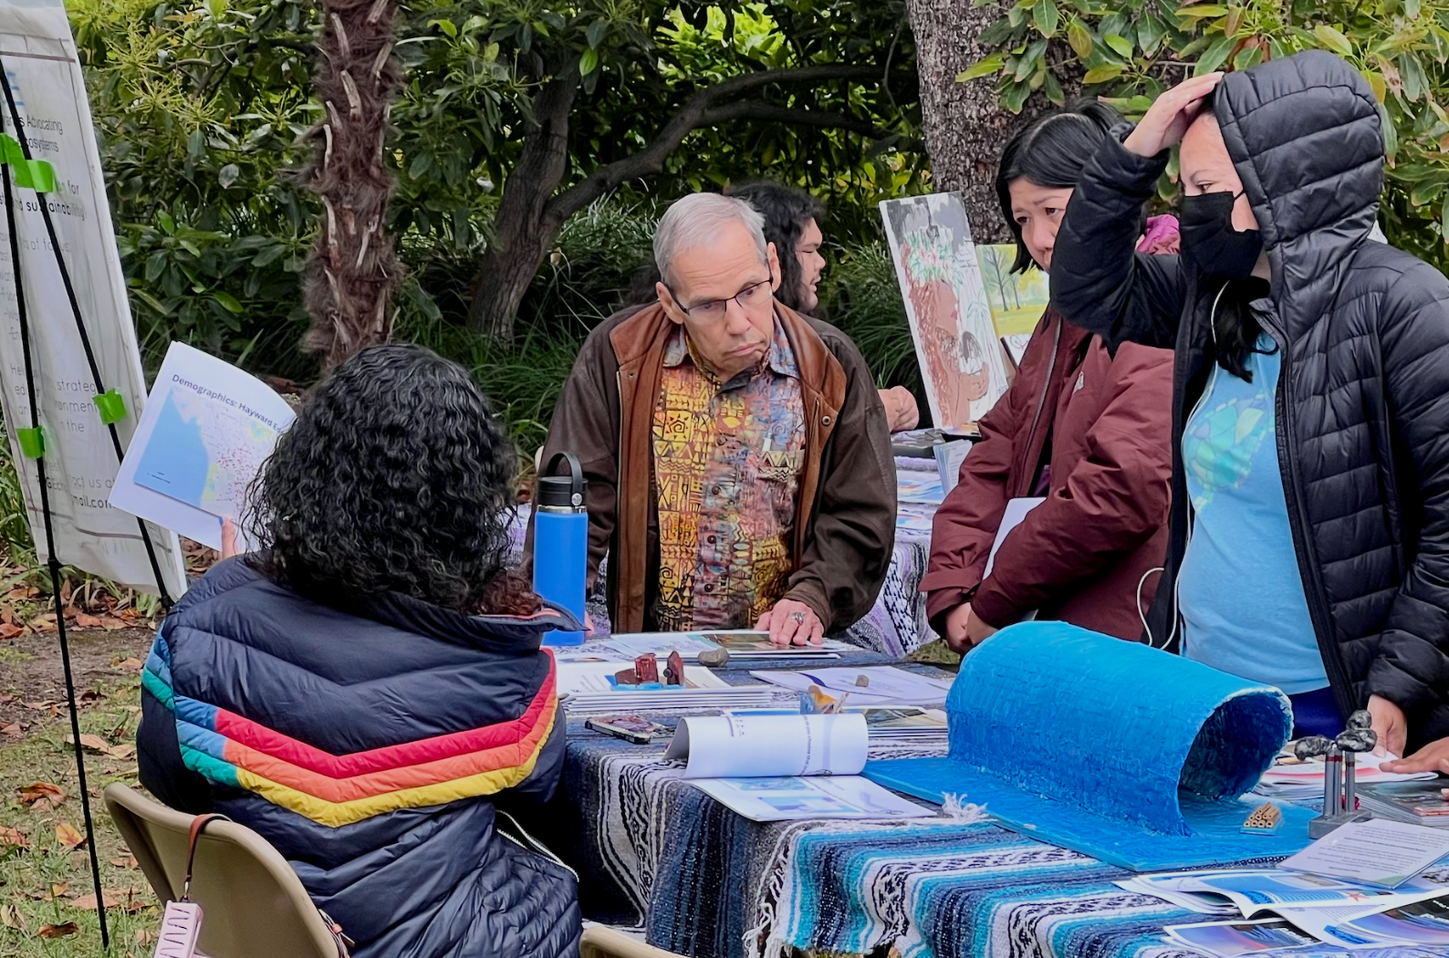
Findings: Community Priorities for the First Mile Horizontal Levee
Amenities
Observation Areas
Environmental Education and Programming
Activities and Events
Cultural Representations
Community members want to be invited into the process of stewarding the Hayward Shoreline and active participants in developing the First Mile Horizontal Levee
Photo credit: City of Palo Alto
Community members provide input on the First Mile Project

Slide 53
City of Hayward
Nature Based Solutions (NbS)
Notes:
Lindsey

Slide 54






Hayward NbS | Team Overview
Notes:
Jeanette

Slide 55
San Lorenzo Community Center
Hayward NbS | Site Overview
First Mile Horizontal
Levee Project
Hayward NbS Project
Cogswell Marsh
Hayward Water Resource Recovery Facility (WRRF)
Basemap provided by Esri

Slide 56
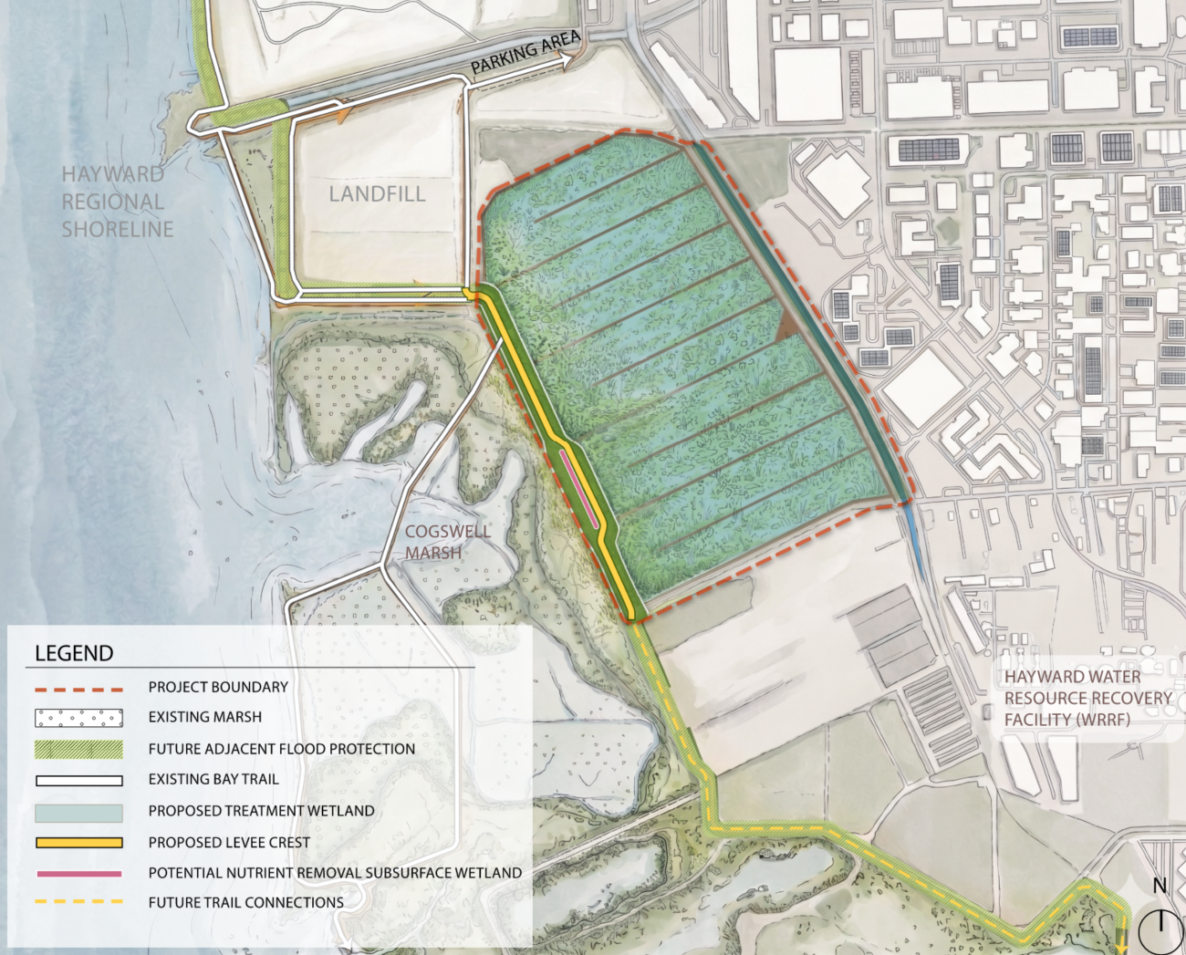
HAYWARD NBS | PROJECT GOALS
1
IMPROVE WATER QUALITY
Transform 120 acres of ponds to treatment wetlands
2
PROTECT COMMUNITIES FROM SEA LEVEL RISE AND FLOODING
Construct a new levee along the bayward edge of the treatment wetland
2
1
3
EXPAND RECREATIONAL ACCESS
Integrate Bay Trail with the crest of the new levee
3

Slide 57


GOAL: IMPROVE WATER QUALITY
Algal bloom (Summer 2022) caused major fish and wildlife die-off in the San Francisco Bay
Causes: Warm water, drought, and excess wastewater nutrients
Response: Third Nutrient Watershed Permit adopted
Goal: 40% reduction in dry-season nitrogen discharges over 10 years.

Slide 58


PROPOSED TREATMENT WETLAND
Current use: 120 acres of ponds provide wet-weather effluent storage for the Hayward WRRF.
Project goal: Convert ponds into treatment wetlands to reduce nutrient discharges to the San Francisco Bay.
TREATMENT WETLANDS
LEVEE
COGSWELL MARSH
Existing Ponds
Proposed treatment wetlands and levee

Slide 59



GOAL: PROTECT COMMUNITIES FROM SEA LEVEL RISE AND FLOODING
Sea level rise in next 50-100 years anticipated to overtop existing levee at ponds
TYPICAL CONDITIONS
JANUARY 2026 KING TIDE
ASSUMPTION: 6.4-FT SLR (2100)
SOURCE: ADAPTING TO RISING TIDES (https://explorer.adaptingtorisingtides.org/explorer)

Slide 60


GOAL: PROTECT COMMUNITIES FROM SEA LEVEL RISE AND FLOODING
TYPICAL CONDITIONS
JANUARY 2026 KING TIDE
ASSUMPTION: 6.4-FT SLR (2100)
SOURCE: ADAPTING TO RISING TIDES (https://explorer.adaptingtorisingtides.org/explorer)

Slide 61
PROPOSED LEVEE FOR SEA LEVEL RISE RESILIENCE
TREATMENT WETLANDS
LEVEE
COGSWELL MARSH

Slide 62


PROPOSED NUTRIENT REMOVAL AT LEVEE
City is evaluating a horizontal levee with an integrated subsurface-flow wetland
Treats reverse osmosis concentrate through soil, plants, and microbial processes
Reduces nutrients and pollutants before discharge
Provides co-benefits: habitat creation and shoreline resilience to sea-level rise
TREATMENT WETLAND
VEGETATION OVER SUBSURFACE TREATMENT
TOP OF LEVEE
INFLUENT DISTRIBUTION PIPE
COGSWELL MARSH
TREATMENT LAYER: WOODCHIPS & ROCK
EFFLUENT COLLECTION
NUTRIENT REMOVAL AT SUBSURFACE WETLAND
SEA LEVEL RISE
SUBSURFACE TREATMENT ZONE
(20:1 SLOPE)
ECOTONE HABITAT ZONE
(10:1 SLOPE)
COGSWELL MARSH

Slide 63

GOAL: EXPAND RECREATIONAL ACCESS
Bay Trail Access
Levee integration with the East Bay Regional Parks District Bay Trail and adjacent levee projects
EBRPD Guidelines (2025)

Slide 64
Hayward NbS | Project Schedule
2025
2026
Concept Development
Engagement - Phase 1
Options Analysis
Concept Design
Engagement - Phase 2
Concept Design Completion
PROJECT EVENT
CONCEPT DESIGN START
WE ARE HERE
CONCEPT DESIGN COMPLETION
MILESTONE
HOW TO USE: EXAMPLE PROJECT 1
DURATION OF PHASE A (USE LIGHT TEAL)
DURATION OF PHASE B (USE MEDIUM TEAL)
DURATION OF PHASE C (USE DARKEST TEAL)
SLIDER LENGTH CAN BE ADJUSTED USING SHIFT + DRAG
PROJECT EVENT 1
PROJECT EVENT 2
PROJECT PREMILINARY DEADLINE 1
FINAL DEADLINE
Notes:
Jeanette

Slide 65
Thank you!
For Questions:
jlaramee@sherwoodengineers.com

Slide 66
RESTORE HAYWARD MARSH PROJECT - PHASE 1A

Slide 67


Restore Hayward Marsh Project | Overview

Slide 68

Restore Hayward Marsh Project | Project Goals and HASPA Master Plan Elements
Project Goals:
Enhance Wildlife Habitat
Plan for Sea Level Rise
Improve Public Access Opportunities
Improve Management Capabilities
HASPA Master Plan Implementation:
Keep Bay Trail Along the SF Bay
Adaptive Retreat Approach - SF Bay Trail and Least Tern Islands
Tidal Marsh Connectivity to Cogswell and HARD Marshes

Slide 69




Restore Hayward Marsh Project | Existing Conditions

Slide 70


Restore Hayward Marsh Project | Current Conditions / Baseline

Slide 71


Slide 72

Restore Hayward Marsh Project | Project Timeline
Feasibility/Pre-Design
2020-2022
Design/Permitting
2023-2025
Construction
2026 - ongoing
Feasibility Studies
Schematic Design Development
Technical Advisory Committee
Consultant Contract Award
Public Outreach & Participation Plan
Public Workshop
Stakeholder Engagement
Project Webpage
Project Brochures
Site Visits
Preferred Concept Approval
Consultant Contract Amendment
CEQA Exemption – SERP
Regulatory Agency Meetings/BRRIT
Technical Advisory Committee
Design Development to 100%
Regulatory Permits
Quality Assurance Project Plan (QAPP)
Site Visits
HARD Marsh Acquisition
Phase 1A Construction
    Grading Permit
    Bid Set Plans
    Bid Process
    Award Construction Contract
    Construction ~ September
    Future Phases: 1B, 1C, 2

Slide 73
Restore Hayward Marsh Project | Permits | Agency Coordination | Right of Way
PERMITS
BRRIT - Consultation
BCDC – Major Permit
CDFW – RMP
RWQCB - 401
ACOE – 404
NMFS – Biological Opinion
USFWS – Biological Opinion
CEQA – SERP
Office of Historic Preservation - 106
City of Hayward (Grading)
COORDINATION
HASPA
City of Hayward
Alameda County Flood Control
Hayward Area Recreation and Park District (HARD)
Mosquito Abatement
Eden Landing / South Bay Salt Ponds
East Bay Dischargers Authority
Invasive Spartina Program
ACOE – Beneficial Reuse/Design with Nature
SFEI – Regionally Adapting to Living Shorelines
RIGHT-OF-WAY
HARD
City of Hayward
USD
EBDA
Flood Control
Caltrans
State Lands
Private/Adjacent Land Owners

Slide 74



Restore Hayward Marsh Project | Next Steps

Slide 75

Restore Hayward Marsh Project | Construction Implementation - Phase 1A
BAY TRAIL

Slide 76


Slide 77


Slide 78
GALLERY WALK
Stations
HASPA Long Term Planning Process
First Mile Horizontal Levee
Nature Based Solutions
Hayward Marsh
Teach Earth Action
Plantify
Community Mapping Exercise
Walk around each station to learn more and ask questions about each project.
Notes:
Zoe

Slide 79


QUESTIONS?
Connect with us! HaywardShoreline@greenbelt.org
415-543-6771 (ext. 305)
If you didn't register online make sure to register at the check in table so we can let you know about upcoming events.
flyer for bike tour
Scan the QR code to register for the Shoreline Bike tour!
Notes:
Zoe

Slide 80
YEAR X
YEAR Y
WE ARE HERE
HOW TO USE: EXAMPLE PROJECT 1
DURATION OF PHASE A (USE LIGHT TEAL)
DURATION OF PHASE B (USE MEDIUM TEAL)
DURATION OF PHASE C (USE DARKEST TEAL)
SLIDER LENGTH CAN BE ADJUSTED USING SHIFT + DRAG
PROJECT EVENT 1
PROJECT EVENT 2
PROJECT PREMILINARY DEADLINE 1
FINAL DEADLINE

Slide 81


OVER DARK BACKGROUND
OVER LIGHT BACKGROUND
TAG LABELS
BUBBLE CALL OUT
TAG LABELS
BUBBLE CALL OUT
TAG LABELS
TAG LABELS
TAG LABELS
TAG LABELS
TAG LABELS
TAG LABELS
TAG LABELS
TAG LABELS
TAG LABELS
TAG LABELS
LEADER LABELS
LEADER LABELS
LEADER LABELS
LEADER LABELS
LEADER LABELS
LEADER LABELS
KEY MAP
KEY MAP
HIGHLIGHTED AREA
HIGHLIGHTED AREA

