Slide 1
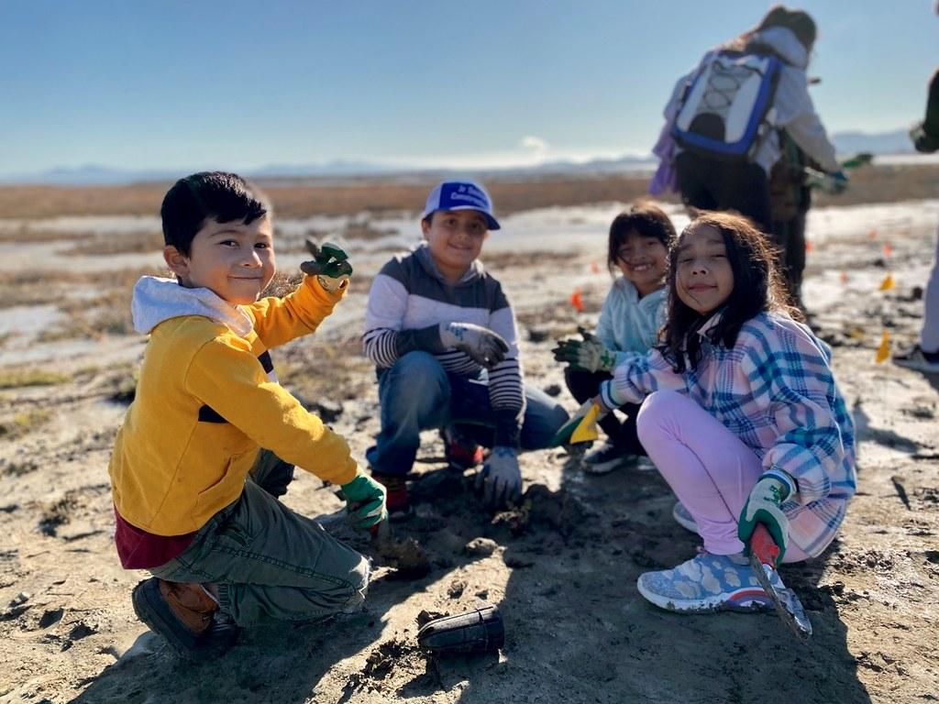
Communities Restoring
the Wetland Edge
Julian Wood and Josh Nuzzo
Presentation to the Wetland Migration Workshop - Sept 18-19, 2023
Notes:
Using science to inform restoration
Answer the question- how does tzone benefit tidal marsh dependent birds? how can we do it better?
- 20 min presentation and 15 min questions, after all presenters done
- Send presentations 1 week before from Will
- titles asap

Slide 2
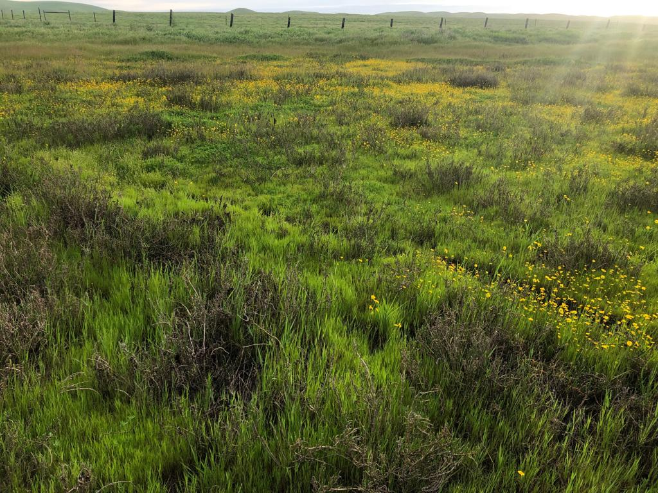
Menu du Jour
Story of STRAW
The Question
Tzone monitoring methods
Results
Recommendations
Looking forward
Restoration and study design
Community science

Slide 3
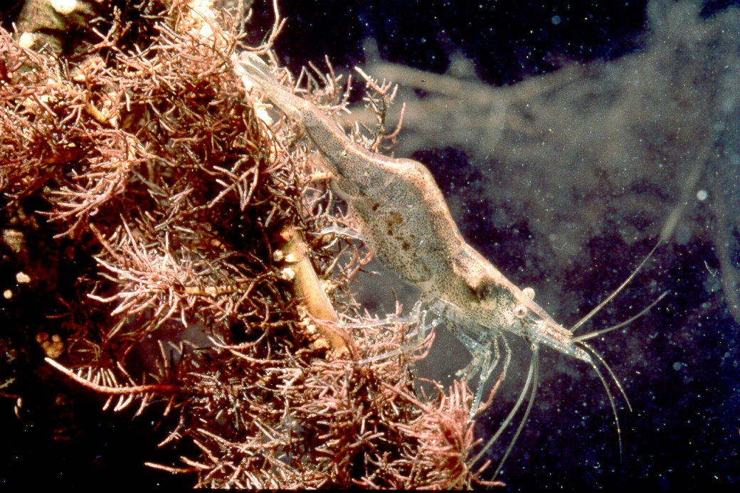
30 Years Ago...
Notes:
It empowers communities to heal the land, revitalize habitats, generate cleaner water, sequester carbon, empower children, train teachers, and inspire the conservation leaders

Slide 4
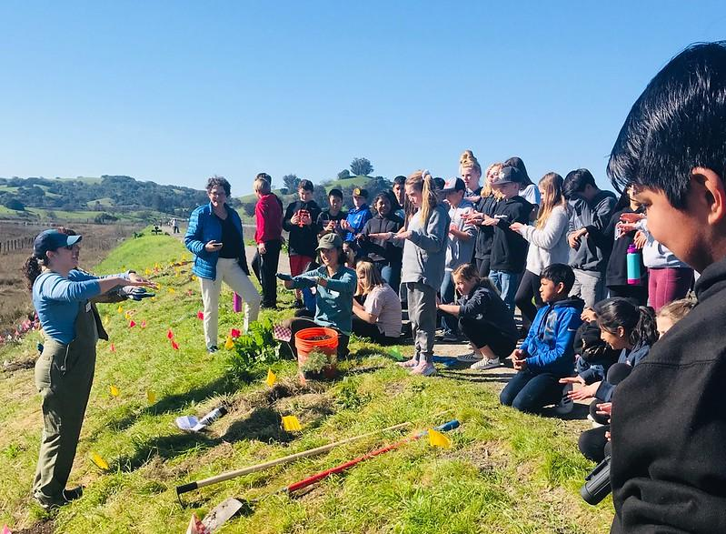
Students & Teachers Restoring A Watershed
Engaging local schools

Slide 5
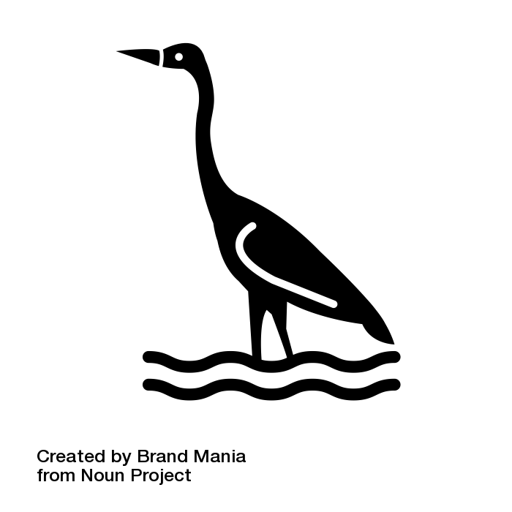
STRAW Today
Photo: Riparian habitat. Point Blue photo. Icons: the Noun Project.
Over 60,000 Students
More than 10,000 volunteers
Over 750 restorations
Over 40,000 native plants
Over 42 miles of riparian habitat
Over 12 acres of marsh/upland transition zone habitat
Notes:
That is the work we do, we work with students, often very young people, and schools across the Bay Area to he
Nod to our historical #s/scope/scale (slide) = “big picture” slide

Slide 6
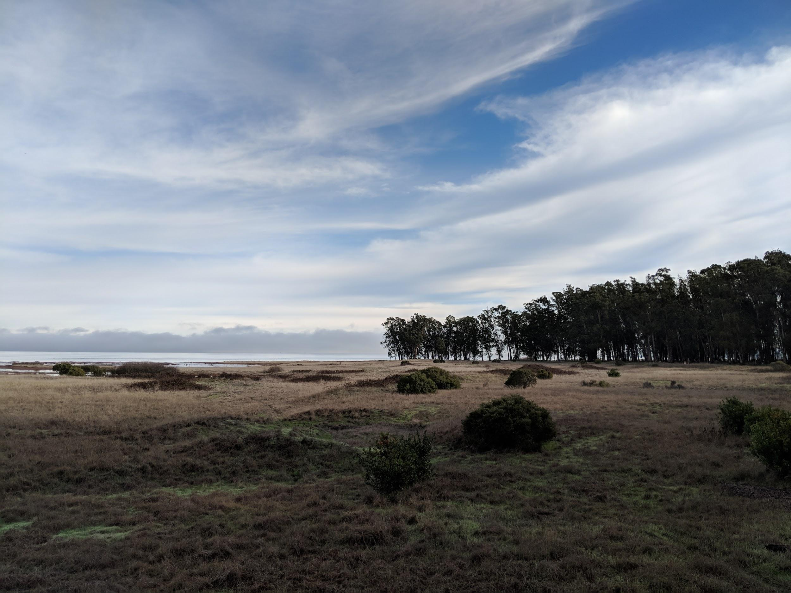
Josh asks me…THE QUESTION

Slide 7
Key Restoration Questions
Marsh birds benefit from transition zones?
What features are beneficial?
What birds in the transition zone?
Restoration recommendations?

Slide 8
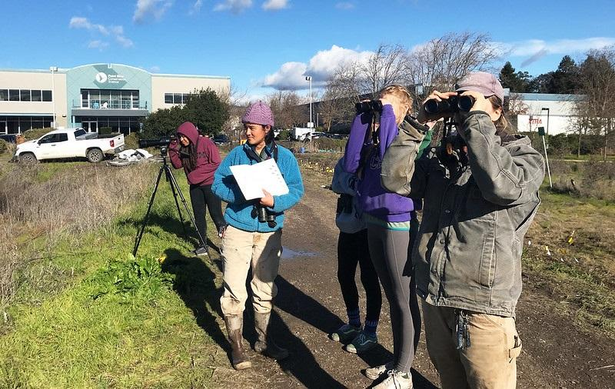
STRAW and the TBirds Project

Slide 9
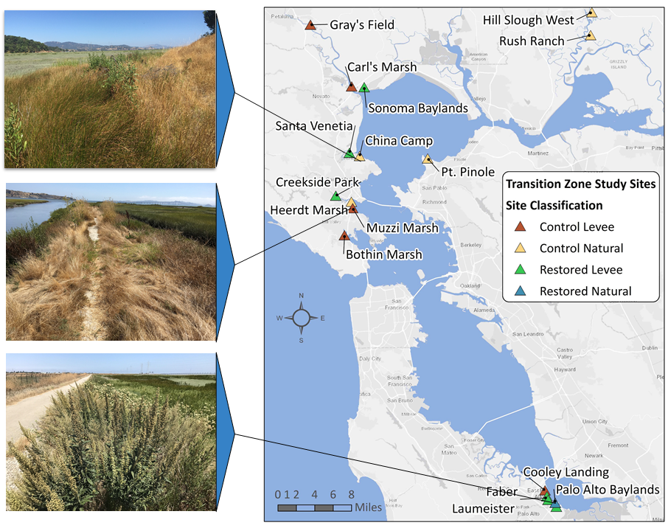
Notes:
How many have worked in one of these sites?

Slide 10
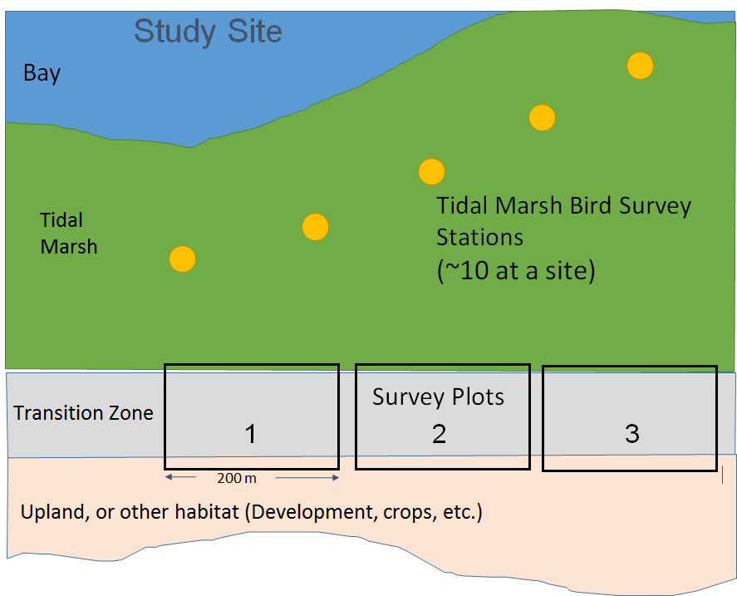

Slide 11
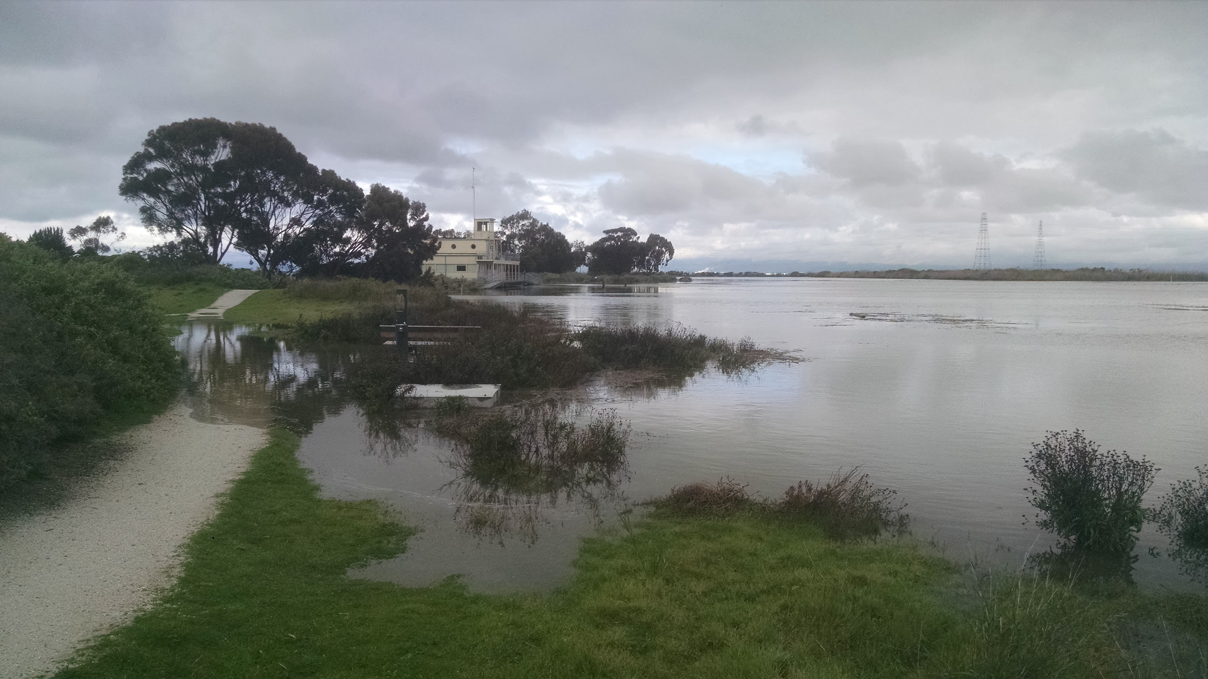
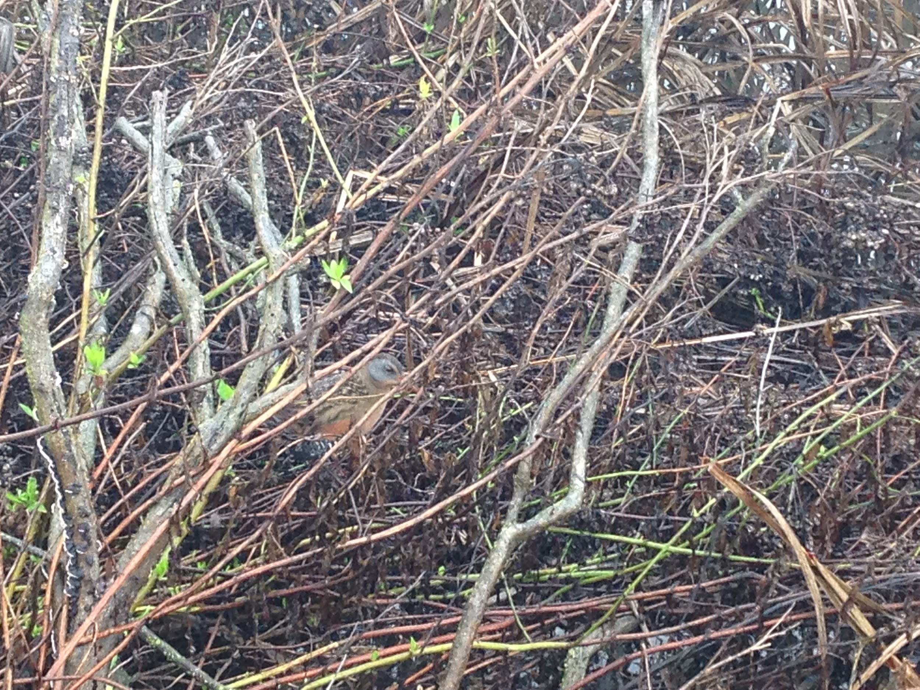
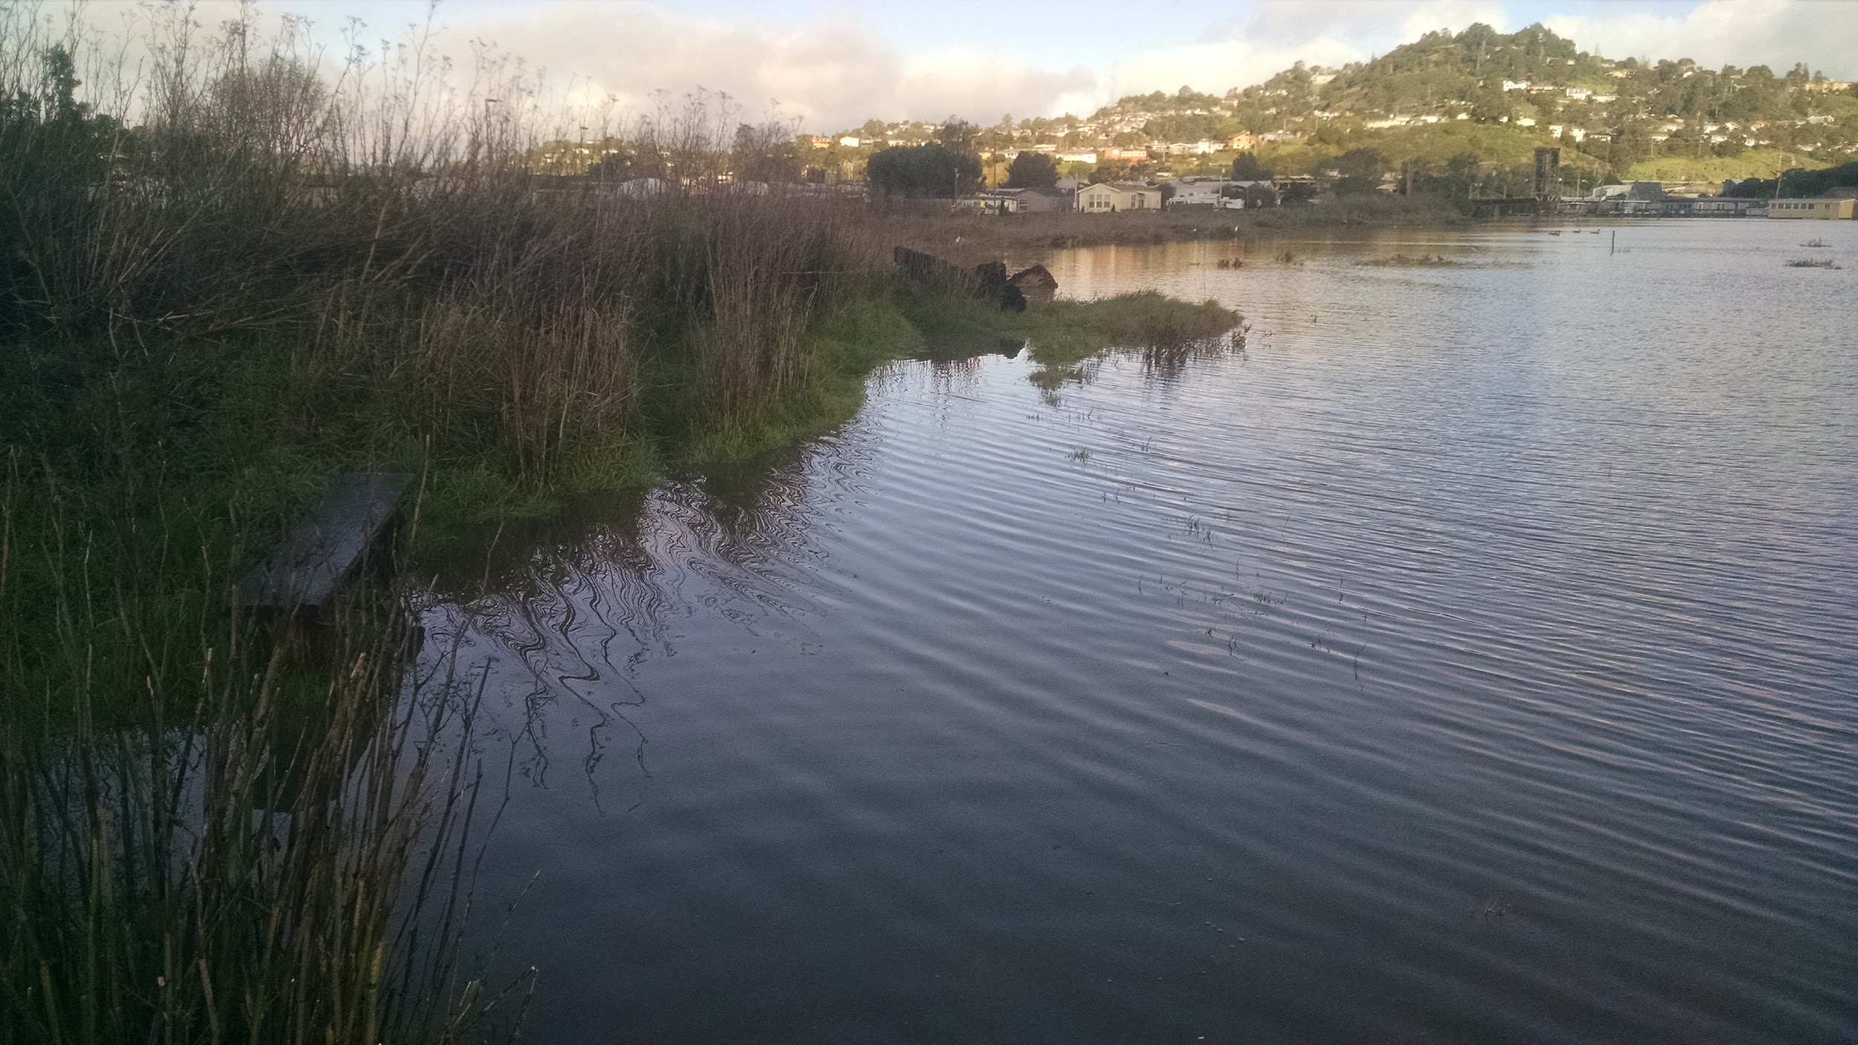
Seasonal Field Data Collection
Protocol | Jan | Feb | Mar | April | May | June | July | Aug | Sept | Oct | Nov | Dec
Winter Vegetation
Marsh Bird Surveys
Tzone Bird Survey
Spring Vegetation

Slide 12
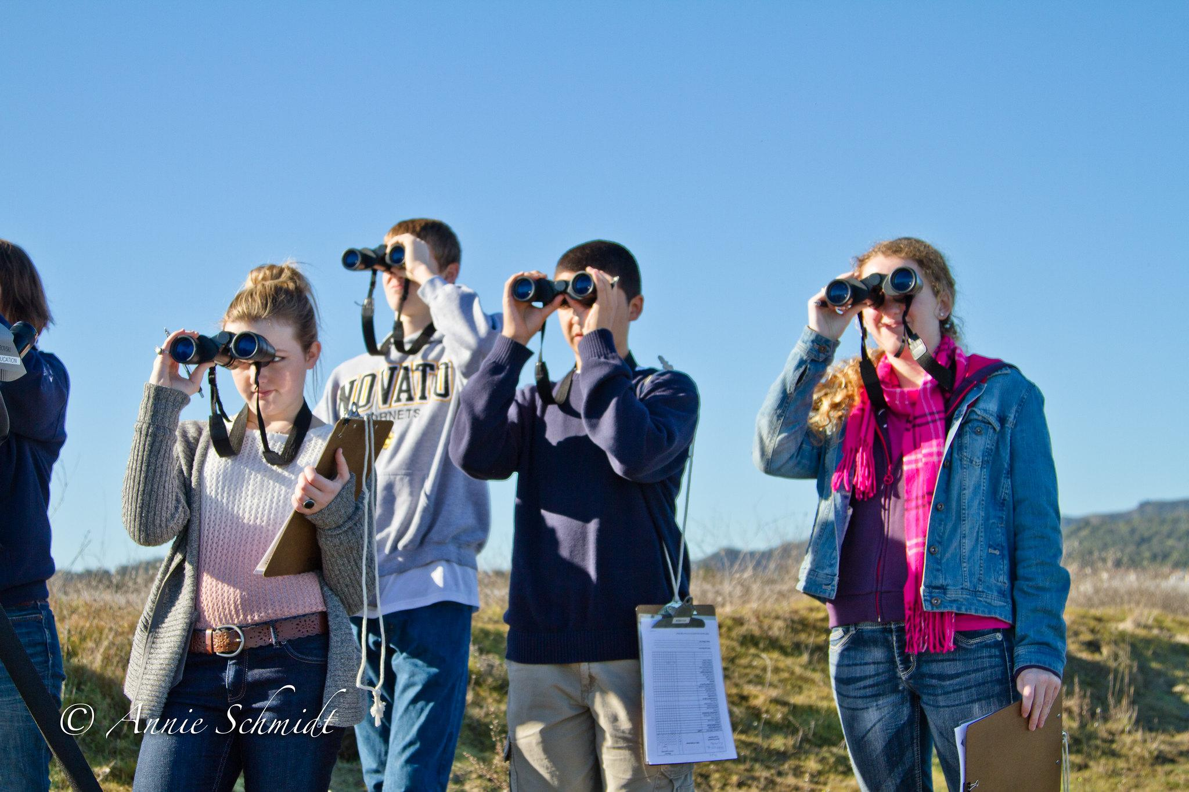
Tzone bird area search surveys
20 minute walking survey
Number of individuals by species
Breeding observations
Predators
.org/tbirds

Slide 13
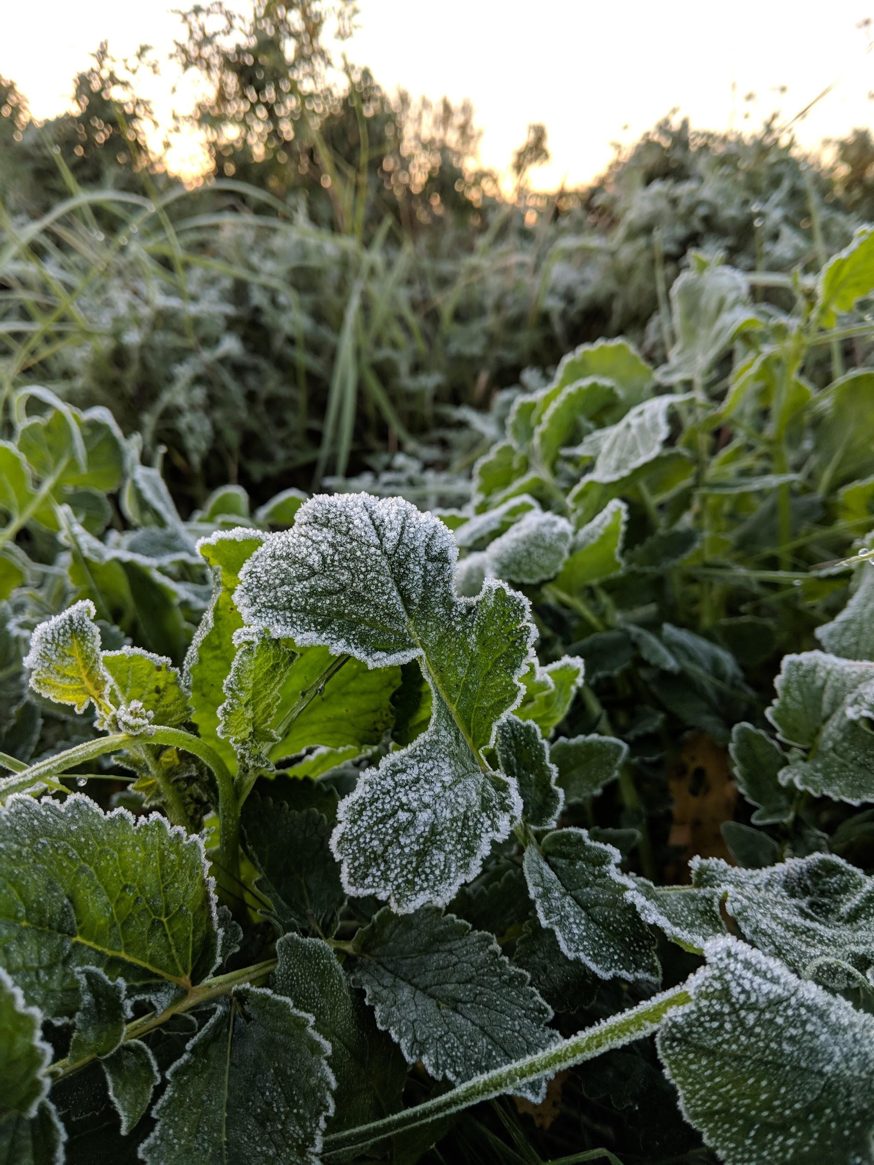
Spring vegetation surveys
Photo points
Percent cover (veg, bare, wrack, other)
Percent cover of dense veg
width and slope
Percent cover by species
Plant height
.org/tbirds

Slide 14
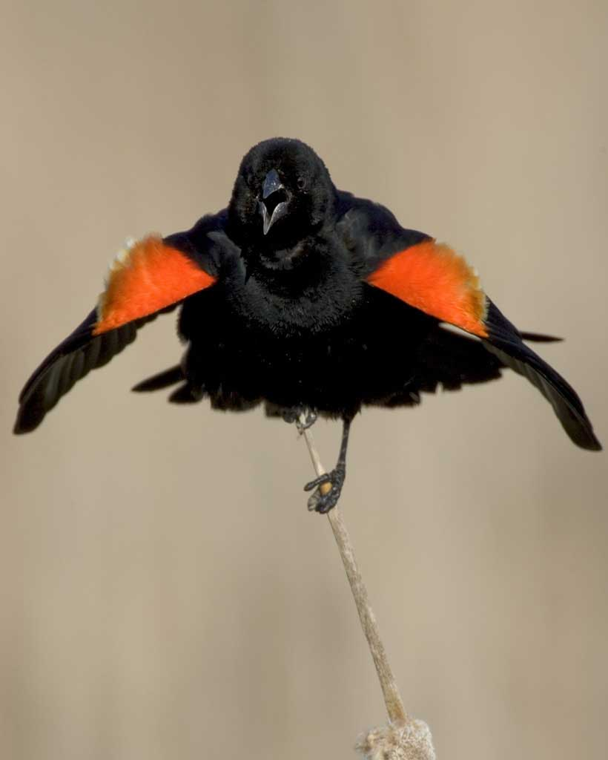
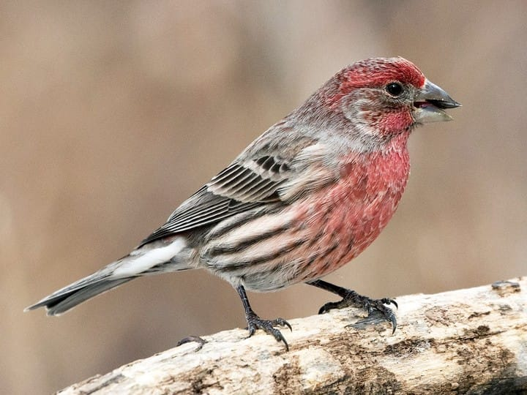
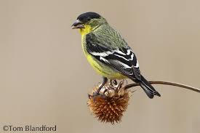
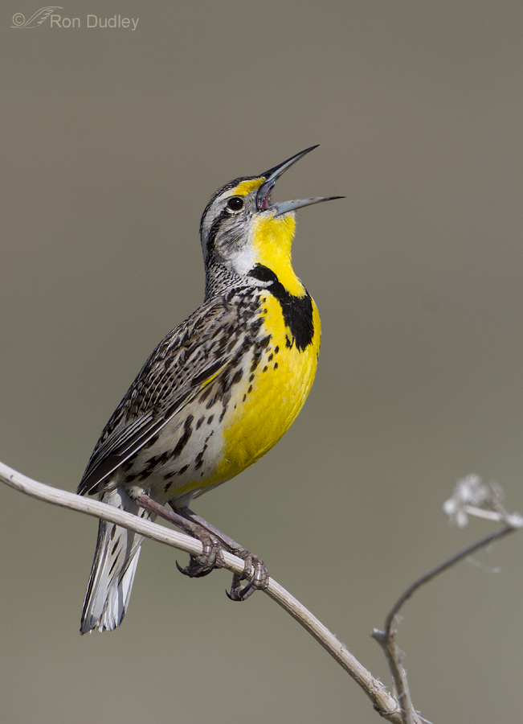
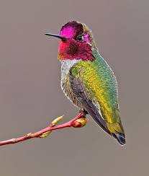
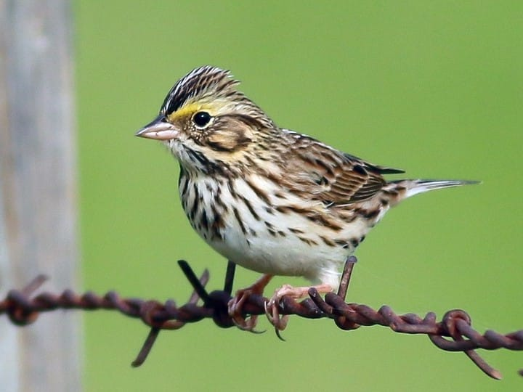
Common Tzone Bird Species
Red-winged Blackbird
House Finch
Lesser Goldfinch
Western Meadowlark
Anna’s Hummingbird
Savannah Sparrow
Notes:
Criteria for selecting tzone spp
top 10 species plus, by abundance
TIMA species we’ve always had

Slide 15
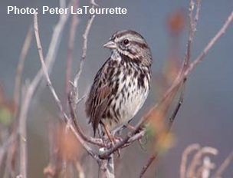
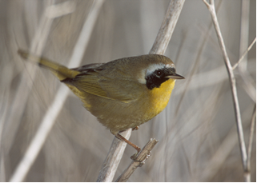
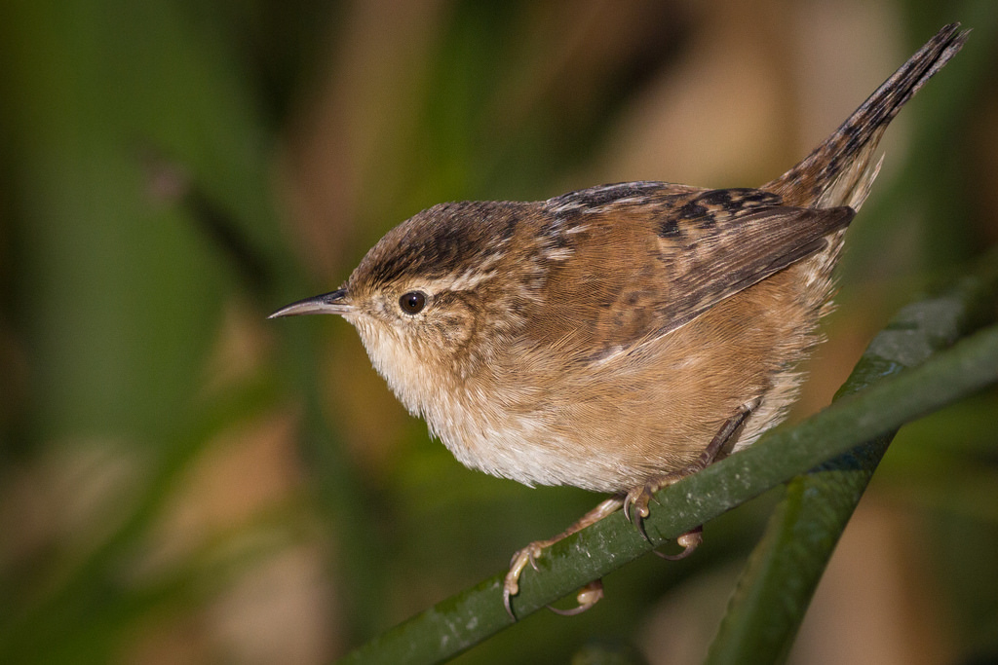
Common Marsh Bird Species in Tzone
Tidal Marsh Song Sparrow
Saltmarsh Common Yellowthroat
Marsh Wren

Slide 16
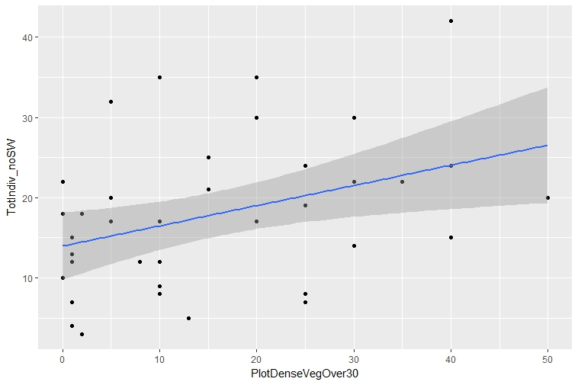
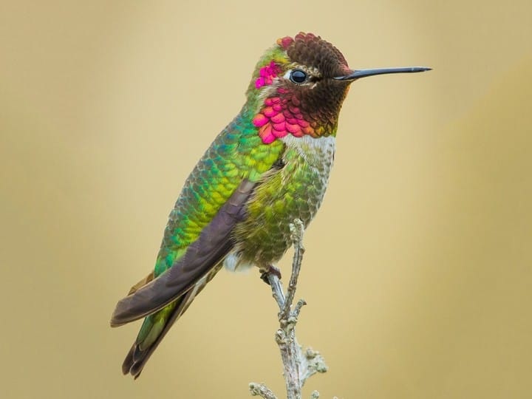
Tzone Birds Like Dense Veg
(Megan Elrod, Nadav Nur, Annie Schmidt)
Red-winged Blackbird
total individuals
Percent Dense Veg Over 30 cm
.org/tbirds
Notes:
dense veg over 30 cm
Gray shading is error
All individuals

Slide 17
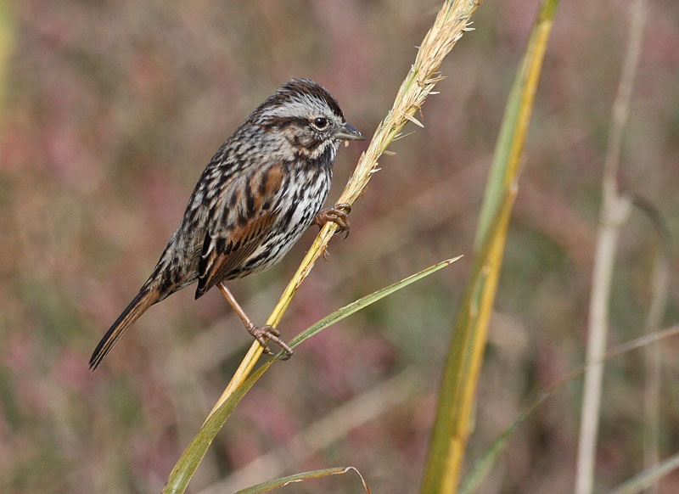
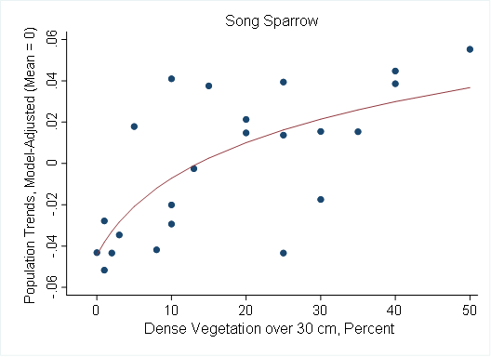
Tidal Marsh Song Sparrows:
Respond to Dense Vegetation in Tzone
Photo: Glen Tepke
.org/tbirds
Notes:
Negative decline with less than 10% dense veg. trails off beyond about 15% cover of dense veg.
Controlling for tidal marsh age and development, effect of dense veg, P < 0.01.

Slide 18
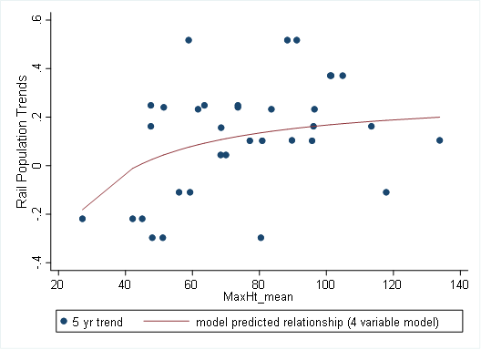
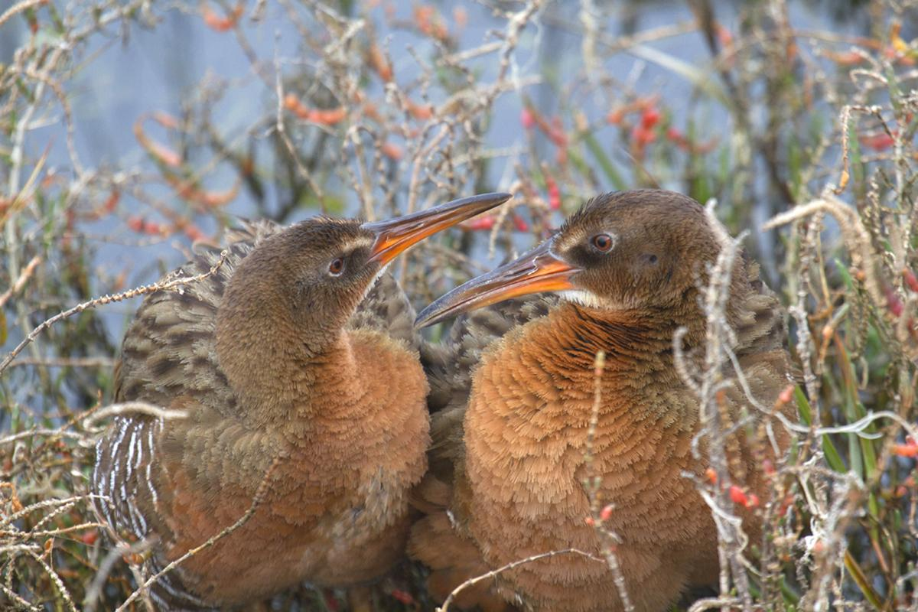
Ridgway’s Rail:
Respond to Maximum Veg Height
Photo: Rick Lewis
.org/tbirds
Notes:
height is important up to a certain point, rail doesn’t care about height over ~90
Controlling for development (neg), amount of mid-marsh (pos) and width (pos).
Tops out at about 90-100 cm.

Slide 19
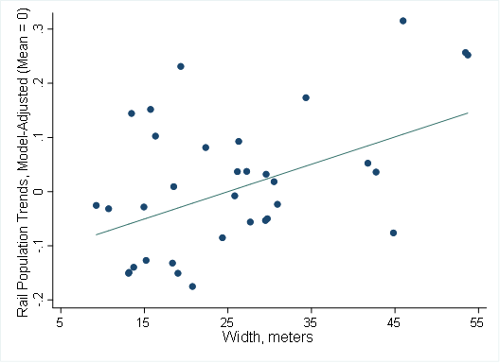
Ridgway’s Rail:
Respond to Tzone Width
Photo: Rick Lewis
.org/tbirds
Notes:
Trends more positive as width increases.
Controlling for development (neg), amount of mid-marsh (pos) and maximum veg height (pos).
Relationship appears linear

Slide 20
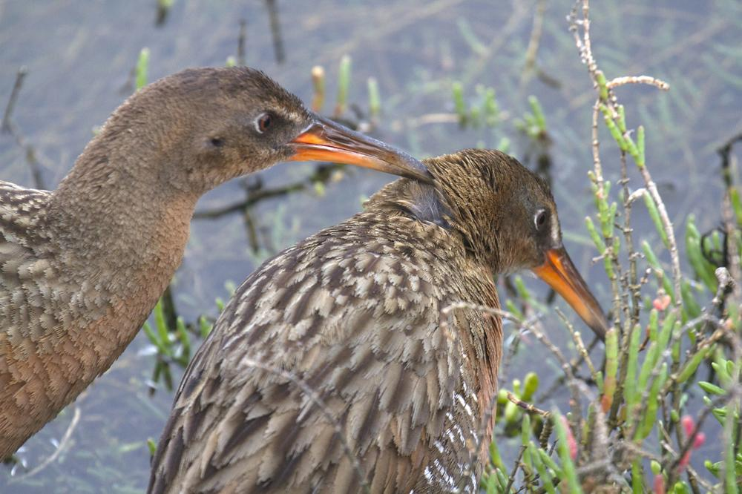
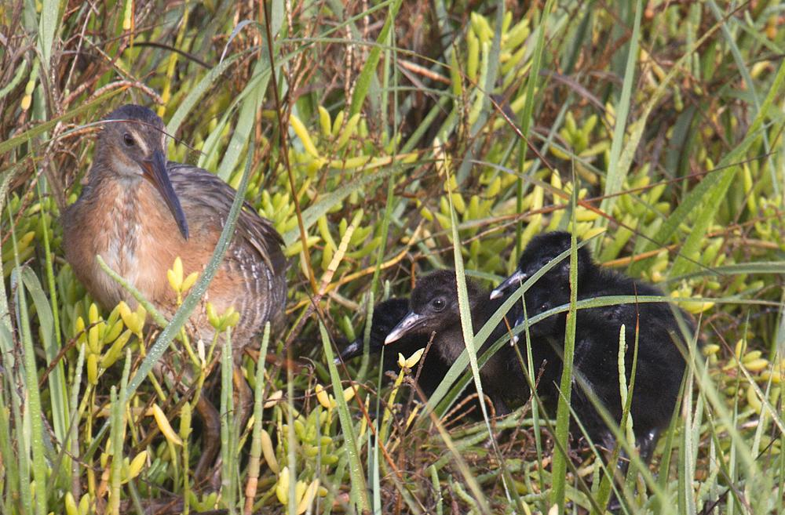
Restoration Recommendations
Restore for dense vegetation >30 cm, >30 % cover
Plant tall plants 50-100 cm
Design wider Tzones
Don’t focus on single plant species
Don’t remove grasses
Photo: Rick Lewis
Photo: Rick Lewis
Notes:
can’t separate effects of grass cover from width, since they are well-correlated in our study.

Slide 21
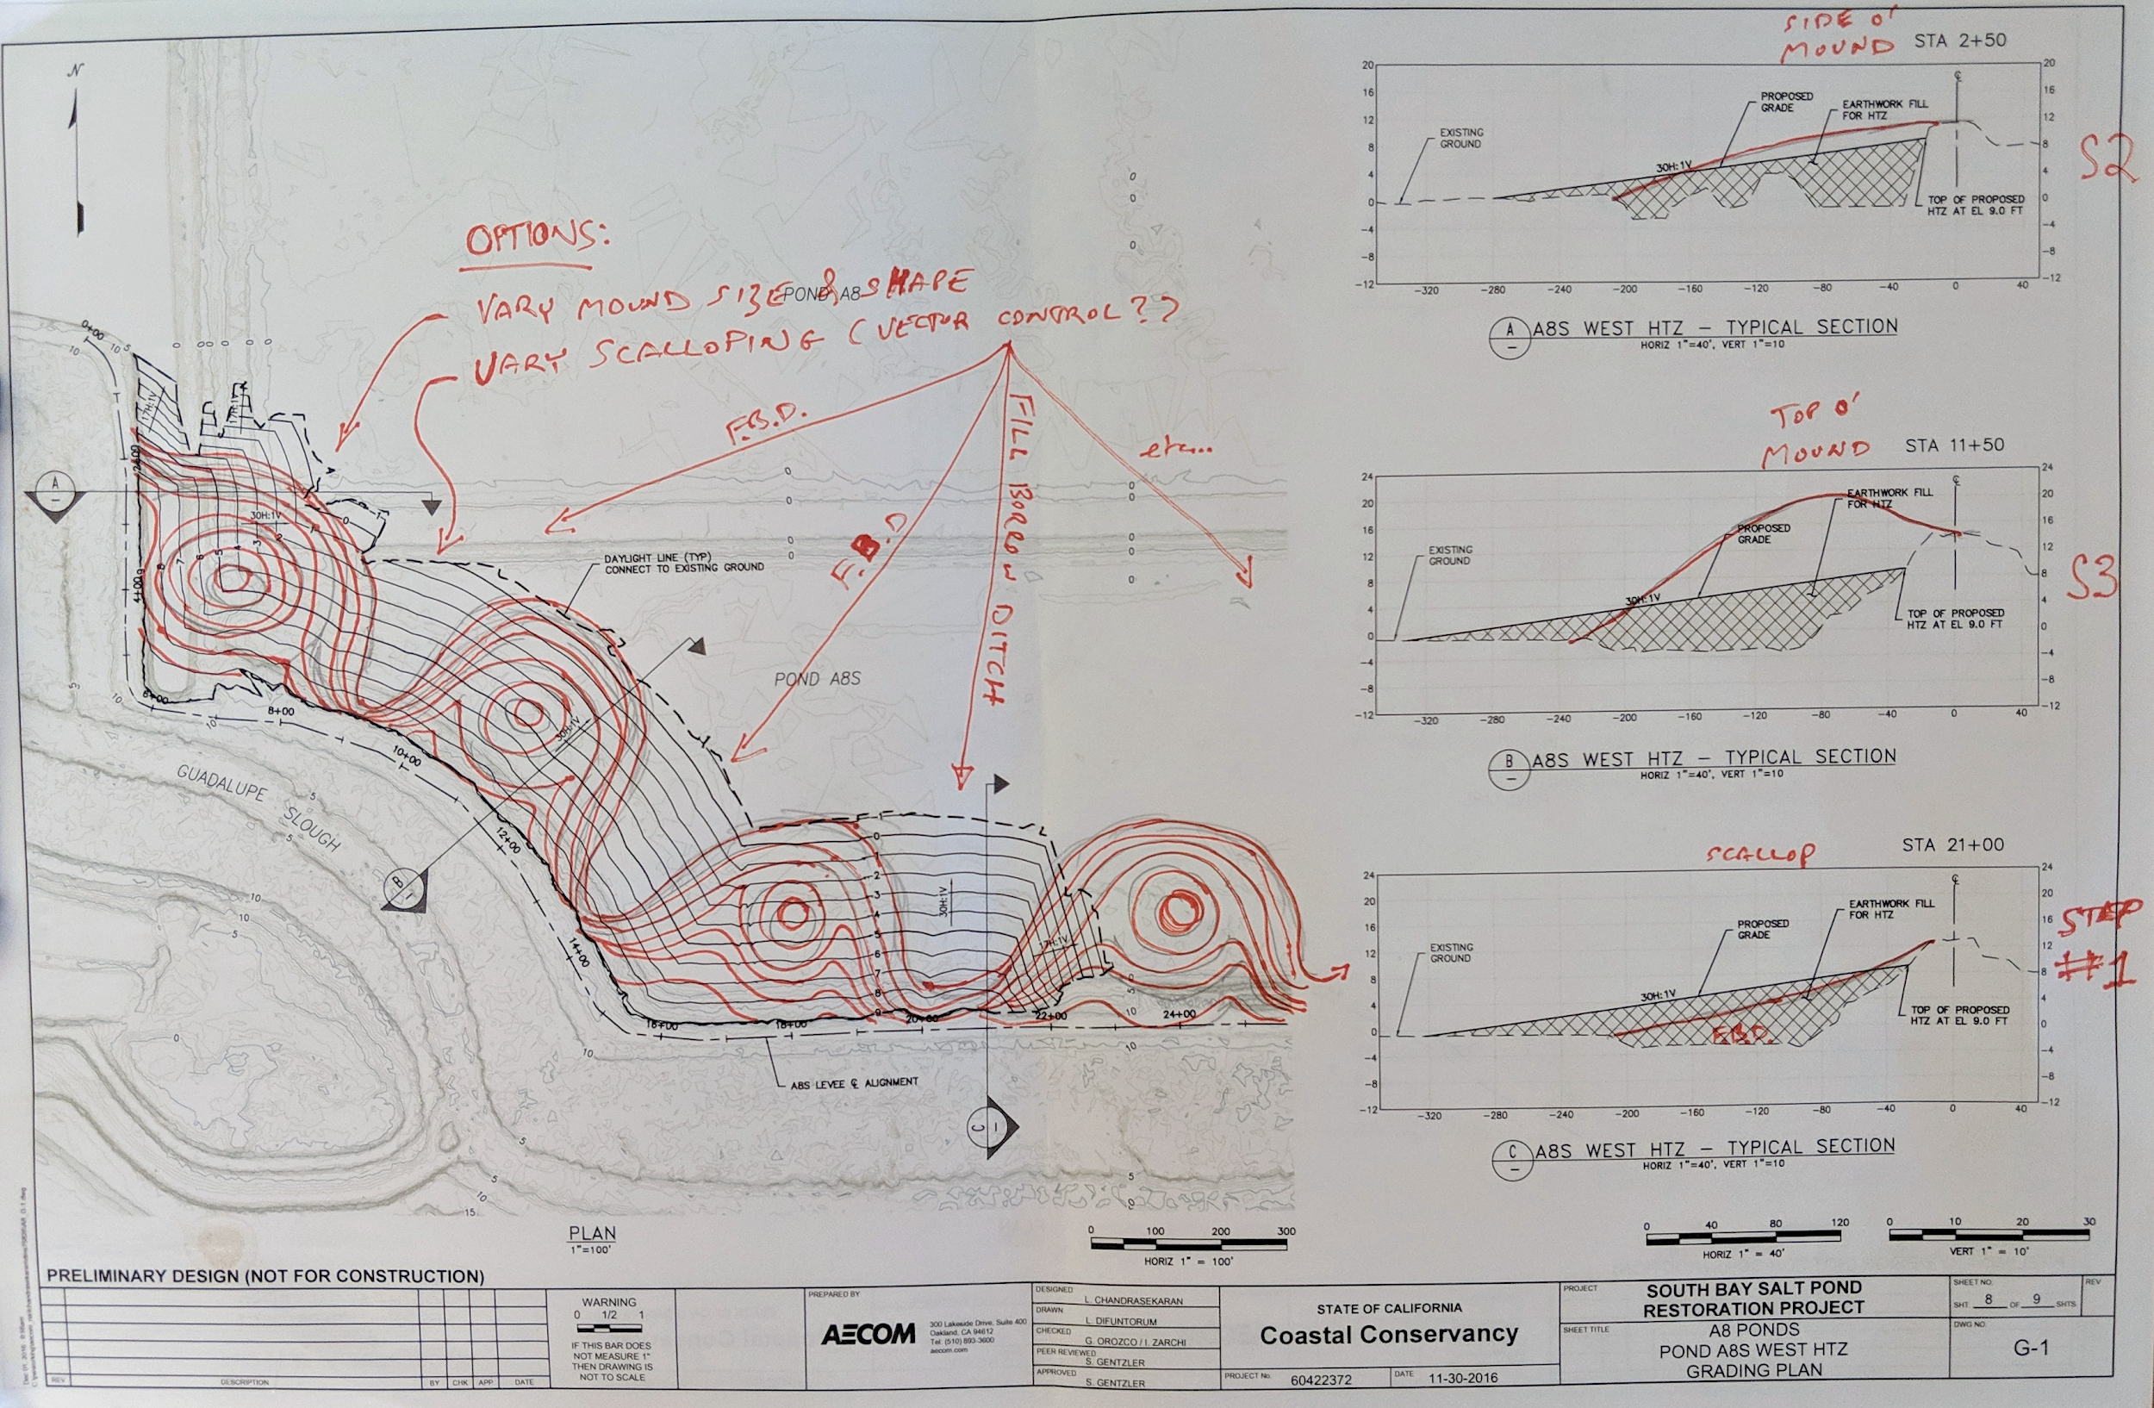
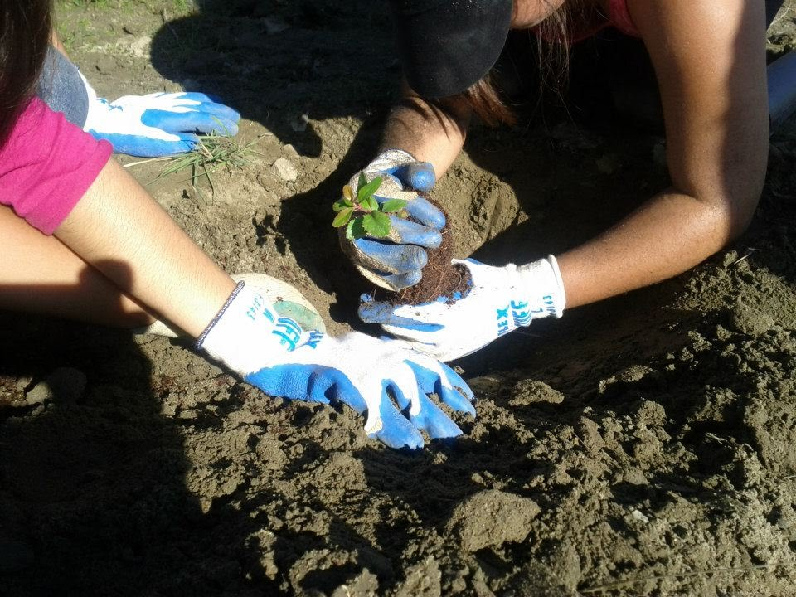
Questions for Tzone Restoration
How much grass should we plant?
How do we improve restoration to better benefit wildlife?
How can we restore tzone more efficiently?
Are native plant species more beneficial?

Slide 22
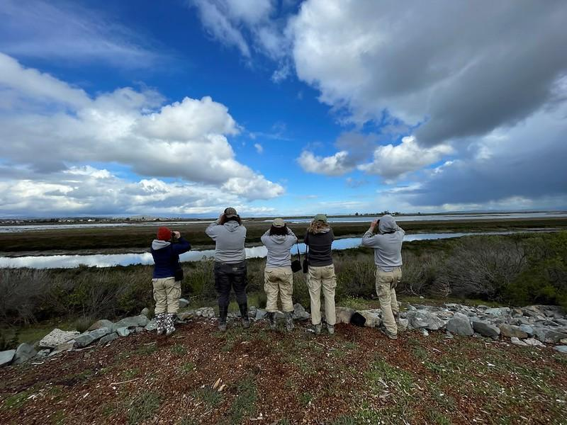
Looking Forward
Improving restoration with tzone monitoring

Slide 23
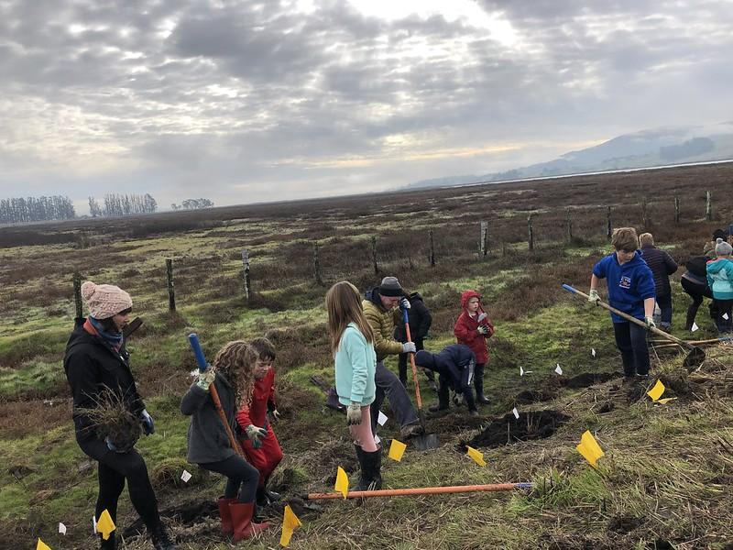
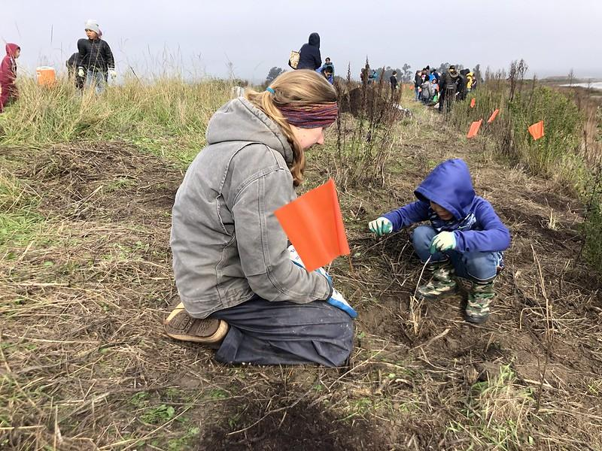
Shollenberger Park
SPBNWR: Dickson Unit
Bahia Wetlands

Slide 24
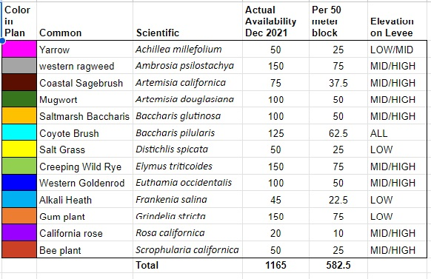
Study Design
Shrub and grass plot
Grass only plot

Slide 25
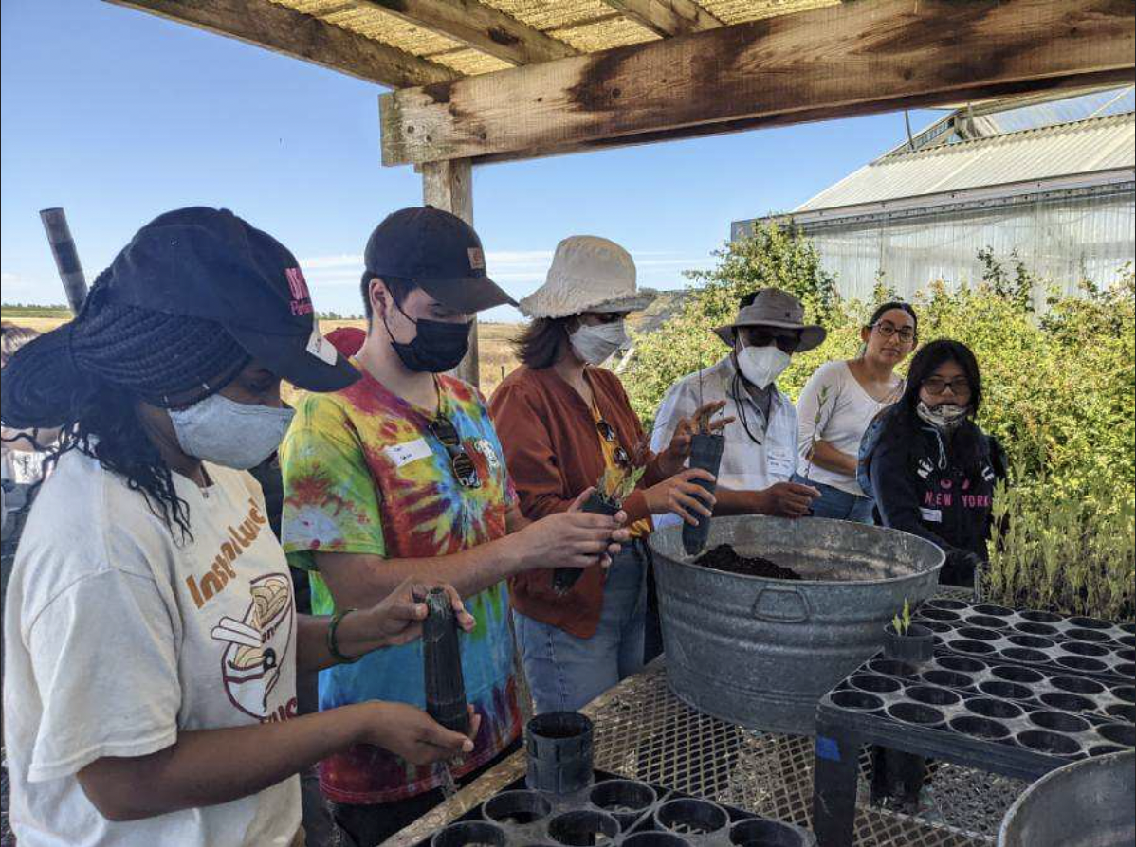
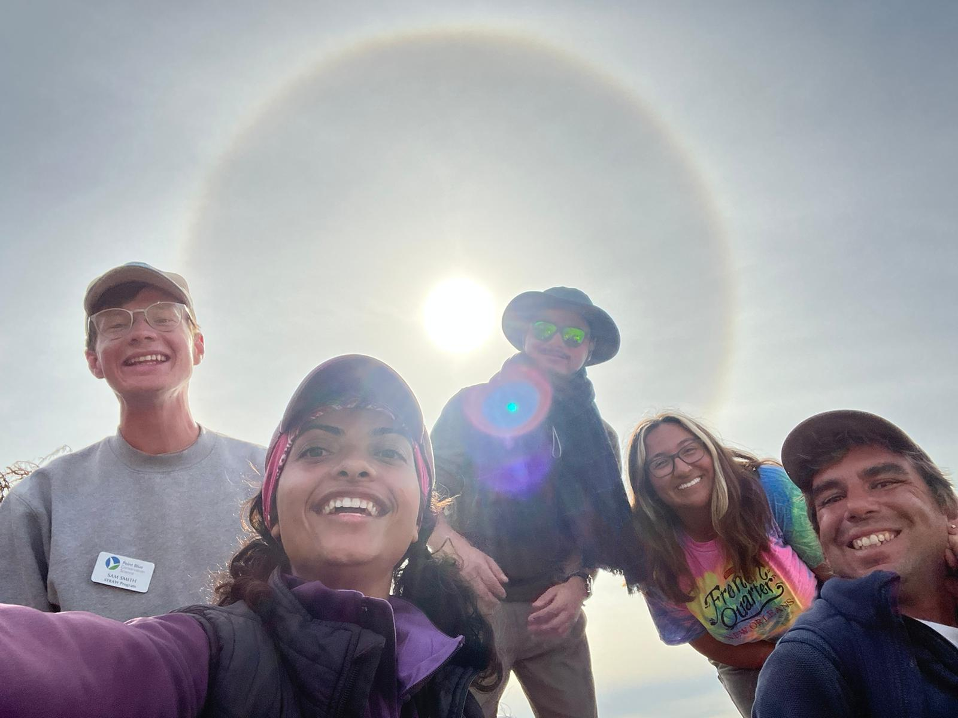
Community Science and Monitoring
Community College Conservation Internship (CCCI)
Apprenticeship programs
Notes:
interns and now apprentices as well as some CCCI folks were involved in spring veg, breeding season area search bird surveys

Slide 26
Take home messages
Healthy tzones benefit tidal marsh birds
Restoration using study design improves understanding
Community-based restoration has lasting benefits

Slide 27
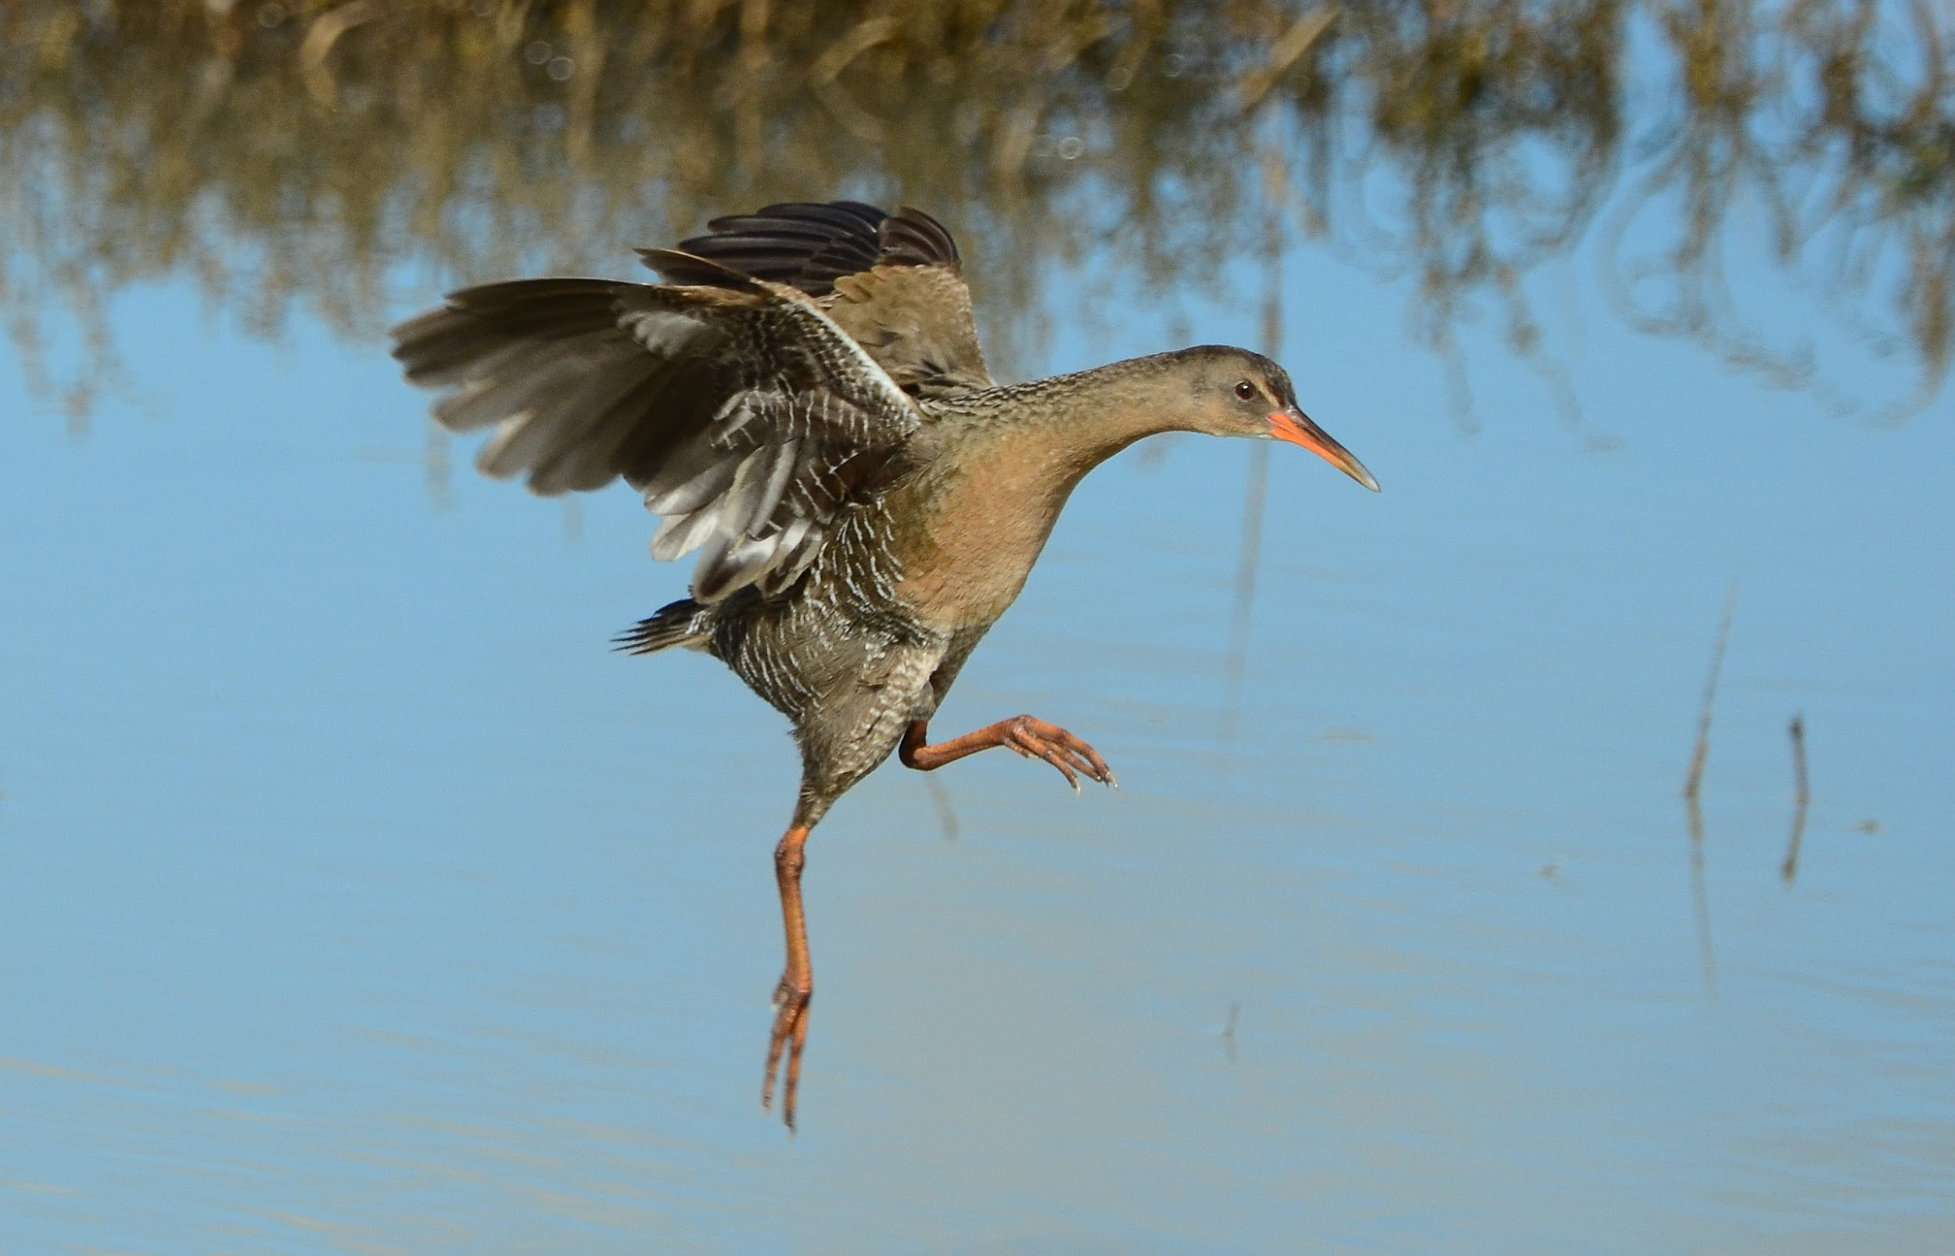
Thank You
www.pointblue.org/tbirds

