Slide 1
WRMP: monitoring change to advance regional adaptation
Marsh Migration Workshop
09/19/2023
Caitlin Mullan Crain
Photo: Shira Bezalel

Slide 2
Outline
Brief overview of the WRMP
Science priorities and early achievements
- regional habitat map
Monitoring (current and proposed) relevant to marsh migration
Notes:
Establishing baselines
Seeing how historic wetland - Tzone change occurs as reference
convening regional experts in aligning around common terminology or understanding why we dont

Slide 3
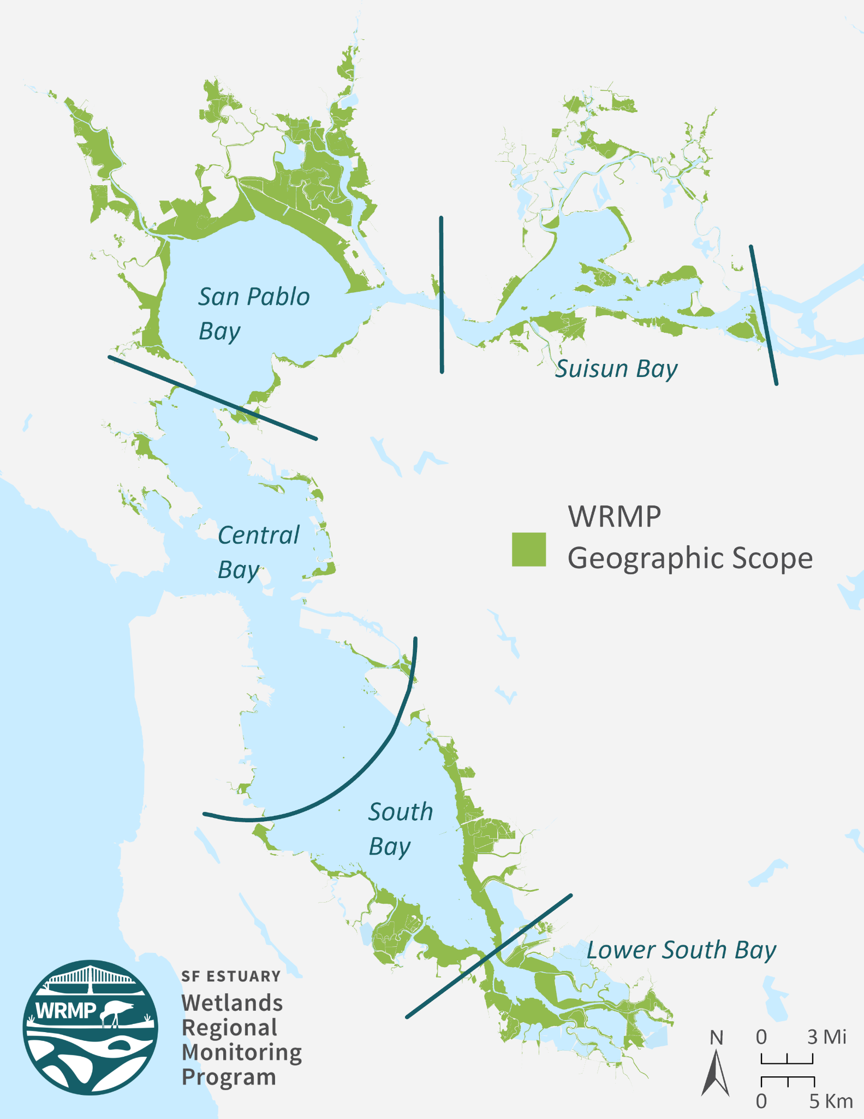
WRMP Scope and Goals
Deliver coordinated regional science to inform stewardship, restoration, and adaptive management of San Francisco Estuary wetlands. ​
Monitoring site network
Open data sharing platform
Comprehensive science framework to guide monitoring
Maintain an inclusive, collaborative, transparent process
Notes:
Regional monitoring to evaluate large scale drivers (climate change, watershed, restoration at scale) as well as context for project-level monitoring
Develop a consistent approach for implementing and contextualizing permit-driven monitoring of tidal wetland restoration projects
Transform data into information to support decision making
Establish a robust, sustainable program
More effectively and efficiently leverage ongoing and legacy monitoring data and programs to answer key questions
Maintain an inclusive, collaborative, transparent process

Slide 4
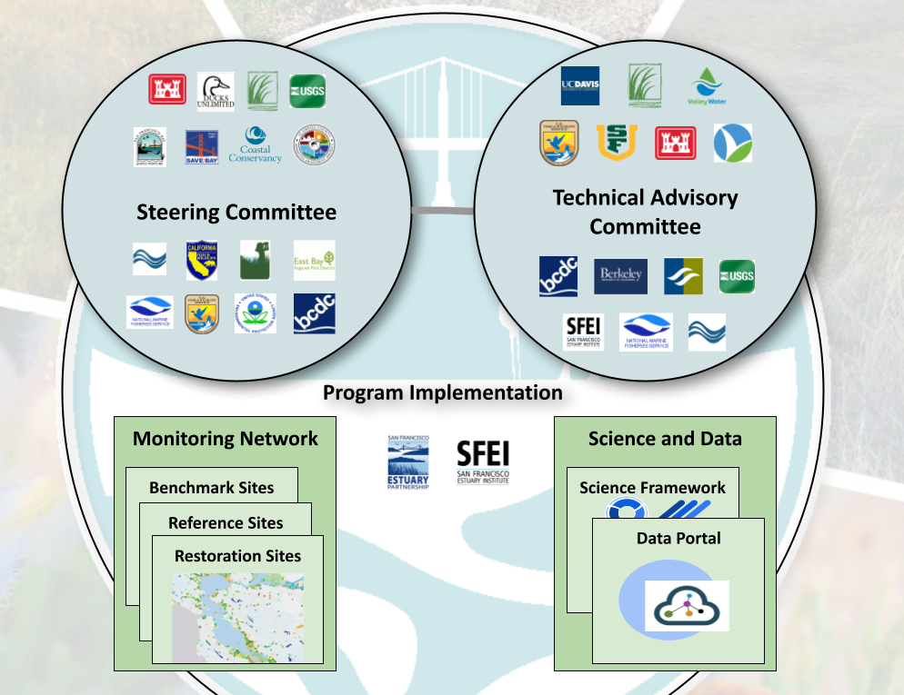
Notes:
Program in development since 2016 with funding from EPA
supported by SC and TAC made up of many regional partner organizations
Currently funded by SFBRA grant to SFEP and SFEI to move towards implementation of the program

Slide 5
WRMP Monitoring Guidance
Guiding Questions
Management Questions
Monitoring Questions
Indicators/Metrics
Protocols
GQ 1: Where are the tidal wetlands and how are they changing?
GQ 2: How are external factors impacting tidal wetlands?
GQ 3: How are plants and animals affected?
GQ 4: What new information do we need?
GQ 5: How are public health, safety, and recreation affected?
Hydrogeomorphic SOP
People and Wetlands SOP
Geospatial SOP
Fish and Fish Habitats SOP
Vegetation SOP

Slide 6
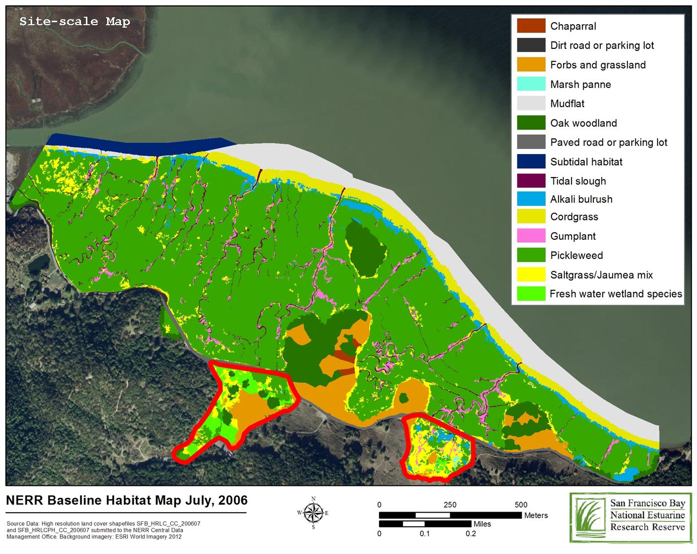
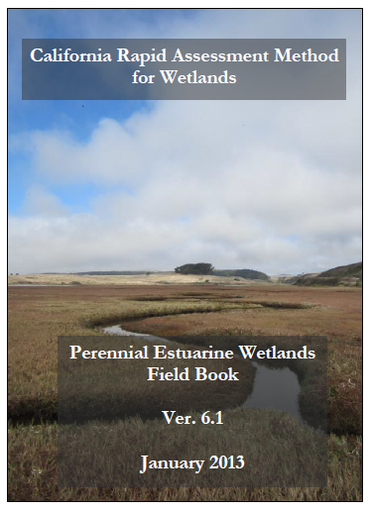
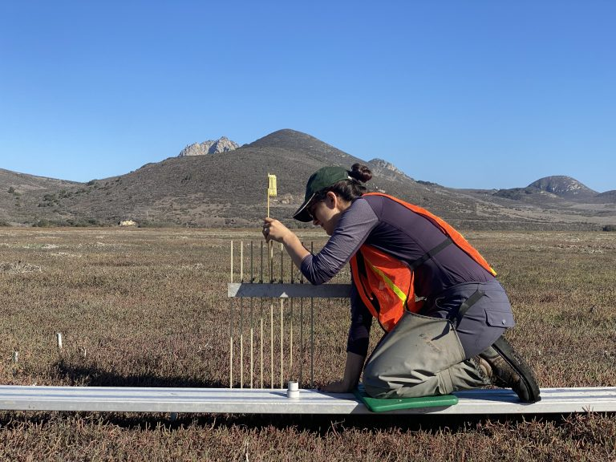
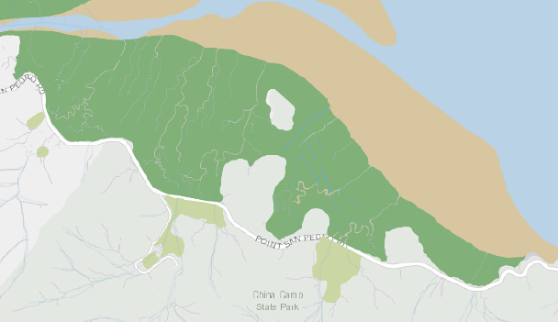
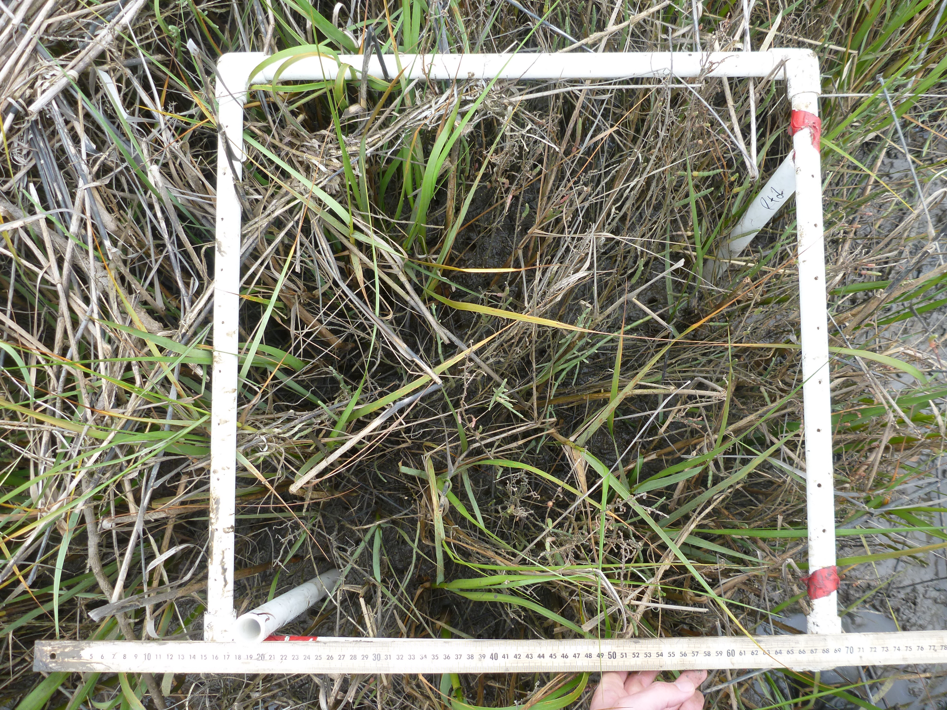
Level 1 Level 2 Level 3
Notes:
Monitoring framework is consistent with EPA Wetlands Monitoring and Assessment designed to establish baseline in extent, condition, and function to be able to detect change and characterize trends over space and time.
L1 - GIS/remote sensed landscape assessment, coarse landscape level info - Mapping of habitat types and elements (tidal flats, channels, pannes, etc) including transition zones - which is what Our Baylands Change Basemap will capture
L2 rapid assessment - CRAM to provide a coarse scale rapid assessment of individual sites to compare to habitat development curves for a broader set of established sites.
L3 Intensive site assessment/biological assessments of function

Slide 7
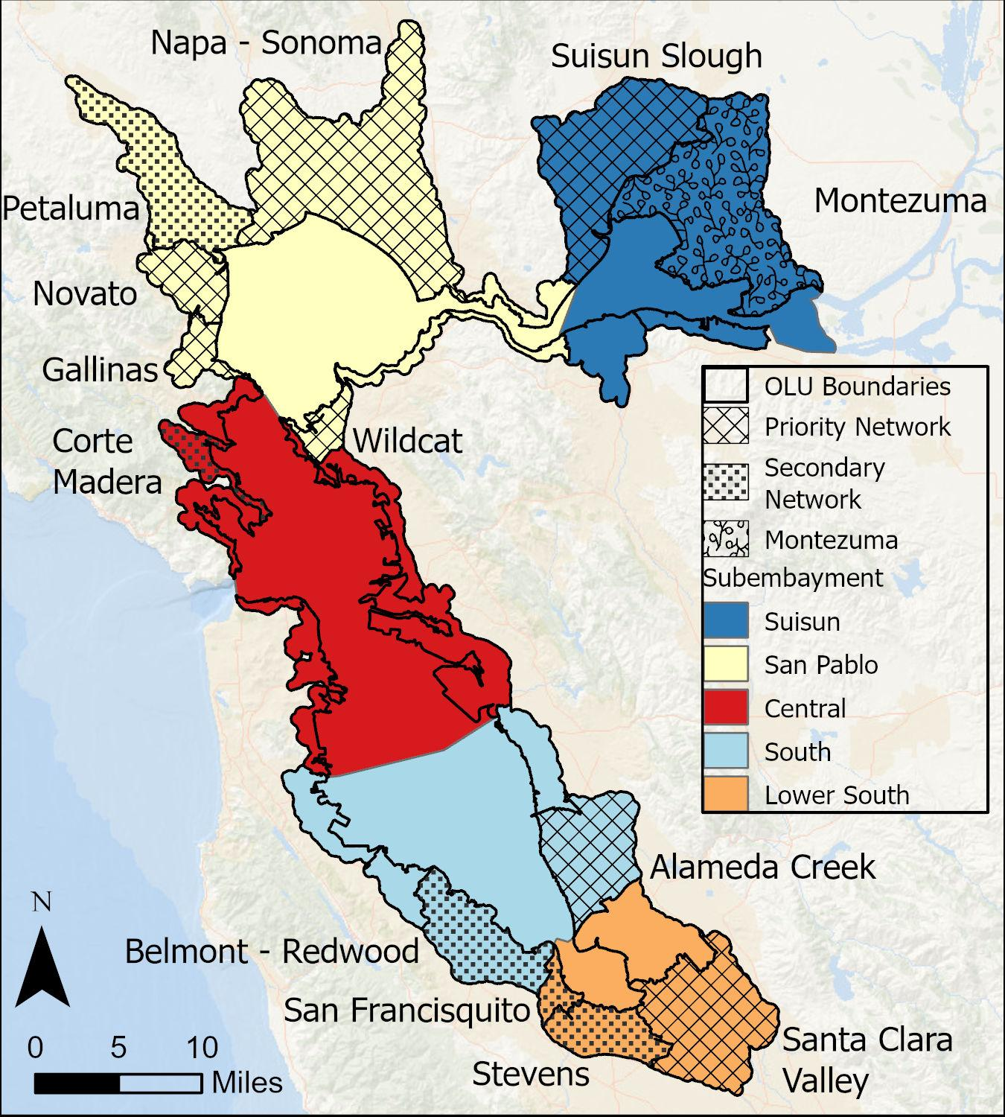
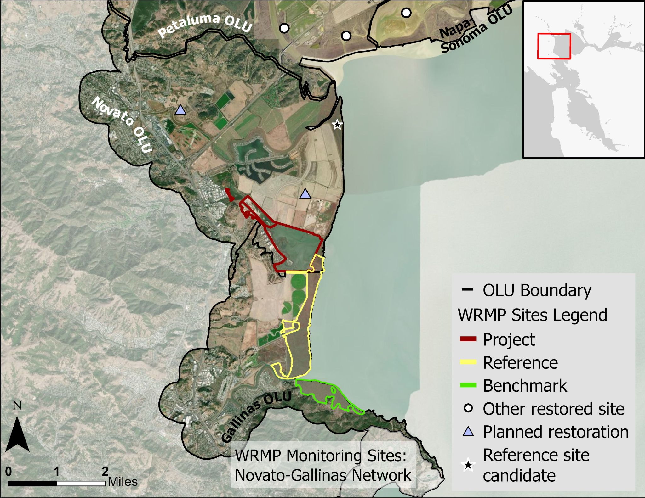
WRMP Priority Monitoring Site Network
Hamilton Wetlands
Outer McInnis
China Camp
Notes:
Big success of the past year - establishing the WRMP Priority Monitoring Site Network

Slide 8
Near-term monitoring priorities
Science Priorities & Early Achievements
Near-term program focus
Where are our tidal wetlands?
How are they doing?
Are they drowning or keeping pace with sea-level rise?
Landmark Baylands Habitat Map
standardized analyses of characteristics
California Rapid Assessment Method (CRAM) - condition assessment
Regional network of Sediment Elevation Table- Marker Horizons (SETs)
Notes:
Track how much tidal marsh we have and how it connects across the landscape. ​
Track how well restored marshes are functioning. ​
Detect if marshes are beginning to drown.

Slide 9
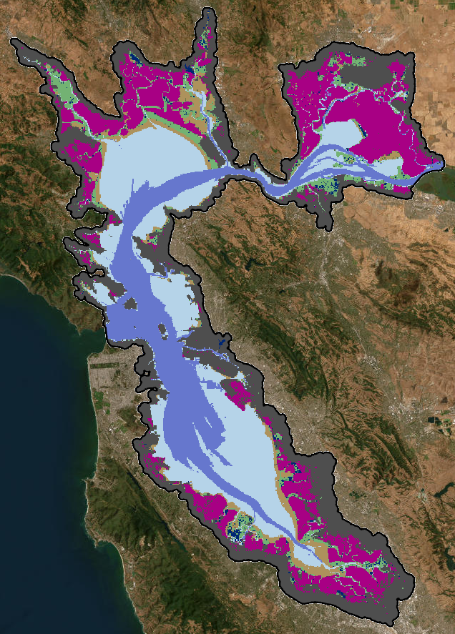
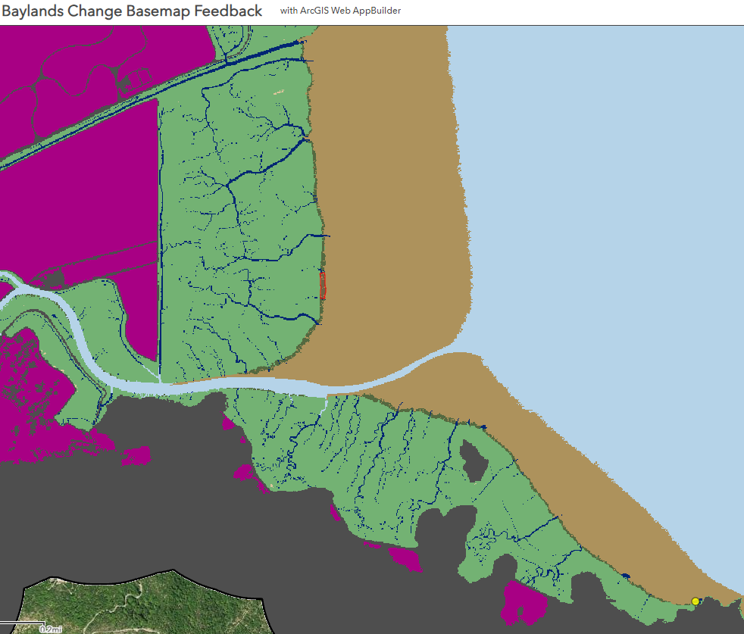
Baylands Habitat Map
Region-wide standardized mapping protocol
2020 NAIP imagery (4-band)
Compiled most-up-to-date DEMs
Built enhanced tidal datum surfaces
Training e-Cognition software to classify habitats
Baylands Change Basemap Feedback Tool
DRAFT
Notes:
Landmark Baylands Maps (Indicator 1)
Automated Object Based Image Analysis Classification with manual refinement
Bayland Change Update Maps (Indicator 1)
Change Detection -remap update areas of change from previous Landmark Baylands Map
Refined/Clarified Classification Scheme
Obtained and compiled 60cm NAIP 2020 Imagery (4-Band)
Compiled most-up-to-date DEMs (contractor provided)
No Vegetation-Correction (except using LEAN-Corrected for Suisun)
Updated nearshore to remove hydro-flattened areas
Resampled to 60cm to match NAIP resolution
Processed derivatives (Slope, Curvature, Flow Accumulation, etc.)
Built enhanced tidal datum surfaces leveraging AECOM/VDatum/Other
Begun modifying Shoreline Inventory to incorporate changes
Begun eCognition ruleset development/testing
Met with experts to guide further classification decisions and eCognition techniques
Subdivided Study Extent by OLU (avoid tiling issues and renting eCognition Server)

Slide 10
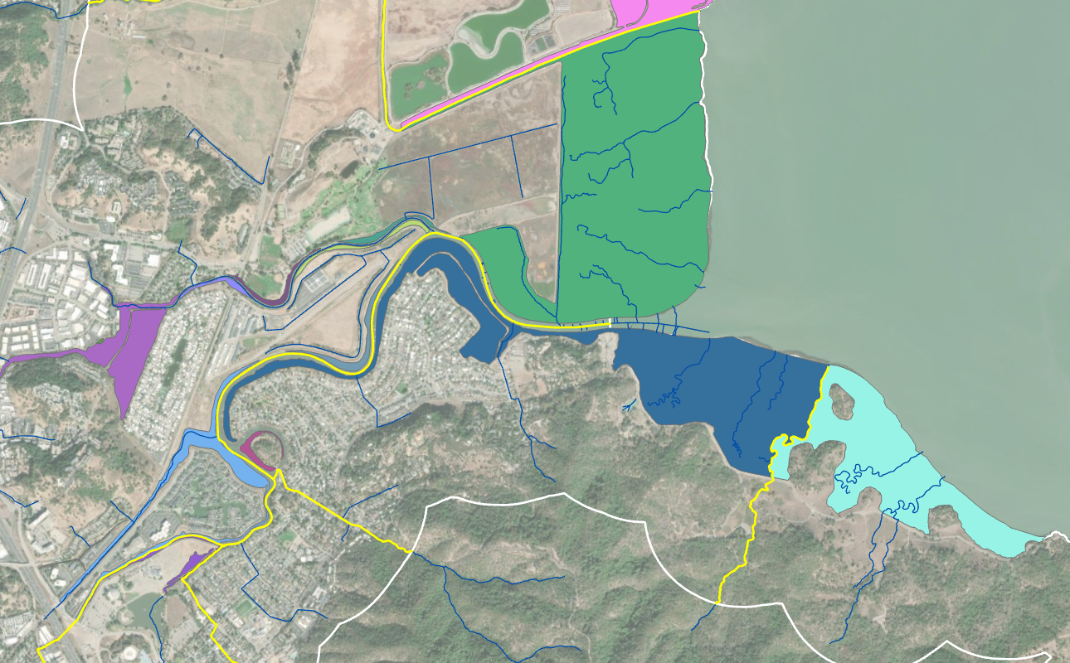
Standardized metrics of regional wetland characterics from the Basemap
Such as sub-regional differences in:
marsh gain and loss
patch size and configuration
percent vegetated marsh
elevation capital
complete marsh (connectivity across mudflat, marsh, terrestrial T-zone)
Notes:
Determine standardized polygon unit for analyses
Sp
Calculate dimensionless elevation layer (Z*) = (Z- MSL)/(MHHW - MSL)
Create histogram and hypsometric curve for each marsh unit
Also explore: Proportion of the marsh above MHW, inundation time

Slide 11
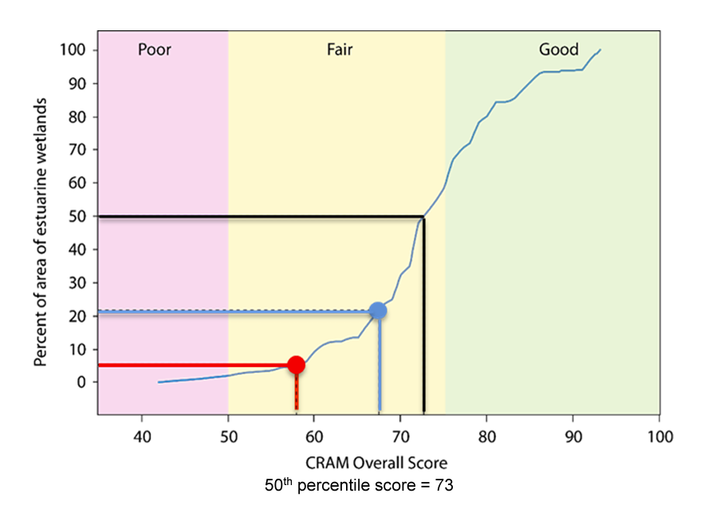
California Rapid Assessment Method (CRAM):
Condition over time and by region
100
Wetland Condition
Landscape & Buffer
Hydrology
Physical Structure
Biotic Structure
Cumulative Distribution Function curves show how CRAM scores are distributed across a region
Notes:
Rapid assessment of condition that can be applied and understood for historic and restoring wetlands

Slide 12
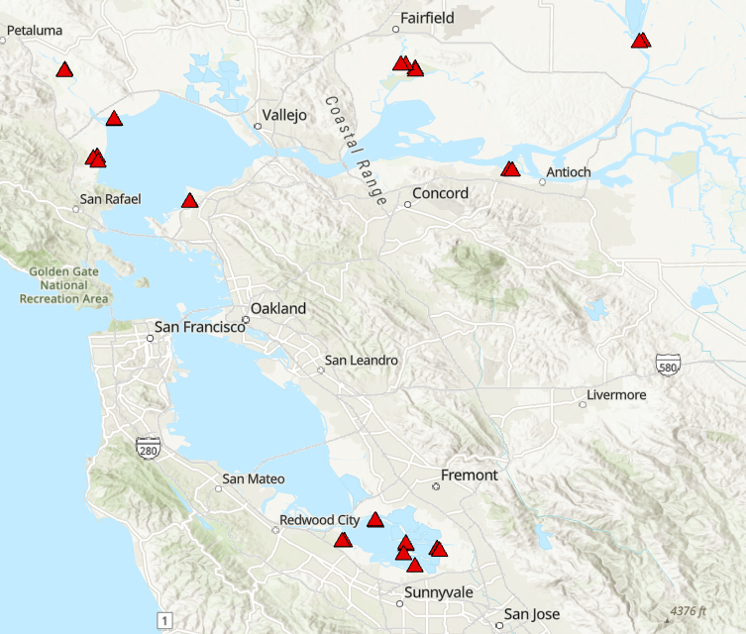
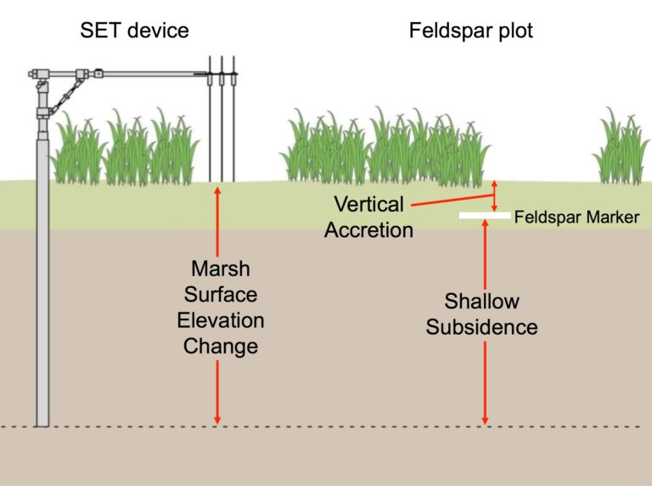
Site-level monitoring: accretion and elevation change
Notes:
Site level assessments of accretion and elevation change Ultimately building out a network to relate to elevation change more broadly
Partnering with USGS to monitor across a regional scale. - funding them to monitor their stations and add to the existing network

Slide 13
Future potential monitoring relevant to marsh migration
Geospatial SOP
Transition zone and marsh migration space mapping
Vegetation SOP
Vegetation alliance mapping
Special study to track vegetation composition at transition zones
Hydrogeomorphic SOP
Elevation (regional DEMs and site-based)
Water surface elevation
Notes:
Transition Zone (Indicator 3)
Upper Boundary method (inclusive definition & consistent with other efforts)
Migration Space (Indicator 3)
Undeveloped areas expected to be inundated with 2.0m SLR, above today’s highest astronomical tide (z* 1.34) (consistent with Adaptation Atlas)

Slide 14
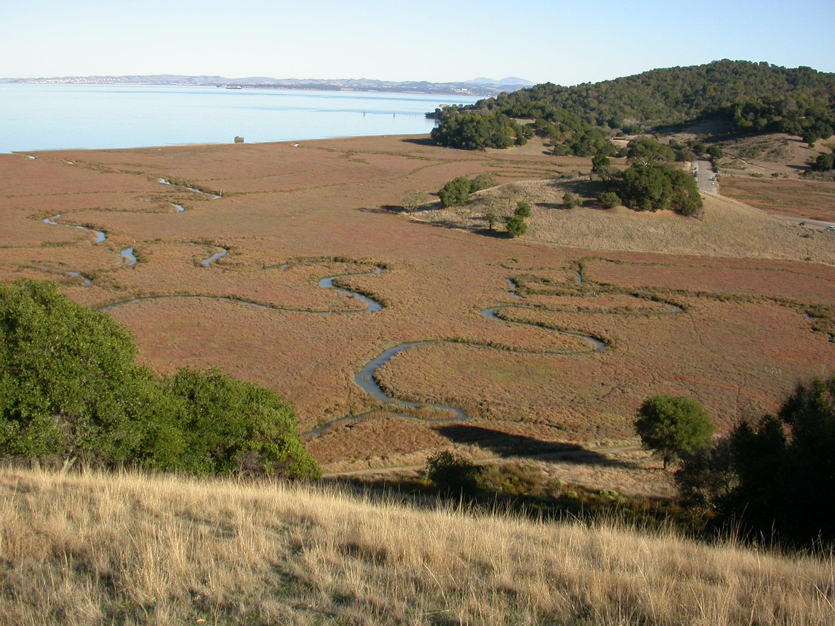
Proposed special study tracking wetland vegetation across transition zones
High Marsh
Terrestrial
1
PVC markers
3
2
Belt transect to detect shifts in
species composition
species distribution
elevation

Slide 15
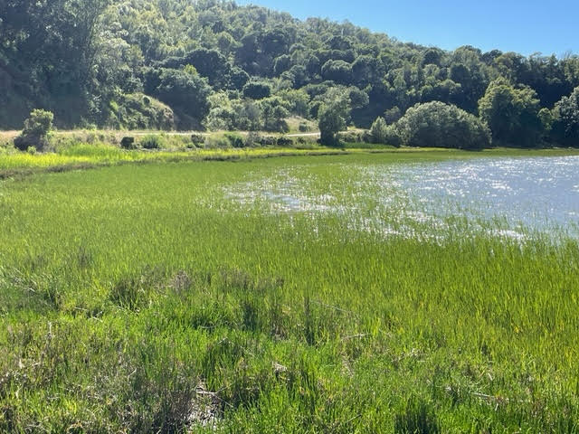
What’s Next?
Hydrogeomorphic SOP
Initial Monitoring Plan
Implementation Plan
Continue to serve as regional hub for monitoring

Slide 16
Thank you!
Questions

