Slide 1
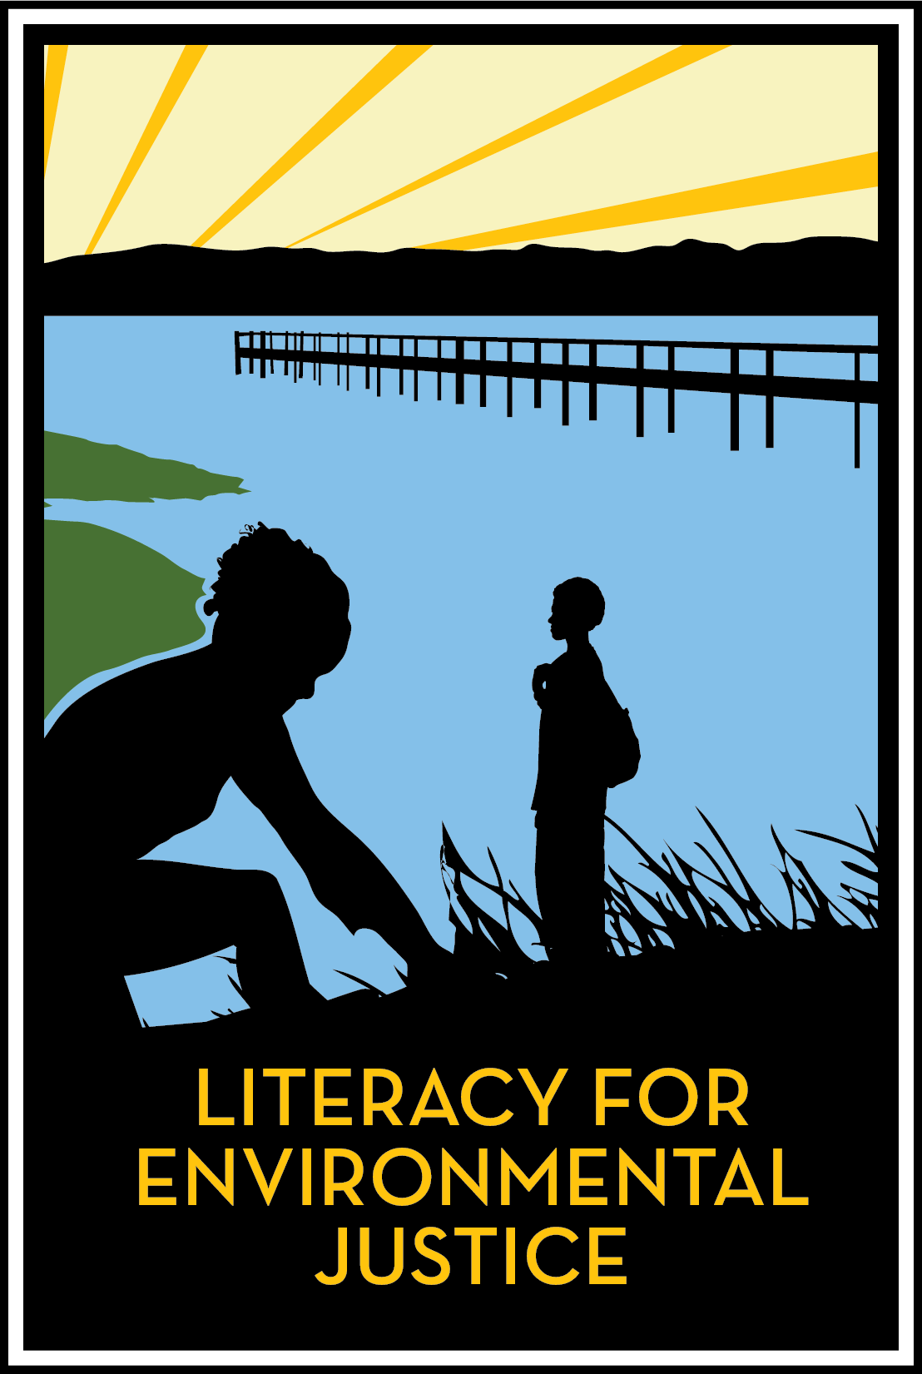
Building a Living Shoreline in Bayview’s Heron’s Head Park
Through Community Stewardship, Youth Education, and Workforce Development
Nina Omomo
Community Stewardship Manager
Literacy for Environmental Justice

Slide 4
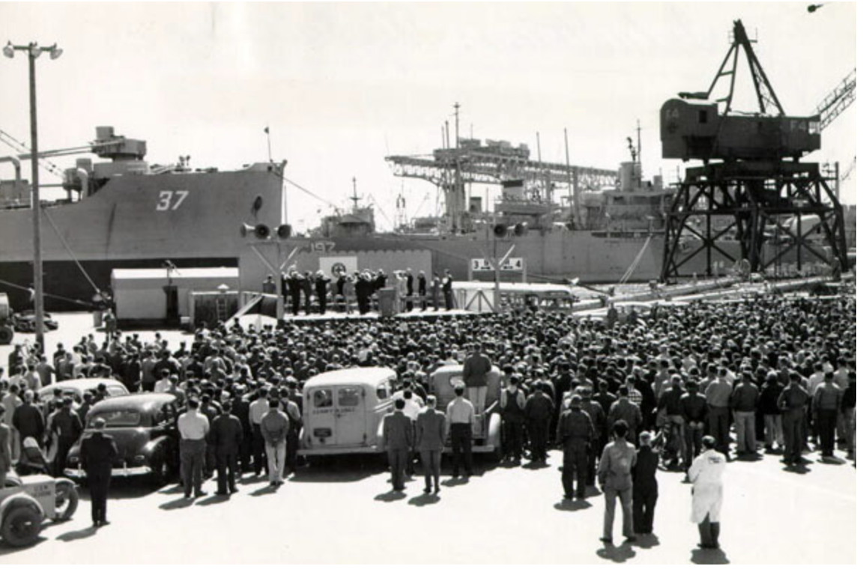

Slide 5
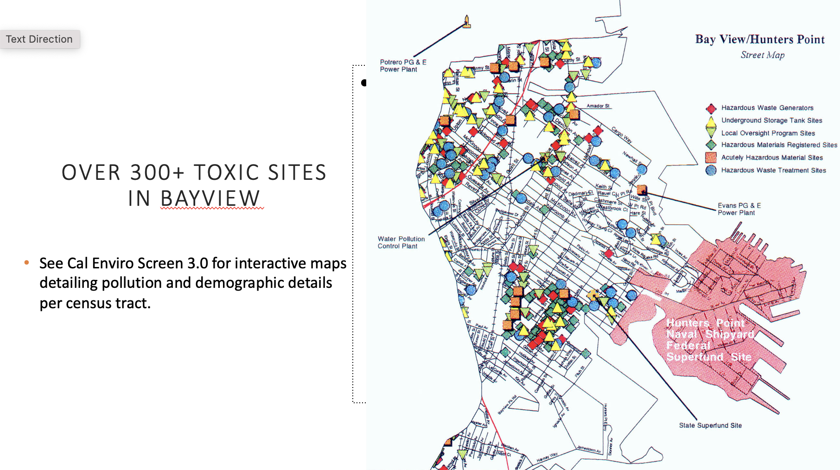

Slide 6
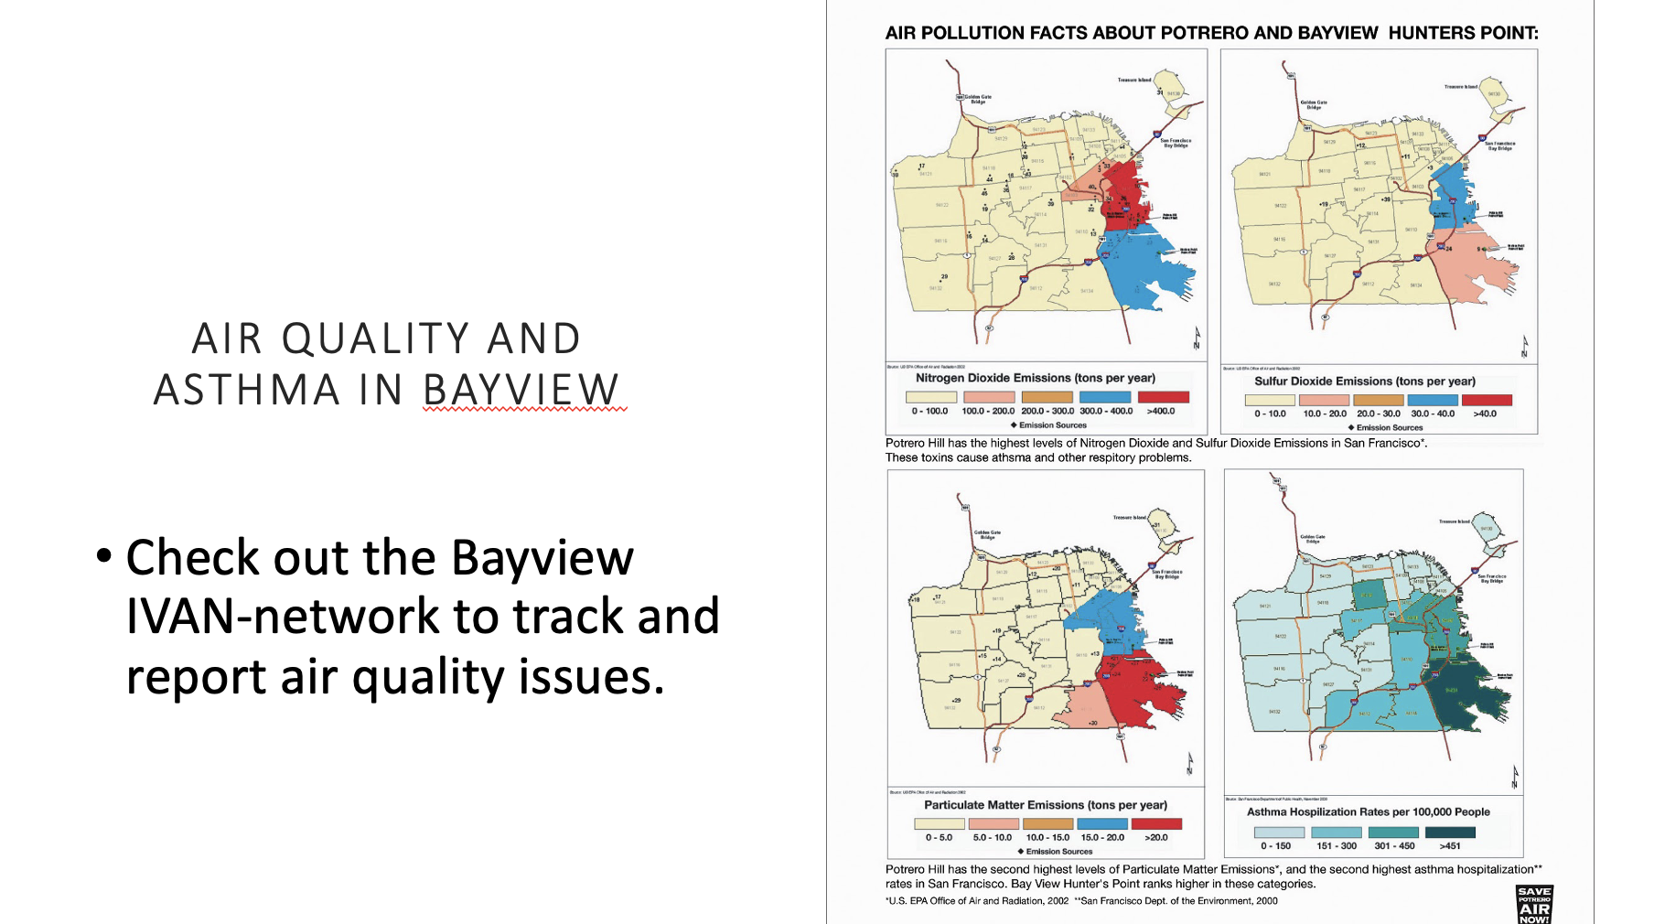

Slide 7
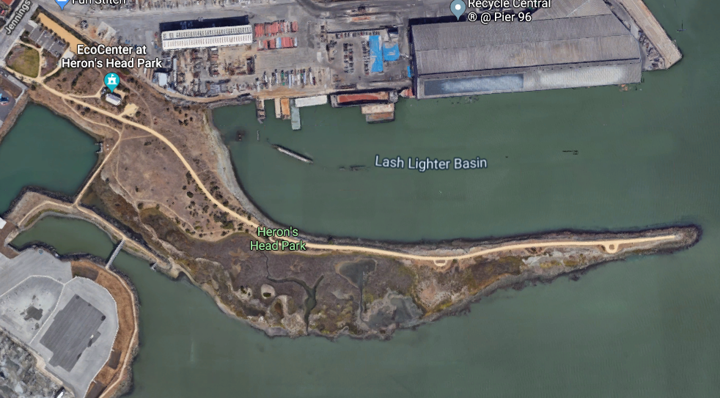
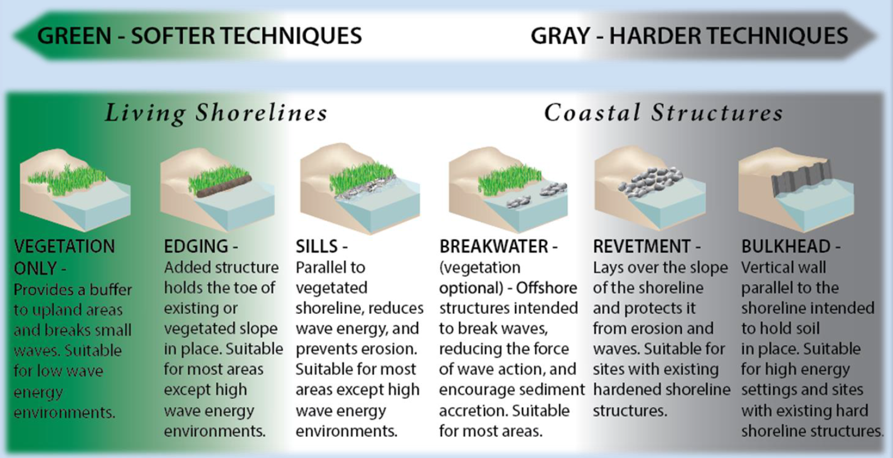
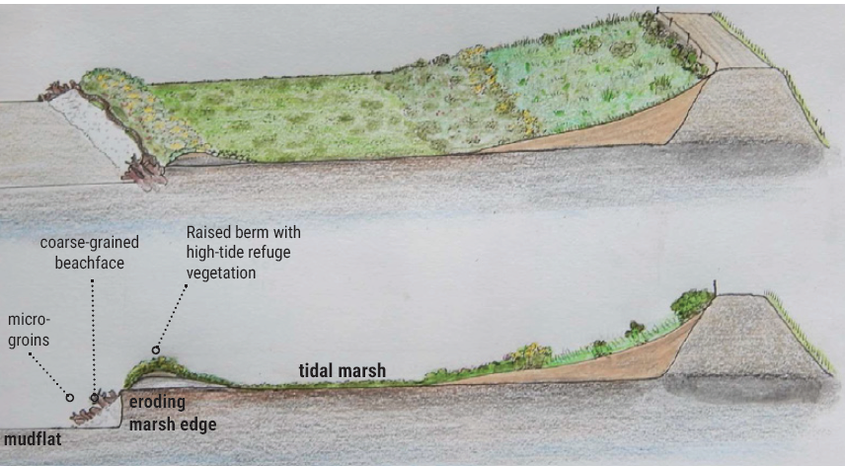
Heron’s Head Park
Shoreline Resilience
Project
What is a living shoreline?

Slide 8
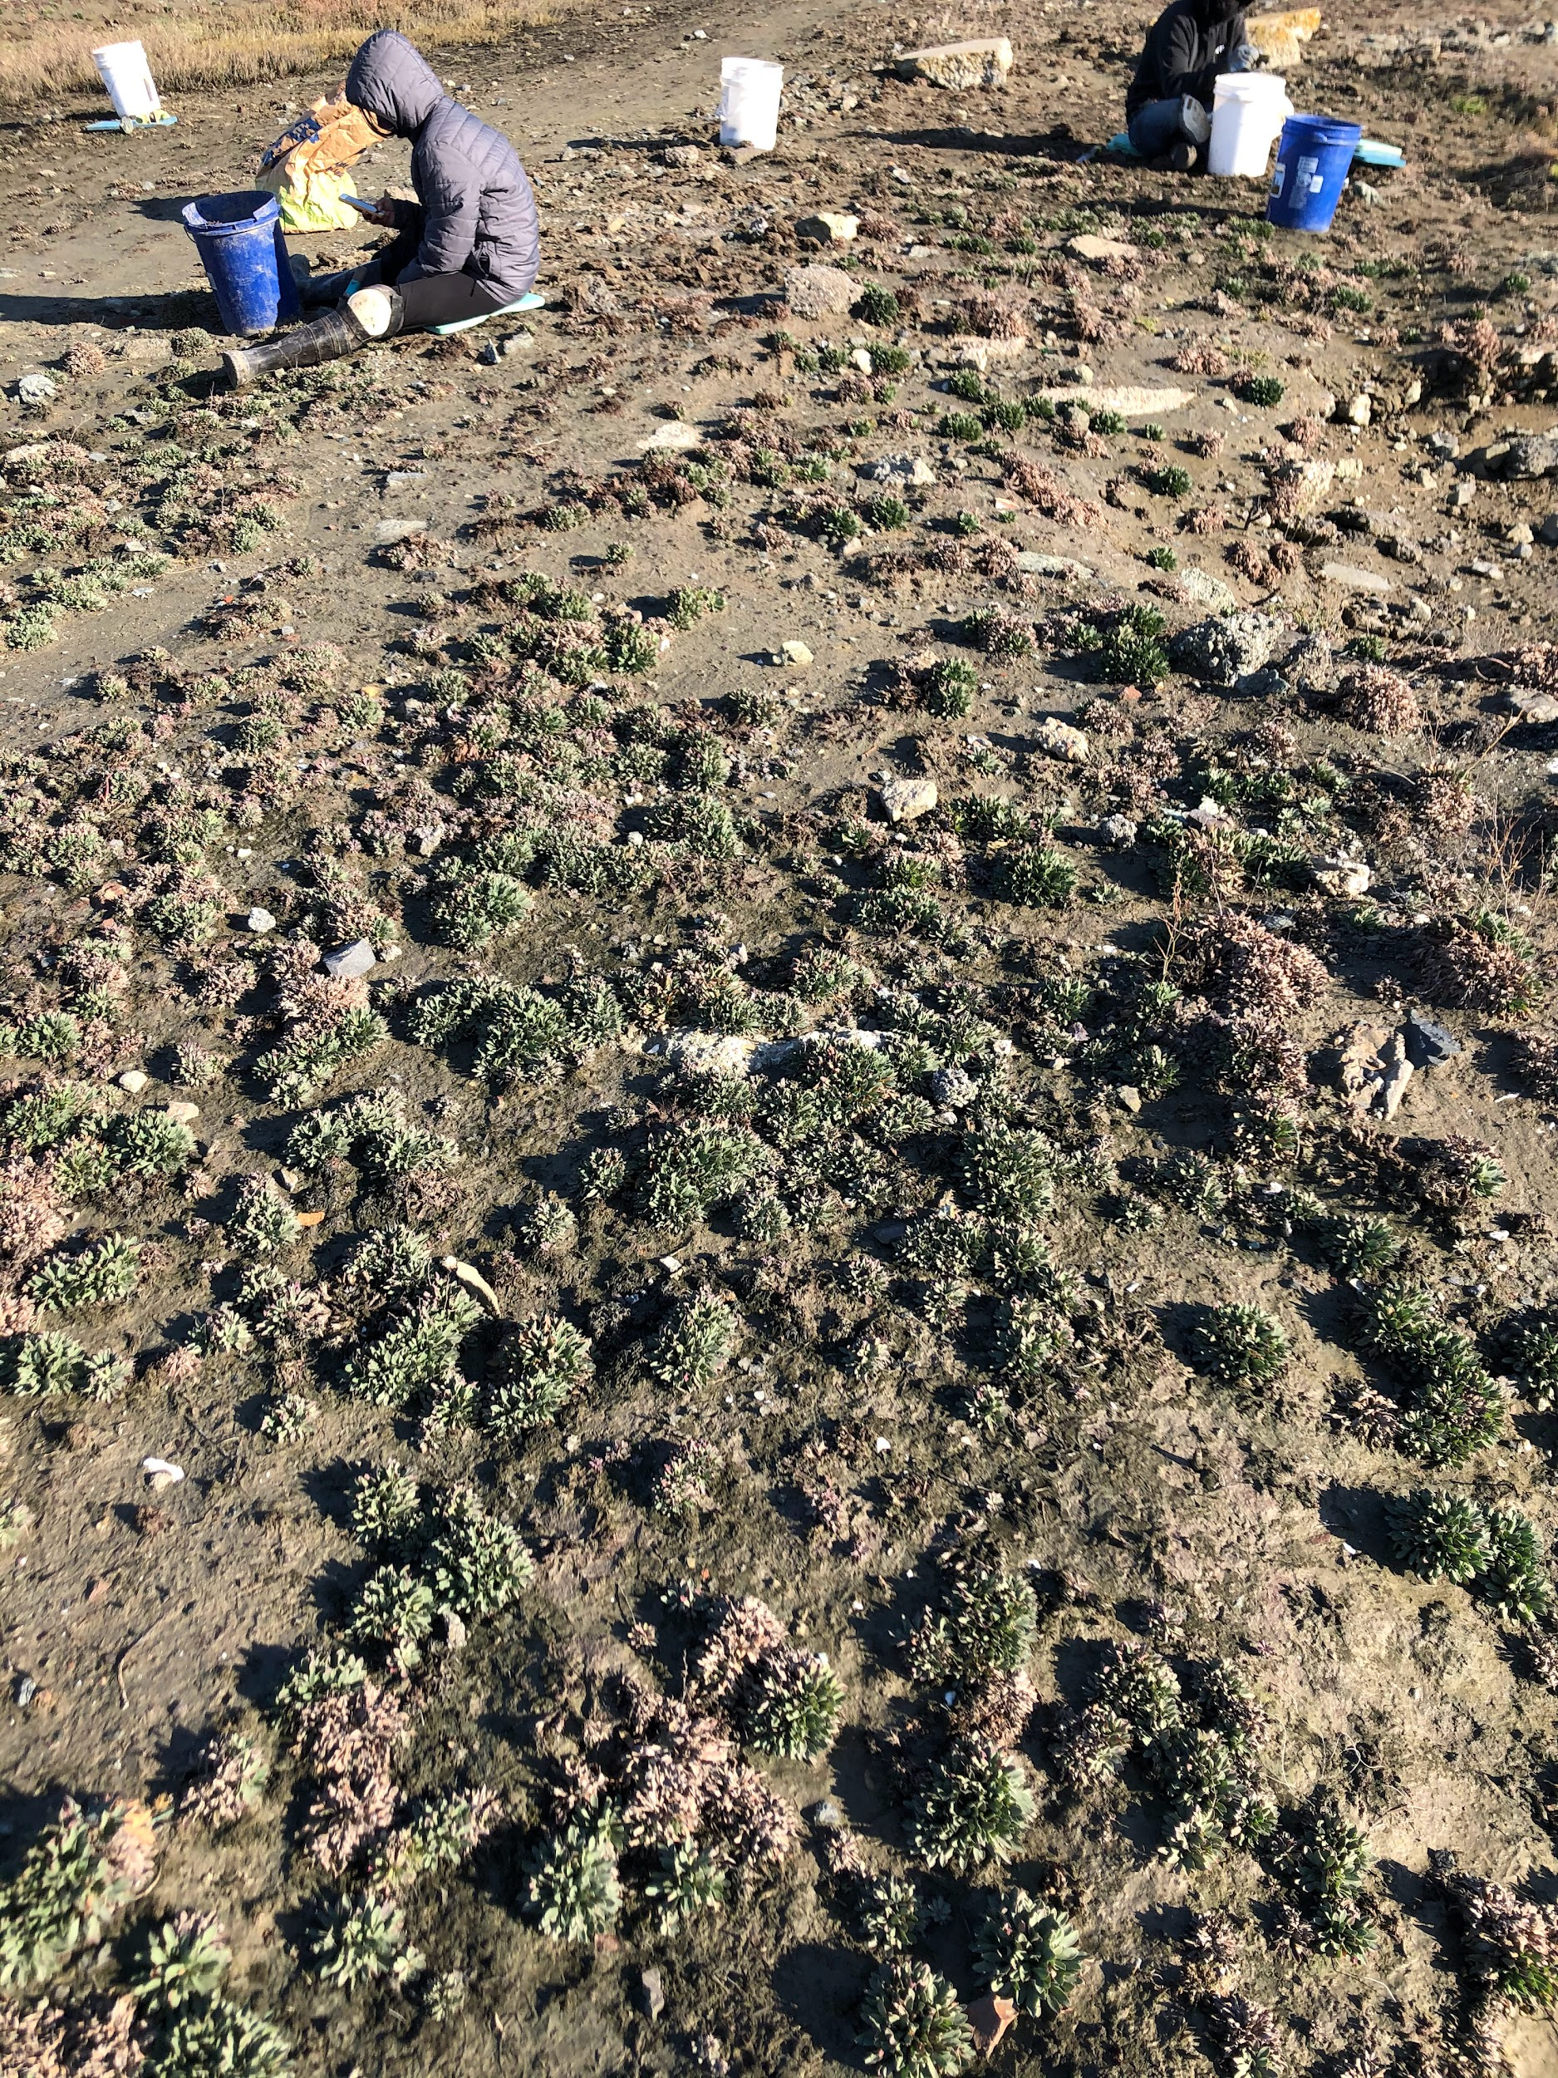
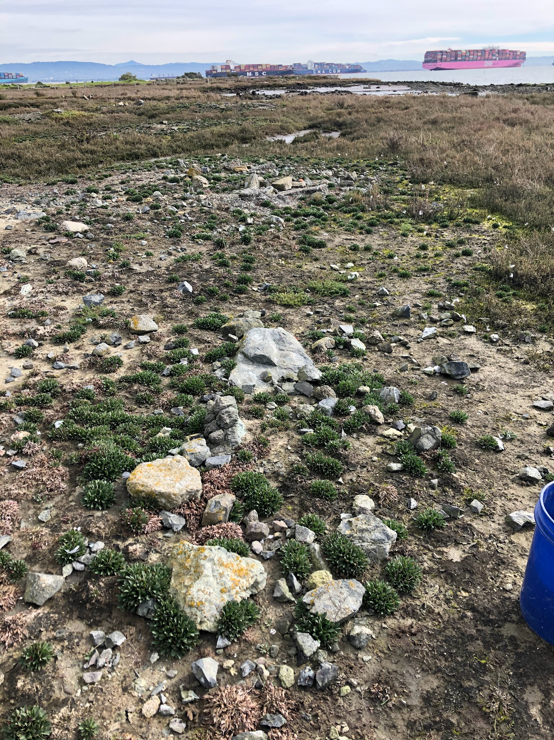
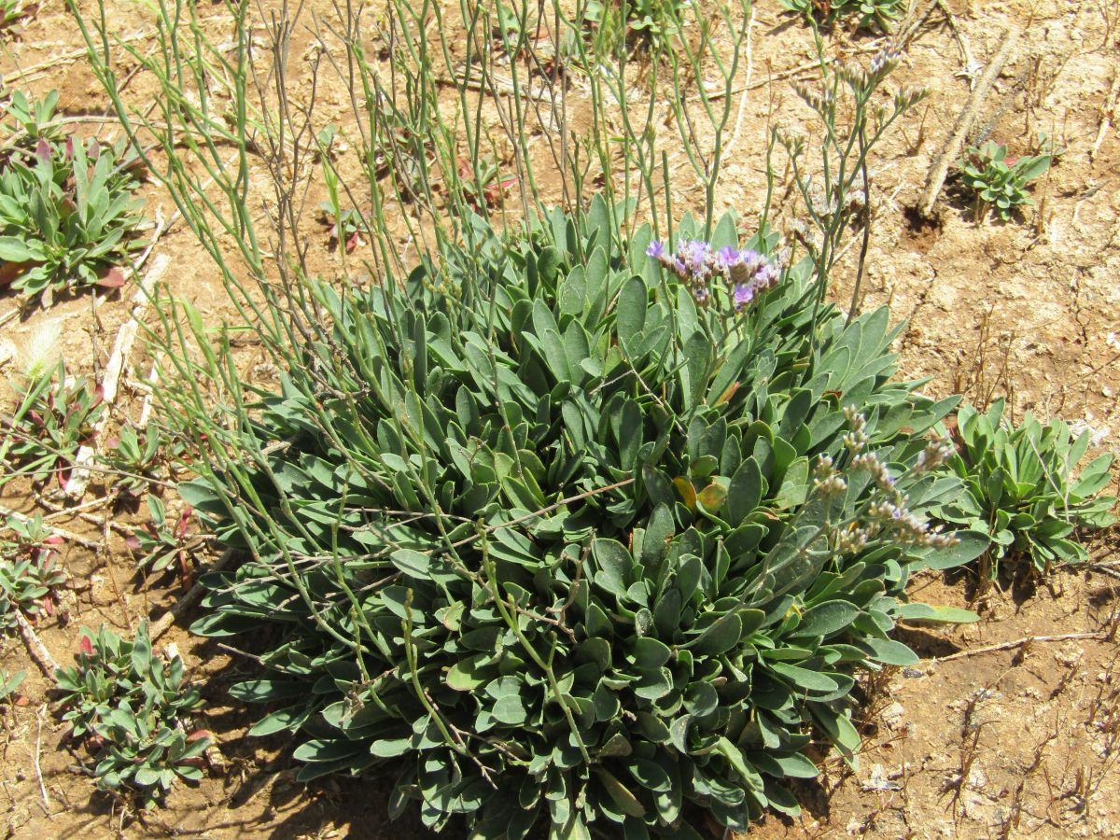
First Year Focus: Algerian Sea Lavender Removal and Techniques…
Limonium ramosissimum, referred to as LIRA, being hand-pulled by Eco-Apprentices at its densest cover (Spring 2020)

Slide 9
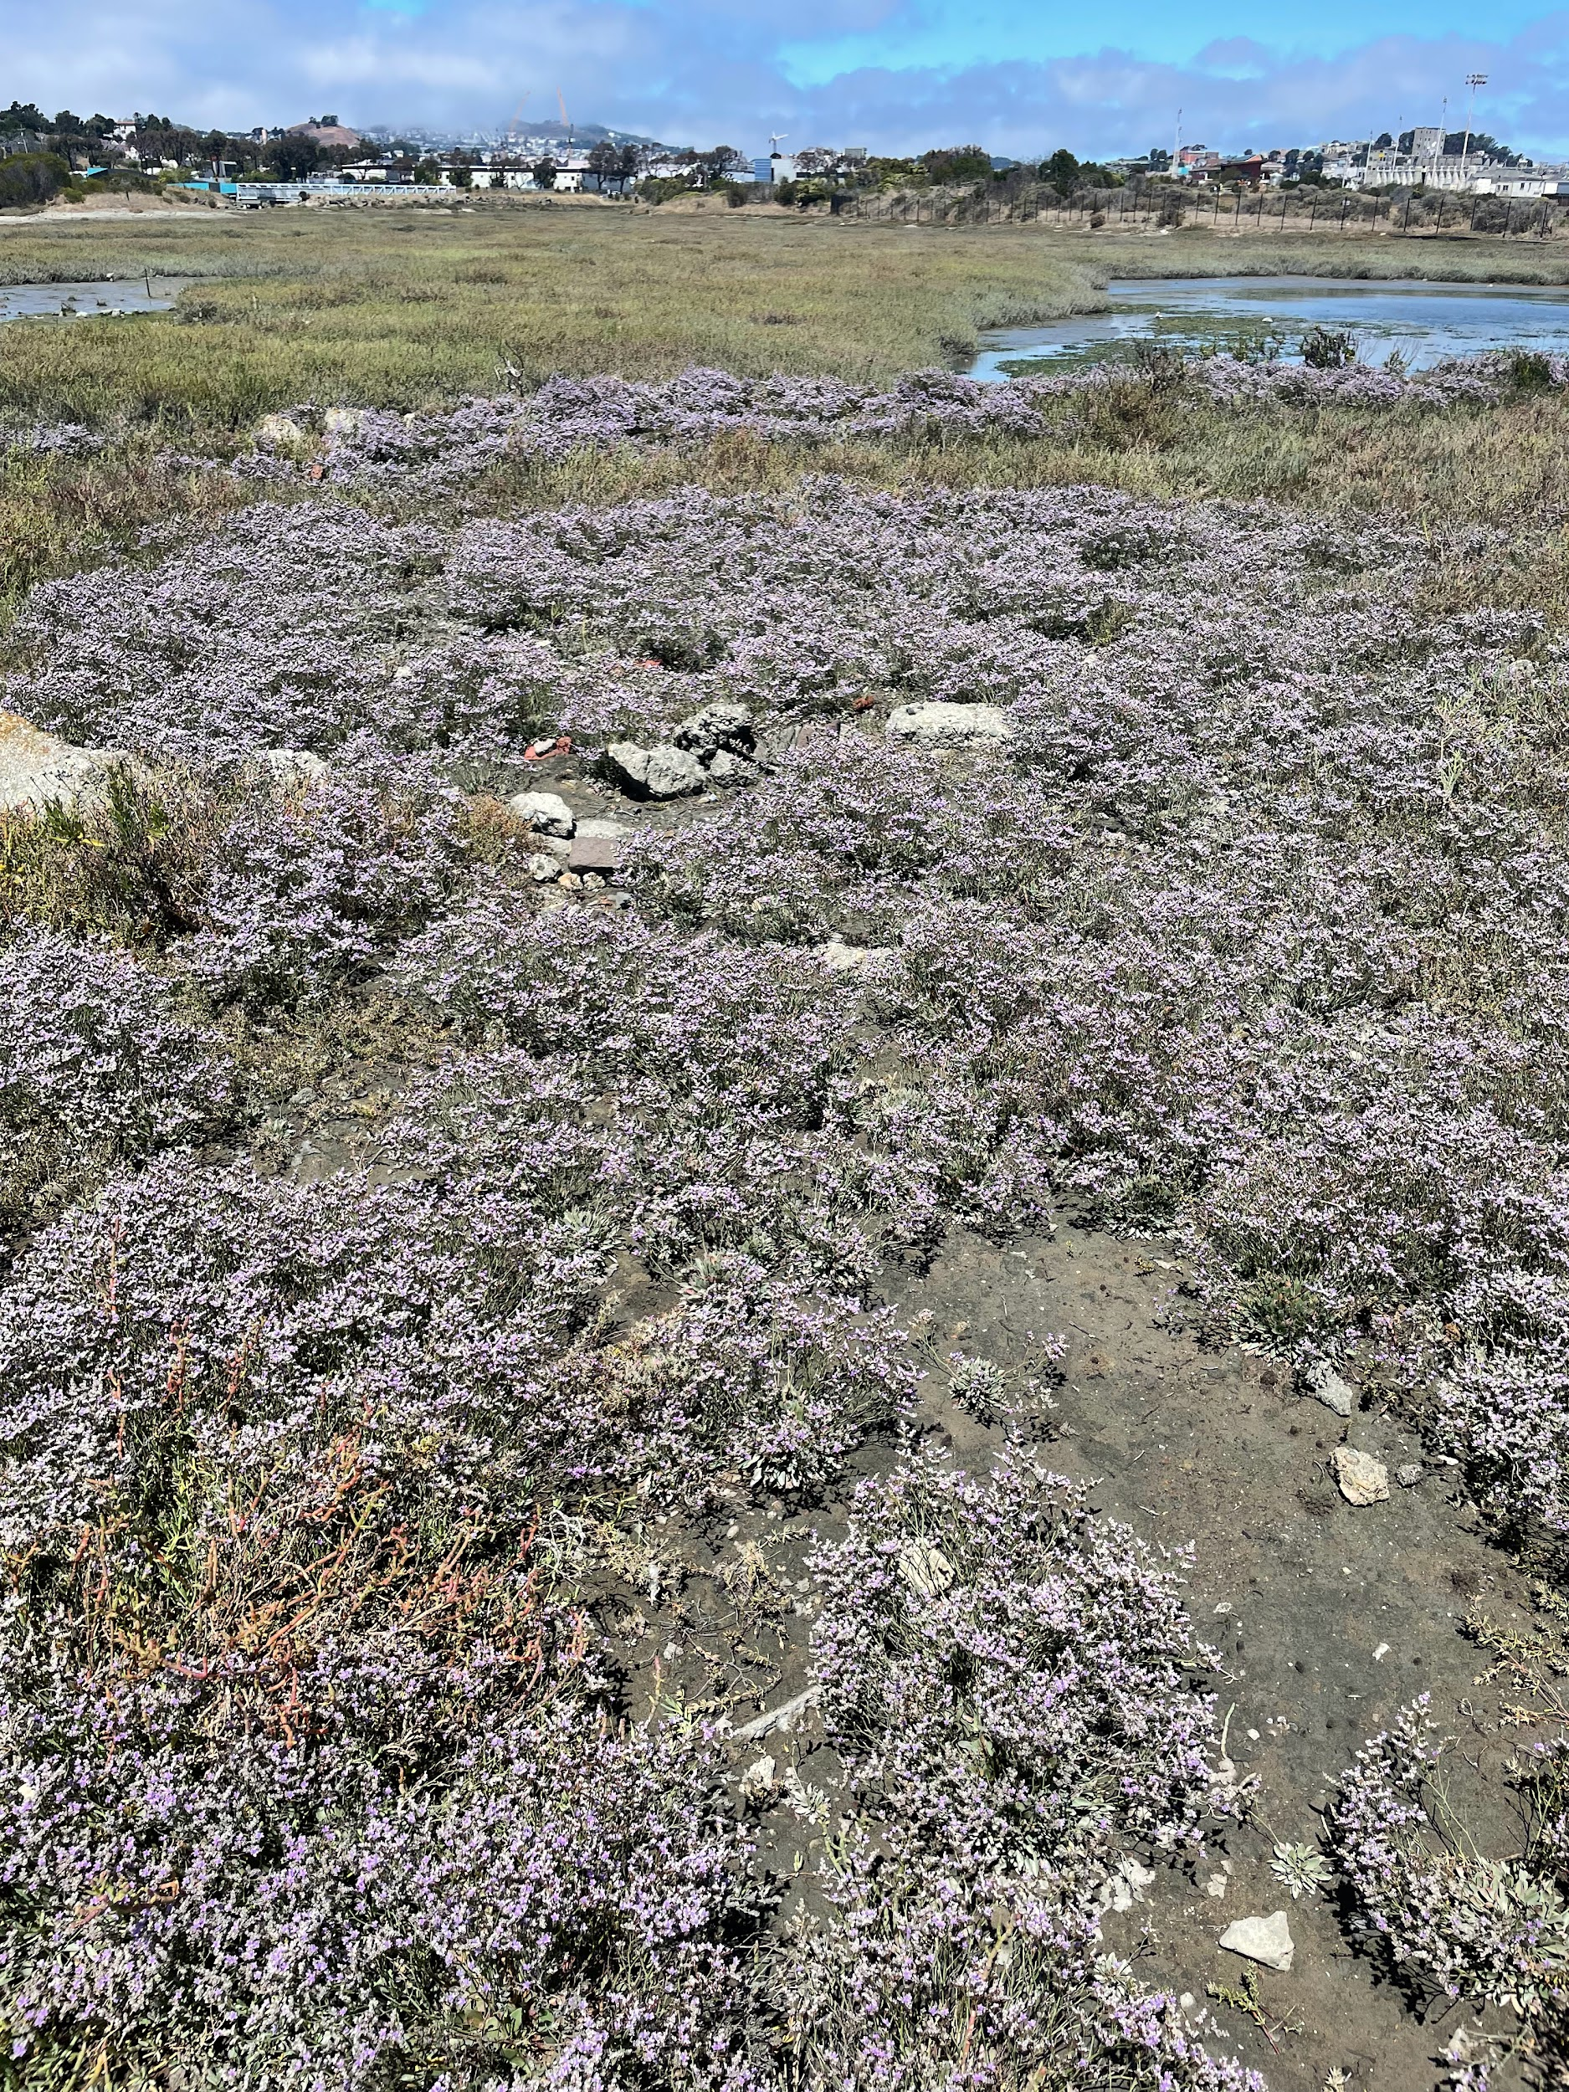
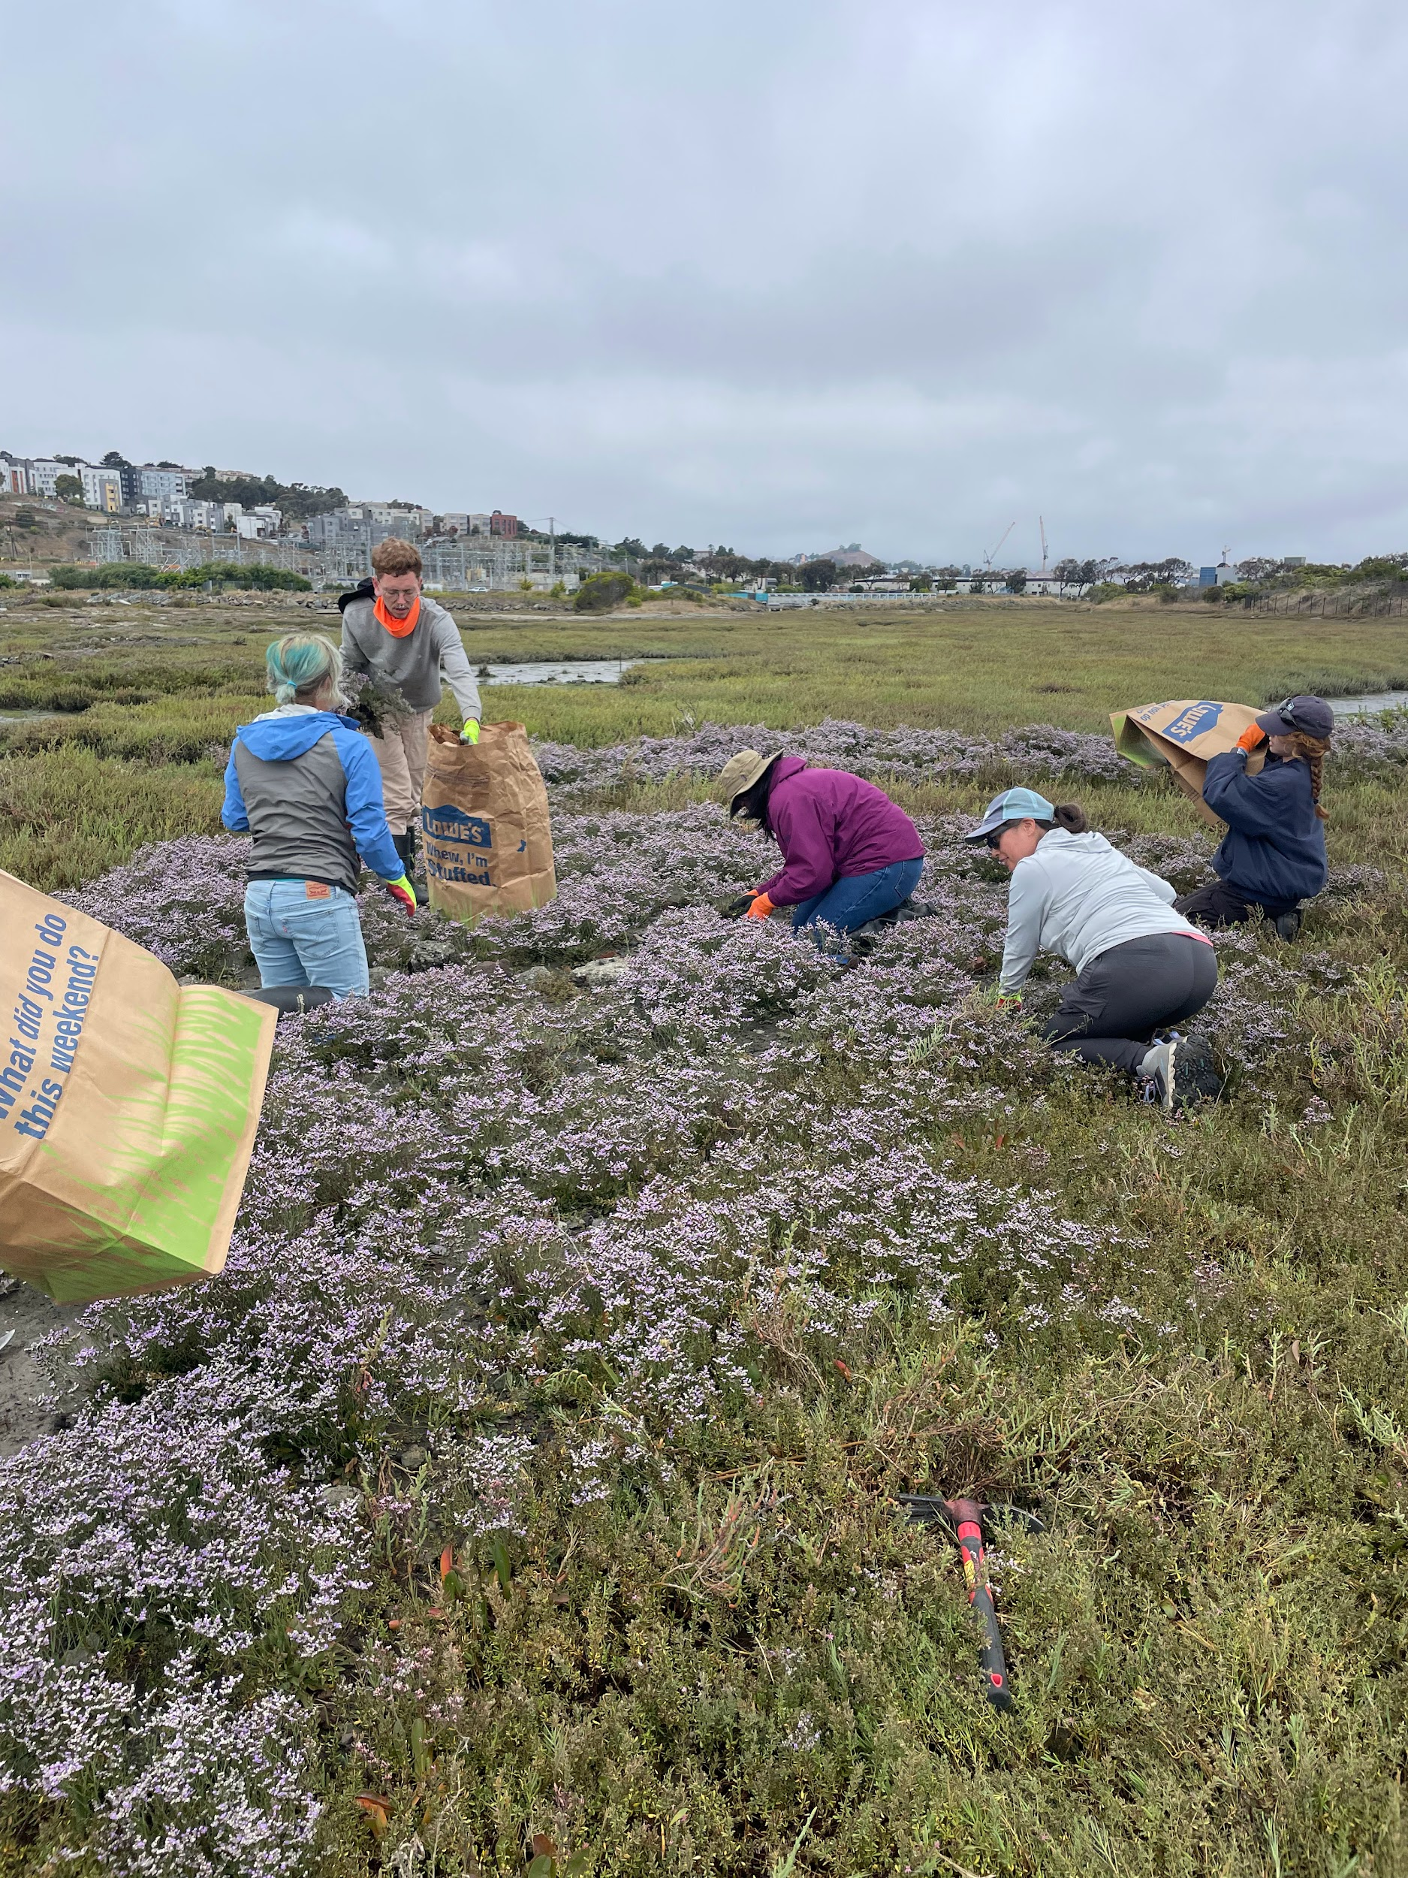
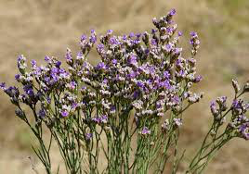
Second Year Focus: Algerian Sea Lavender Removal Cont. and Native Plantings…
LIRA in flower, below, being hand-pulled by Eco-Apprentices in July 2022

Slide 10
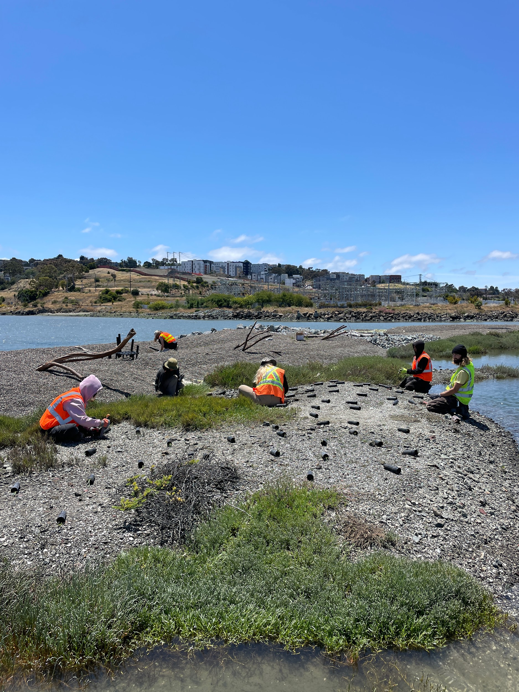
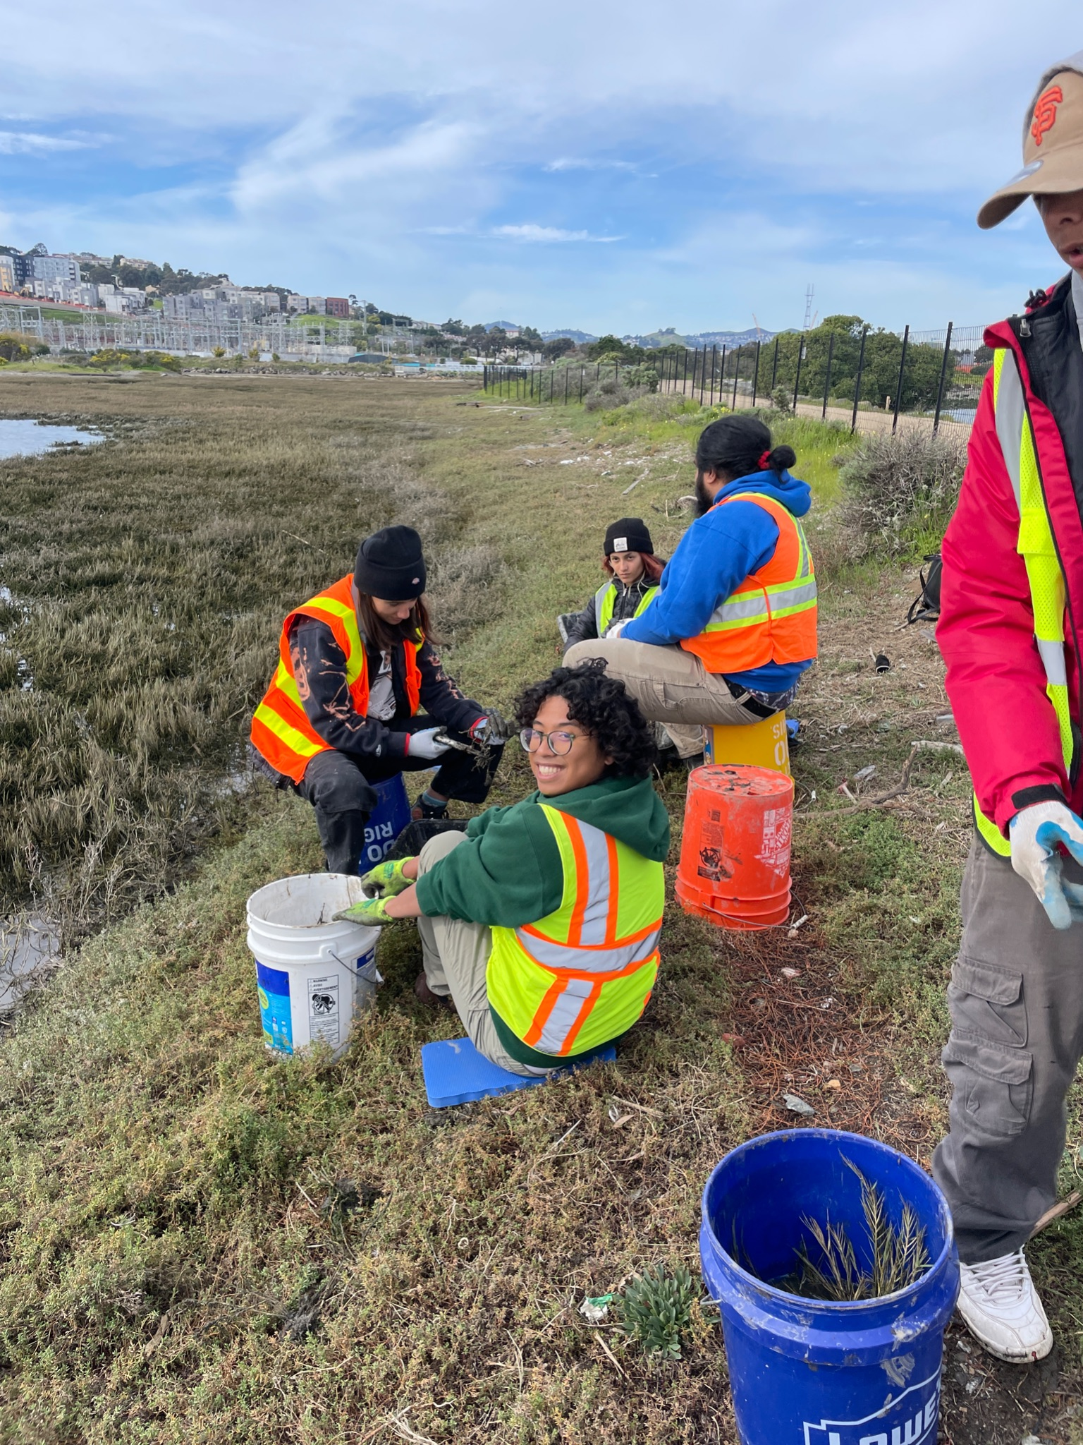
Third Year Focus: Outplanting of 8,500 natives this 2022-2023 Winter

Slide 11
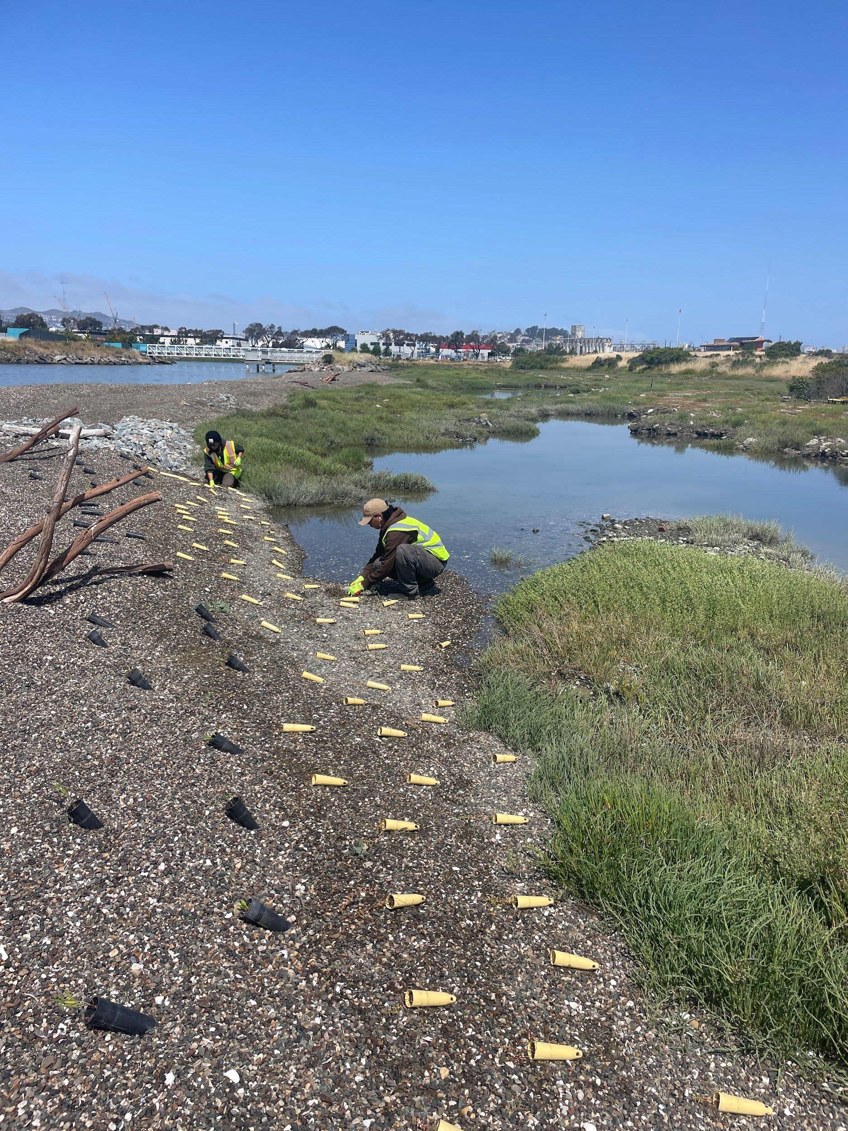
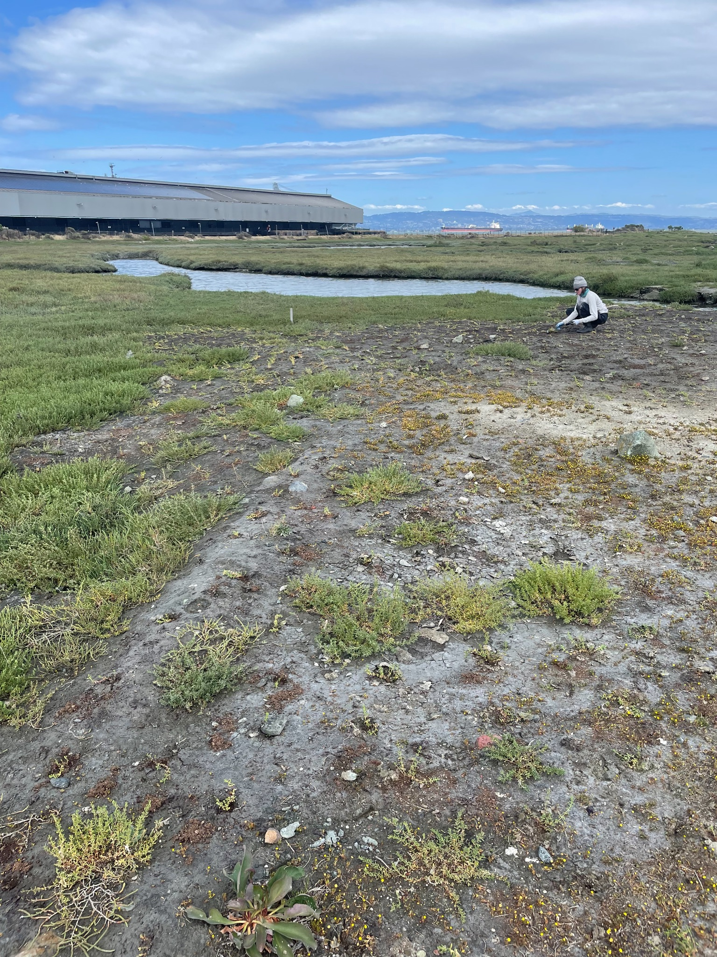
Outplaning Alkali Heath into the newly constructed berm
<
Alkali Heath planting near tidal pools
>

Slide 12
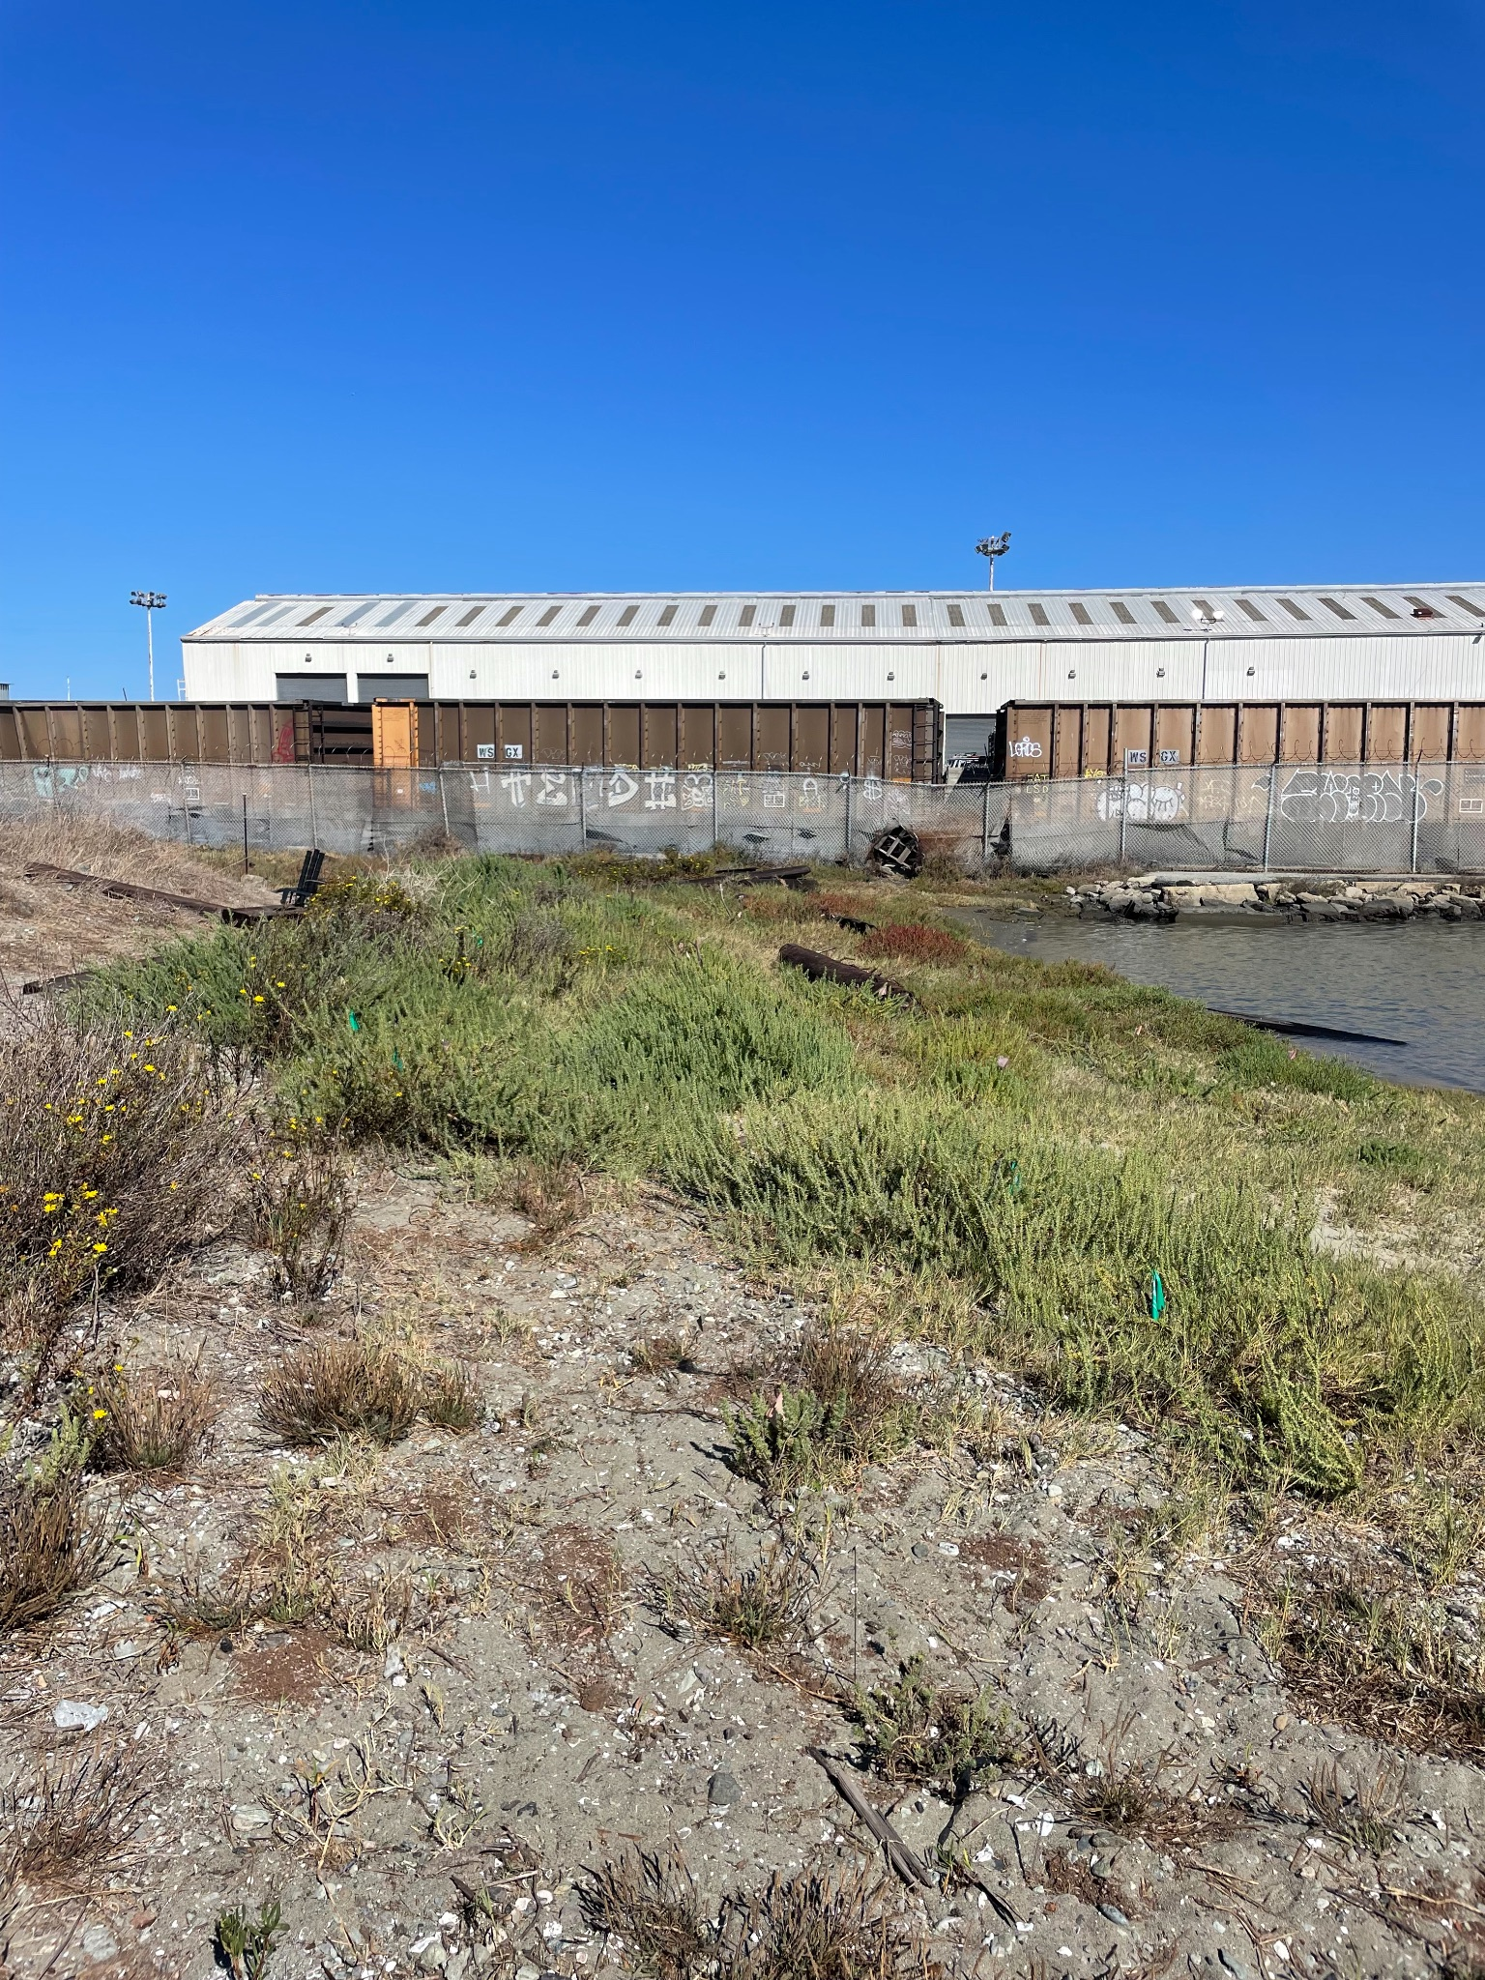
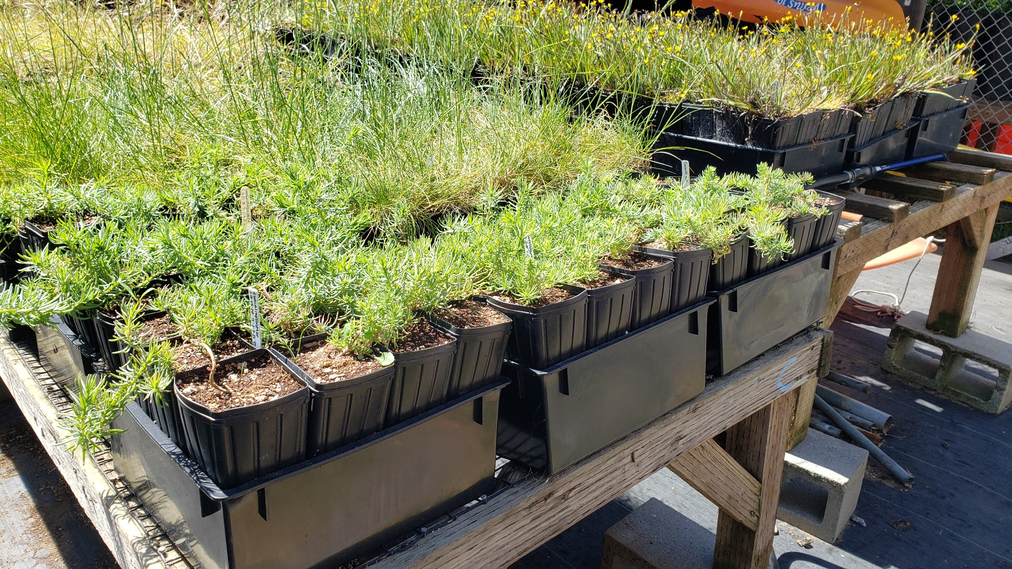
Endangered Suaeda californica (Sea Blite) Propagation and Establishment in Collaboration with San Francisco State University’s Estuary and Ocean Science (EOS) Center
Kathy Boyer - katboyer@sfsu.edu
Margot Buchbinder - mbuchbin@sfsu.edu

Slide 13
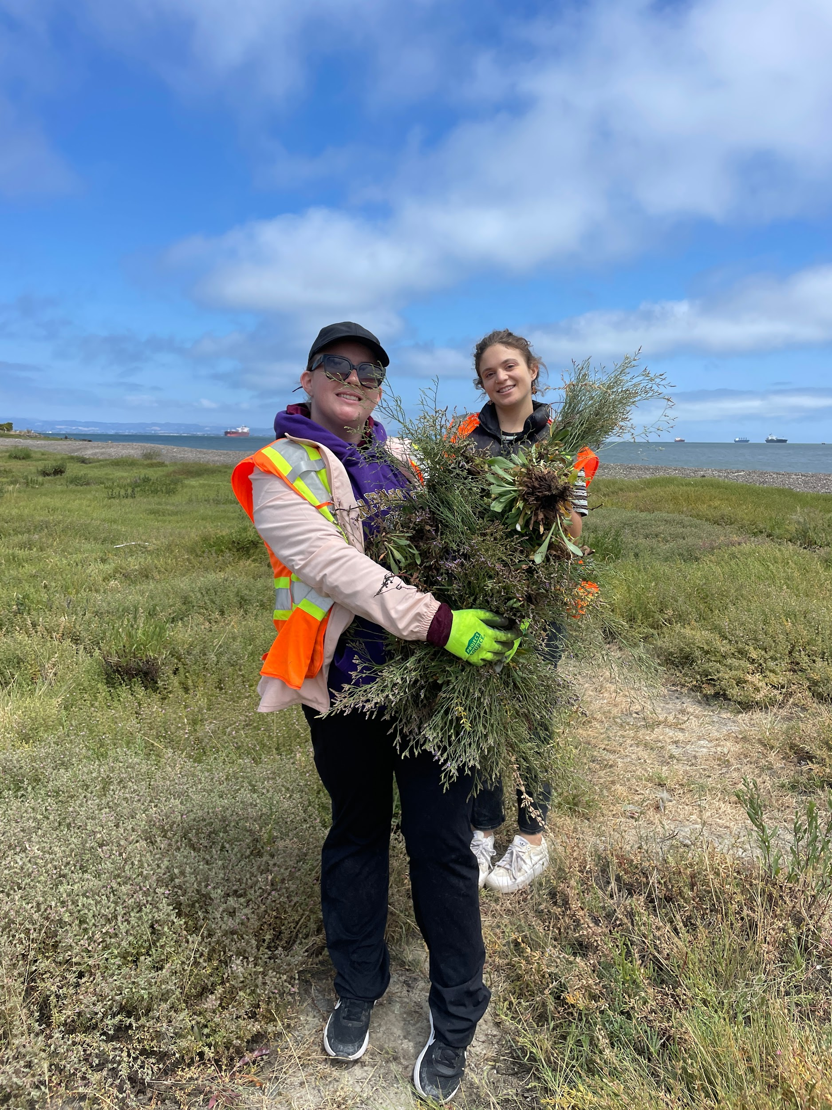
Community Engagement and Programing
Youth programing through District 10 schools and BVHP organizations
Workforce development (Eco-Apprenticeship) with outreach to transitional aged youth (18-24) in BVHP
Community Stewardship and outreach

Slide 15
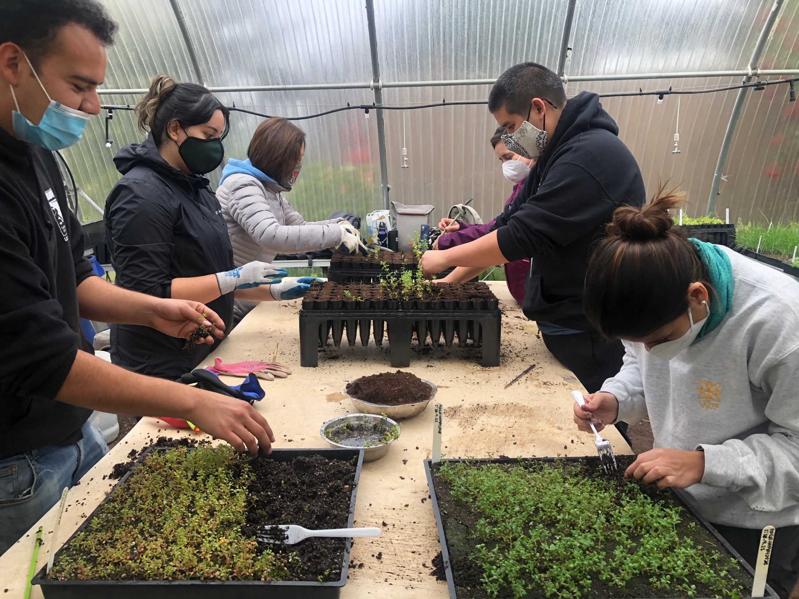
Eco-Apprentices

Slide 16
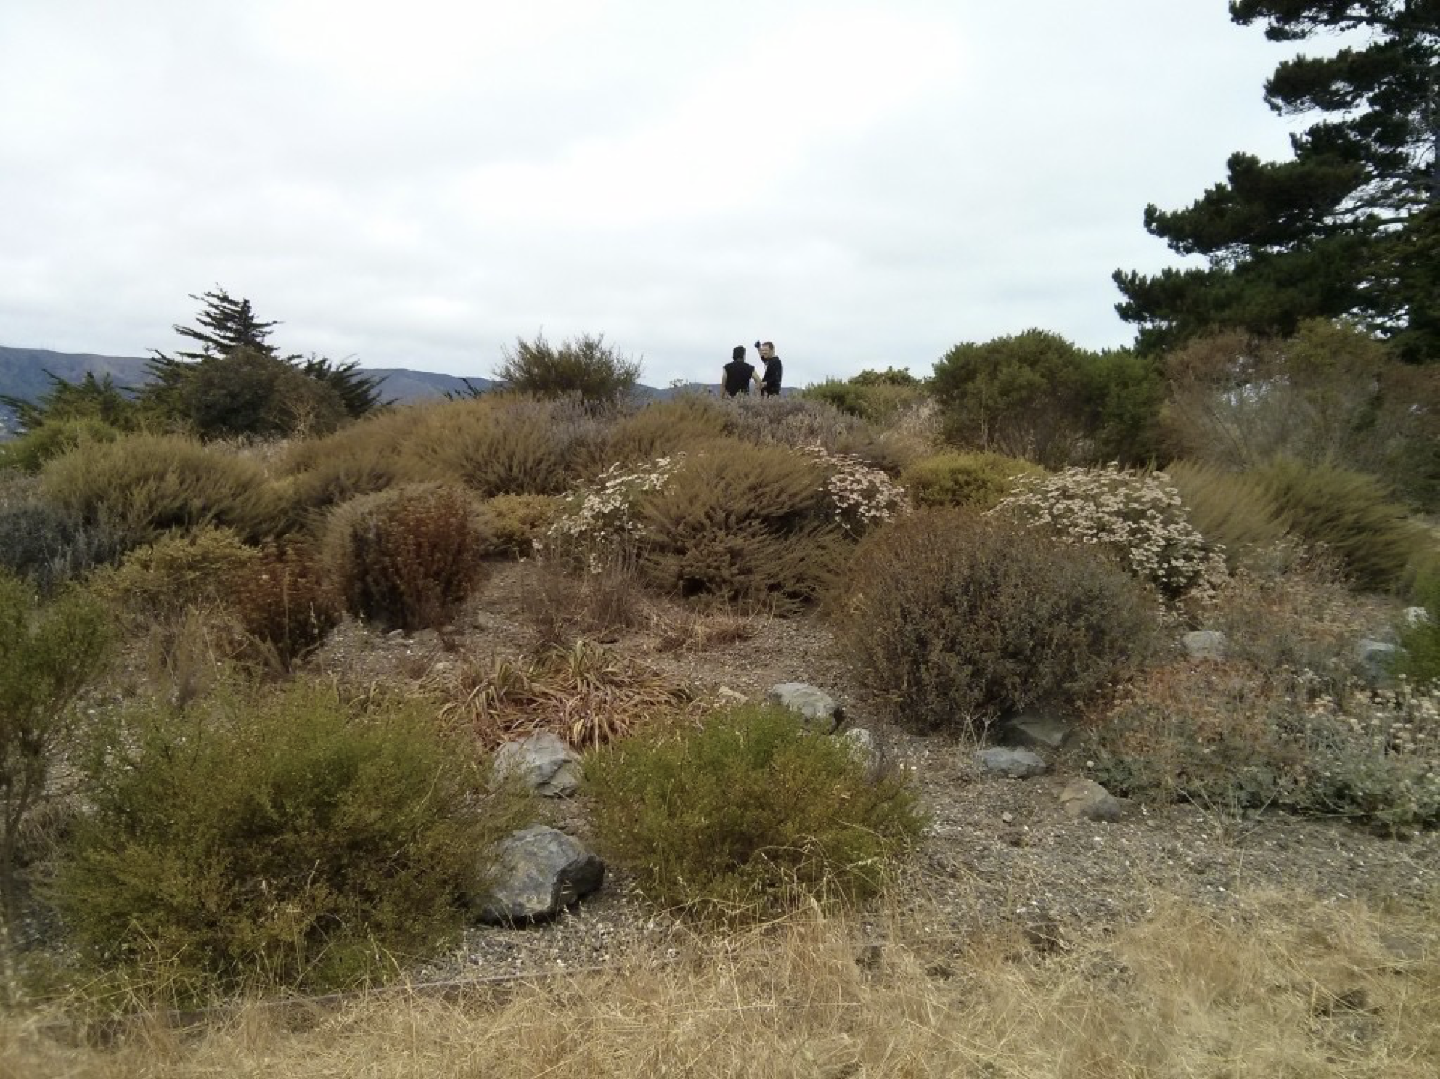

Slide 18
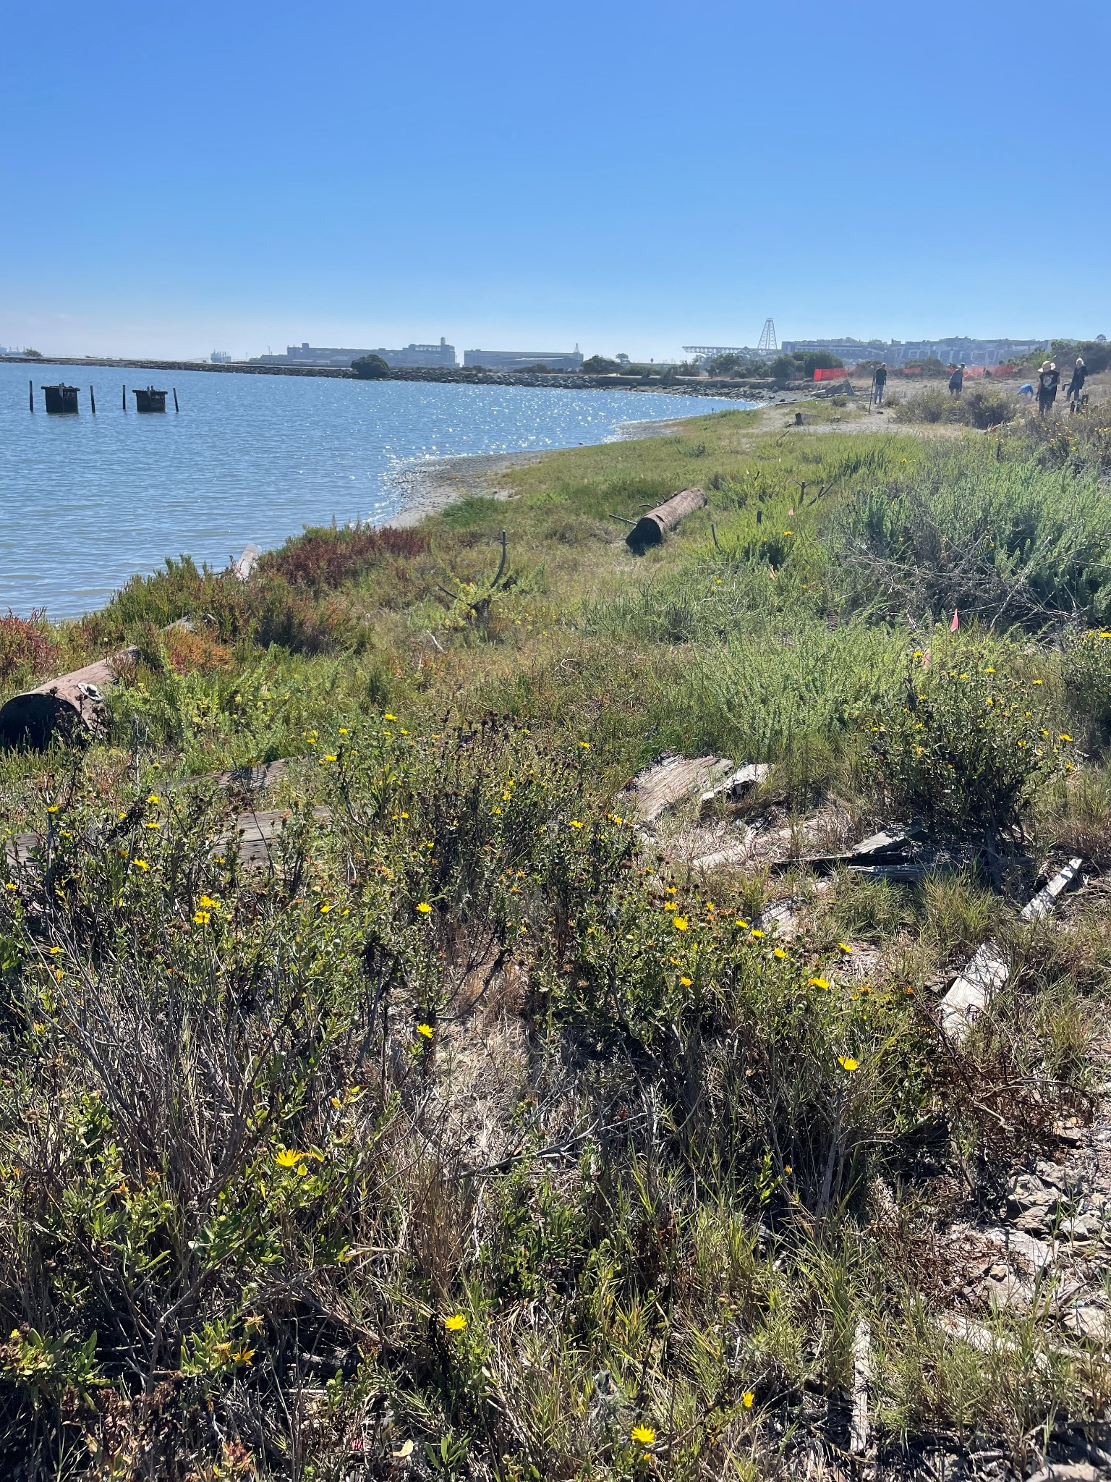
How to keep in touch and follow our work!
Nina Omomo
nina.omomo@lejyouth.org
Website:
www.lejyouth.org
Instagram:
@lej_ecostewards

