Slide 1
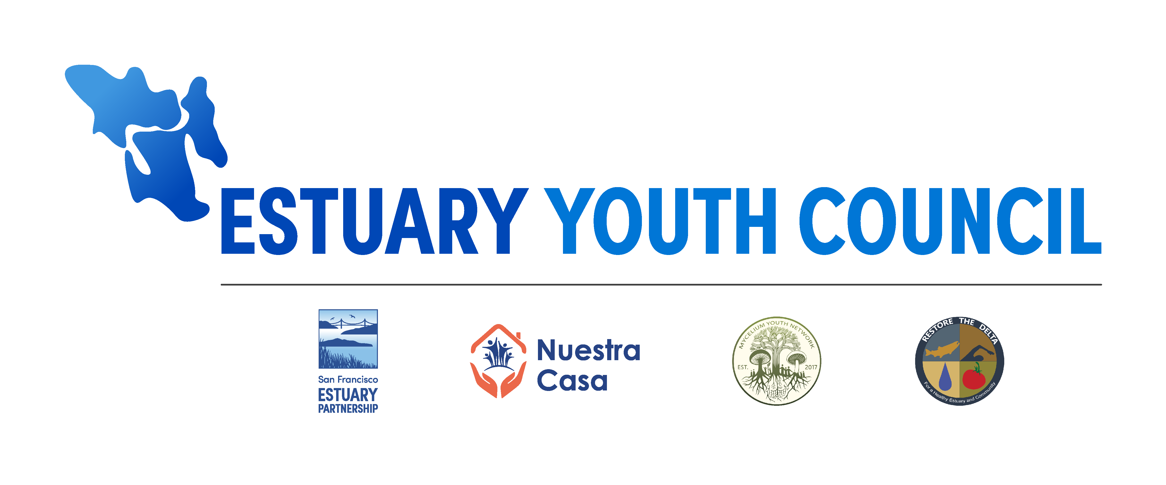
Diana Fu
Wetland Migration Workshop
September 19, 2023

Slide 2
What is the Estuary Youth Council (EYC)?
Youth leadership and professional development program dedicated to empowering young people to engage with environmental and climate challenges facing the San Francisco Estuary Region
Notes:
The Estuary Youth Council (or EYC) was very much a pie-in-the-sky idea grounded in the strong conviction that our communities’ young people will inherit the Estuary from us, and thus have an inherent right to participate in discussions for the way it is managed and how it will benefit their future. At its core, it is a youth leadership and professional development program dedicated to empowering young people to engage with environmental and climate challenges facing the San Francisco Estuary Region.

Slide 3
Goals of the EYC
Leadership & Professional
Development
Address knowledge
gaps
Advise environmental managers, planners, and decision-makers by filling existing knowledge gaps of youth-centered perspectives, concerns, and priorities in the restoration and adaptation of the San Francisco Estuary.
Provide leadership & professional development opportunities to emerging environmental leaders from underrepresented and underserved communities in the San Francisco Estuary watershed
Notes:
In my eyes, the Estuary Youth Council program has two main goals that can be seen as mutually inclusive:
Provide professional development opportunities to emerging environmental leaders from underrepresented and underserved communities in the San Francisco Estuary watershed; and
Advise environmental managers, planners, and decision-makers by filling existing knowledge gaps of youth-centered perspectives, concerns, and priorities in the restoration and adaptation of the San Francisco Estuary.

Slide 4
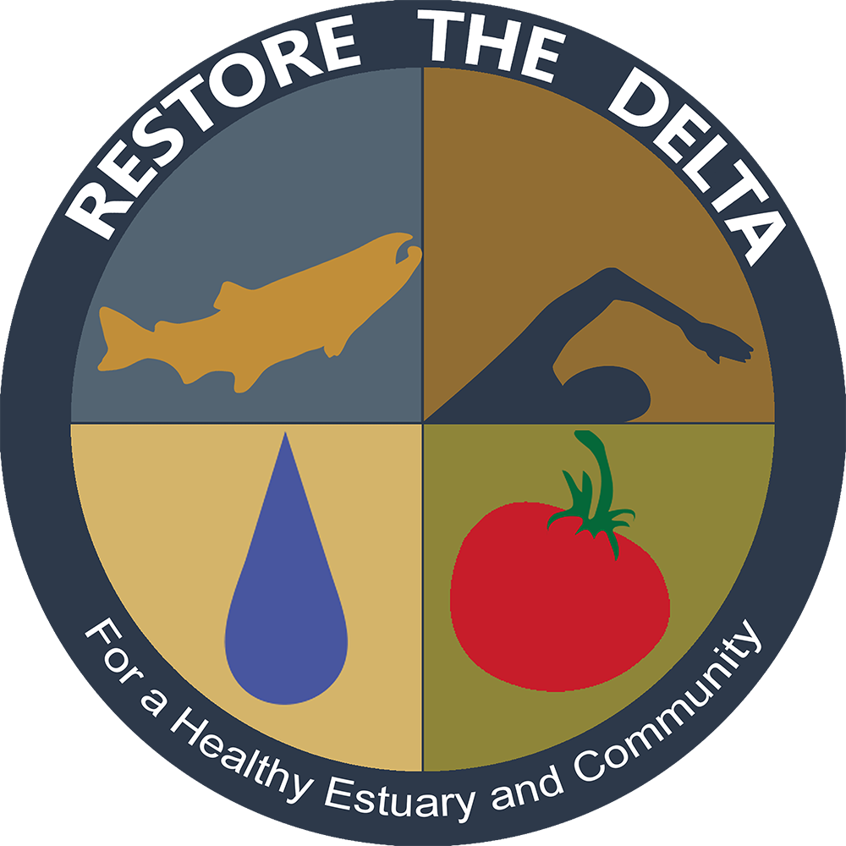
Building the right community-based organization (CBO) advisory committee
Notes:
For those of you who are familiar with SFEP and the work of other similar government agencies, you know that community engagement is not one of our strengths. We are getting better at it, but we still have a long way to go. Coming from a background of working in environmental justice communities in New York City, I knew that the expertise of community engagement, visioning the Estuary Youth Council, and designing the program could not be done alone. With the support of funding secured from private donors, I started approaching community-based organizations around the Bay-Delta region with the idea of the Estuary Youth Council and having very transparent conversations about what amount of funding we had to support their participation.
The three organizations we ended up partnering with this pilot year brought different strengths to the table, but all were dedicated to serving frontline communities and had prior experience working with youth. These organizations were: Nuestra Casa serving the East Palo Alto/mid-peninsula region, Mycelium Youth Network serving the San Francisco/Oakland area, and Restore the Delta, which serves Stockton and its surrounding areas.

Slide 5
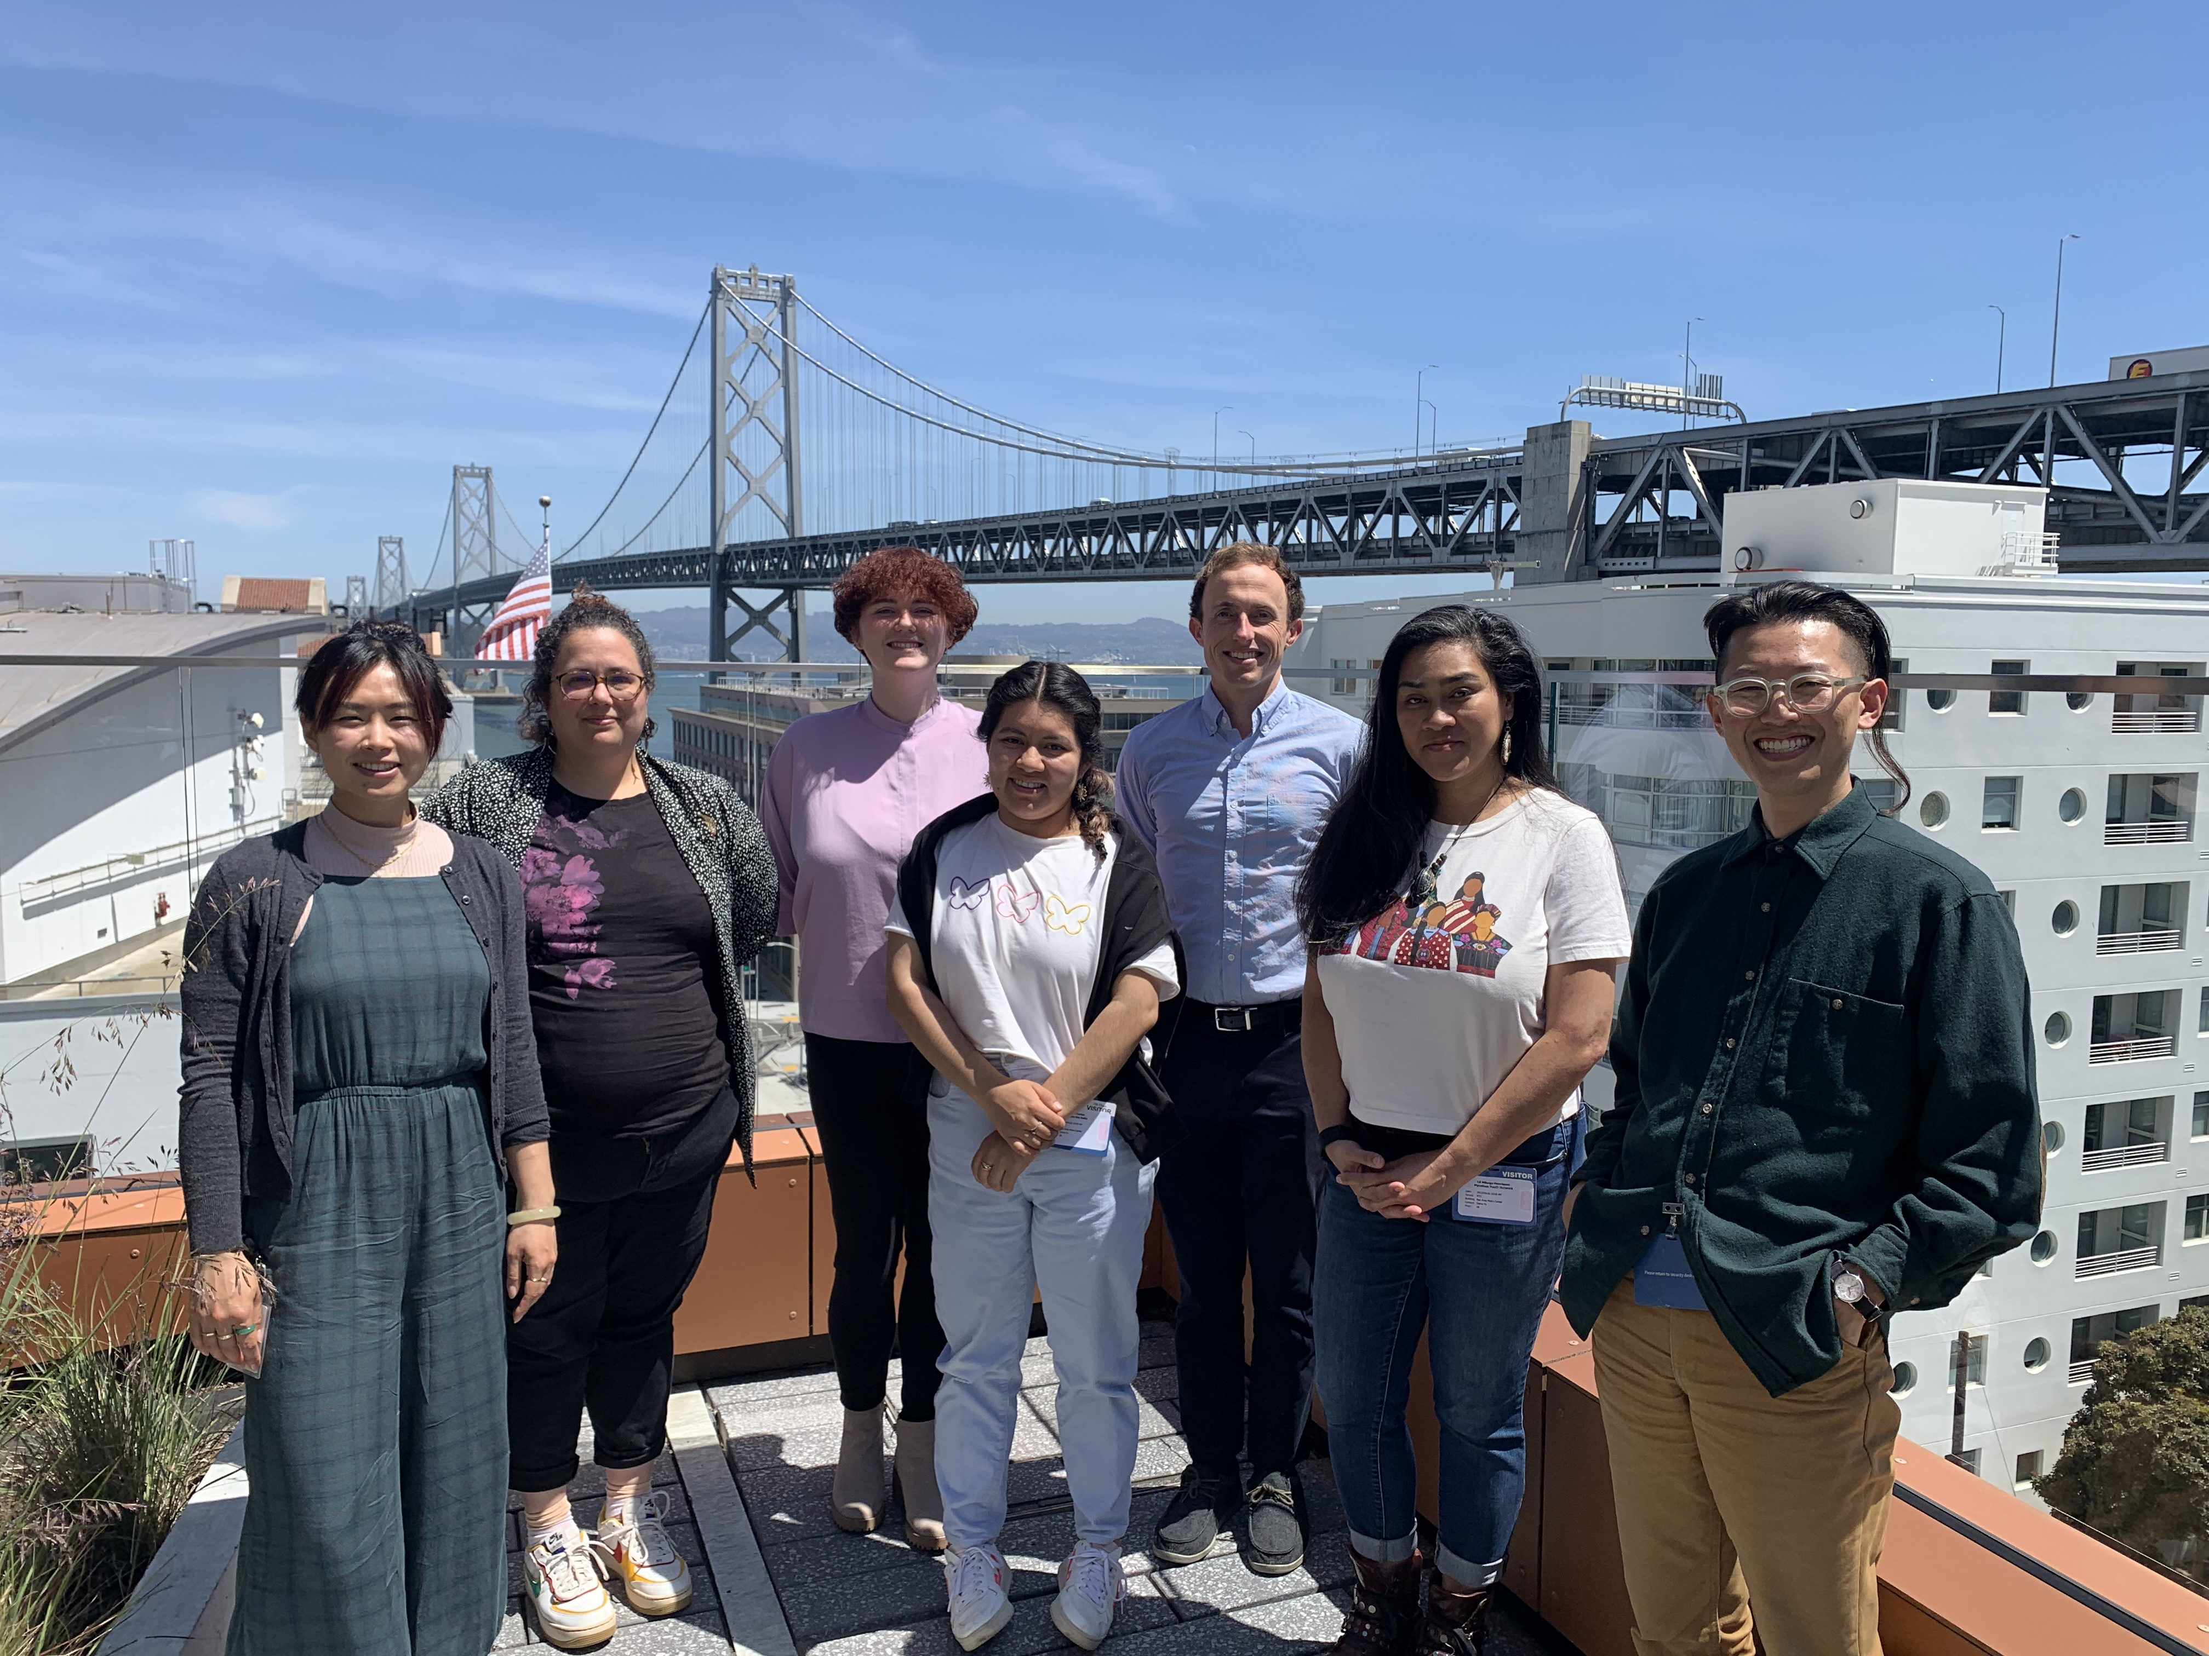
Collaborative vision & Design
Program kickoff with the CBO Advisory Committee
Developed a uniform vision of success
Protecting program integrity – moving at the pace of trust
Notes:
After funding agreements were completed, we had a formal program kickoff with SFEP staff and all of the community-based organizations that we invited as partners to the EYC program. We spent time co-visioning the Estuary Youth Council program, identifying short-term goals and long-term missions that would ground the work of the group and eventually the EYC so that we could come to a uniform vision of what success looks like, and almost just importantly, providing an anchor for the integrity of the program in a funding landscape that will often pull small organizations, projects, and programs in different directions. While it has only been part-way into our first year, I can already share that we’ve been approached with many opportunities. Instead of rushing forward to meet these opportunities, it was important as a group to prioritize relationship and community-building. In a world of endless deadlines and bureaucracy, we have tried our best to move at the pace of trust – and that’s slow!

Slide 6
Onboarding youth
Recruiting youth
Trusting the process
Confronting “adultism”
Empowering & challenging young people
Notes:
After about 3 months of visioning, each CBO began recruitment from their communities either through existing programs that their organizations offered (ex: in-school programs, internships, etc.) or tabling at community events. Each CBO had a highly individualized recruitment process that identified the best candidates out of each of their respective communities. I really had no hand in the recruitment process, and at this point, I’d like to point this out as an example of placing trust and faith in each of the CBOs that they knew their communities best, and given our unified vision of success, they knew which candidates would be most competitive for the EYC program.
Once we recruited 3 youth from each community for a total of 9 youth in the EYC program, we took a step back and reflected as a group about what it meant to invite youth into what had been primarily an adult space. One of our project partners coined the term “adultism”, which is really just a term used to describe a culture that prioritizes the needs and concerns of adults, who exercise their power in a way that systematically discriminates against young people . Adultism can be especially jarring when adults communicate to youth that they are important but then go on to dismiss their opinions and take away their agency.
As a group of adults who have designed this program, we are constantly navigating a balance between creating a safe space for young people to engage, while also empowering them and challenging them to meet difficult moments and conversations, such as holding us and other adultist systems accountable.

Slide 7
Lessons Learned & Key takeaways

Slide 8
Lessons Learned & Key takeaways
Paradigm shift in “community engagement”
What does it mean to engage deeply and meaningfully with our communities?
Redefining “expertise”
Intentional spaciousness for rest & reflection
Being O-K with the discomfort of the unknown
Leadership can make-or-break cultural shifts
Relationships are the most valuable capital we have as an agency, and need to be treated as such

Slide 9
Questions?
Diana Fu
Environmental Planner
diana.fu@sfestuary.org

Slide 10
More info about the EYC & Partners
Estuary Youth Council Webpage
Nuestra Casa
Mycelium Youth Network
Restore the Delta
Additional resources
The Spectrum of Community Engagement to Ownership

