Slide 1
Large-scale, low-cost native plant propagation for transition-zone habitat restoration in the San Francisco Bay
Wetland Migration Workshop
September 18-19, 2023
Jesse McKeen-Scott, Restoration Program Manager

Slide 2
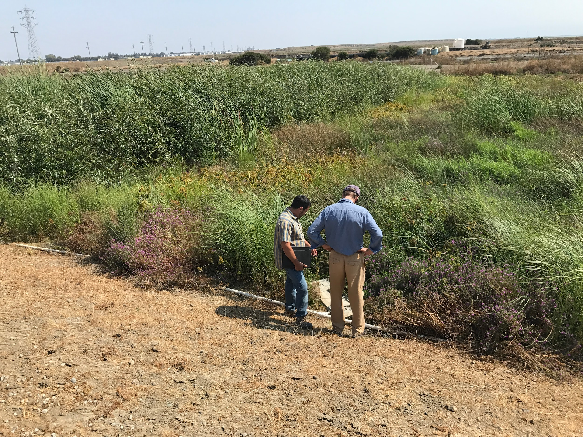
Evolution of our Restoration Projects
Urgent need for rapid, large-scale restoration of transition zone habitat.
Opportunities to engage and educate more adult community members.
Success at Oro Loma as a demonstration of project techniques
Notes:
We have worked at the MLK Shoreline (East Bay Regional Park District) and the Palo Alto Baylands (City of Palo Alto) for nearly 20 years. These sites are primarily used to engage the public, student, and corporate groups through our on-site and nursery programs.
We have also taken on large scale, transition-zone restoration projects after the successful completion of the Oro Loma Horizontal Levee Demonstration Project. Those newer projects are as follows:
- Eden Landing
Eden H - ~3 acres
Bel Marin Keys Wetland Restoration project
Seasonal wetland complex – 42 acres
Ravenswood/South Bay Salt Pond Levee projects
All American Canal – 9 acres
Bedwell Bayfront Levee – 16 acres

Slide 3
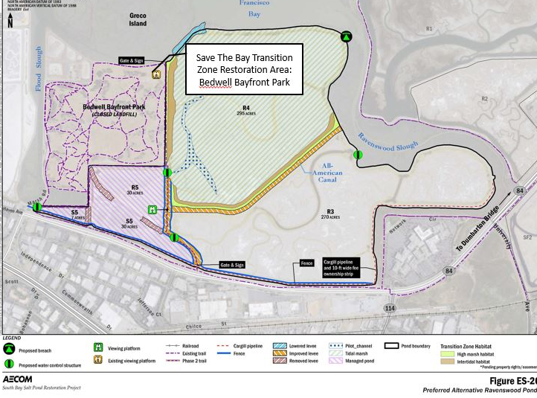
Ravenswood
2 Habitat Transition Zone Sites
1 On Site Division Bed Nursery
Many Project Partners: USFWS, Ducks Unlimited, State Coastal Conservancy, West Bay Sanitary District, South Bay Salt Pond Project
Notes:
Large Scale Restoration Project. Sense of Urgency to restore more acres more quickly. Guided by Peter Baye
Amplifying rhizomatious perennials in abbreviated timeline with nursery for Oro Loma. Success there made us confident to scale it up even more at Ravenswood
R4 - Slope vegegated Dec. 2021-Feb. 2023.
AAC - to be vegetated starting this fall/winter

Slide 4
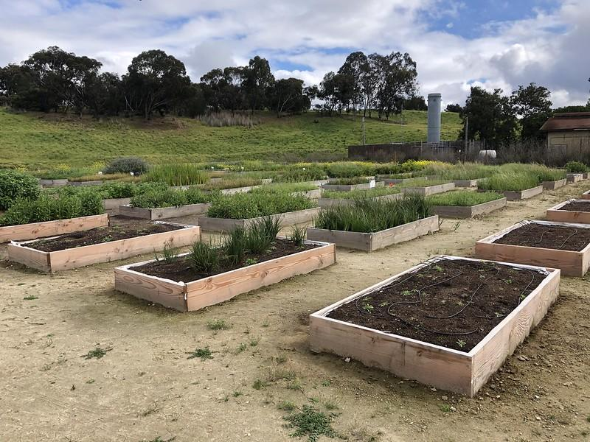
Ravenswood On-site Nursery
84 division beds
Rhizomatous perennial species that can migrate upslope
Adjacent to the project site
Locally collected seed and vegetative material
Minimal maintenance
Notes:
Division Bed vs. Container Plants: Cost $1.50-10.00 per container grown plant over the course of the plants life in the nursery. We’re very invested in each individual transplant as empty pots are wasted real estate. Numerous additional materials and space for a nursery are required, including pots, benches, infrastructure, other transplanting/engagement tools. We have limited capacity in nursery facilities and grow approximately ~40, 000 plants between two container plant nurseries The nursery needs to be kept within near sanitary conditions, as plant diseases are easily spread in nursery conditions. Save the Bay treats pots, soil, tools - anything that comes in contact with the nursery is sanitized with isopropyl alcohol or steam heat.
A major benefit of the nurseries, however, is how easily we can engage students and volunteers through a variety of tasks.

Slide 5
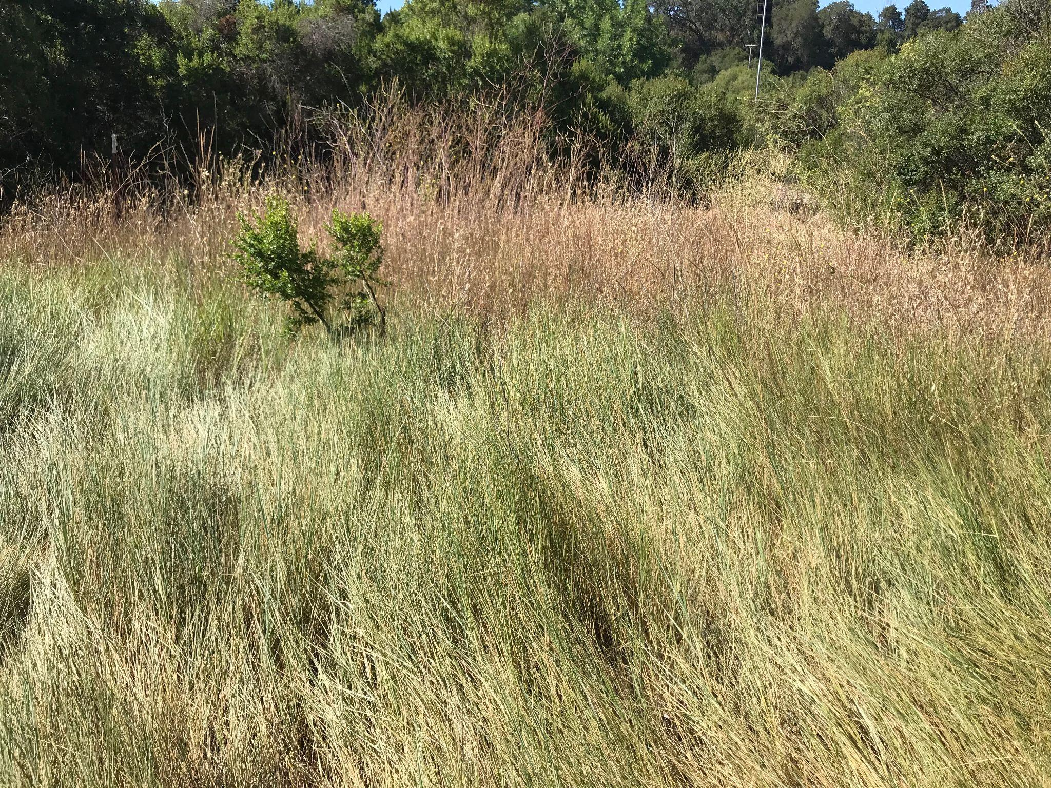
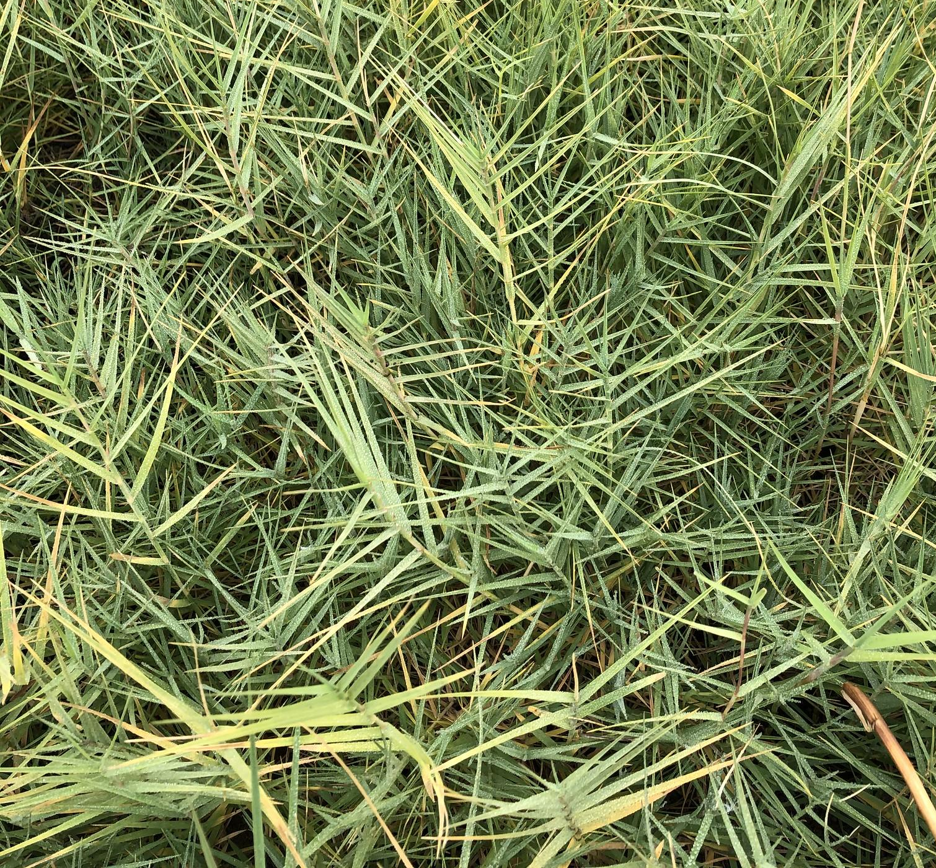
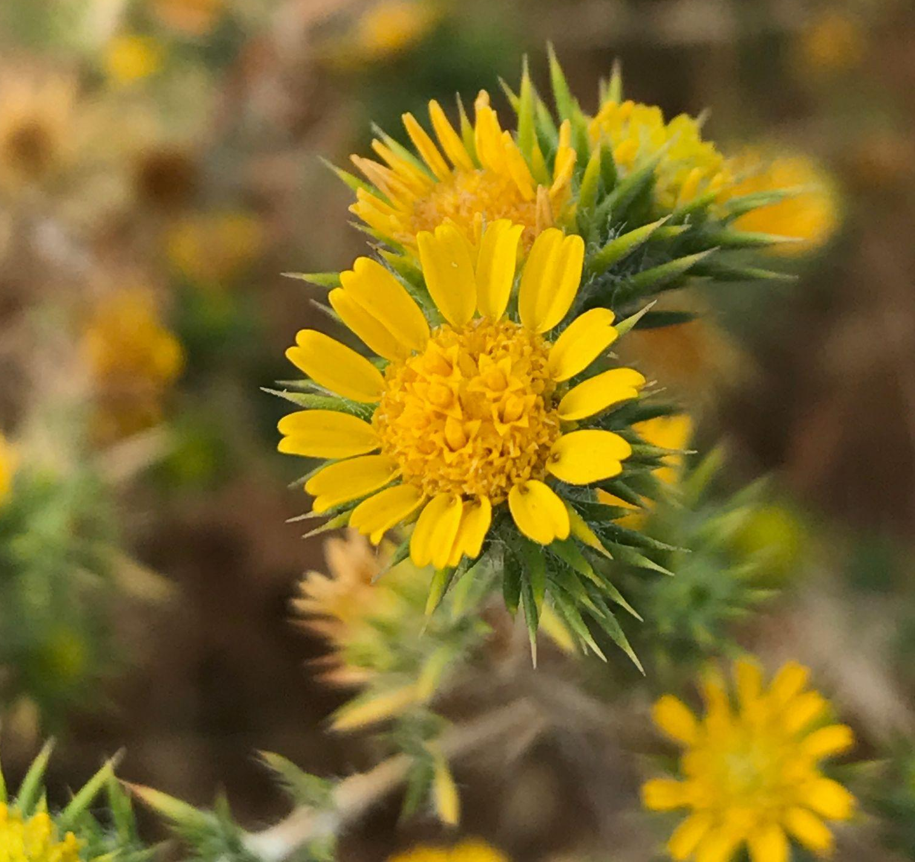
Species
Clonal meadow species
Abundant, stress tolerant
Mechanized equipment planting method
Diversity patch species
Less stress tolerant, perennial species critical for pollinator habitat, cover, and biodiversity
Hand-planted
Refuge patch species
Provide dense, shrubby high tide refugia
Hand-planted
Annual cover crop species
Functionally competitive native annual species
Hand-broadcast
Notes:
Methods and species selection guided by Peter Baye. how planting should be done with itention with them moving up slope as sea level rises. not always case in project design. In past more shrubby species but as water table moves up they can die.

Slide 6
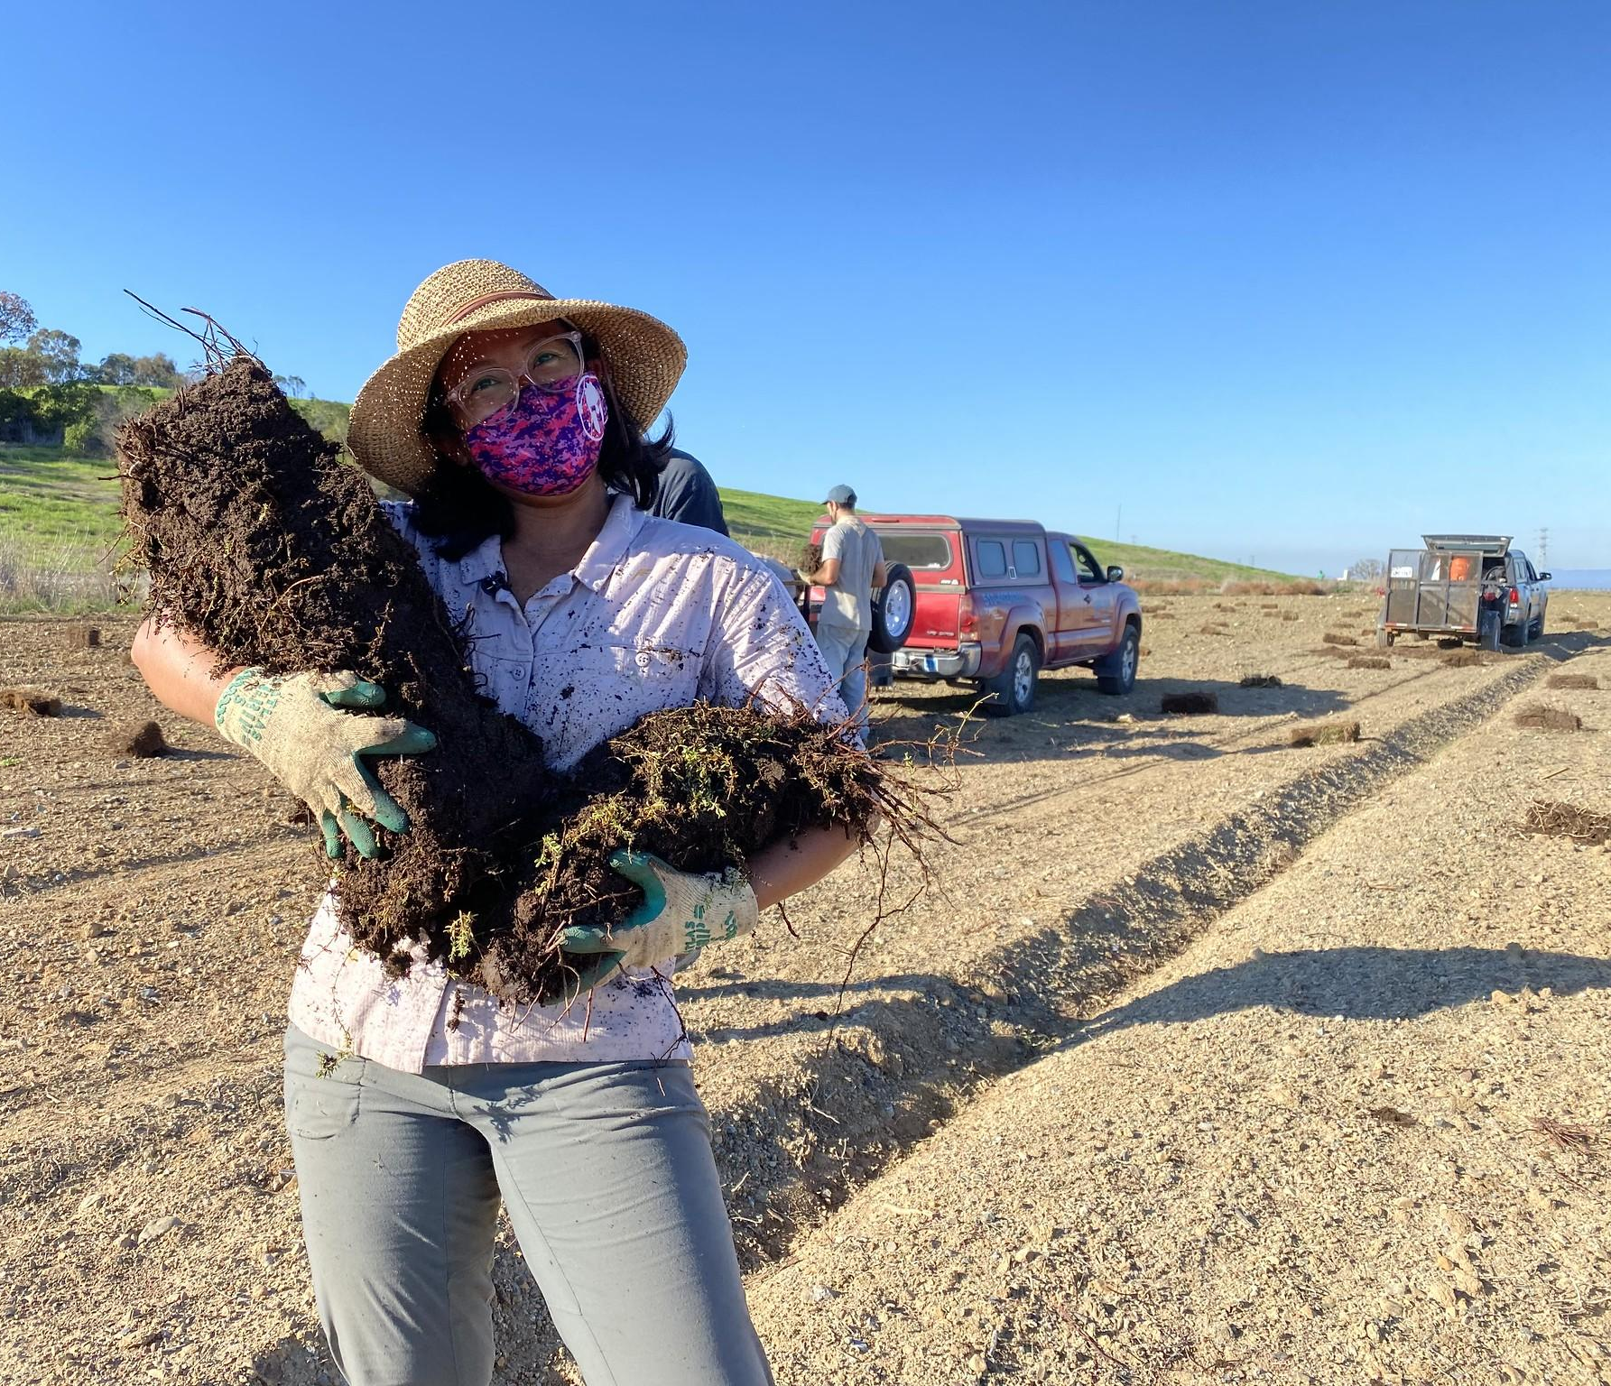
Planting Process
October - November
Site preparation
Prepare sod planting material
November
Translocate to slope
Disc in using farming equipment
Broadcast annual seed mix
November- January
Diversity patch planting
January
Refuge species planting/infill planting
February-April
Supplemental irrigation and targeted weeding

Slide 7
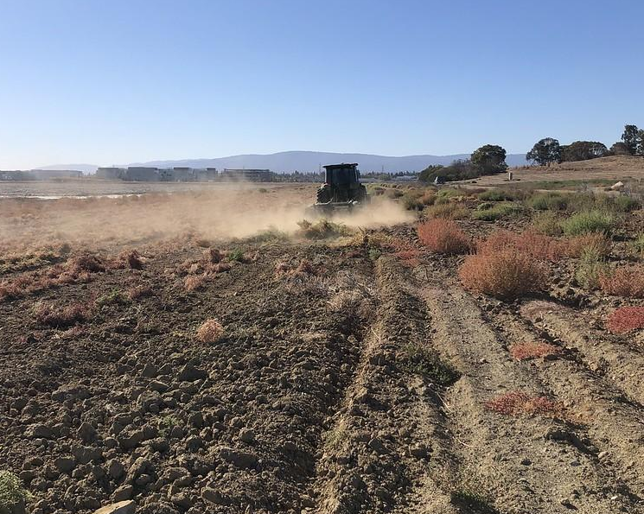
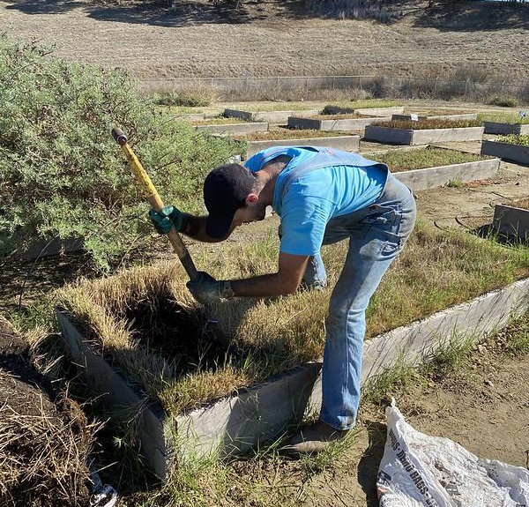
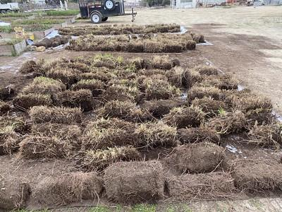
Planting Process
Site Preparation
Prior to planting, the slope was disked to eliminate invasive species cover and reduce compaction from grading.
Sod Material Preparation
Reduced irrigation over the summer/fall to promote natural seasonal dormancy. Then hand-harvested from the beds into 6” by 18” sod pieces.
Translocation to Slope
Loaded sod pieces into trailer and staged on slope. Counted # of sod pieces of each species per transect.
Notes:
Clonal meadow - four species - creeping wildrye (Elymus triticoides), Western ragweed (Ambrosia psilostachya), salt grass (Distichlis spicata), and alkali heath (Frankenia salina)

Slide 8
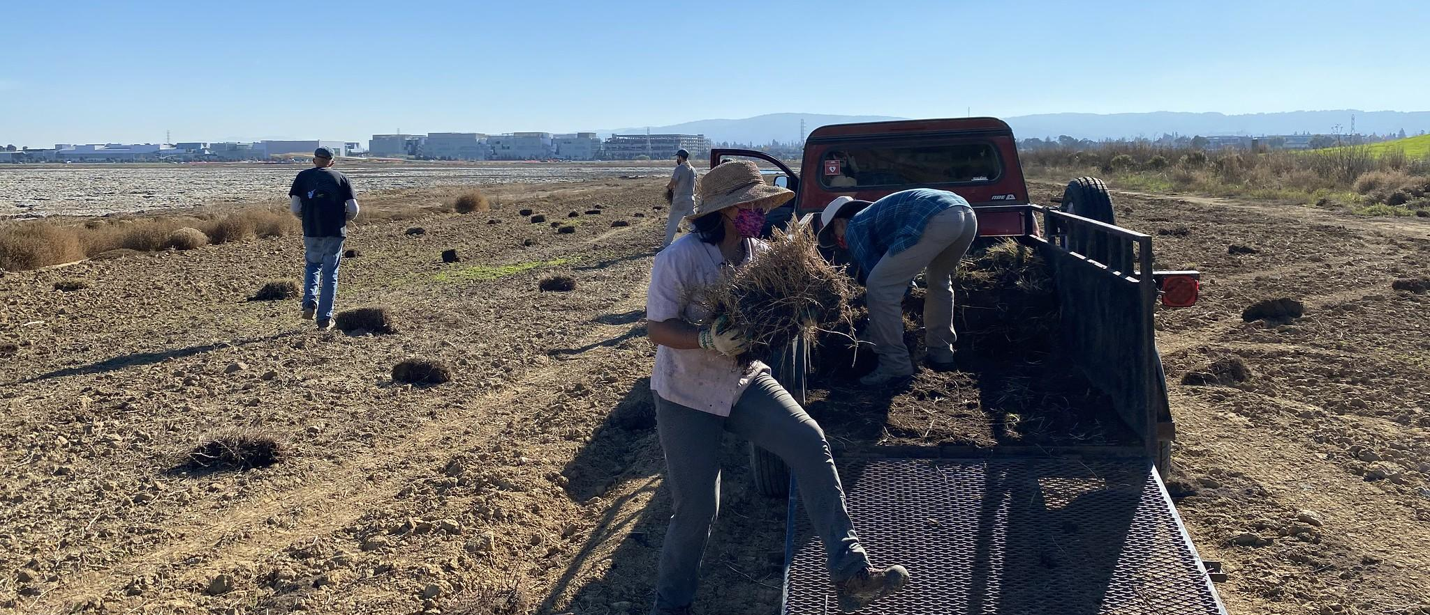
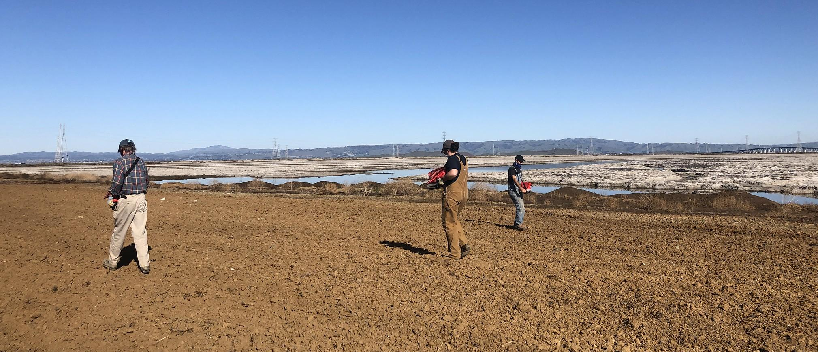
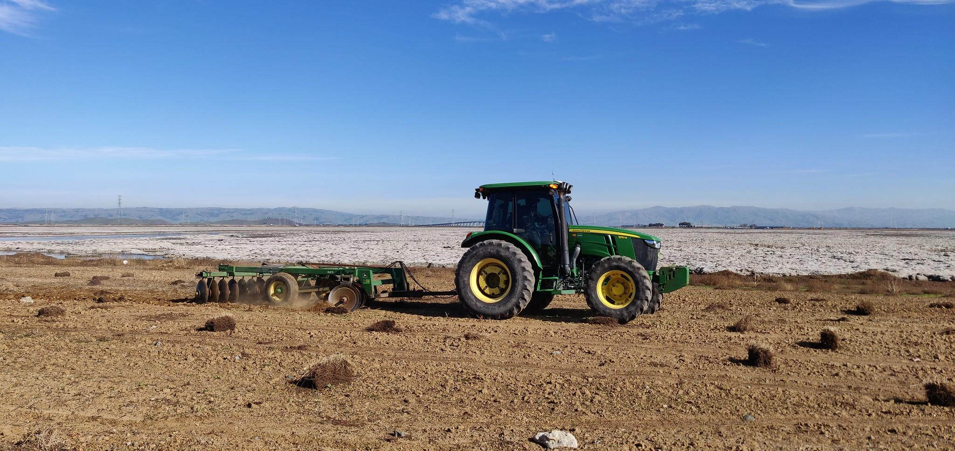
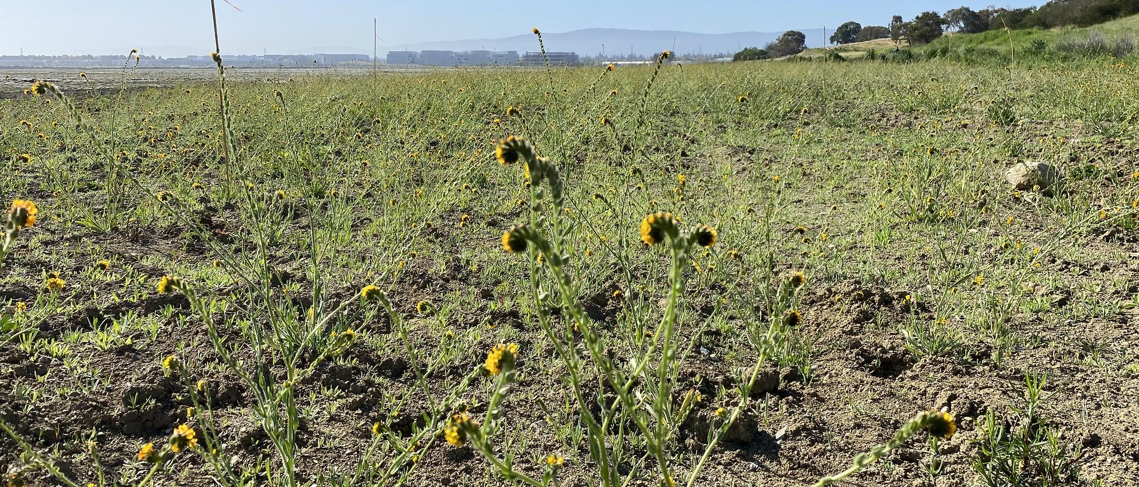
Planting Process
Mechanized, clonal meadow species planting
Annual Seed Mix Dispersal
Notes:
three afternoons able to plant what would otherwise take us more than 1 full season of containers.
Sod hand-placed on the slope by staff. Slope then disked with tractor and disker.
Seed mix progress in April 2022
Spring annuals setting seed
Dense summer and fall annuals cover the slope
“Most of the widespread and long-term dominant native plant species of “wild” HTZs in the San Francisco Estuary (tidal marsh-terrestrial ecotones with the natural soils, slopes, and vegetation on which restored HTZs are based) are clonal perennial forbs and graminoids that have a creeping, sod-forming growth.” (Baye et al. 2000, Baye 2008, 2012, Whitcraft et al. 2011). Clonal, perennial forbs and graminoids are persistent and stress and drought tolerant, expanding to form dense, closed native grassland and wet meadow habitat. They were able to handle a great deal of physical disturbance – being collected, planted into the nursery, divided, and outplanted again. Mind you, this was all done by hand and with hand tools. As part of scaling up, we want to see how they handled being translocated by machinery.
At Oro Loma, we put in ~30,000 rhizomes to grow 70,000 (banking on some not making it); had over 10 times what we needed for the project when outplanting came around.
At Ravenswood and BMK, similarly functioning but project specific plants were chosen and grown in the same methods, taking advantage of their natural proclivity to “self-propagate” rhizomatously.

Slide 9
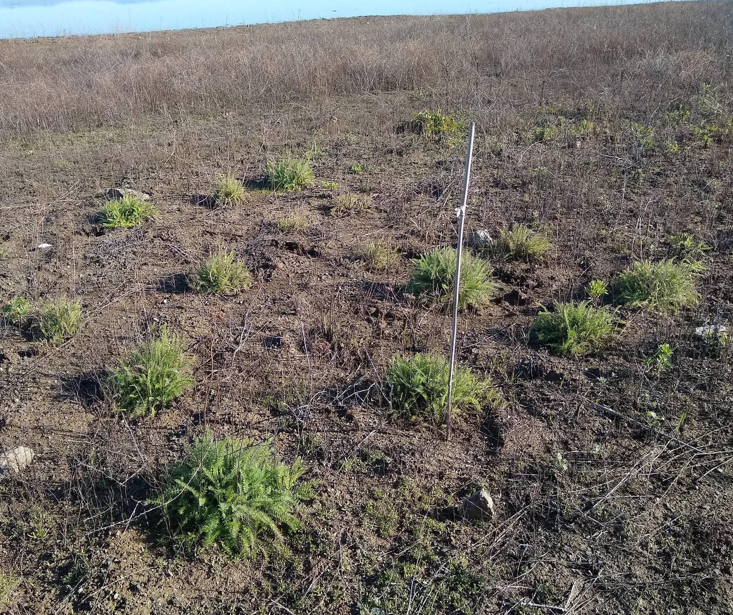
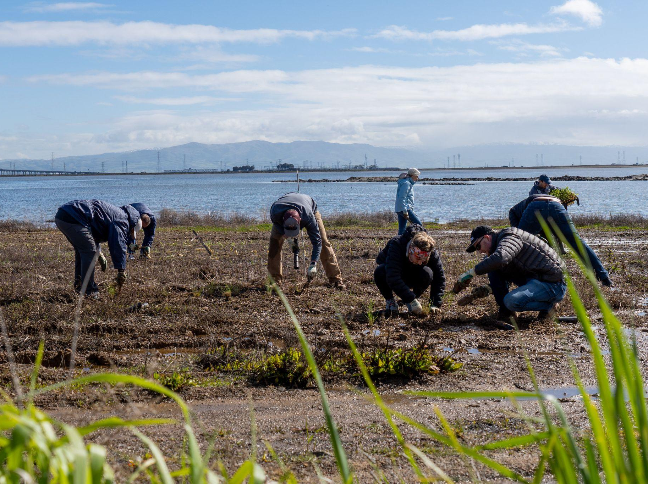
Planting Process
Diversity Patch Planting
3,860 sod pieces harvested from the nursery beds. Equivalent to 15,440 container plants
Refuge Patch Planting
3,800 container plants to provide dense, shrubby high tide refugia adjacent to the tidal marsh
Notes:
Major output from rhizomatous species.
The value of unconventional partnerships
Ease of locating the nursery adjacent to the project site
Irrigation as a critical entity to project success and timeline
Annual seed mix
Unpredictability in project timelines, weather, California, anything you can imagine

Slide 10
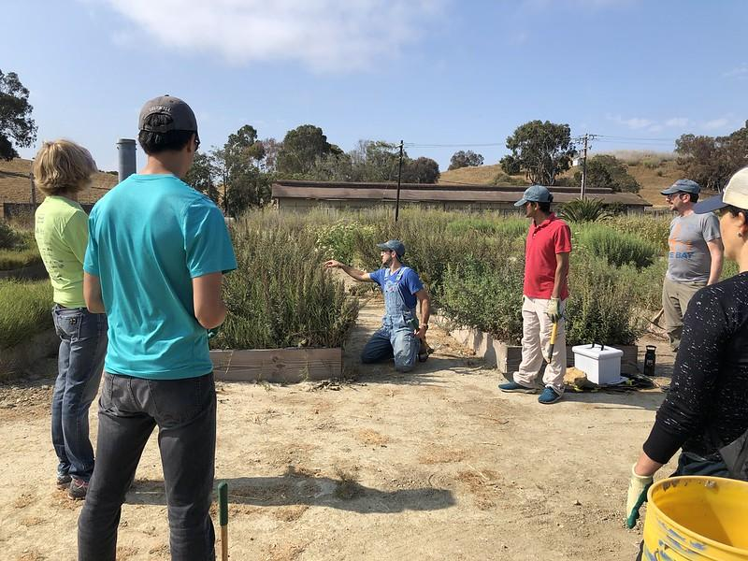
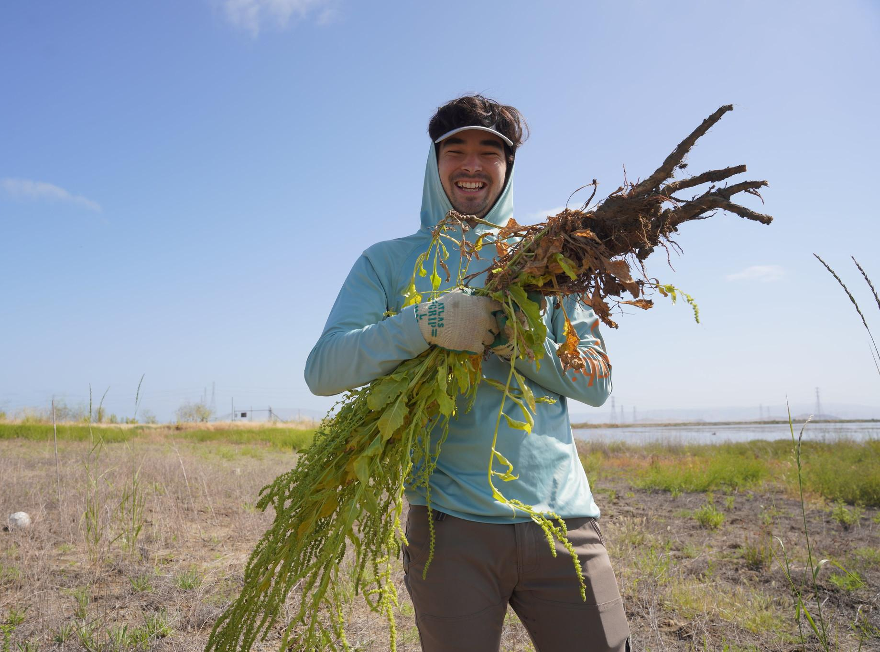
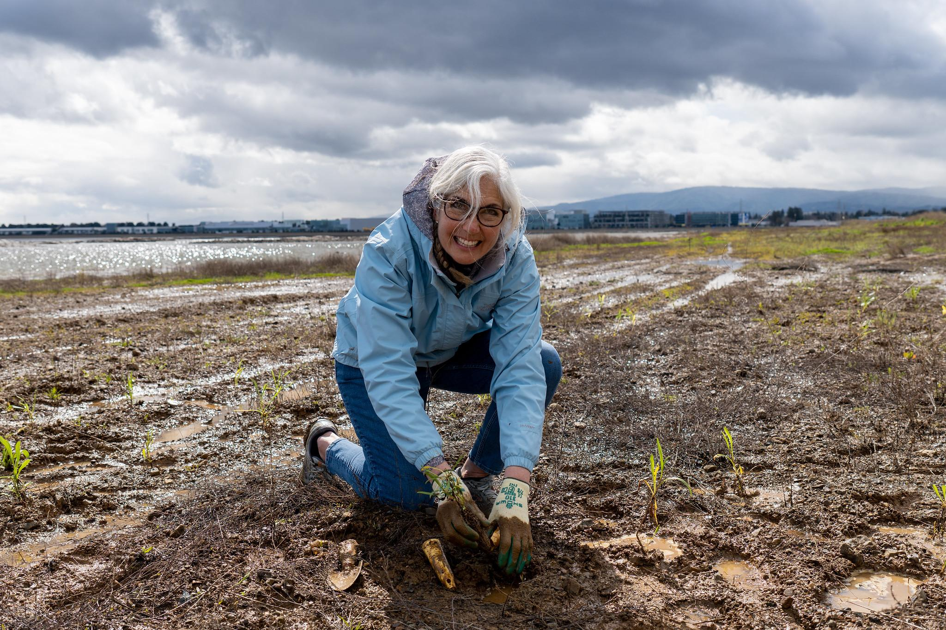
Community Engagement
Covid Delays
Covid-19 postponed our timeline for engaging the public on site. Spring 2022 was the first opportunity for bringing community members on site.
Educational Opportunities
Difficult site to access with students. Focus on adult corporate programs and public programs. Educate adults about HTZ, nature based adaptations, marsh migration.
Support for Restoration Goals
As Covid restrictions loosened, corporate and public community-based programs contributed to weeding efforts & second season planting goals.
Notes:
Big community engagement goals which were stifled a bit due to covid. We couldn’t bring members of the public on site during our first planting season (21-22)
This site is a further walk which makes it harder to engage school students like we do at some of our other sites.
However, it was a fantastic opportunity to educate adults about the transition zone, nature based adaptations and marsh migration.
As covid-restrictions loosened, corporate and community-based programs contributed to weeding efforts, and in our second winter season (22-23) helped us install additional container plants across the slope to increase diversity and overall native plant cover.

Slide 11
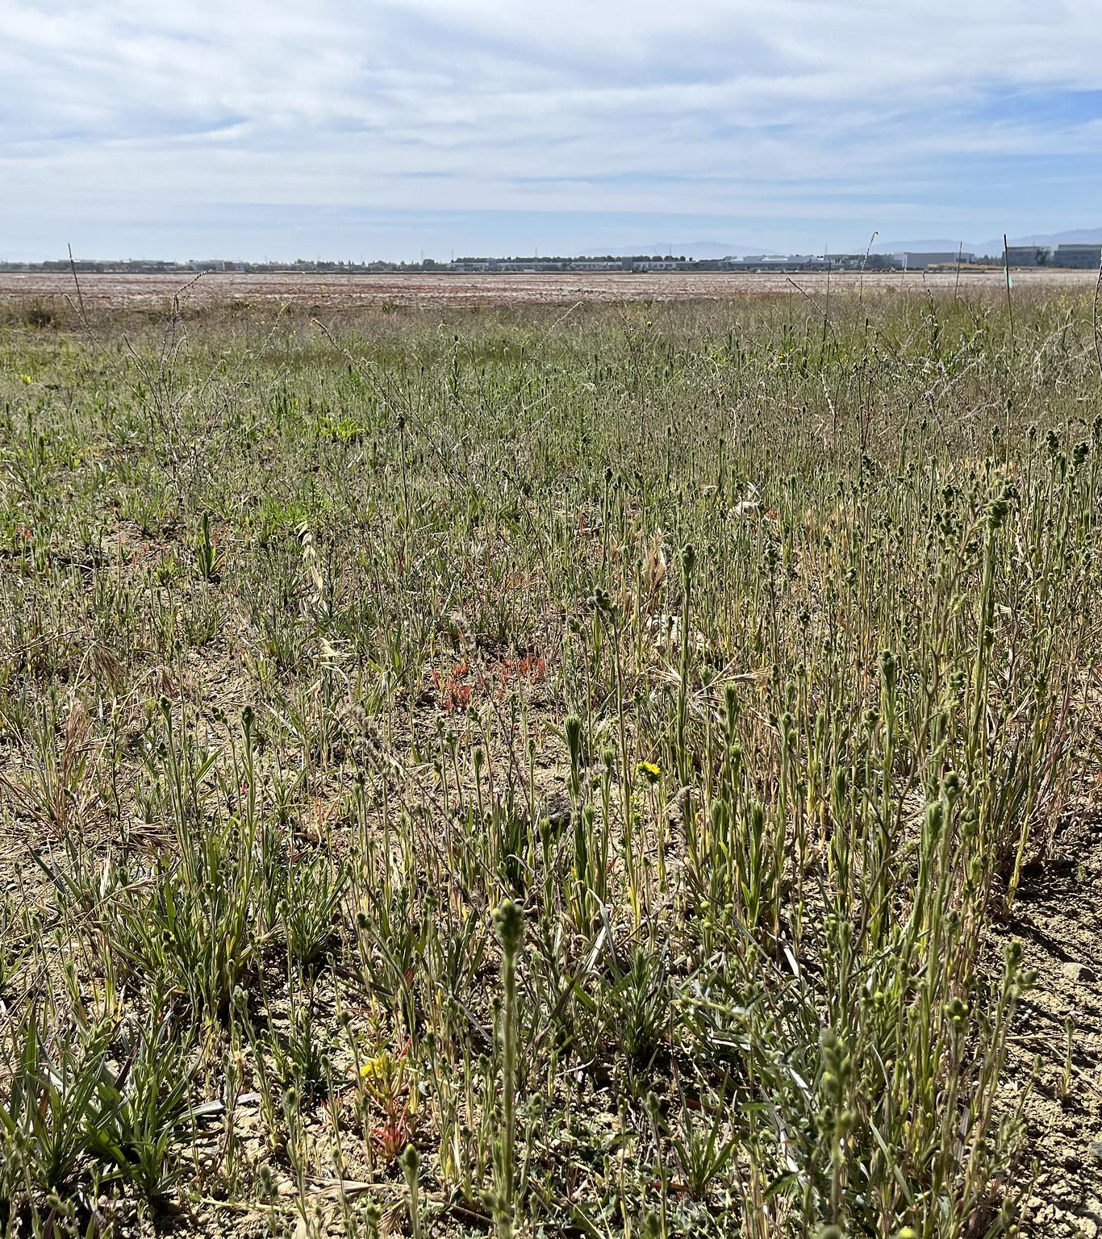
Lessons Learned
Successes
Broad and dense coverage from annual seed mix
Survivorship of the perennial rhizomatous sod species planted via the disking process
High survivorship of diversity patch species
Hardworking and methodical team
Constraints
Labor associated with preparing and translocating sod pieces to the slope
Lack of volunteer engagement - Covid
Invasive and non-native seed bank in the soil
Limited irrigation across the slope
Notes:
Outplanting
We had planned to scale back our education programs through the winter to accomplish these goals, now we will have no in-field programs at all due to covid
Staffing as no volunteers
HRT staff
Hiring some part time field staff
Fellowship positions - working partially in the field with us
Methods of planting
Outplanting plan by Peter

Slide 12
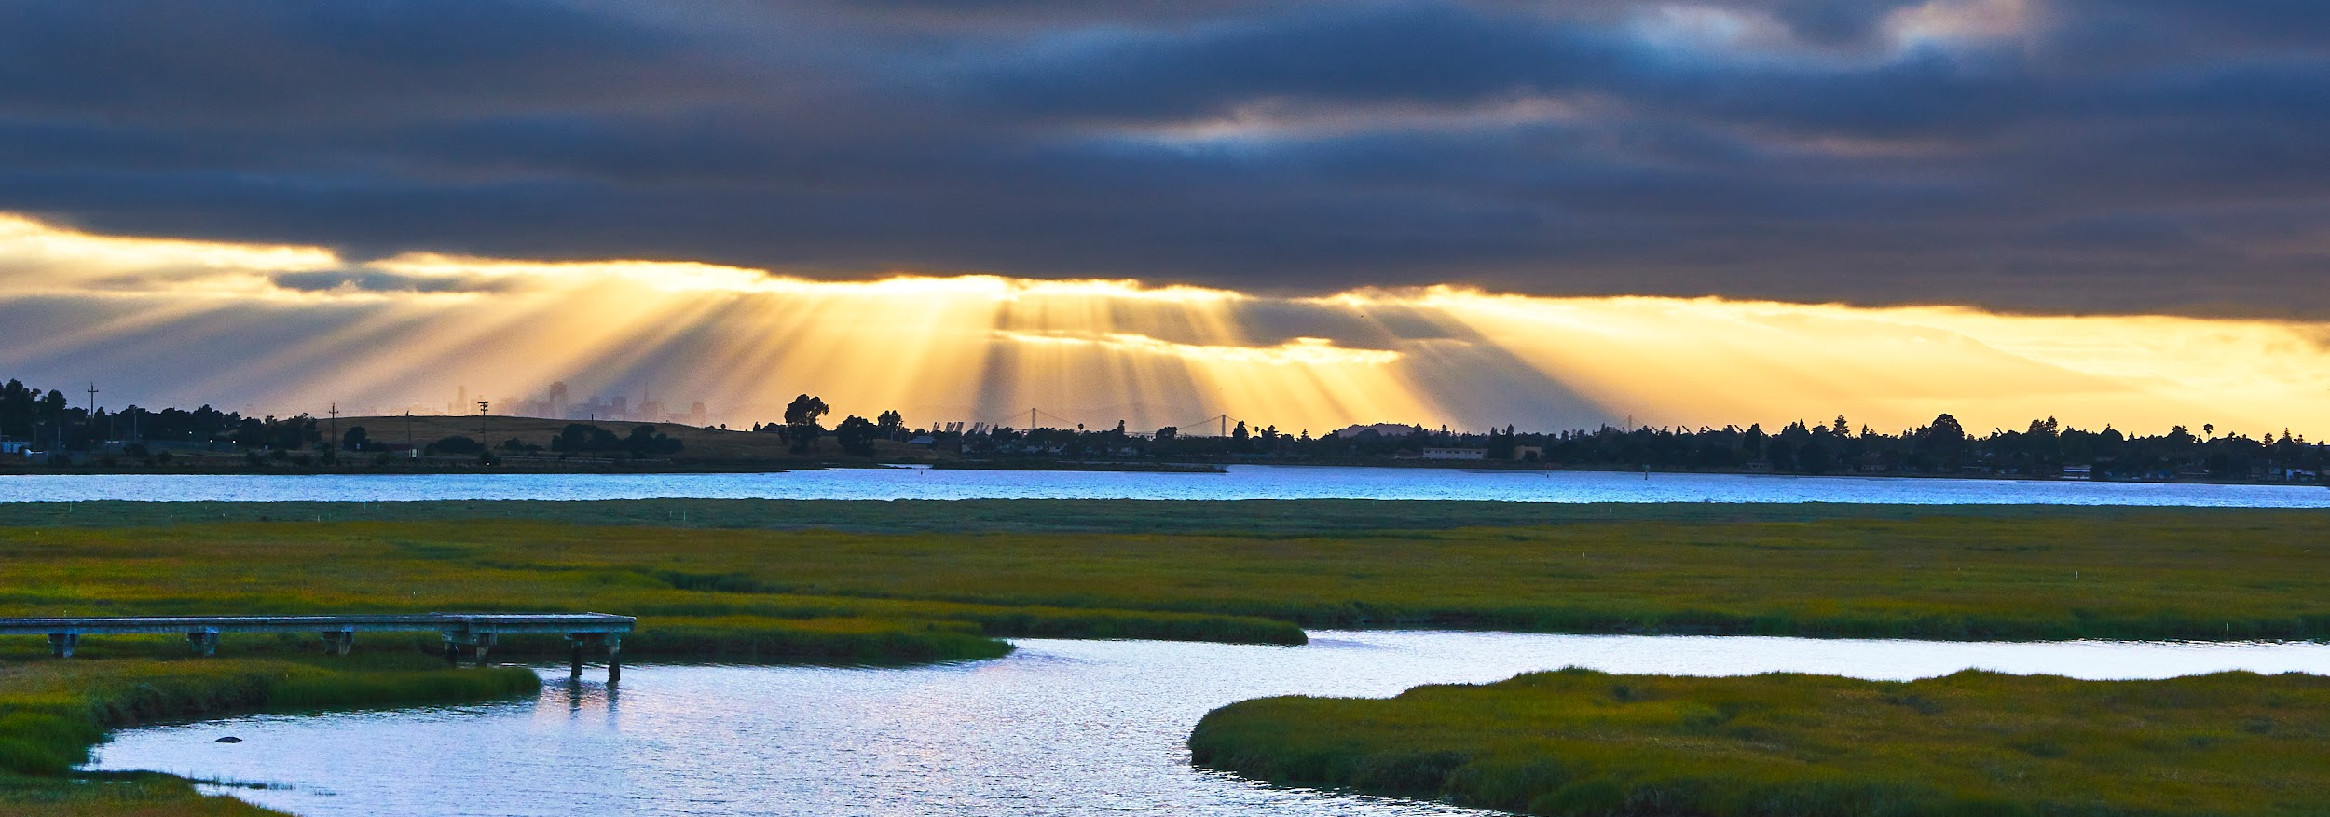
Moving Forward
Iterating this process on the 16-acre All American Canal site this winter.
Increased Community Engagement, including partnership with San Jose Conservation Corps
Ongoing monitoring and data analysis to further inform site successes/constraints & to compare before/after levee breach.
Notes:
reduced cost and labor method to reveg large acreage sites more quickly. Still a lot to learn. What we have seen hope.

Slide 13
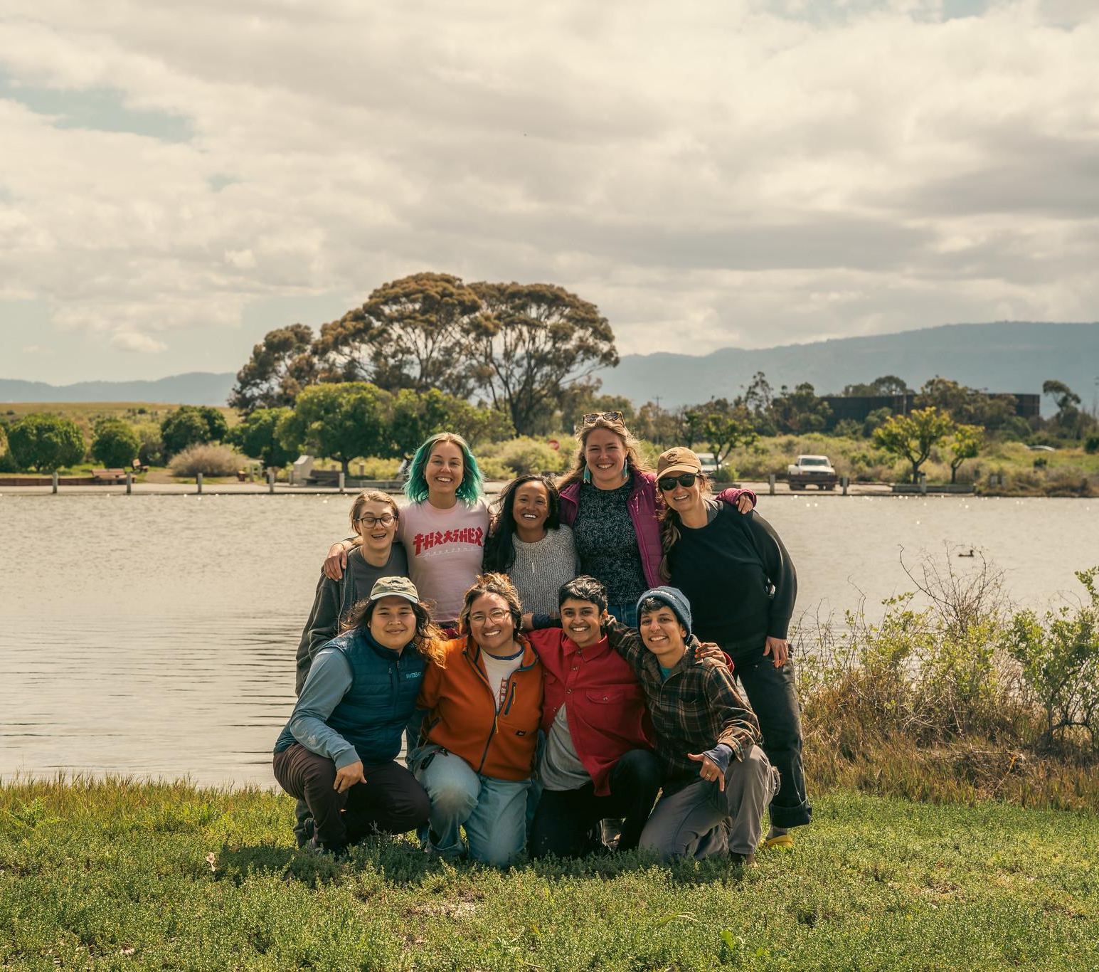
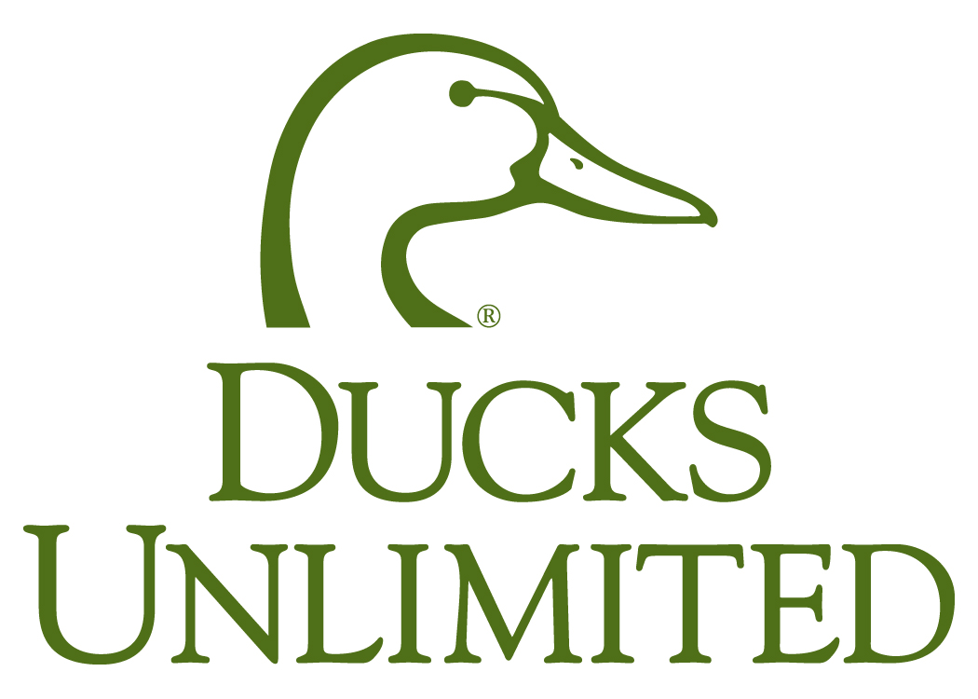
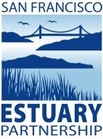
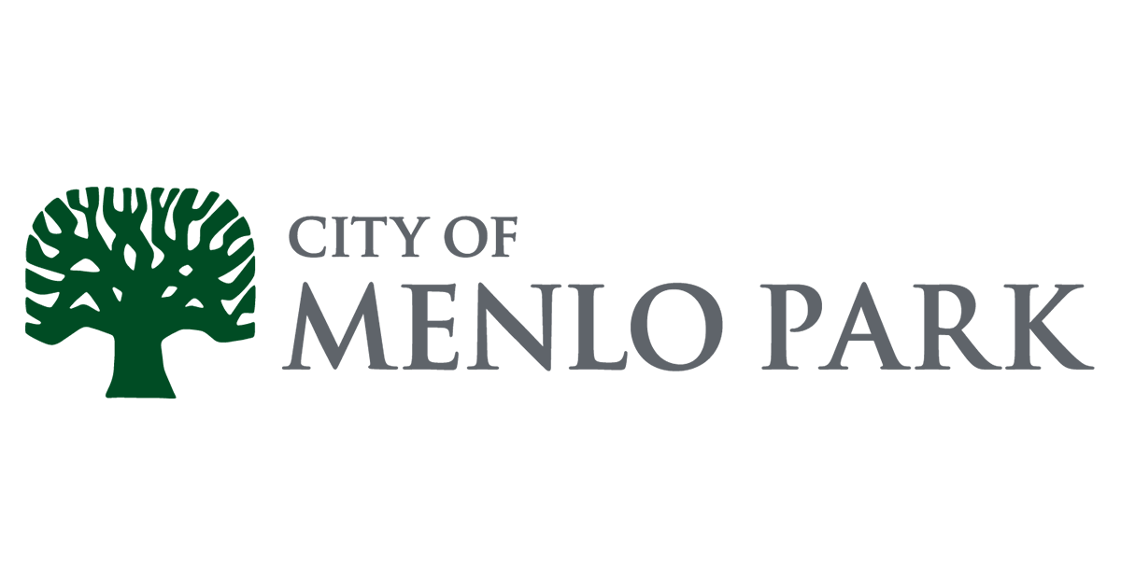
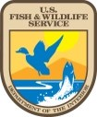
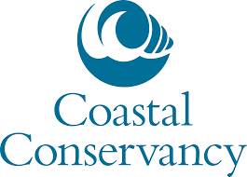
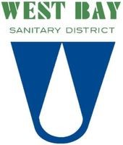
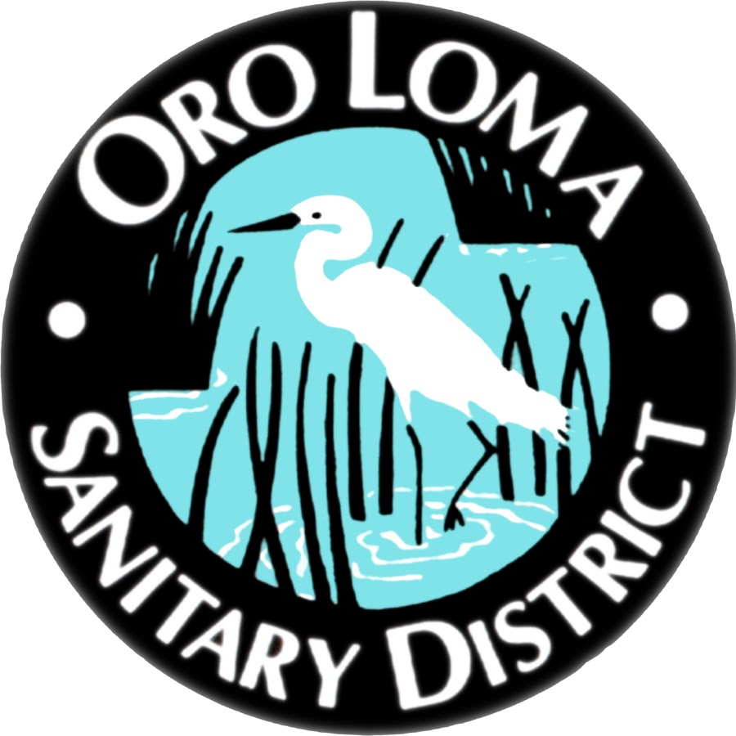
Thank you to project partners and to the Habitat Restoration Team and volunteers!
Questions?
Notes:
As Save The Bay’s restoration projects have grown, so have our propagation methods. My goal of this presentation is to tell you about our recent work scaling up our native plant propagation using low cost, low-labor methods in order to revegetate transition zone plant communities in the SF Bay area. We were brought in to these large projects because of our success with the Oro Loma Horizontal Levee demonstration project in 2016, in which we grew 70,000 native plants using these methods in a very abbreviated timeline.
But it’s been over four years since then and we’ve continued this type of propagation - what have we learned!
This has been taken on as a portion of the effort to restore tidal marsh in the face of sea level rise and climate change. The physically diverse 400 mile shoreline of the SF Bay will be deeply impacted and large-scale tidal marsh restoration projects are urgently needed now.

