Slide 1
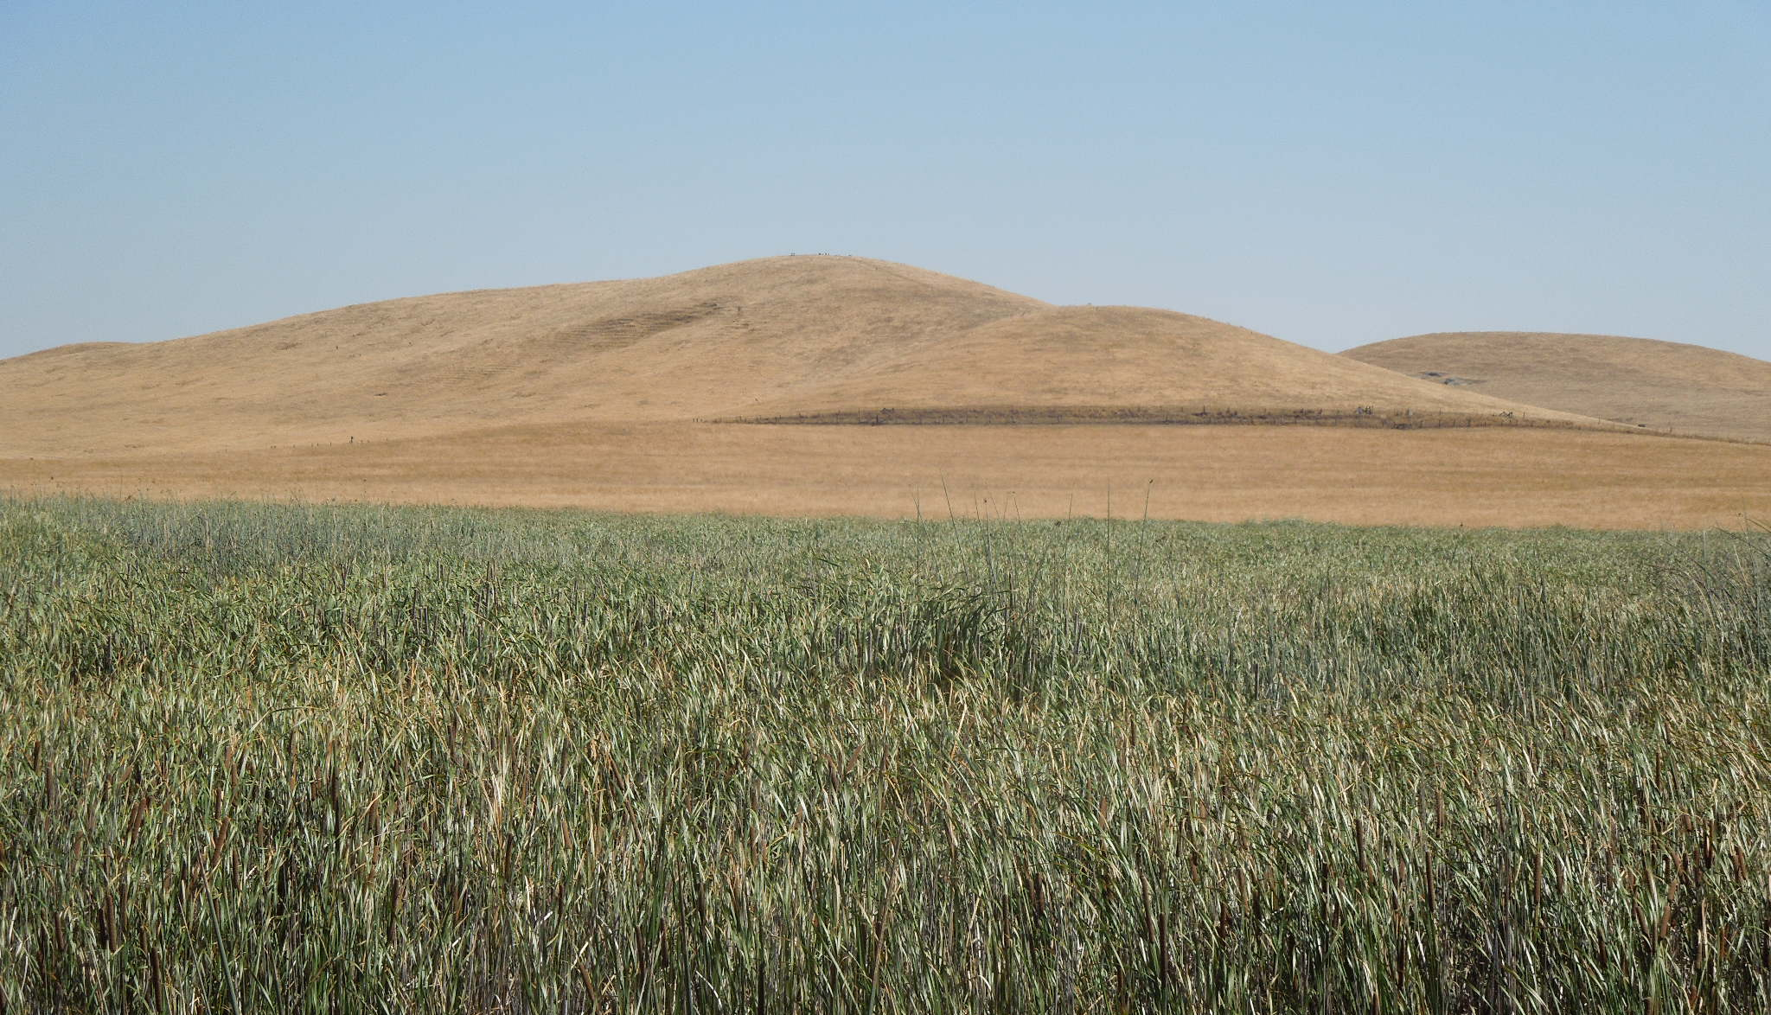
Aim for a Moving Target:
Adapting Tidal Restoration Methods and Materials for
Rapidly Shifting Shores of the San Francisco Estuary
Peter Baye
Coastal Ecologist, Botanist
Wetland Migration Workshop, San Francisco Estuary Project
September 18, 2023

Slide 2
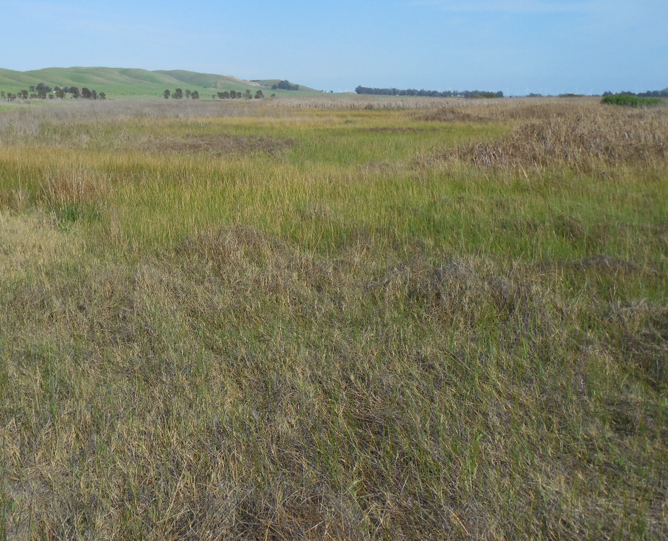
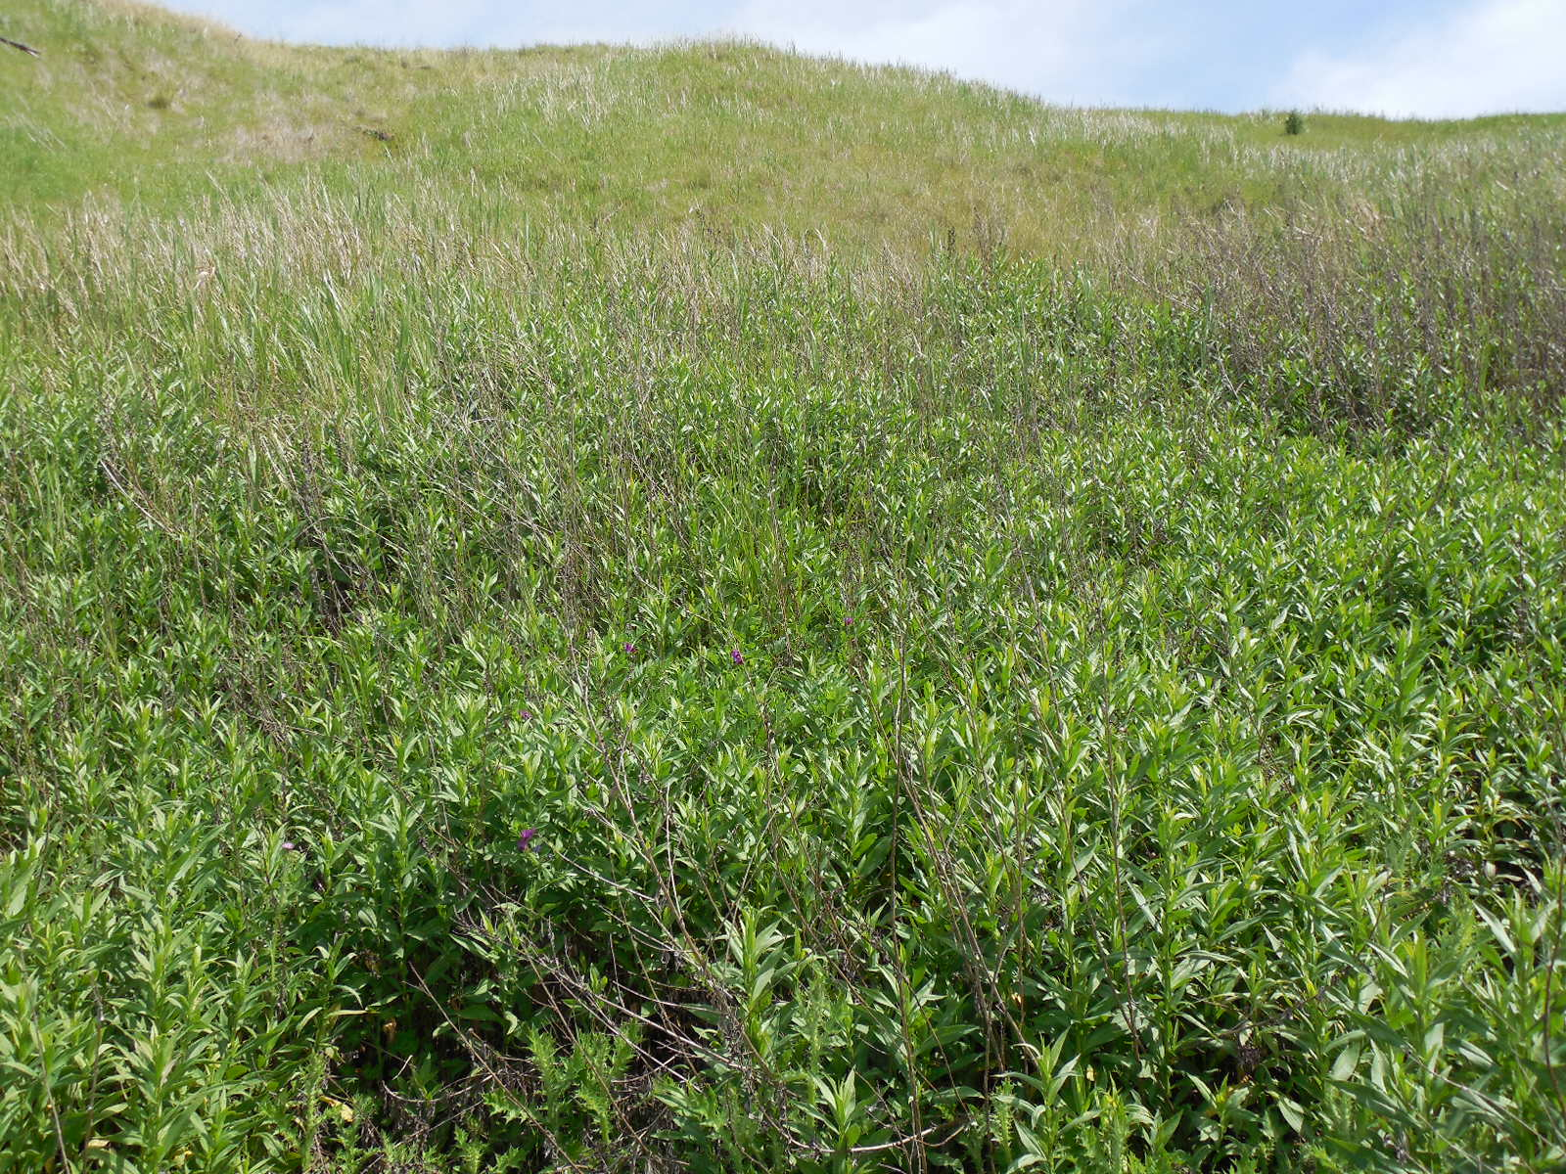
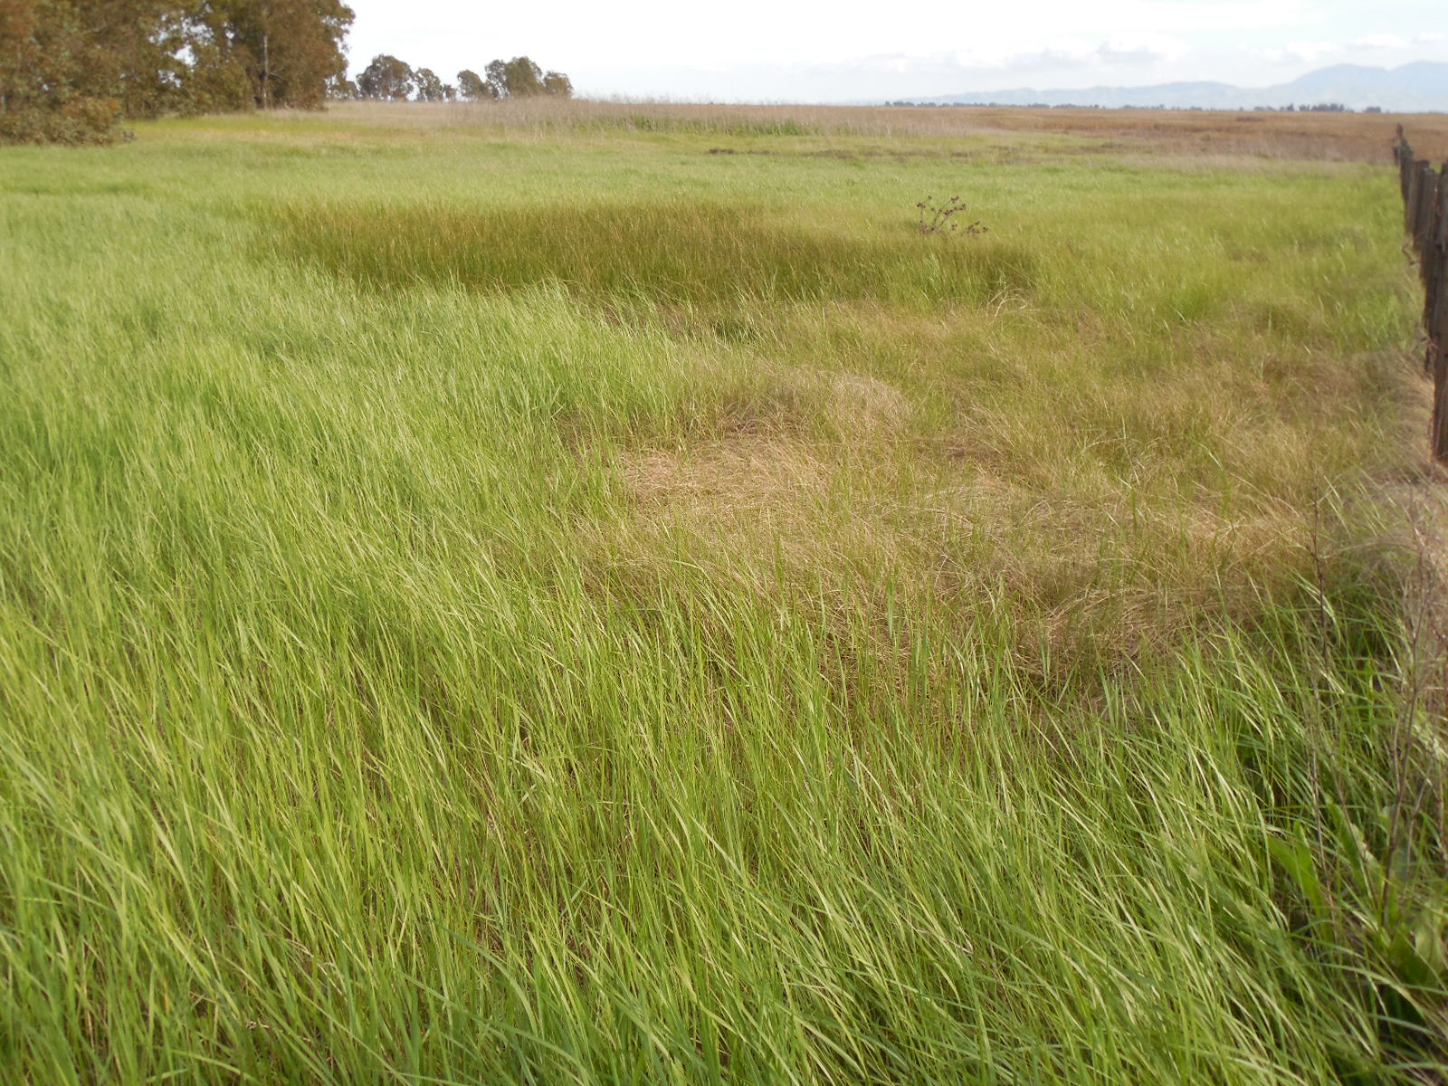
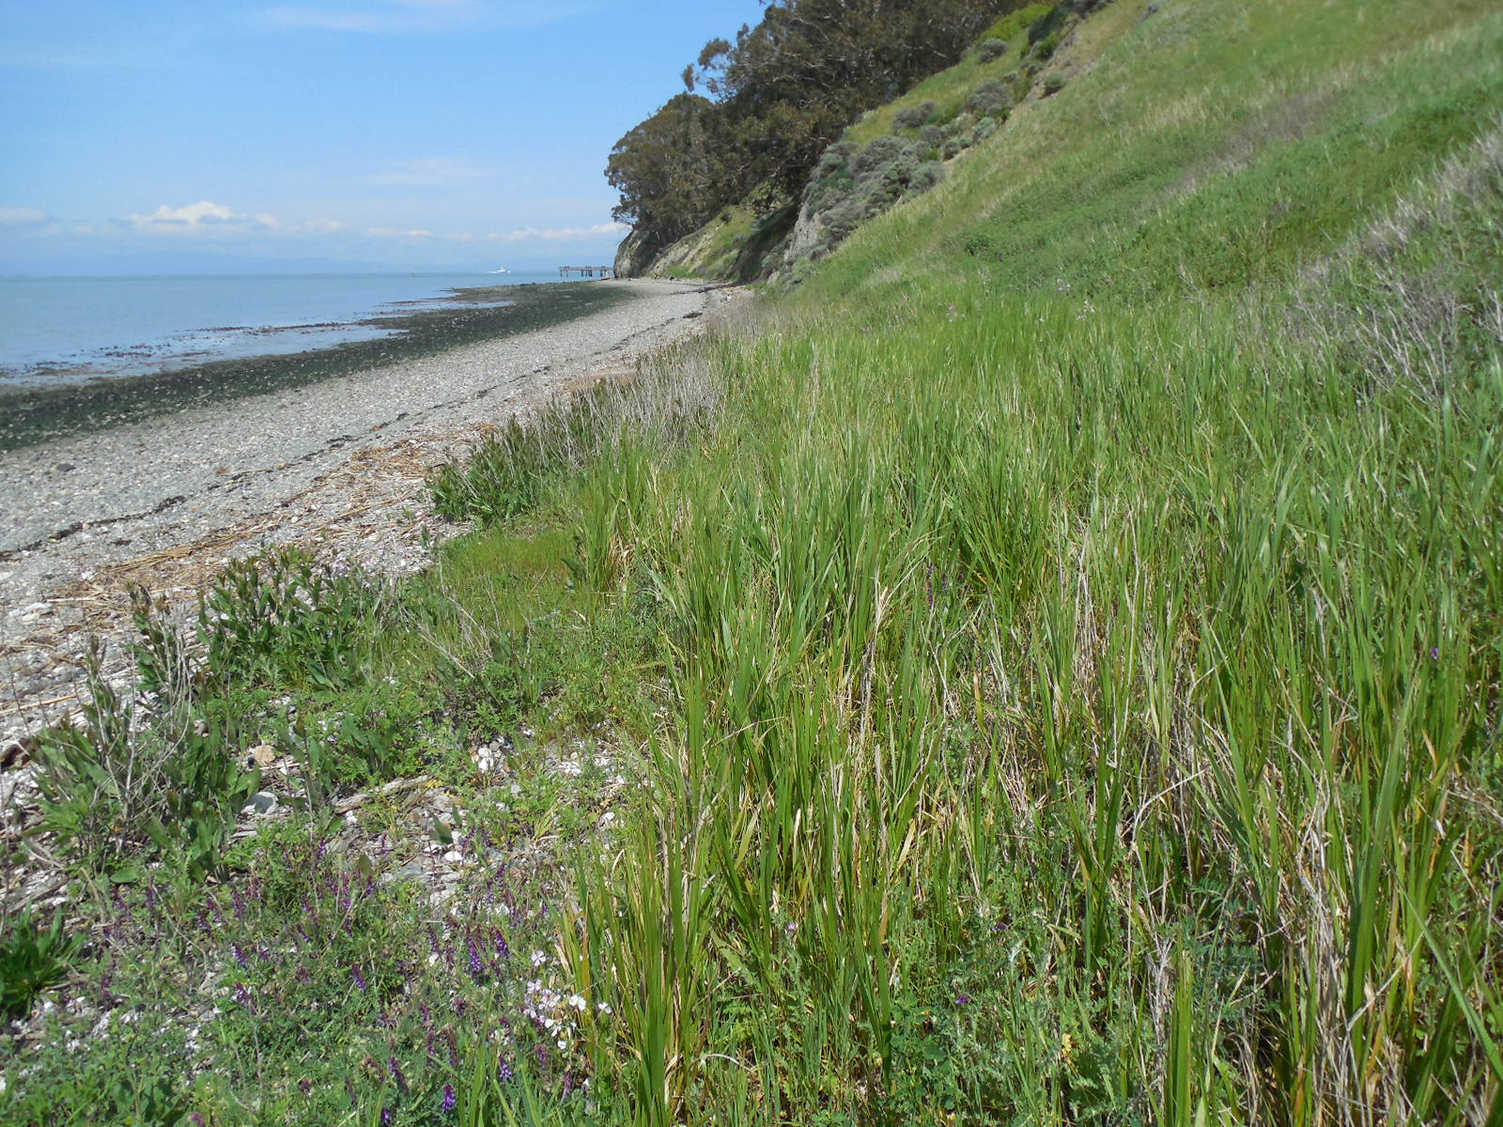
Holocene and Anthropocene Tidal Marsh Transgression Landscapes: Lowland Alluvial Valleys, Plains, Fans, Deltas
Tidal marsh ecosystems persisted during rapid SLR by submerging lowlands: High Tide Line migrated across lowland terrestrial landscapes
Tidal marsh ecosystems expanded bayward only during slow SLR and high sedimentation by accretion of mud and peaty soils.
Remnant native historic valley and alkali grassland-tidal marsh ecotones: resilient reference systems for estuarine transgression during climate change
Dominant herbaceous vegetation: clonal perennial forbs and graminoid functional groups – Aster, grass, sedge, rush family
Rush Ranch NERR
Point Pinole
Rush Ranch NERR
Point Pinole

Slide 3
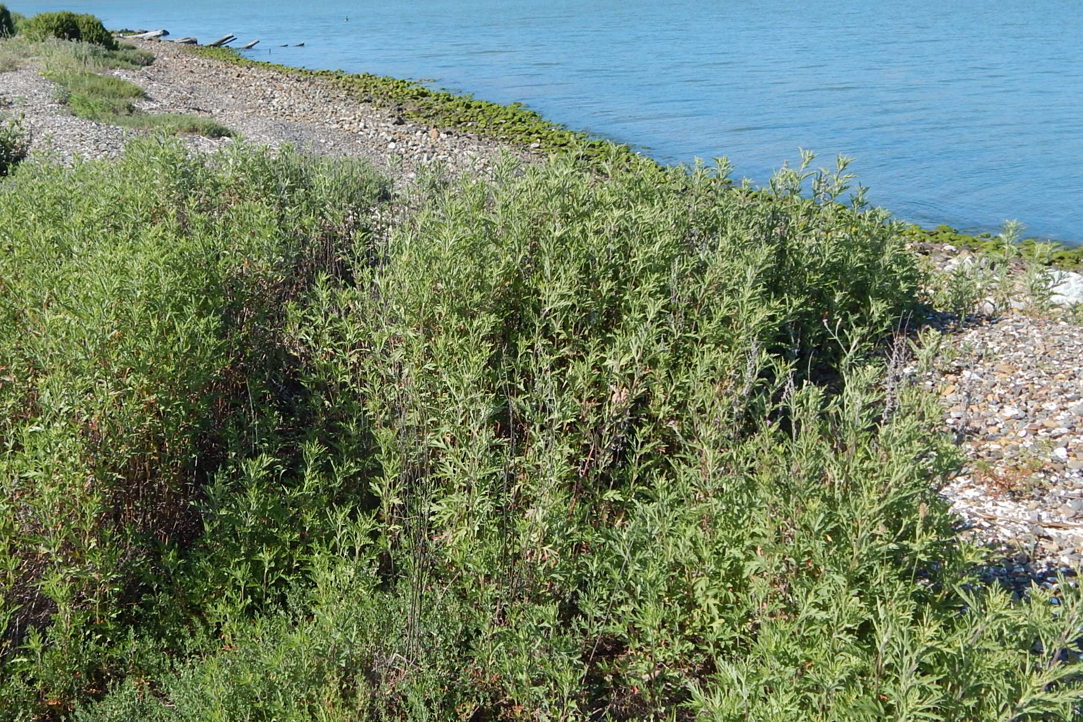
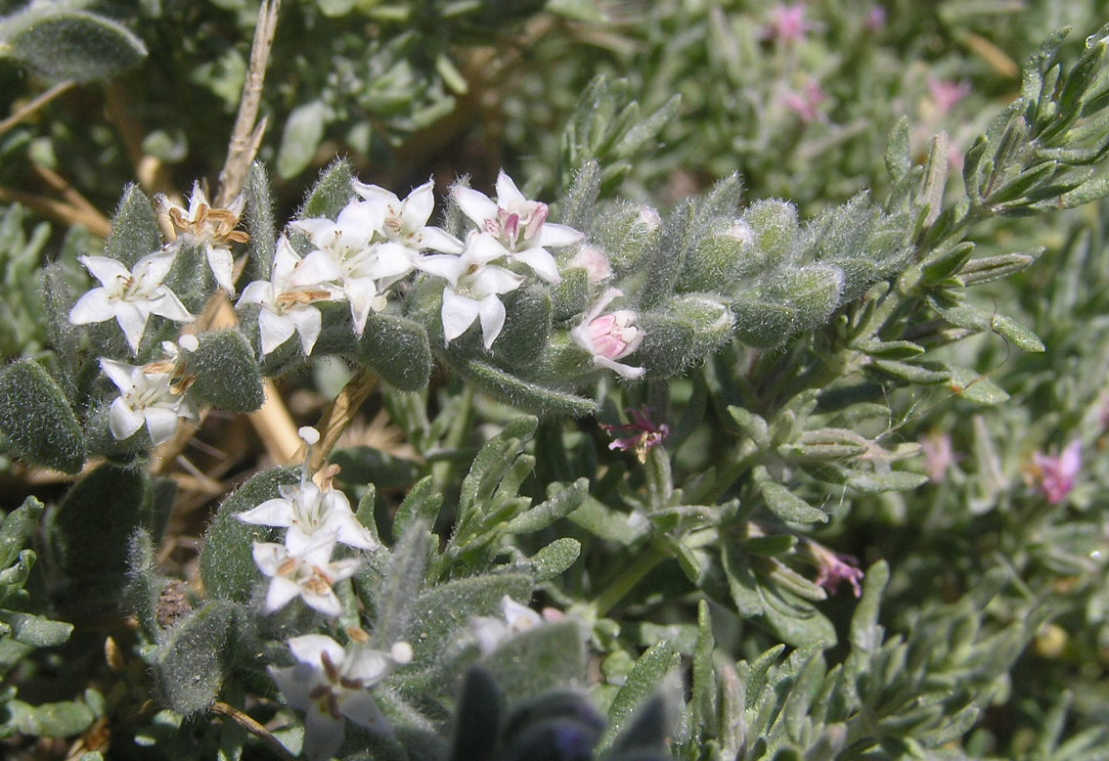
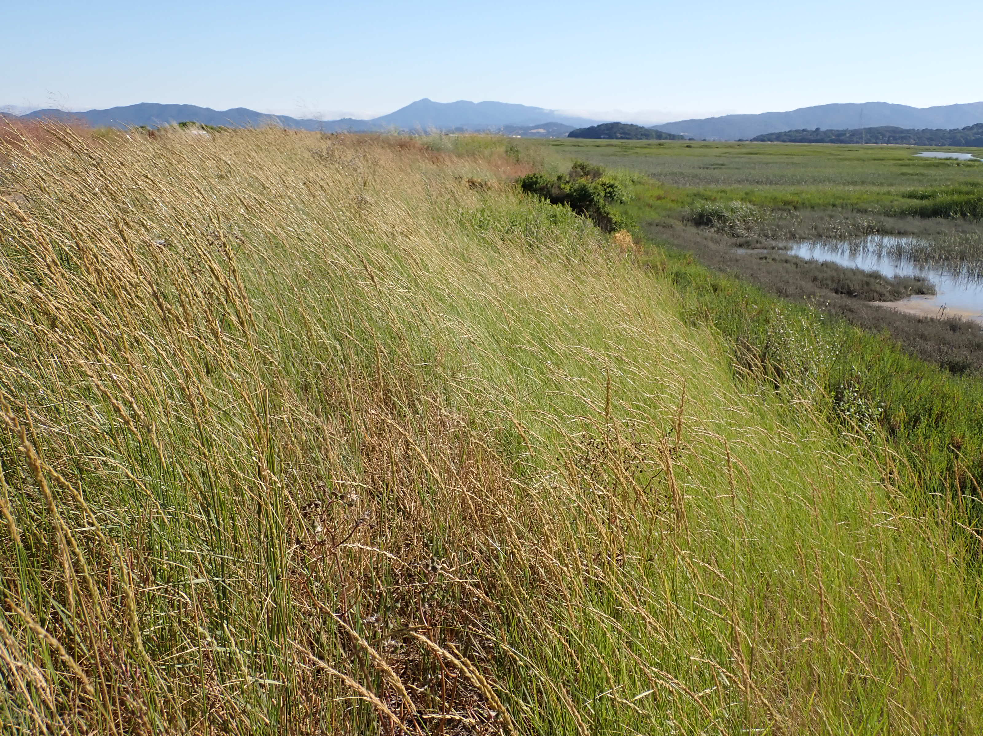
Ambrosia psilostachya
Cressa truxillensis
Terrestrial ecotones: Plant functional traits essential to resilience during estuarine transgression
Clonal integration of substrate salinity tolerance: cross-clone transfer of low-salinity water, above-tide to upper intertidal zones
Taxonomy: Plant family, species physiological tolerance to alkali and subsaline soils, salinity flood pulses, drought
Erosion resistance traits: rhizomatous, spreading root architecture for sod-forming vegetation, high soil shear strength,
Widespread historic dominant native herbaceous creeping species throughout SFE, Suisun to South Bay
Sonoma Baylands, Main Unit – Leymus triticoides

Slide 4
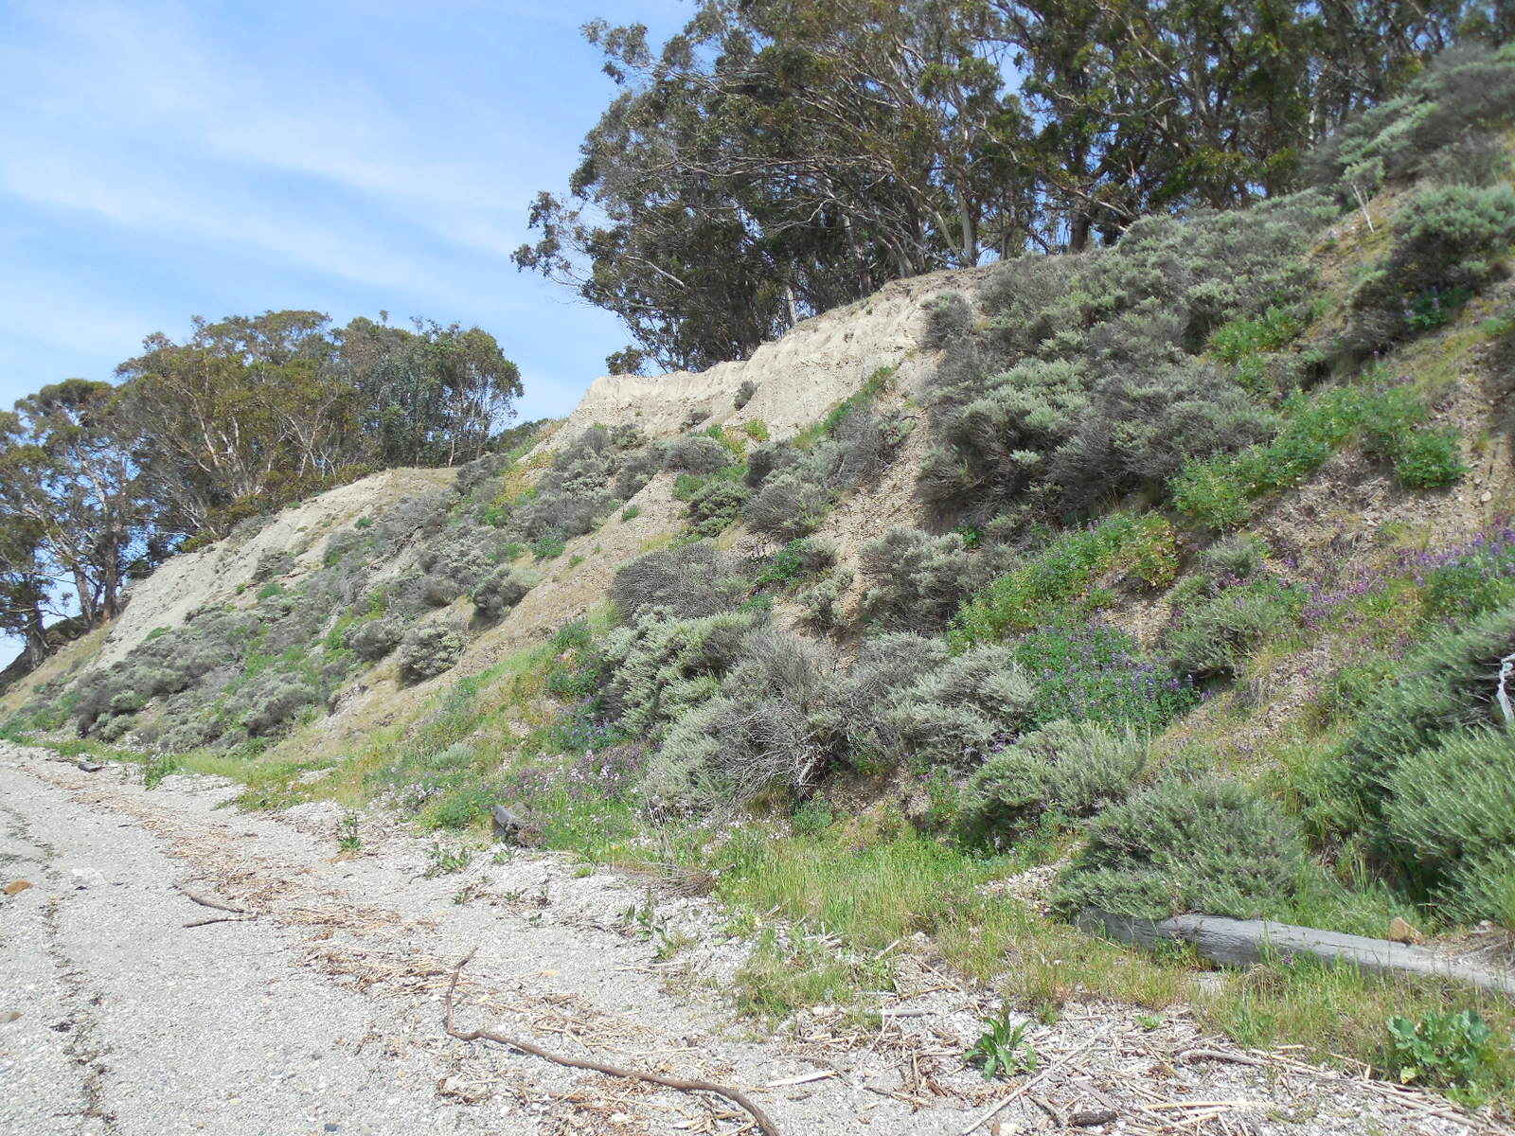
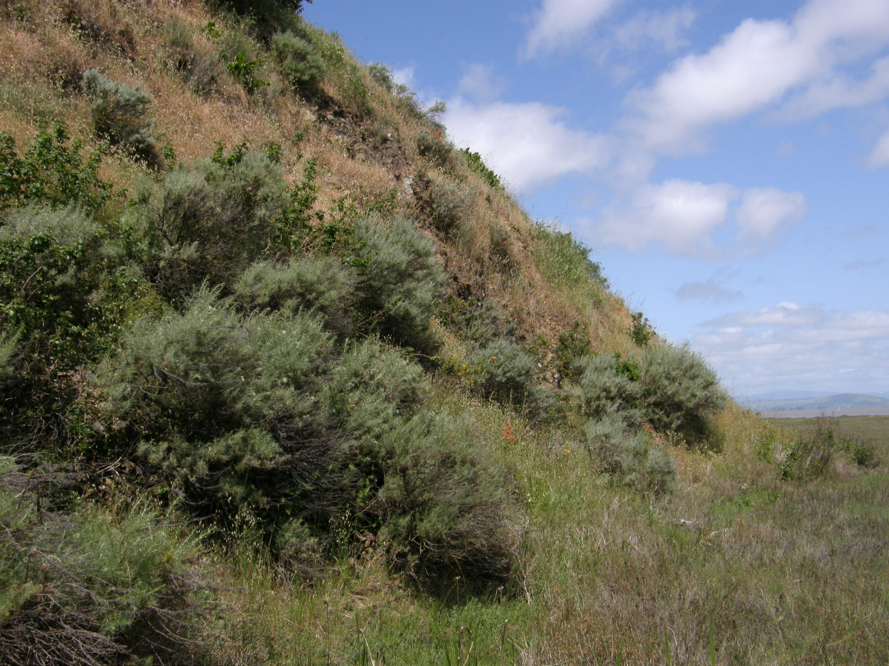
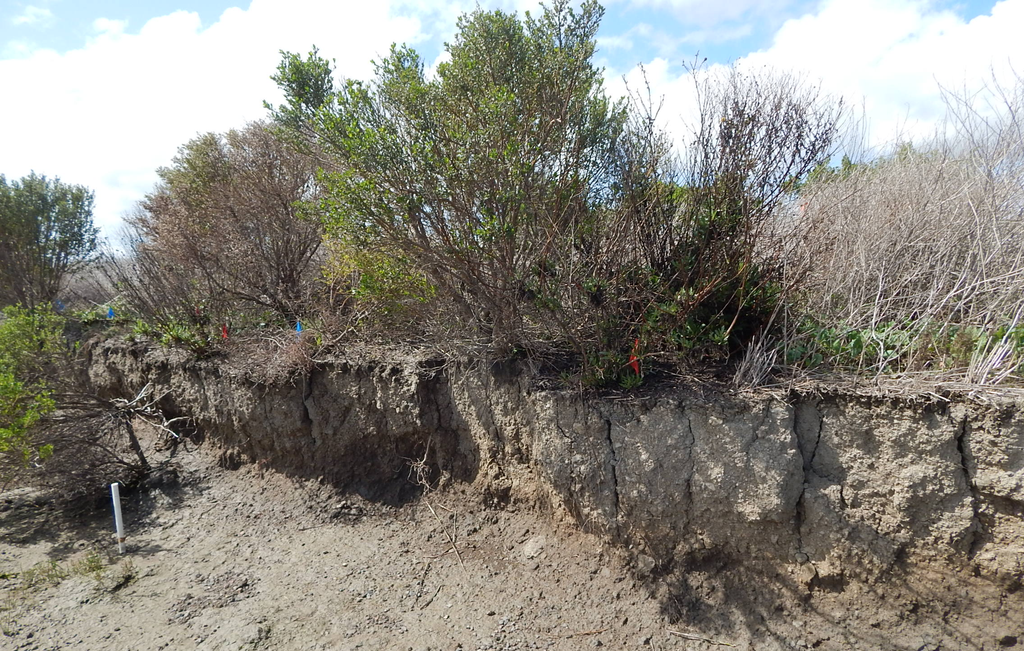
Upland Hillslope and Coastal Bluff Vegetation
of SFE Tidal Shores: low or no resilience to SLR in wetland migration zone
Steep upland slopes, abrupt terrestrial vegetation zones
Plant functional traits not resilient to SLR: non-clonal, taproot shrubs
Rapid growth short-term in atypical fine-grained soils
Substrate salinity-intolerant
Soil salinization injury, dieback, or mortality
Dieback below migrating high tide line;
Low soil stabilization function; weak erosion resistance
West Point Pinole bluff
Jake’s Island
China Camp Marsh, NERR
Sears Point
West Levee
2021
Artemisia californica

Slide 5
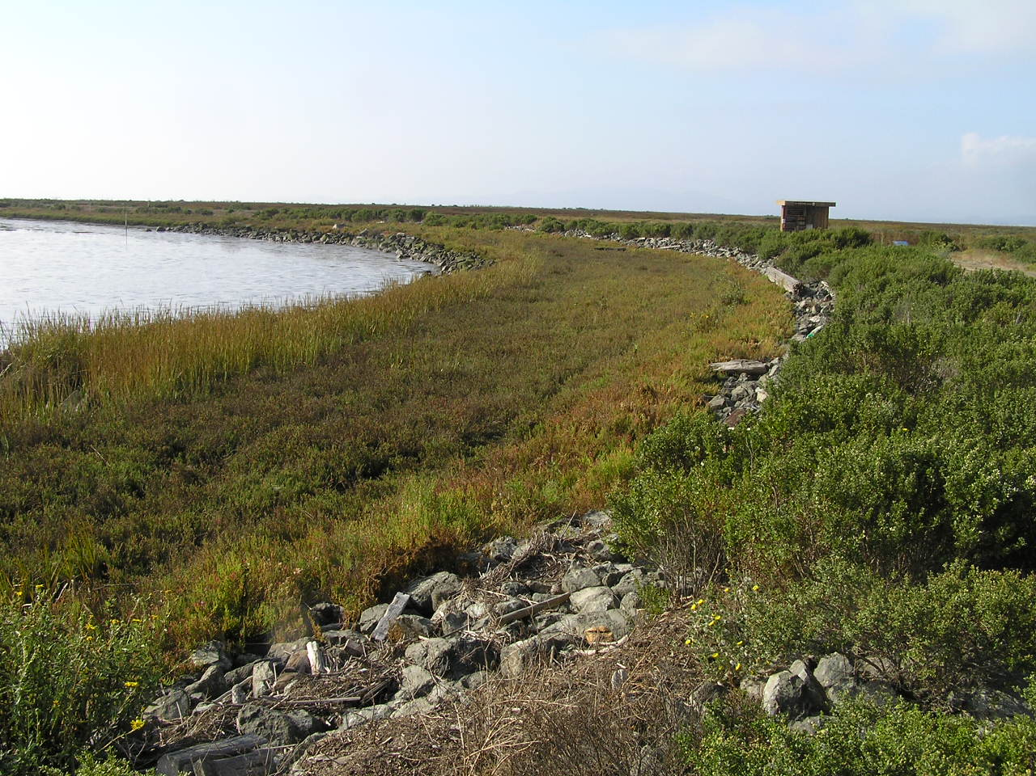
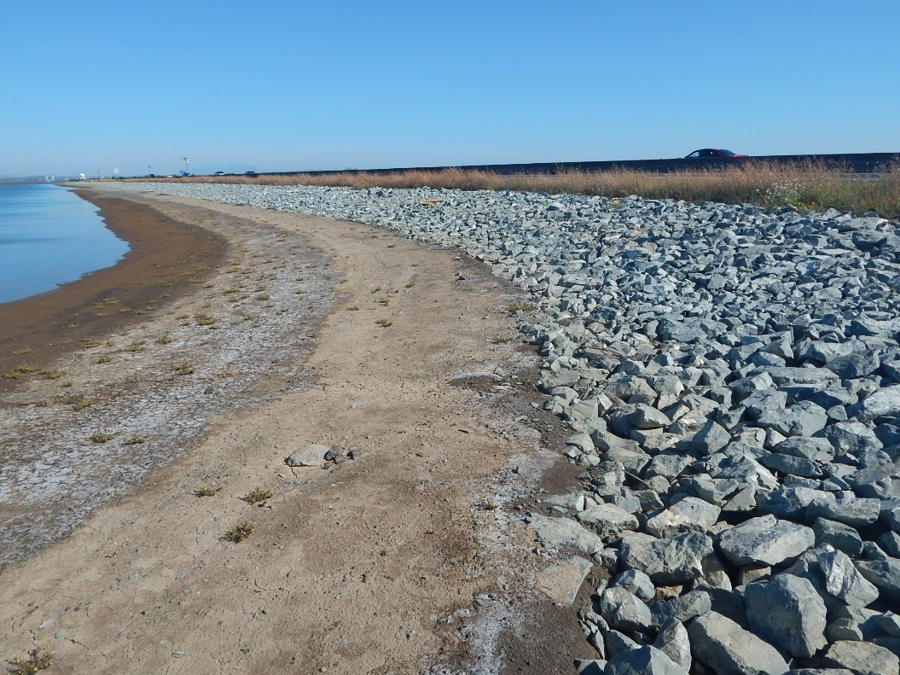
ARMORING TIDAL WETLAND MIGRATION PATHS:
SHORT-TERM/PERMANENT TREATMENT FOR MARSH SCARP EROSION
Immobilizes dynamic transition zones, wetland migration space
Displaces high tide flood cover for wildlife native plant diversity
Low roughness, reduced wave attenuation v. marsh vegetation
TRADITIONAL SHORE EROSION CONTROL:
RIP-RAP QUARRY STONE ARMORING
Lower Tubbs Island tidal marsh restoration
USFWS Refuge – San Pablo Bay
Cullinan Ranch tidal marsh restoration
USFWS Refuge – San Pablo Bay
RIP-RAP
RIP-RAP
RIP-RAP

Slide 6
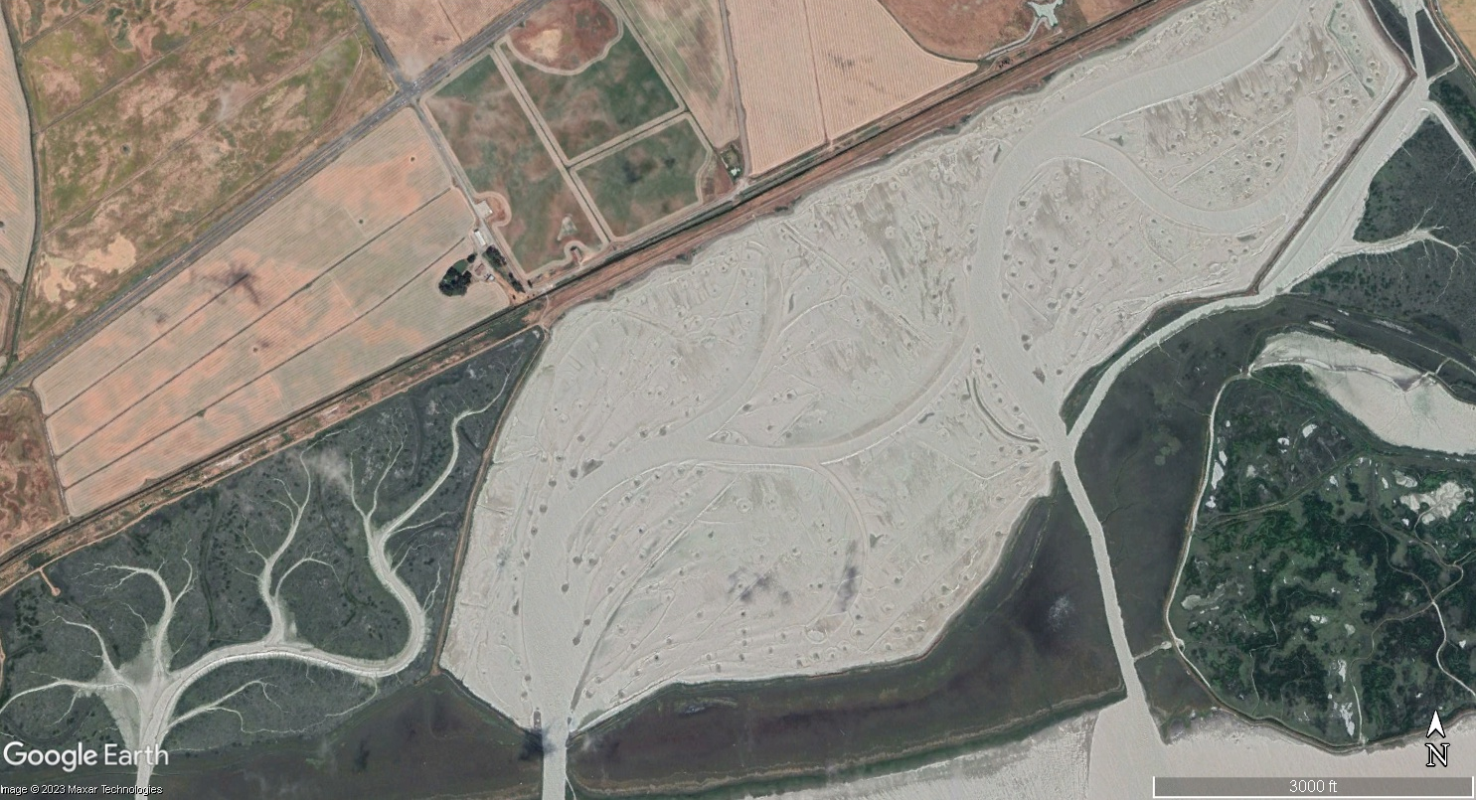
Sears Point Wetland Restoration Project
San Pablo Bay National Wildlife Refuge, Petaluma
Farmed oat hayfields
SR 37
Habitat transition zone levee
RAIL LINE
Farmed oat hayfields
Sears Point
Tidal Wetland Restoration Site
2019
Sonoma Baylands

Slide 7
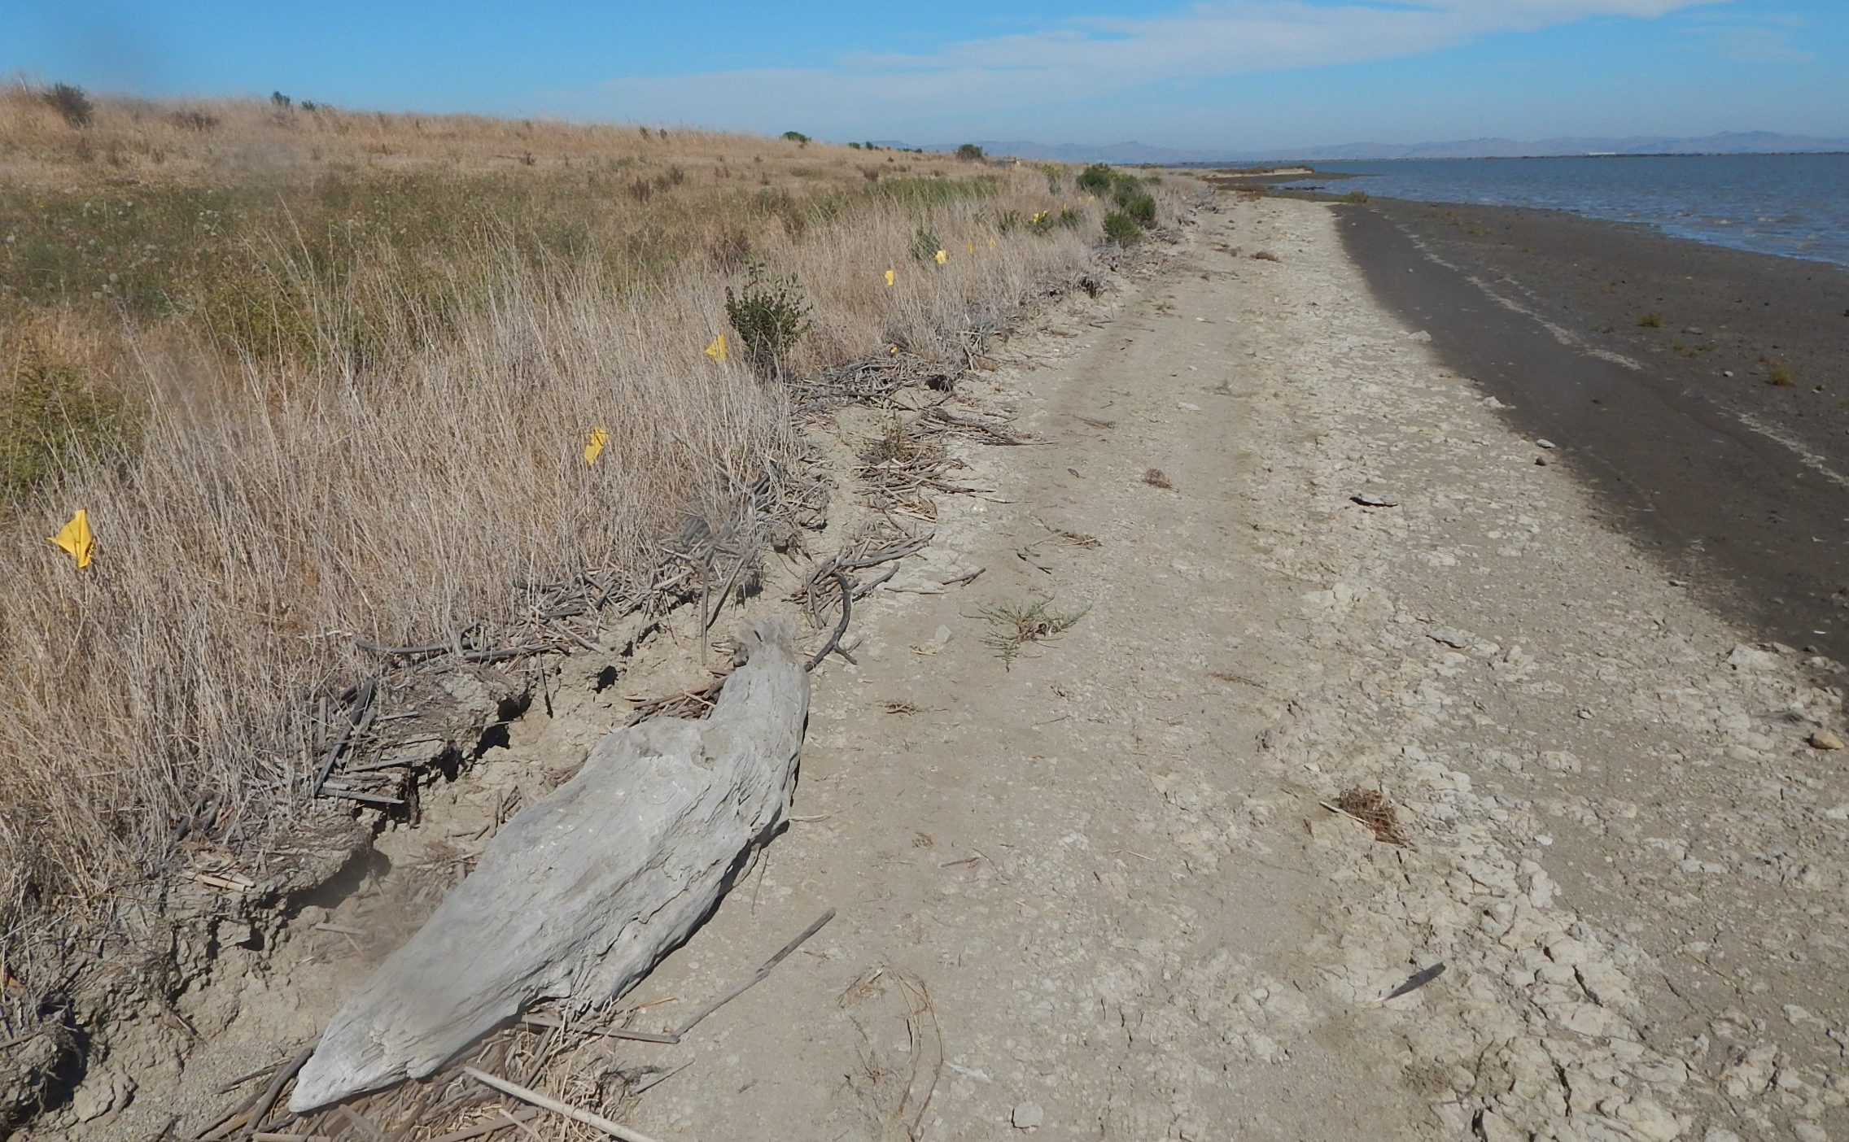
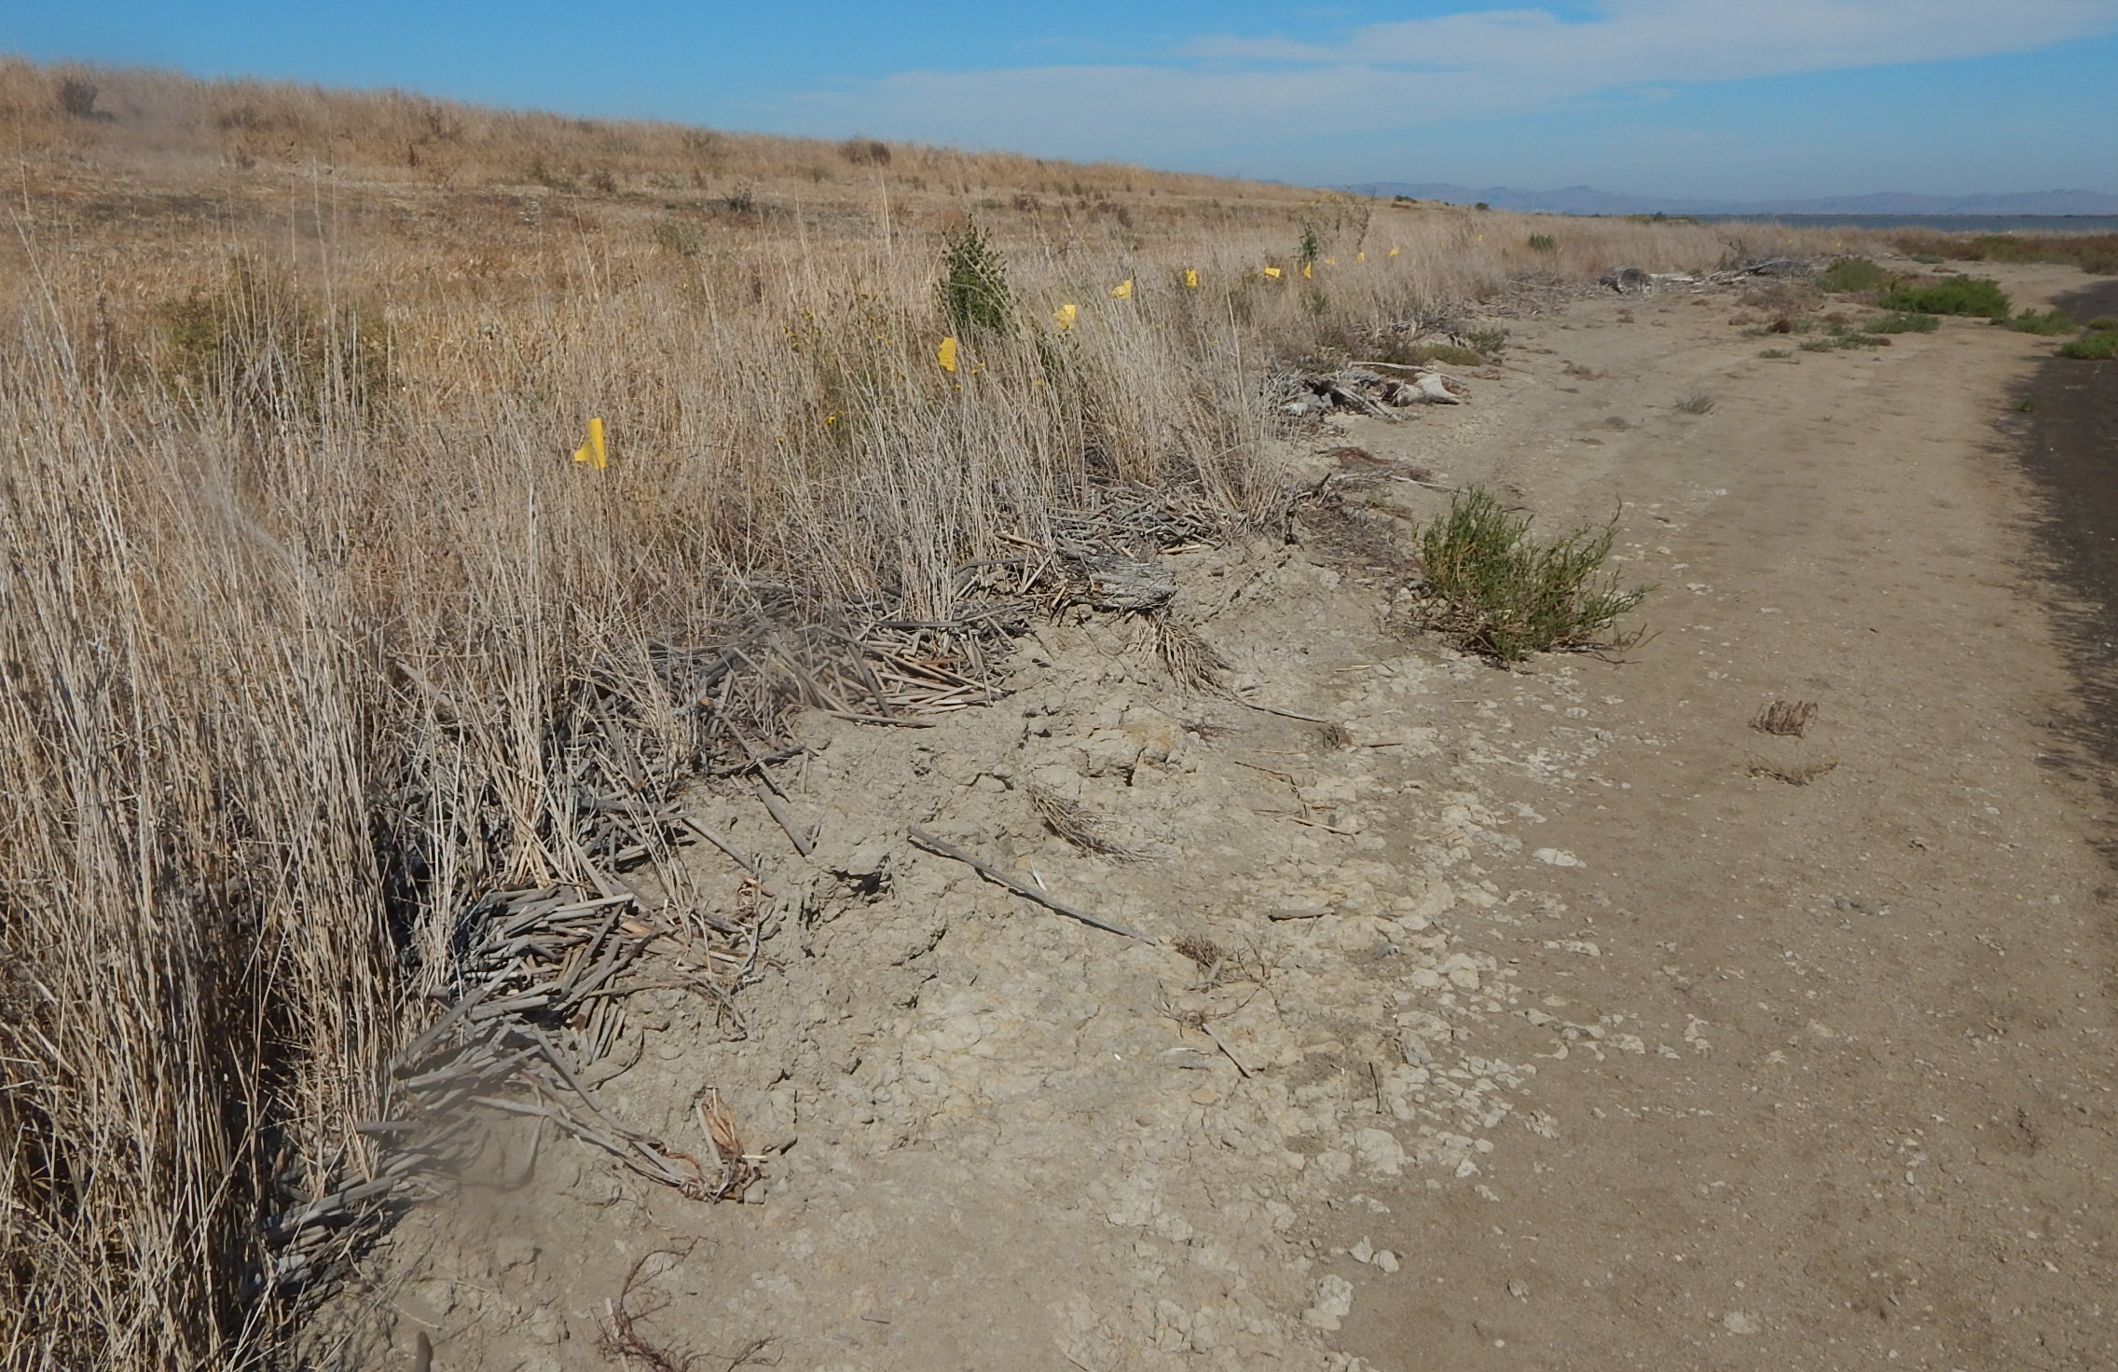
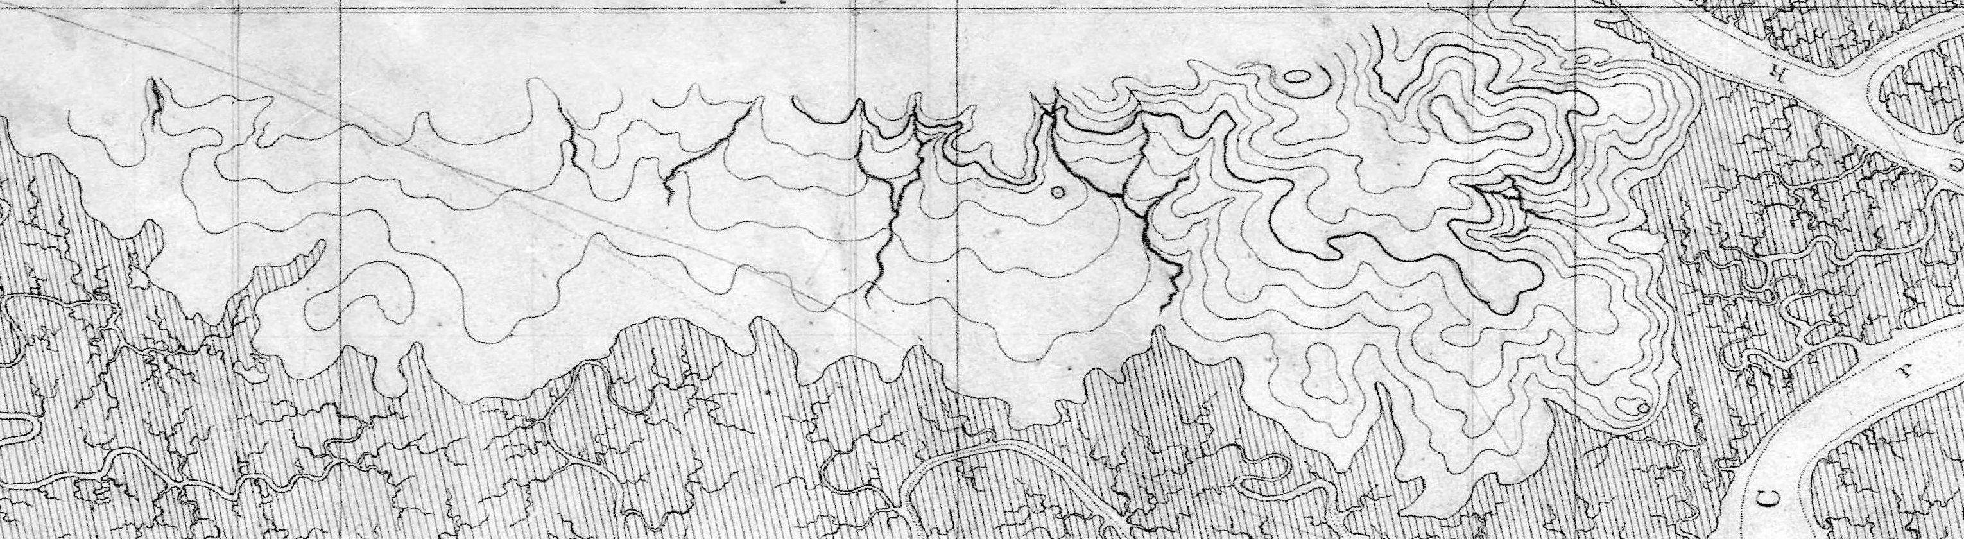
Sears Point North Shore Levee and Transition Zone Erosion after Tidal Re-flooding
SURROGATE TERRESTRIAL LOWLAND TRANSITION ZONE
Concept design: 10:1 – 20:1 levee bench slope, vegetated wave-dissipating transition zone, high marsh migration platform
Unvegetated slope: most shoreline pioneer tidal salt marsh vegetation erodes before establishing
Rapid erosion scarp retreat, concave profile
Sept 2018
EROSION SCARP RETREAT
TERRESTRIAL TRANSITION ZONE PLANTINGS ERODED
1856 original lowland tidal marsh/lowland

Slide 8
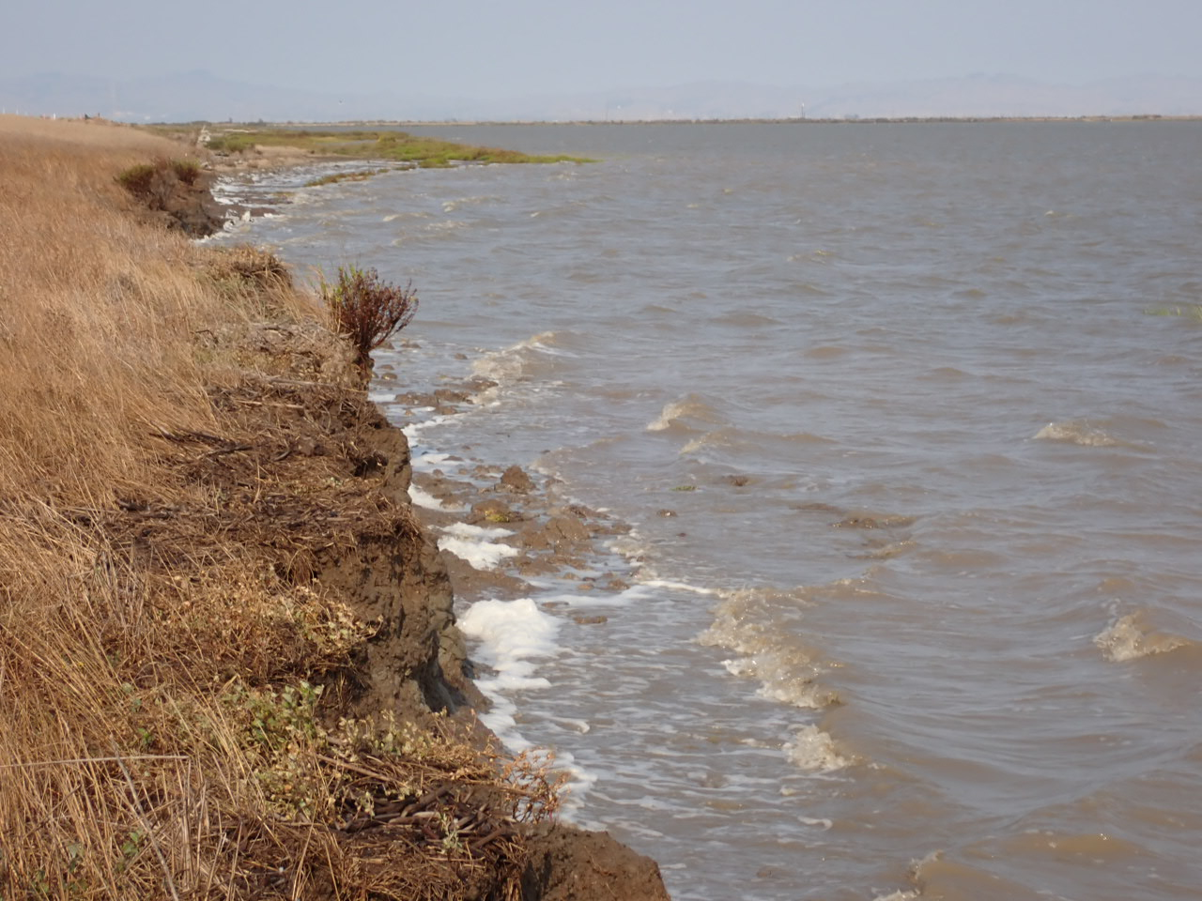
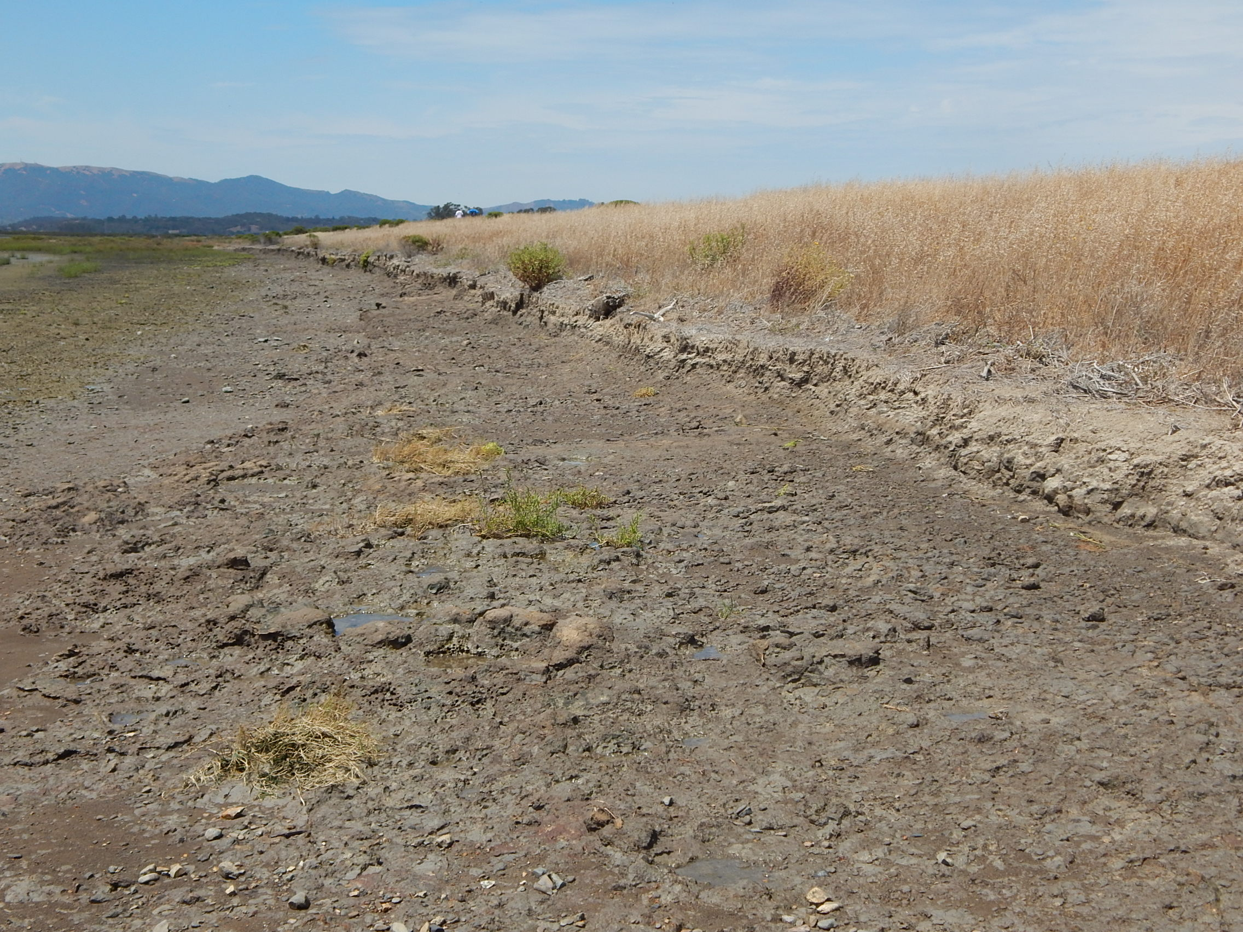
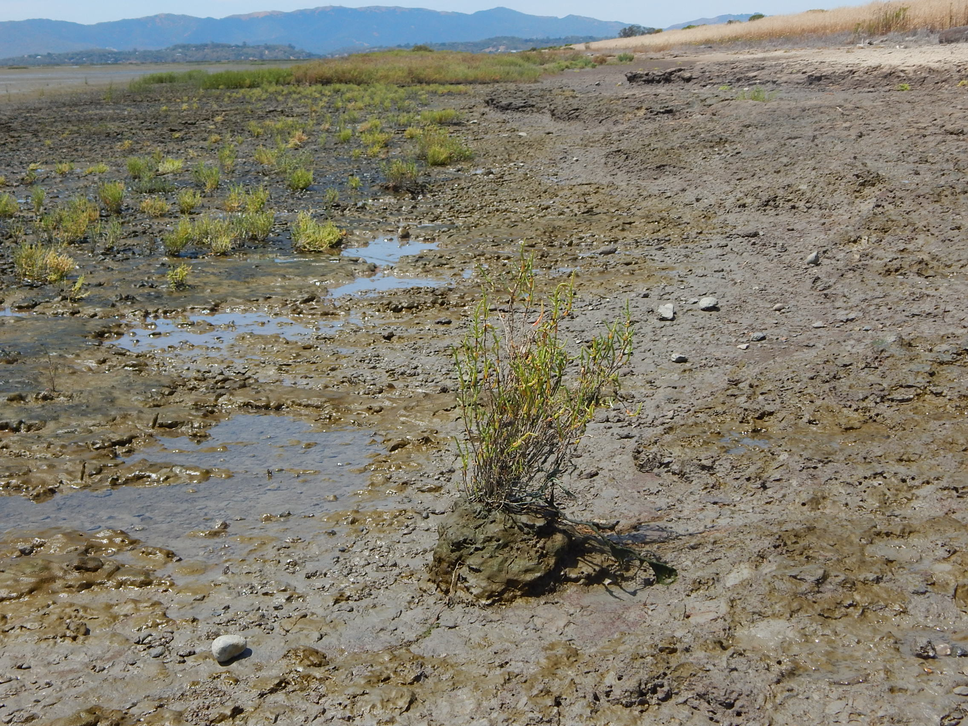
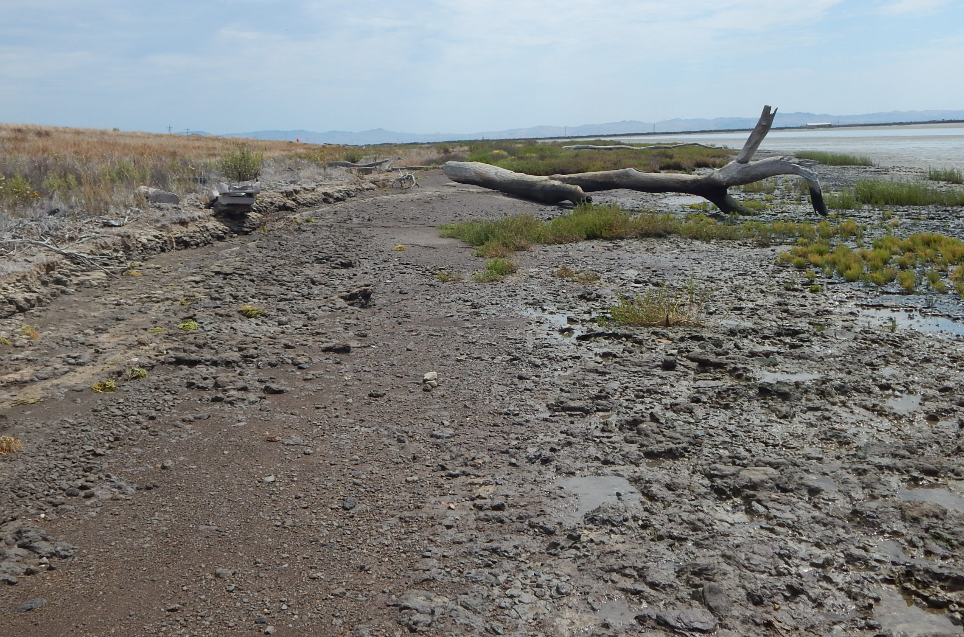
Pre-construction North Levee shore erosion severity
July 2021
> 5 yr erosion
Wind-wave reflection, concussive wave breaking
Continued erosional exposure of compacted levee foundation substrate; shallow root restriction

Slide 9
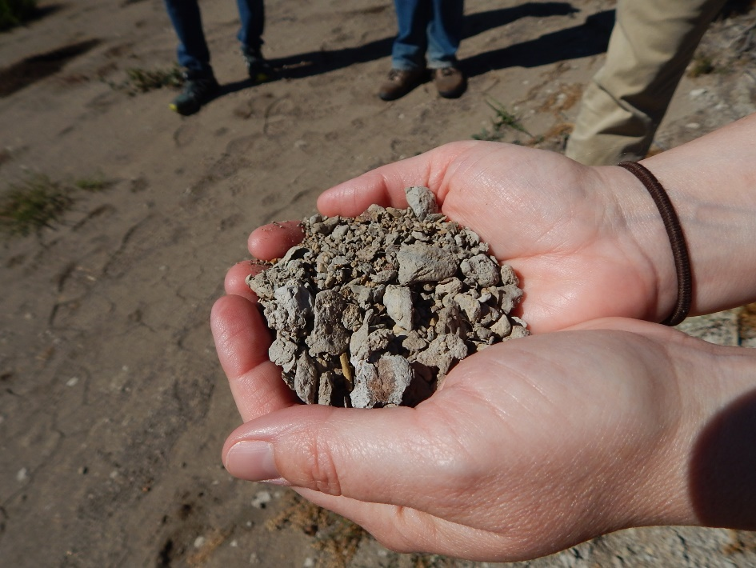
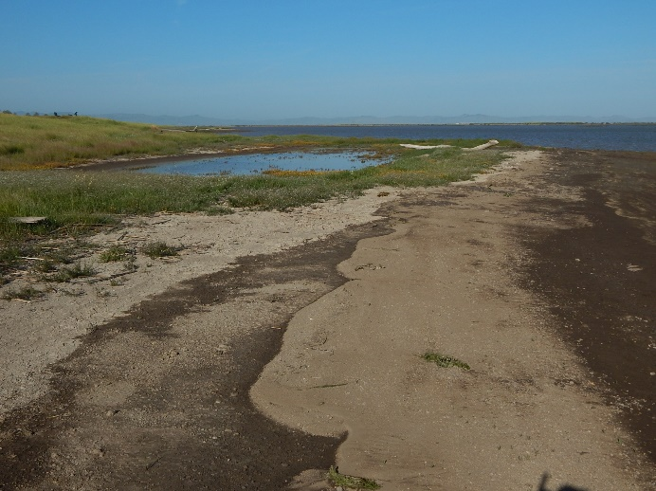
Basis of local nature-based living shoreline design:
Sears Point 2016-2017: Mud clast erosion, deposition of unconsolidated beach ridges
      Annual fair-weather deposition of mud clasts swash bars
      Granular mud particles eroded from levee behave like gravel and sand
      Some vegetatively stabilize as salt marsh ridges; others disintegrate
Dry bay mud clasts
Sand to gravel size
wave-eroded levee bench
wave-eroded levee bench
Wave-deposited mud granule swash bar
(beach)

Slide 10
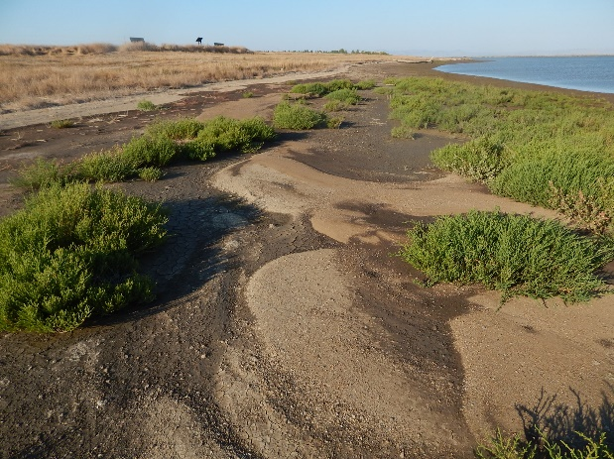
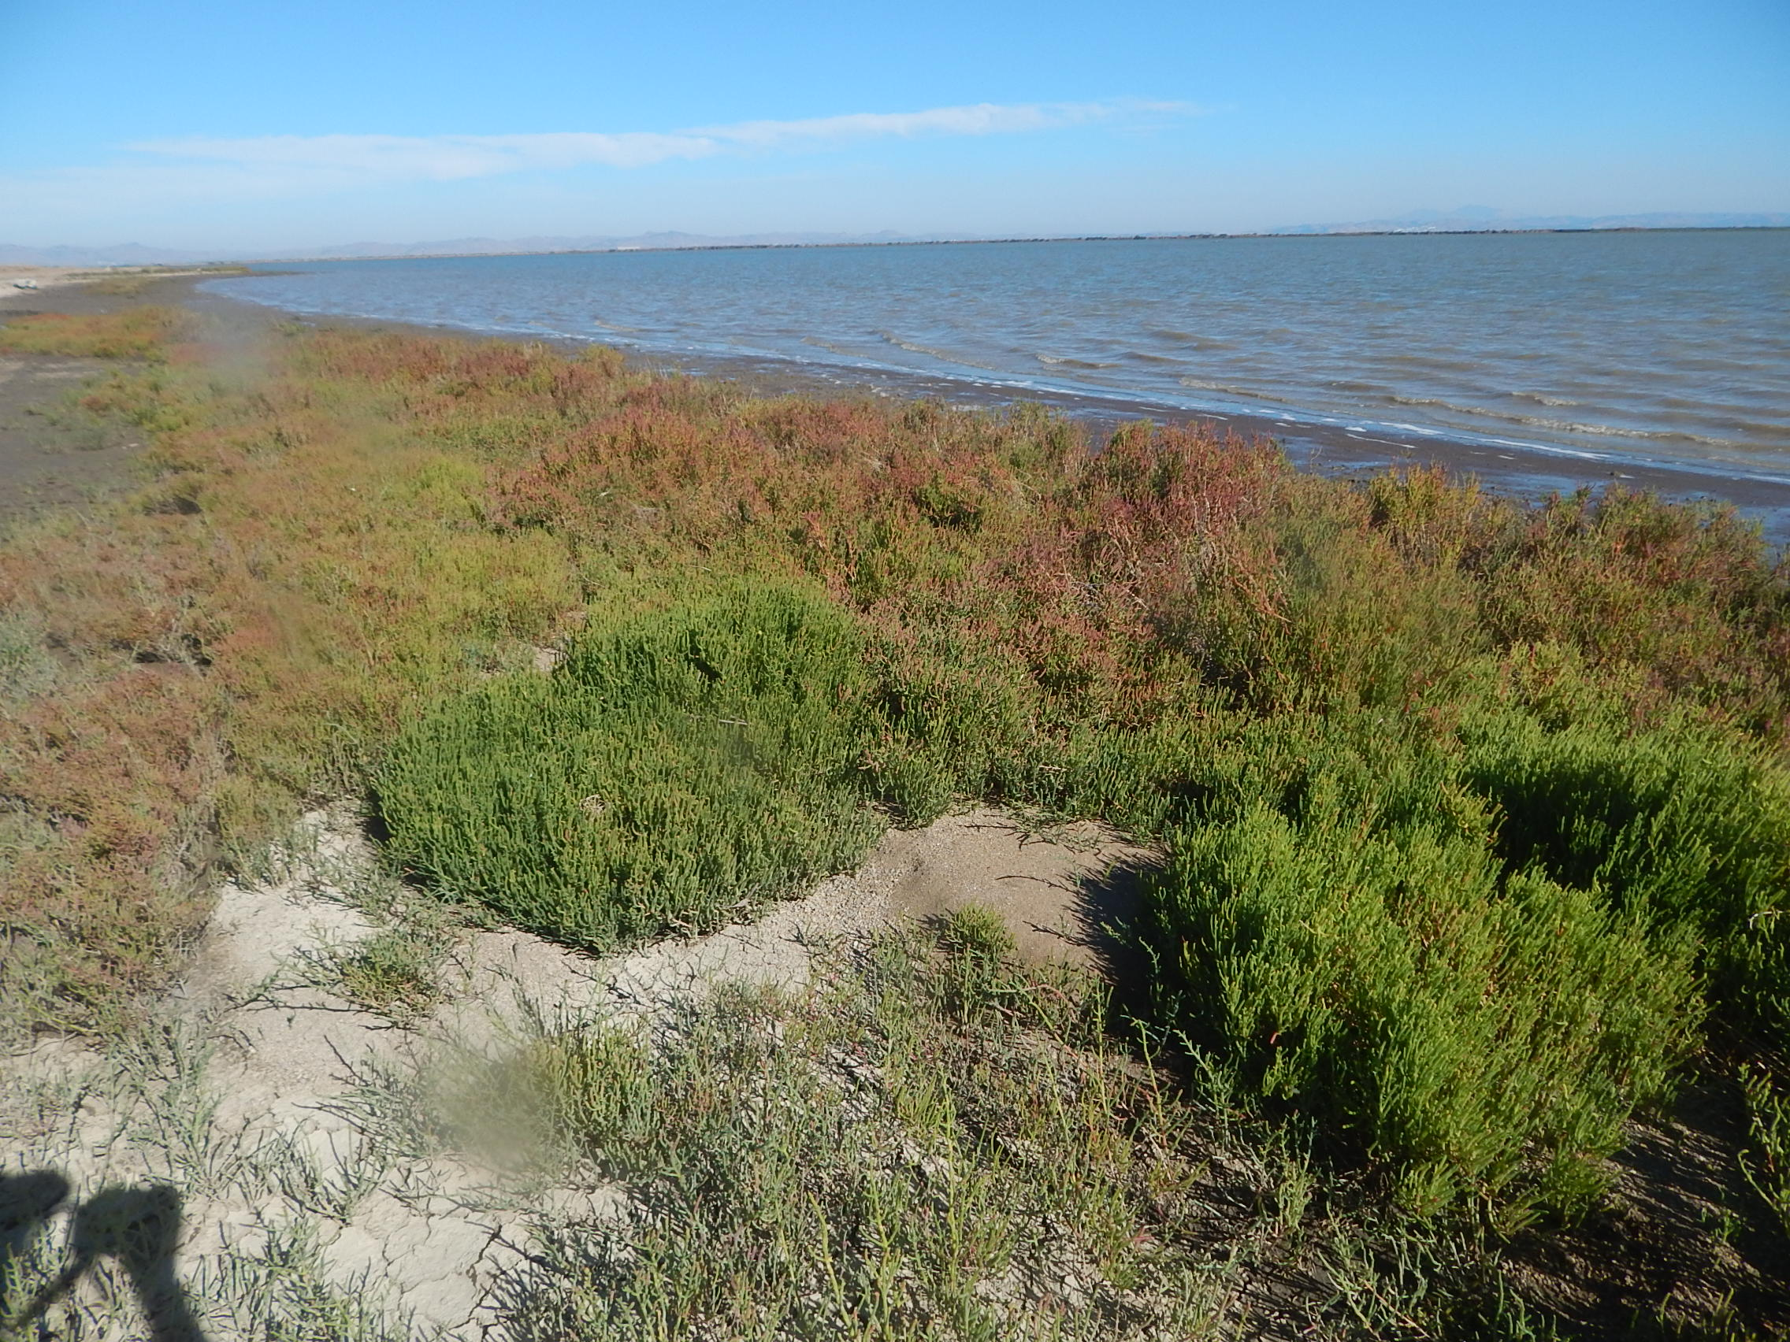
Sears Point 2016-2017:
Mud clast erosion and deposition of unconsolidated beach ridges
Local nature-based design reference
October 2017
September 2018

Slide 11
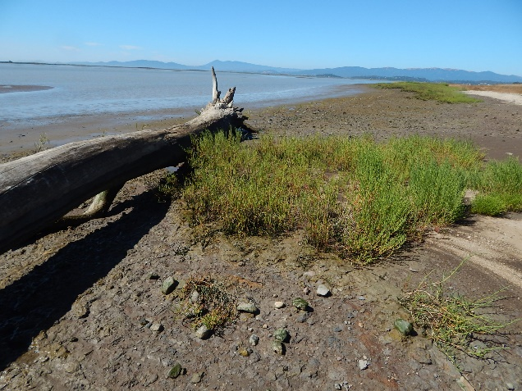
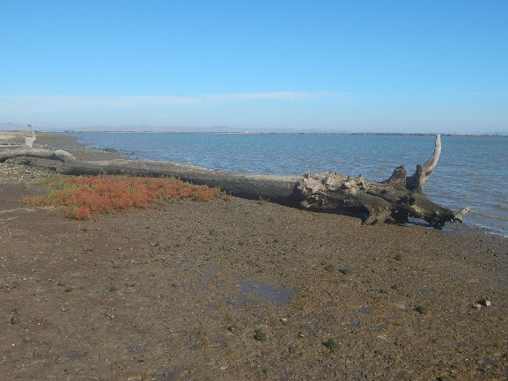
Basis of local nature-based living shoreline design:
Driftwood, mud clast deposition, and vegetation interactions
Local wave-sheltered zones, mud clast “sediment shadow” pocket deposits
Facilitation of salt marsh in otherwise eroded mud shorelines
2019
Wave shadow zone behind natural driftwood
Small salt marsh patch only in driftwood-sheltered wave shadow; erosion prevalent
Reduced wave erosion
Greater salt marsh vegetation persistence

Slide 12
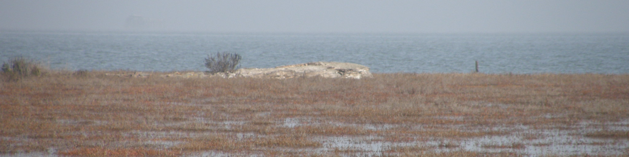
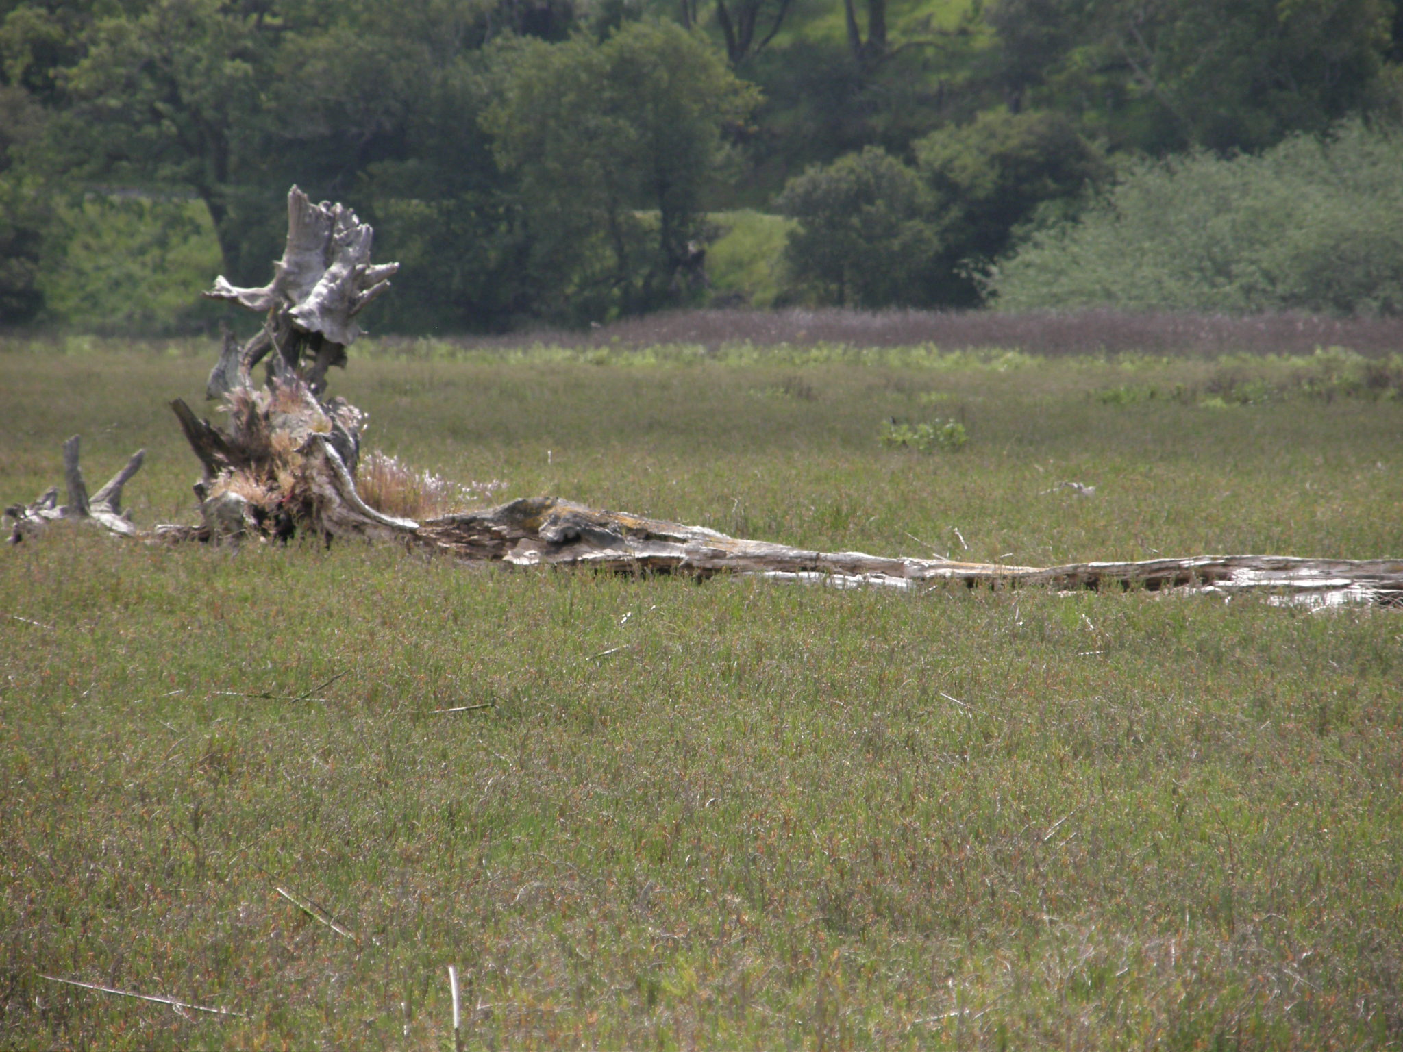
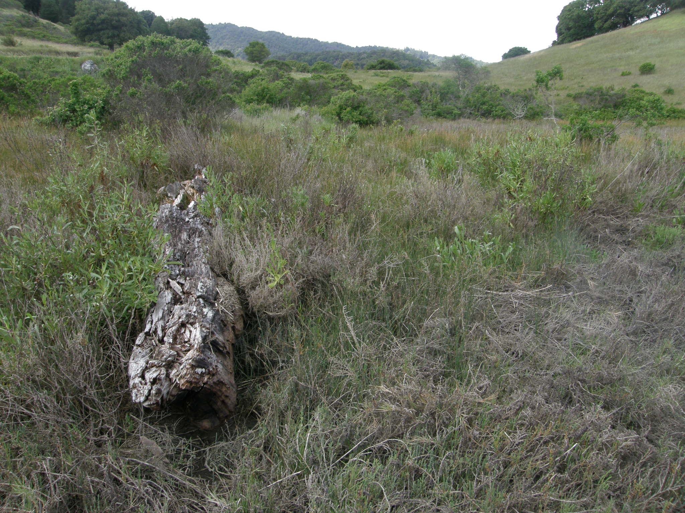
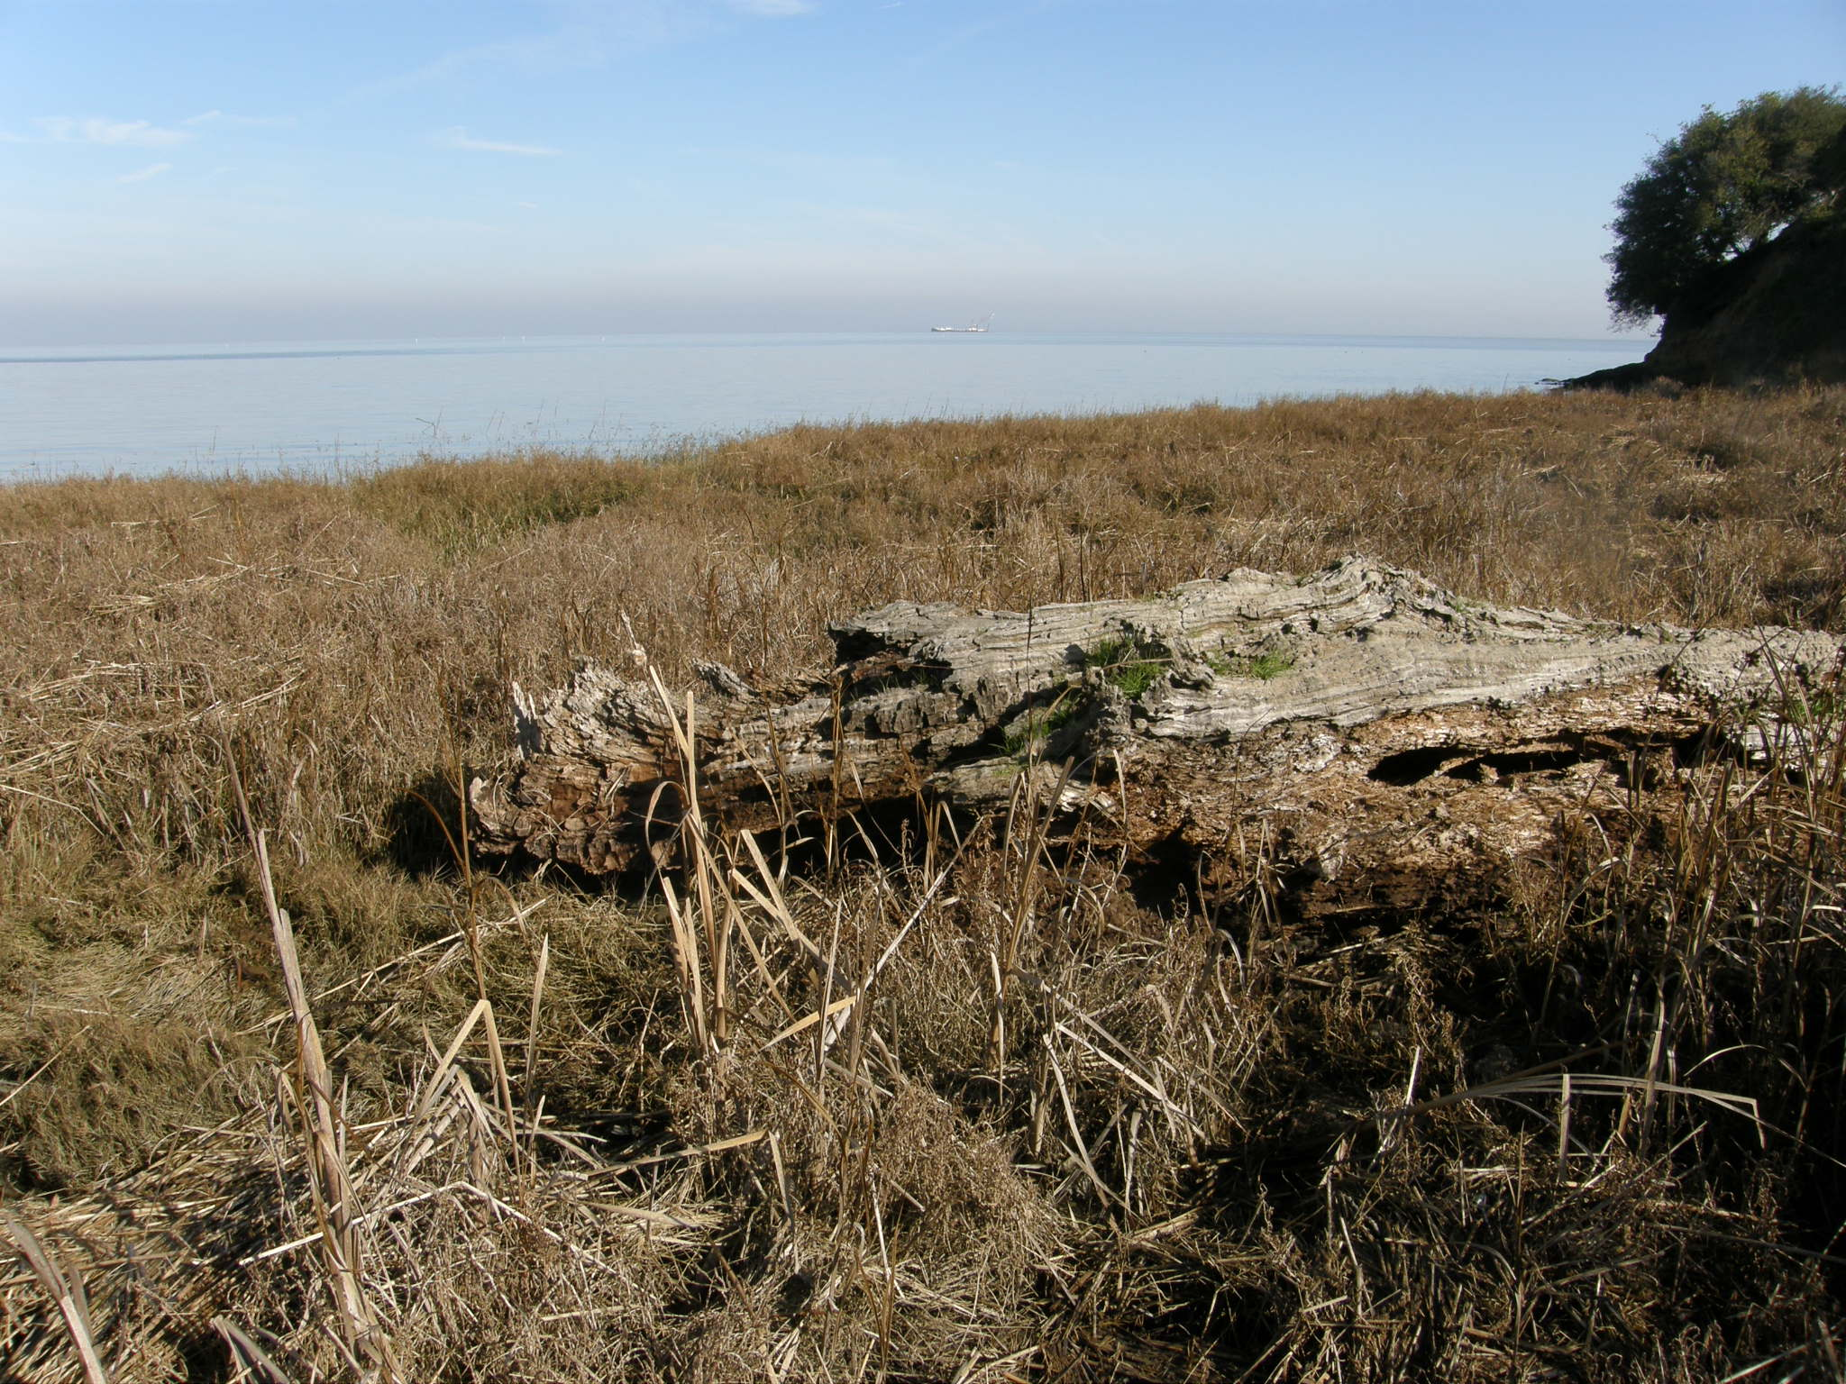
Basis of local nature-based living shoreline design:
Driftwood deposits in SFE tidal marshes
China Camp Marsh, Western San Pablo Bay – NERR

Slide 13
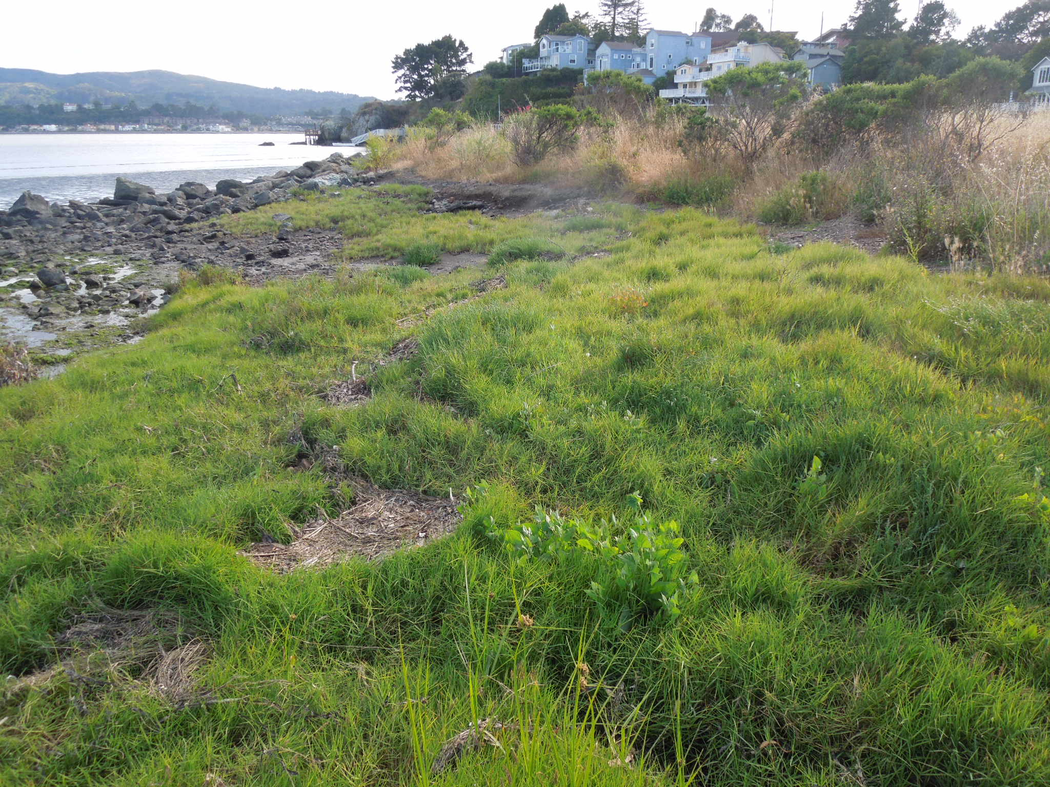
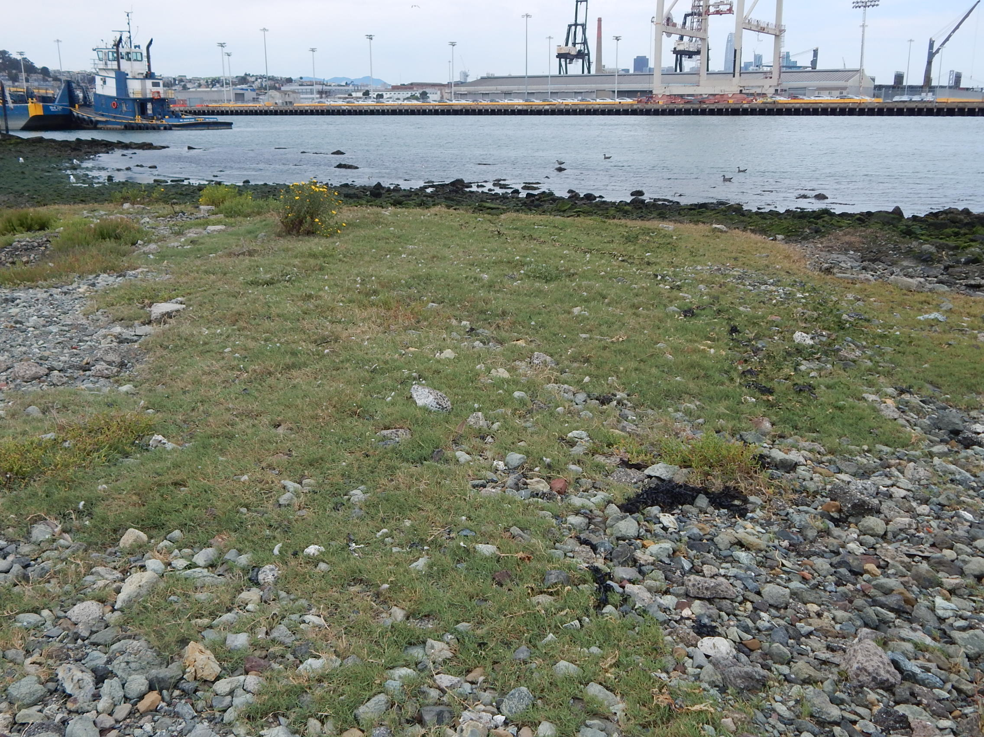
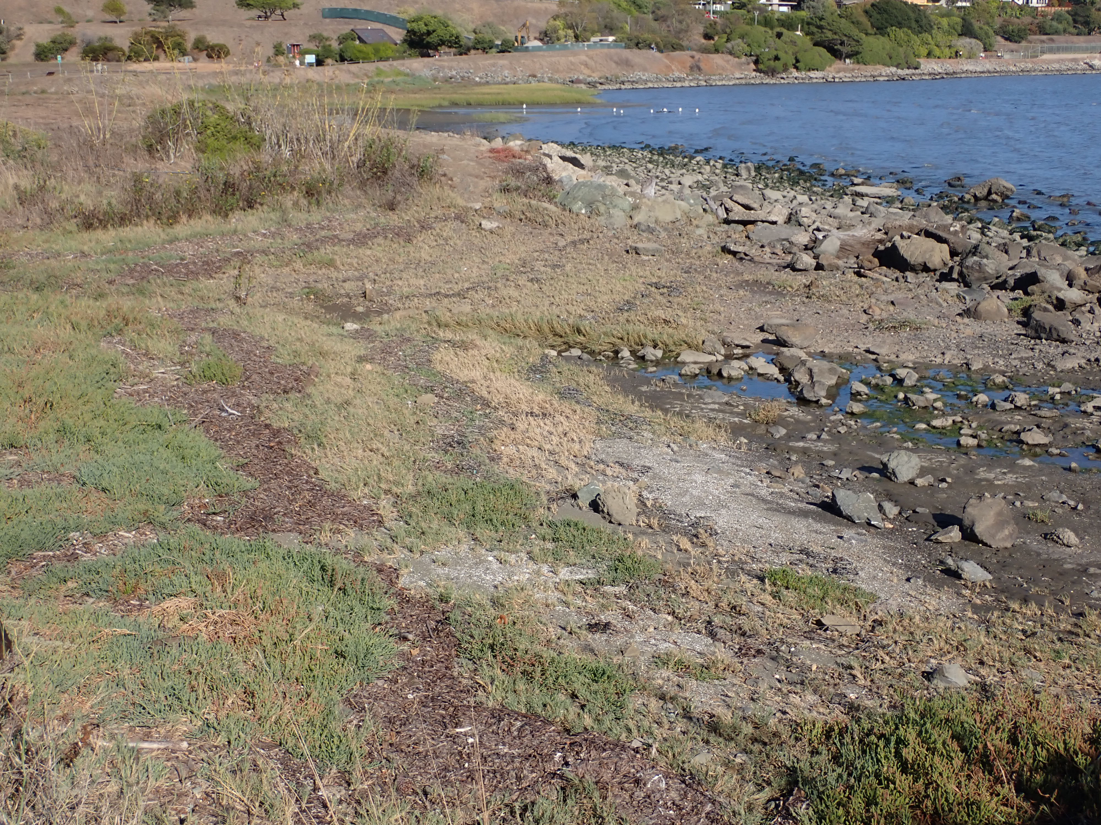
Basis of local nature-based living shoreline design:
Gravel and Cobble Salt Marsh
Intermediate Wetland/Rocky Shore/Beach Habitat
With High Erosion Resistance
, Tiburon, Marin County
Widespread but uncommon in SF Bay (Marin, Richmond shores)
Gravel lag over soft sediment, or interstitial mud
Pier 94, Port of SF
Inhibits wave undercutting of shore vegetation
Potential coarse sediment accretion

Slide 14
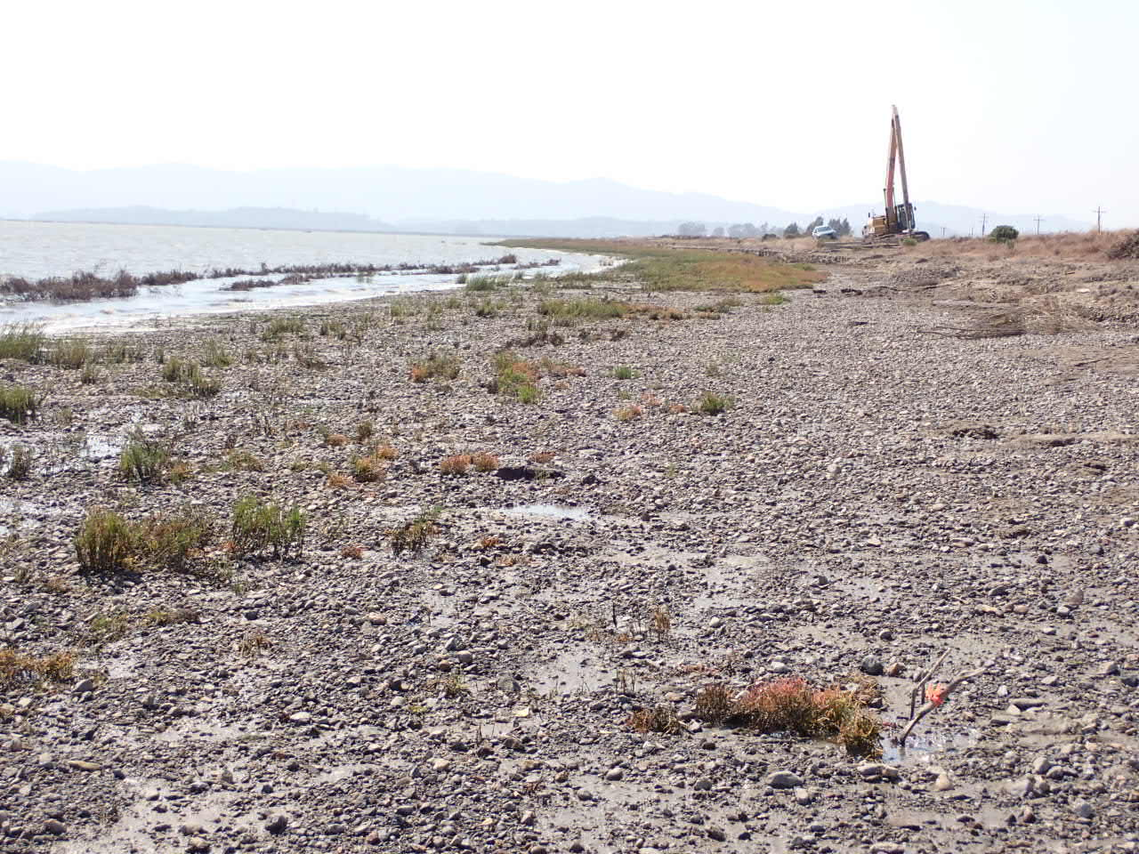
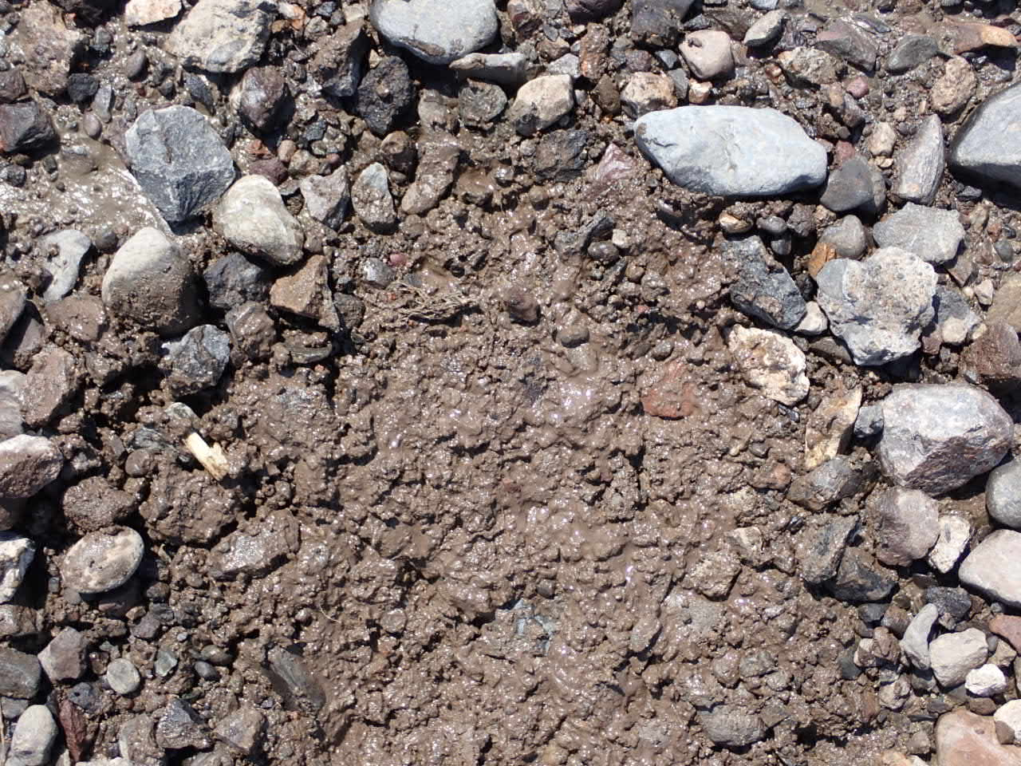
Thin layer of gravel erosion armor over eroded levee bench
Surface erosion resistance “backstop” over bay mud
Placed by long-reach excavator working from levee; grainflow deposition preserves salt marsh pioneer vegetation, facilitates seedling colonization in wave-impacted shore
Artificial gravel lag veneer

Slide 15
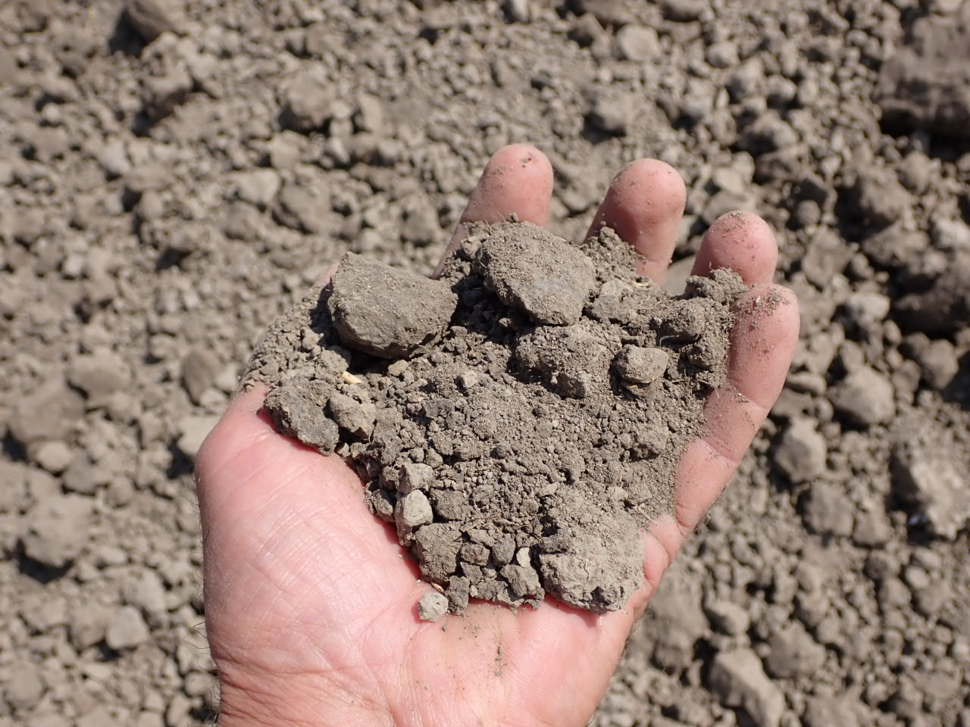
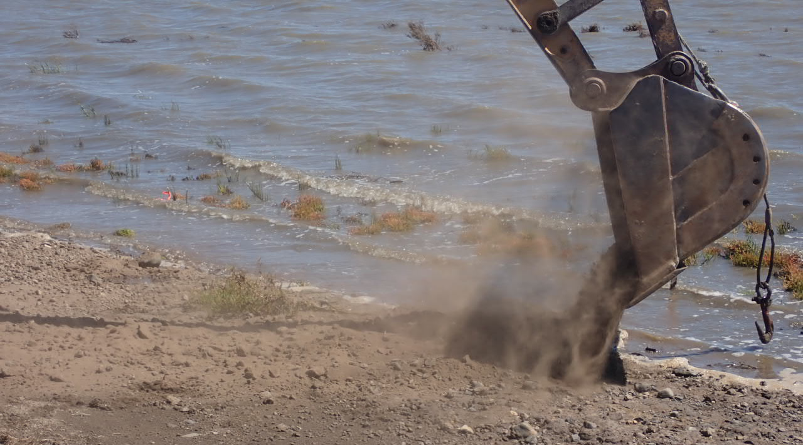
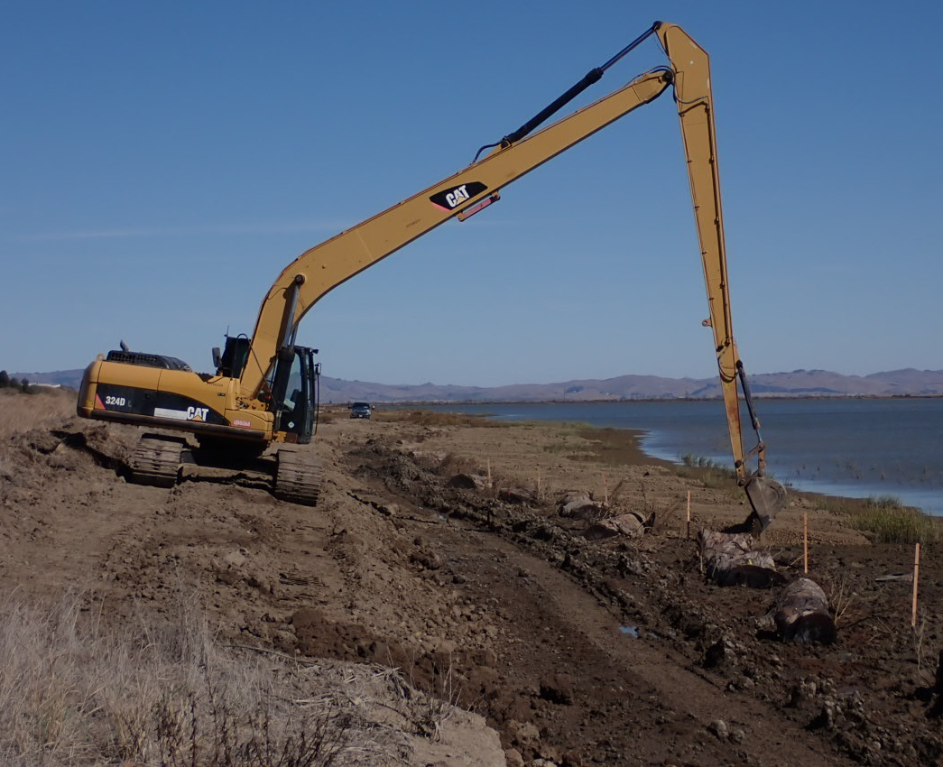
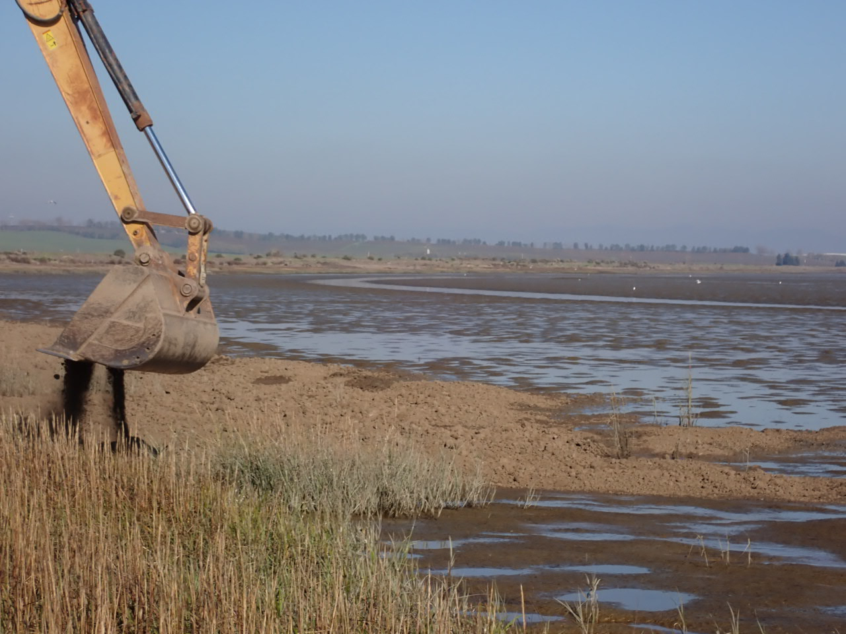
Dry granular bay mud clast mechanical placement
Thin layer placed over standing pickleweed, cordgrass; minimal lodging of shoots
Long-reach excavator bucket shaken; slow, low height release, grainflow precipitation
Foreman:
Kalloch Fox,
Dixon Marine Services

Slide 16
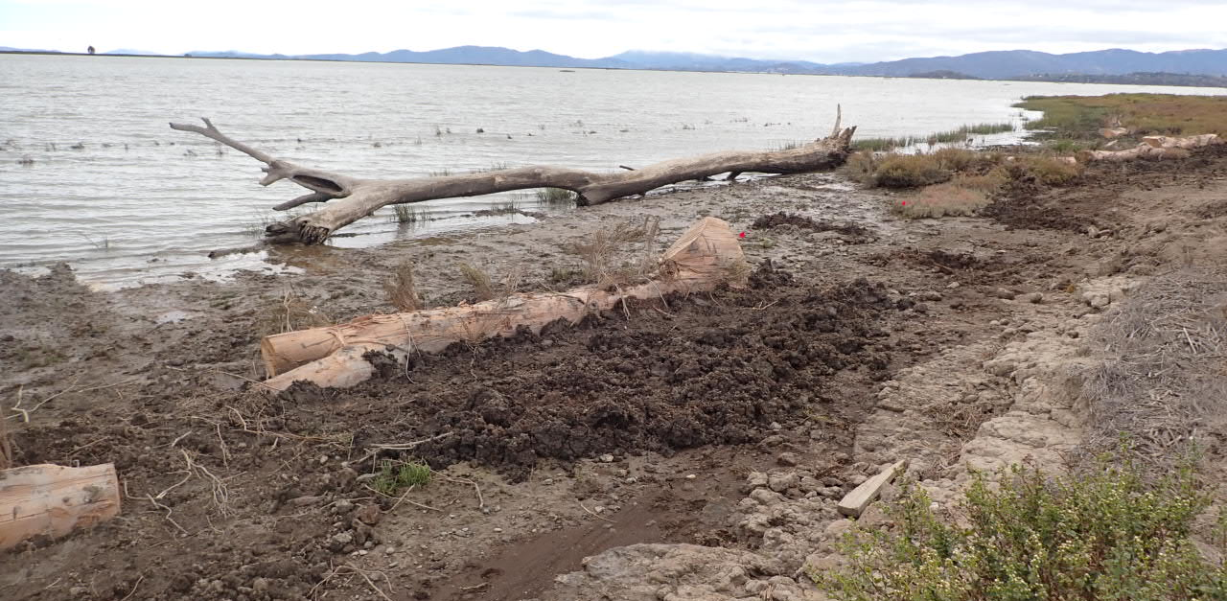
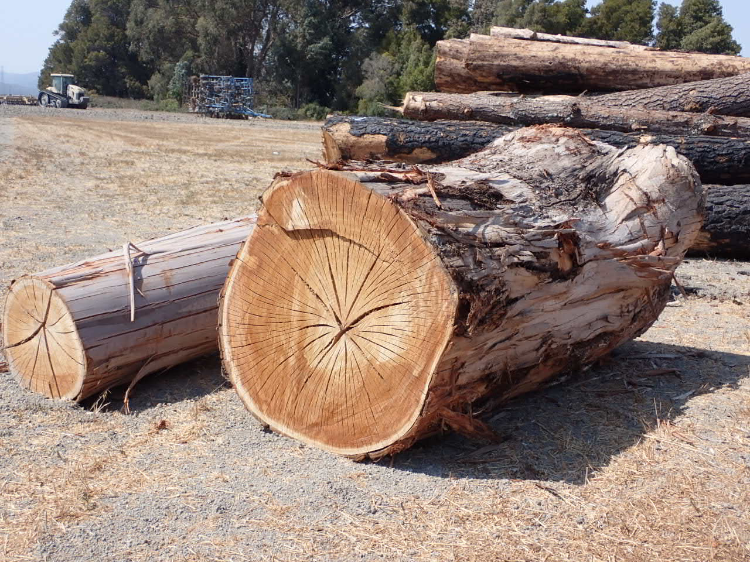
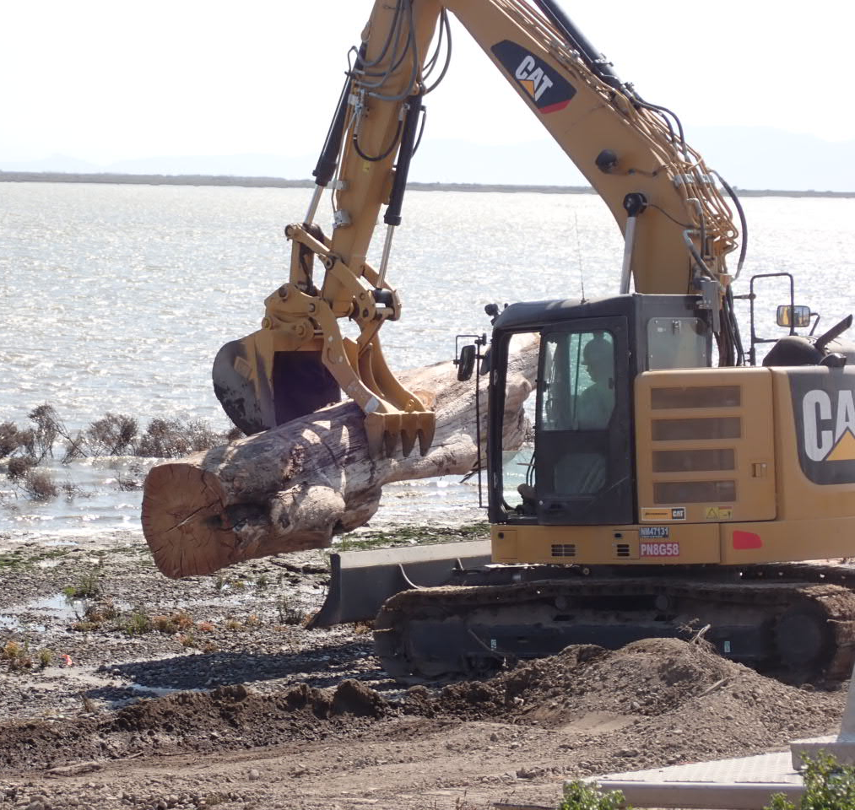
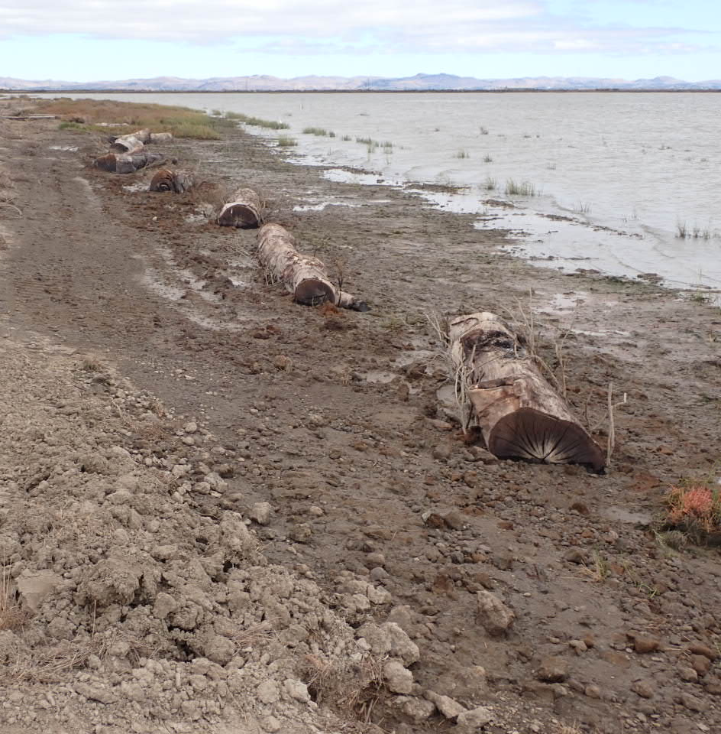
Artificial Driftwood:
Large Woody Debris Placement
Seasoned dry high-density wood: salvaged eucalyptus logs, 1-2 ft diameter
Embedded in bay mud, waterlogged; anchored
Oriented toward prevailing wind-wave approach
Wave-break and sediment shadow deposition functions, seedling shelter zone

Slide 17
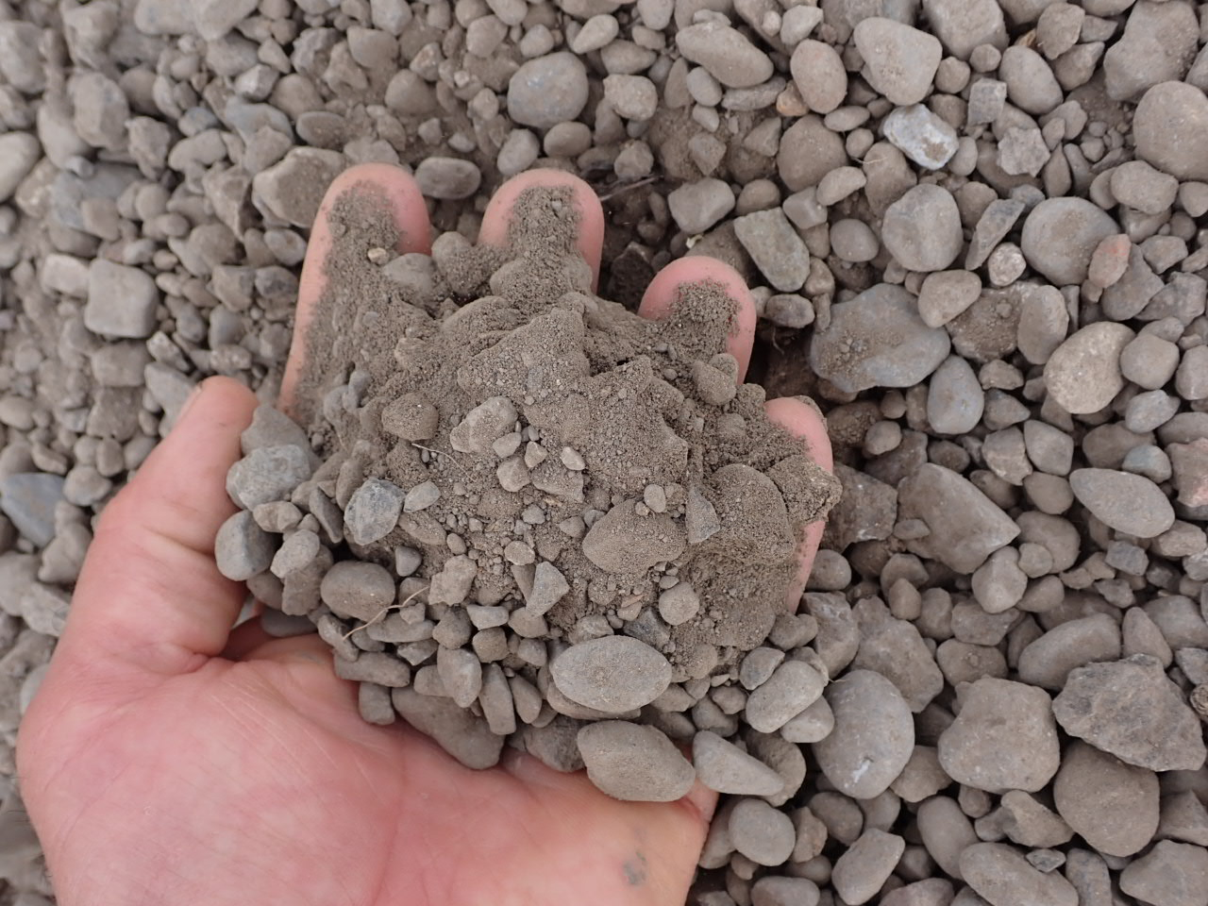
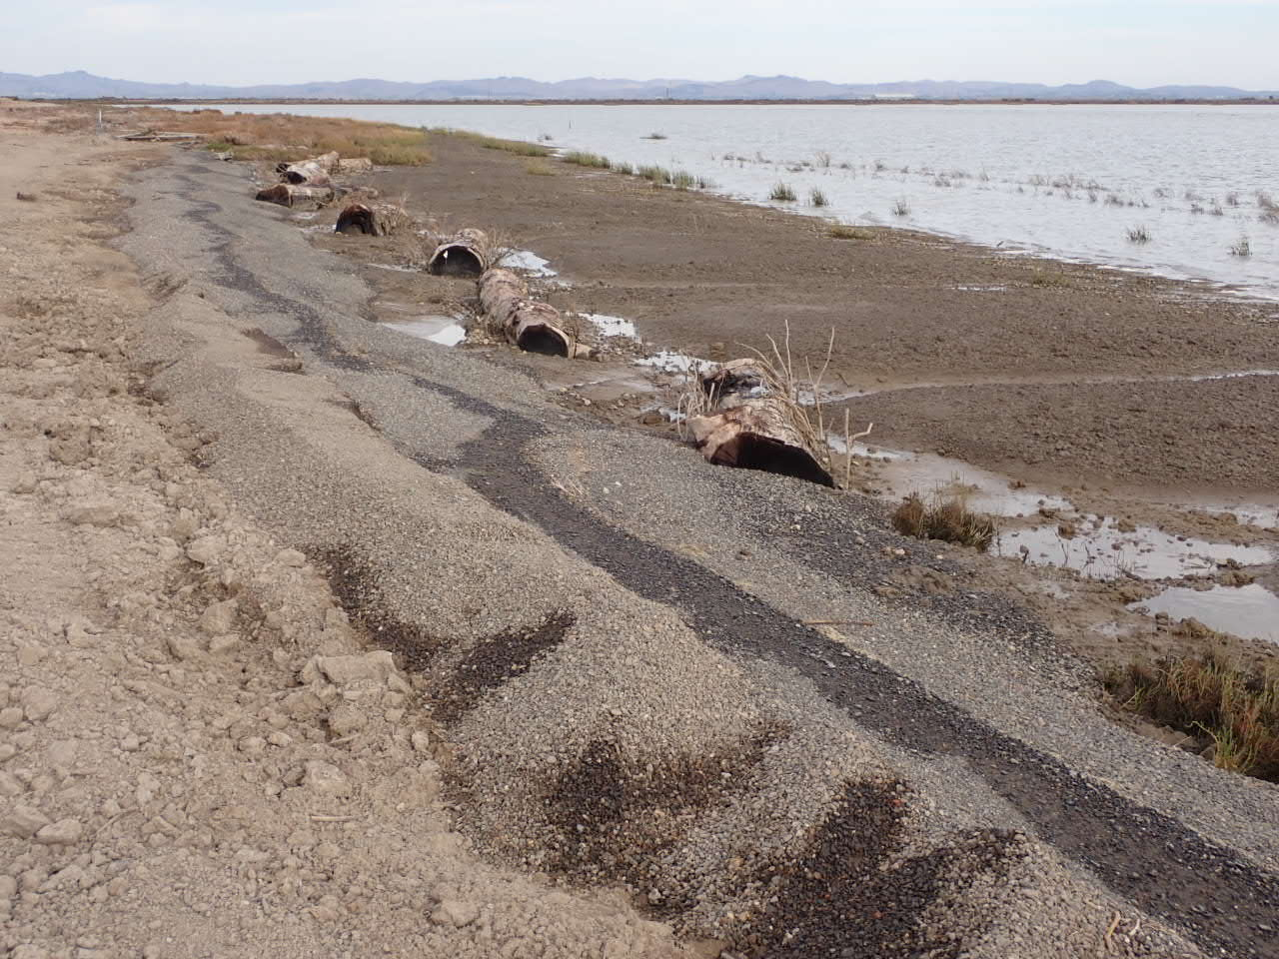
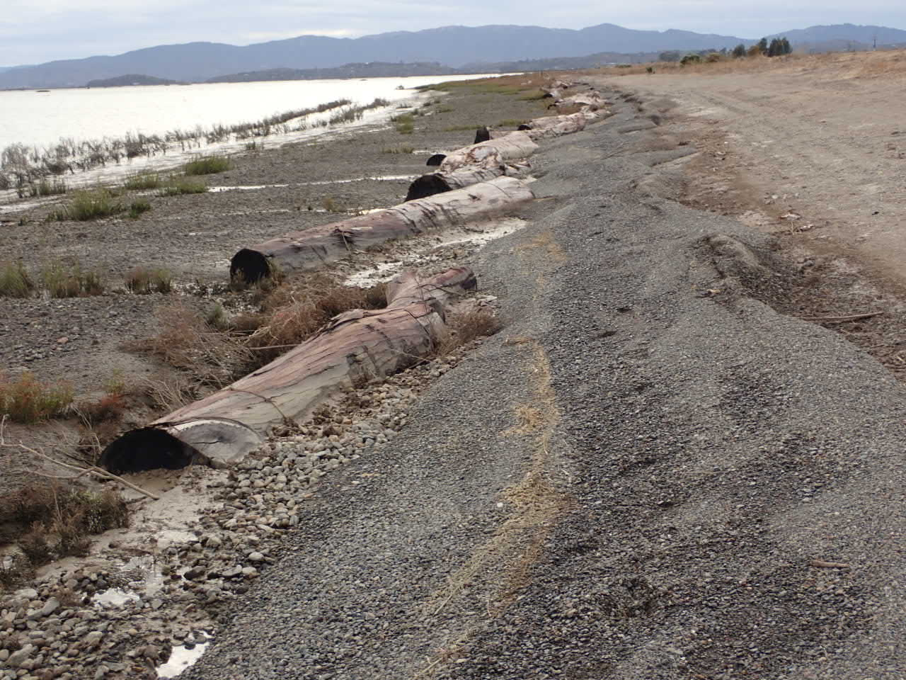
Sacrificial mixed sand-gravel berm in high tide zone
Transient beach in graded scarp, placed over ramp profile
Successional coarse beach to vegetated high salt marsh
Provides storm wave erosion buffer, inhibits scarp initiation
Not permanent artificial beach habitat
Toe interacts with logs
Oct 2021

Slide 18
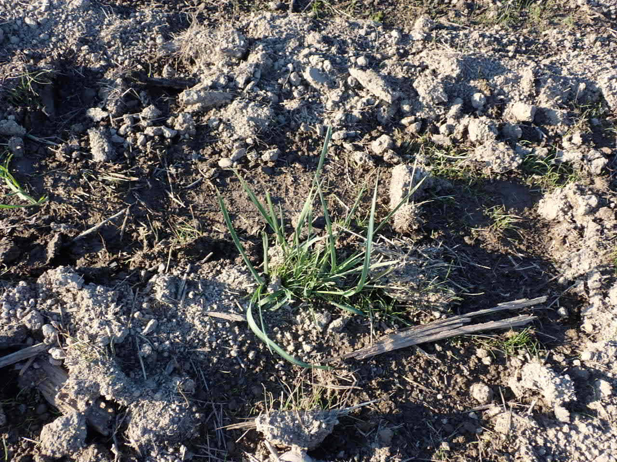
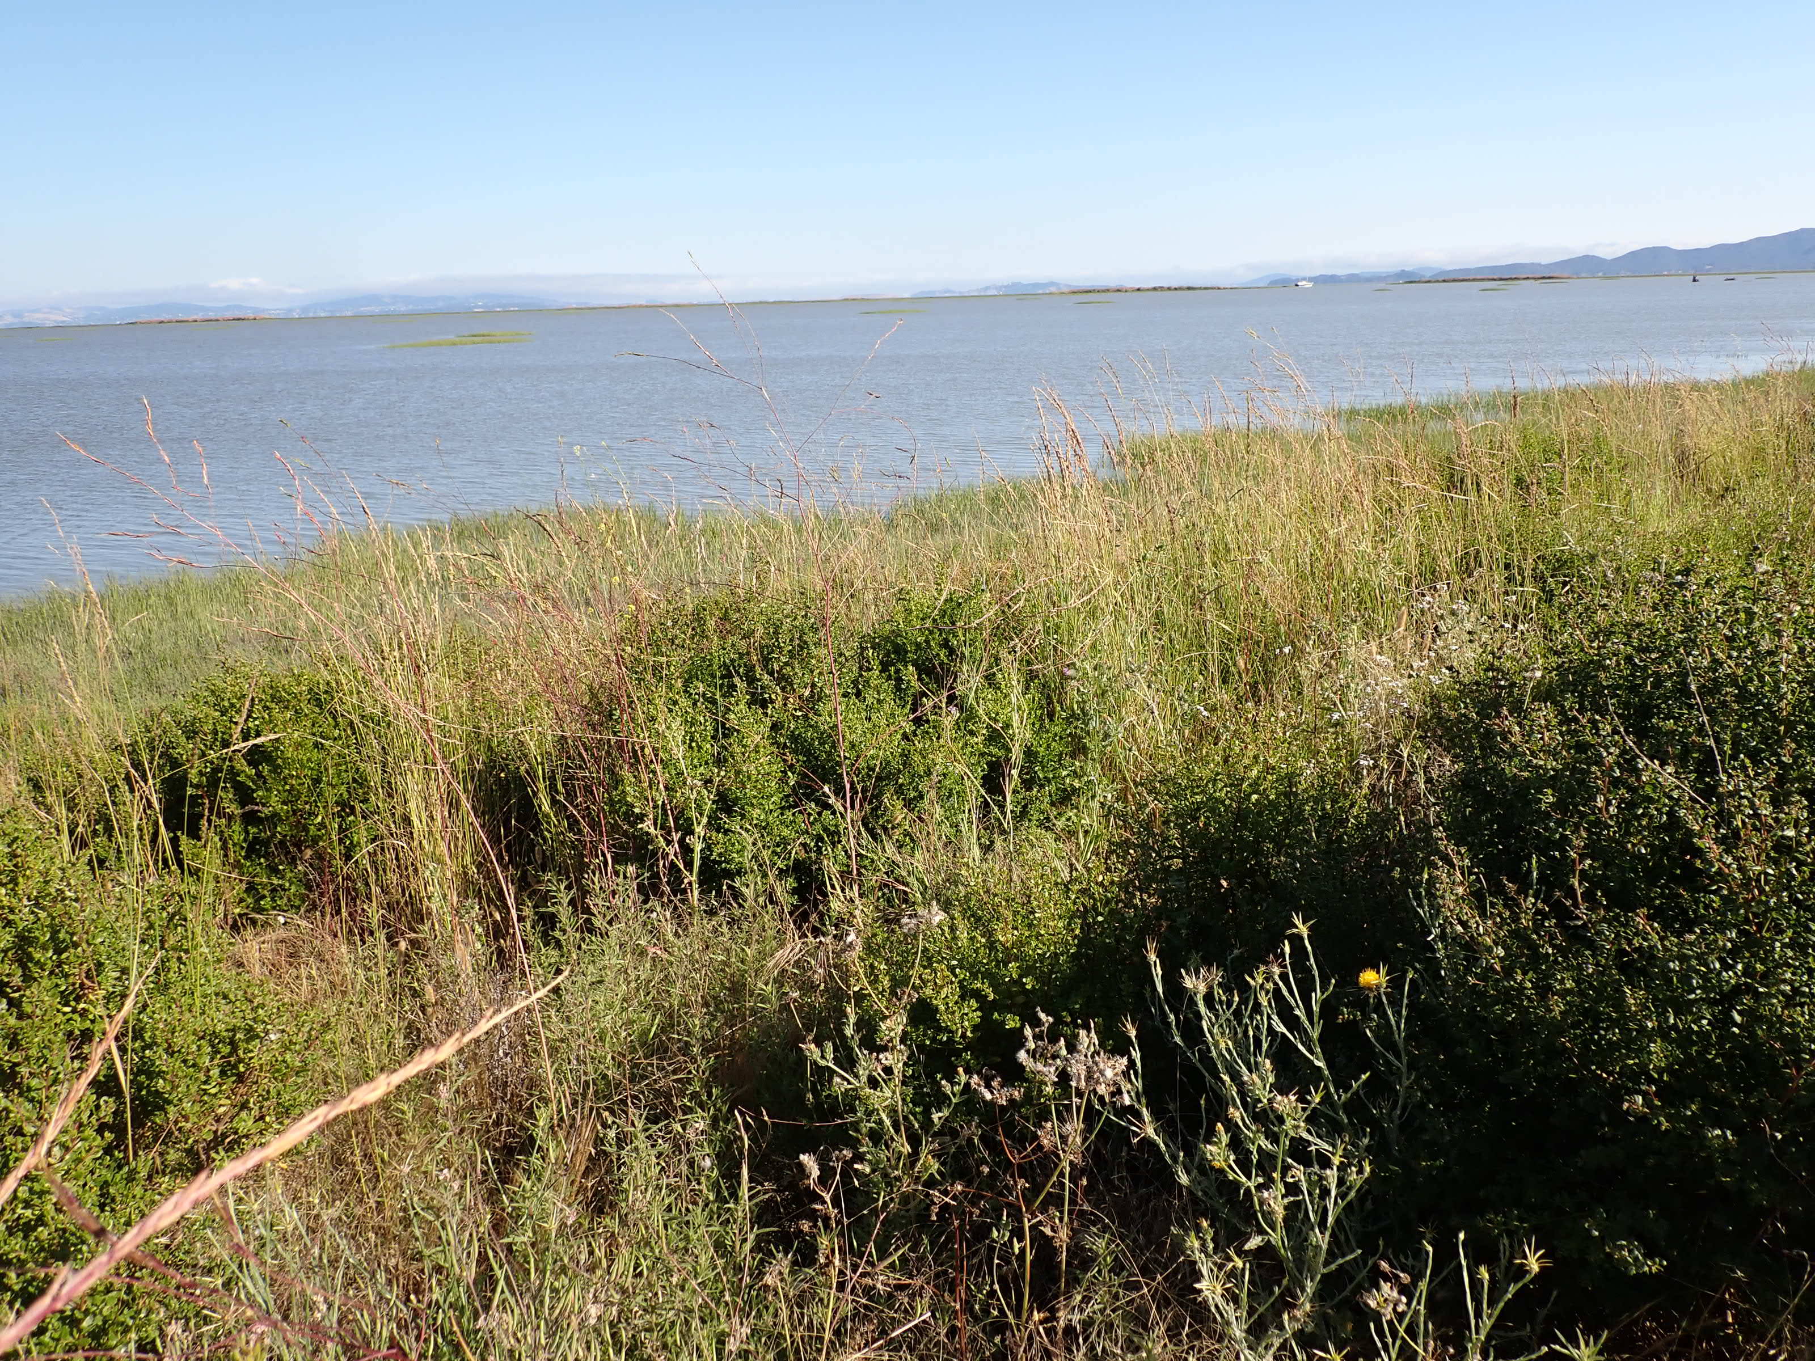
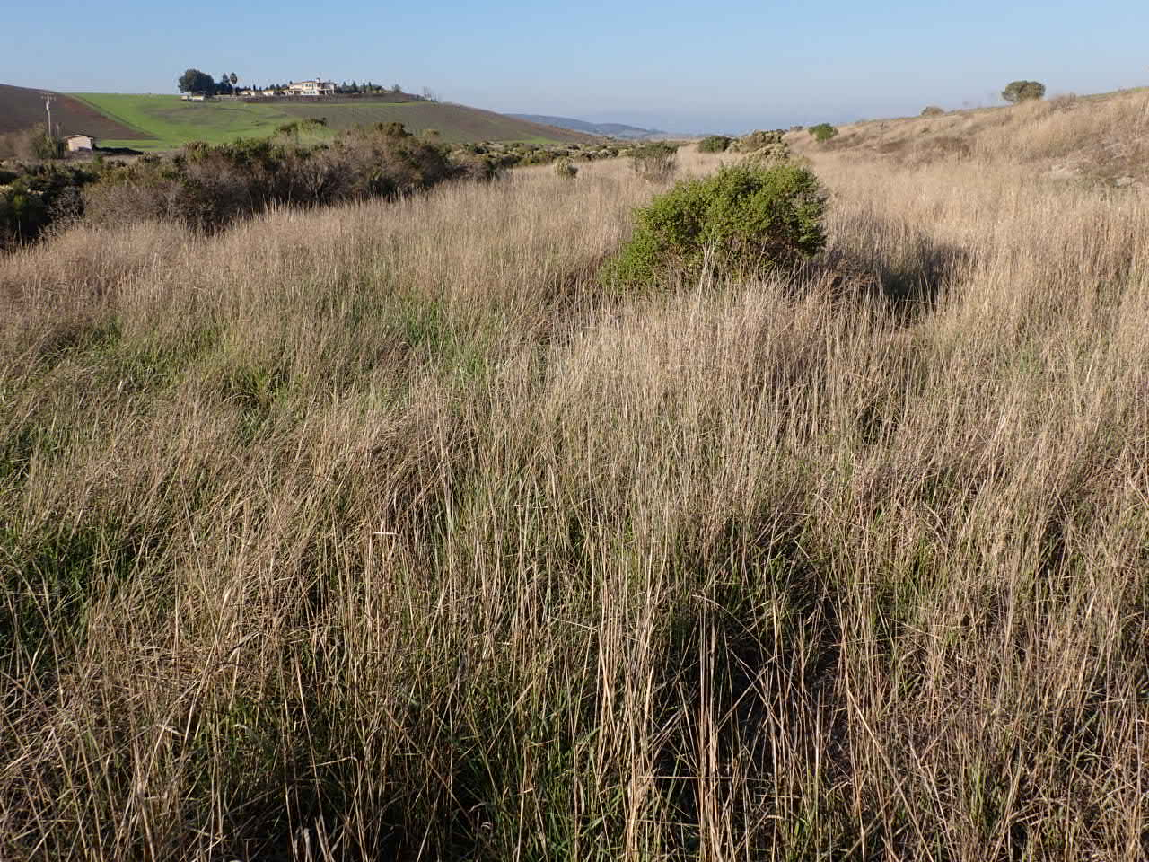

Levee Grading Disturbance Mitigation Technique:
Grading with dormant vegetative propagules incorporated in topsoil layer
Rhizomatous native grassland established incidental to 2015 levee grading of dry soil – Leymus triticoides
Translocation of dry sod fragments; graded, compacted
Wet season vegetative regeneration from burial
July 2023
December 2021
Borrow source
Translocation

Slide 19

Living Shoreline construction
Fall 2021
Post-construction oblique ground view, east end, maximum wind-wave fetch
CROSS-SHORE INTEGRATION
Graded vertical erosion scarp to ramp profile
Gravel lag veneer over bay mud surface
Sand-gravel sacrificial berm
Shore-parallel embedded logs
Granular bay mud over and among vegetation patches

Slide 20

One growing season, spring-Summer 2022
Tidal marsh vegetation cover increase:
4.73 ac to 10.66 ac
225% increase
Net conversion of eroded terrestrial transition zone to tidal marsh
Landward migration of MHW line, narrowed ecotone and wetland migration space due to pre-project erosion 6 yr

Slide 21

Second growing season, September 2023, after severe winter storm season

Slide 22
Living Shoreline construction
Fall 2021
One growing season, spring-summer 2022
Tidal marsh vegetation cover increase:
4.73 ac to 10.66 ac
225% increase
Net conversion of eroded terrestrial transition zone to tidal marsh
Example reach shown: East end, North Levee shore; most wave erosion, longest fetch to W

Slide 23




Grateful Acknowledgements – Sears Point Project and Monitoring Team
Stuart Siegel, PhD, PWS, Siegel Environmental LLC
Dan Gillenwater, PWS, Gillenwater Consulting
Roger Leventhal, PE, FarWest Restoration Engineering
Rebecca Morris, Estuary & Ocean Science Center (San Francisco State University)
Kalloch Fox, Dixon Marine Services, Inc.
Julian Meisler, Sonoma Land Trust
Meg Marriot, San Pablo Bay National Wildlife Refuge

