Slide 1
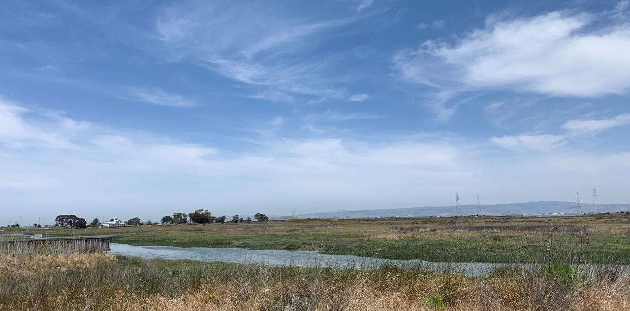
Advancing Nature-based Shoreline Solutions – Regional to Local Initiatives
Heidi Nutters, Senior Program Manager, SF Estuary Partnership
Notes:
Introduce speakers
Heidi – provide overview of presentation
-framing the issues on NBS
-regional significance
-PAHL overview

Slide 2
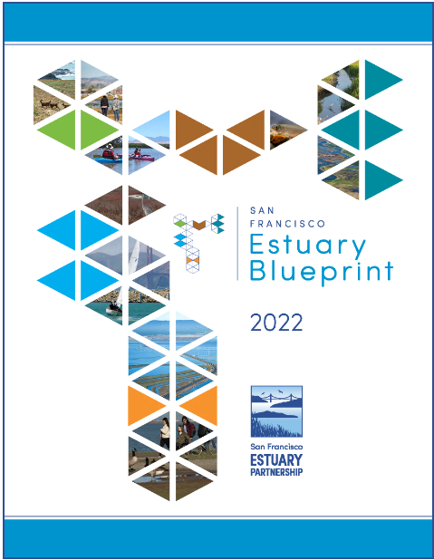
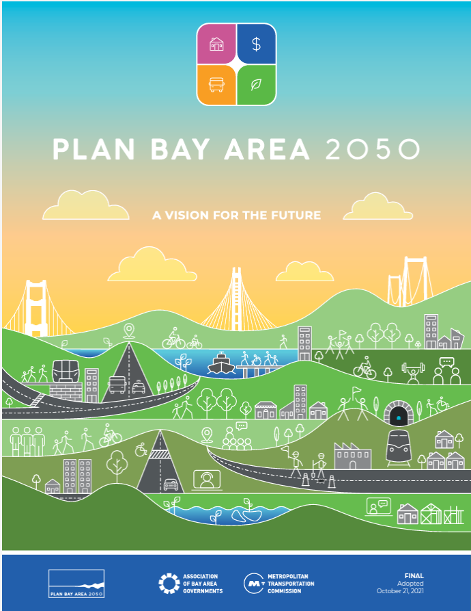
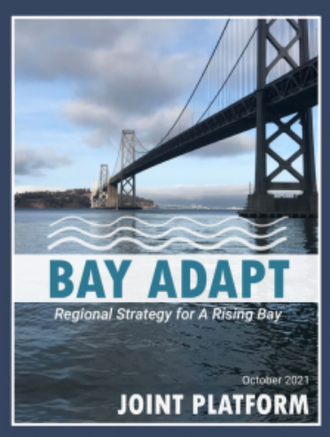
Why Nature-based Solutions?
Increasing urgency to advance projects using innovative approaches that support multiple benefits – people, nature, communities
Regional Guidance
  Plan Bay Area 2050, Bay Adapt Joint Platform, Estuary Blueprint
State and Federal Guidance
  Executive Orders

Slide 3
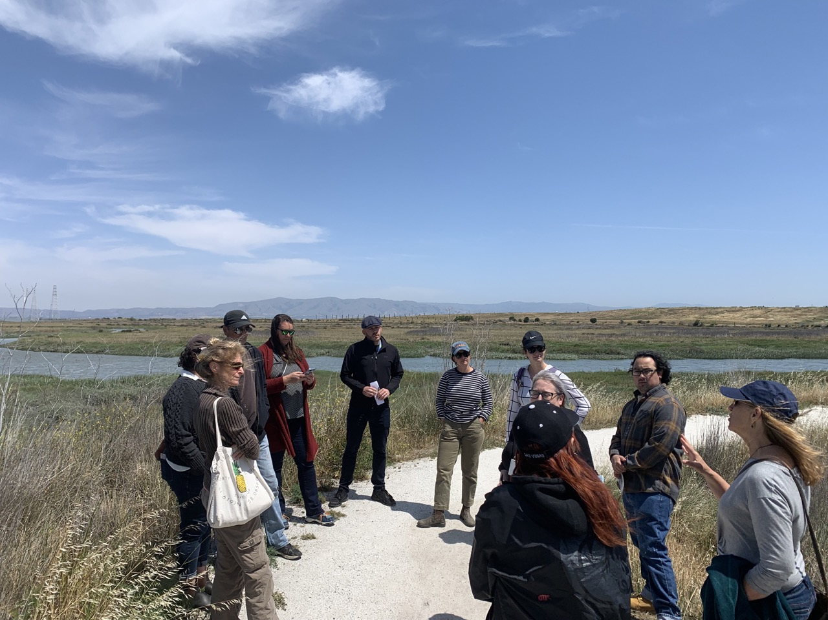
SFEP's Work on NBS
Regional Scale
Technology transfer & convenings
Address barriers to implementation – funding, regulatory, governance
Local Scale
Advance on the ground projects in partnership with local jurisdictions and communities

Slide 4
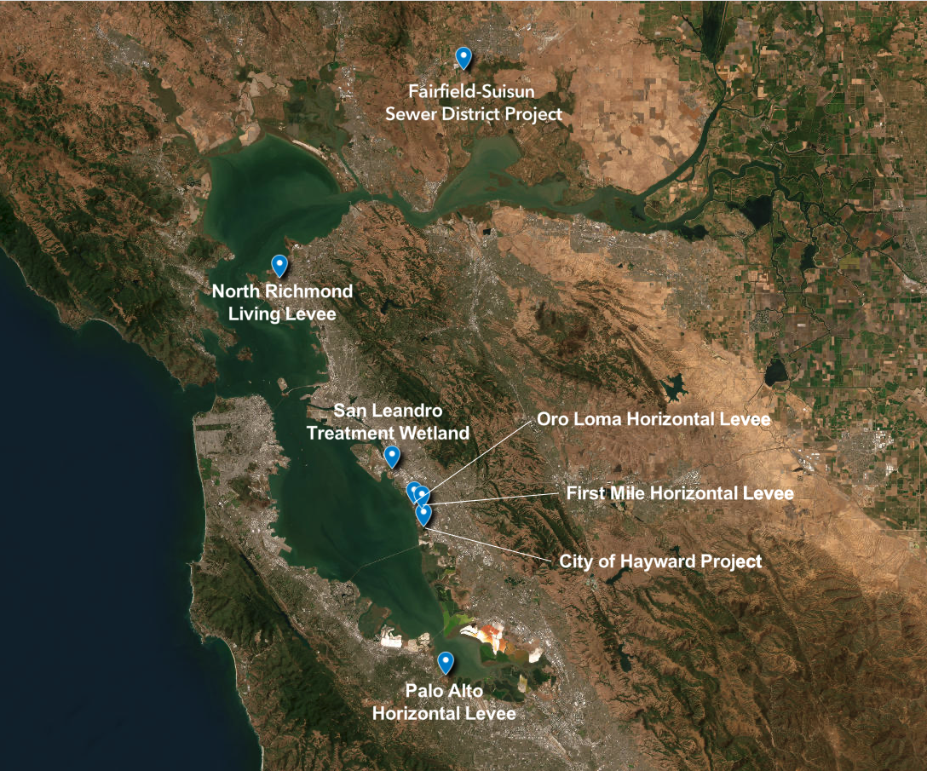
We partner with communities around the region

Slide 5
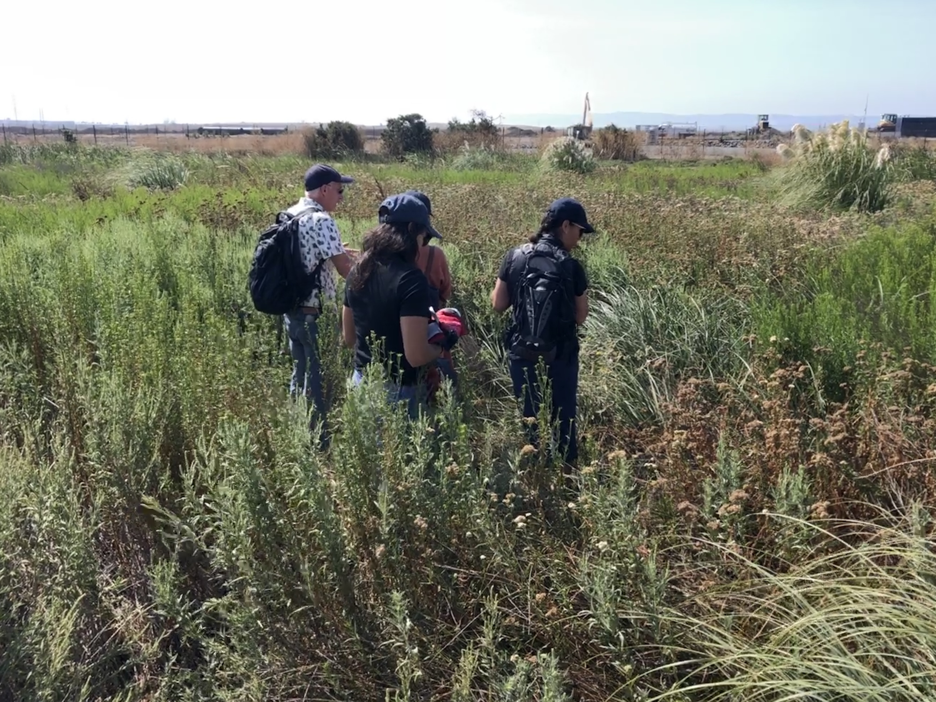
Oro Loma Horizontal Levee
Pilot project built in 2015 to study water quality improvement opportunities
Partnership between UC Berkeley, Valley Water, Oro Loma Sanitary District, SF Estuary Institute, Save The Bay, East Bay Dischargers Authority, SFEP
Findings show significant removal of nutrients and contaminants of emerging concern

Slide 6
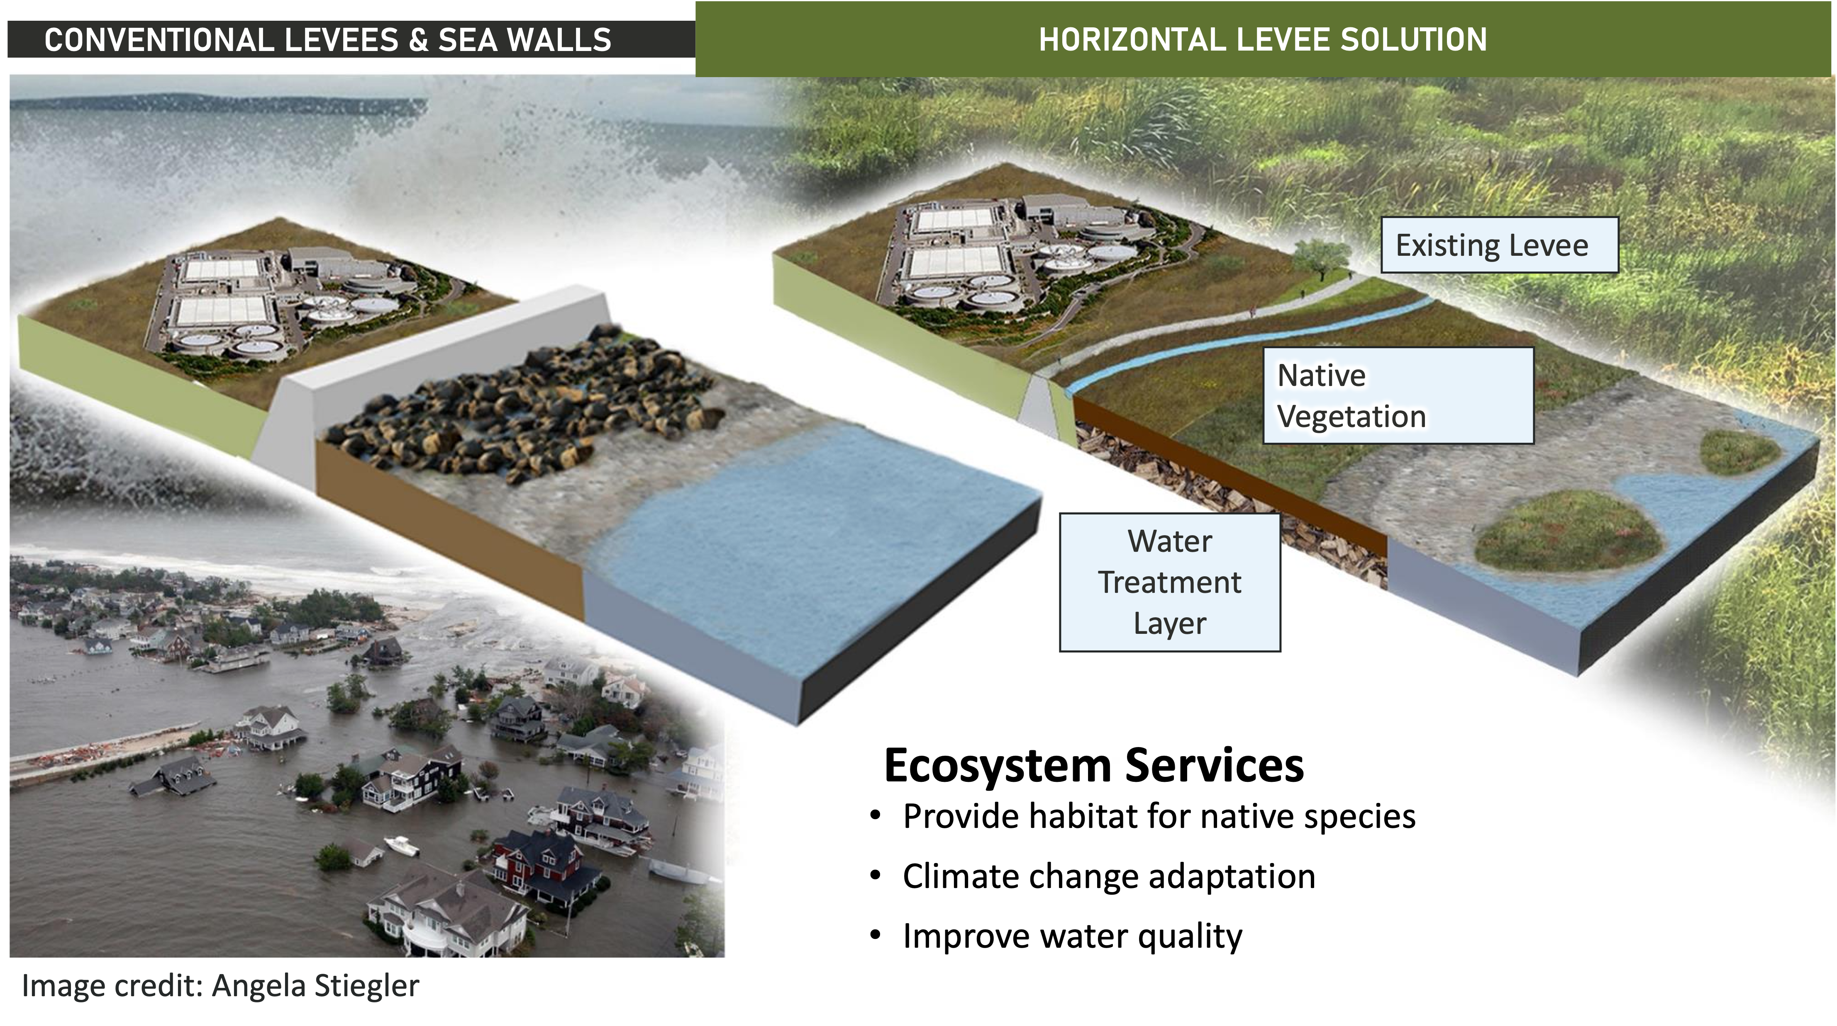
Conventional Levees and Horizontal Levee

Slide 7
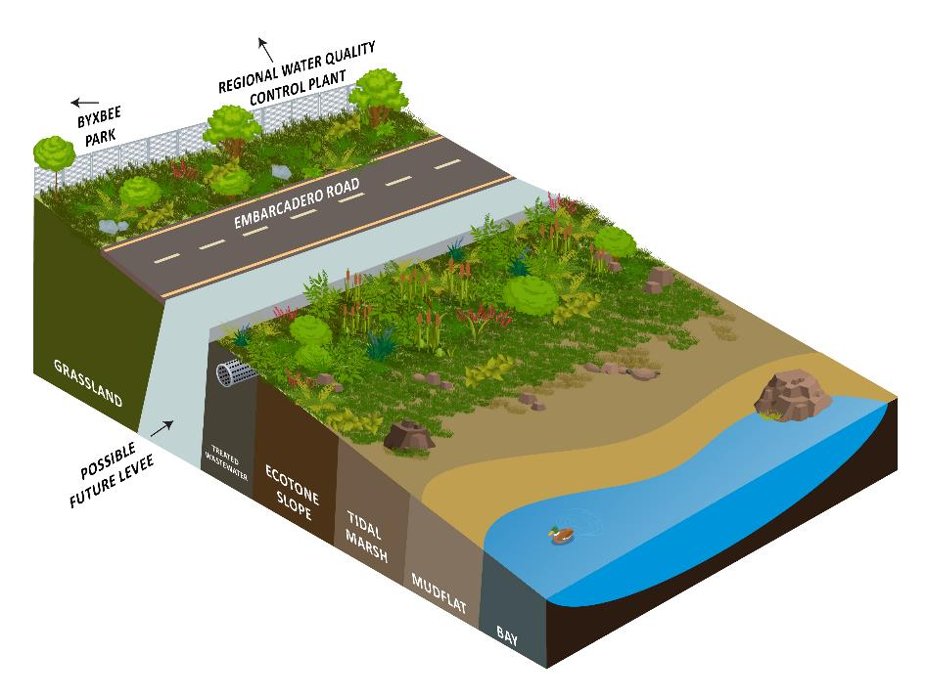
Palo Alto Horizontal Levee – Project Goals
Improve habitat along the perimeter of Harbor Marsh.
Adapt to sea level rise and coordinate with future larger levee improvement project (i.e., SAFER Bay/Shoreline Study).
Maintain public access to the existing trail system while providing opportunities for compatible low-impact recreation, increased social infrastructure, and educational opportunities on sea level rise.
Ensure perspectives of marginalized communities are incorporated into social infrastructure and educational components.
Provide polishing treatment to discharged treated wastewater.

Slide 8
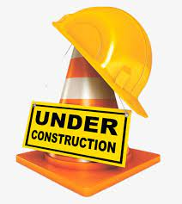
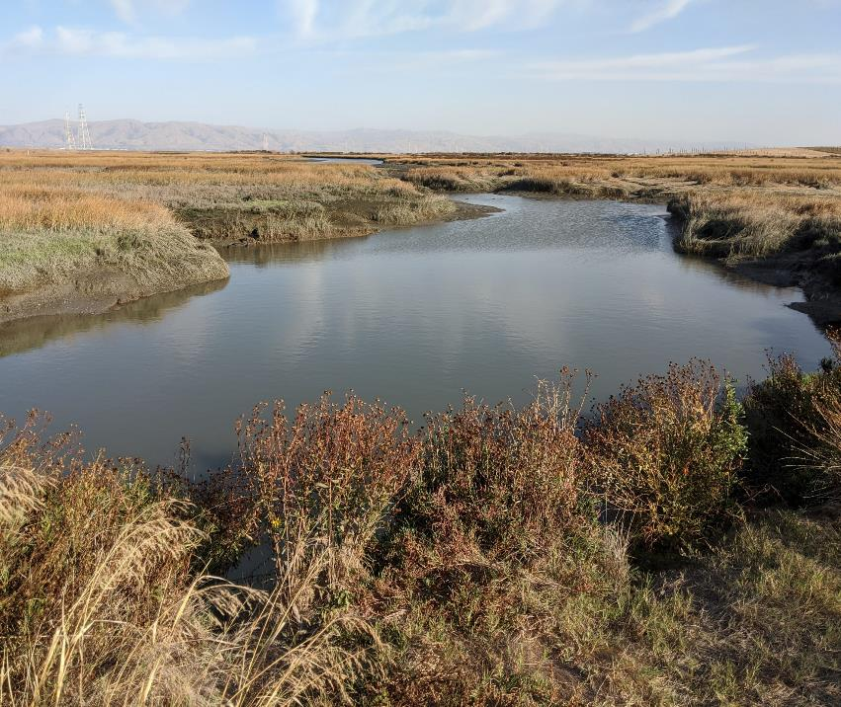
Project Highlights
Expected Construction start date – July 2024
First horizontal levee with treated wastewater conveyance directly to the SF Bay
Implements Estuary Blueprint Task 3-1, 4-1, 4-2 – focused on design and implementation of nature-based shoreline adaptation projects
Innovative design, permitting and construction strategies
Paves the way for future horizontal levee projects regionally
Funding from US EPA Region 9 WQIF and Climate Ready Estuaries, State Coastal Conservancy, City of Palo Alto
Notes:
Innovative design, permitting and construction
BRRIT coordination
NPDES coverage horizontal levees
CA Cutting the Green Tape (CGT) Restoration Permit
ABAG – City of Palo Alto partnership

Slide 9
Key Implementation Challenges
Pace and scale
Regulatory
Governance
Keeping communities at the center

Slide 10
Regional Capacity Building
The Transforming Shorelines Collaborative (TSC)
  Practitioners and experts on nature-based solutions, wastewater treatment, resiliency and nutrient management including regulators, landowners and stakeholders, individual wastewater treatment facilities, regional entities and practitioners/experts involved in habitat restoration, treatment wetlands, or shoreline resilience.
  Meets 2-4 times per year
  Deep dives into individual case studies using expert consultation model, and specific topics. Recent topics:
    Regulatory Pathways
    First Mile Horizontal Levee
    Reverse Osmosis Concentrate

Slide 11
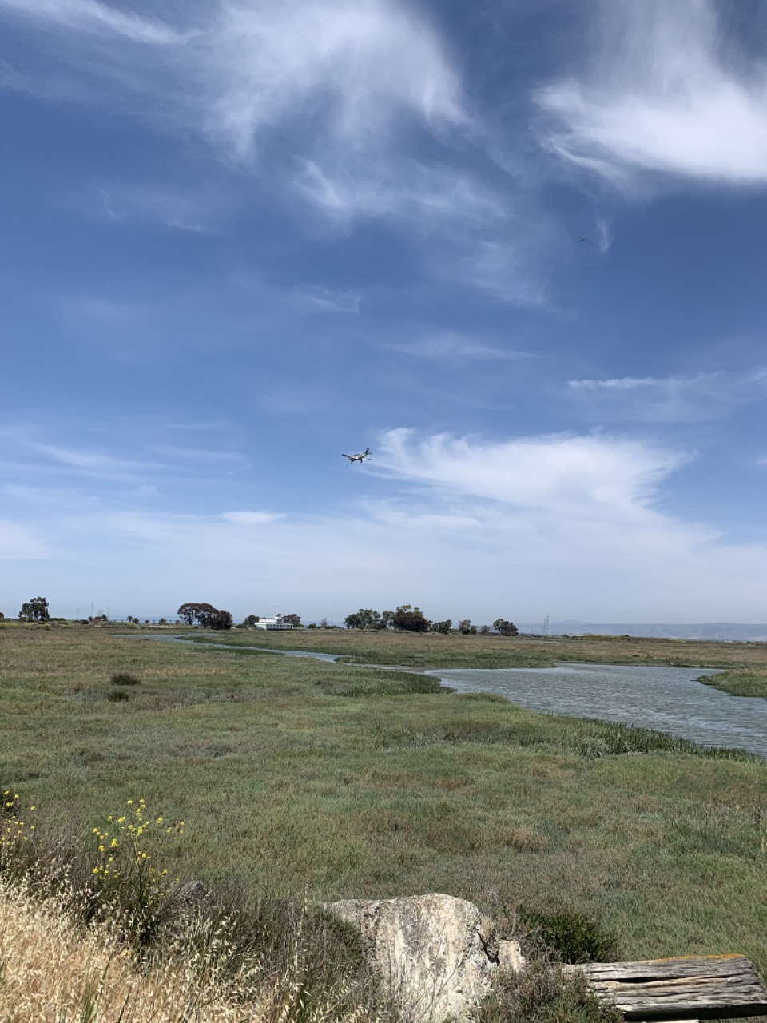
Thank you!
Heidi Nutters, Senior Program Manager
heidi.nutters@sfestuary.org

