Slide 1
Implementation Pathways: Planning drivers and regulatory context
Sahrye Cohen
Wetlands and Oceans Manager
EPA Region 9

Slide 2
Photo: SFBRA

Slide 3
Planning drivers – Executive Orders

Slide 4
Planning Drivers - Funding
Photo: SFBRA

Slide 5
Planning Drivers – Strategic roadmap
Update Policies
Unlock Funding
Lead with Federal Facilities and Assets
Train the Workforce
Prioritize Research, Innovation, Knowledge and Adaptive Learning

Slide 6
Regulatory Context
Complex environment and regulations
Many agencies, many regulations
Agencies have differing mandates
Regulations were not developed with restoration and green infrastructure in mind
Innovation/Uncertainty increases cost
Sea level rise and Infrastructure Constraints

Slide 7
Regulatory Context – Analysis Issues
Watershed and Regional Approach
Short Term impacts vs. Long Term benefits
Feasibility and Risk
Monitoring

Slide 8
Regulatory Context – Implementation Pathways
Permitting Collaboration and programmatic efficiencies
Technical Tools
Analytical Approach to net benefit projects
Adaptive management for project success
Collaborative forums for lessons learned

Slide 9
Regulatory Context – Technical Tools
Regional Planning
Estuary Blueprint
Adaptation Atlas
Bay Adapt
Aquatic Resource Type Conversion Framework
Pilot Projects

Slide 10
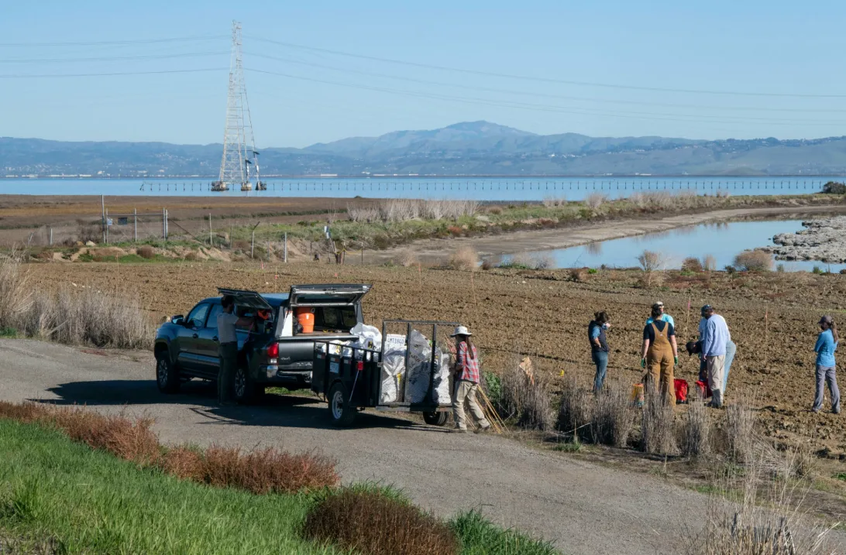
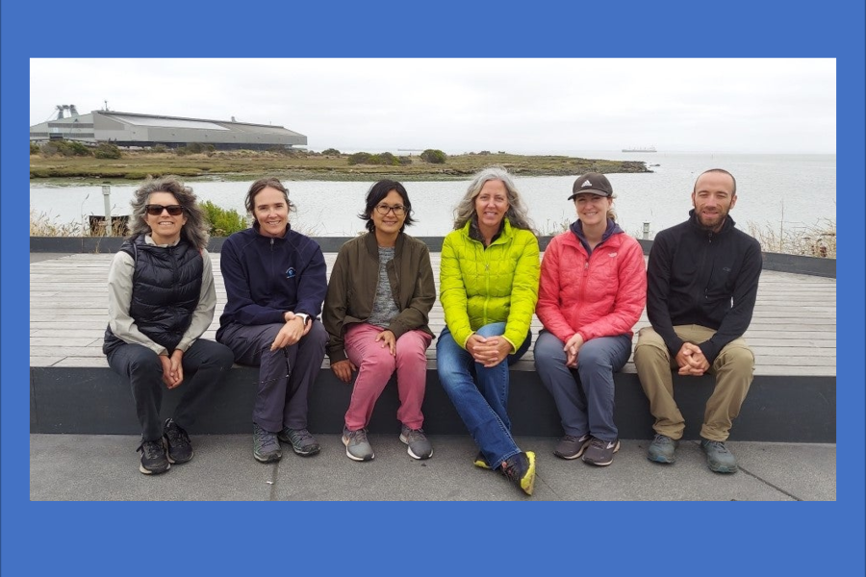
Regulatory Context - Permitting Collaboration and programmatic efficiencies
Bay Restoration Regulatory Integration Team (BRRIT)
Improved Permitting efficiency
Identify conflicts BEFORE design is fixed (Pre-application meetings)
Agencies and applicants work collaboratively to resolve issues
Dedicated permit managers and agency management
Challenges and Lessons Learned
Cutting the Green Tape
Programmatic Water Quality Orders and Biological Opinions

Slide 11
Opportunity to Accelerate!

