Slide 1
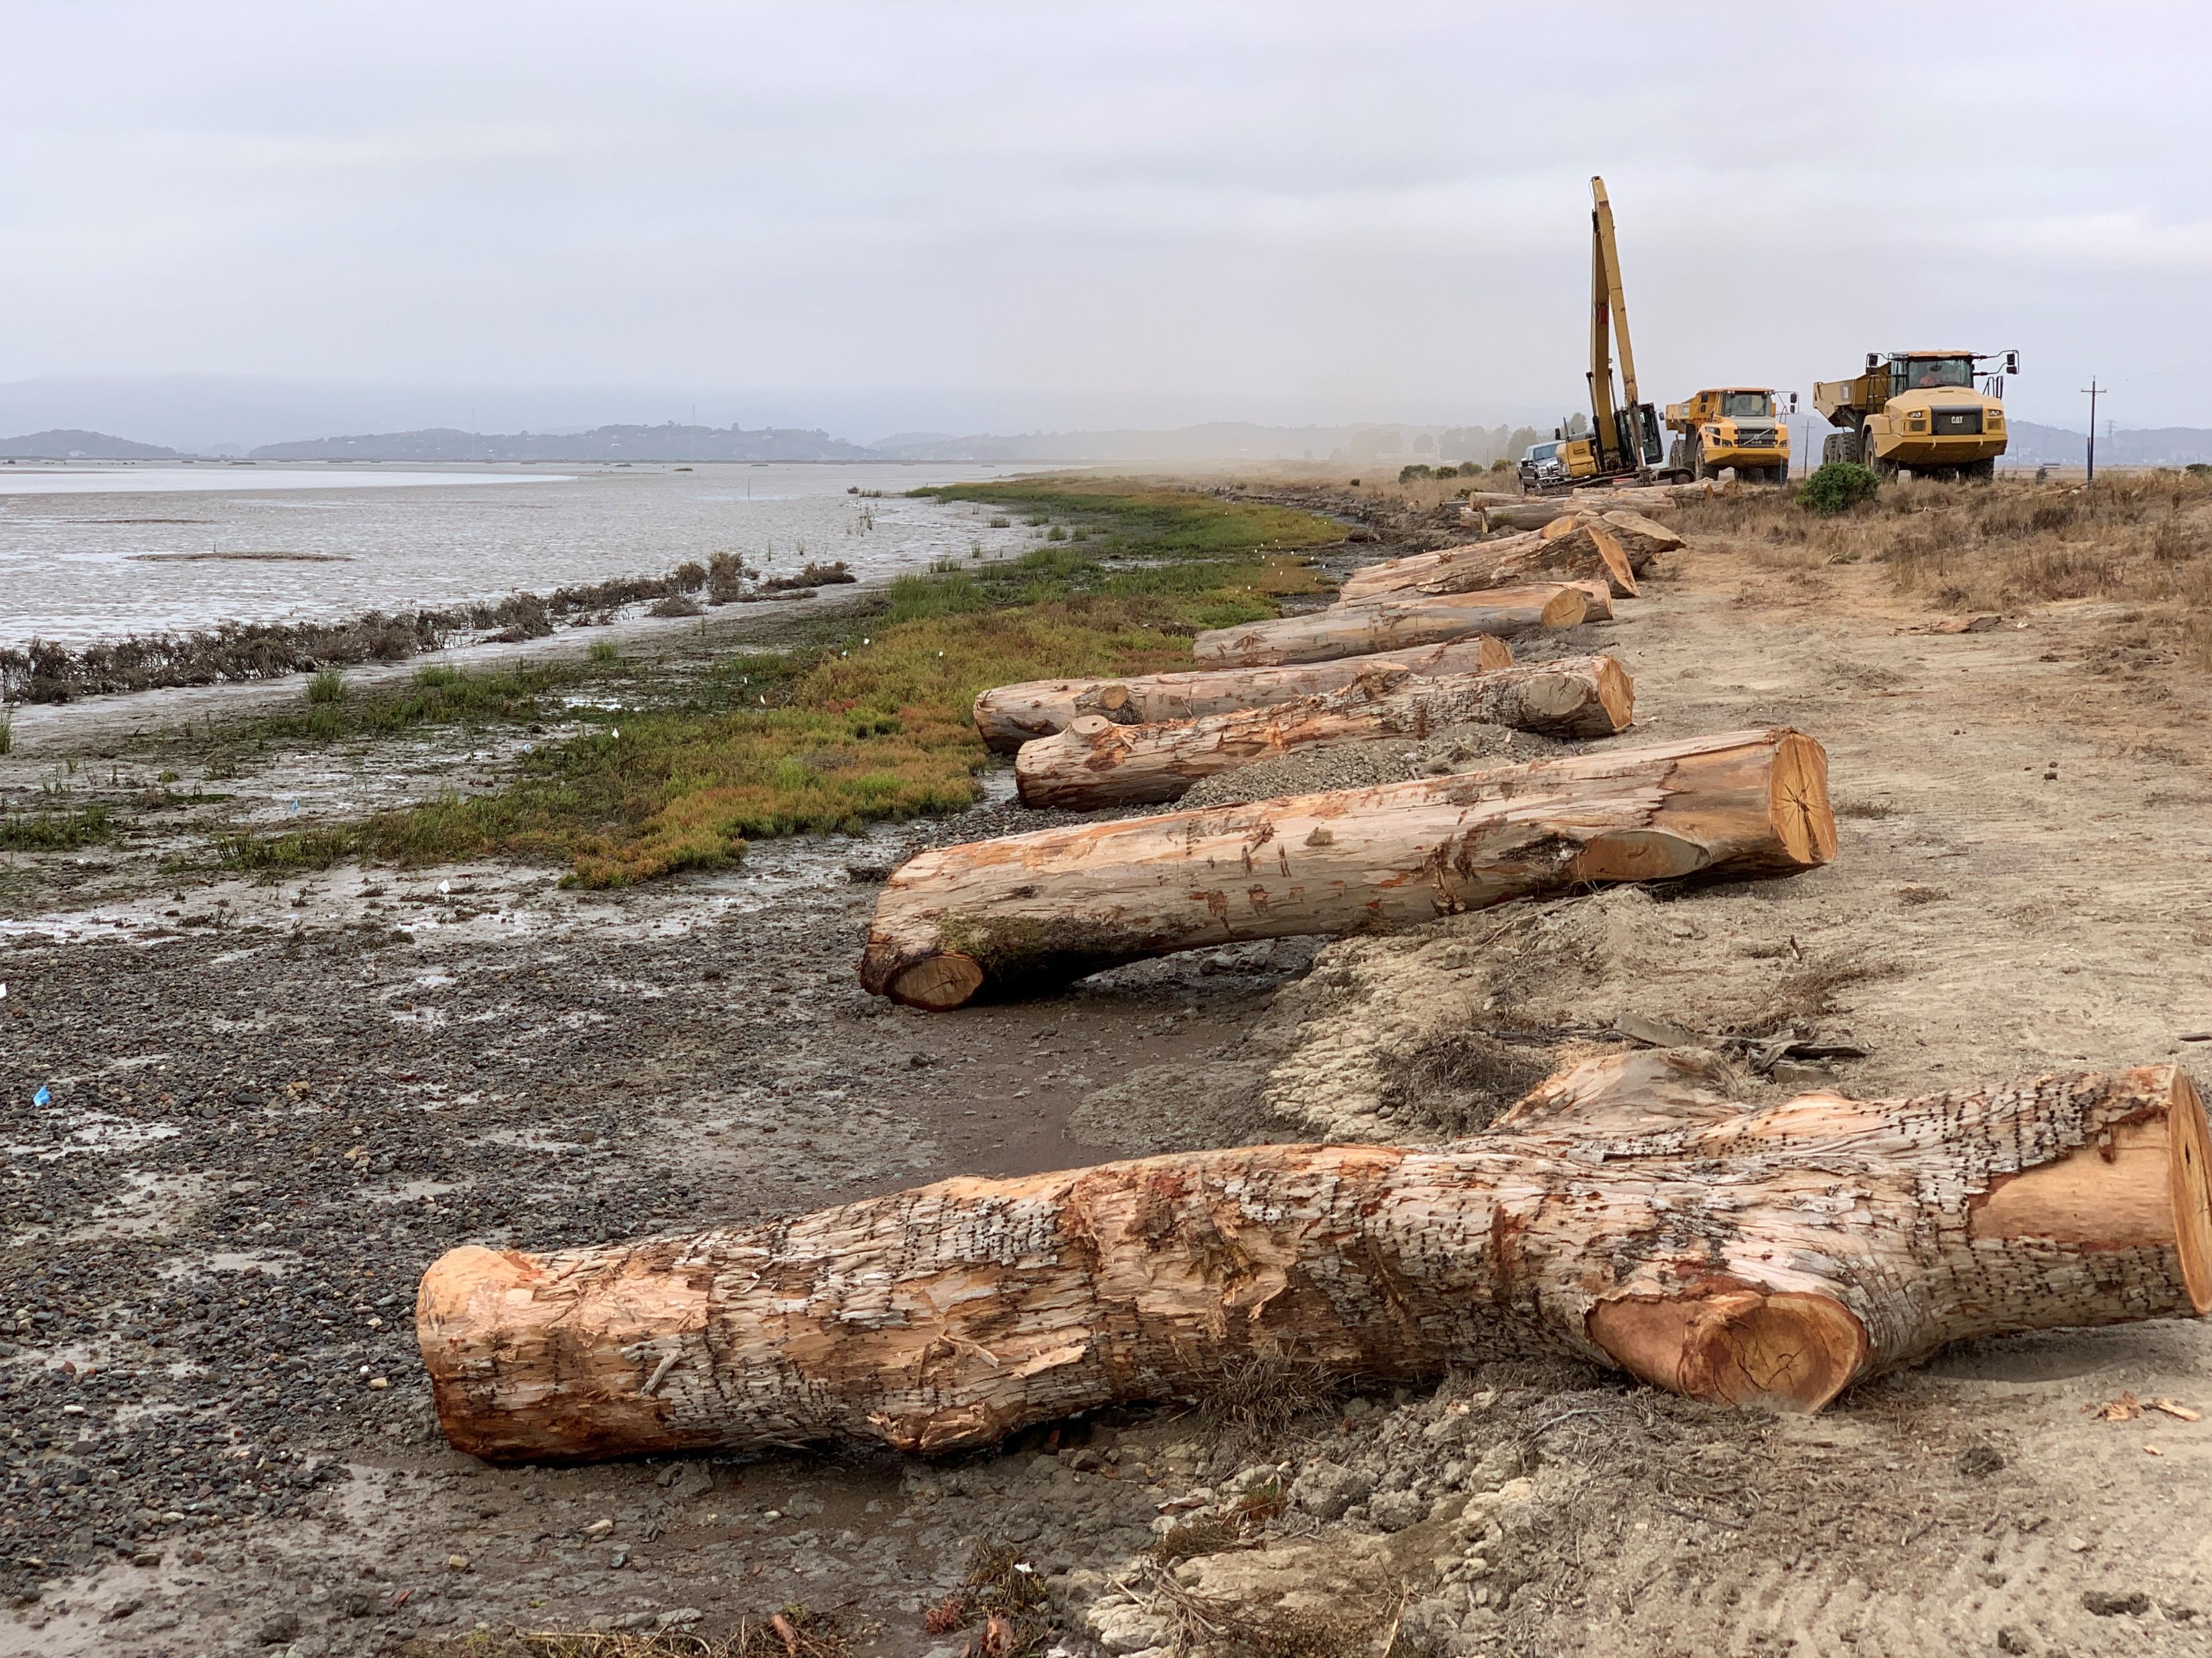
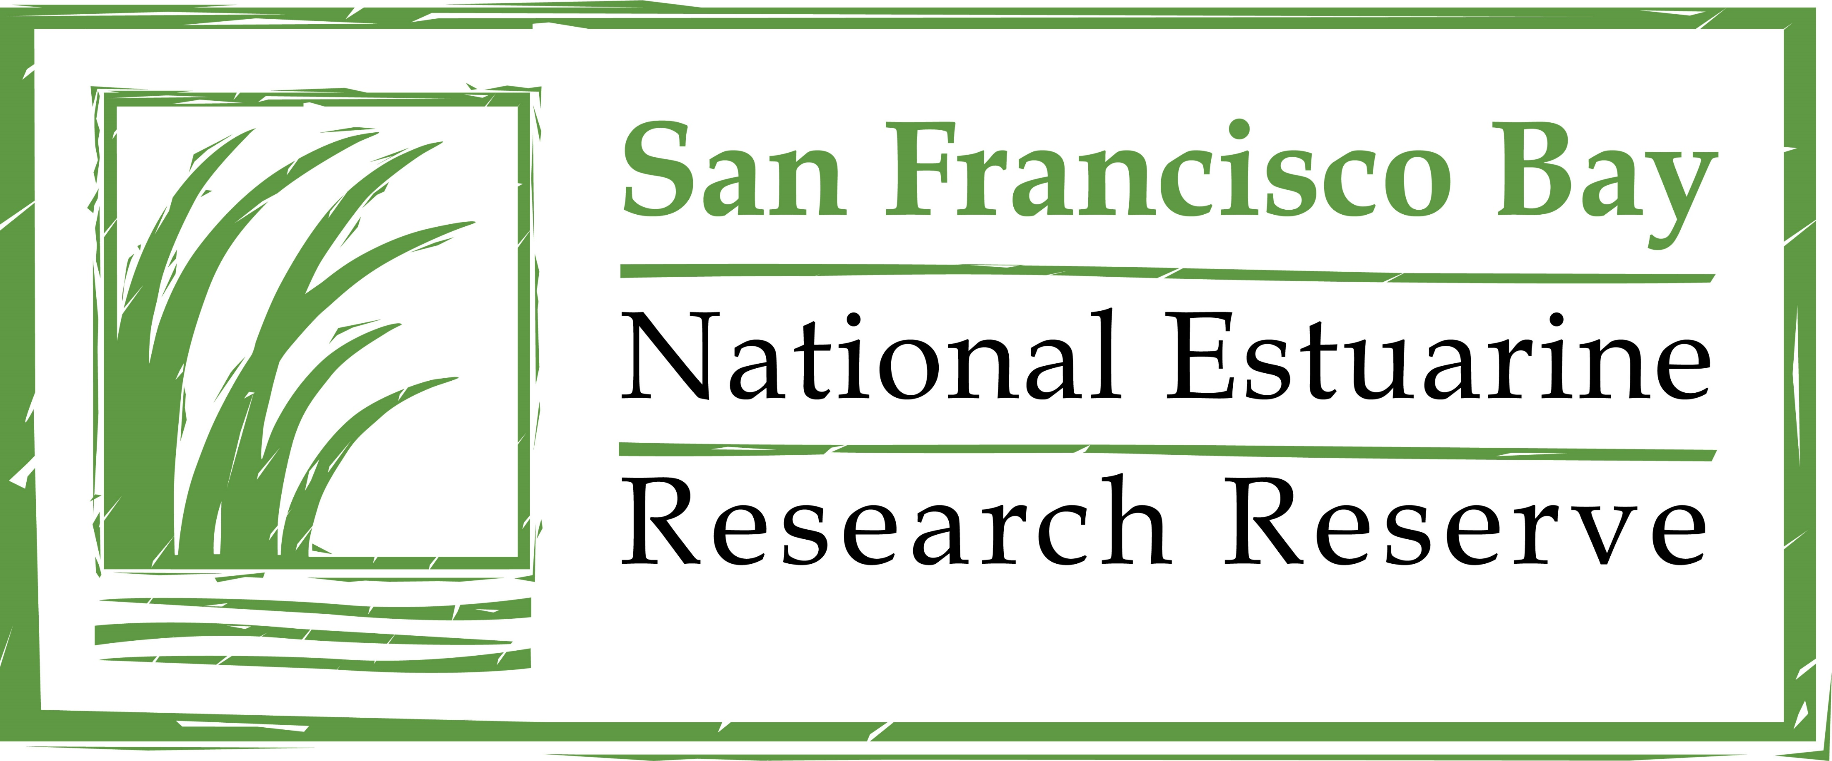
Designing Nature-Based “Migration” Projects in Face of Uncertainties
Stuart Siegel, PhD, PWS
San Francisco Bay National Estuarine Research Reserve
siegel@sfsu.edu
Presentation at the Wetland Migration Workshop
September 18, 2023

Slide 2
Design Foundation
Why are we pursuing wetland migration?
To maintain wetland functions over the long term in the face of environmental change
To utilize a valuable function: capacity for natural systems to benefit people (e.g., “nature based strategies”)

Slide 3
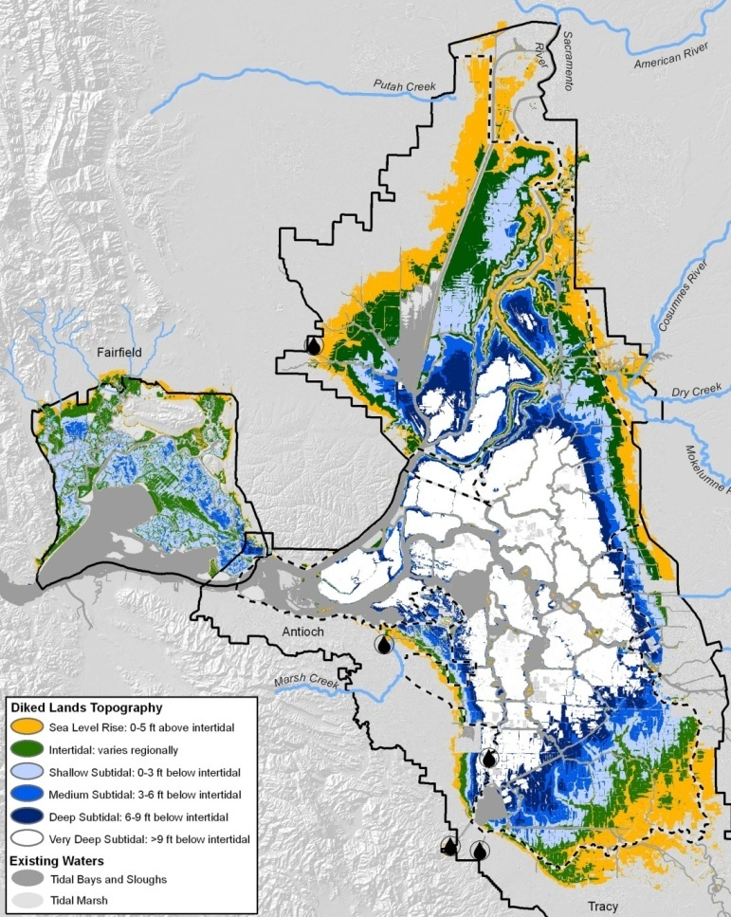
Migration Type 1: Horizontal
Estuarine Transgression
Gentle slope
Ample opportunity
Steep
slope
Limited opportunity
Levee/
Hard
Shoreline
T₂
T₁
Sea
Level
Rise
Very minor opportunity
Notes:
Last key strategy = allowing for marshes to migrate landward, aka Transgression
Works well where land slopes are gentle –
Common around the Delta
Some available around Suisun
Lower estuary very limited to non-existent
Developed shorelines
Steeper shorelines
San Pablo Bay has some potential
Maybe some potential in South Bay but mostly developed

Slide 4
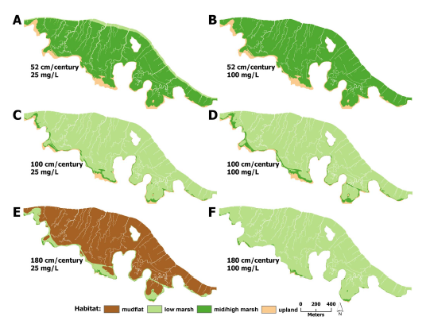
Migration Type 2: Vertical (winner: SLR or accretion?)
Suspended Sediment Concentration (mg/L)
25
100
😐
☺
52
😐
😐
100
Sea Level Rise (cm/century)
☹
😐
180
Schile et al. 2014
Notes:
Putting time, SLR scenarios, and SSC scenarios together paints a range of outcomes, China Camp illustrated. Which path we follow remains to be seen, and perhaps we can do something about some parts of this equation.

Slide 5
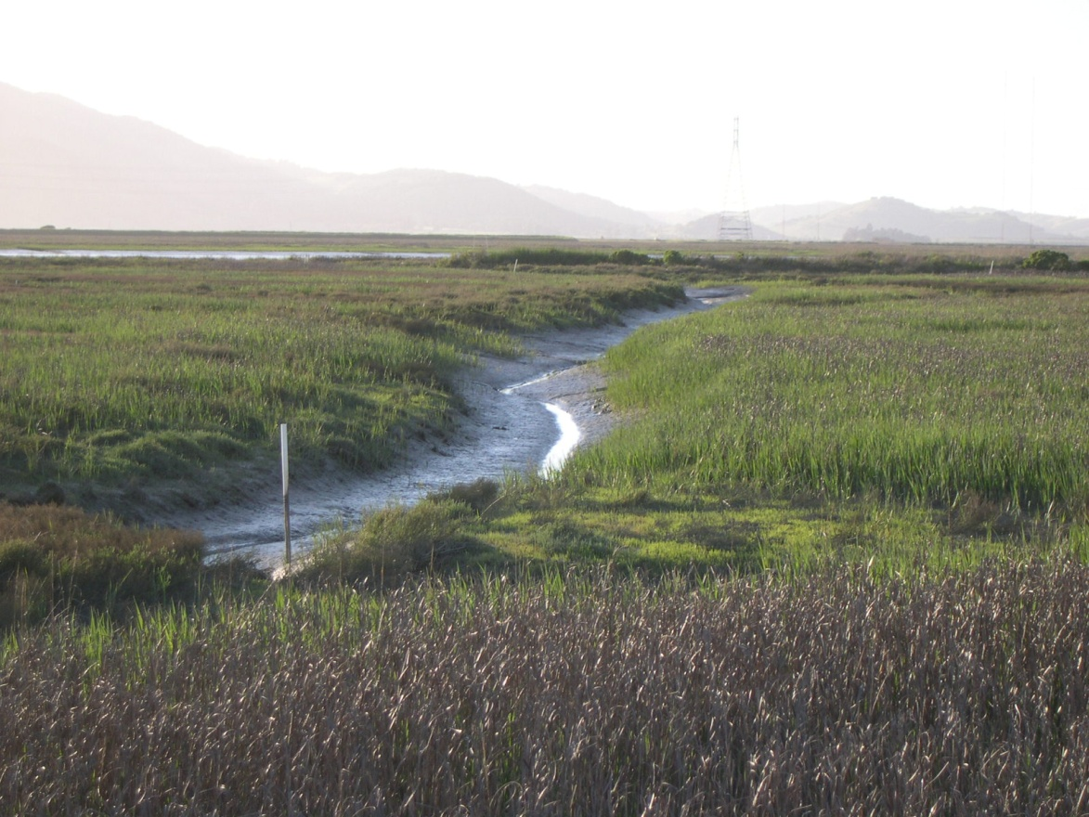
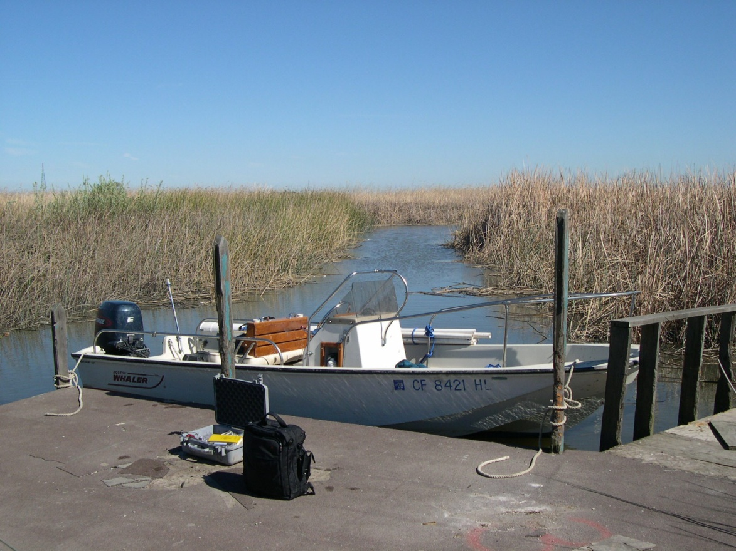
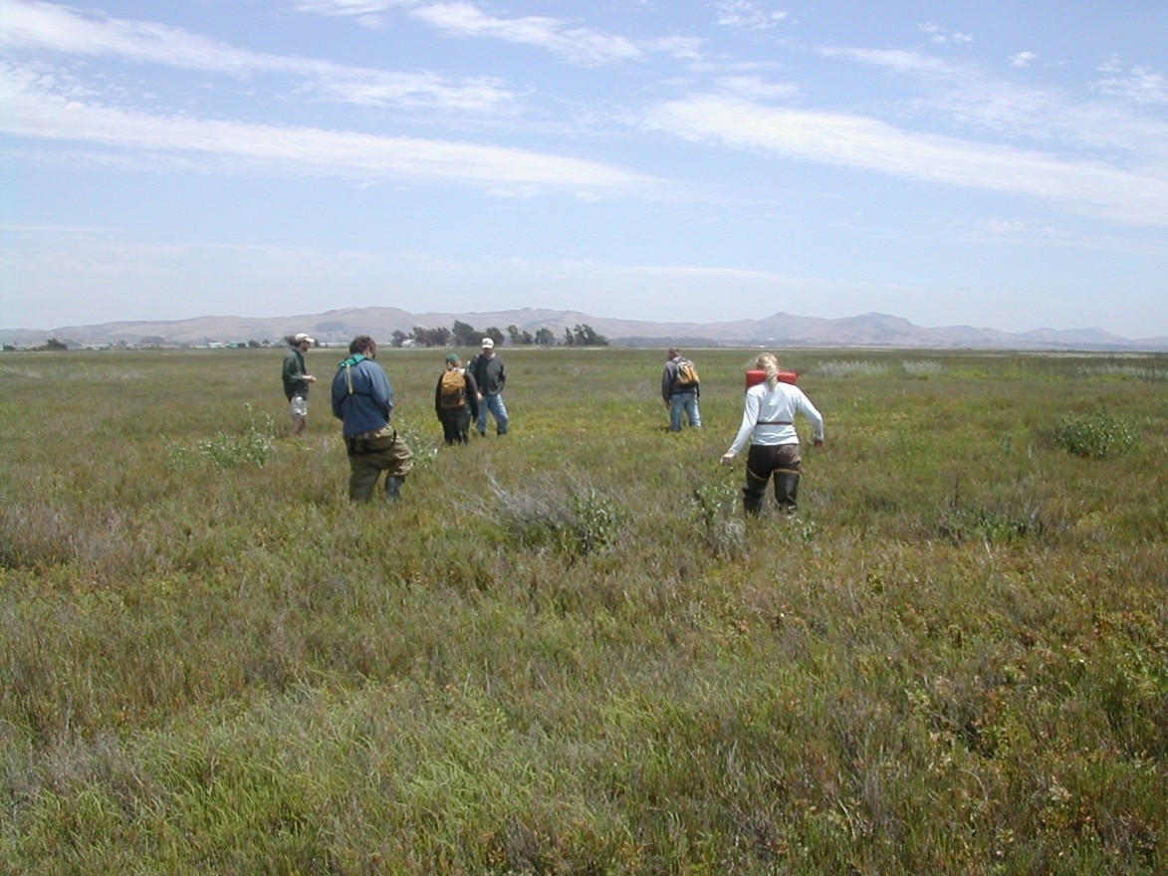
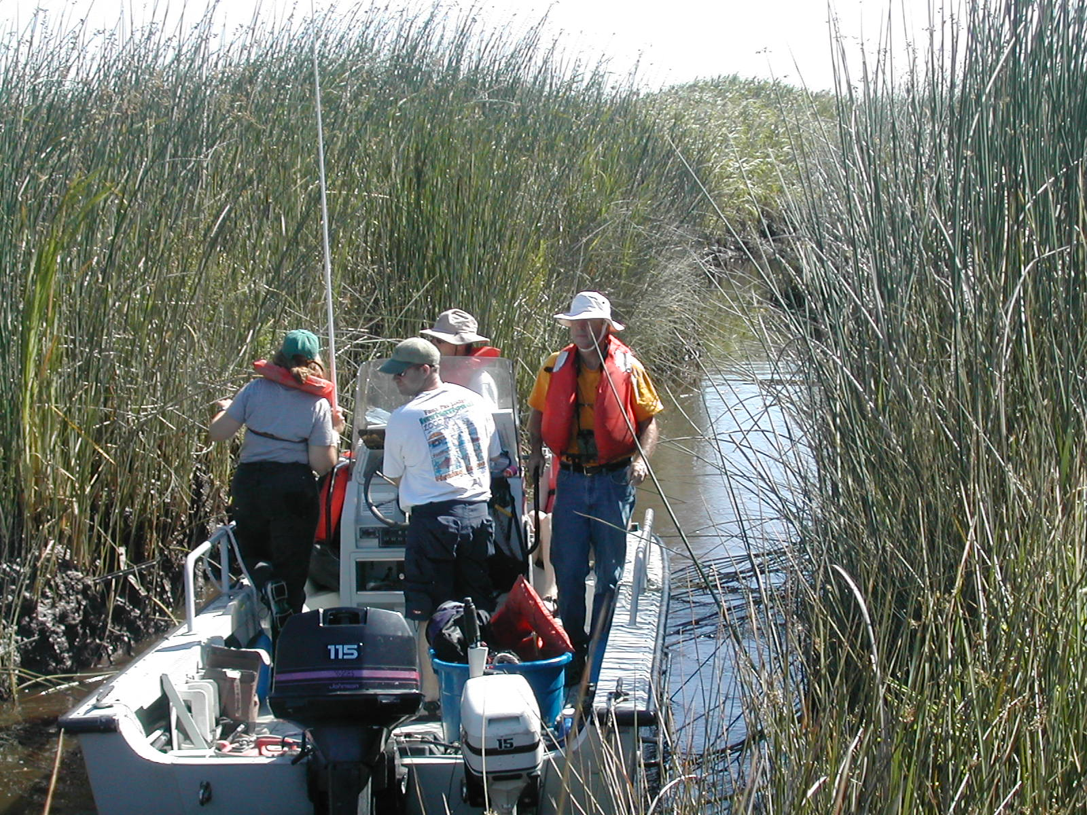
Migration: Estuarine Location Matters
Tidal Salt Marsh
Tidal Brackish Marsh (fresher)
Vegetation depth & salinity
H
M
L
S B F
Tidal Freshwater
Marsh
Tidal Brackish Marsh (saltier)
Notes:
Relevant to maintaining marsh elevations and reversing subsidence in restored marshes
Relevant to sediment trapping and retention capacities
5

Slide 6
Design Foundation: Core Uncertainties of Change
How fast the changes will arrive
How big the changes will be
How many changes we will have to contend with
How our actions and inactions will promote or ameliorate these changes
How interactions amongst these changes and with societal actions may play out

Slide 7
Design Foundation: Projects Require Permits!!
State Agencies: BCDC, RWQCB, CDFW, DSC, SLC, SHPO, CVFPB, Caltrans
Federal Agencies: USFWS, NMFS, USACE, USEPA, USCG
Clean Water Act Section 401
Porter-Cologne Water Quality Control Act
Clean Water Act Section 404
Clean Water Act Section 402
Fish and Game Code
Suisun Marsh Protection Act
Rivers and Harbors Act
Clean Water Act Section 303(d)
McAteer-Petris Act
California Endangered Species Act
Magnussen-Stevens Act
Federal Navigation
Delta Reform Act
National Historic Preservation Act
Federal Endangered Species Act
California Environmental Quality Act
33 USC Section 408
State Leases and Encroachment
Title 23
Migratory Bird Treaty Act
National Environmental Policy Act

Slide 8
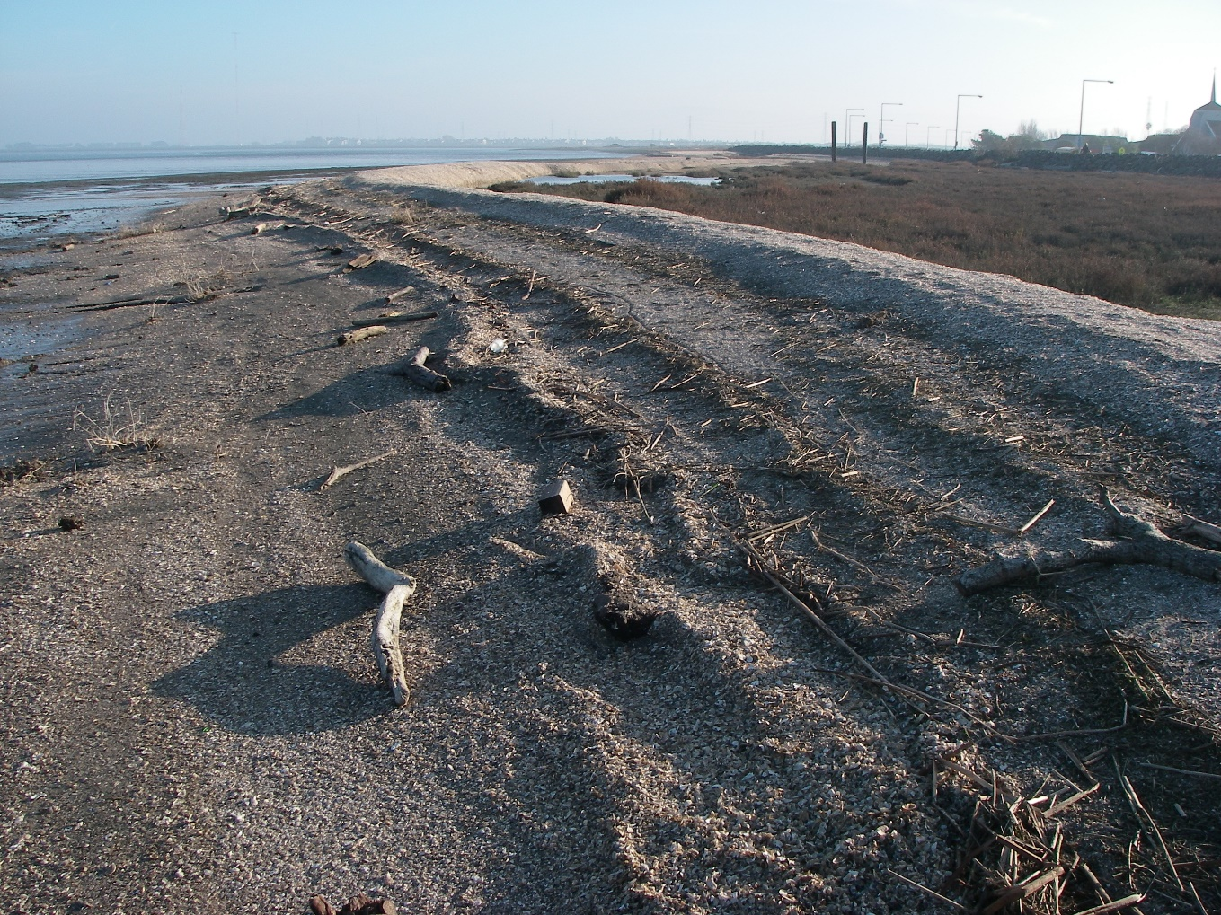
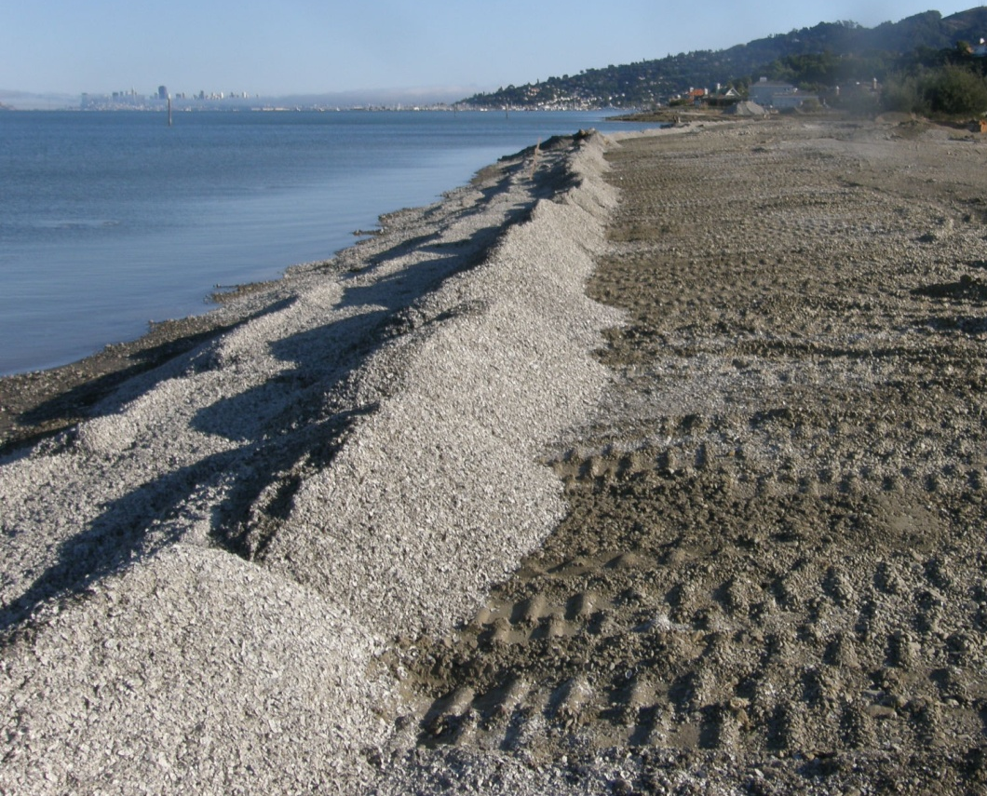
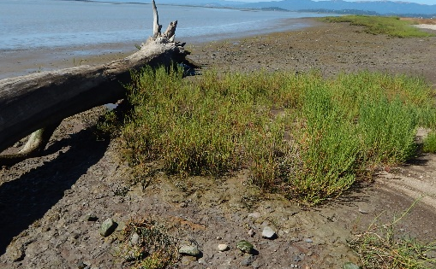
Project Design Overarching Approach
Look forward as far as viable, follow natural examples, integrate techniques, understand place and people. Then design projects with the greatest likelihood of natural processes maintaining functions over the long term.
Local Natural Examples
Applied in Local Project Designs

Slide 9
Hydrogeomorphic Settings Drive Design
Tidal edge: open bay (wind fetch, water depth), large tidal slough (currents), smaller tidal slough, watershed connection
Upland edge: steepness; levee or infrastructure; managed (e.g., agriculture) or natural
Marsh/former bayland type: tidal ancient, centennial, older restoration, new(er) restoration, diked subsided bayland (elevation, width, veg type)
Tidal flood protection: natural edge (none needed), integrated (eg levee), segment (not protecting stand alone)
Sediment supply: bay (low, med, high), watershed

Slide 10
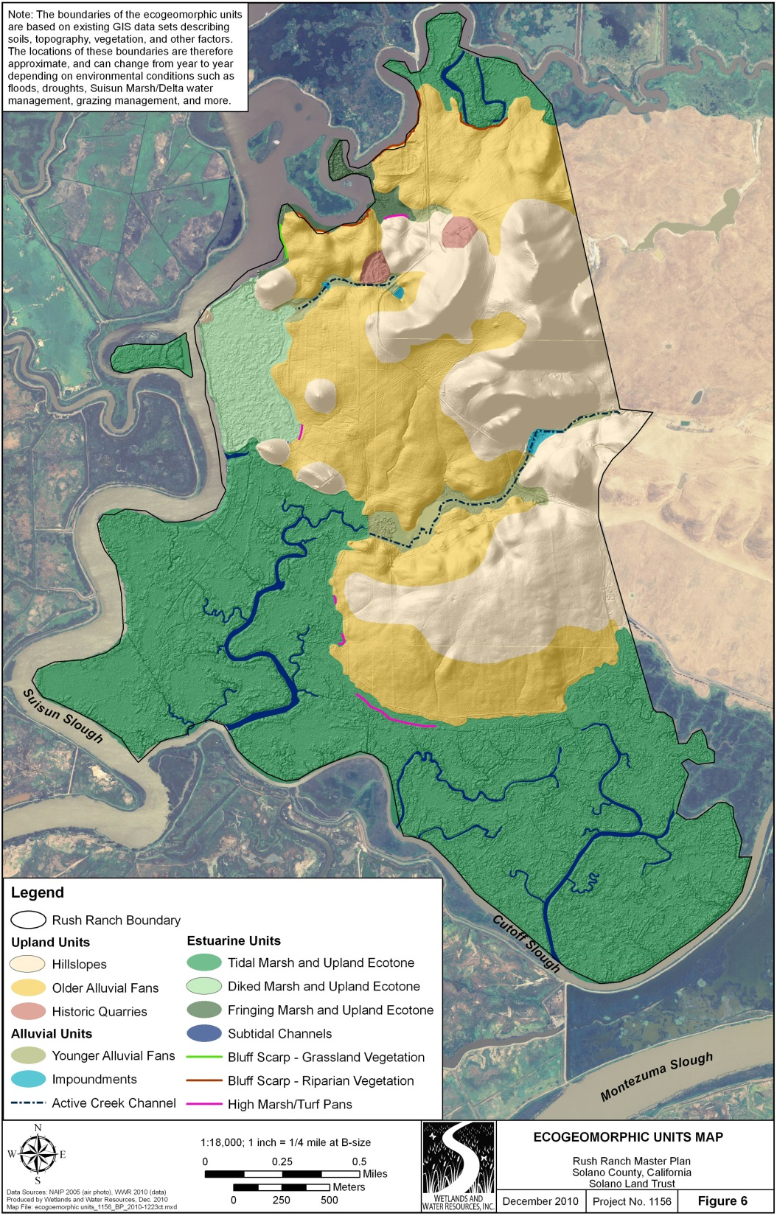
Rush Ranch: Natural Edges, Seasonal Streams
Three Restoration Projects
Lower Spring Branch Creek (built 2019)
Seasonal stream flows into First Mallard Slough
15-acre tidal marsh restoration
Reconnected 14 floodplain acres and 1 mile of edge to wetland migration
Suisun Hill Hollow (built 2019)
Seasonal stream flows into Goat Island Marsh (currently diked)
8-acre seasonal wetland restoration
Goat Island Marsh (final design starting)
80-acre tidal marsh restoration
4,200-ft natural upland transition
Will connect to Suisun Hill Hollow
Goat Island Marsh
Suisun Hill Hollow
Diked marsh
Seasonal drainages
Lower Spring Branch Creek
Tidal marsh
Figure 3
Restoration Projects Location Map

Slide 11
Lower Spring Branch Creek: Before Restoration
Two 3.5’ open culverts
Seasonal floodplain
Muted tidal marsh
Tidal marsh
“L-shaped” berm

Slide 12
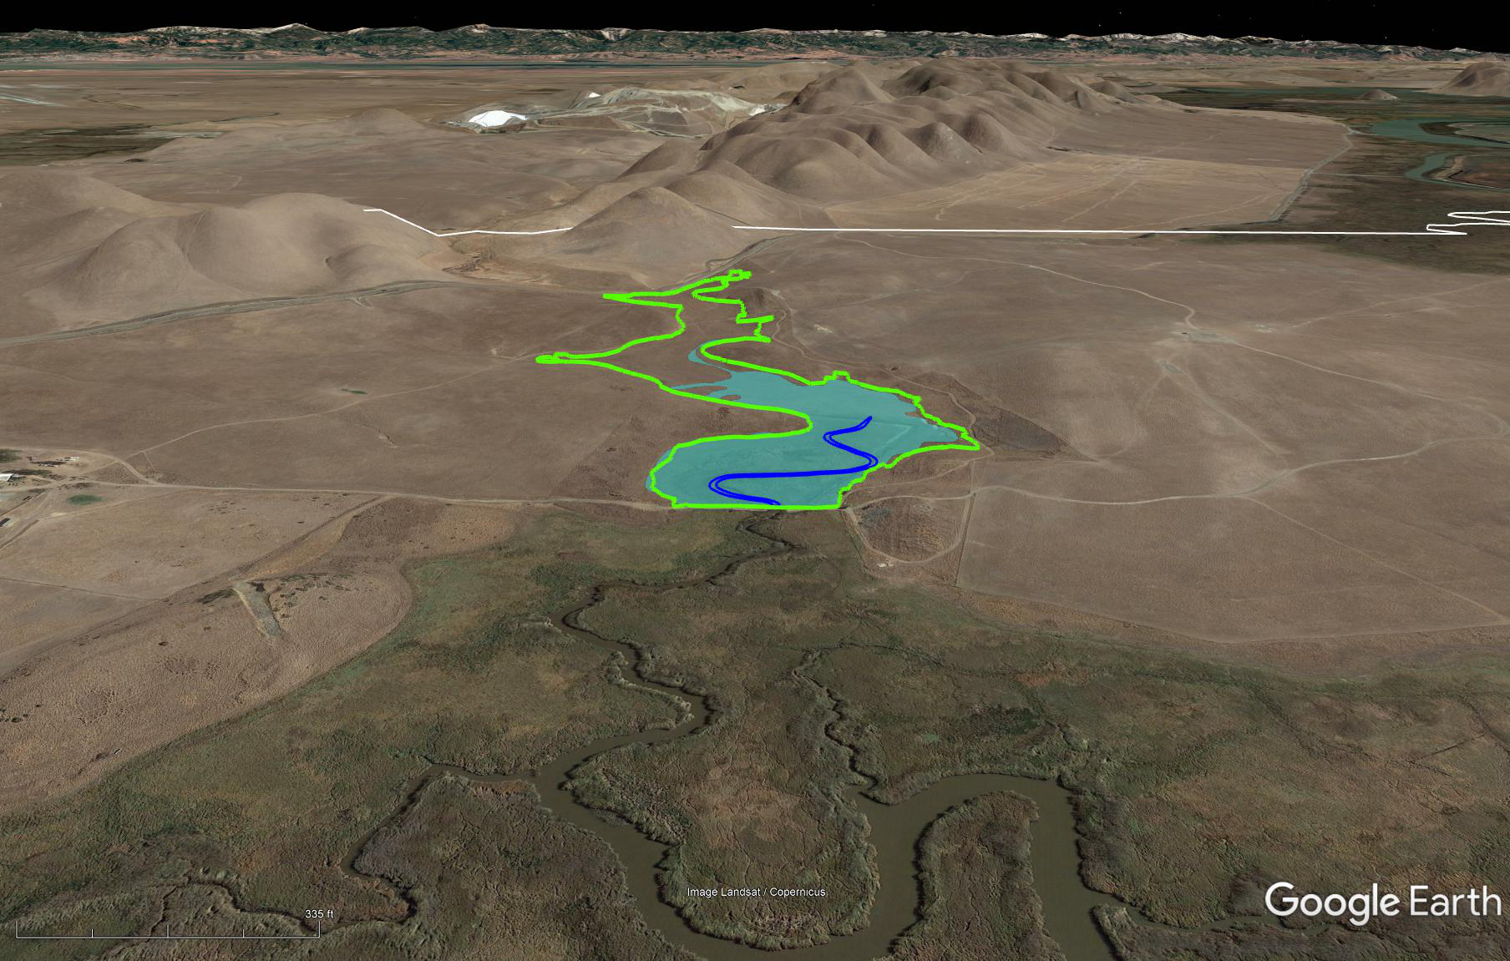
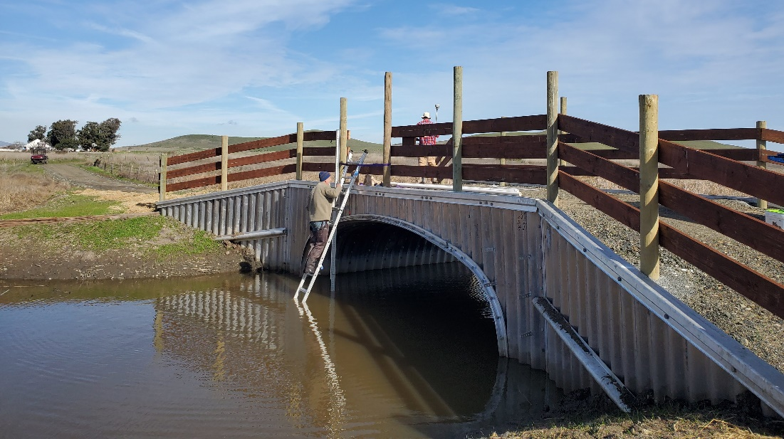
Linking Habitats Across the Landscape
Old ranch road,
two 3.5’ culverts
Upper Spring Branch Creek
Lower Spring Branch Creek
First Mallard Slough (tidal)
Lower Spring Branch Creek (muted)
Rush Ranch SF Bay NERR
First Mallard Slough Tidal Marsh
Tidal reconnection via arch culvert
Lower Spring Branch Creek Restoration (2019)
Goal: reconnect floodplain to tidal marsh
Replace two 3.5’ culverts with one large arch culvert – full tidal connectivity, SLR accommodation
1,200’ of new tidal channel – tidal circulation
Lower an old berm – create high marsh
Lower ranch road – allow storm overflow

Slide 13
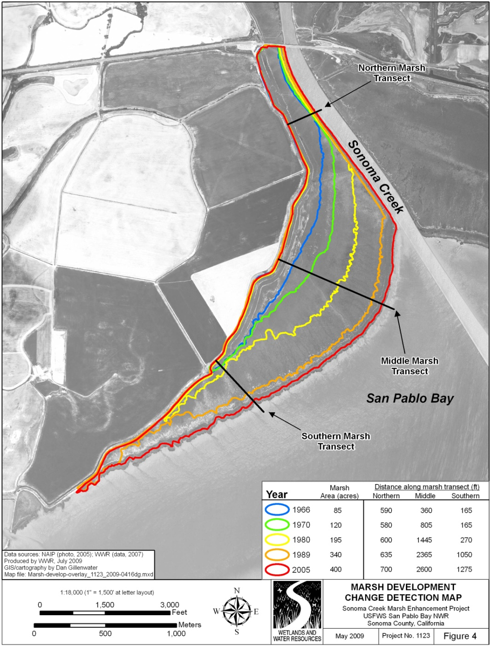
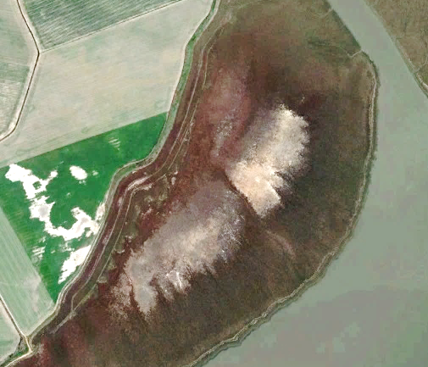
Sonoma Creek: Centennial Marsh, Levee at Upland
Limited or no transition habitat or high tide refuge
Drowned marsh interior and levee toe: little/no veg, breeds mosquitoes
Low ability for habitats and resident organisms to adapt to stressors (e.g., climate change and SLR)

Slide 14
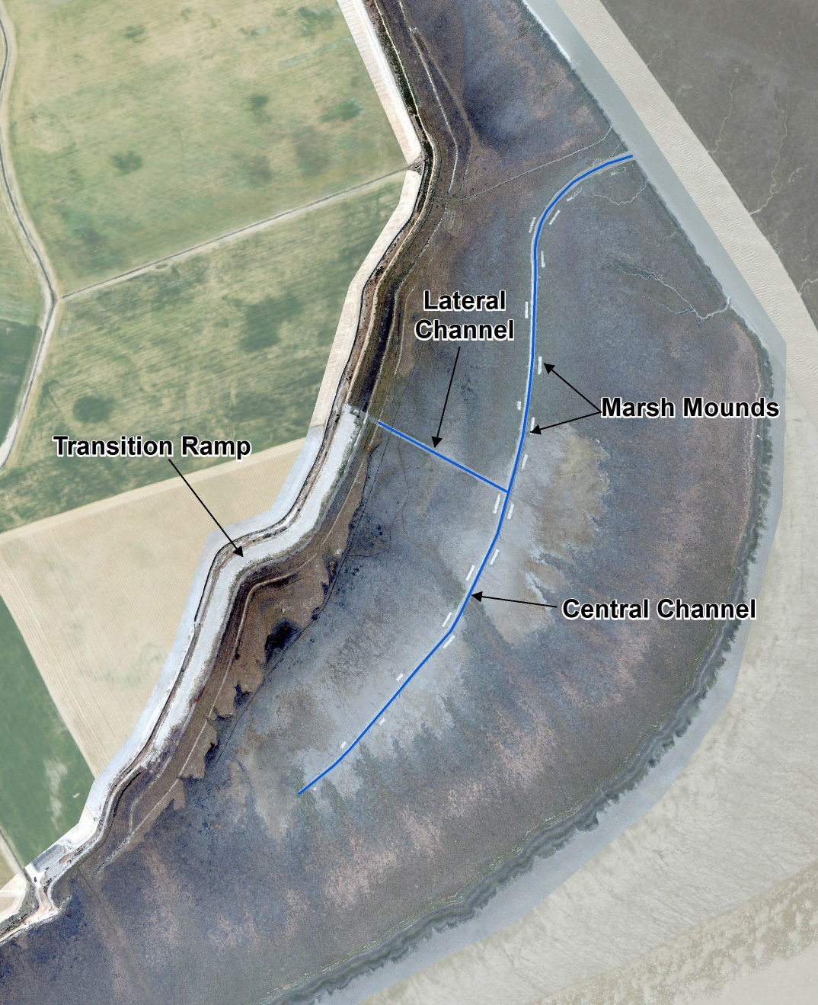
Design Elements
Use of multiple design elements
Central channel to drain interior excess ponding
Lateral channel to drain swales along levee toe
Marsh mounds for high tide refuge
Marsh-upland transition ramp
Flood tide asymmetry (natural bayfront berm) + high sediment load = impeded direct bay connection, may limit channel longevity (SLR could help!).
Lateral Channel
Transition Ramp
Marsh Mounds
Central Channel

Slide 15
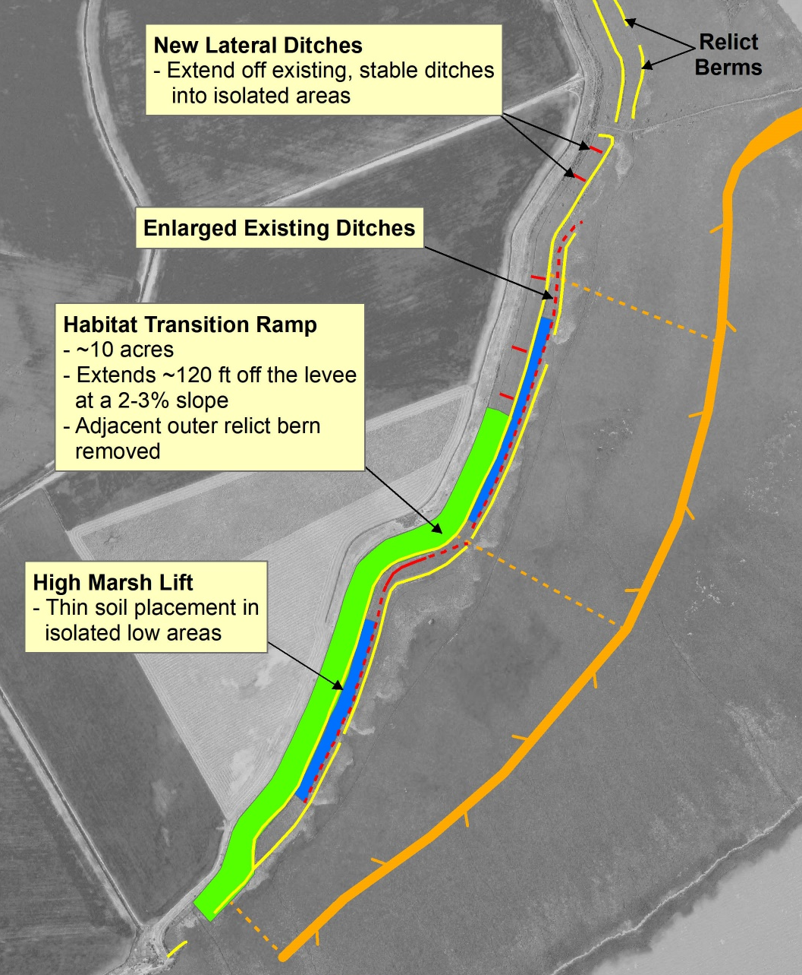
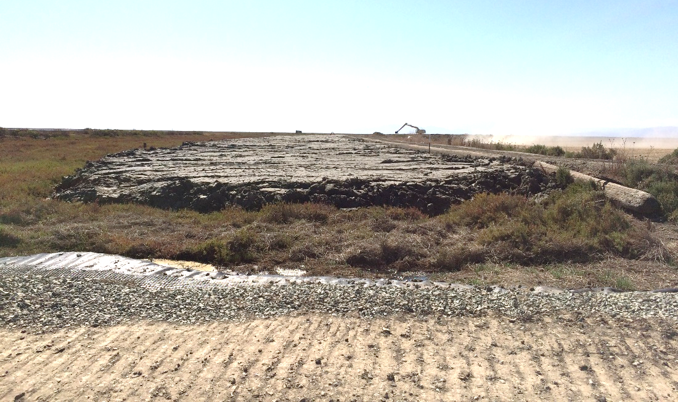
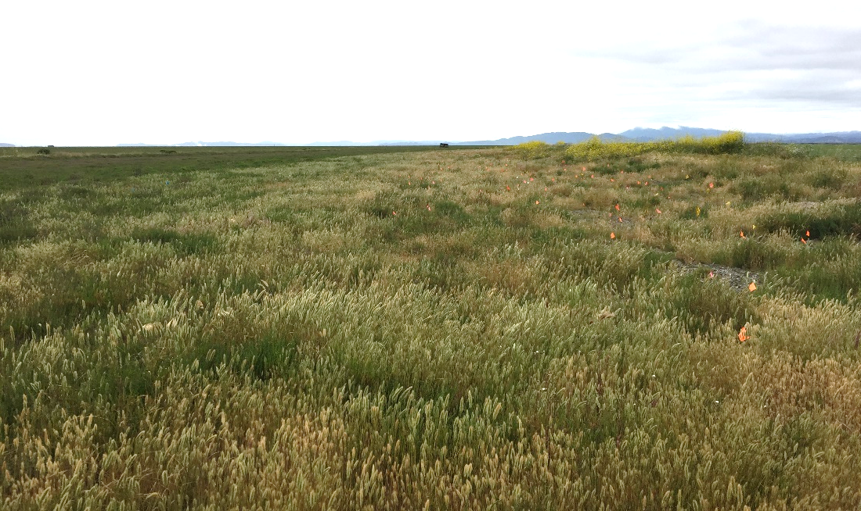
Design: Very Gentle Sloped Transition Ramp
2015
2018

Slide 16
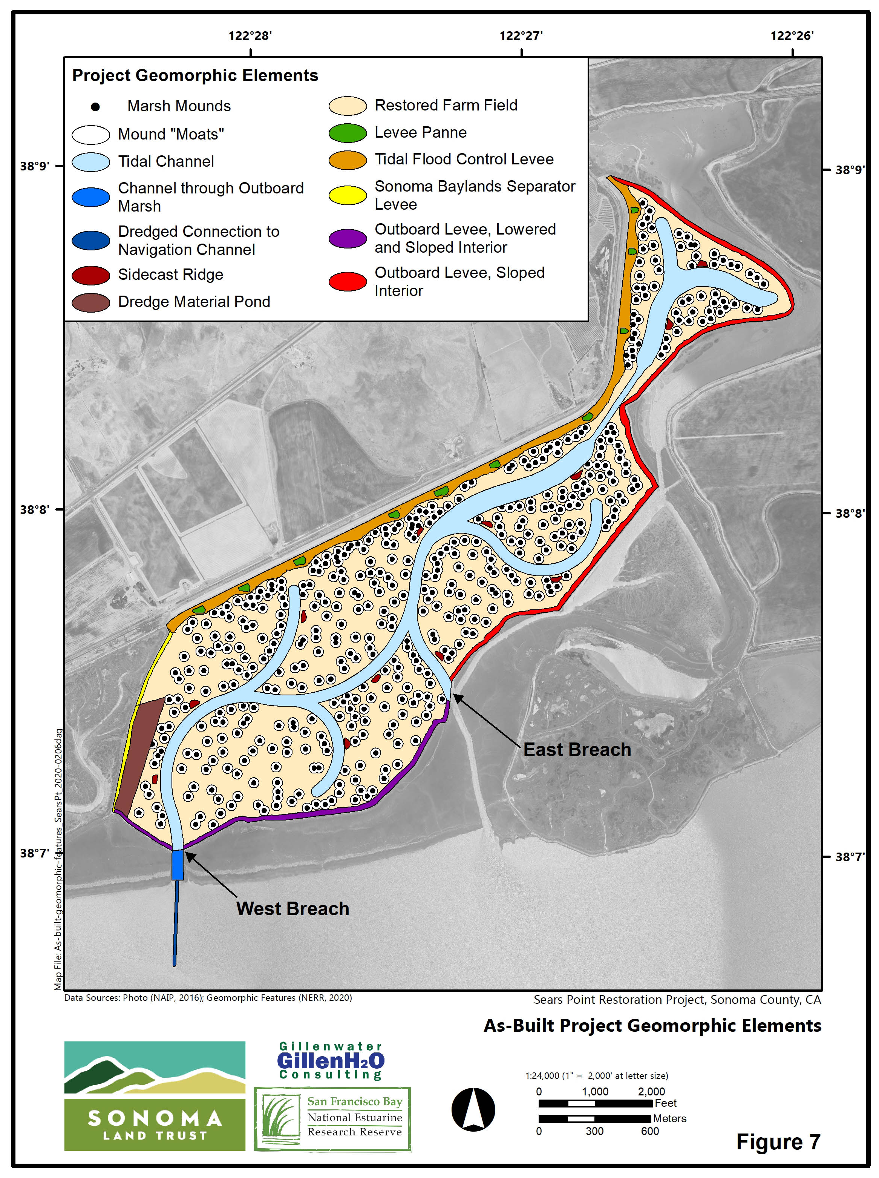
Restoration Project Design
North levee: tidal flood control, habitat levee
Levee pannes
North Habitat Levee
West levee: separates Sonoma Baylands
West Levee
Dredge ponds
Marsh mounds
Notes:
Do we want to add an animation to call out the mounds (arrow, inset photo) to highlight the issue that the re-veg components were not completed (leads into the problem statement)?

Slide 17
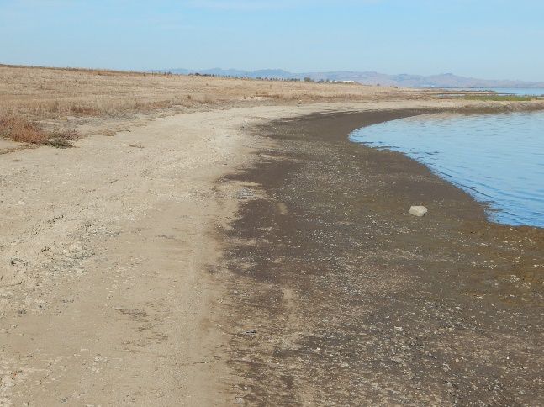
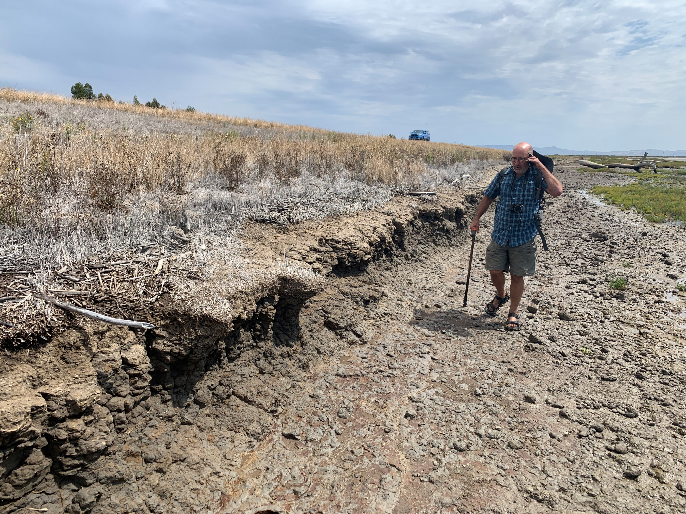
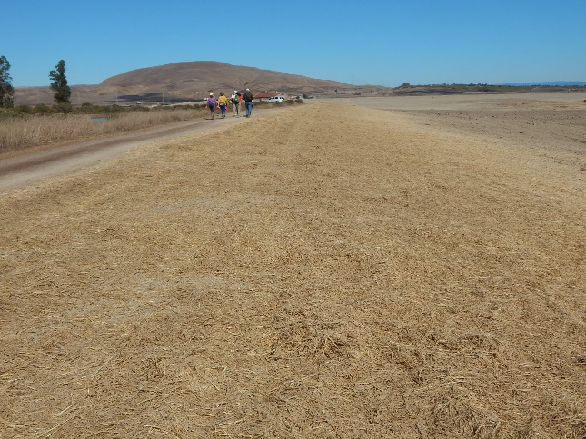
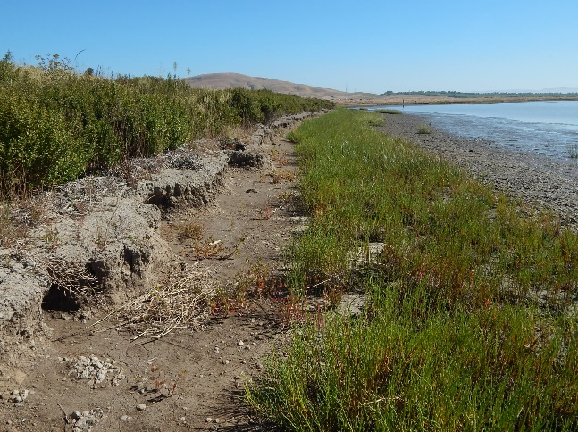
Omitted: Vegetate < Breach. Result: Erosion
Oct 2016 (1 yr tidal)
July 2021 (4.75 yr tidal)
Northern levee
scarp
Oct 2015 (pre-breach)
July 2019 (3.75 yr tidal)
Western levee
scarp

Slide 18
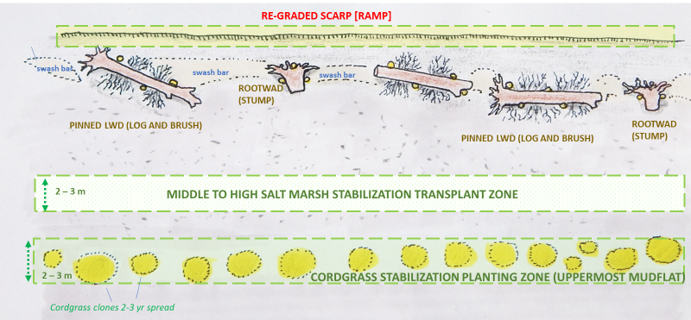
The Fix: Multi-Element Nature-Based Ecotone Rebuild
Physical elements: scarp grading, LWD installation, vegetation planting, dried bay mud placement, gravel armor and toe berm placement, brush fence
Process elements: tidal redistribution and vegetation colonization of placed mud (into swash bars) and gravel (into “beaches”), continued accretion of full site
Schematic: Peter Baye (2019)

Slide 19
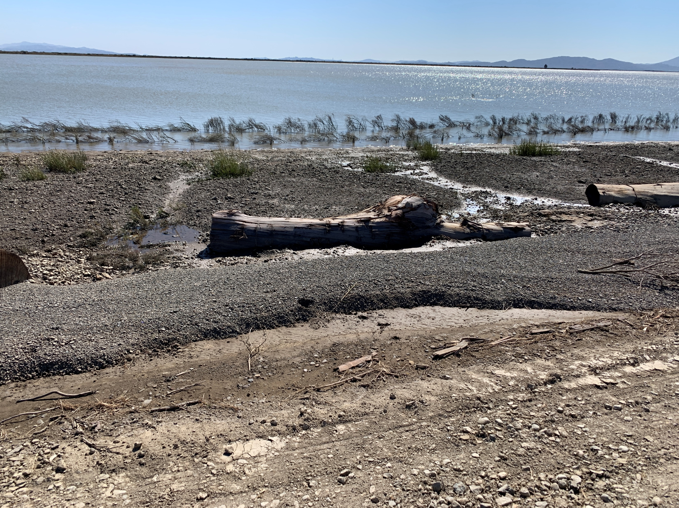
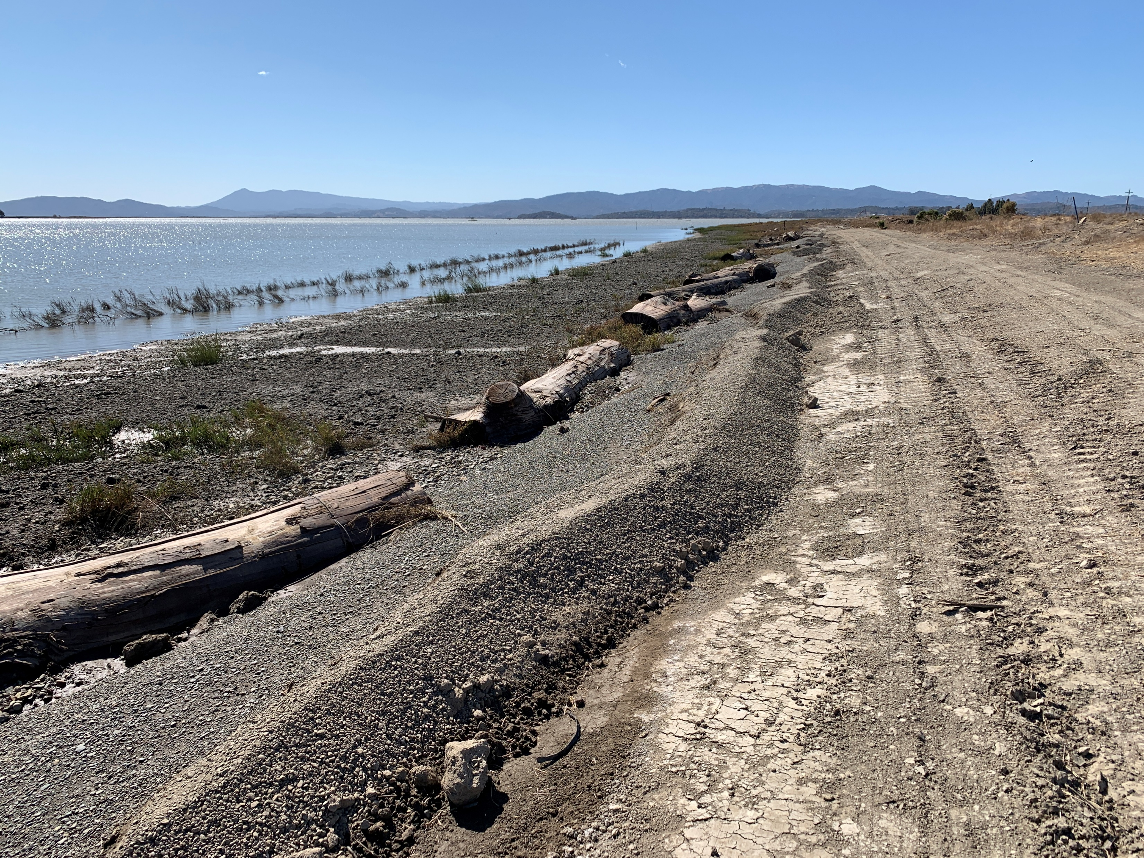
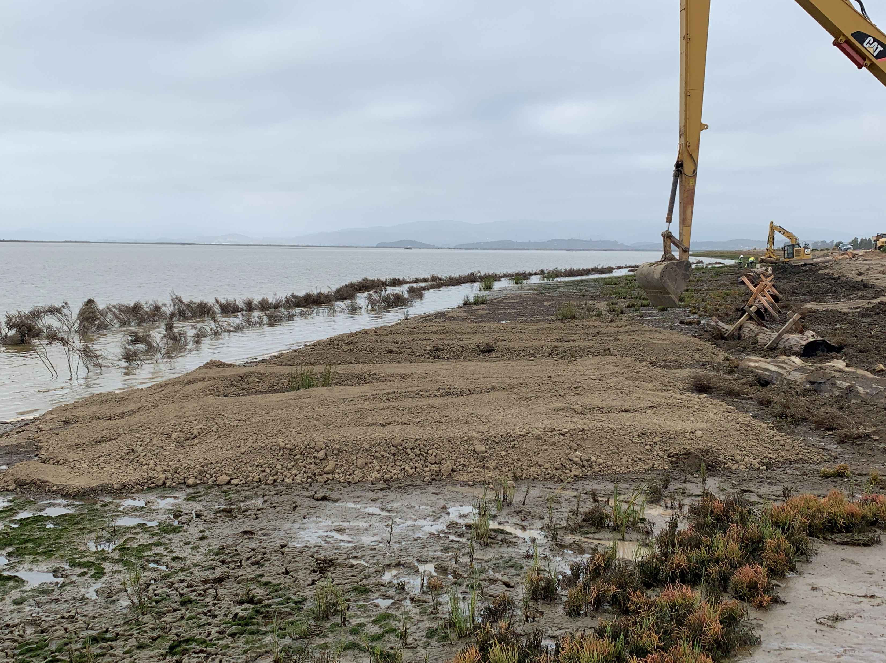
Brush Fence, Toe Berm, Lag Armor, Bay Mud
Brush Fence
Bay Mud
Brush Fence
Gravel Toe Berm
Logs
Gravel Toe Berm
Brush Fence
Bay Mud
Gravel lag armor (below mud)

Slide 20
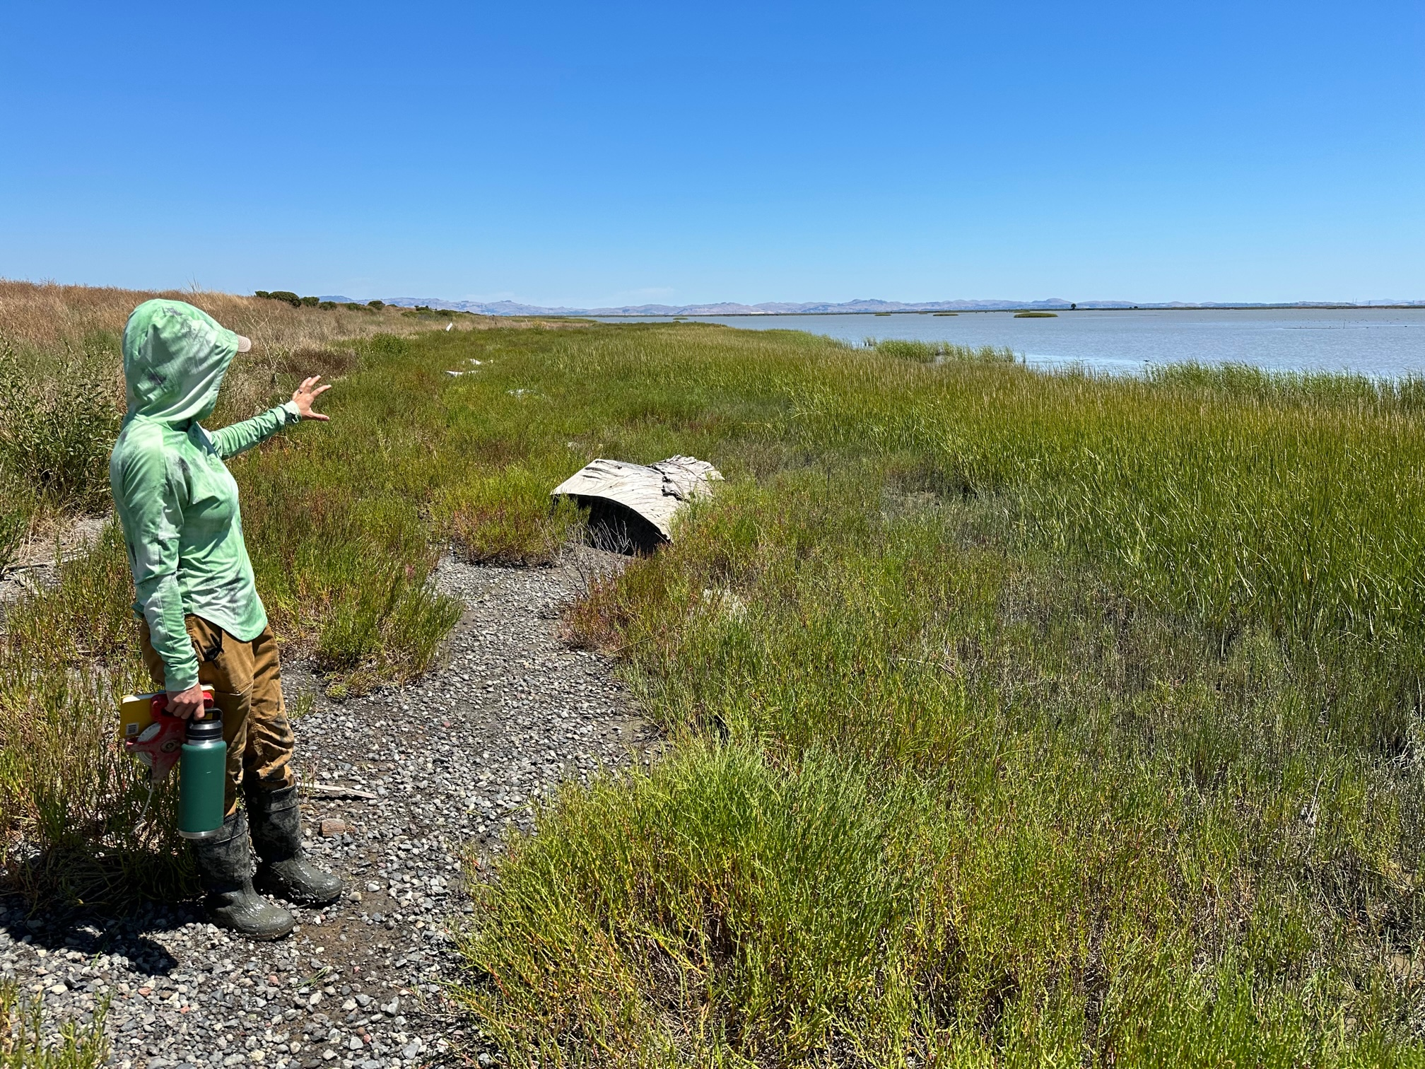
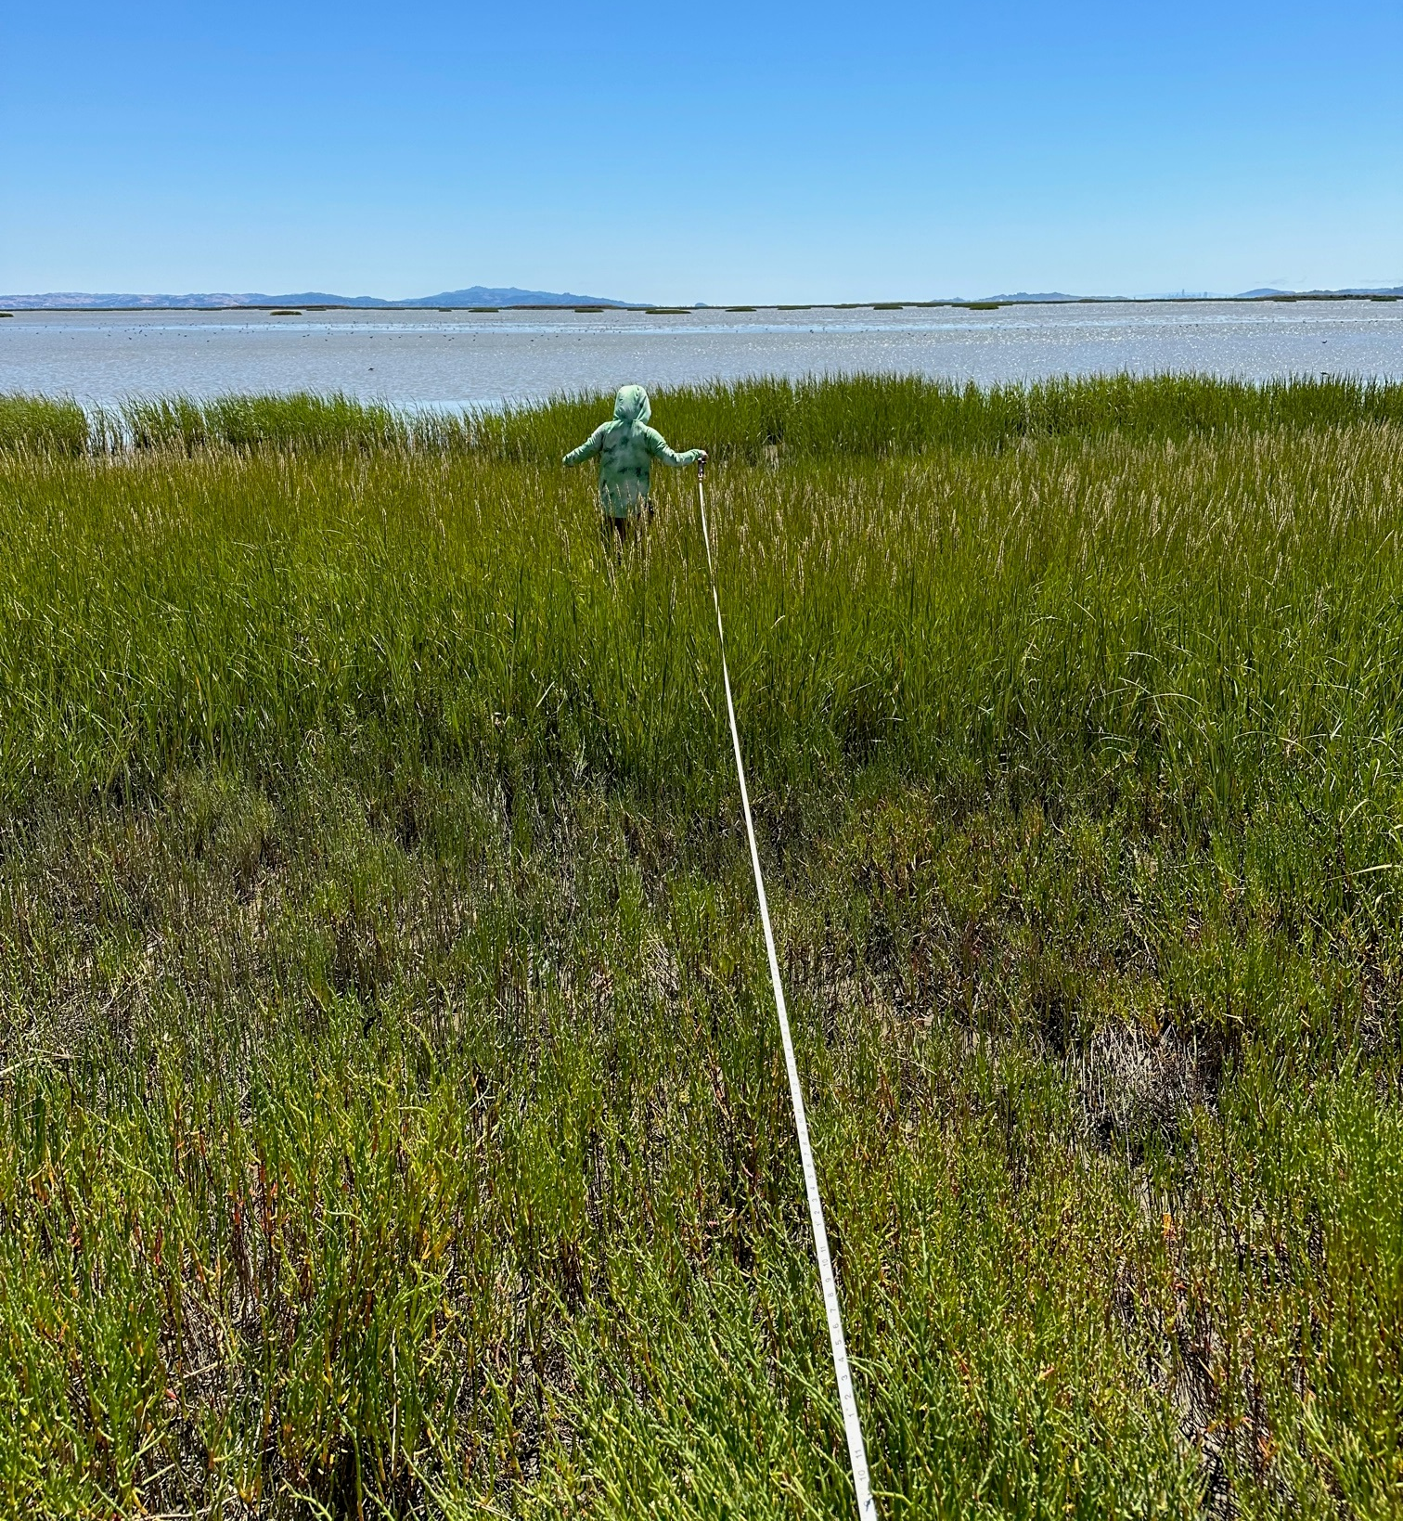
Nature-Based Shoreline Erosion Protection Works!
August 2023
July 2021

Slide 21
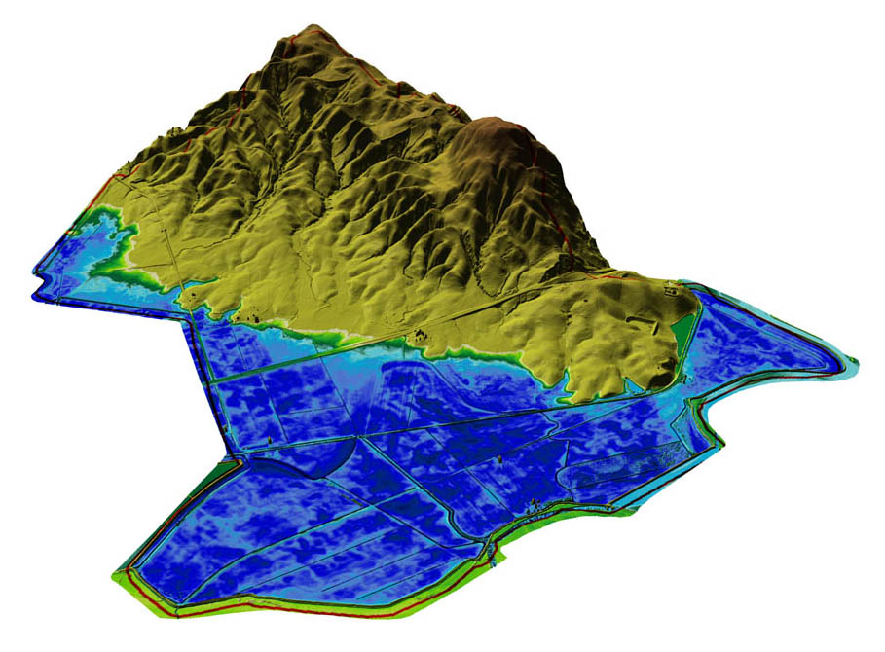
Timing is Everything!!
Opportunity: natural edge
Constraints:
Highway 37
Lakeville Highway
Rail line
Cougar Mountain
(Sears Point Raceway over hill to the north)
Lakeville Hwy
Hwy 37
Diked Baylands
Below Sea Level
Rail line
Area restored in 2015 to tidal marsh
Result:
Restore 1,000 acres south of rail line only
Zero natural edge
Stuart Siegel, Feb 2016
Notes:
Note that Roger will get into what did get done along the rail line edge

Slide 22
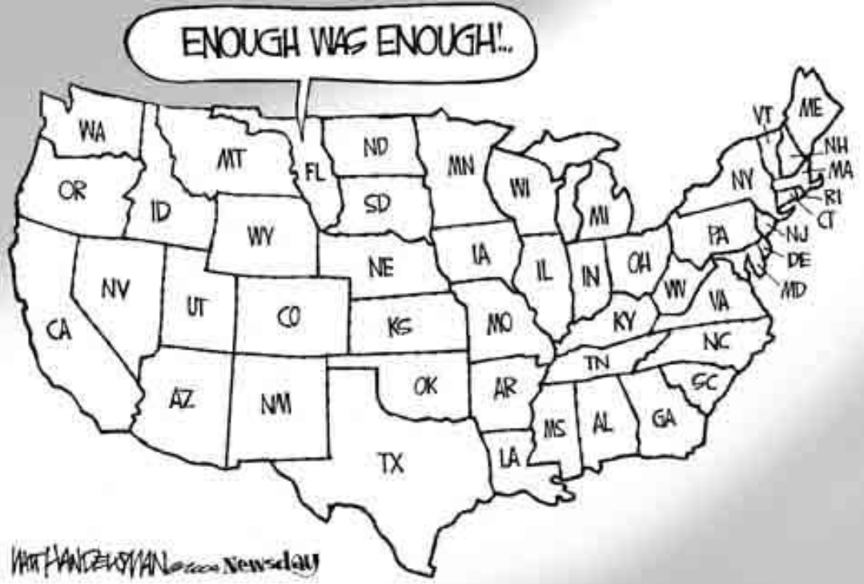
Think Boldly! Thank you
siegel@sfsu.edu

