Slide 1
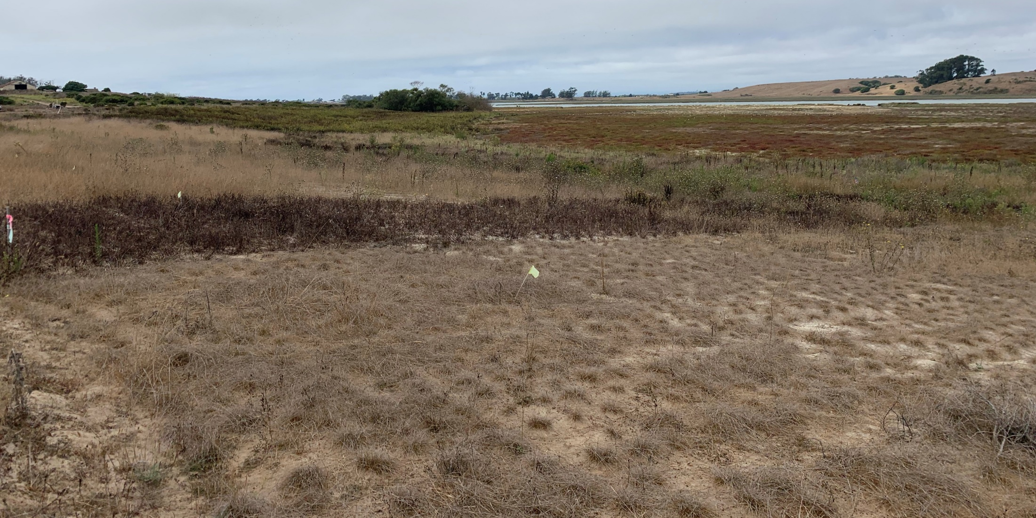
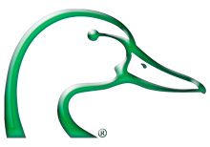
DESIGN AND ENGINEERING ADVANCES TO SUPPORT NATURE-BASED ADAPTATION
Marsh Migration Workshop
September 18, 2023
Steve Carroll, P.E.
Senior Regional Engineer
Ducks Unlimited, Inc.
Notes:
Slide: Title
Presentation for the Marsh Migration Workshop, September 18-19 2023.
There is a lot of guidance available for designing traditional structural solutions to shoreline protection. The performance of these approaches is tried and tested and well documented. But there’s not much guidance for designing resiliency with nature-based solutions. There is a lot of interest in developing it though. The American Society of Civil Engineers along with the USACOE and numerous university and other partings, including Ducks Unlimited, are working to develop design guidelines for nature based solutions.
References:
Image:
Ducks Unlimited, September 2023. Elkhorn Slough Tidal Wetland Restoration – Hester II

Slide 2
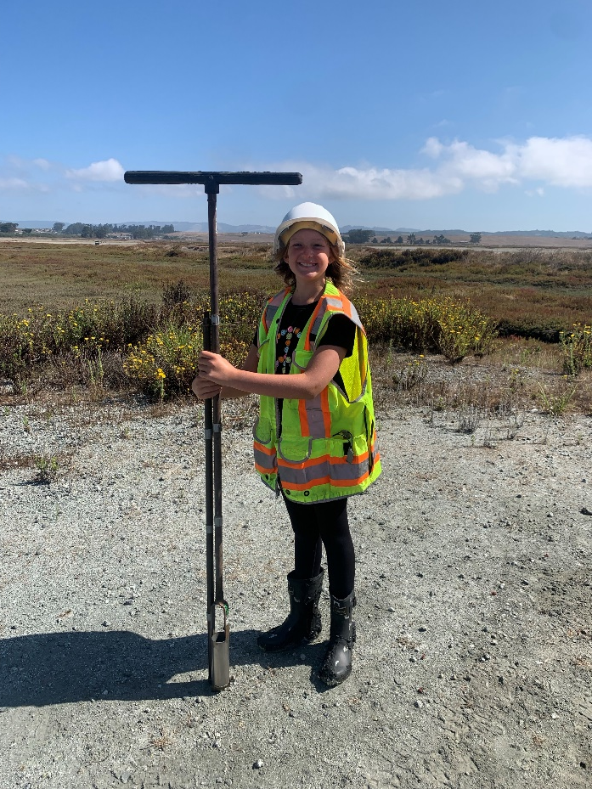
Many parameters feed into the design of habitat transition zones
Site characteristics
Adjacent land uses and infrastructure
Soil type and availability
Soil strength
Tidal datum and ground elevations (water depth)
Flood elevations
Sea level rise projections
Wind exposure and fetch (wind waves)
Erosion rates
Presence of special status species
Site access and constructability
Permit ability
Notes:
Slide: Site Assessment
Many parameters feed into the design of habitat transition zones
Site characteristics - Is the site in or adjacent to existing marsh, is it a retired salt pond, reclaimed farmland?
Adjacent land uses and infrastructure – What level of flood protection is required? What risk level are we comfortable with? How much space is available for the HTZ (levee or gradual uplands)?
Soil type and availability – Can we find the right soil in the right quantity in the right timeframe?
Soil strength – Affects method and speed of construction as well as settlement rates of final HTZ
Tide datums and water depth – designate the height, volume, and footprint of the HTZ
Flood elevations
Wind exposure & fetch (wind waves) – Primary erosional forces on HTZ’s
Erosion rates – Erosion rates of the existing shoreline can indicate protective features needed.
Presence of special status species – Affects the footprint, timing, speed, and method of construction.
Site access & Constructability – What type of constraints are their to accessing the site with the necessary equipment. Can the equipment build what is desired.
Permit ability – Can we permit what we want to build?
Image: Ducks Unlimited, Inc.

Slide 3
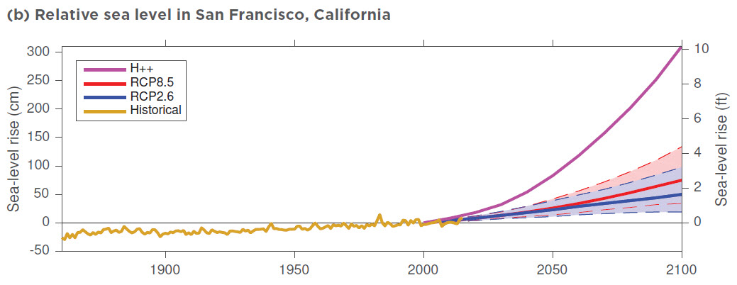
Sea level is expected to rise significantly over the next century.
63 AC
32 AC
34 AC
63 AC
Notes:
Slide: Sea Level Rise
Sea level rise is one of the few impacts of climate change that we can attempt to address in our tidal restorations.
Sea Level Rise (SLR)
SLR has been occurring for about 18,000 years, since the last ice age. Most of that time SLR rates were much greater than they are now.
Around 8,000 years ago the world stabilized and SLR progressed at less than 1 mm/year, primarily driven by a gradual warming of the earth and resulting thermal expansion of water and melting of land ice.
During the industrial age we started increasing GHG emissions and warming the planet, this caused SLR rates to increase to between 1 to 2 mm/year for the 20th century (50% thermal expansion and 50% melting land ice). However, since 1990, rates have more than doubled and continue to accelerate. This acceleration occurred when sufficient energy was trapped in the system that large scale ice melt began; this is when projections start to take an exponential increase.
This increase in SLR rates is a result of the ice loss from the great polar ice sheets covering Greenland and Antarctica. This will soon become the primary contributor of SLR, overtaking the contributions from ocean thermal expansion and melting mountain glaciers and ice caps [1].
The Presidio gauge near the Golden Gate Bridge has continuously measured tides since June 30, 1854. Only one other tide house (in Brest, France) has a longer uninterrupted record. [2]
Chart interpretation:
RCP 2.6 – a GHG scenario of stringent emissions reduction (in line with the 2015 Paris Agreement goals)
RCP 8.5 – a GHG scenario in which there are no significant global efforts to limit or reduce emissions.
H++ – represents a rapid Antarctic ice sheet loss early in this century (which is currently being documented by scientists).
Solid line is the median (50% probability) and shaded areas are the 5th and 95th percentiles (95% percentile equates to a 1/20 (5%) chance of exceedance).
References:
Griggs, G., Árvai, J., Cayan, D., DeConto, R., Fox, J., Fricker, H., et. al. [California Ocean Protection Council Science Advisory Team Working Group]. (2017). Rising Seas in California: An Update on Sea-Level Rise Science. California Ocean Science Trust, April 2017.
SF Gate: https://www.sfgate.com/bayarea/article/SAN-FRANCISCO-TIDES-OF-HISTORY-Presidio-gauge-2745805.php
Image:
Griggs, G., Árvai, J., Cayan, D., DeConto, R., Fox, J., Fricker, H., et. al. [California Ocean Protection Council Science Advisory Team Working Group]. (2017). Rising Seas in California: An Update on Sea-Level Rise Science. California Ocean Science Trust, April 2017.

Slide 4
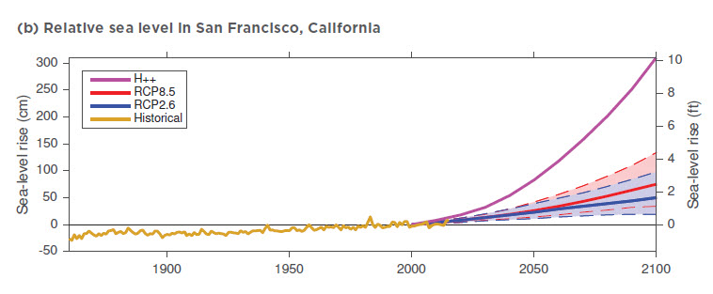
Our flood control systems are in jeopardy.
63 AC
32 AC
34 AC
63 AC
Notes:
Slide: Diminishing Flood Protection
This slide demonstrates the impact of sea level rise on the Bay Area’s flood protection.
The squiggly line at the bottom is a plot of mean sea level in San Francisco Bay and the dashed line represents projected sea level rise.
The individual data points above the mean sea level line are measured maximum monthly tide levels, which are the elevations of concern for flood protection.
The red line represents the elevation of our current day 100-year flood protection. As you follow that line out in time you find that by the year 2033 the flood protection drops to a 20-year event, and by 2100 drops to a 2-year event.
This represents a monumental task. The USACOE, Santa Clara Valley Water District, and California State Coastal Conservancy have undertaken the South Bay Shoreline Project. This will provide flood protection for about 4 miles of shoreline and includes levee construction, HTZ and restoration, and other elements at a cost of $545 million. This is a fraction of the shoreline in San Francisco Bay.
Reference:
Jeremy Lowe
Image source:
Jerome Lowe, ESA

Slide 5
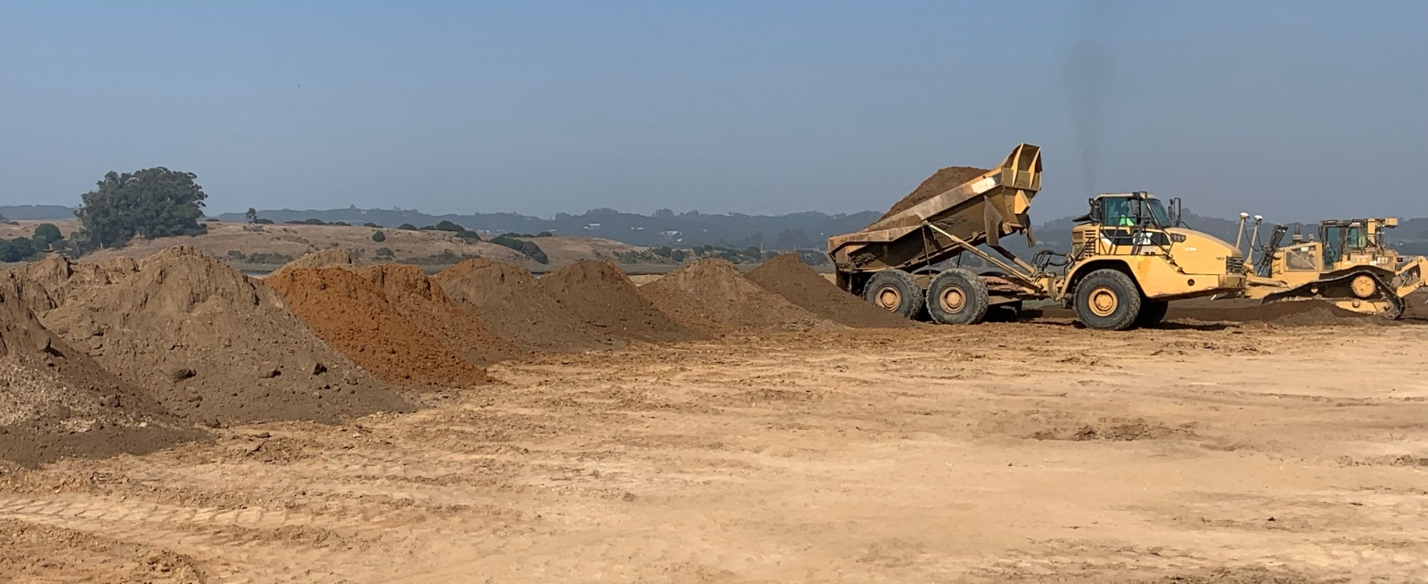
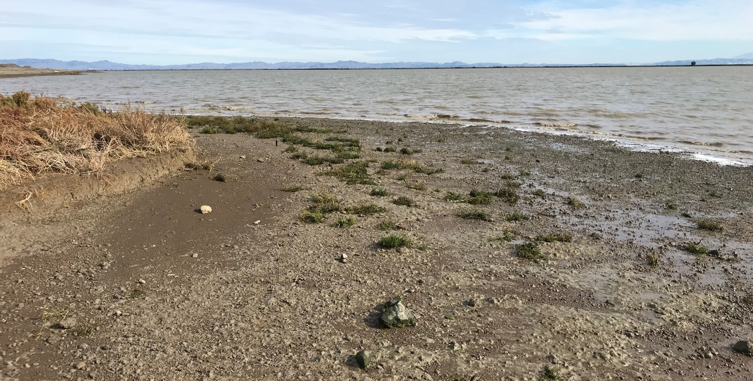
Soil type and availability are key parameters in migration zones
63 AC
32 AC
34 AC
63 AC
Elkhorn Slough stockpile
Scarp on the Sears Point habitat transition slope
Notes:
Slide: Earth Fill
Obviously we need fill in order to construct marsh migration zones. The type of material we get makes a difference.
The soil needs to be clean, it needs to be an adequate medium for plant growth, and it needs to be resistant to erosion.
We are not necessarily looking for material that meets the geotechnical specifications for levee fill, but we do typically want material that is cohesive, meaning clays and silts.
Non-cohesive materials such as sands move around too much. The work on beaches because of the shear volume of sand present. They get moved offshore during the winter storms then brought back by smaller waves in the summer. This won’t work for most transitional slopes.
The fine grained cohesive soils have different sediment dynamics than that of sandy shorelines.
Wave energy is required to dislodge cohesive soils. Once dislodged and suspended, these particles are readily maintained in suspension and can be transported significant distances by weak currents.
The recession of cohesive shorelines normally begins with the lowering of the mudflats in the nearshore, which then permits larger depth limited waves to impact the shore and causes it to recede. In other words, the scarp has been developed by the downcutting of the levee slope in front of it, not from the undercutting of the levee at the scarp.
Image source:
Ducks Unlimited, September 2023, Elkhorn Slough Tidal Marsh Restoration construction
Ducks Unlimited, December 2018, Sears Point Restoration HTZ

Slide 6
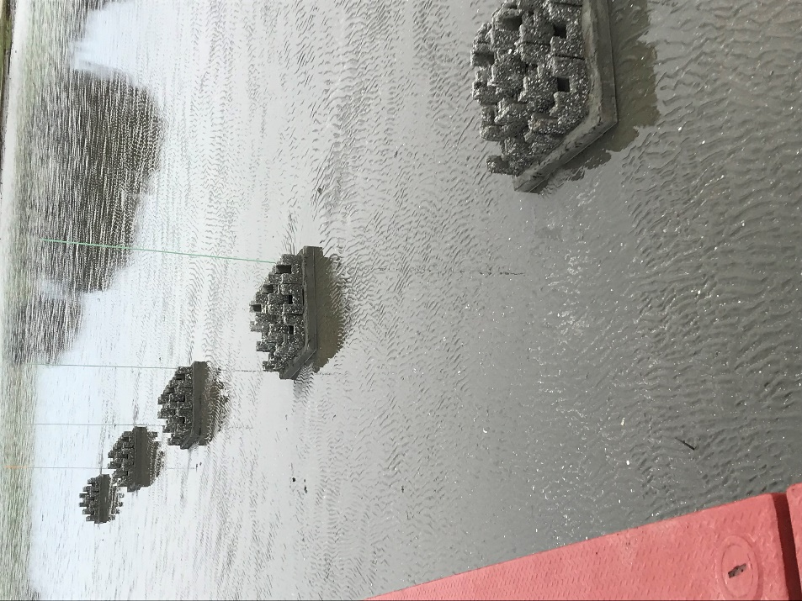
Creating resiliency with Nature Based Solutions
Increasing erosion resistance
Vegetation
Gravel filter/ gravel beach
Flatter slopes
Wave attenuation
Minimize fetch
Reduce water depth
Sacrificial berms or mounds
Hybrid approach
Reef balls, breakwaters, rock reefs
Open celled articulated concrete matts
Buried armoring
Placing reef castles at Giant Marsh
Notes:
Slide: Nature Based Solutions
We want our transition zones to be part and parcel to the wetland; they need to undergo the geomorphic process along with the rest of the system. We don’t want wholescale loss of material however. These are some nature based solutions to develop resiliency:
Vegetation - Vegetation has been shown to provide erosion control benefits in some shoreline conditions. The aerial portion of the plants can form a flexible mass that dissipates wave energy and creates an environment conducive to sediment deposition. Plants with dense root rhizomes can also stabilize the soil. One study found that dense marsh vegetation reduced the energy in a ½ foot wave by 72% over 15 feet (USACOE 1989). Minimum vegetation width for successful erosion control is around 20 feet.
Wave attenuation – Wave energy is proportional to the square of wave height. If you reduced the height of a 1-foot wave by 1/10 of a foot, the energy would be reduced by 20%. A decrease in wave height greatly reduces the energy. This could be raising marsh in front of the HTZ, creating sacrificial islands or mounds, flattening the HTZ slope.
Gravel filter – or a gravel beach. Using progressively larger aggregates to a size that’s resistant to being transported.
Hybrid approach between structural and nature-based solutions.
Breakwaters/reef in front of the HTZ (reef balls, rock barriers)
Articulated concrete matt with open cells for out planting
Buried armoring under the HTZ as failsafe in case of erosion
Image source: Ducks Unlimited.

Slide 7
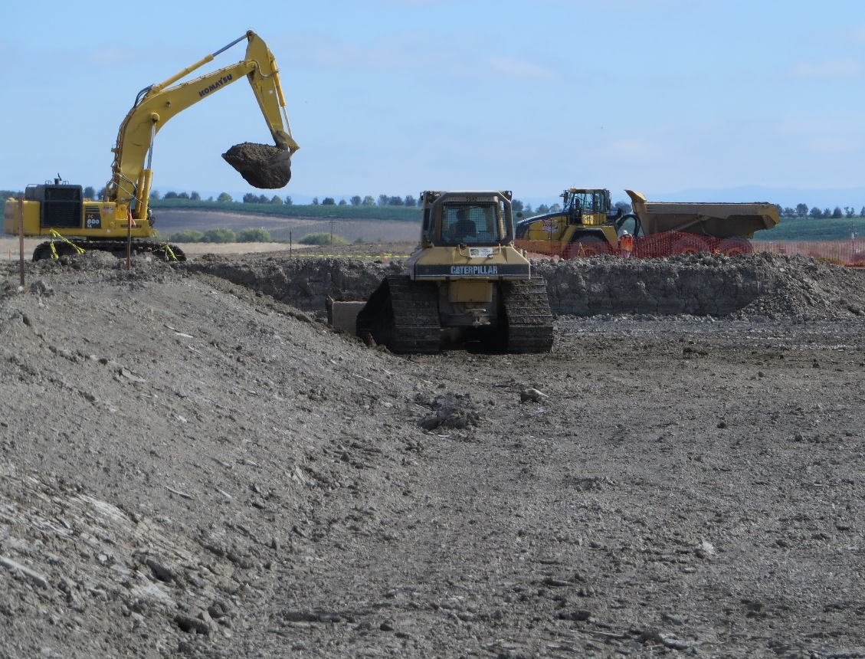
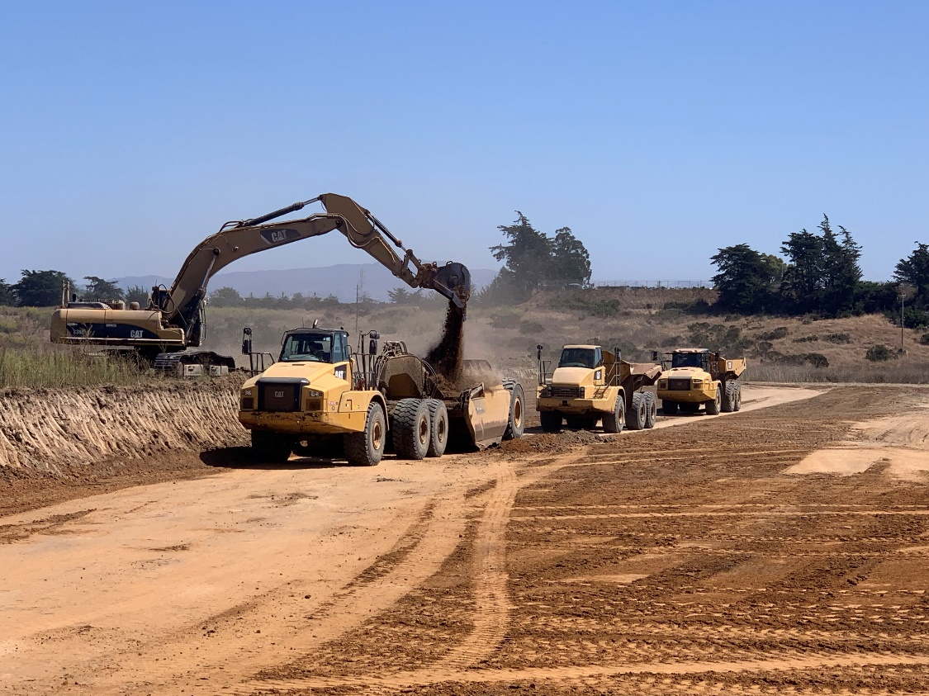
On-site borrow allows for full control of the project schedule
63 AC
34 AC
Sears Point channel excavation
Elkhorn Slough seasonal wetlands & grassland excavation
Notes:
Slide: On-Site Sediment Sources
So where do we get the needed sediment? If situations allow, it can be borrowed from within the site.
Benefits
On-site borrow sources allow for full control of the construction schedule. Material is borrowed as needed and hauling distances area greatly reduced compared to off-site sources
Habitat features such as tidal channels can be created through the borrow operations.
Upland areas can be regraded to create marsh migration zones, seasonal wetlands and riparian areas.
Drawbacks
Material supply is often limited.
Tidal channels may need to be much larger than necessary to generate fill.
General site lowering could result in lower marsh and larger wind waves
Material suitability
On-site fill, especially from deeper digs, may not be a suitable growing medium
Excavation in wetlands tends to produce acid-sulfate soils which require amending and additional work
Image source: Ducks Unlimited, Inc.

Slide 8
Importing off-site sediment adds complexity to the project
Ravenswood upland import
Notes:
Slide: Off-Site Sediment Sources
Off-site sediment sources adds complexity to the project.
Benefits
Soil quality can be specified.
On-site excavations are limited to features that enhance the restoration effort; they don’t have to be expanded or created to harvest fill.
Offsite sources include commercial development projects, desilting projects from creeks and channels, and dredged material.
Challenges
Using the dirt broker model, the project is linking itself to other external projects that have completely different objectives. The restoration project is looking to obtain off-haul dirt, a waste product from the source’s perspective, and therefore is not in control of the construction schedule. The project has to be ready to accept material when it’s ready to be hauled and in a position to accept as much as they can produce.
It is the construction triangle of Time – Money – Quality. The project gets to pick two of the three, the contractor get’s the third.
Material availability is subject to the construction market. Timing doesn’t necessarily line up, if there is any material available at all.
Engendered species presence complicates import; species breading windows tend to coincide with off-hauling windows from commercial projects. There have been multiple cases where we couldn’t import available fill due to presence of special status species.
Upland material must be approved through the QAPP. Dredge material must be approved through the DMMO
Image source: Dave Halsing, SBSPRP

Slide 9
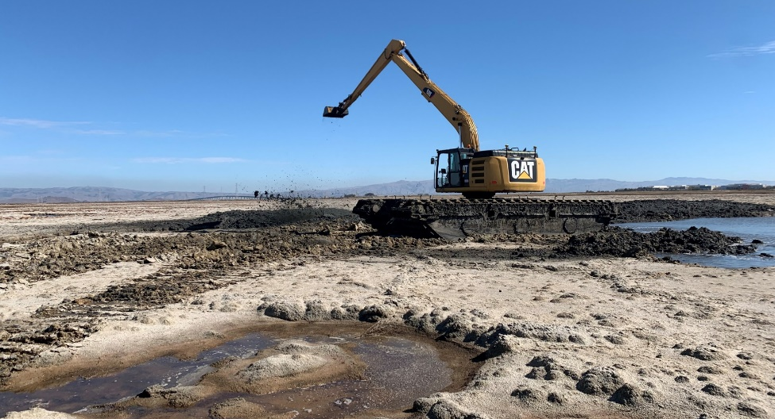
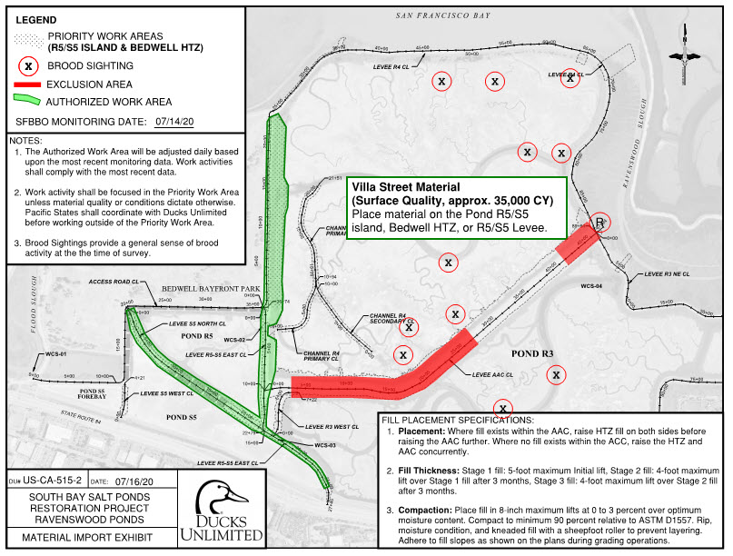
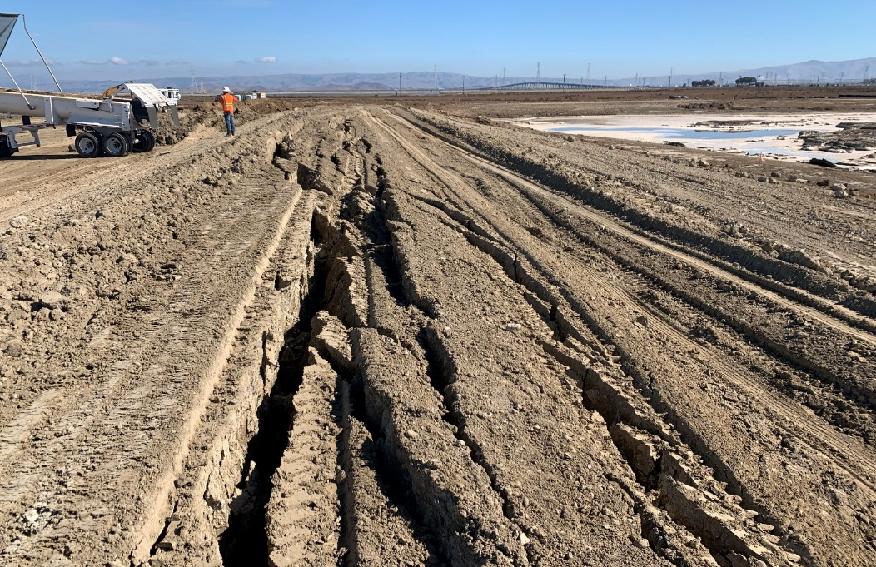
Ravenswood, Mountain View, Pond A8 (USFWS) and Eden Landing (CDFW) are importing upland material for HTZ
63 AC
Amphibious excavator excavating tidal channels
Special status species tracking
Slope failure due to overloading soft soils
Notes:
Slide: Ravenswood Unit of the South Bay Salt Pond Restoration Project
Importing material to Ravenswood has been challenging and resulted in an extended project duration.
For example, in 2022
The project missed out on substantial quantities of material due to slow approval process.
The site was broadly populated with endangered species, which precluded placement of soil where needed and necessitated stockpiling. This meant that soil had to be picked up and moved a second time at increased project cost.
The presence of endangered species (Ridgeway’s rail and Snowy plovers) prohibited placement at end of AAC. In an attempt to complete the work in 2022 the project decided to place fill in exceedance of the geotechnical guidance, and we caused a levee failure. Had to take corrective actions which extended the project into 2023.
In 2023 there has been no material available. The project is waiting for a final amount of 25,000 cy. We are currently putting in motion the process to pay to import the needed fill so that we can complete the project this year.
Image source:
Ducks Unlimited

Slide 10
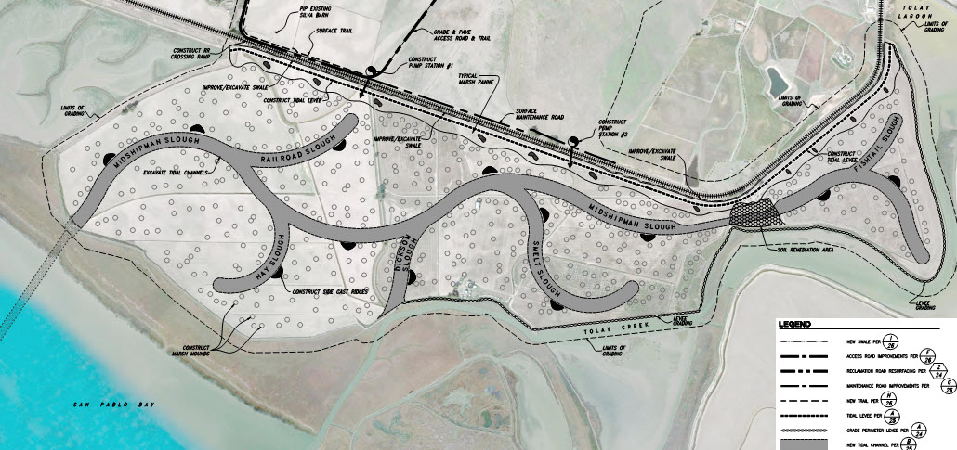
The Sears Point HTZ performs multiple functions
Notes:
Slide: Sears Point Restoration Project
Sears Point is located in north San Pablo Bay.
The site is a subsided agricultural parcel that is bound by agricultural lands, restoration sites, and infrastructure requiring flood protection.
In this case it is bisected by a railroad which limited the extents of tidal wetlands. As a result, the project restored approximately 1,000 acres of tidal wetlands and 600 acres of wildlife friendly agricultural lands and seasonal wetlands.
Its upland boundary is a state highway, which necessitated the installation of large stormwater pumpstations to prevent highway inundation during storm events.
A tidal channel was excavated through the surrounding mudflats to connect the subsided site with the Petaluma River Channel. Material from the dredging operation was beneficially used onsite.
Tidal channels were excavated trough the site. The channels weren’t essential given the sites low elevation but were needed to generate the 1 million cubic yards required for the new levee.
The 2.5-mile levee was constructed on highly compressible young bay mud. It was constructed in two stages with a final height that ranged from 12 feet to 16 feet, depending on the thickness of the YBM beneath. The levee was constructed with a broad habitat transition slope projecting into the tidal wetlands that varied between 10:1 and 20:1. The slope incorporated marsh pannes to add habitat diversity.
To accelerate construction and to address sea level rise, the levee was constructed with a stability berm on the landward side. This stability berm could become a borrow source for future levee raising once pore pressures reduce and primary consolidation is complete. The levee was constructed with a wide top width to accommodate future raising. The habitat slope performs the same function on the wetland side.
Sears Point was restored in its subsided state. The site is located in an area of the bay that consistently has high suspended sediment concentrations and it expected to rapidly aggregate.
Around 2018 a scarp formed on the transition slope and Sonoma Land Trust undertook adaptive management actions to address it.
Image source:
Ducks Unlimited

Slide 11
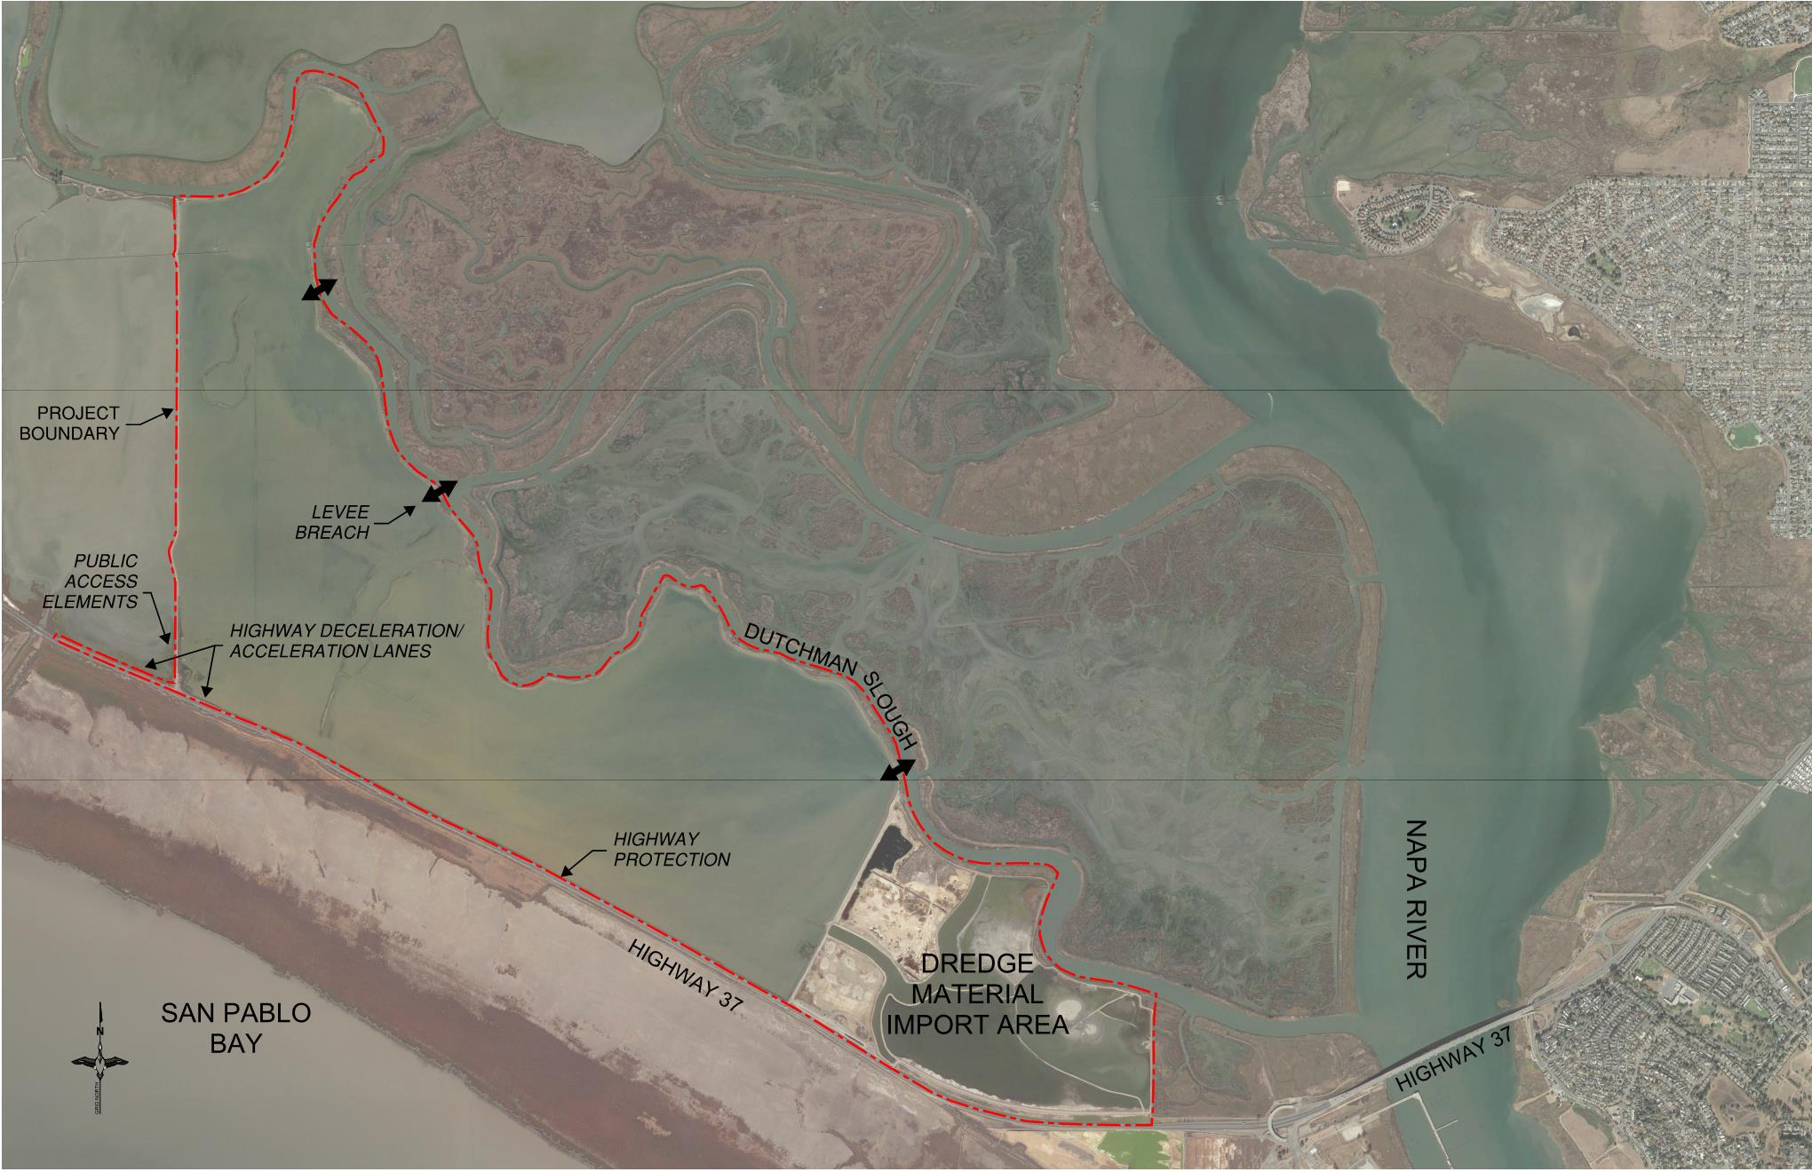
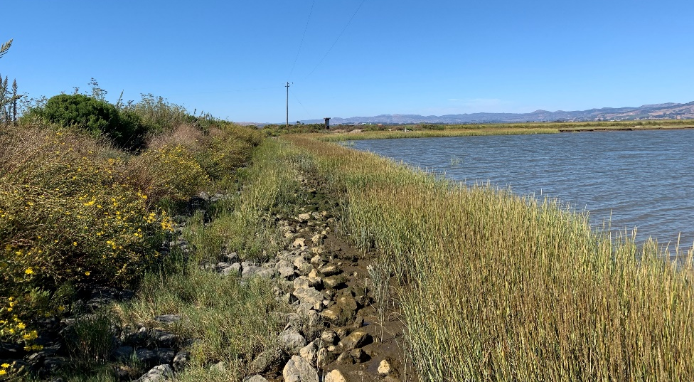
Adaptive management at Pond 1 used a hybrid approach
Notes:
Slide – Cullinan Ranch Pond 1 levee adaptive management
The Pond 1 Levee HTZ was constructed against an existing levee. Material was borrowed onsite and used to construct a 7:1 slope up to elevation 8, where it transitioned to a 3:1 slope to the levee top.
Cullinan was restored in 2015. The scarp formed around 2018 and began to erode into the levee rapidly (erosion began about the same time that the scarp formed at Sears Point).
HTZ was on the downwind side of the predominate wind so the energy should have been minimal.
Material delivery and construction was challenging. A hybrid approach was taken where rip rap was buried under the rebuilt transition slope. The rock was backfilled with imported soil and extensive upland and wetland plants were out planted. Work was completed in 2020. Photo was taken in 2023.
Image source:
Ducks Unlimited

Slide 12
Thank you for your time and attention!
Canvasbacks at Cullinan Ranch after Restoration
Notes:
Slide: Closing
In conclusion
Each site is unique and will respond to restoration actions in its own unique way
Engineering with nature is evolving; there are several efforts underway attempting to provide design guidance
Engineering with nature is a worthy pursuit but sites should incorporate the ability to take adaptive management actions that include grading modifications and addition of fill as necessary.
Sites that provide critical flood protection benefits or that have high exposure to erosional forces should consider using a hybrid approach to incorporating nature based solutions
Image source:
Ducks Unlimited, Cullinan Ranch

