Slide 1
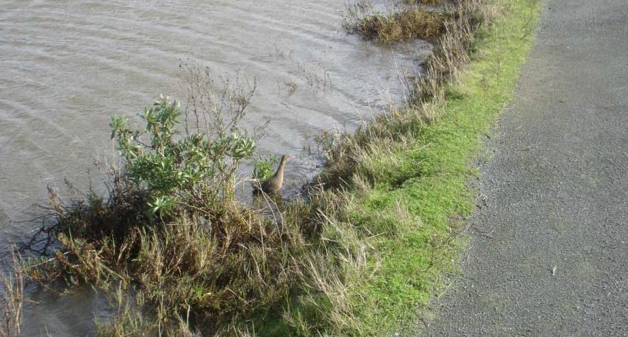
T-Zone Design Is Context Specific: Lessons from Two South Bay Flood Risk Management Levee Projects
California Ridgway’s
rail
Wetland Migration Workshop September 18, 2023
Gavin Archbald, M.S. Associate Restoration Ecologist
H. T. Harvey & Associates

Slide 2
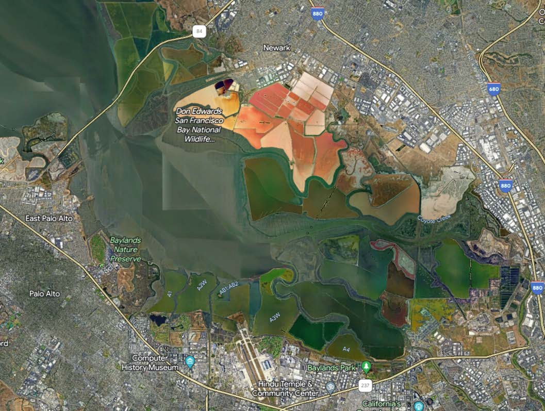
Outline
Ecological functions of tidal- terrestrial transition zones
SAFER
Bay Project
2 projects, 2 different transition zone designs
South SF Bay Shoreline Project
Limits of t-zones to sustain marshes with SLR

Slide 3
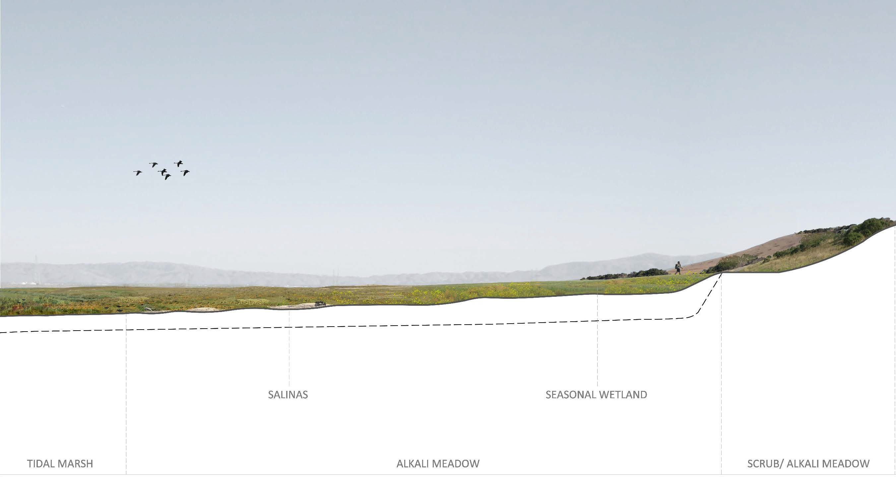
Tidal-terrestrial transition zone provides:
Habitat diversity
Buffer from upland land use High-tide refugial habitat SLR accommodation space
Also, see: Baylands Ecosystem Habitat Goals Science Update 2015

Slide 4
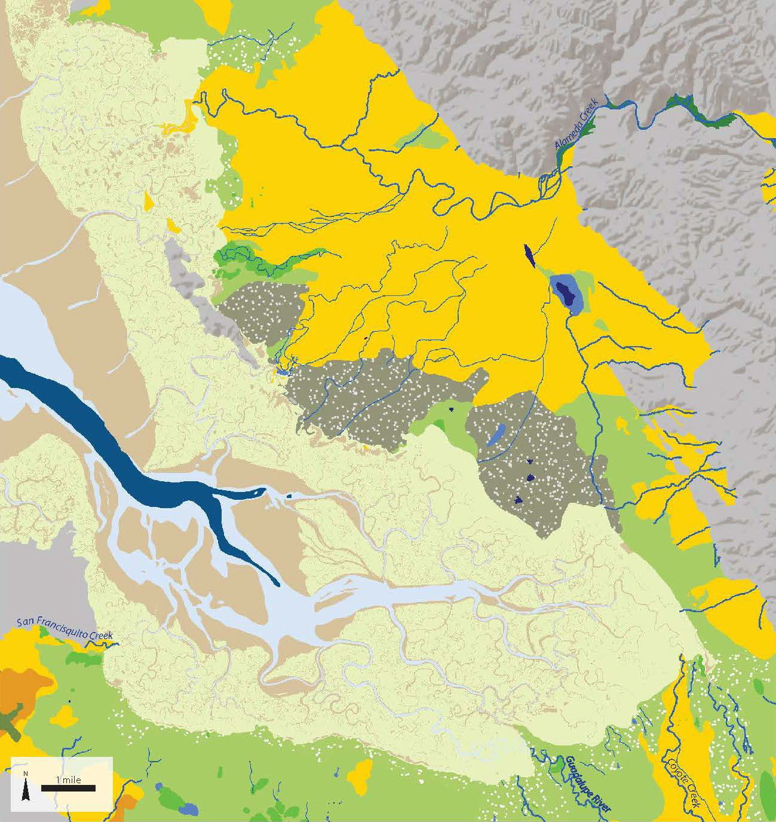
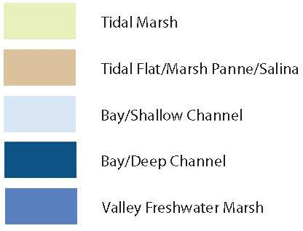
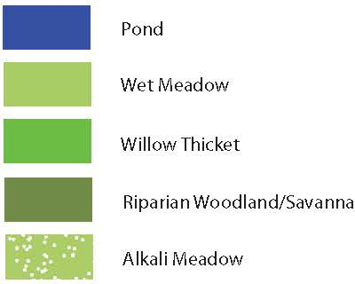
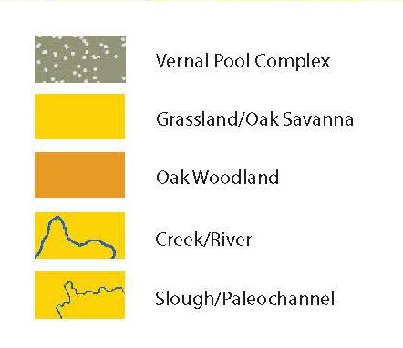
Lower South Bay T-Zone Historical Habitats
70% low gradient seasonal wetlands- marsh
Width varied from several feet to several miles
SFEI Historical T-zone Study (Beller et al 2013)

Slide 5
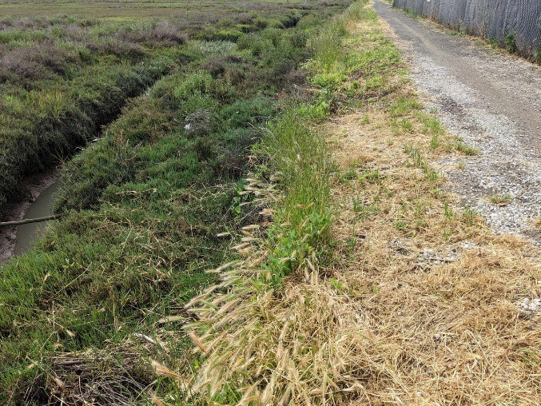
By contrast, steep berms now mostly comprise the t-zone.
Trail
T-zone
Marsh
Restoration part of the tidal marsh recovery plan for SMHM and CRR and other species
(USFWS 2013)

Slide 6
But…one t-zone size and design does not fit all projects!
Slope, habitat types, and construction methods are all context specific.
What t-zone functions are needed?
What design will provide the greatest ecological lift?

Slide 7
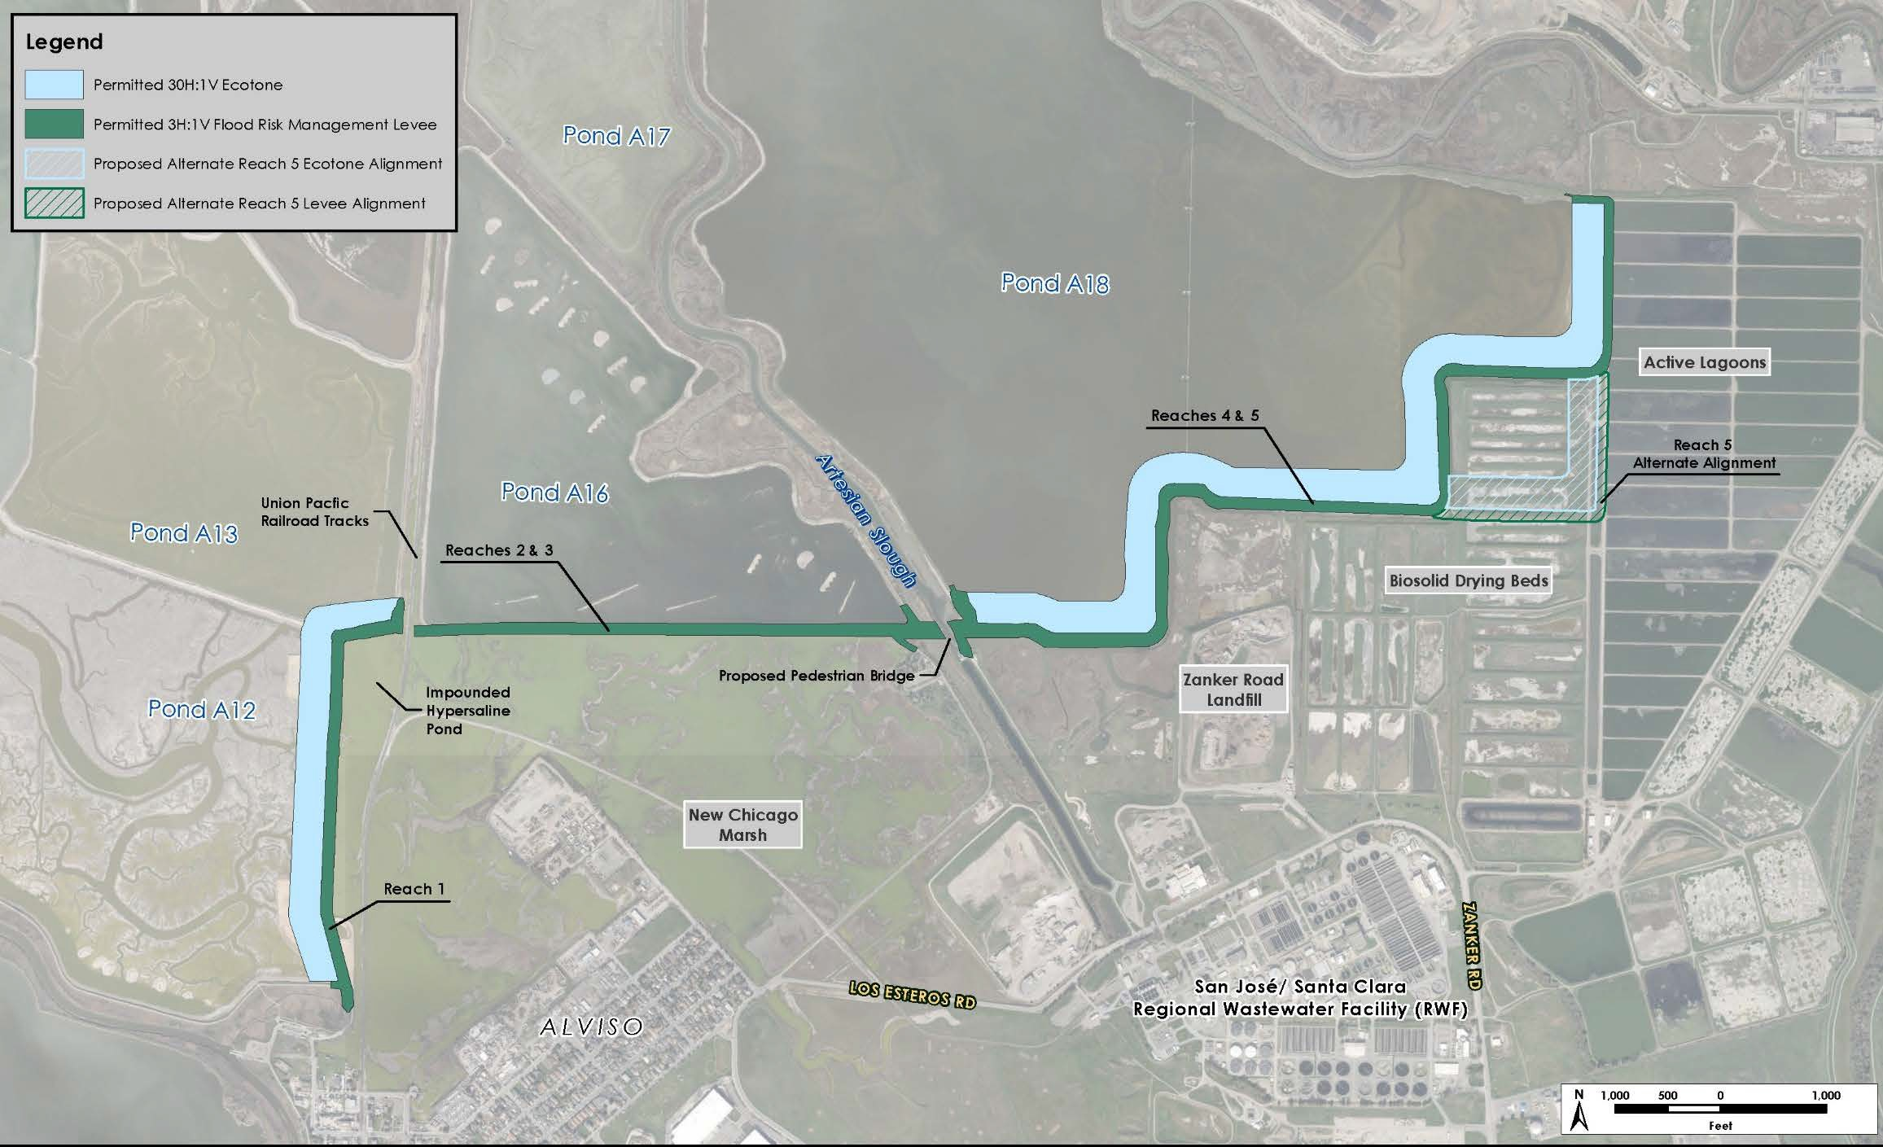
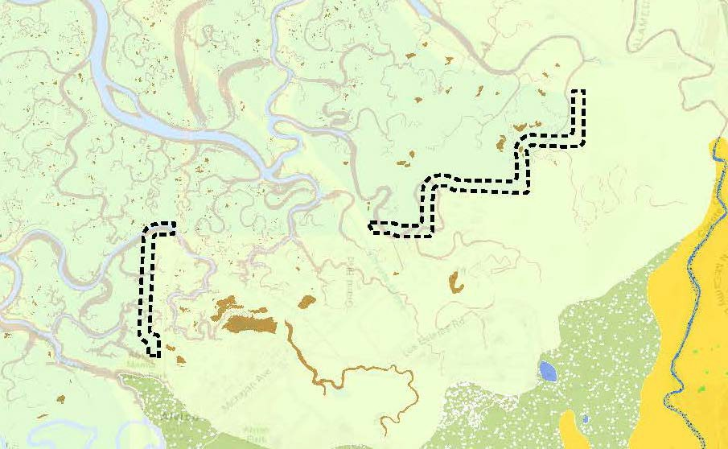
South San Francisco Bay Shoreline Project
5-mile flood risk management levee
30H:1V
Ecotone at Ponds A12, A13, A18
Reach 1-3 in construction
H. T. Harvey with Schaaf & Wheeler (2021) developed Basis of Design for t-zones Coastal Conservancy

Slide 8
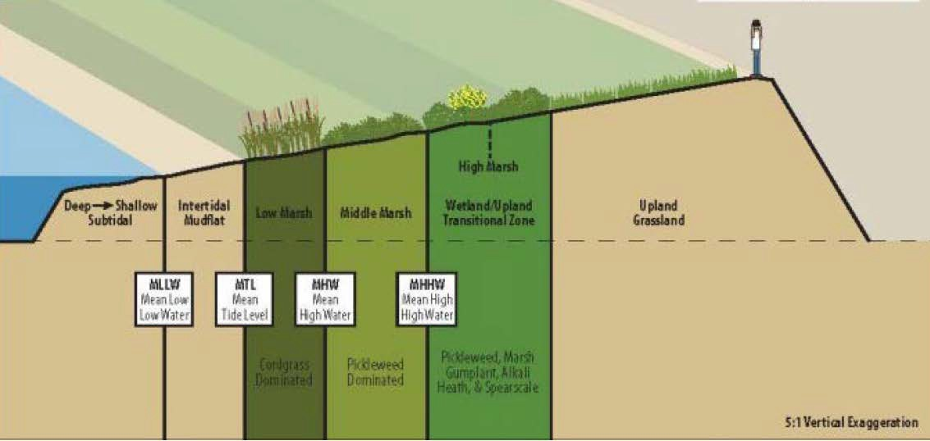
Restoration Goals
EIS/EIR calls for:
Continuous, gently sloped 30H:1V t- zone
Diverse native habitat mosaic representative of
historical t-zone habitats
HDR Engineering 2015
Pond A12 Proposed Ecotone with 30:1 Side Slopes Cross Section at Year 2020

Slide 9
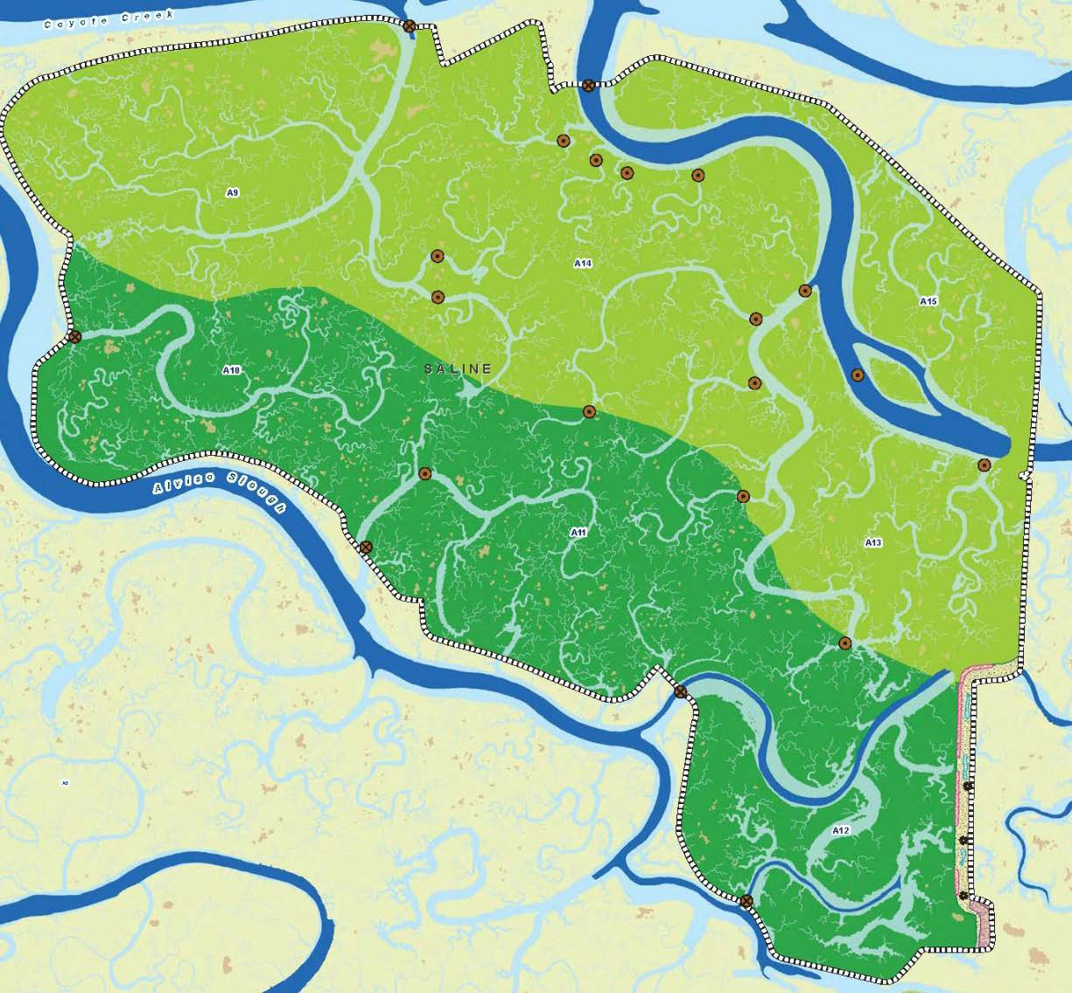
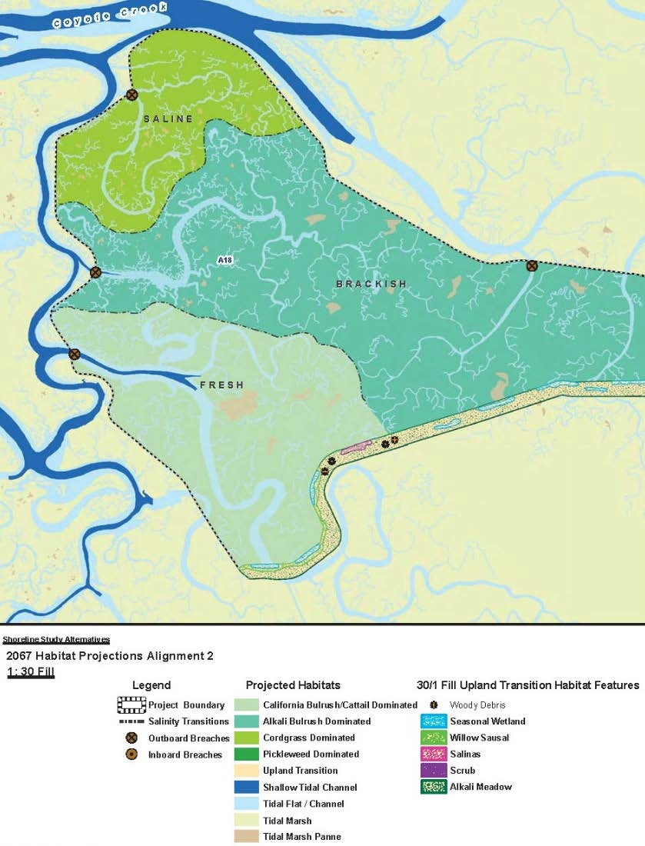
Permits call for:
~90 acres of t-zone
~2,900 acres of restored marsh
Figure from H. T. Harvey and SFEI 2012
Ecotone planned along Reach 1 (Ponds A12 and A13)
Figure 6: 2067 Habitat Projection – Alignment 2 – 30/1 Fill
Shoreline Study (2606-02)
October 2012

Slide 10
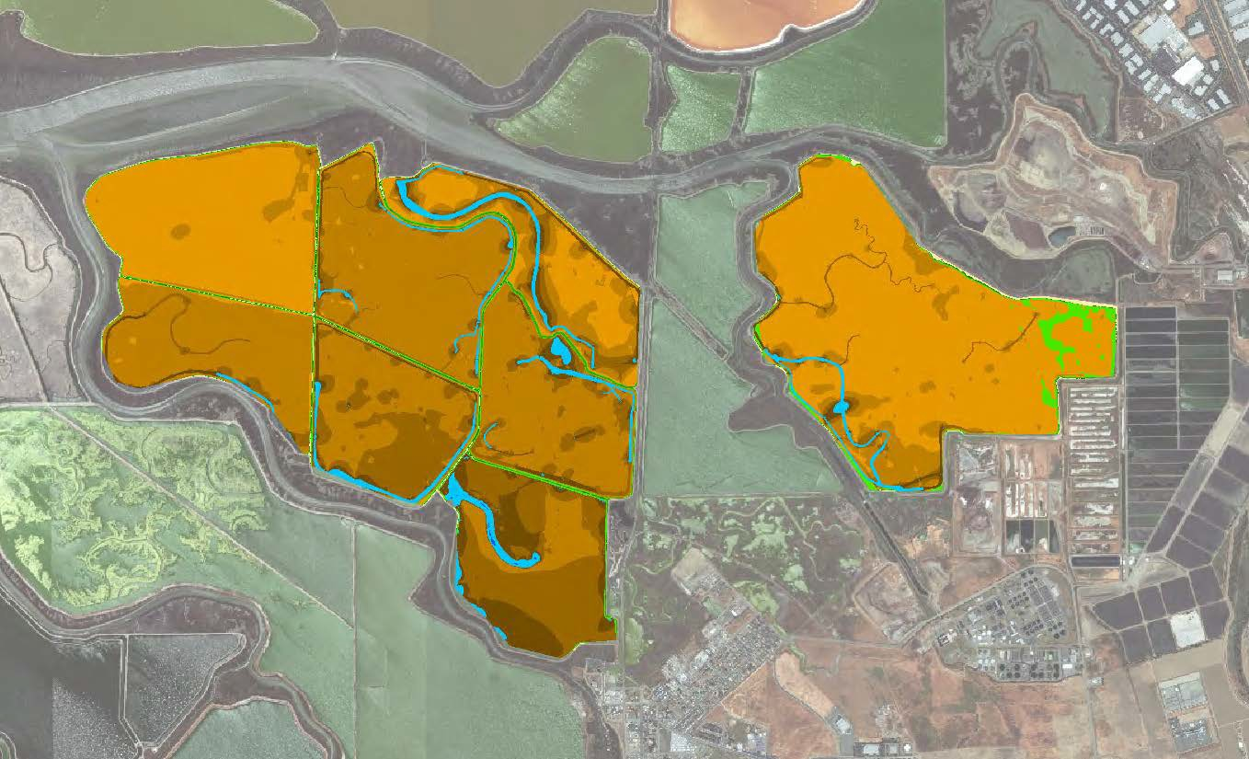
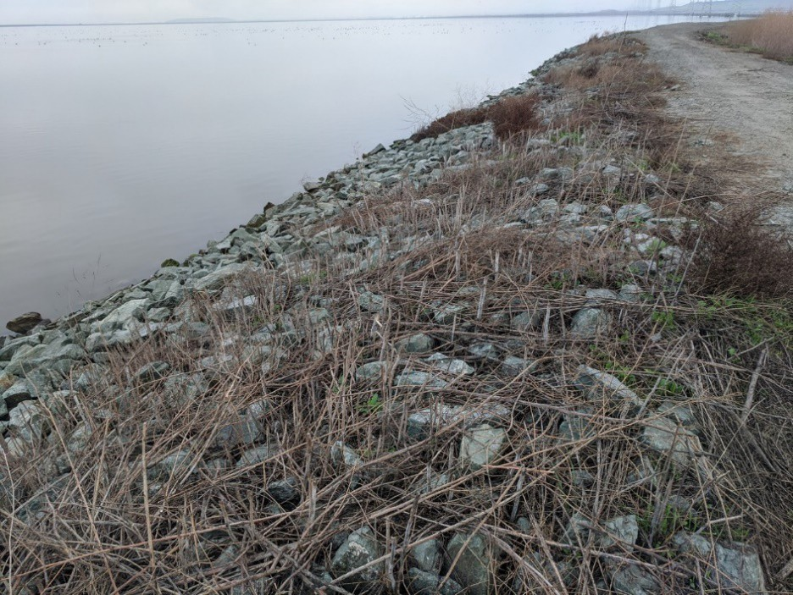
Open Water
Shoreline Study Alternatives
2067 Marsh Elevations with C0=100mg/L and 2017 Start
Could take decades for tidal marsh to establish
Wind wave erosion could threaten goal
Planned ecotones
ESA PWA 2021

Slide 11
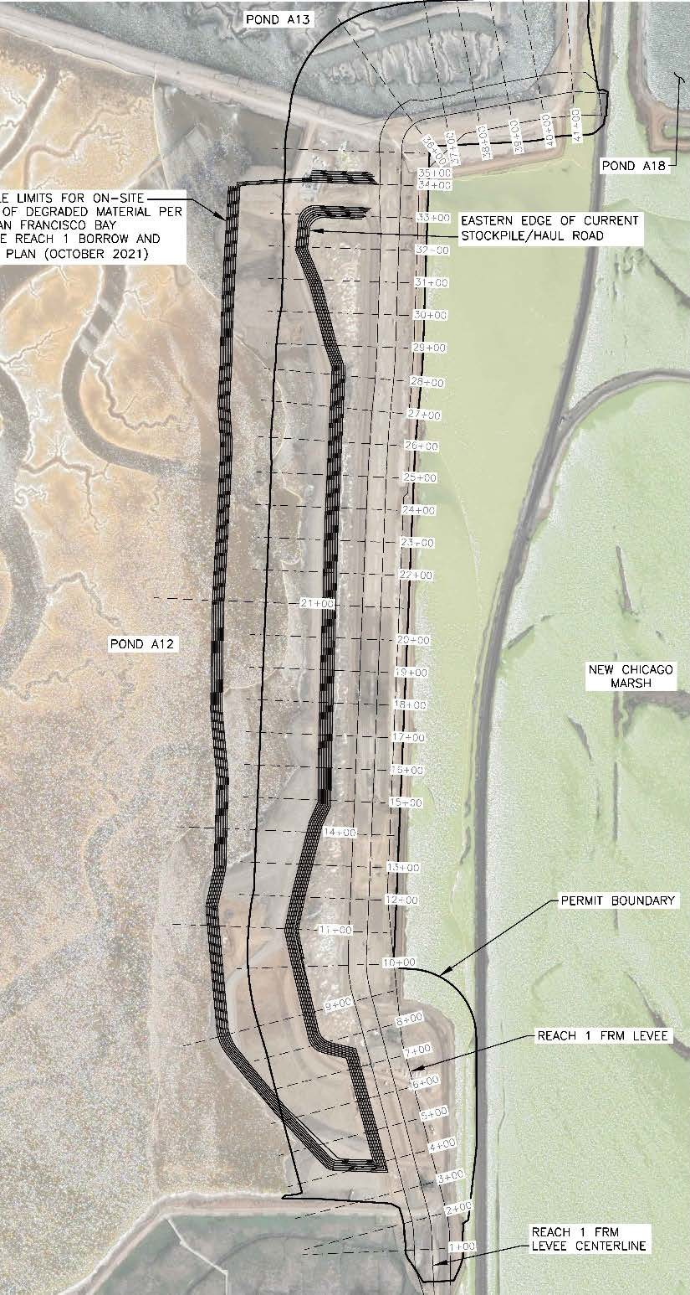
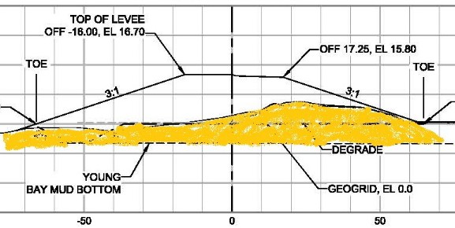
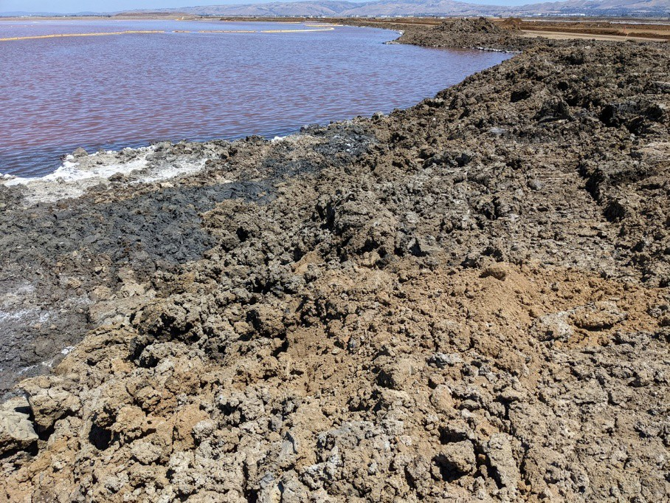
Earthwork
Stockpile
Reworking bay mud costly
Stockpiled outboard of t-zone
Avoid reworking bay mud
Maximize habitat values
FRM
Levee
U.S. Army Corps of Engineers South San Francisco Bay Shoreline Project November 2022

Slide 12
Recommended Design
Maximize marsh on t-zone
Support marsh species sooner
Prevent erosion
30:1 transitions to marsh plain
60 feet above HTL after 3 ft SLR
150 ft of t-zone
350 ft of marsh
Import terrestrial fill as base for habitats above MHHW
Bay mud stockpile
H. T. Harvey with Schaaf & Wheeler. 2021

Slide 13
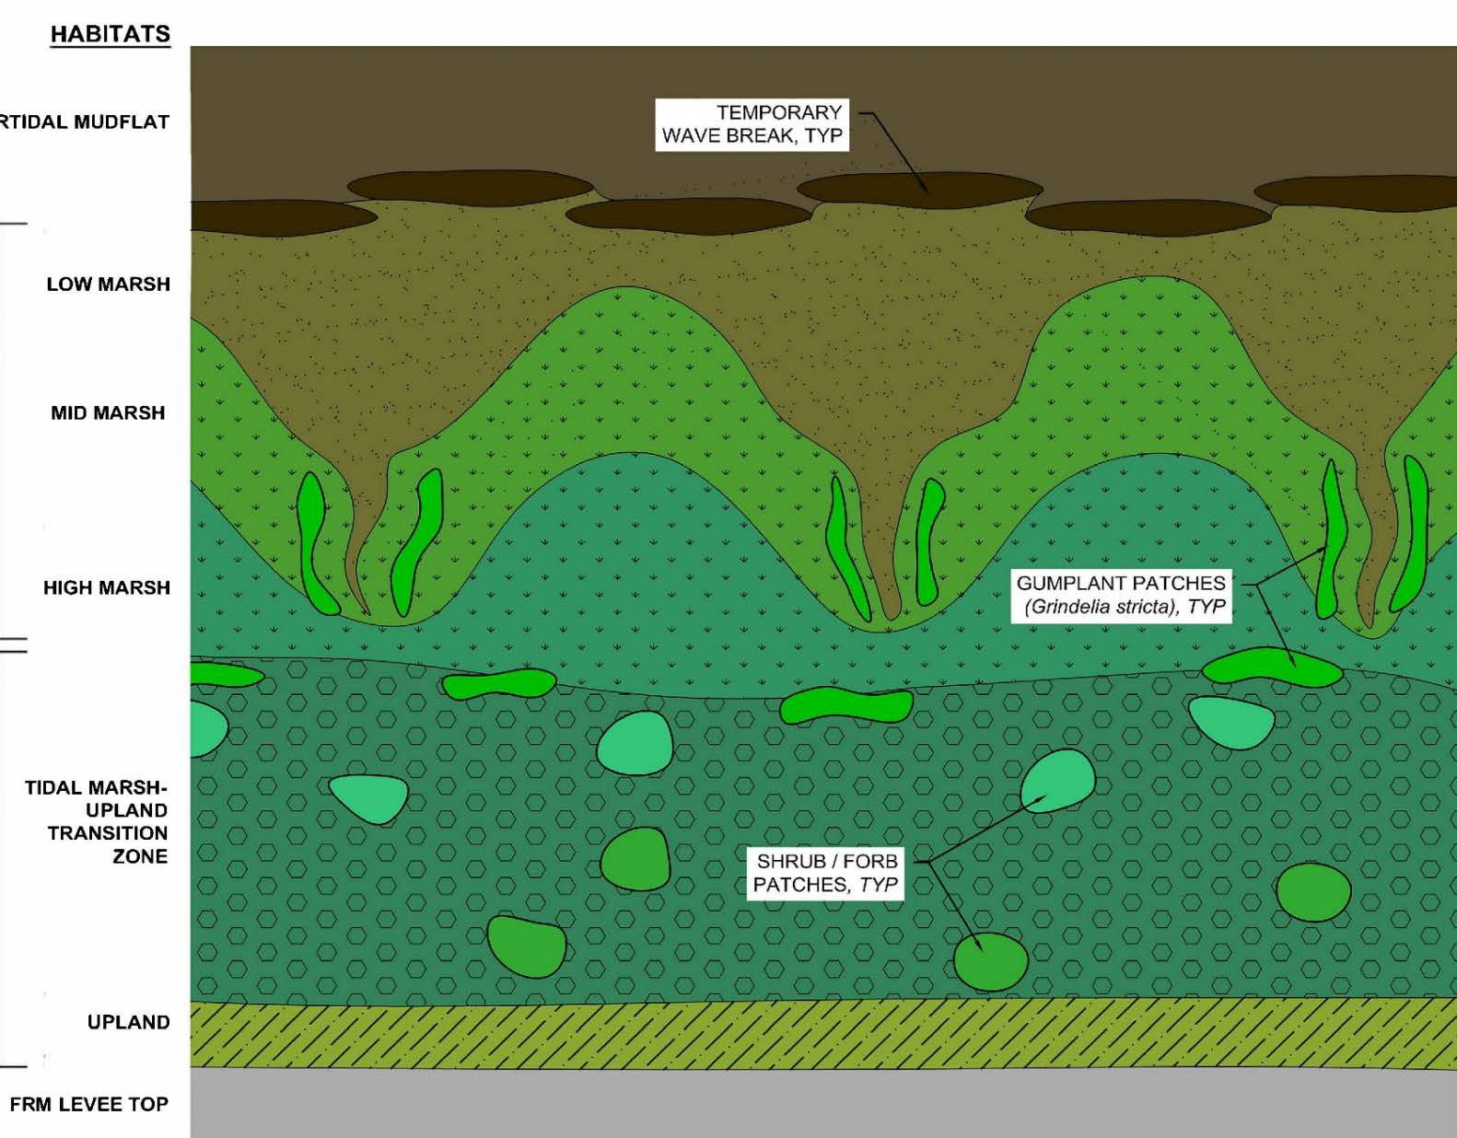
Habitat elements:
Micro-watersheds
1st order tidal channels
Diverse marsh plant community
Alkali grassland from seed
Rhizomatous forb patches
Low growing shrub patches
H. T. Harvey with Schaaf & Wheeler. 2021

Slide 14
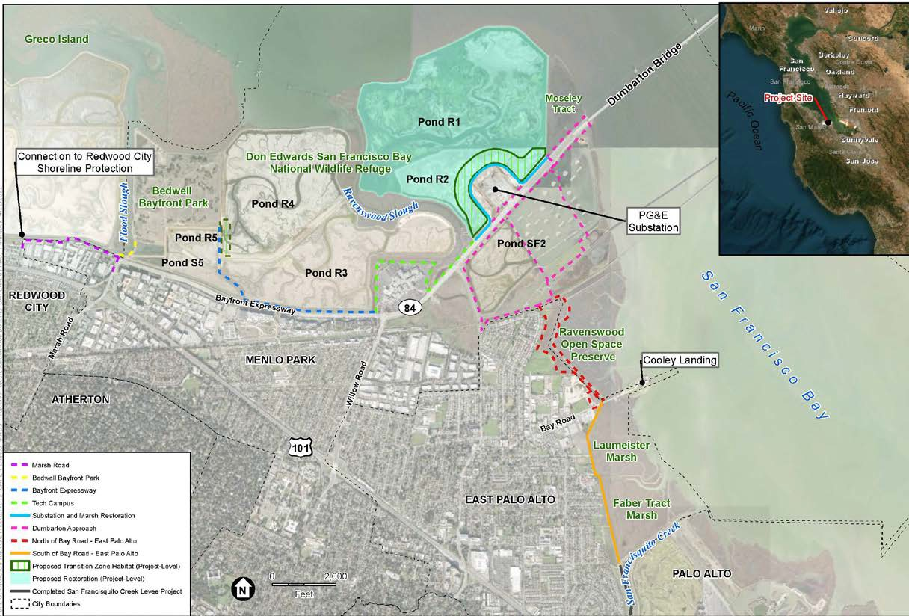
Strategy to Advance Flood Protection, Ecosystem restoration and Recreation along San Francisco (SAFER) Bay Project
Protects 7 miles of shoreline (East Palo Alto and Menlo Park)
~550 acres of habitat restoration
w/South Bay Salt Ponds Restoration Project at Ponds R1 and R2
Gently sloping transition zones where ecologically advantageous
Note: Several design elements shown on this figure have changed

Slide 15
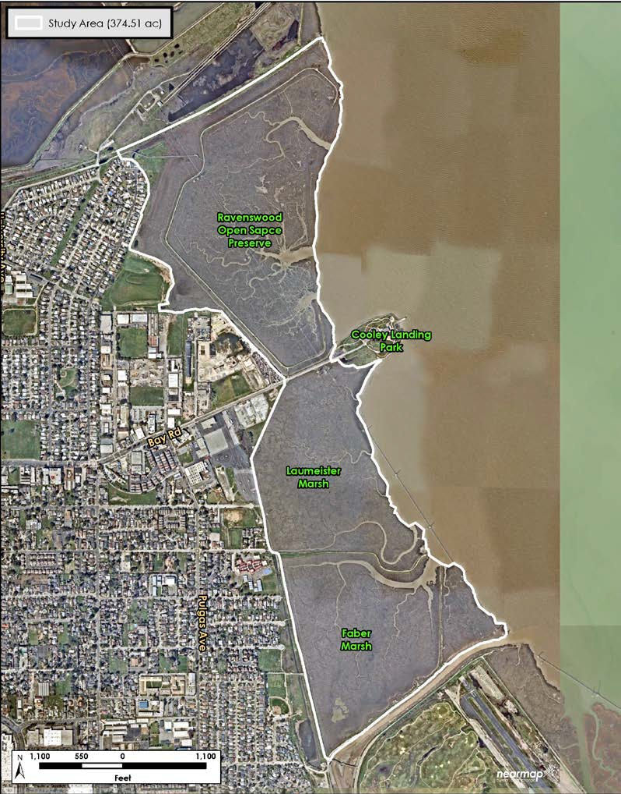
SAFER High Tide Refugial Habitat Study
Purpose
What is the recommended t- zone width and slope?
Methods
Map existing refugia habitat quality
Qualitatively compare impacts vs benefits of building a t-zone into the marsh
H. T. Harvey & Associates 2023

Slide 16
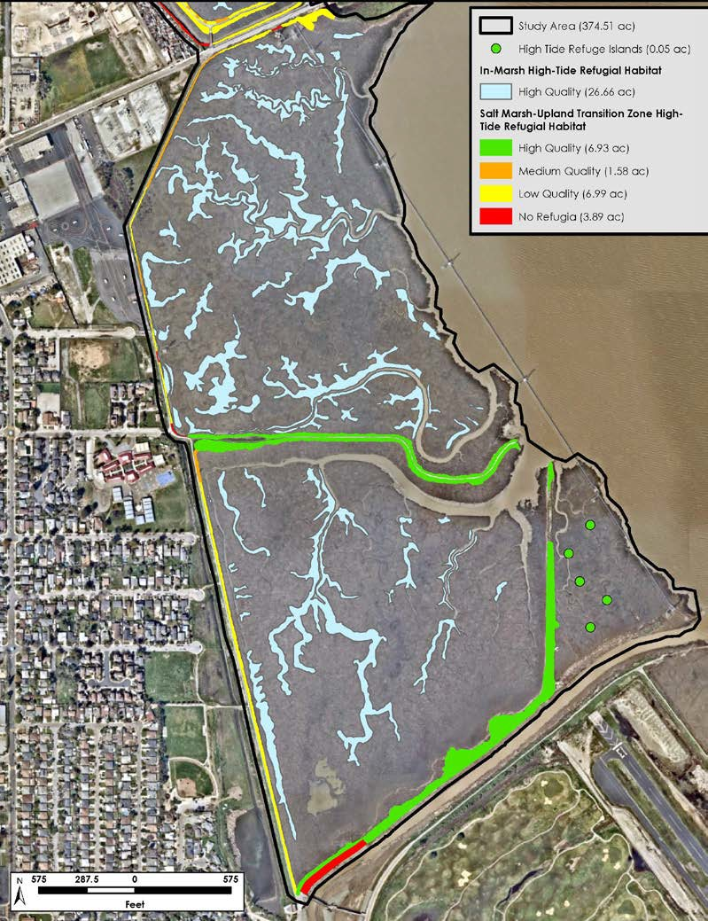
Habitat Study Results
Existing marshes have high value
Consistently high CRR observations
In-marsh refugia abundant
T-zone at landward edge low quality
Extending t-zones into marsh would not benefit SMHM and CRR
20H: 1V t-zone would fill 36 ac of study marsh (10%)
Already adequate refugia
Even if there wasn’t, t-zones accessible as refugia primarily within 200-300 feet – so to enhance refugia would be better off enhancing in marsh refugia
What about SLR accommodation space?

Slide 17
High Tide Refugial Habitat Study: Option Considered
20H: 1V t-zone
After 3.5 ft of SLR, 15 acres of marsh would transgress upslope
But if outboard marsh converts to mudflat, only 4% of current marsh would remain!
More important to sustain the marsh and its in marsh refugia
17

Slide 18
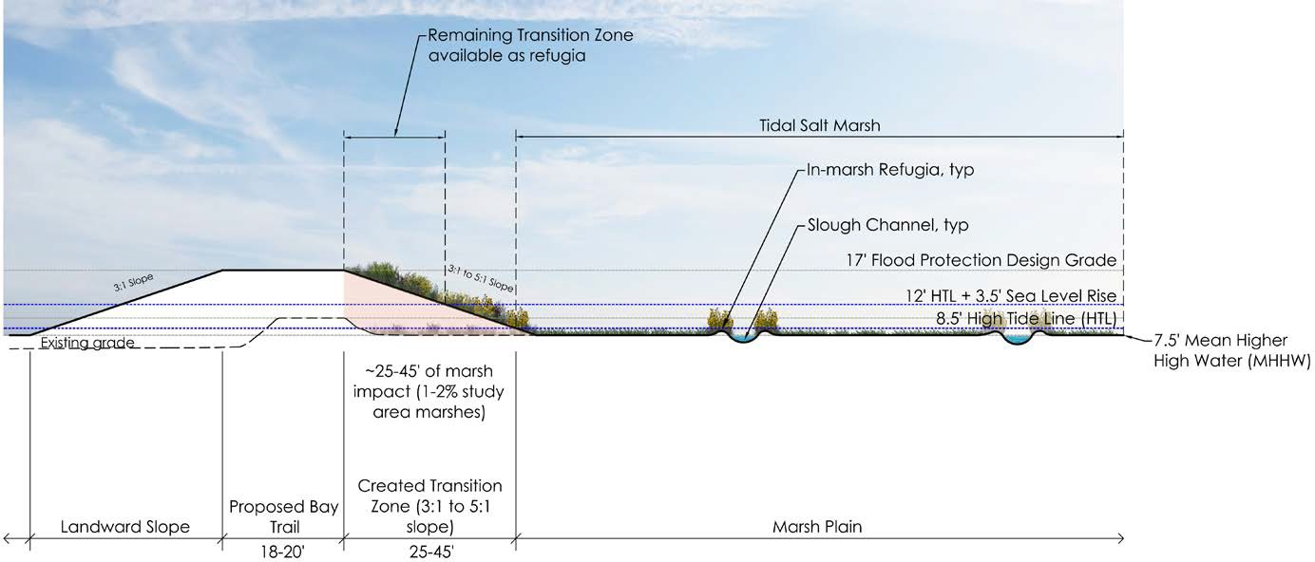
High Tide Refugial Habitat Study: Design Recommendation
Narrower t-zone (3H:1V to 5H:1V)
Reduce impact to marsh
12 to 22 ft t-zone buffer above HTL after 3.5 ft of SLR
Improvement from existing condition
preferable to losing highly productive marsh

Slide 19
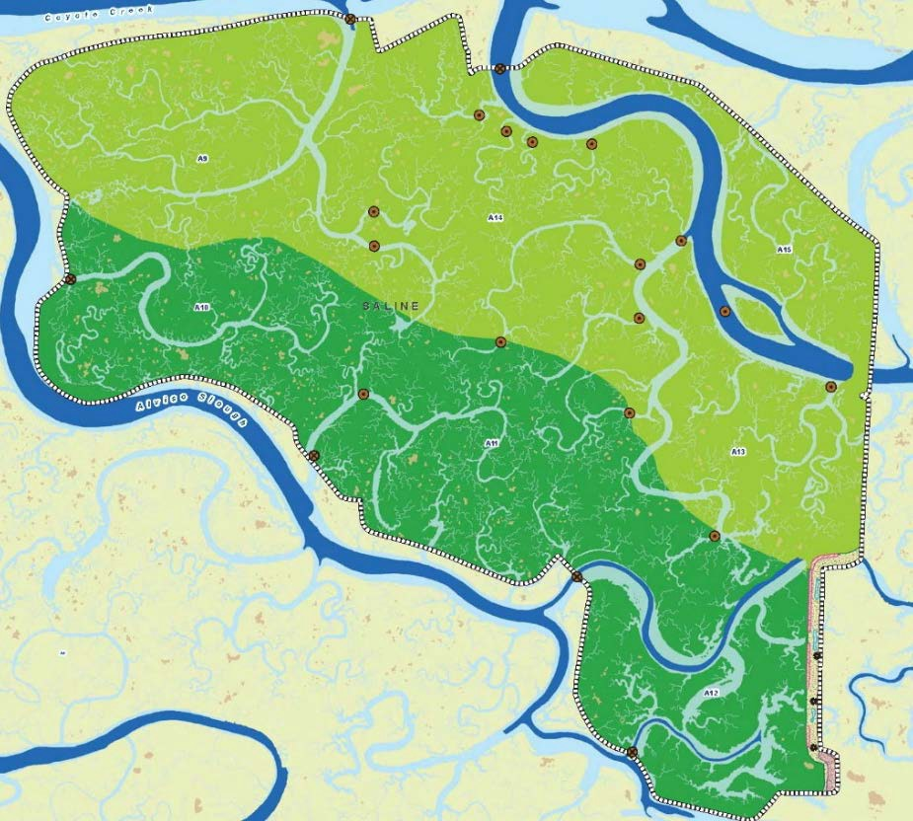
Key Conclusions
T-zones benefit habitat diversity, refugia, buffer space and SLR resilience, but one size doesn’t fit all.
Adjacent to open water, building broad t-zones with wide marsh has multiple benefits.
If in a marsh, sustaining existing marsh may be a higher ecological priority then a broad t-zone.
To maintain marsh function with SLR, will need to sustain marshes and their in-marsh refugia.
T-zones are valuable as refugia for adjacent marsh but does not substitute for in-marsh refugia.
Even relatively broad (30:1) t-zones provide minimal SLR accommodation space.

Slide 20
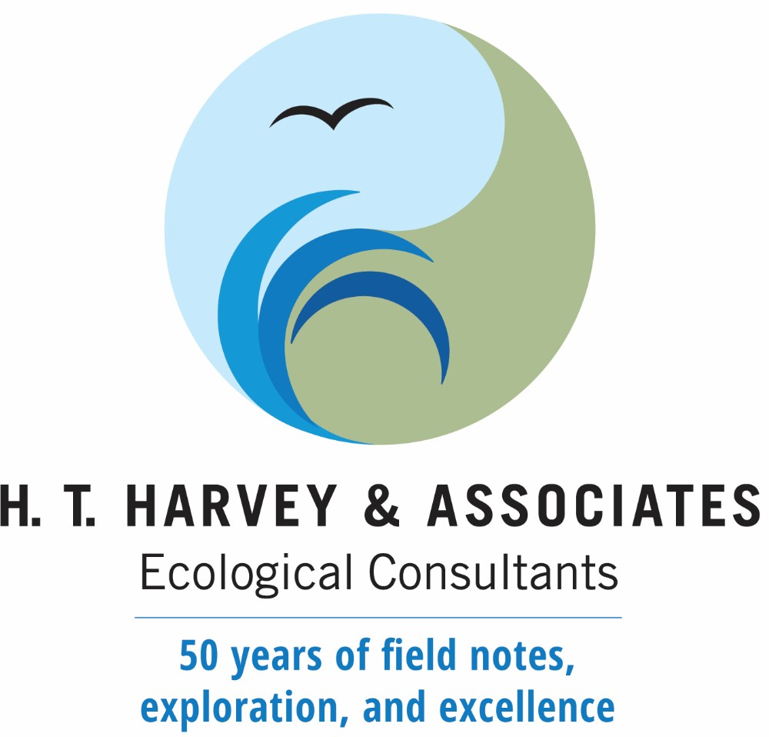
Thank You!
Gavin Archbald, M.S.
Associate Restoration Ecologist
garchbald@harveyecology.com
Max Busnardo, M.S.
Principal Restoration Ecologist, Vice President
mbusnardo@harveyecology.com
www.harveyecology.com

Slide 21
Literature Cited
Beller, E. E.; Salomon, M.; Grossinger, R. M. 2013. An Assessment of the South Bay Historical Tidal-Terrestrial Transition Zone. SFEI Contribution No. 693. San Francisco Estuary Institute: Richmond, CA.
ESA PWA. 2021. Shoreline Study Preliminary Alternatives and Landscape Evolution. Prepared for the California State Coastal Conservancy. San Francisco, California.
Goals Project. 2015. The Baylands and Climate Change: What We Can Do. Baylands Ecosystem Habitat Goals Science Update 2015 prepared by the San Francisco Bay Area Wetlands Ecosystem Goals Project. California
HDR Engineering. 2015. South San Francisco Bay Shoreline Phase 1 Final Interim Feasibility Study with Environmental Impact Statement/Environmental Impact Report. Prepared for the U. S. Army Corps of Engineers, San Francisco District. Sacramento, California.
H. T. Harvey & Associates and San Francisco Estuary Institute and Aquatic Science Center. 2012. U. S. Army Corps of Engineers South San Francisco Bay Shoreline Study California Rapid Assessment Method (CRAM) Habitat Evolution. Los Gatos, California.
H. T. Harvey & Associates with Schaaf & Wheeler. 2021. Basis of Design for Ecotones at Reaches 1, 4 and 5. Prepared for the California State Coastal Conservancy. Los Gatos, California.
H. T. Harvey & Associates. 2023. SAFER Bay Project High Tide Refugial Habitat Assessment and Resulting Salt Marsh-Upland Transition Zone Configuration Recommendations, North and South of Bay Road, East Palo Alto. Los Gatos, California.
San Francisquito Creek Joint Powers Authority. 2022. Notice of Preparation of a Draft Environmental Impact Report for the Strategy to Advance Flood Protection, Ecosystems and Recreation along San Francisco (SAFER) Bay.
U. S. Fish & Wildlife Service. 2013. Recovery Plan for Tidal Marsh Ecosystems of Northern and Central California. Sacramento, California

