Slide 1
Funding Community Engagement Wetland Migration Workshop: Community Engagement Session September 19, 2023 Linda Tong, Project Manager

Slide 2
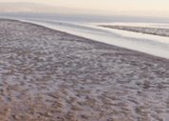
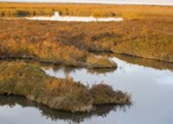
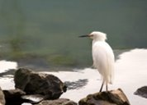
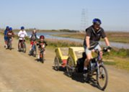
Community engagement as a funding priority
San Francisco Bay Restoration Authority
Emphasize community engagement as grant solicitation priority
Support new partnerships with community-based organizations

Slide 3
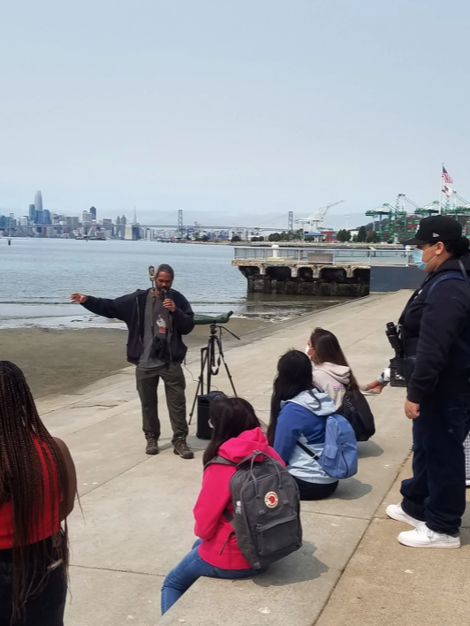
Developing a Community Grants Program
Fund projects led by community-based organizations in economically disadvantaged communities
L Tong
Oakland Shoreline Leadership Academy hosted by WOEIP

Slide 4
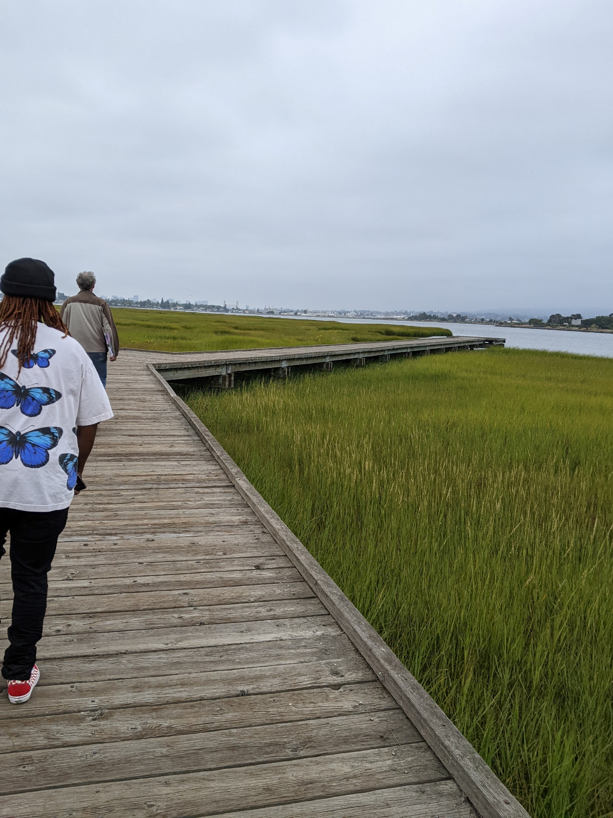
Improving our grant programs
Incorporate input from Advisory Committee members and community-based orgs
Conduct more targeted outreach to community-based orgs
Arrowhead Marsh, Oakland

Slide 5
Creating a Community Grants Cohort
Site visits
Online workshops
New connections with community-based organizations
Brower Dellums Institute, San Leandro Creek staging area

Slide 6
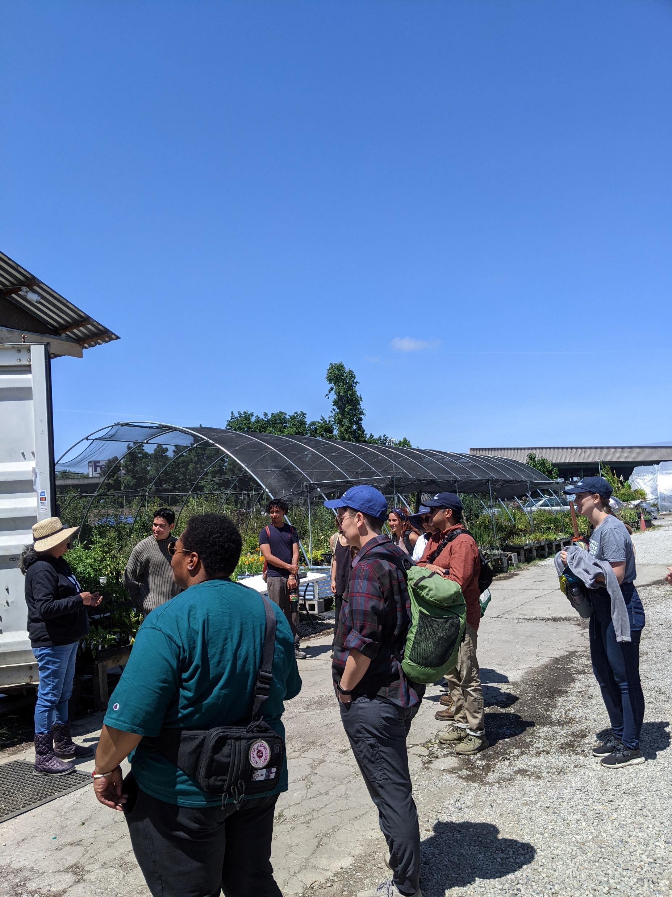
Networking and Board Tours
Participants from public agencies, environmental nonprofits, community-based organizations
L Tong
Planting Justice plant nursery, Oakland

Slide 7
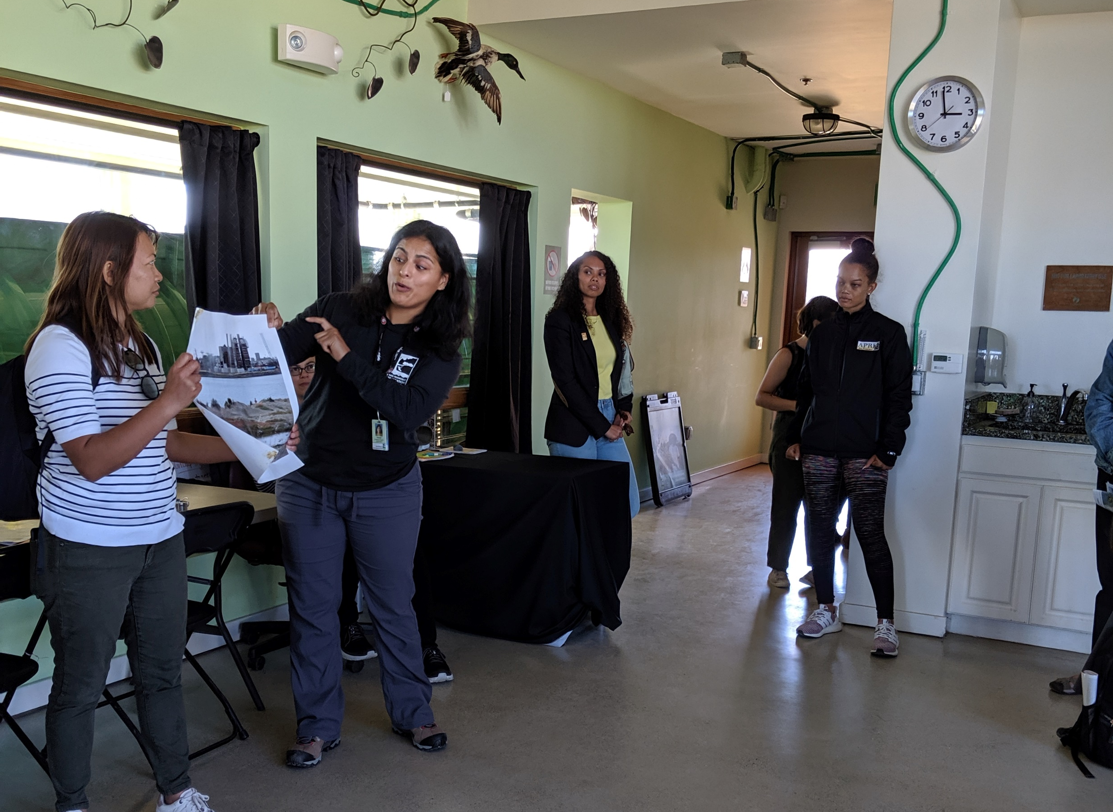
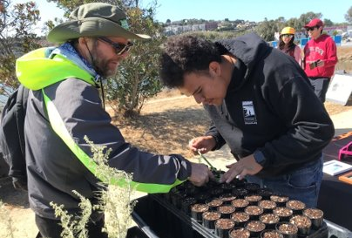
Moving forward
Facilitate info sharing with community-based grantees
Develop long-term framework of equity guidelines
Develop Tribal Engagement Recommendations
EcoCenter at Heron's Head Park, San Francisco
Literacy for Environmental Justice, San Francisco

Slide 8
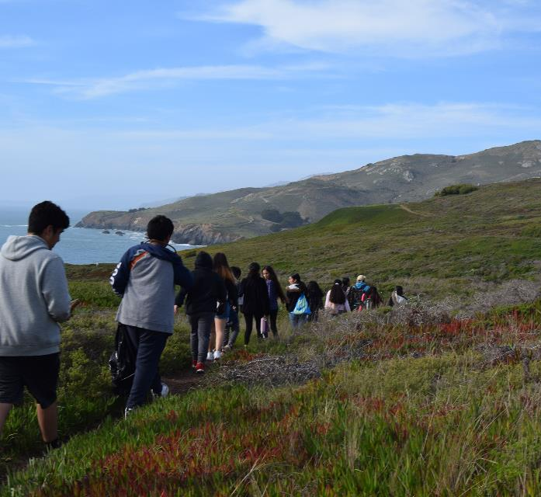
Community engagement as a funding priority
CA State Coastal Conservancy
Agency goals and equity guidelines highlight need for community engagement
Engagement with Tribes

Slide 9
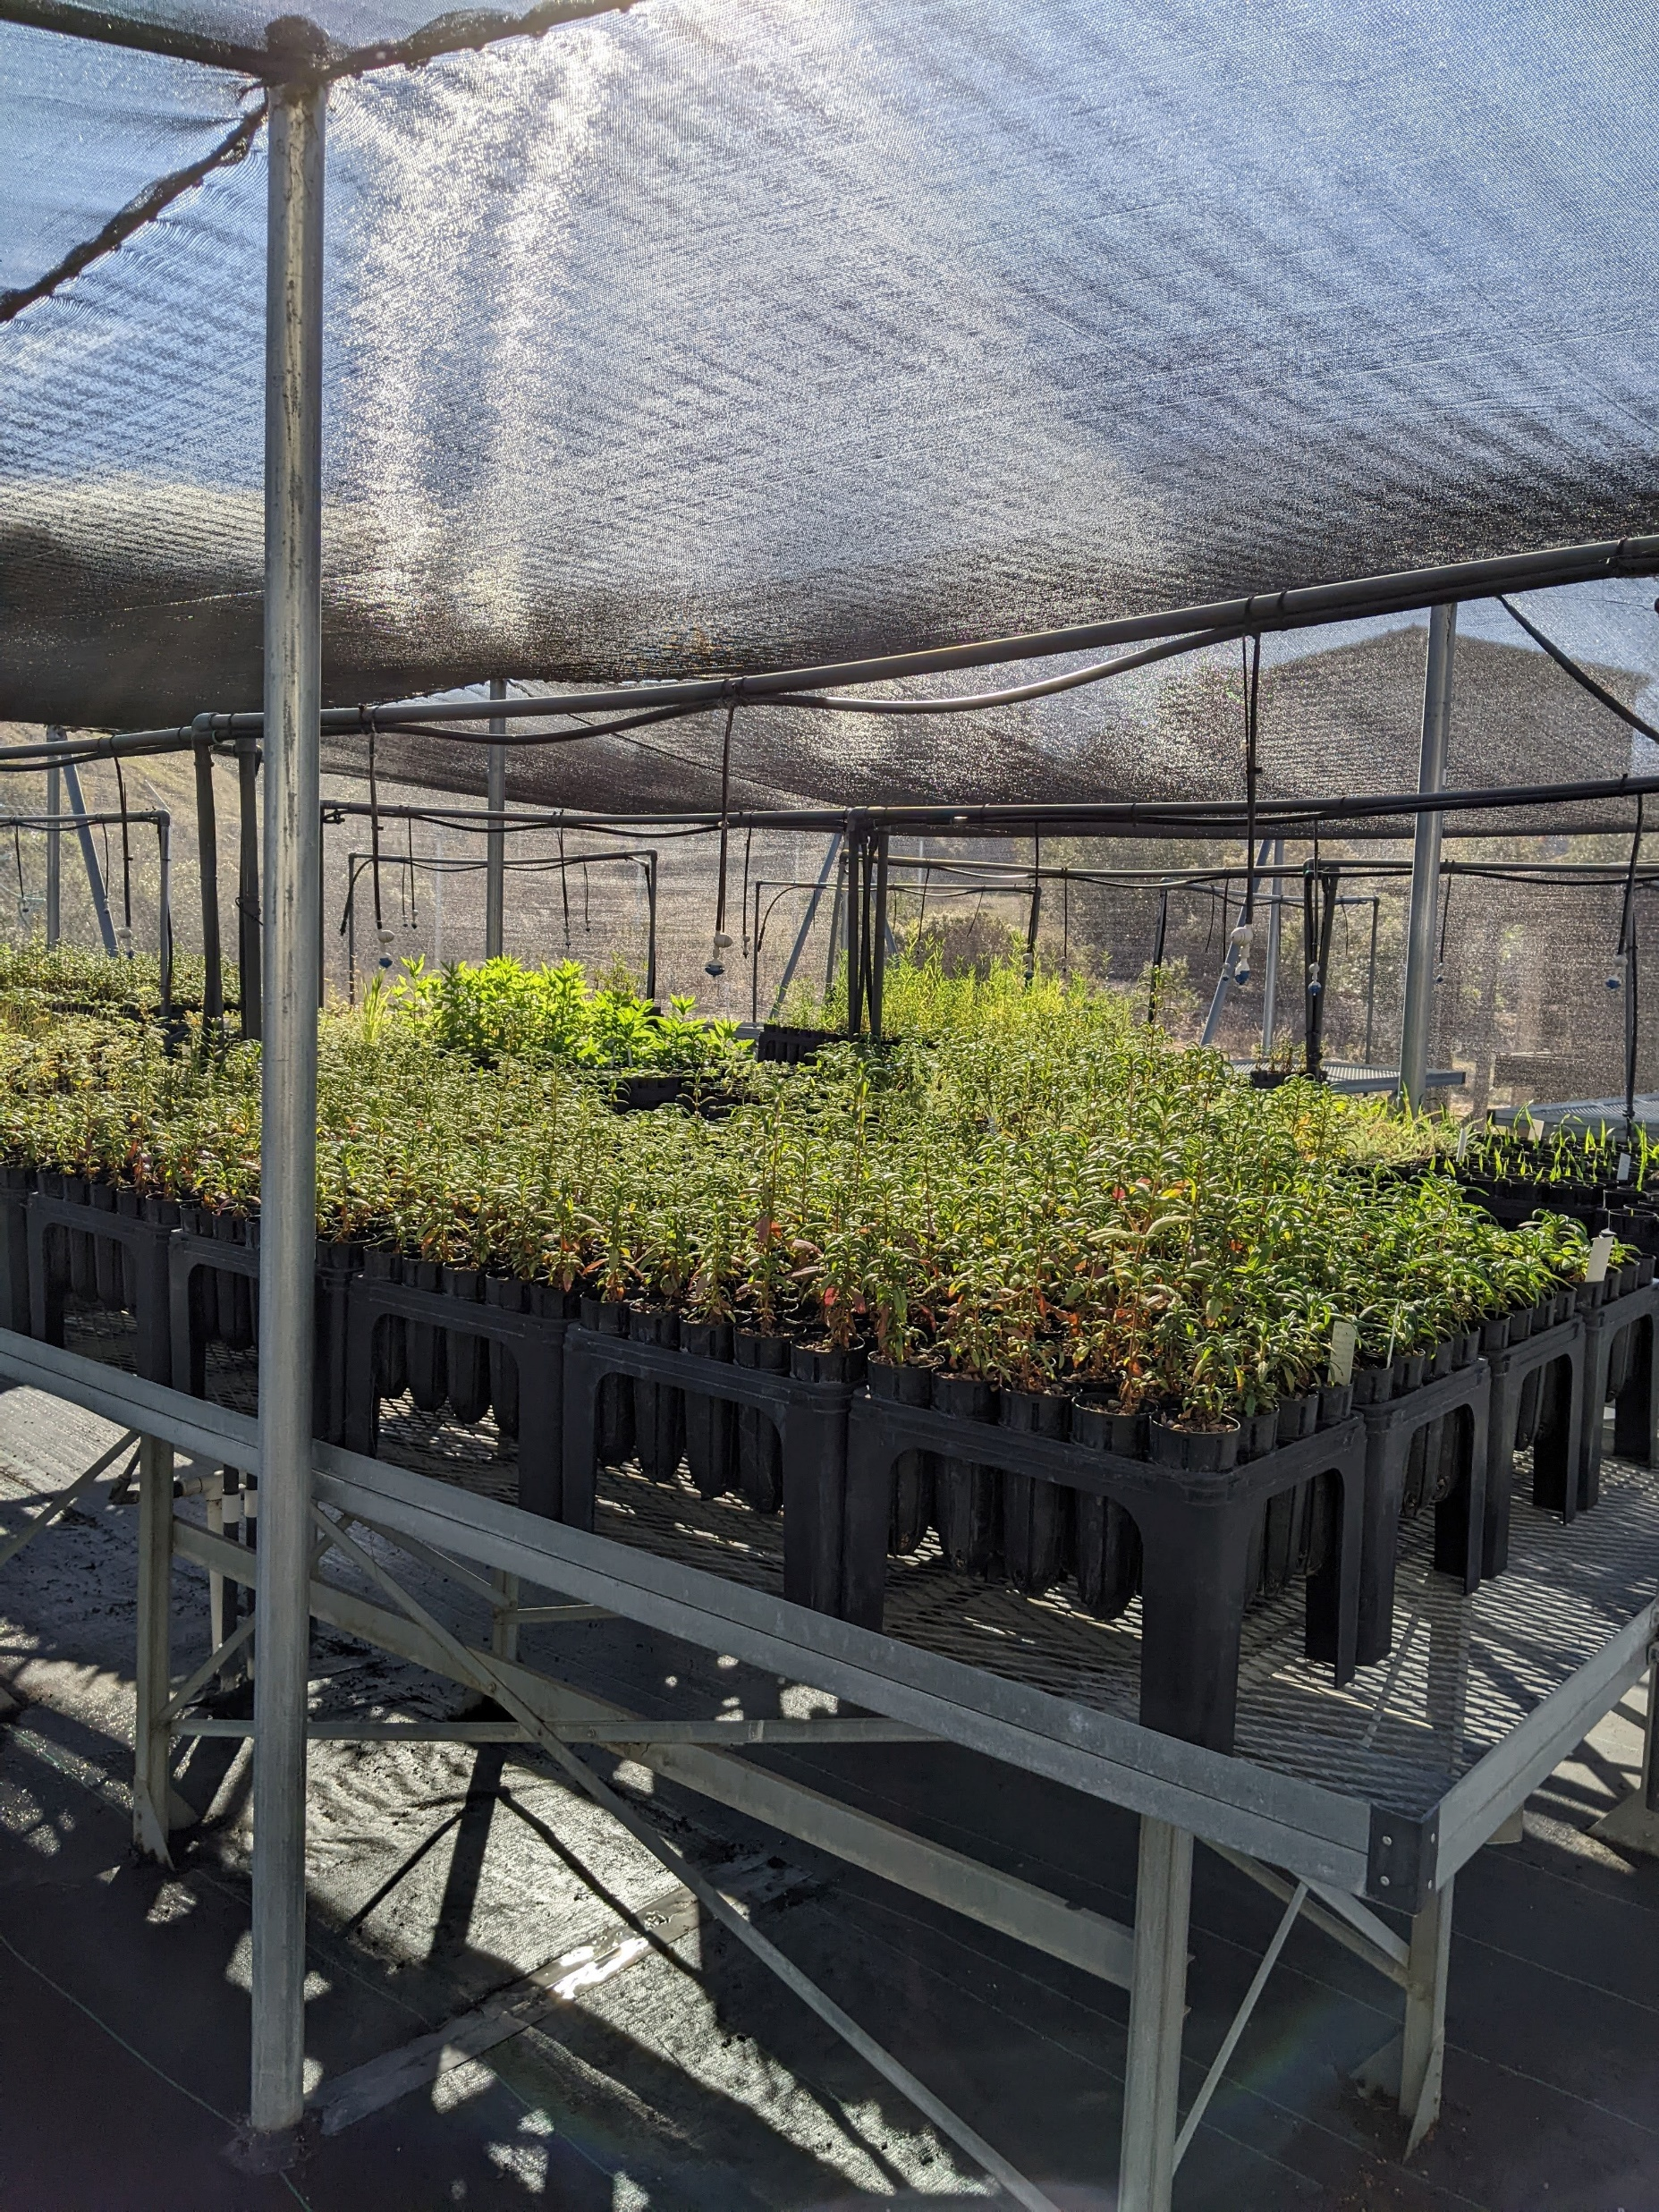
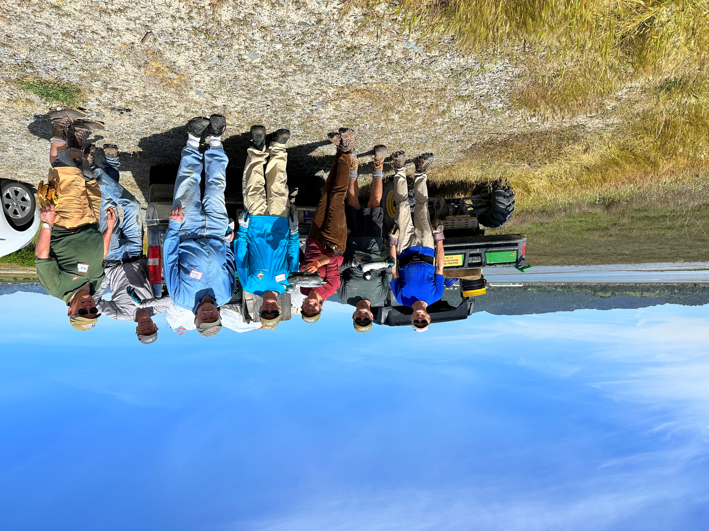
Stewardship at the Novato Baylands

Slide 10
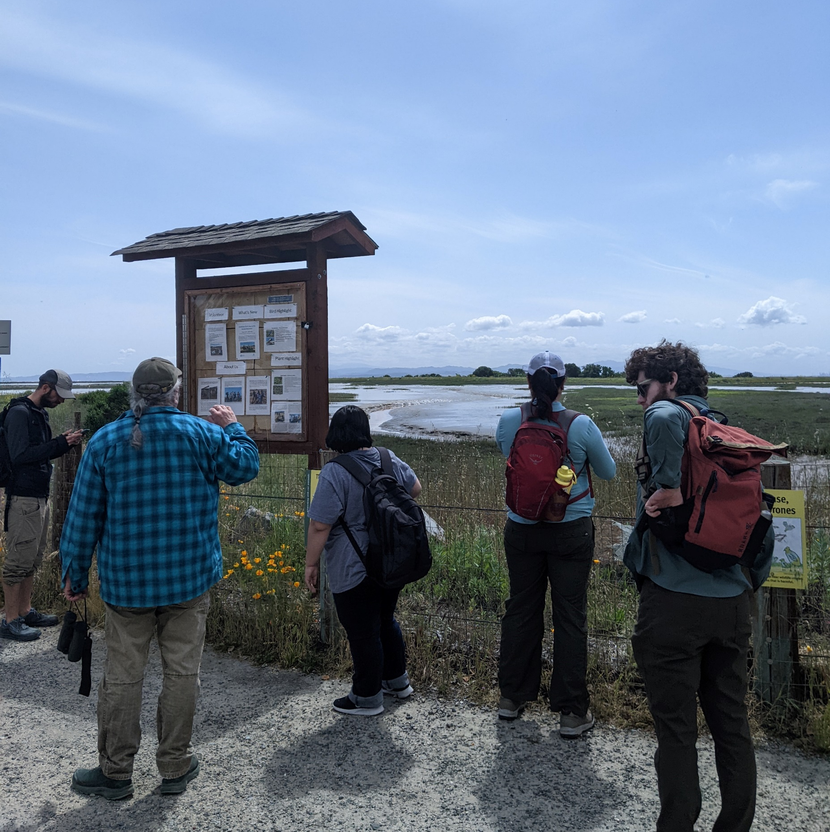
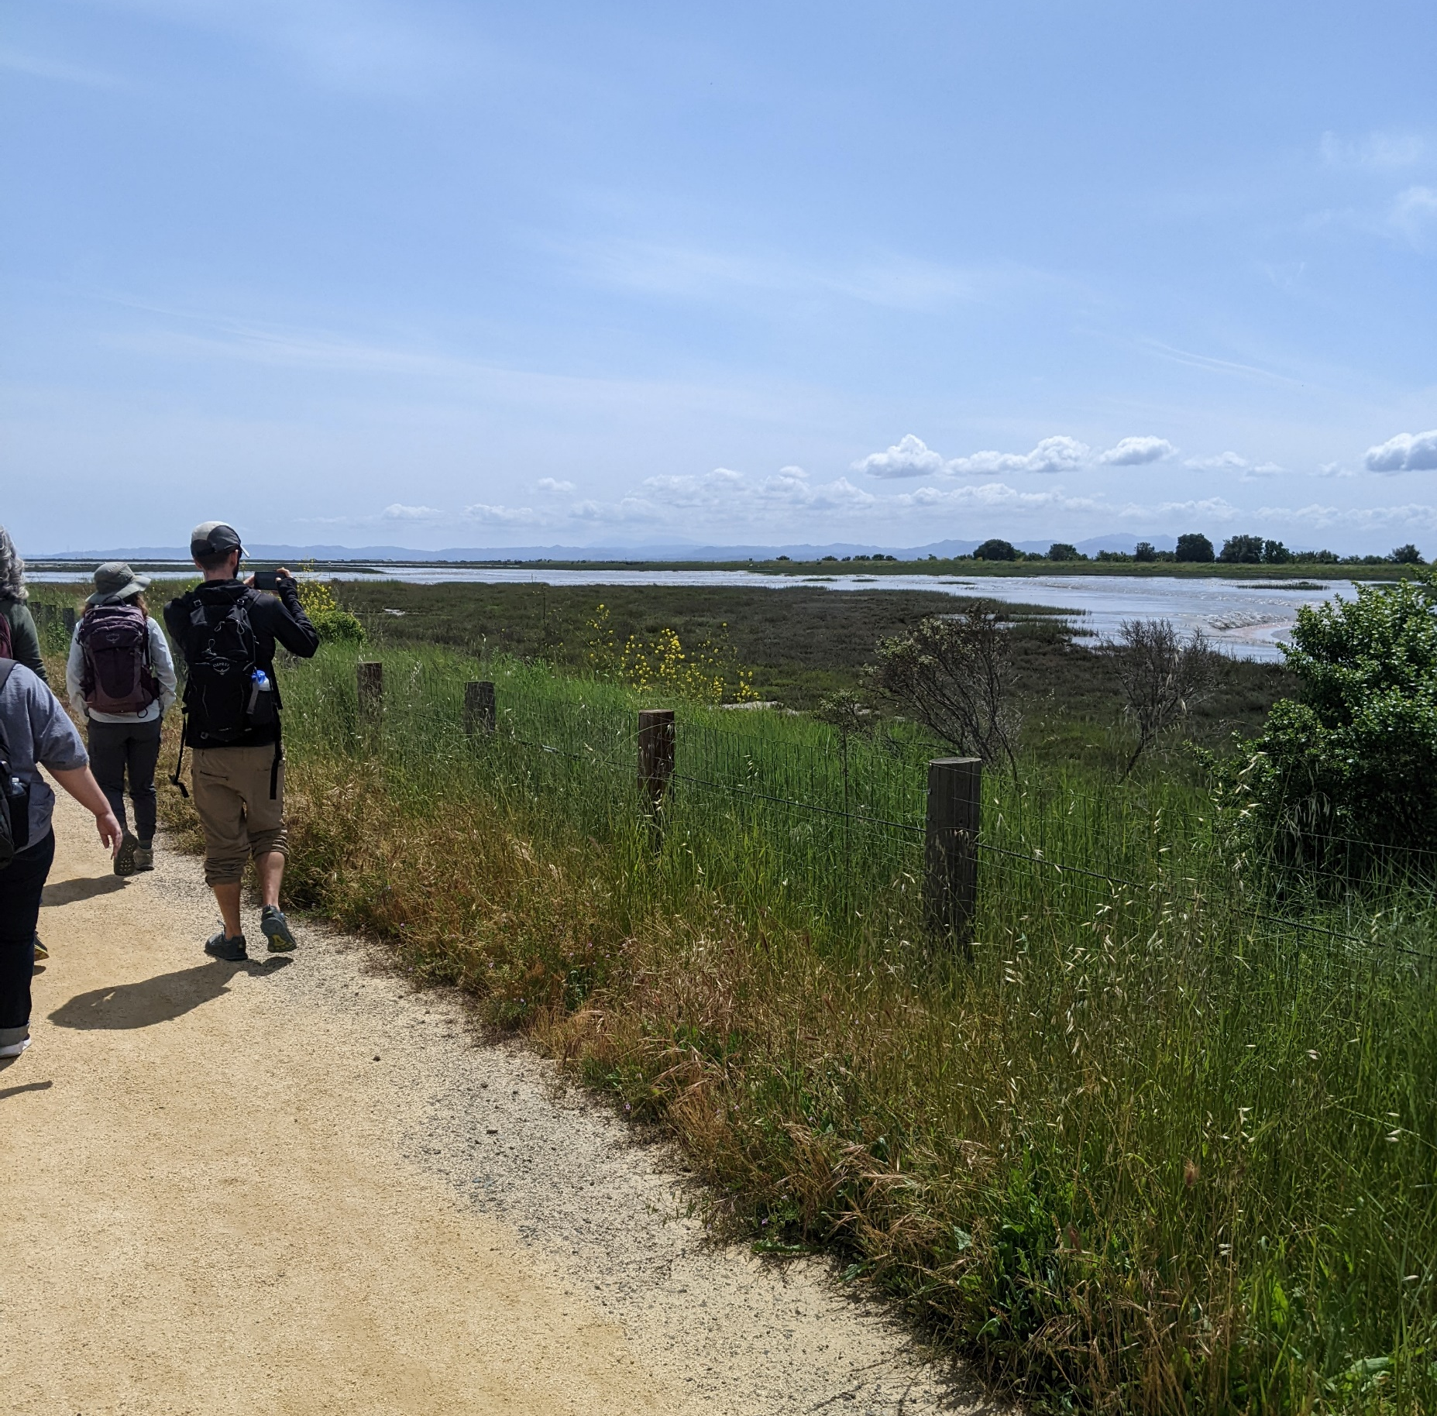
Opportunities to build and deepen relationships

Slide 11
Questions?

