Slide 1
People & Wetlands: Key Themes from Developing Human Dimensions & Equity Indicators for Wetland Monitoring
Alex Thomsen, SF Estuary Partnership
Wetland Migration Workshop, September 2023

Slide 2
Topics:
People & Wetlands Workgroup motivation & objectives
Process
  Who is involved?
  Indicator development
  Management questions
Major themes
  Primary areas of interest
  Key takeaways

Slide 3
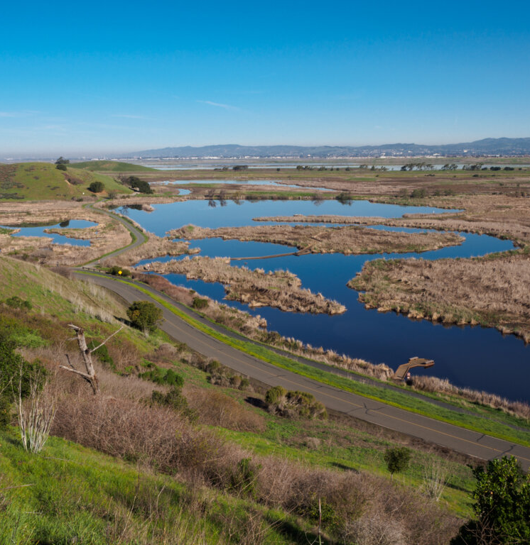
People & Wetlands Workgroup: Objectives
Develop indicators, metrics, and monitoring protocols/standards for human connections to wetlands that:
Emphasize community and Tribal values
Align with information needs of decision-makers
Enable evaluation of equity questions, and
Incorporate diverse ways of understanding wetland health
Image: Shira Bezalel
Notes:
The WG is working to identify indicators, metrics, and methods that the WRMP can use to evaluate how well wetlands, including wetland restoration projects, are supporting connections between communities and wetlands. In developing these indicators, we want to:
-Emphasize community and Tribal values
-Align with information needs of decision-makers
-Enable evaluation of equity questions, and
-Incorporate diverse ways of understanding wetland health
These indicators can help us:
​Painting a picture of why wetlands are important to support advocacy for more funding for protection, restoration, adaptation ​
Understand what physical elements or outreach/engagement efforts lead to increased benefits to people?​
Provide another way of evaluating impact of protection & restoration efforts ​
Evaluate progress on agency mandates about environmental equity.

Slide 4
People & Wetlands Workgroup: Areas of Expertise
Other:
Architect & urban designer;
Wetland scientist & estuarine ecologist (2);
Culture keeper & community consultant

Slide 5
People & Wetlands Workgroup: Timeline
​ | 2022 |  | 2023 |  |  |  | 2024
Major Milestones​ | Jul/Aug/Sep​ | Oct/Nov/Dec​ | Jan/Feb/Mar​ | Apr/May/Jun​ | Jul/Aug/Sep​ | Oct/Nov/Dec​ | Jan/Feb/Mar​ | Apr/May/Jun​
Literature & Monitoring Review | ​ | ​ | ​ | ​ | ​ | ​
Develop Management Questions | ​ |  |  |  | ​ | ​
Develop priority Monitoring Questions & indicators | ​ | ​ | ​ |  |  | ​
Develop monitoring protocols/standards | ​ | ​ | ​ | ​ | ​

Slide 6
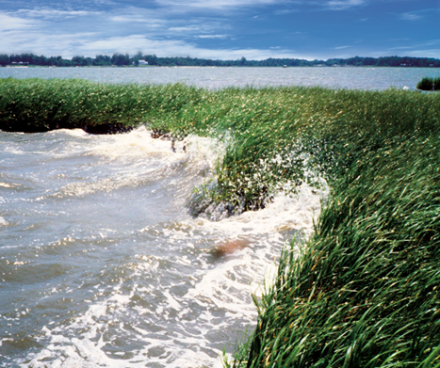
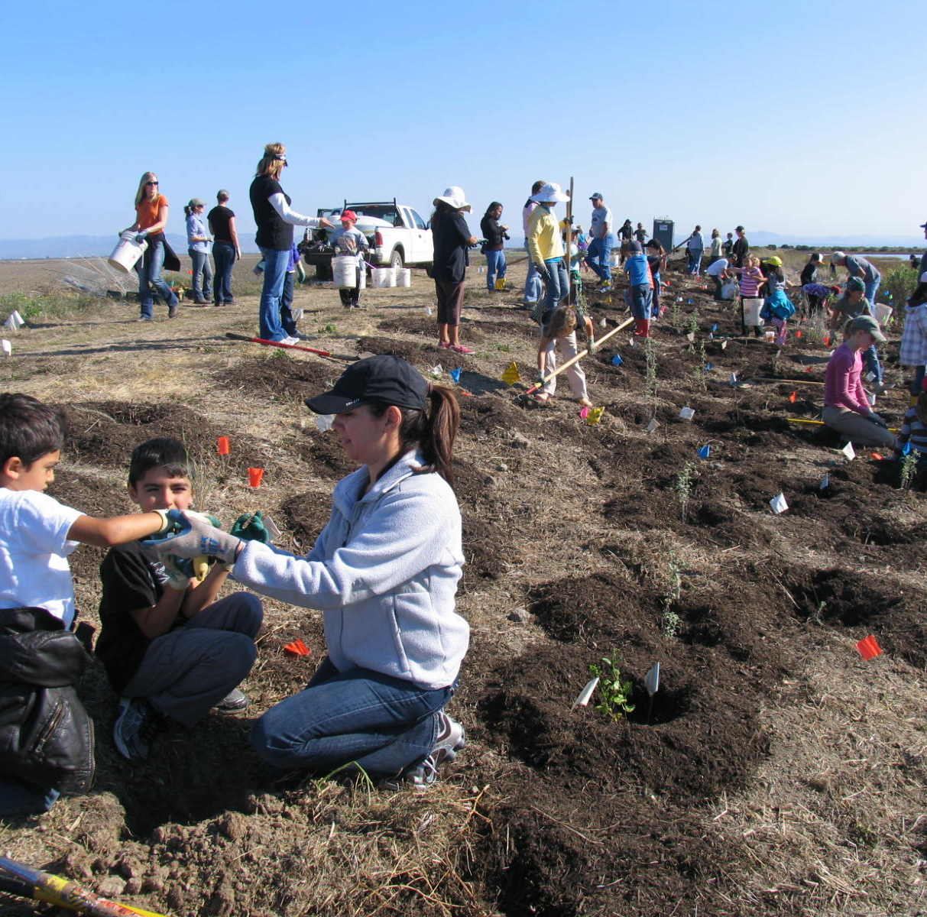
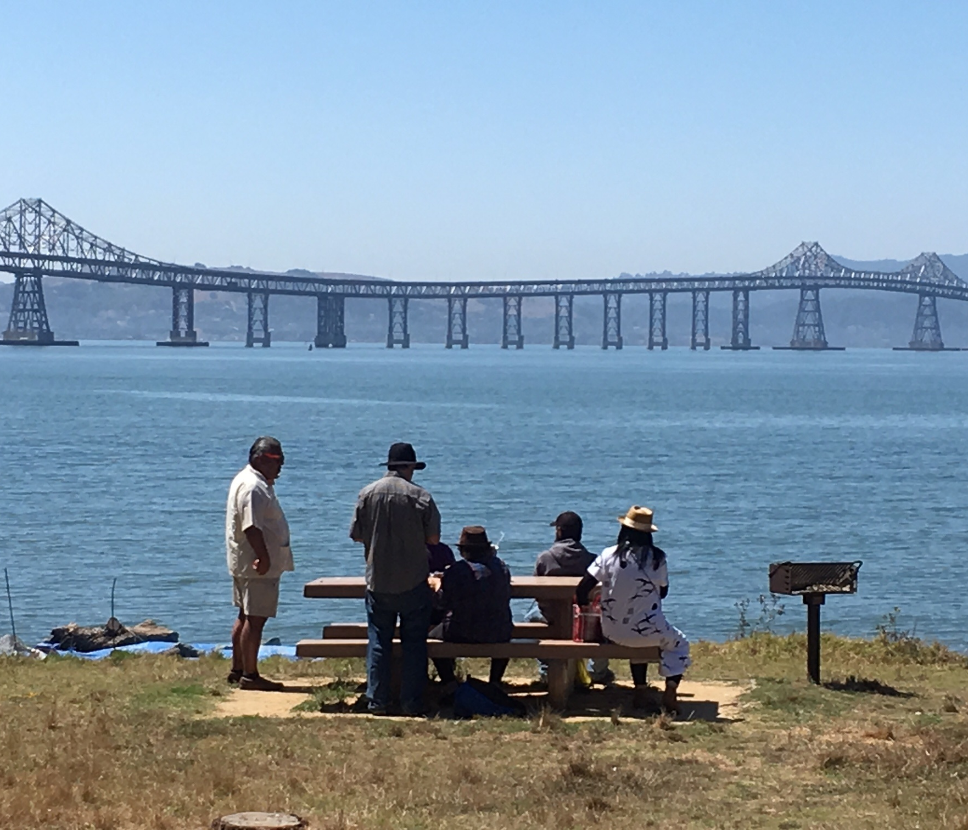
People and Wetlands Management Questions
How are the benefits of wetlands distributed regionally and among different demographic groups?
How does the provision of benefits progress over time at existing and restored wetland sites?
What monitoring data and/or analyses are needed to improve the relationships between tidal marsh restoration, fish and wildlife support, mosquito and vector control, and public access?
Images: NOAA (top), SFEP photo library (right, bottom)
Notes:
Our goal is to design monitoring that addresses these big-picture questions (on the slide) developed/modified by the WG

Slide 7
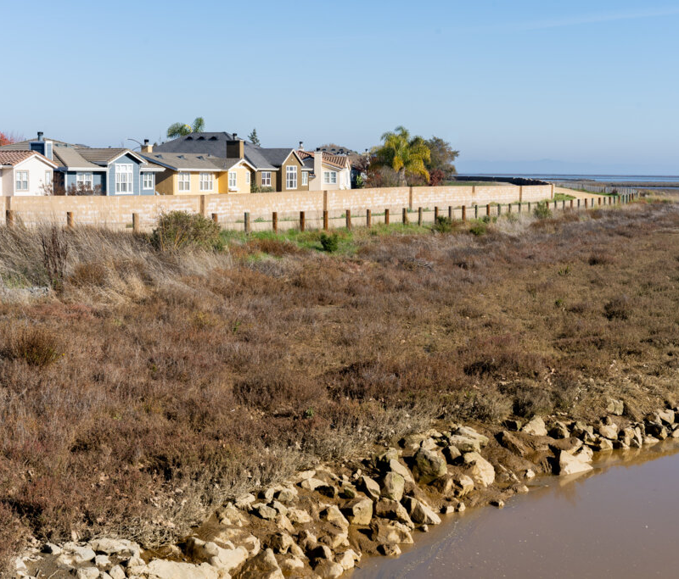
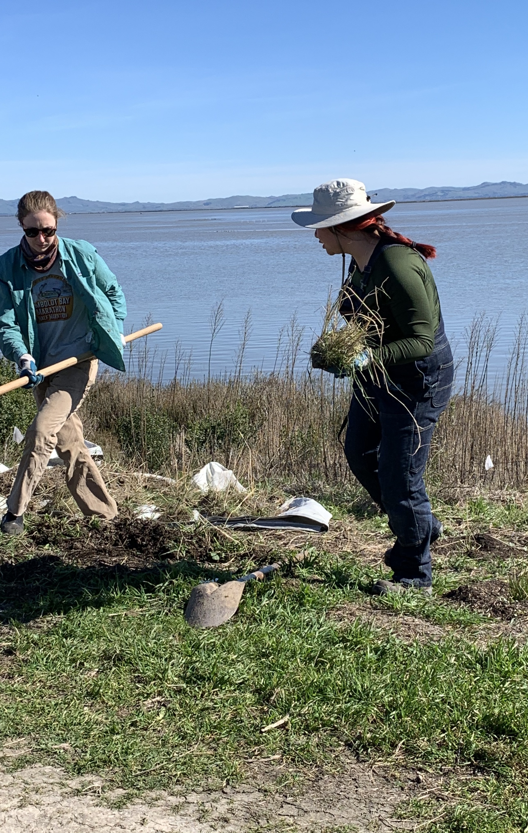
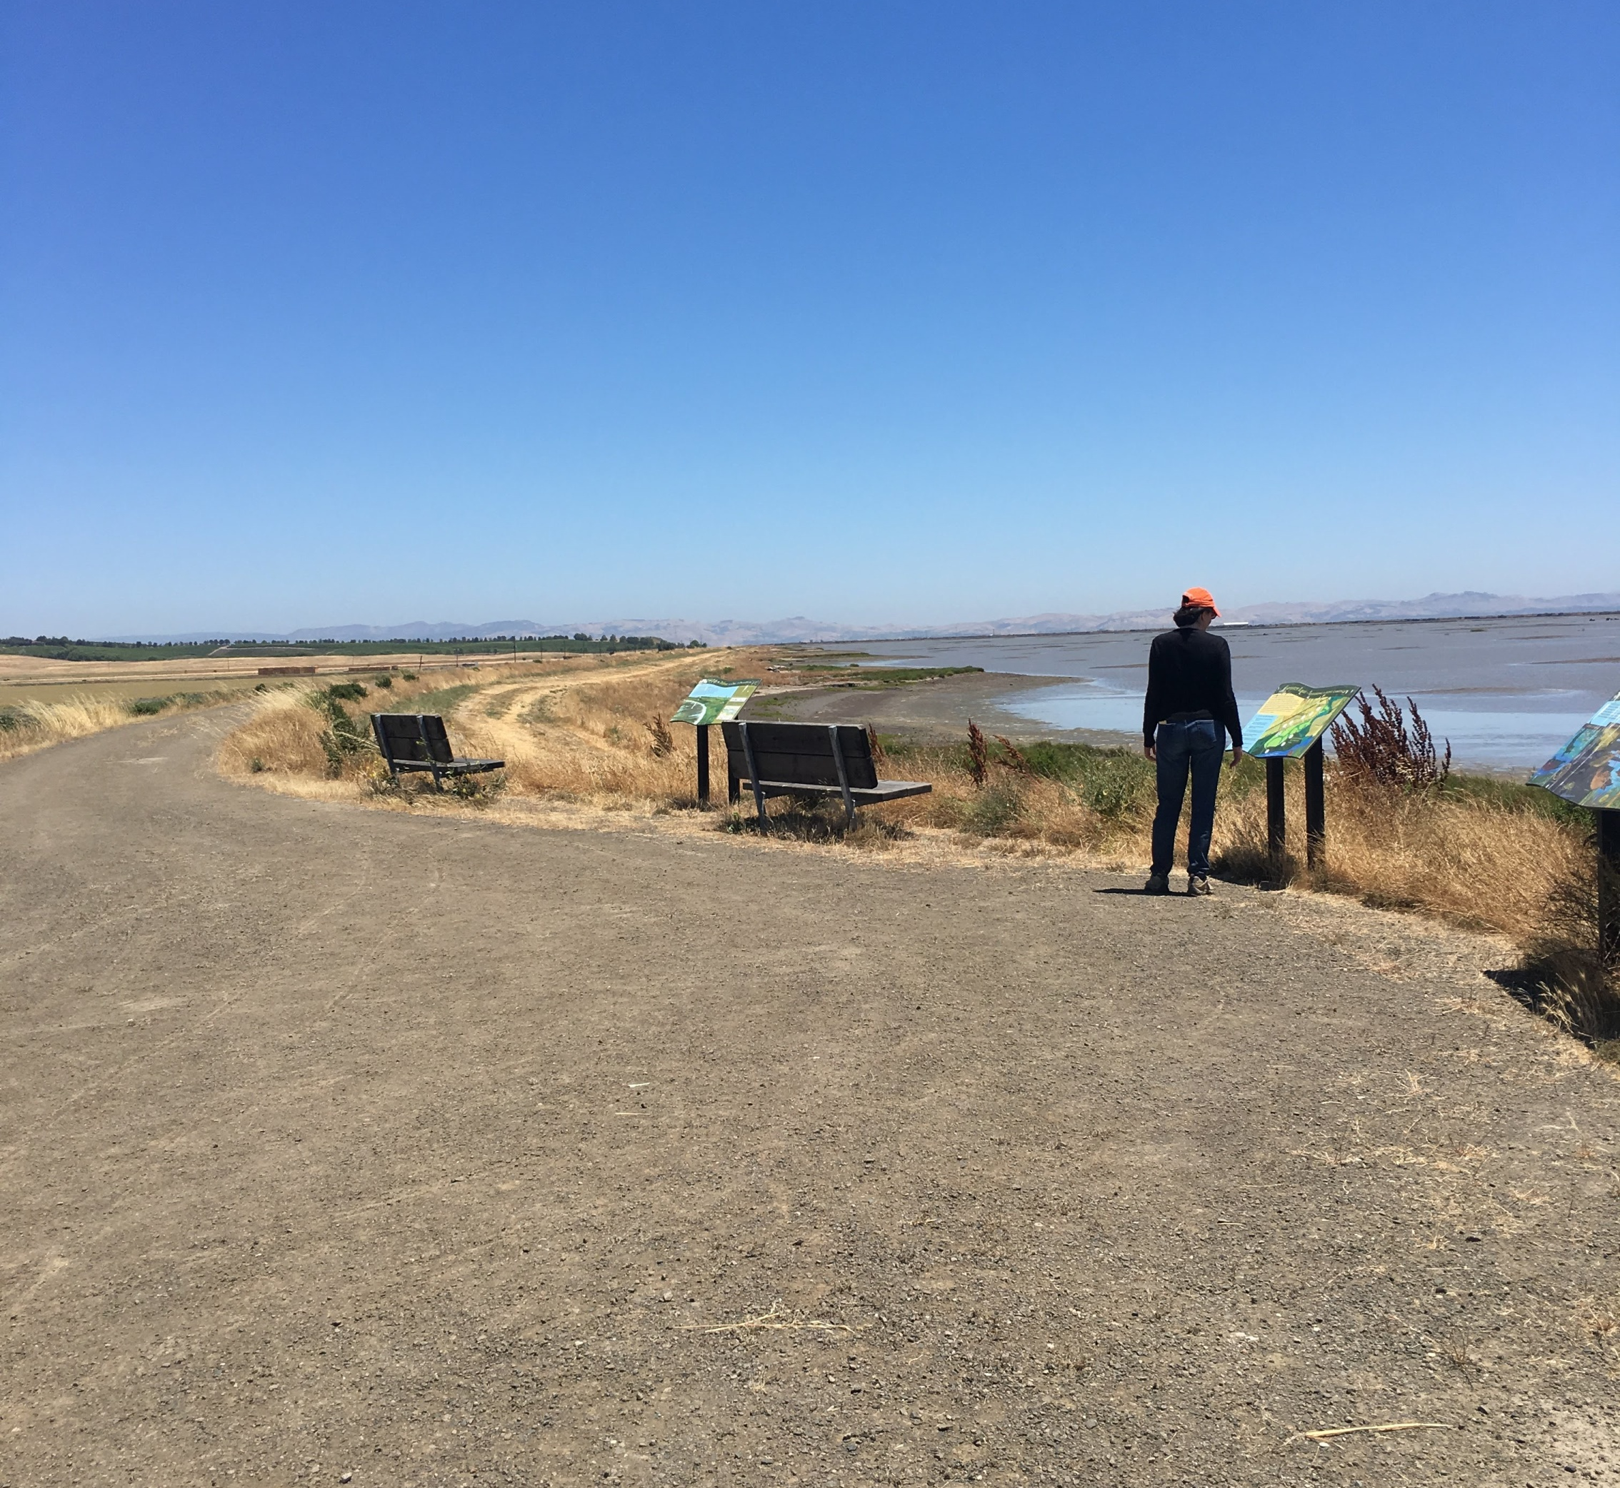
Major Areas of Interest
Shoreline protection
Water quality
Inclusive access
Stewardship
Knowledge production & transmission
Governance & representation
Images: Shira Bezalel (top), SFEP photo library (right, bottom)
Notes:
Major areas of interest we're exploring for developing new indicators. Essentially, the WG wants to develop ways to measure the provision of these benefits and evaluate whether they are being distributed equitably.
[give examples of near-term products and equity metrics if there’s time]
Disclaimer: these are not officially part of the WRMP at this point!

Slide 8
Key Takeaways
Sense of belonging is particularly important
Community involvement throughout all stages of projects
Include community members in monitoring & producing results
Need for public education/outreach about what benefits wetlands provide, and whether they are providing them
Community health & wellbeing
Notes:
Producing & sharing results that are accessible to community members to inform their personal decision-making and advocacy efforts were important for the WRMP to consider along with answering the management questions.

Slide 9

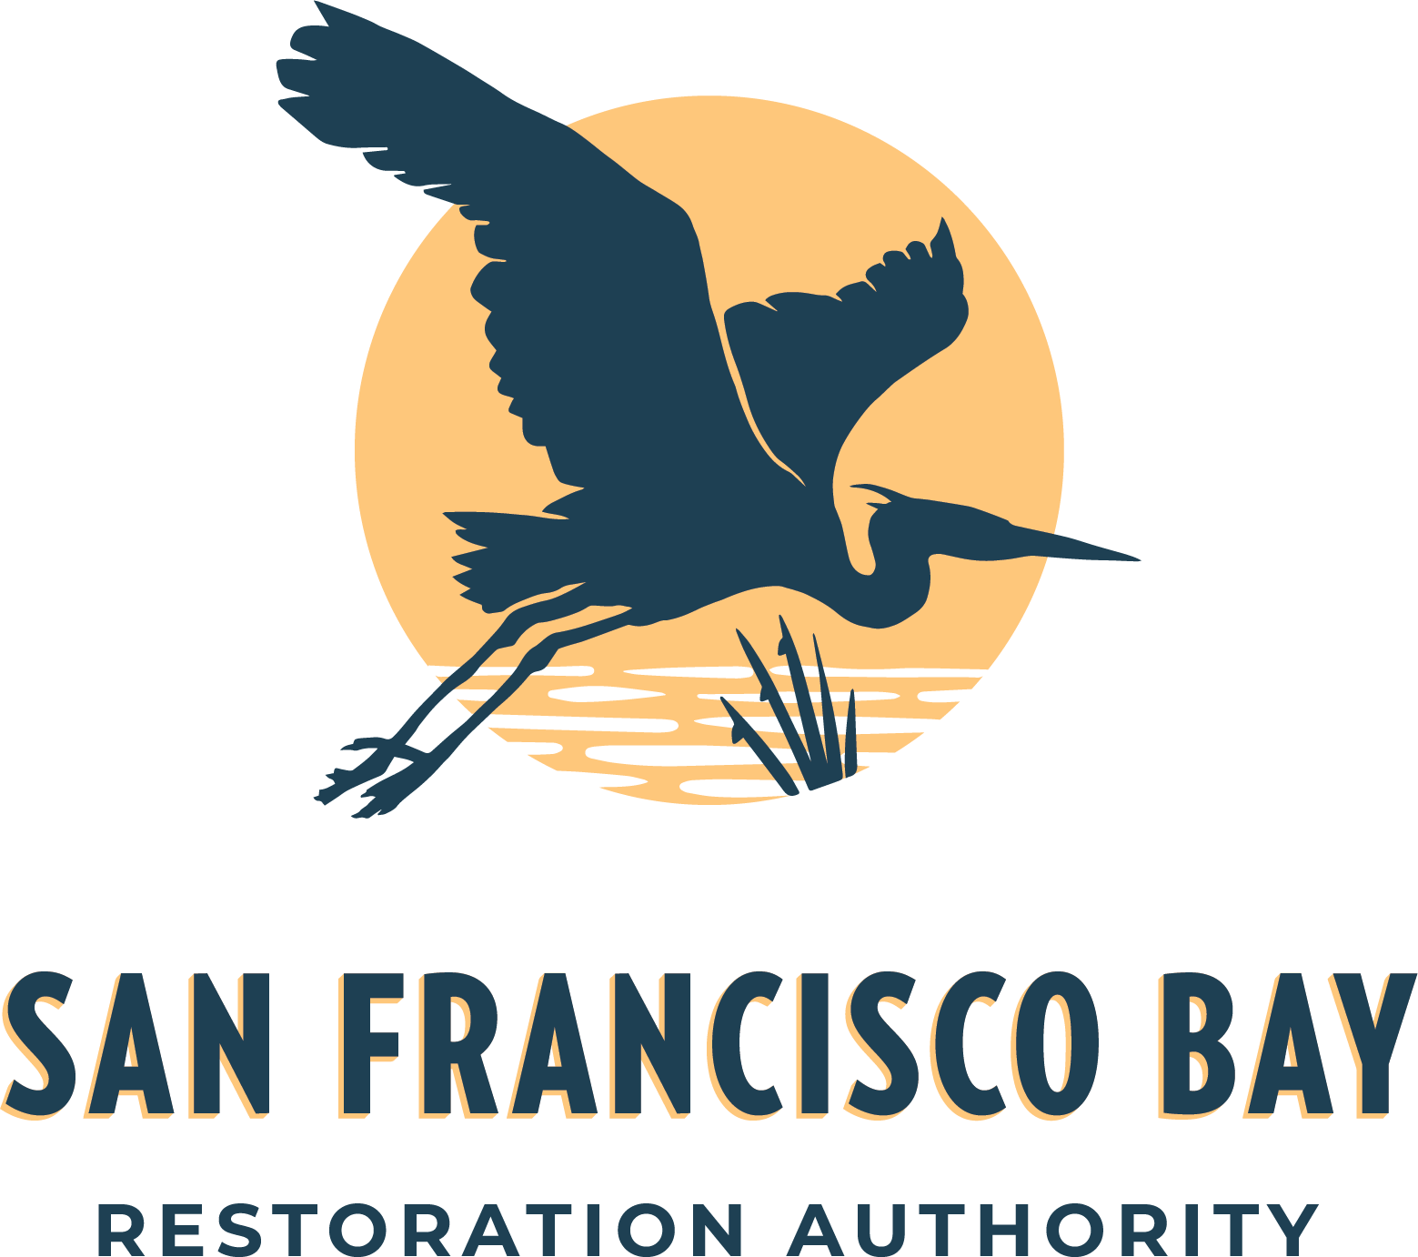



Acknowledgements
Workgroup Members and Co-Facilitators
Keta Price, Hood Planning Group
Denise Walker, SF Estuary Institute
https://www.wrmp.org/about/committees-and-workgroups/
Funders
Co-managers of the WRMP

Slide 10
Thank you!
Questions?
Alex Thomsen, SF Estuary Partnership
alexandra.thomsen@sfestuary.org
Notes:
Turning it over to Linda Tong!

