Slide 1
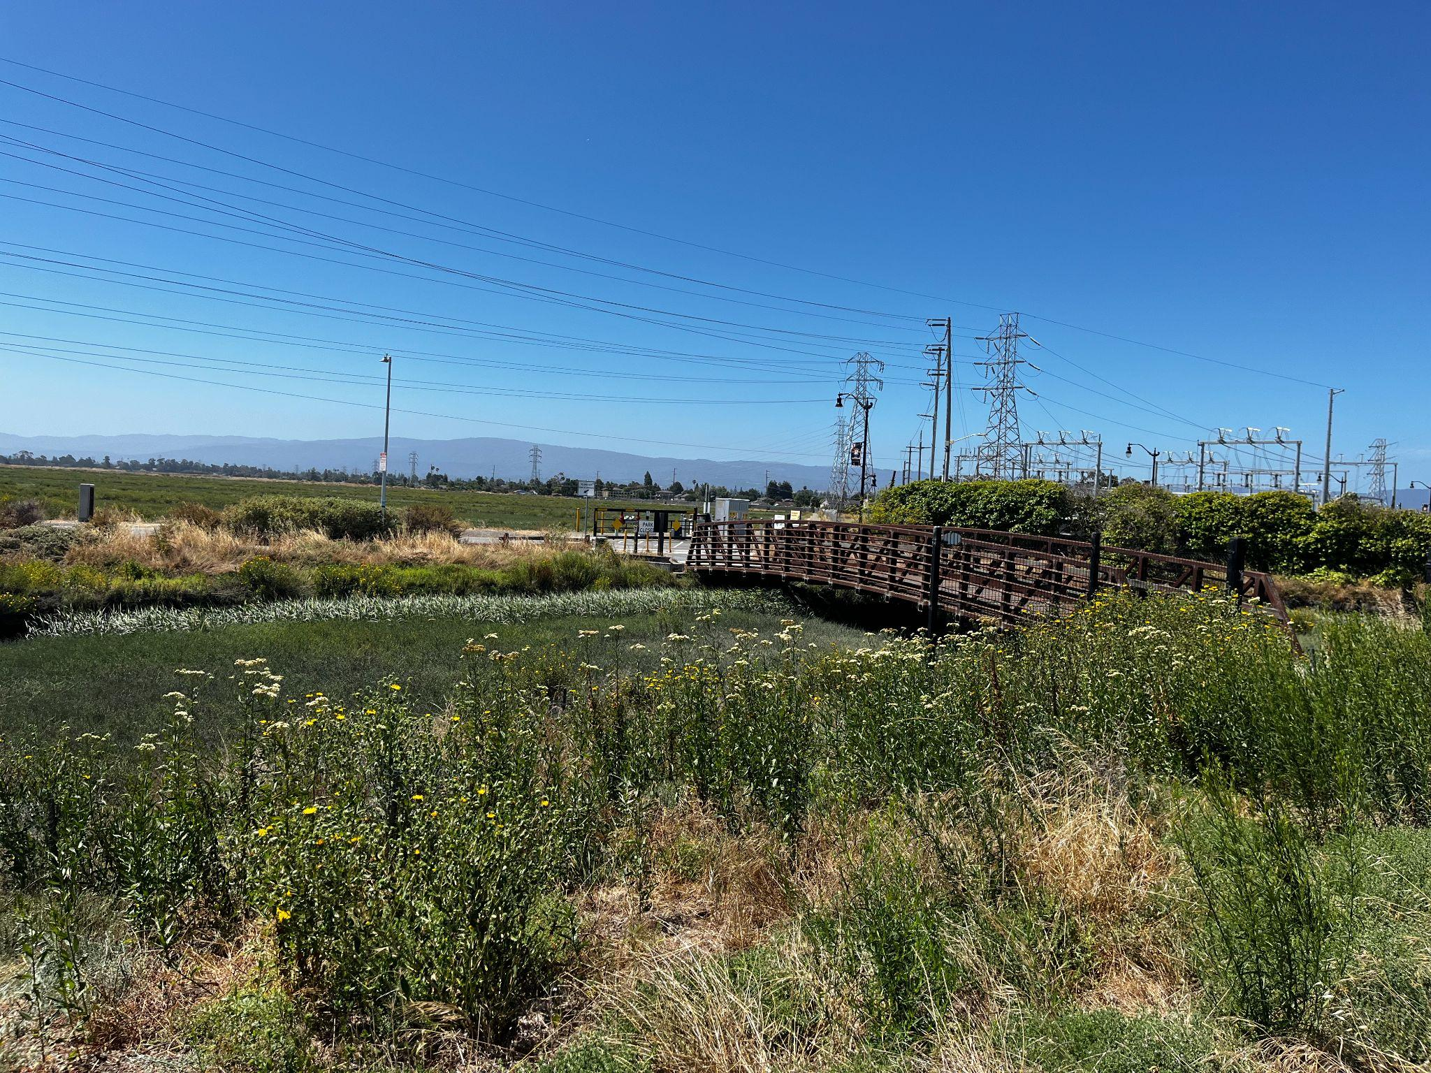
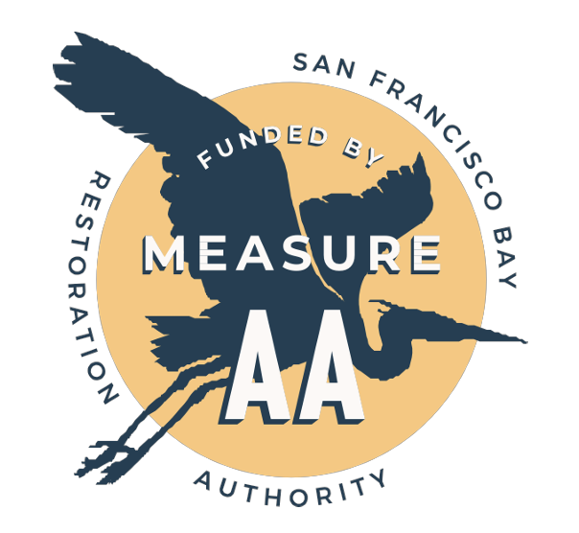
Connecting Communities to Salt Marsh Habitat
Community Engagement -
Wetland Migration Workshop
Violet Saena, Executive Director
Climate Resilient Communities
Barbara Camacho Garcia, Project Lead Grassroots Ecology
Notes:
Thank you so much for joining our session today! We’re so excited to talk about our project together with you all and focus on the community engagement component of our restoration work.
This past year, we began our project, Baylands Habitat Restoration and Community Engagement in East Palo Alto, after receiving a grant from the San Francisco Bay Restoration Authority’s Measure AA grant program.

Slide 2
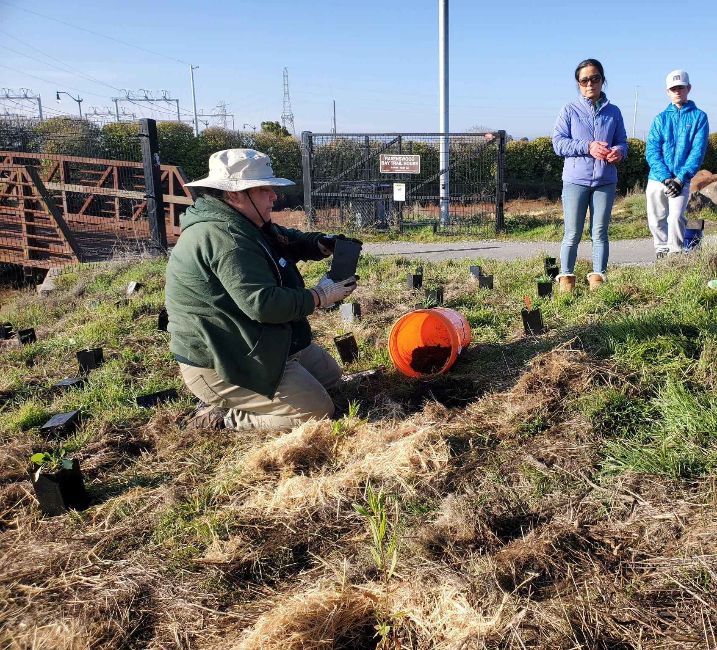
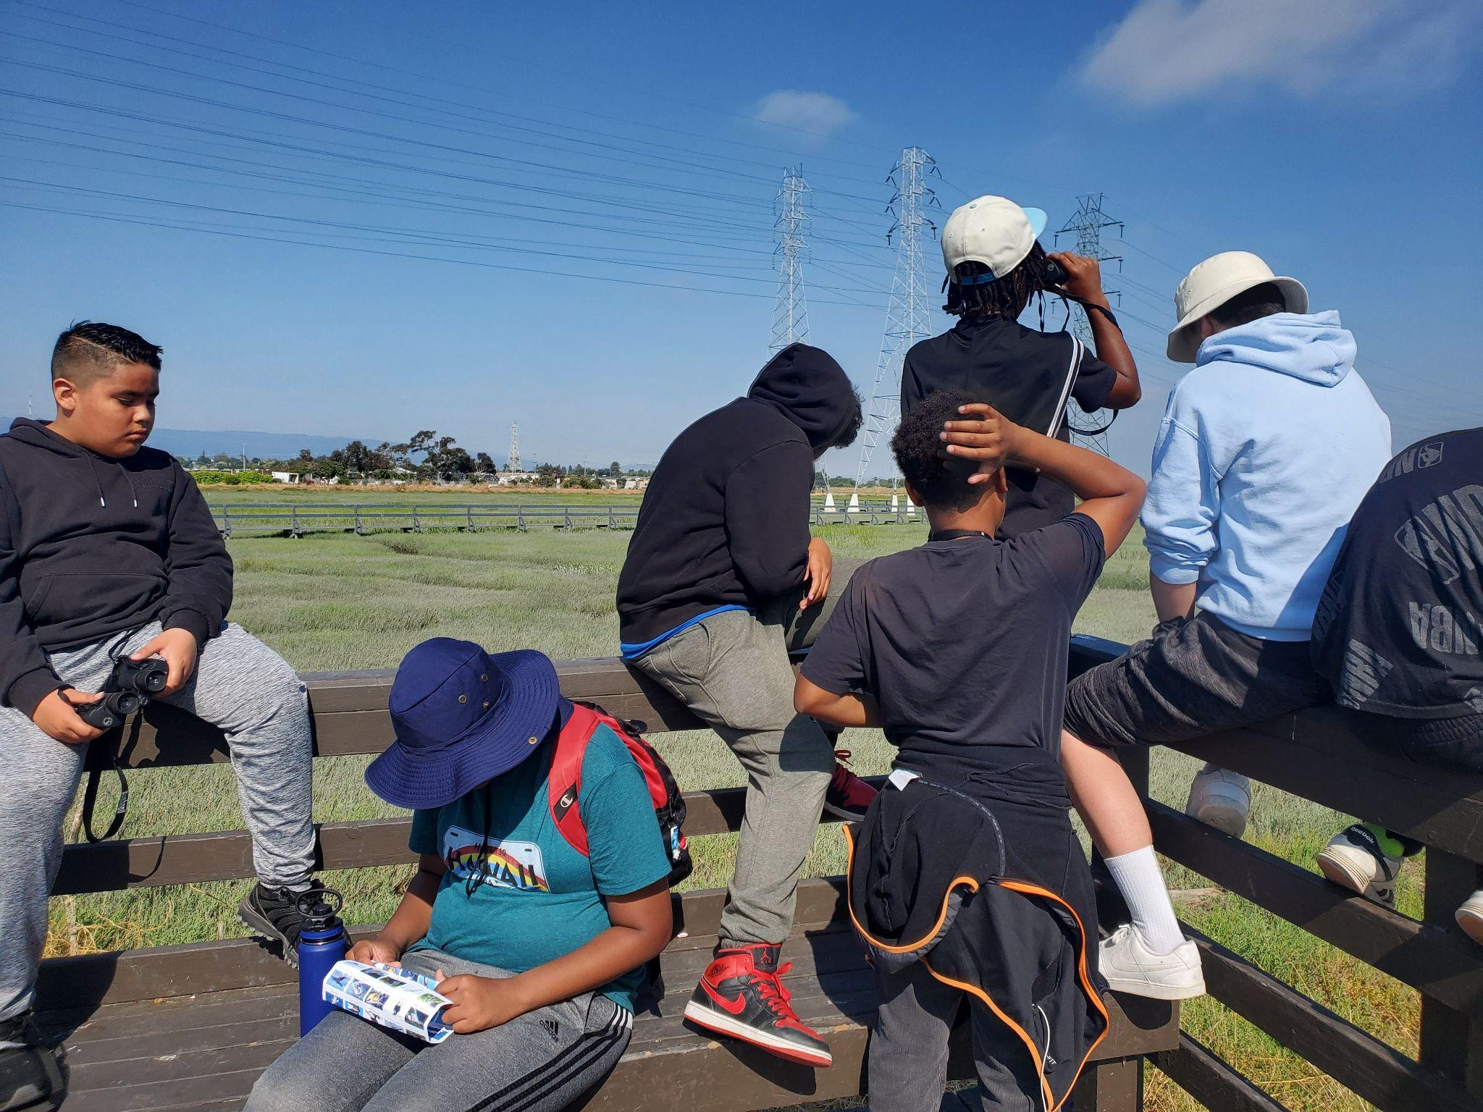
Agenda
Context
Project Overview
Community Engagement Strategies
Themes / Challenges
Acknowledgements
Questions

Slide 3
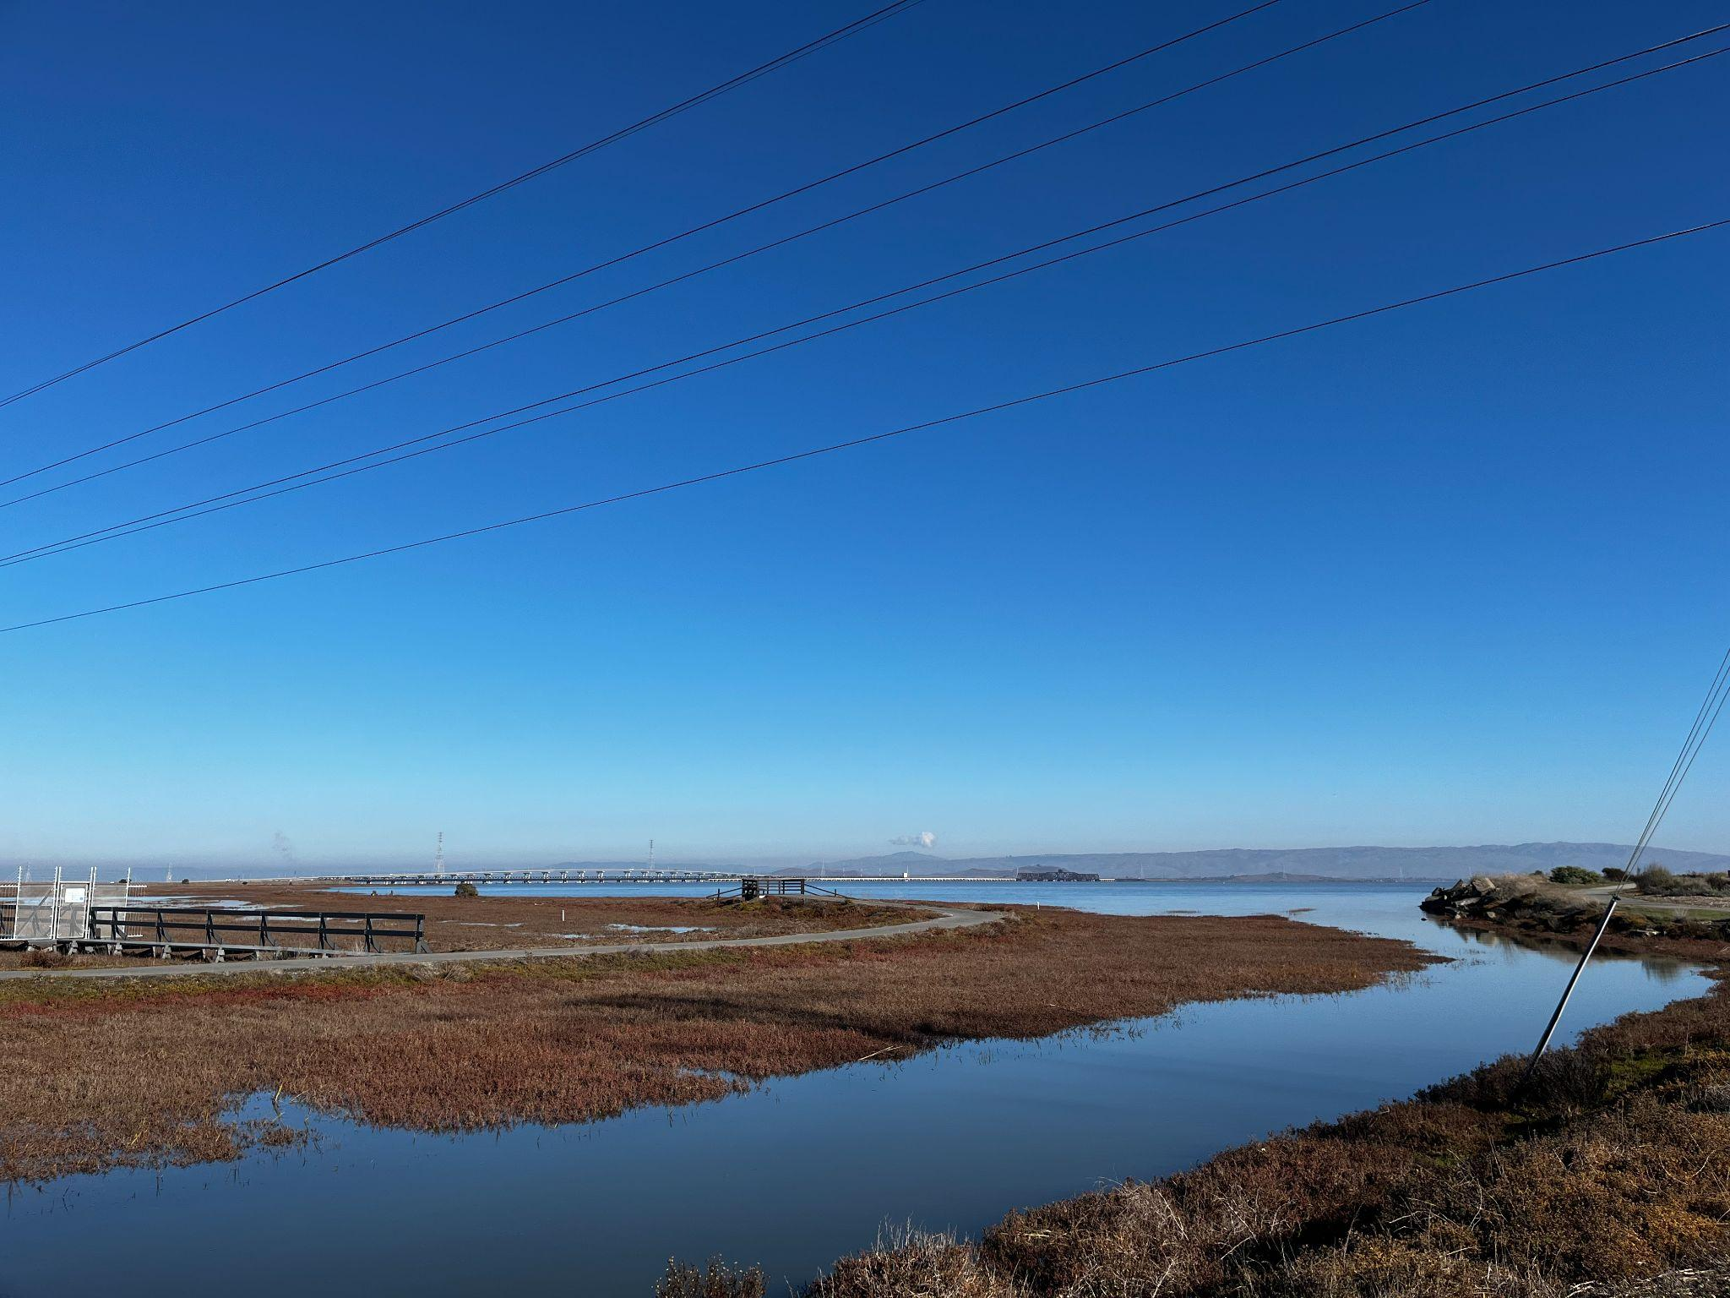
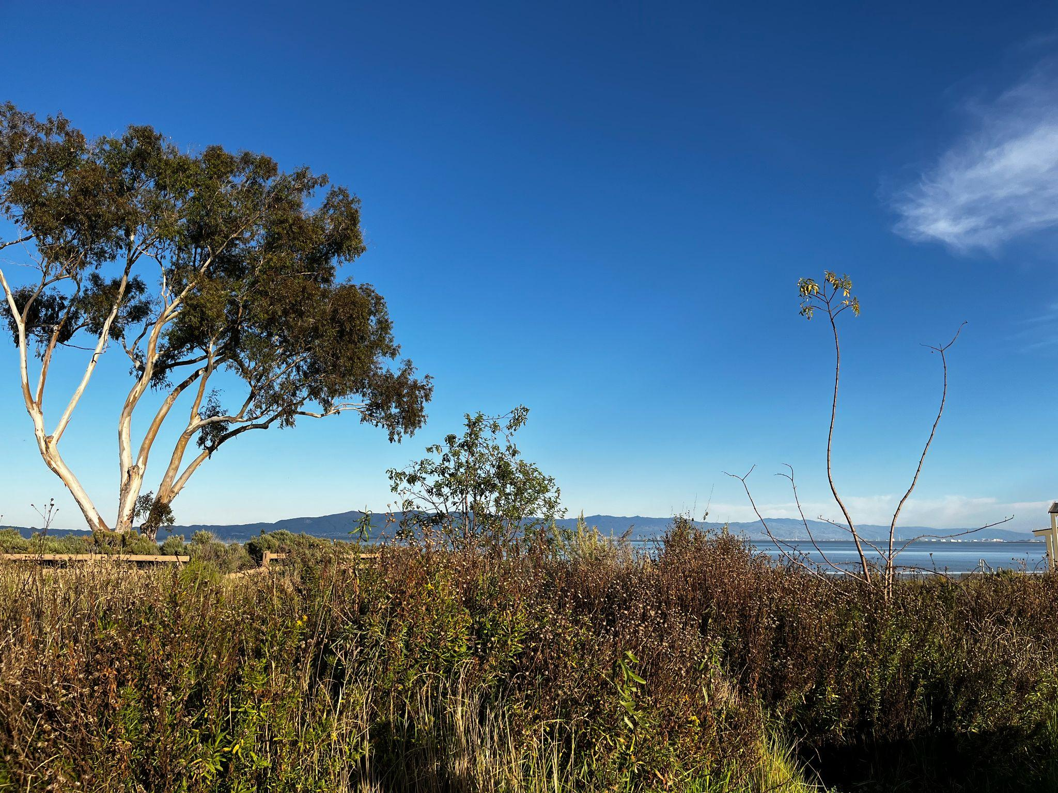
Ravenswood Open Space Preserve
Cooley Landing
Notes:
The purpose of the project is to (1) restore and enhance marsh-upland transition zone habitat along the Bay Trail in Ravenswood OSP and at Cooley Landing, and (2) increase appreciation and stewardship of these natural spaces by EPA residents. We partnered with landowner Midpeninsula Regional Open Space District and local nonprofit Climate Resilient Communities as well as other organizations to carry out the project.
Ravenswood is owned by MROSD. Cooley Landing is owned by MROSD, City of EPA, Don Edwards USFW on the other side. We first began working here in 2016. This past winter was our first year working at Ravenswood Preserve. Together, we were awarded $688,016 for Baylands Habitat Restoration and Community Engagement in East Palo Alto from the San Francisco Bay Restoration Authority’s Measure AA grant program.
Our role is to steward the land and engage folks in connecting to the land.

Slide 4
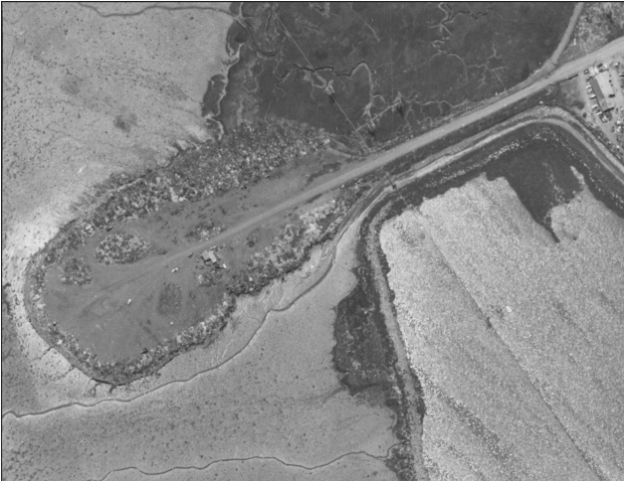
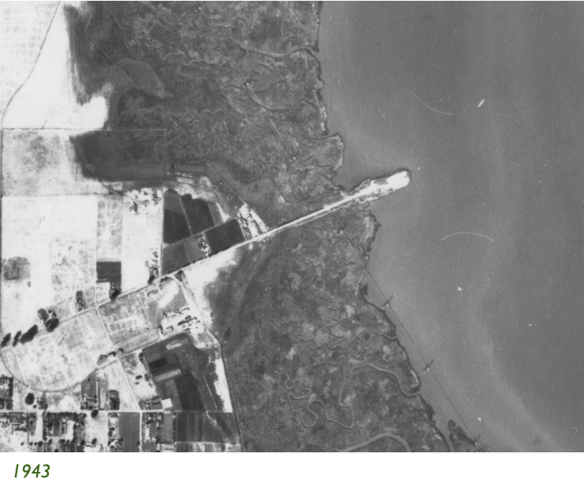
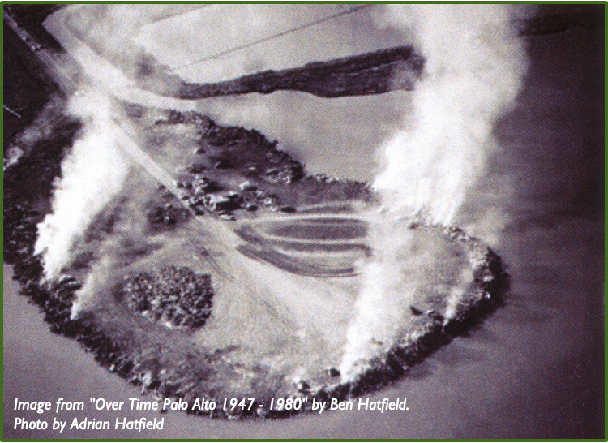
Environmental Justice in EPA
1930s – 1960: San Mateo County Dump
Notes:
For those unfamiliar with the City of East Palo Alto, this city has faced a long history of redlining practices and racial deed restrictions in Palo Alto. Today, the city is comprised of Latinx, Black, and Pacific Islanders community members.
In the 1950s, the Leslie Salt Company turned the marsh into a salt production pond by surrounding it with levees to keep out the tides. MROSD bought the land (376-acre) in 1989 and began restoration of the marsh in 2000.
At around the same time, Cooley Landing was turned into a landfill by the County of San Mateo and operated from 1930s until 1960’s. Cooley Landing opened to the public in 2012. Building opened in 2017. The park is 9 acres.

Slide 5
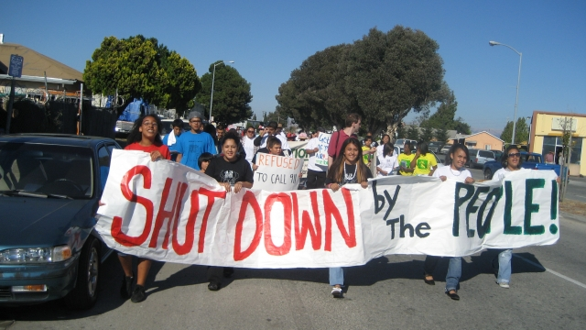
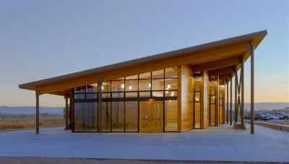
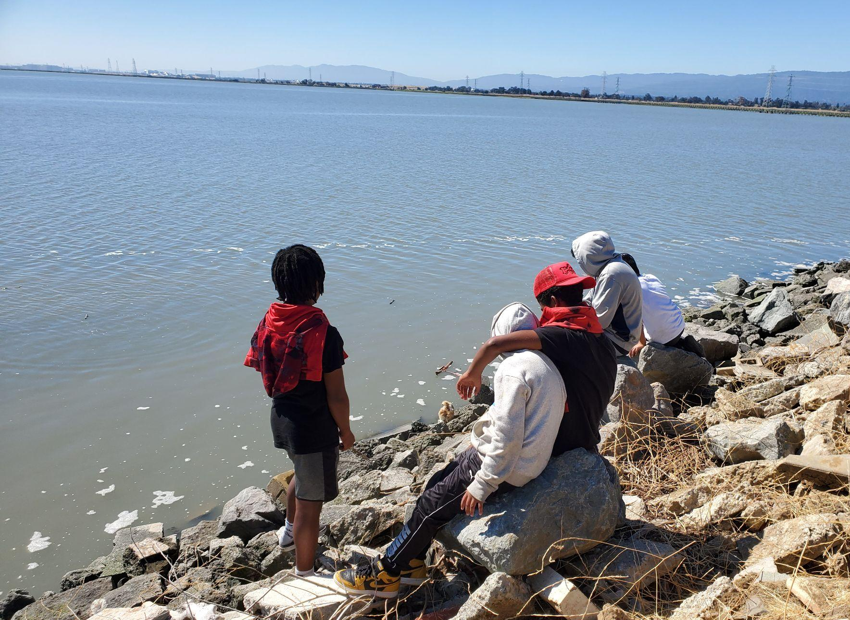
2017 - Cooley Landing Education Center opened
Photo Credits: Ruth Robertson
2007 - East Palo Alto Youth (YUCA) Rally for Romic Shutdown
Present Day
Notes:
Used to be unincorporated, led to crime, demographic shifts when it became corporated part, uplifted diversity
Future challenges for the community / ecology include climate change, sea level rise
Landfills and polluters (like Romic) are disproportionately located in low income / communities of color. This has had negative impacts on both environmental and public health (asthma rates), lack of open spaces, etc. The process of getting Romic to shut down has been due to community members/orgs voicing their concerns and demanding justice. The conversion of Cooley Landing from landfill to the city’s first park has been a touchstone on how a space can turn from harmful to healing for people and habitats alike. This is why community engagement in EPA specifically is such a strong component to all of our work.

Slide 6
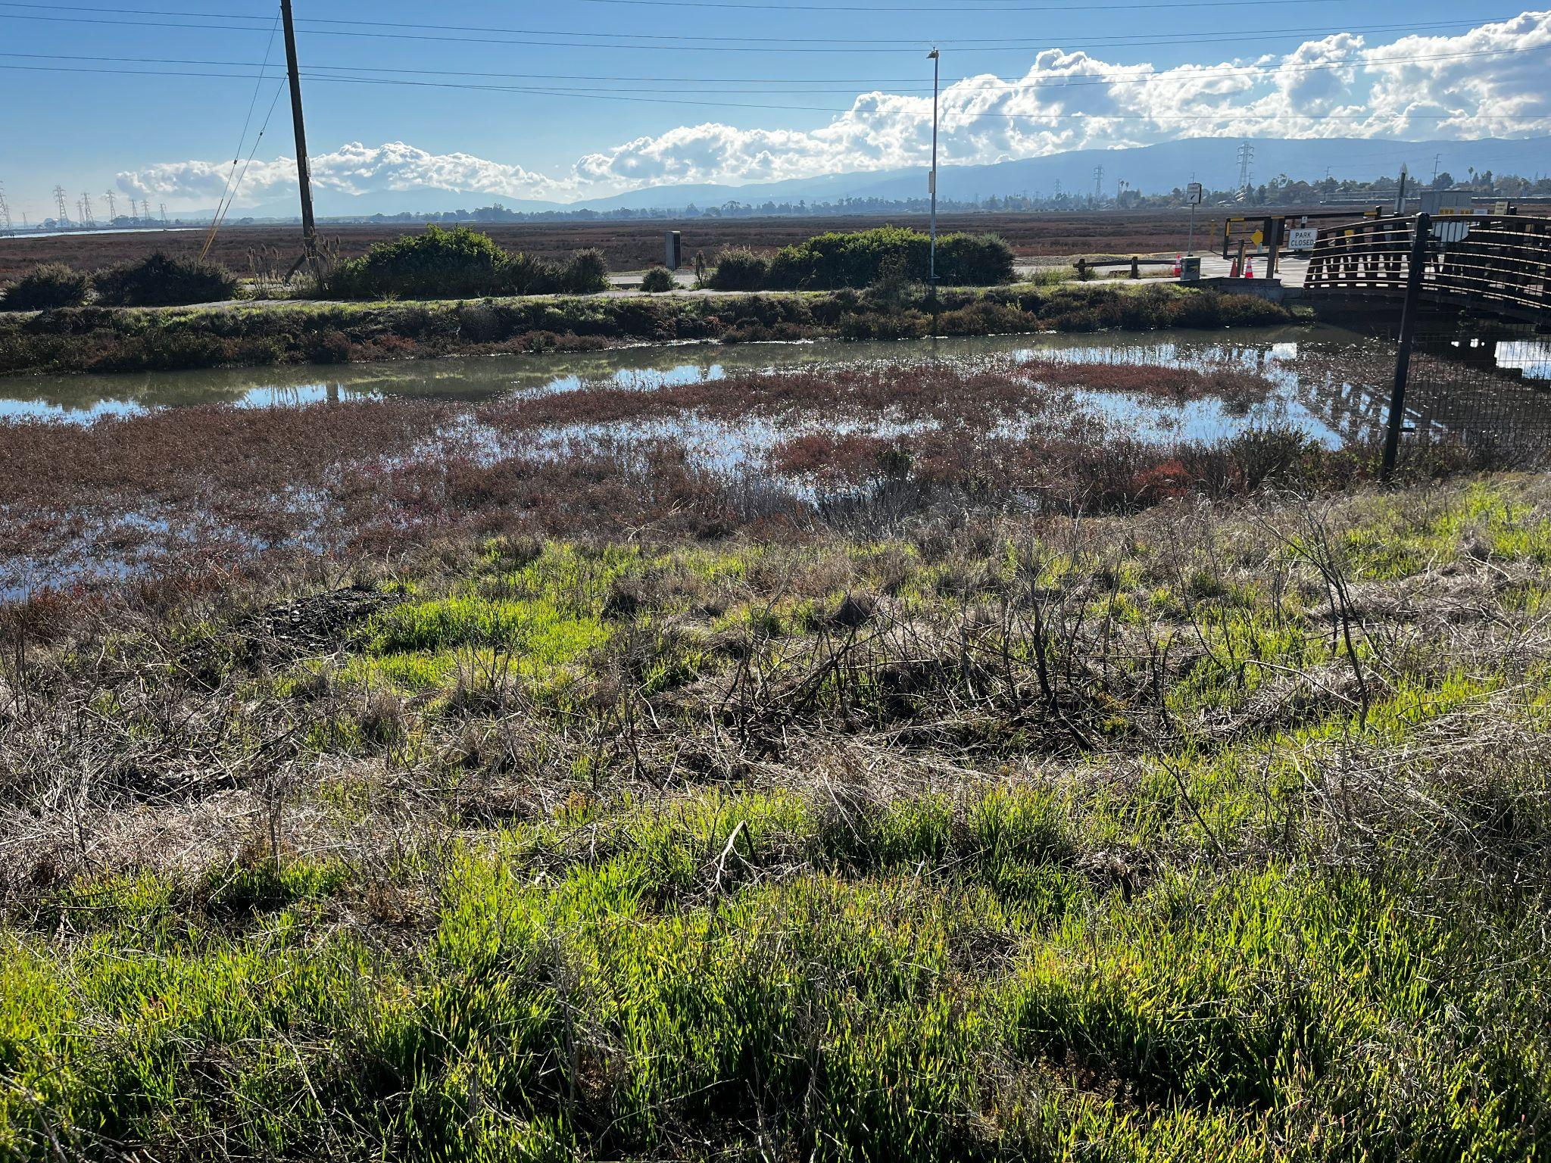
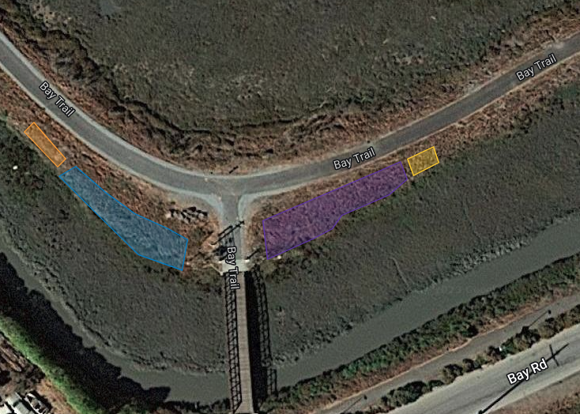
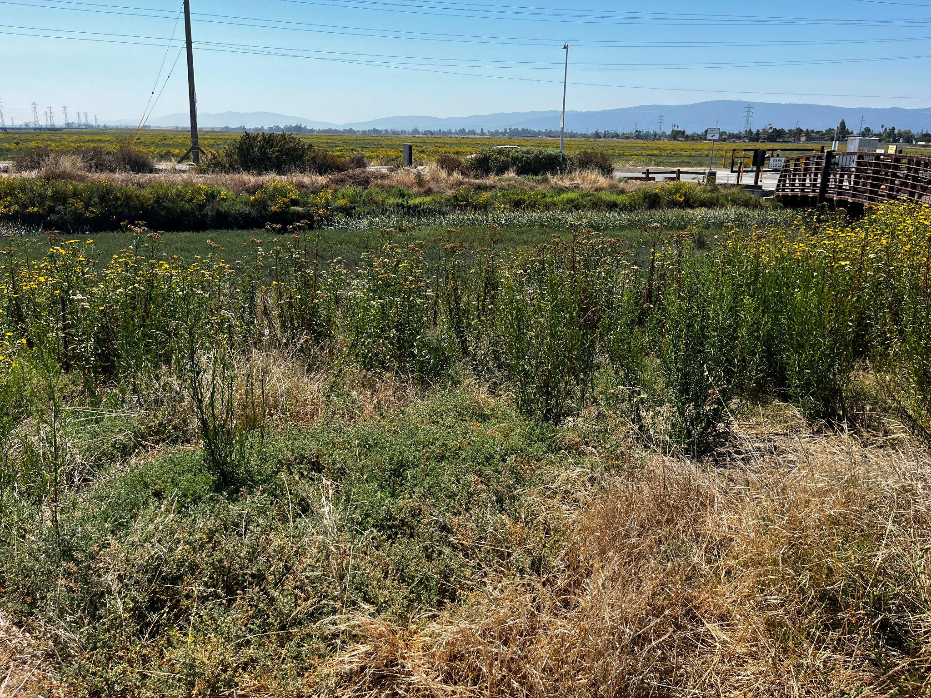
Habitat Restoration
Dec 2022
Winter 22-23 Planting Area
Aug 2023
Notes:
Now that it’s a safe shared space for the community to enjoy. Our project is focused on bringing the community together to continue to restore the space (took a long time coming) and connect them to the natural spaces around us and take ownership over this space.
The project has three major components:
Habitat restoration at the Ravenswood OSP and Cooley Landing will create healthier, more biologically diverse and resilient marsh transition zone habitat through invasive plant removal and revegetation with native plants. Work will be conducted through a combination of community volunteer workdays, San Jose Conservation Corps workdays, and field work with Grassroots Ecology staff and restoration interns.
Plants installed included mugwort, saltmarsh baccharis, creeping wildrye, alkali heath, marsh goldenrod, marsh gumplant, and pacific aster. We installed 385 plants in the first year. We got a lot more planned for this winter!
We hope restoring salt marsh habitat besides providing habitat for endangered species can also buffer flood risk in the face of sea level rise and climate change.

Slide 7
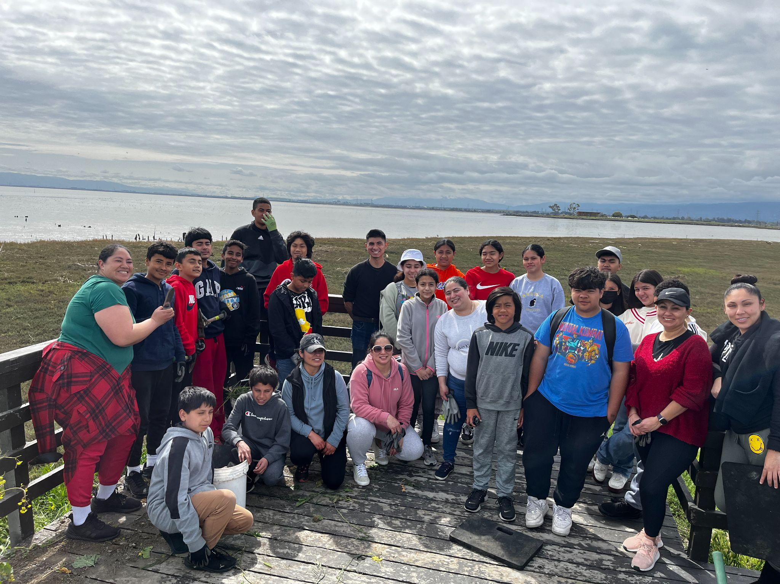
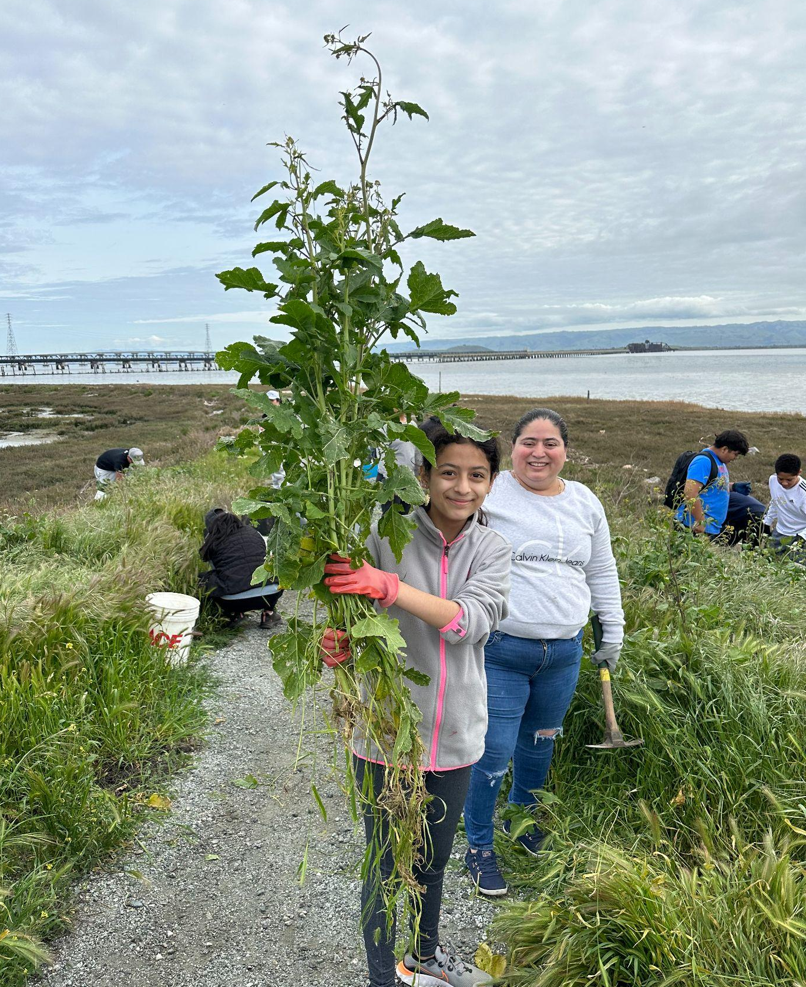
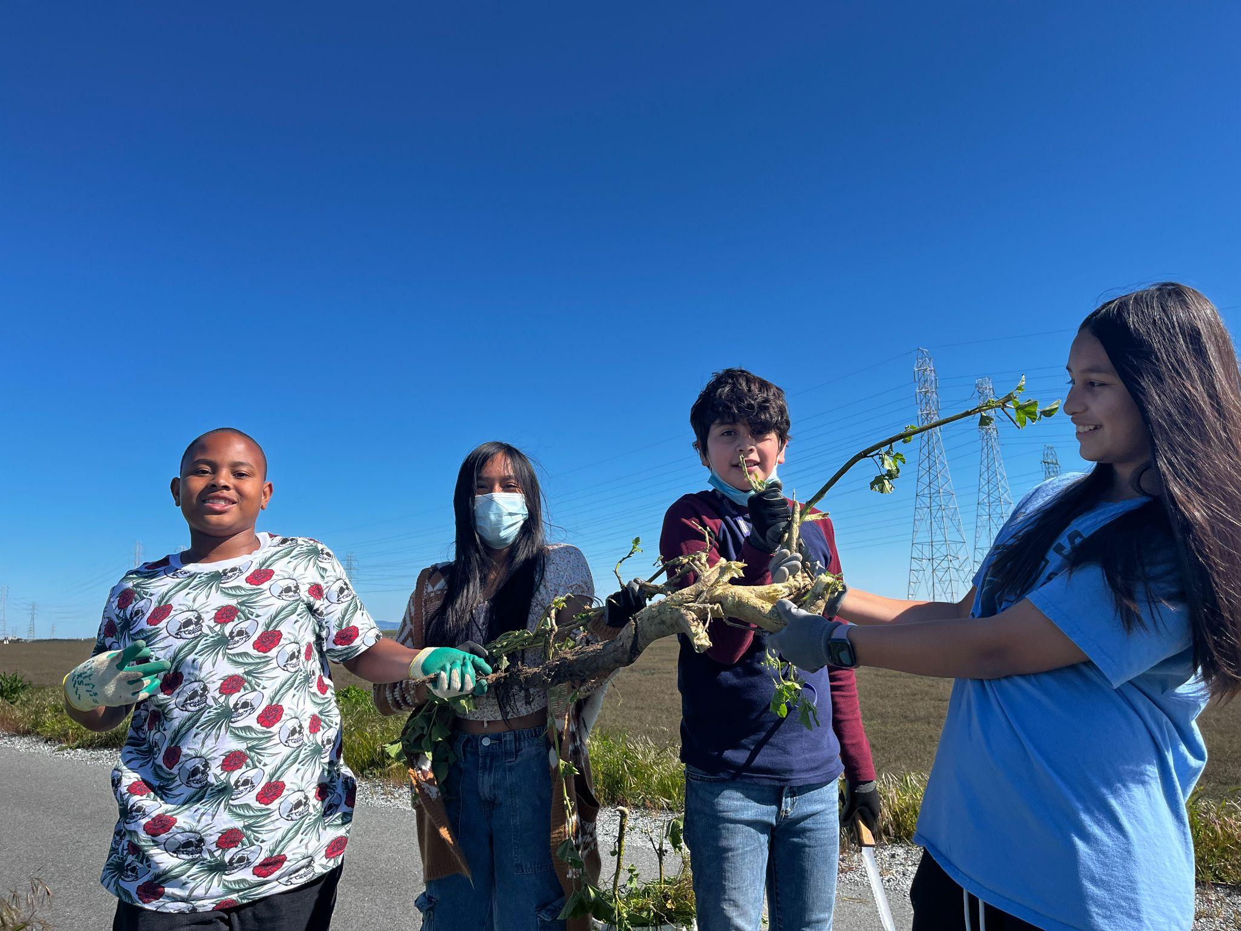
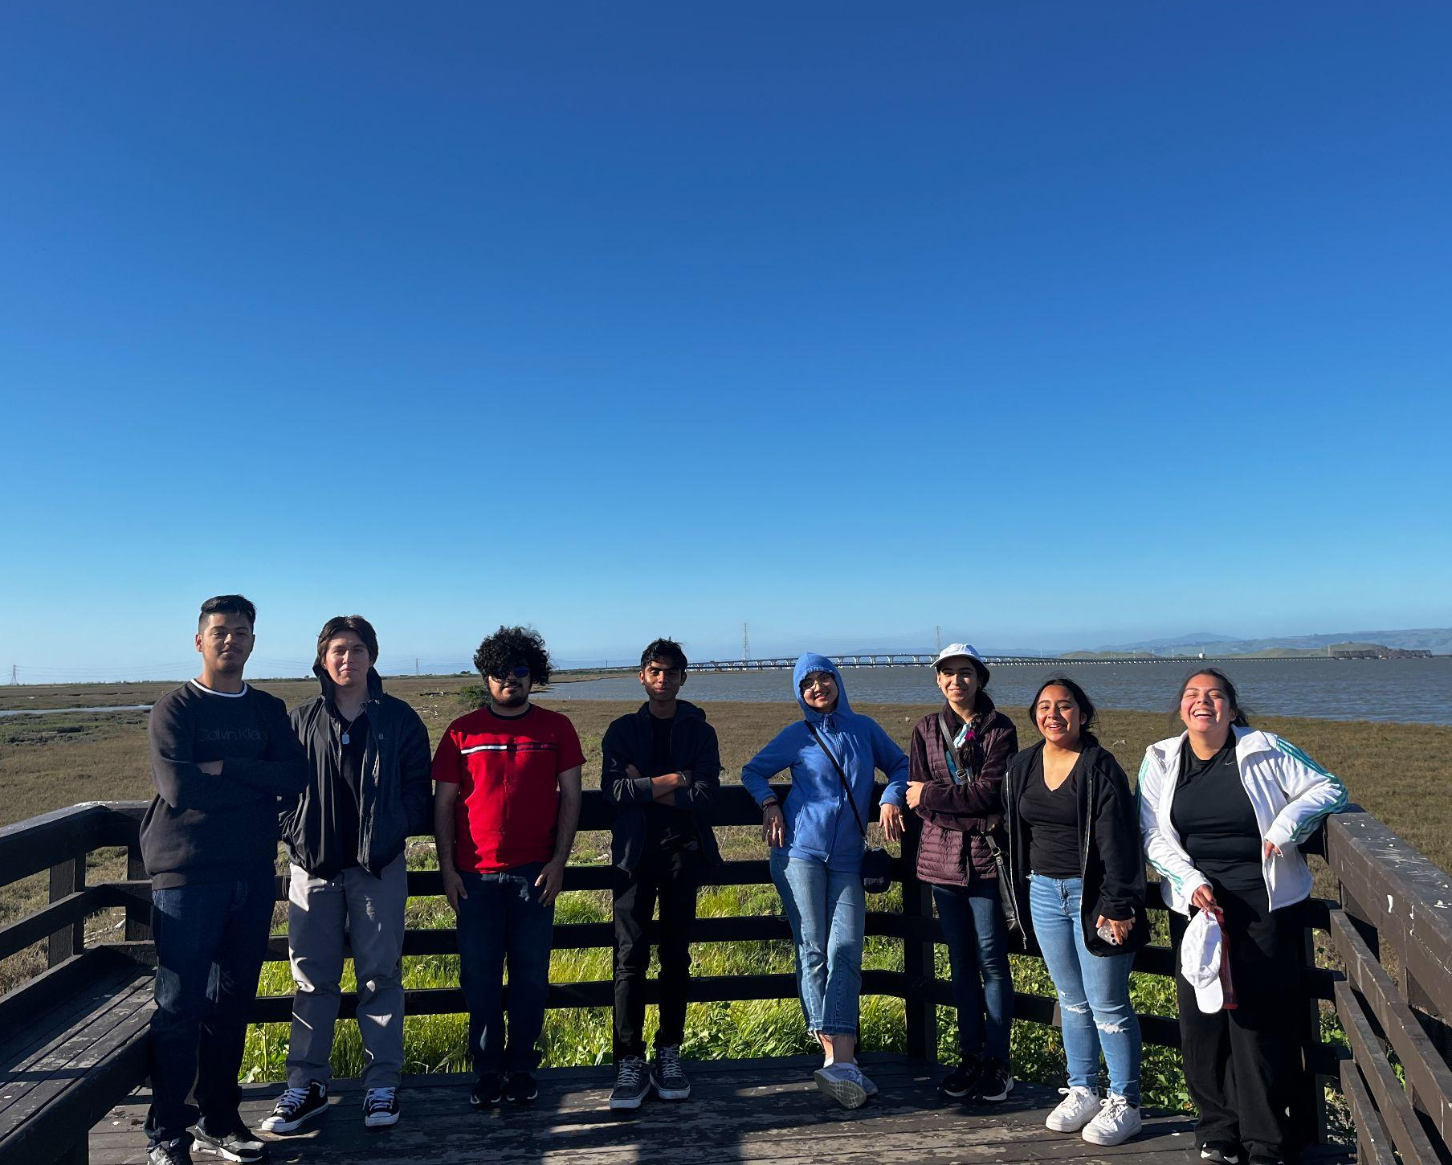
Notes:
Between planting and invasive plant management, we’ve hosted various groups including an inaugural joint event with CRC, community workdays, local schools like St. Elizabeth of Seton School, East Palo Alto Tennis and Tutoring, College Track, and EPA Boy’s and Girl’s Club.

Slide 8
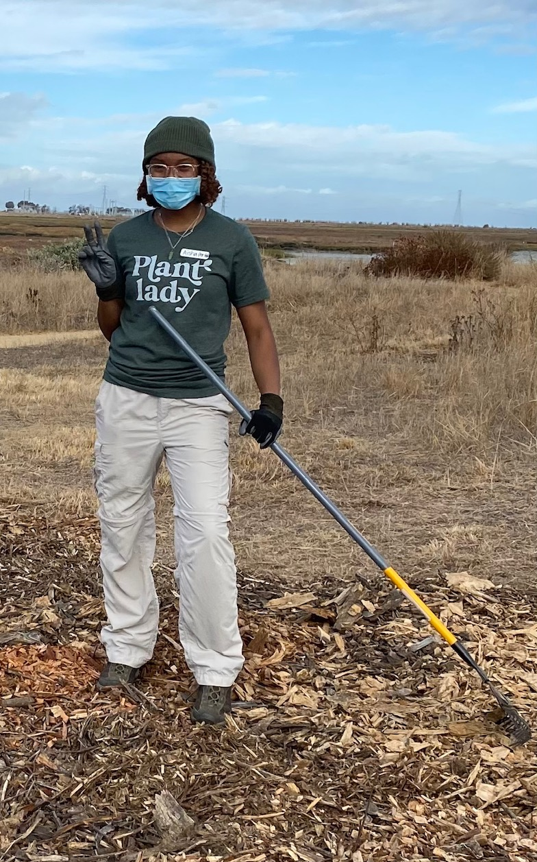
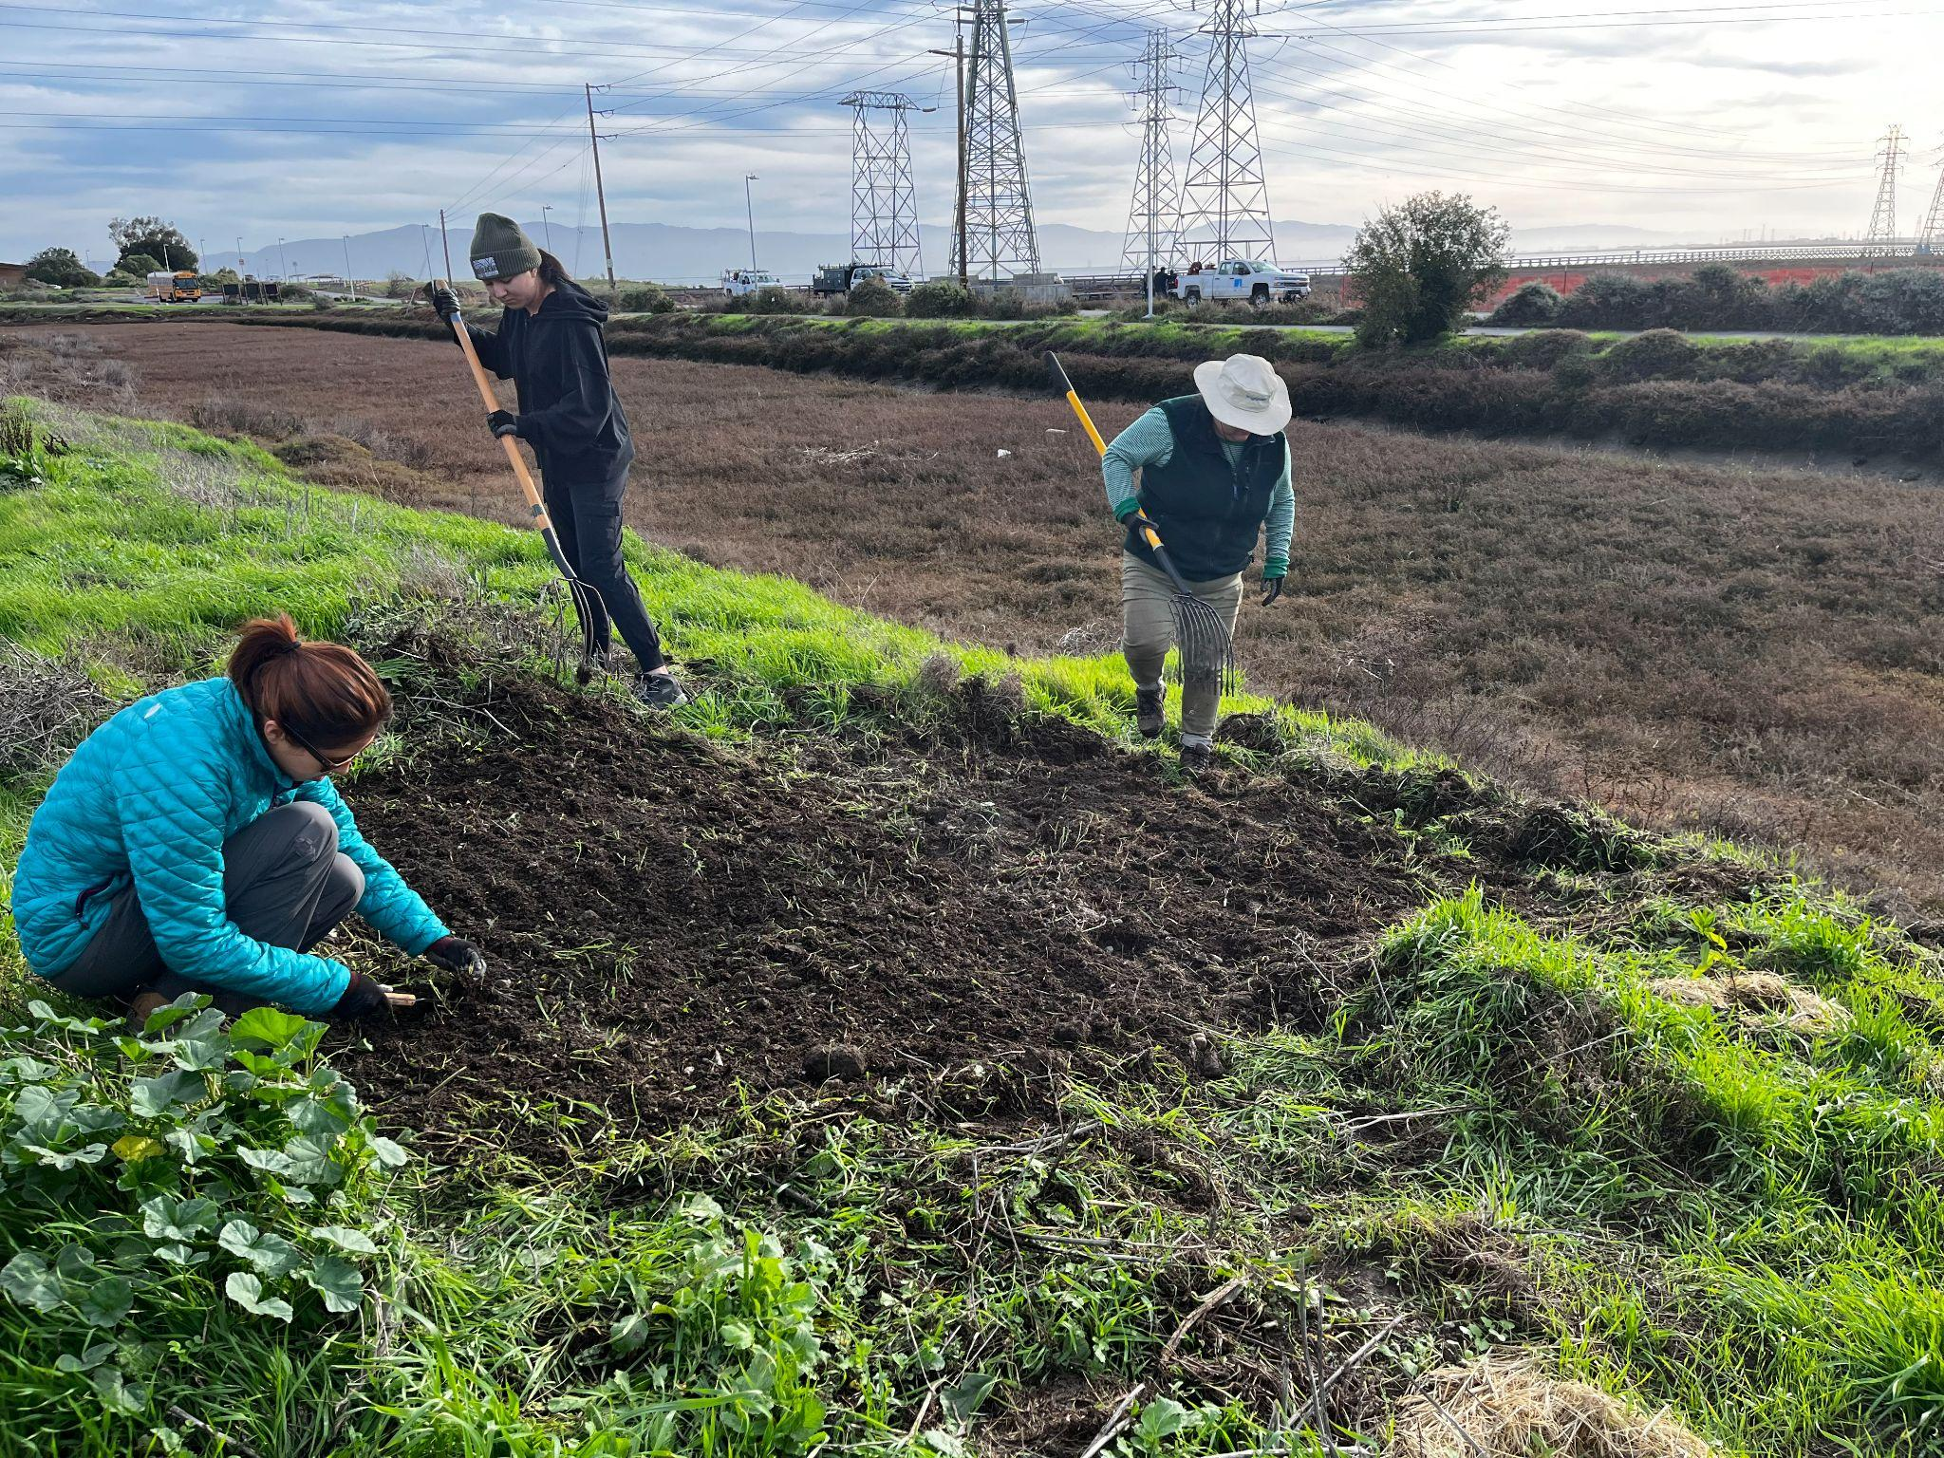
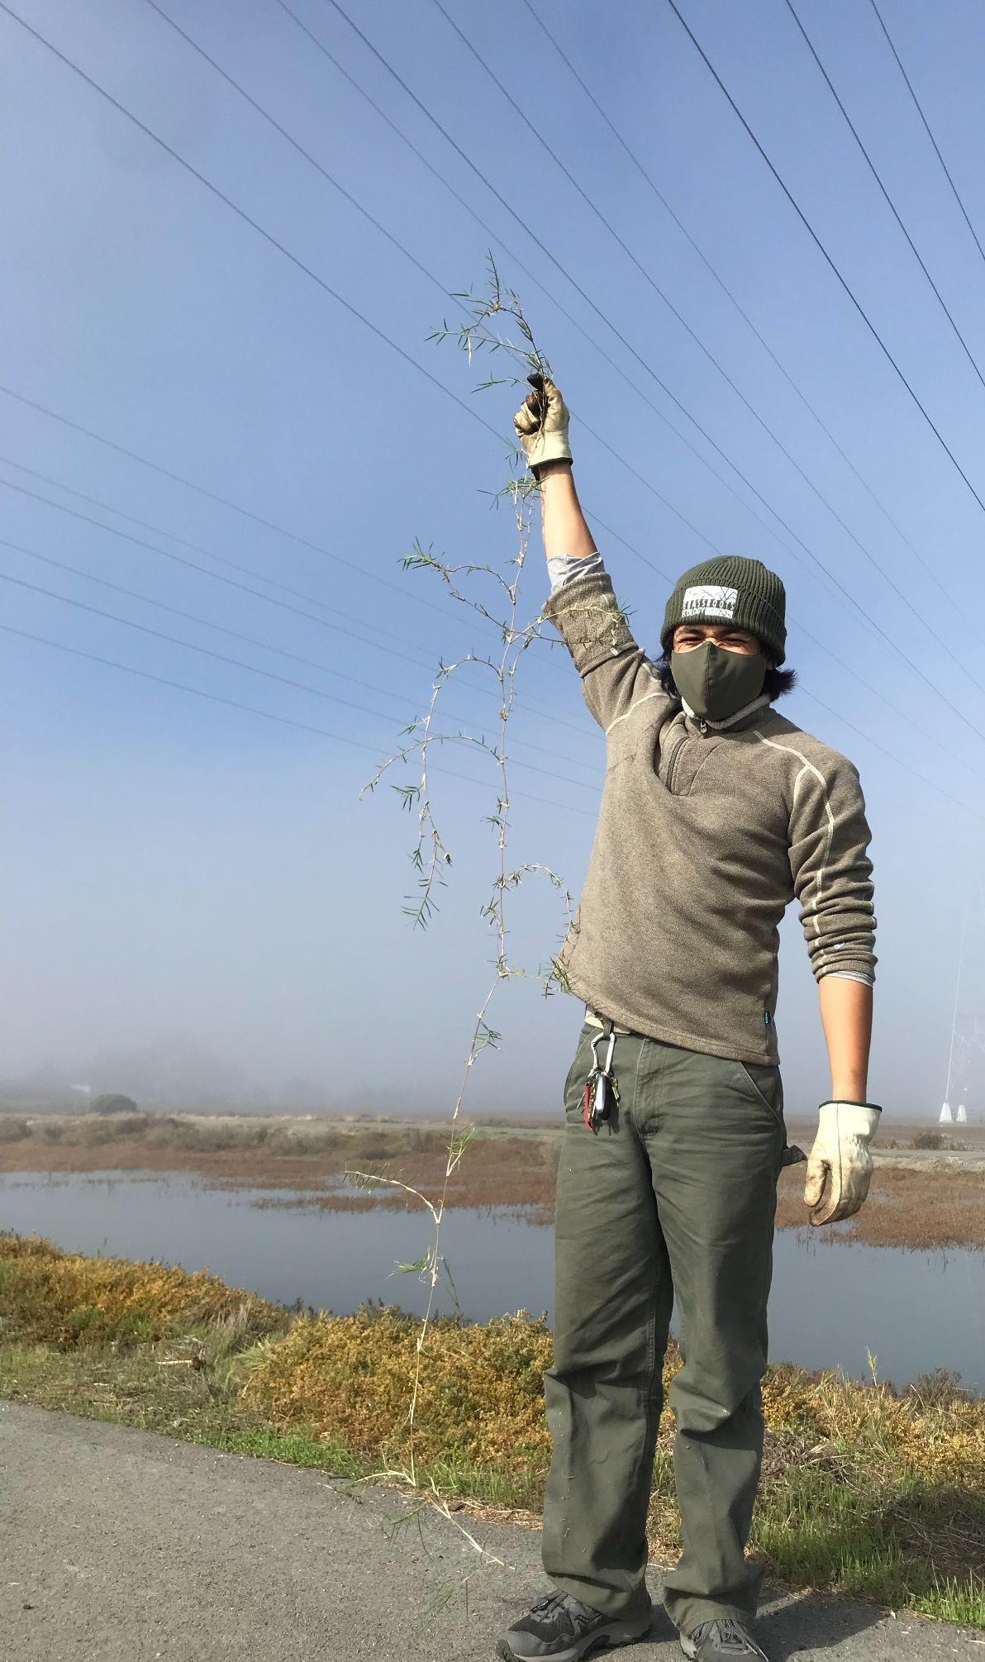
Workforce Development
Notes:
2. Workforce development: Grassroots Ecology will hire interns to work side by side with staff to install and maintain native plants; implement integrated invasive plant management strategies for invasive plants; help manage lands that provide habitat for endangered species; and learn from and network with restoration staff and other environmental professionals working on the project. In addition, Grassroots Ecology will utilize the San Jose Conservation Corps (SJCC) in habitat restoration, empowering its young adult members through job skills and training.
We prioritize hiring from within the East Palo Alto community, for example Alfredo grew up here.

Slide 9
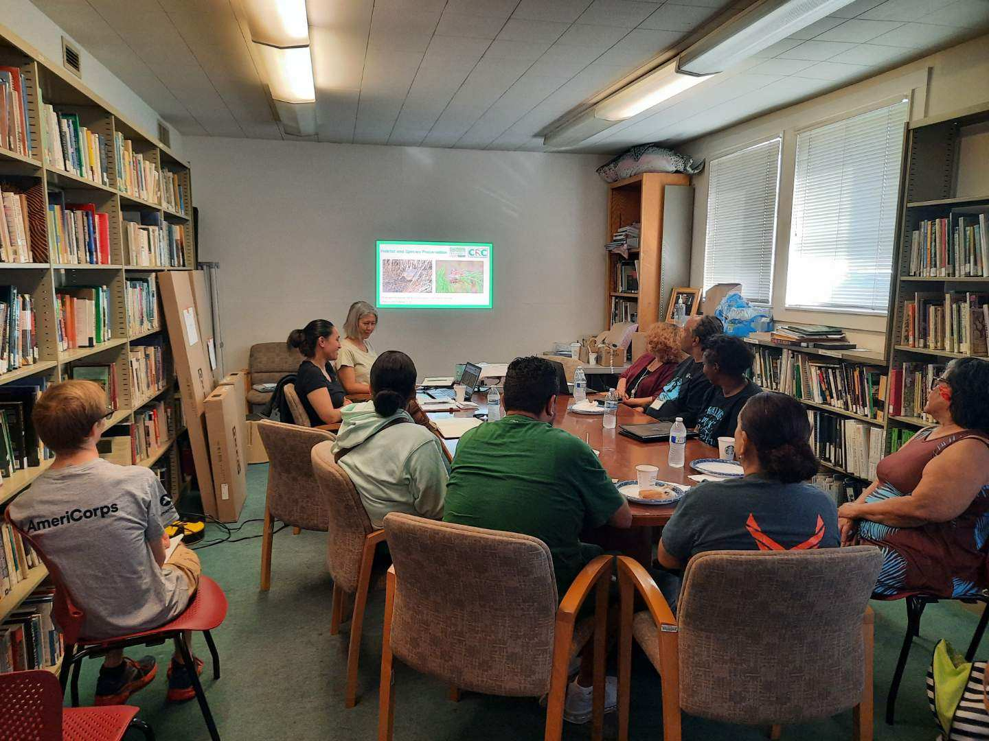
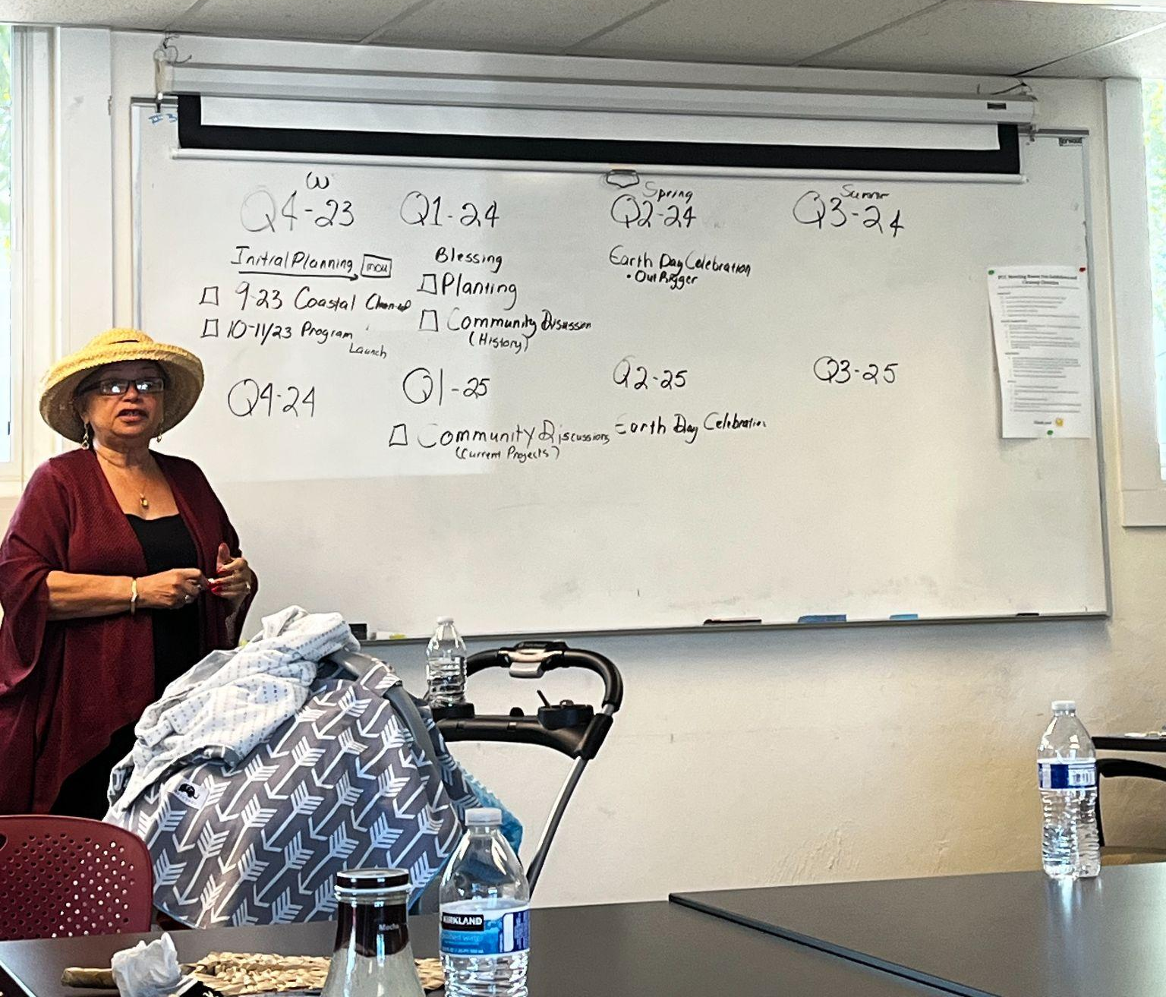
Community Engagement
Focus on community leadership, fostering community ownership for Ravenswood/Cooley Landing, promoting public access, and increasing local knowledge of the marsh habitat benefits in the face of climate change and sea level rise
Planning Phase:
Climate Change Community Team
Anamatagi Polynesian Voices
St Mark A.M.E. Zion Church
El Comité de Vecinos
Notes:
3. Community engagement: Climate Resilient Communities (CRC) will lead engagement via the Climate Change Community Team, which is composed of local leaders and was formed by CRC in 2019 to guide climate work locally. Together with Grassroots Ecology, CRC will provide restoration training for local community groups with the goal of fostering community ownership for Ravenswood OSP and Cooley Landing, promoting public access to these spaces, and increasing local knowledge of the benefits of marsh habitat in the face of climate change and sea level rise. Program elements will include seminars on topics such as marsh ecosystems, habitat restoration, and climate change; events that engage participants in planting, invasive removal, and other restoration activities; and stewardship events including trash cleanups, guided nature walks in multiple languages, and an annual larger community event (e.g. coinciding with Earth Day or Bay Day). Stipends will be provided to training participants and compensation to EPA-based community organizations to take leadership roles in organizing stewardship events.
“Community leaders in East Palo Alto have echoed many times the need for more education and awareness on issues related to climate change and sea level rise. This project will provide these opportunities, foster a sense of ownership for local open space, and increase local knowledge of the many ecosystem benefits of marsh habitat,”
Currently, we’re in the process of determining a schedule of quarterly events with each community group and envisioning what this collaboration could look like. “It’s about working together in the face of the unknown.” - Rev. Virges
Some ideas have already surfaced about incorporating cultural relevant events like fisheries, outriggers team, indigenous traditional knowledge about native plants. They’re also hoping to collaborate together on these events and larger scale Earth Day events.

Slide 10
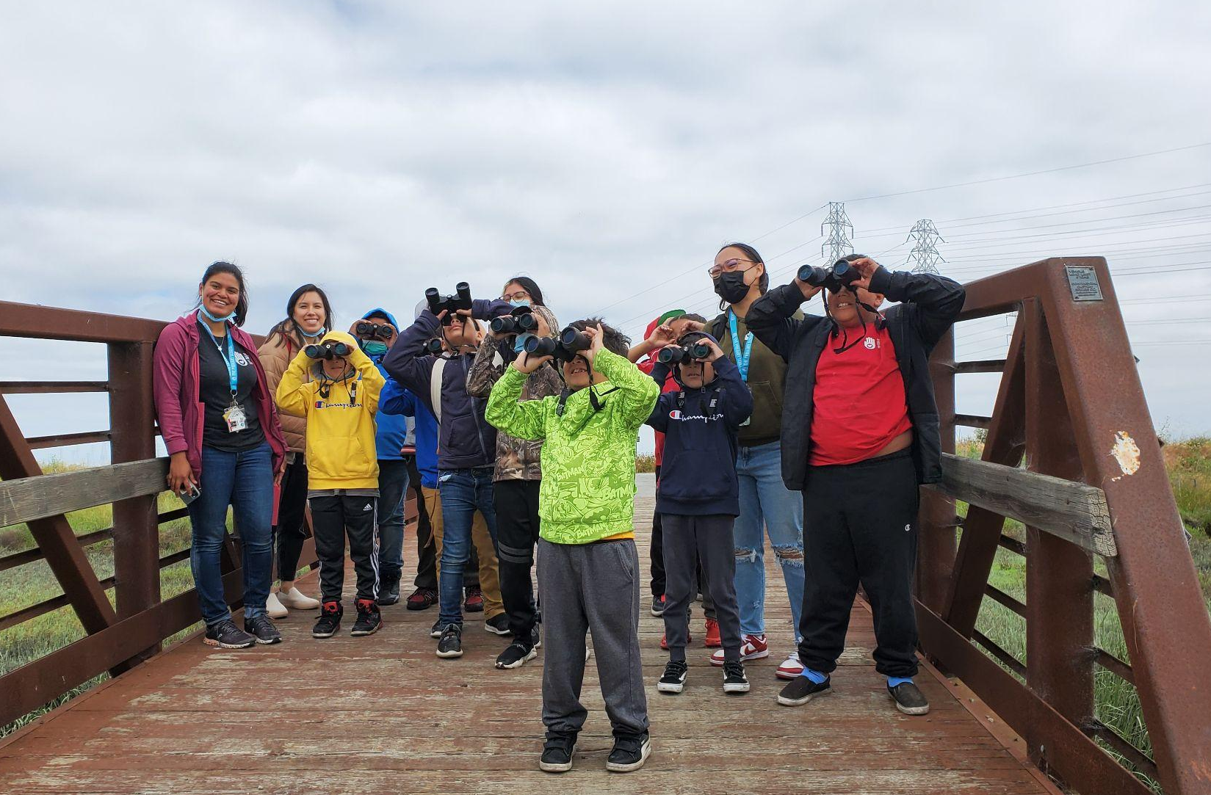
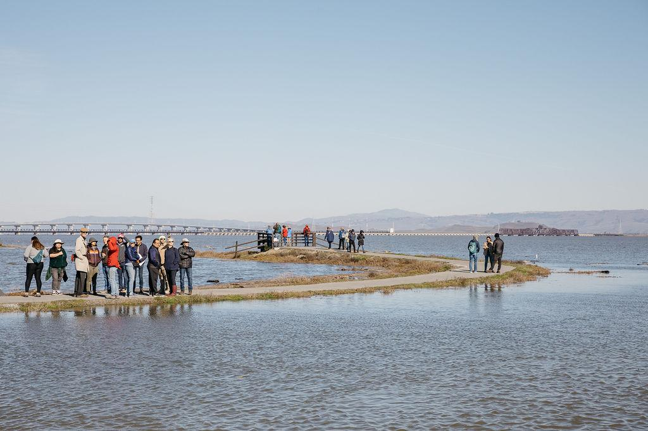
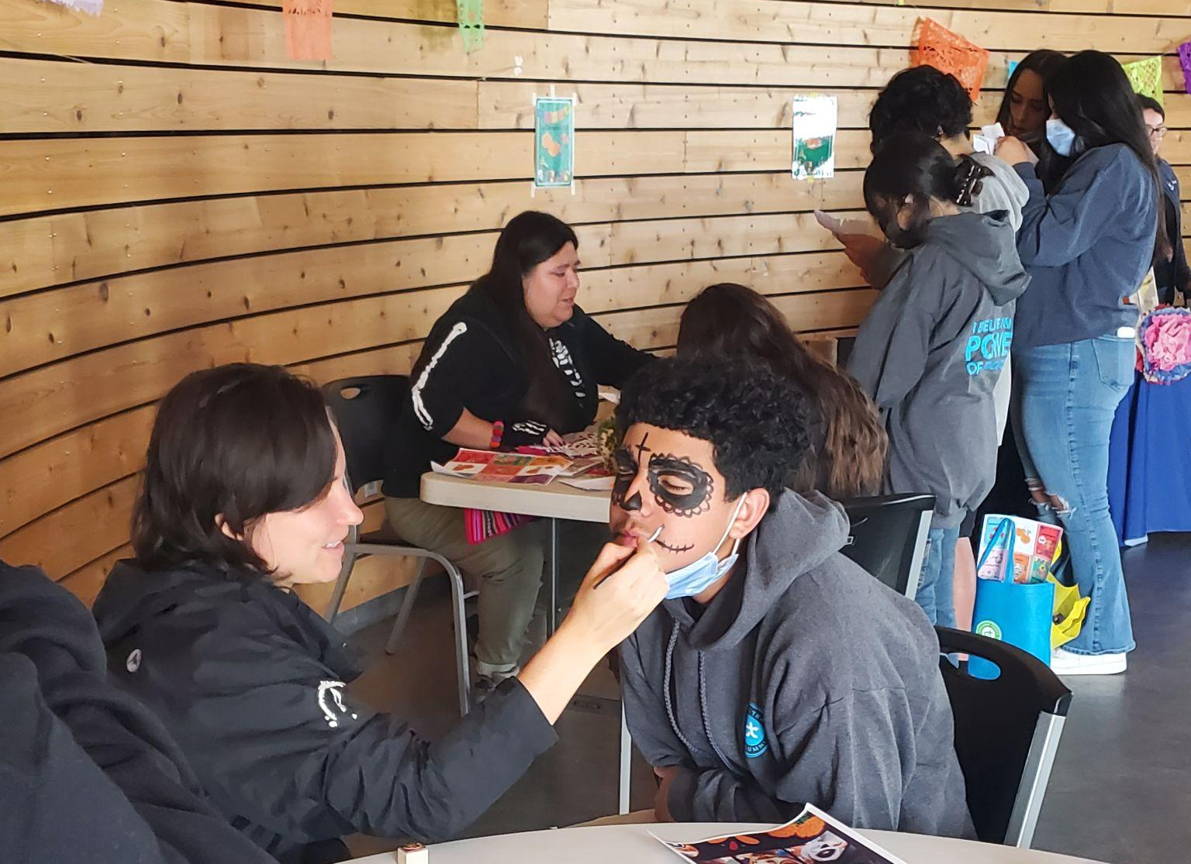
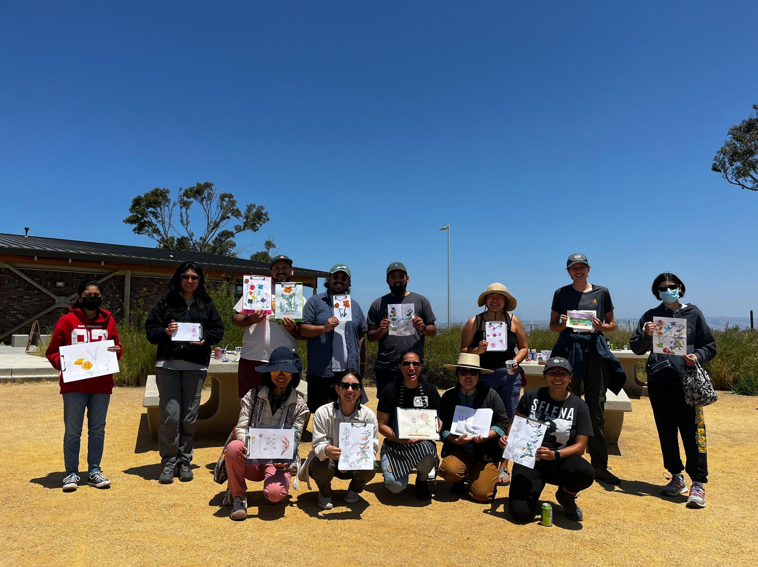
Going Beyond
Bilingual Nature Walks & Interpretive Events
Trash Cleanups
Earth Days
Planting Days
Restoration Training
Photo Credits: Vita Hewitt/Hewitt Visuals
Notes:
How do we foster a sense of stewardship and ownership of these spaces from the local East Palo Alto neighbors? Offering different ways of engaging with the land whether it’s through a cleanup, a celebration of Earth Day, or learning more about the importance of restoring marshes in the face of sea level rise and climate change. In different languages and in culturally relevant ways. The only way to do this is to go the community leaders!
Pictured above, a bird walk with a special day class from the Primary School hosted in May. Below that, CRC, GRE, and Latino Outdoors also co-hosted a bilingual Nature Art Day in June that included a nature inspiration walk followed by watercoloring. On the center, our King Tide event (CRC, GRE, KQED, SMCoS, Exploratorium) that was bilingual and focused on talking about sea level rise and king tide phenomenon. On the left, CRC, GRE, and Nuestra Casa also co-hosted a Dia de los Muertos bilingual event in Nov 2022 to celebrate the holiday and its ties to nature. Together, we built a community alter and hosted stations on face painting, papel picado, skull coloring, reflective activity, and deadheading native plants.

Slide 11
Intentional Strategies
Tabling and outreach at local schools, farmer’s markets, and community events
Continued efforts resulted in connection with other partners (Fresh Approach, Tide Academy, Latino Outdoors, Nuestra Casa)
Prioritize spots for EPA community members in registration & offer naturalist walks in Spanish
Prioritize private events with EPA schools, organizations, and community groups
Notes:
Here’s how we’re intentionally target local groups / comm. members for events

Slide 12
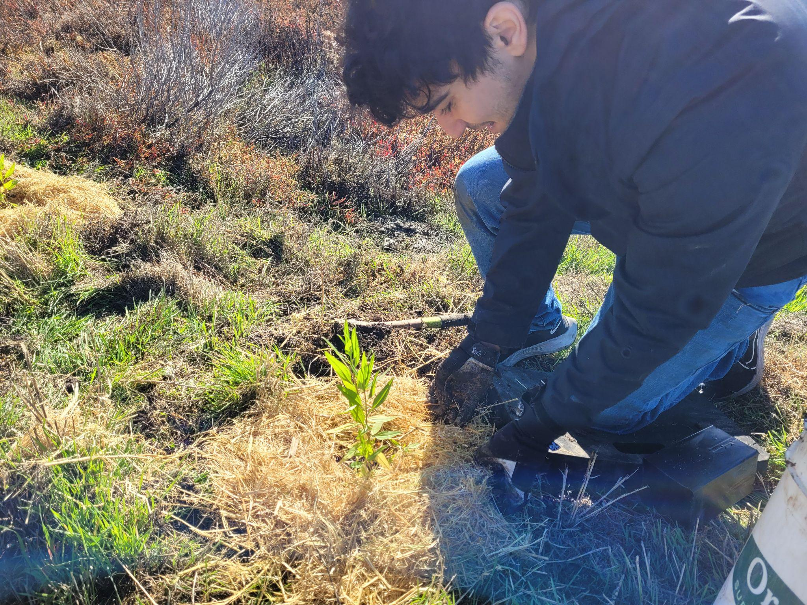
How Have These Strategies Worked?
86% of volunteers at Cooley Landing / Ravenswood have immigrated to the US or have parents who immigrated
33% of volunteers at Cooley Landing / Ravenswood are low-income
38% of volunteers live in East Palo Alto
Notes:
If our goal was to get more East Palo Alto community members out to Cooley / Ravenswood, how do we measure if our outreach strategies worked? We have an optional survey for participants and we track demographic information such as financial status, whether they identify as immigrants, and what zip code they live in. Using this data, we’ve been able to start tracking if we’re actually seeing an increase in volunteers after three years of sustained efforts to see if it’s reflective of the community. This was our first year doing events at Ravenswood and we truly feel like we’re planting the seeds for more involvement of EPA neighbors in the following years. NOTE THIS DATA IS JUST FOR GRE VOLUNTEERS
CRC has led EPA specific cleanups that are all EPA community members

Slide 13
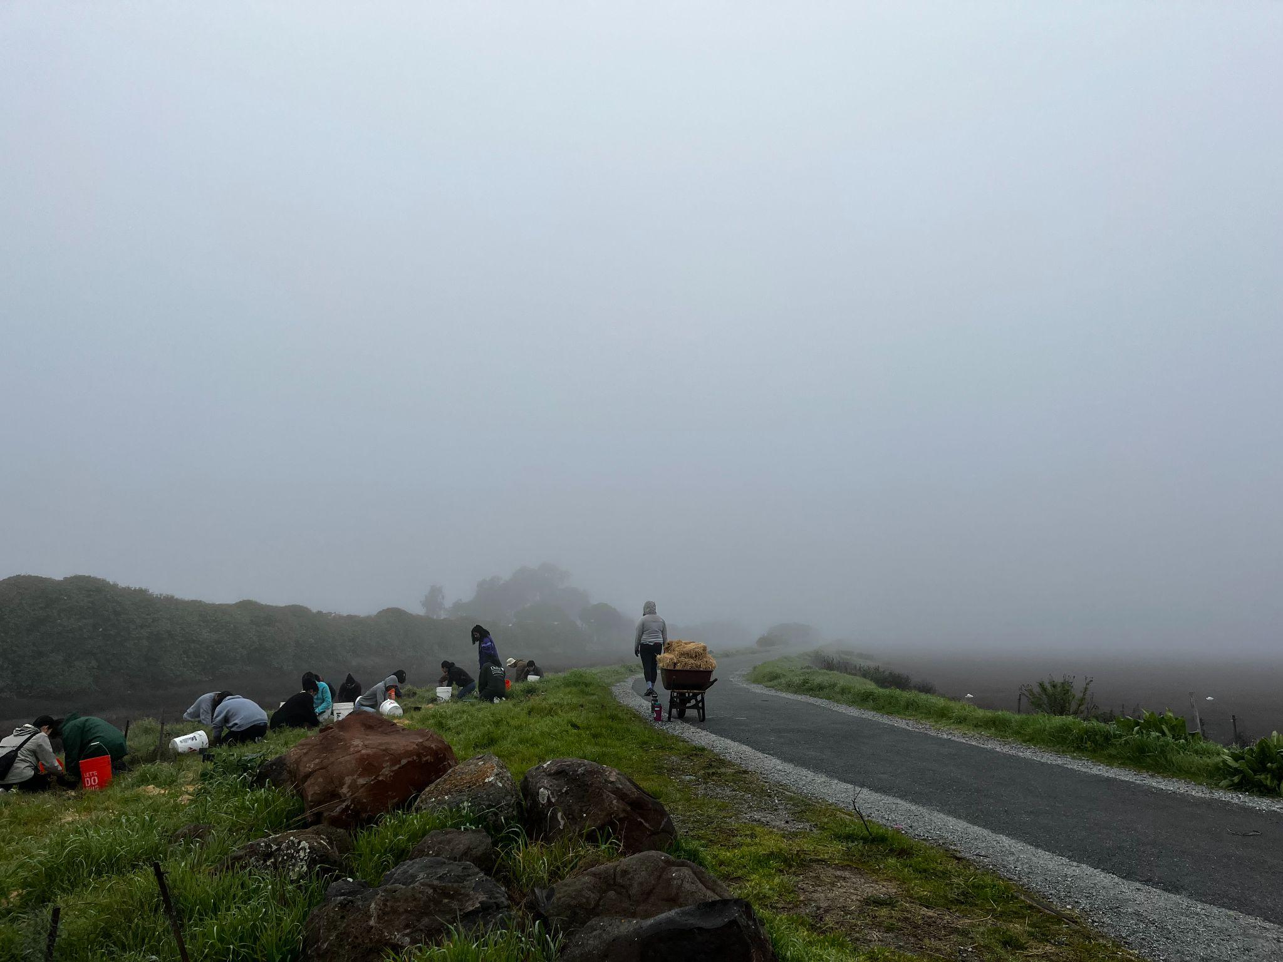
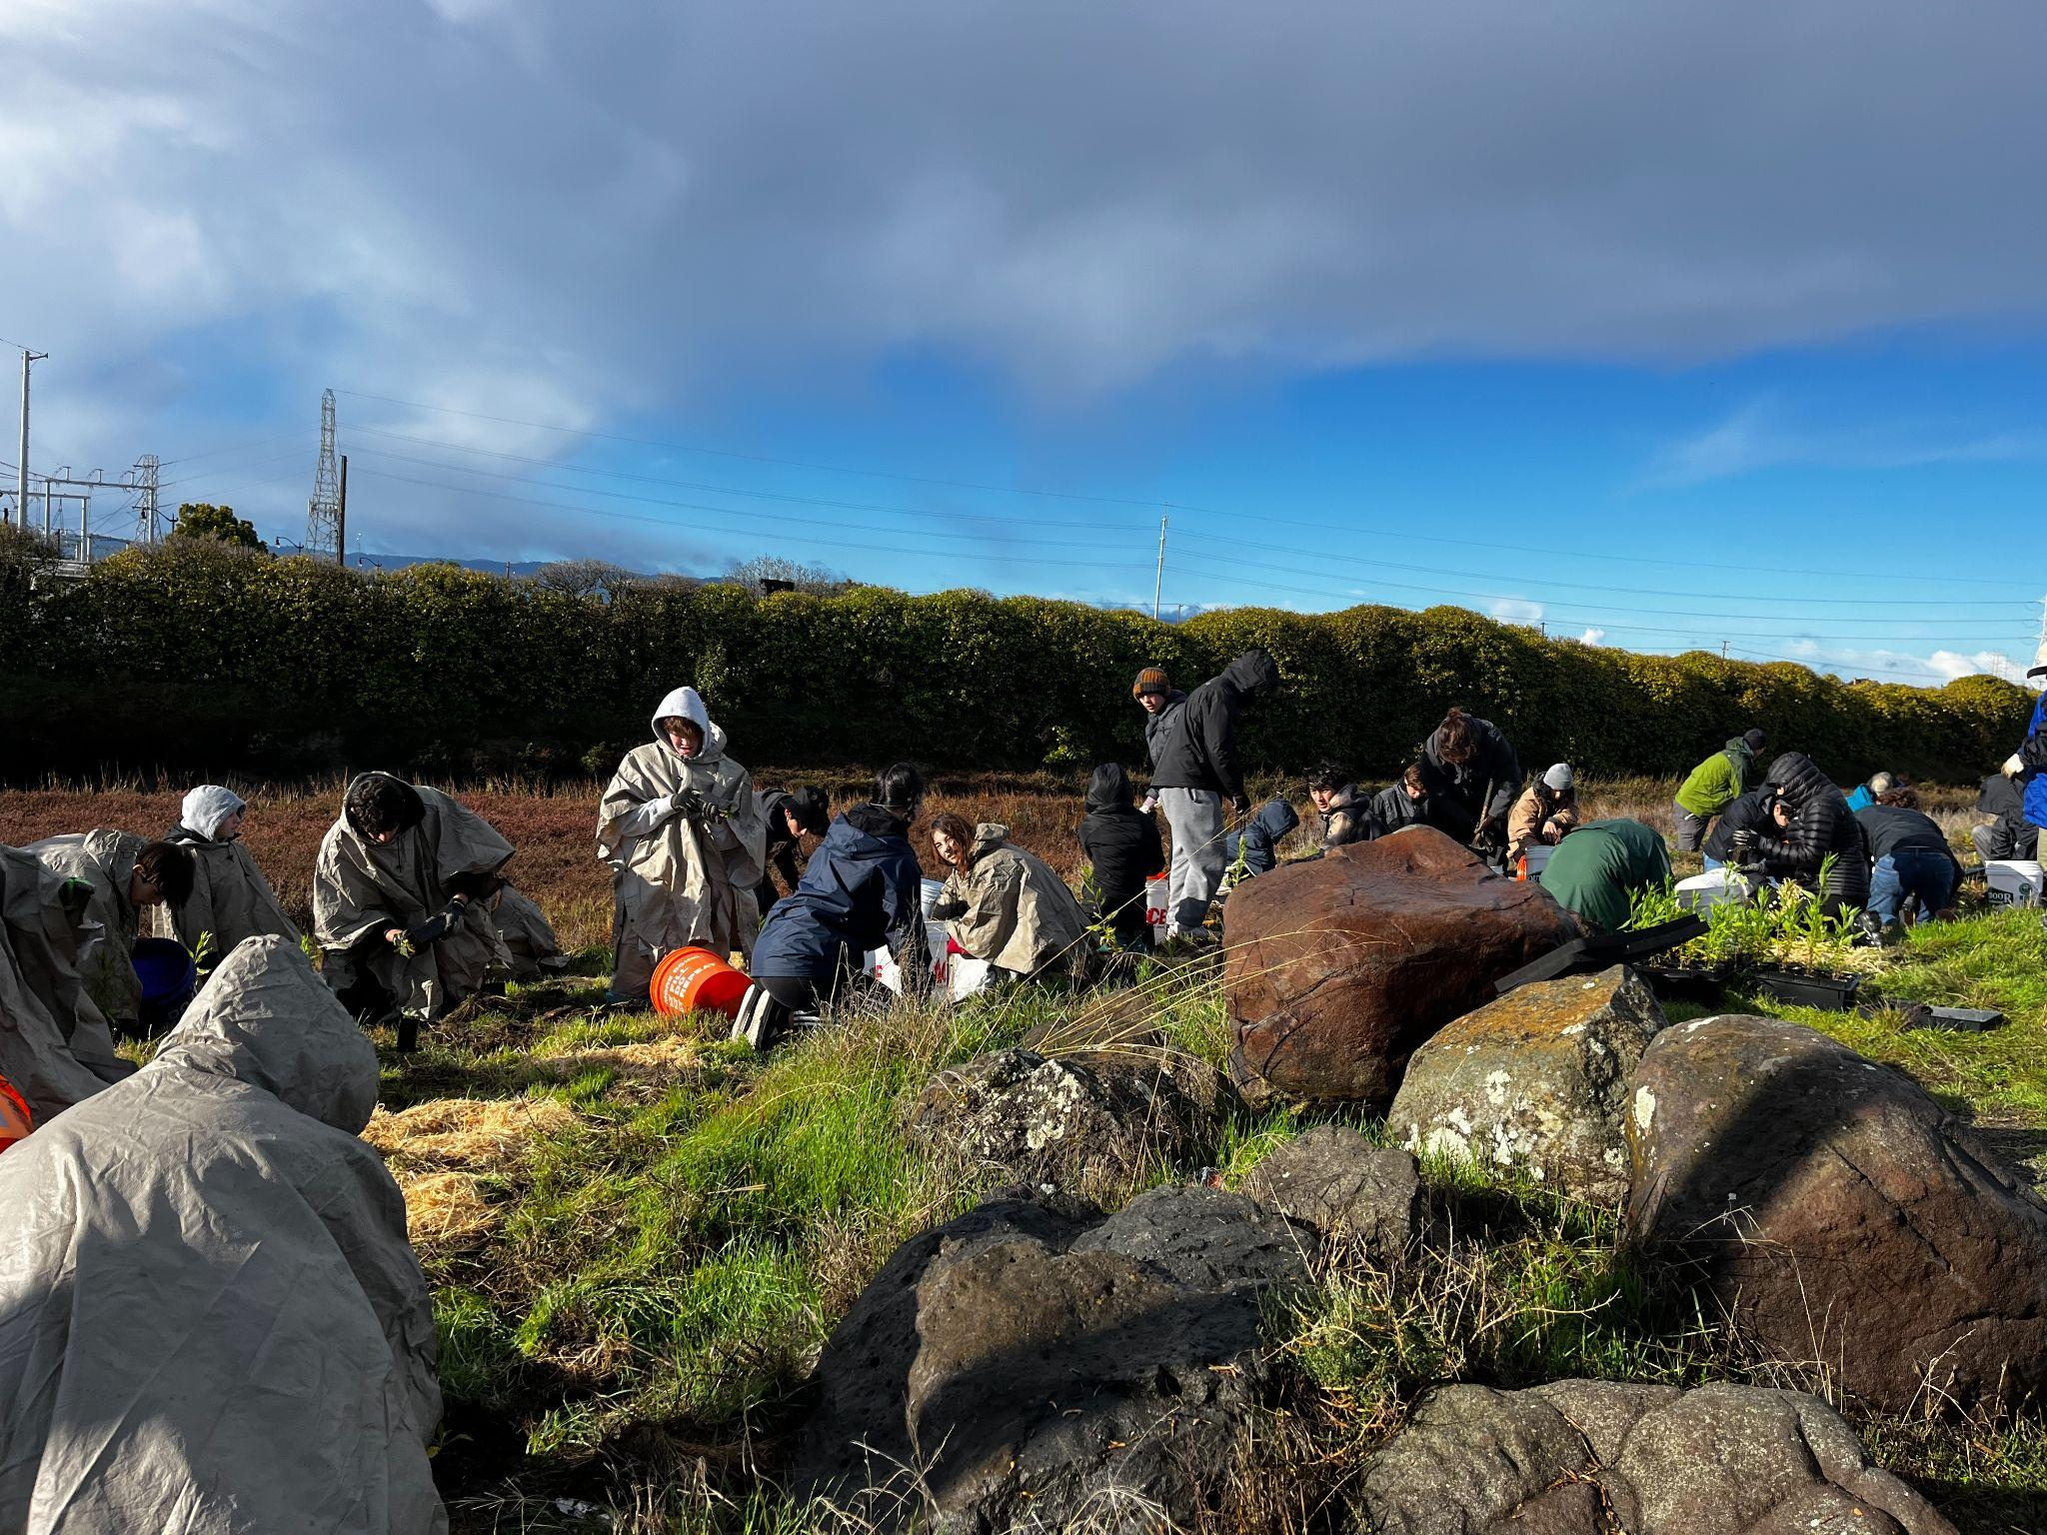
Challenges / Highlights
Challenges:
Outreach, being mindful of different avenues (word of mouth, networking, etc.)
Delayed start due to permitting / weather
Highlights:
Will & commitment coming from our partners to engage more community members is key
Desire to be a true collaboration and uplift cultural diversity (through events, connections, and even through food)
Notes:
Going back to what Rev. Virges said about true collaboration being working together in the face of the unknown. We don’t know what the future holds for the community in the face of climate change and sea level rise, but we know to face it we must work together.

Slide 14
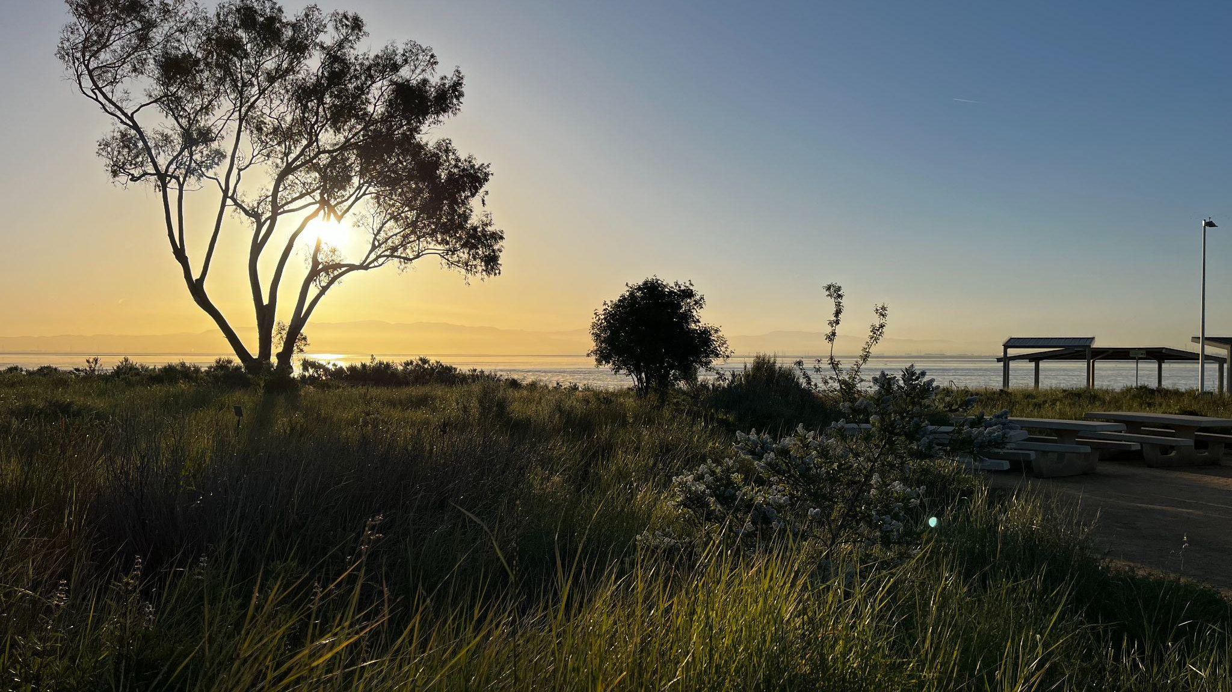
Acknowledgements
Thank you to the San Francisco Bay Restoration Authority, Midpeninsula Open Space District, and the City of East Palo Alto for all the support!
Thank you to all of the community members, partnering organizations, and volunteers who make this work possible!
Notes:
Thank you to our funders! This project would not be possible without the support of the San Francisco Bay Restoration Authority, thank you for funding projects that restore, protect and enhance the wetlands and wildlife habitat in the San Francisco Bay and its shoreline.

Slide 15
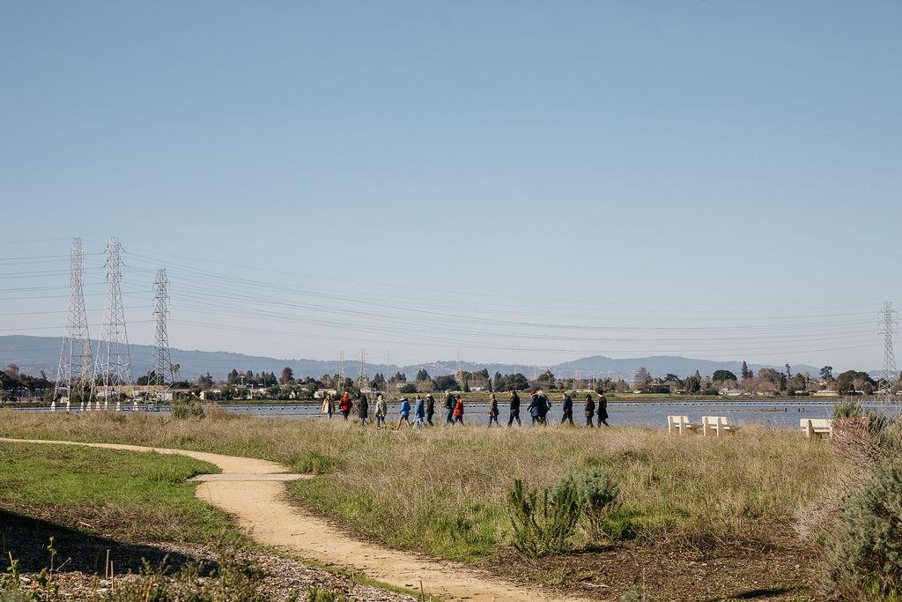
Questions?
Photo Credits: Vita Hewitt/Hewitt Visuals

