Slide 1
IRWM Prop 1 Round 1 Kickoff Meeting: February 2, 2021
Leslie Perry
(415) 778 – 6675
Leslie.perry@sfestuary.org
James Muller
(540) 922 – 2398
James.muller@sfestuary.org
Notes:
Hello and welcome- happy to see you all virtually- any technical issues? Alright, let’s get started…

Slide 2
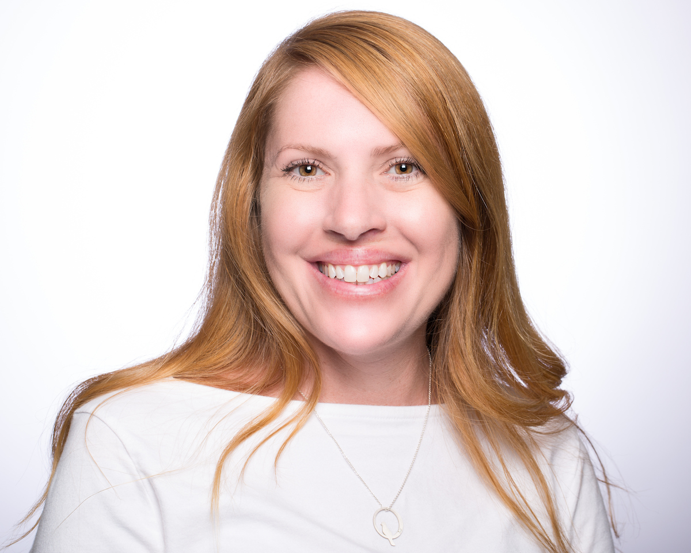
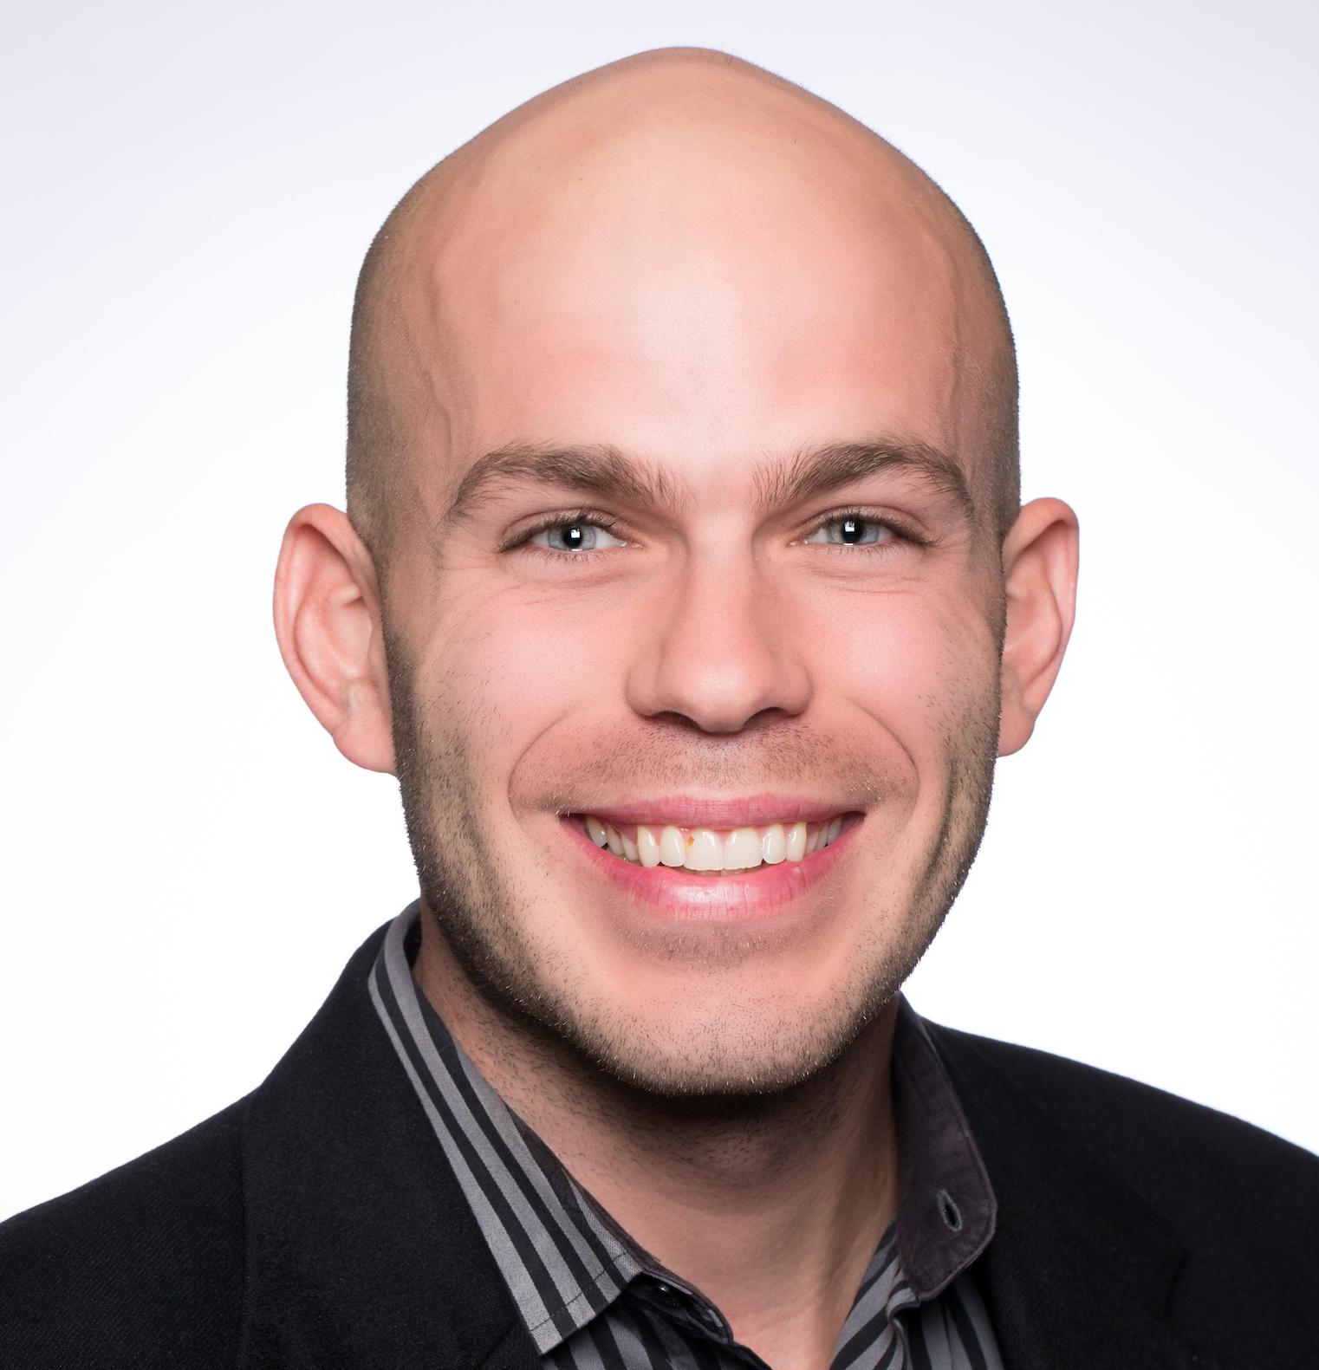
Welcome and Introductions
Leslie Perry
James Muller
IRWM Grant Manager
Contracts & Payments
Progress Reports & Invoices
IRWM Program Manager
Prop 1 Round 1 Support
Notes:
I will be the grant manager for this round of IRWM funding.
I've been with the partnership for over 14 years. Some of you even know me from my previous work!
I’m still getting my feet wet with IRWM and grant mgmt. but I am your go-to person for all things related to this Grant.
I look forward to working with you all!

Slide 3
Federal, State, Local Partnership
SFEP
ABAG & MTC
EPA
Regional Partner
Institutional (administrative, fiscal)
home of SFEP
Federal Partner
Clean Water Act – Sec 320
Legislative home of SFEP
Program approval, base funding
Notes:
SFEP is local, state, federal partnership. We are a national program under U.S. EPA
our fiscal and administrative home is ABAG. With the staff consolidation of MTC and ABAG, we are now MTC employees and work with consolidated staff from all departments of MTC/ABAG to connect the health of the Estuary to land use, resilience, and other regional planning efforts.
The SFEP is guided by a 38-member Implementation Committee, which includes representatives from local, state, and federal agencies, businesses, and environmental organizations, and works with us directly in determining Partnership priorities.

Slide 4
Introductions by Project Number
ACWD
Contra Costa County
NBWRA
City of Calistoga
EBMUD
City of San Jose
SFCJPA
SFPUC
Notes:
Alright, let’s do brief introductions by Project number- I have them listed just for ease via Zoom- ACWD…

Slide 5
Agenda
Grant Agreement
Individual Funding Agreements
Progress Reports and Invoices
Process for Submittals
Wrap up/ Q & A
Notes:
Here’s the agenda- we should have plenty of time for questions!

Slide 6
The Grant Agreement
DRAFT
GRANT AGREEMENT BETWEEN THE STATE OF CALIFORNIA
(DEPARTMENT OF WATER RESOURCES) AND
ASSOCIATION OF BAY AREA GOVERNMENTS
AGREEMENT NUMBER 4600013831
PROPOSITION 1 ROUND 1 INTEGRATED REGIONAL WATER MANAGEMENT (IRWM) IMPLEMENTATION GRANT
Notes:
As you all know we are still working through the Agreement with DWR and it is taking MUCH longer than anticipated- but we are getting close!
With that being said, let’s look at a few of the Standard Sections and Conditions of the Agreement as those will not change—

Slide 7
The Grant Agreement
Standard Sections & Conditions
Section 5: Basic Conditions
Section 7: Eligible Project Costs
Section 17: Groundwater & Surface Monitoring
D.15 – Disposition of Equipment
D.26 – Labor Compliance
D.46 – Travel
Notes:
Many of the Standard Sections and Conditions only apply to us/the grantee-but we wanted to put a few of these on your radar so you are familiar with them once the Agreement is finalized.

Slide 8
Term of the Grant Agreement
The term of this Grant Agreement begins on June 3, 2020 through final payment plus three (3) years unless otherwise terminated or amended as provided in this Grant Agreement. However, all work shall be completed by March 31, 2025, in accordance with the Schedule as set forth in Exhibit C and no funds may be requested after June 30, 2025.
Notes:
First things first- the term of the grant begins the day after award date- so June 3 and goes through March 31, 2025--
This is the term of the grant which is different than your individual project schedules
Some projects will take more time and some less time but all projects should be wrapped up by Dec 2024.
You’ll notice the end date is March 2025 that is to give ABAG time to wrap up administratively

Slide 9
Section 5: Basic Condtions
Unless exempt as per the 2019 IRWM Implementation Grant Proposal Solicitation Package, project(s) that are subject to the California Environmental Quality Act (CEQA) including final land purchases, shall not be included in this Agreement until the CEQA process is completed and all permits necessary to begin construction are acquired. Projects providing at least 75% of benefits to a disadvantaged community (DAC), economically distressed area (EDA), and/or Tribe (based on population or geography), or projects implemented by Tribes will be exempt from this requirement.
Such projects will be included in the Agreement as a placeholder. Placeholder projects are not eligible for grant reimbursement and may not submit invoices to DWR until such time as they are fully included in the Agreement.
ii. Placeholder projects that complete CEQA and/or acquire permits (necessary to begin construction) within eighteen (18) months of the agreement execution date will be amended into the agreement. At the end of the eighteen (18)-month term, any placeholder projects that fail to complete CEQA and/or acquire permits will be deleted from the Agreement. The total grant award will be reduced by the amount of the deleted project(s). Replacement projects will not be allowed. Reduced amount will be made available to the respective Funding Area in future funding rounds on a competitive basis. Deleted placeholder projects will not be eligible to receive any grant reimbursement under this Agreement; however, such project could be eligible under the next round of grant solicitation.
Notes:
I know there is a lot of text on this slide but lets just look at the bolded/highlighted language!
And to note, these conditions are new for us and IRWM!
DWR has parsed out the projects into two groups- Placeholder and full LPS projects
Everyone will submit quarterly progress reports but only LPSs can submit invoices
Placeholder projects have 18 months to complete CEQA and obtain all permits required for construction AFTER THE AGREEMENT EXECUTION DATE, so approx. to Nov 2022---

Slide 10
Section 7: Eligible Project Costs
The Grantee shall apply State funds received only to Eligible Project Costs in accordance with applicable provisions of the law and Exhibit B, “Budget”. Eligible Project Costs include the reasonable costs of studies, engineering, design, land and easement acquisition and associated legal fees, preparation of environmental documentation, environmental mitigations, monitoring, and project construction. Reimbursable administrative expenses are the necessary costs incidental but directly related to the Project included in this Agreement.
Costs incurred after June 2, 2020 may be eligible for reimbursement!
Notes:
Section 7 discusses eligible project costs- it worth being familiar these –
And please note that the entire scope of your project is eligible as that has already been approved by DWR-
this section also includes costs that are not eligible- James

Slide 11
Costs that are not eligible for reimbursement include, but are not limited to:
Costs, other than those noted above, incurred prior to the award date of this Grant.
Costs for preparing and filing a grant application.
Operation and maintenance costs, including post construction performance and monitoring costs.
Purchase of equipment that is not an integral part of a project.
Establishing a reserve fund.
Purchase of water supply.
Replacement of existing funding sources for ongoing programs.
Meals, food items, or refreshments.
Payment of any punitive regulatory agency requirement, federal or state taxes.
Purchase of land in excess of the minimum required acreage necessary to operate as an integral part of a project, as set forth and detailed by engineering and feasibility studies, or acquisition of land by eminent domain.
Overhead and Indirect Costs.
Mitigation for environmental impacts not resulting from implementation of the Project funded by this program.

Slide 12
Section 17: Statewide Monitoring Requirements for Groundwater & Surface Water Monitoring
The Grantee shall ensure that all groundwater projects and projects that include groundwater monitoring requirements are consistent with the Groundwater Quality Monitoring Act of 2001 (Water Code § 10780 et seq.) and, where applicable, that projects that affect water quality shall include a monitoring component that allows the integration of data into statewide monitoring efforts, including where applicable, the Surface Water Ambient Monitoring Program carried out by the State Water Resources Control Board. See Exhibit G for web links and information regarding other State monitoring and data reporting requirements.
Notes:
And finally, the last section I’d like to make sure you’re familiar with- Section 17- If you’re doing GW or SW monitoring, you need to submit it to state!
And with that I’d like to turn it over to James for the next few slides

Slide 13
Standard Provisions…
The following slides discuss a few of the Standard Conditions to note in Exhibit D of the Grant Agreement.

Slide 14
STANDARD PROVISIONS:
Exhibit A – Work Plan
Exhibit B – Budget
Exhibit C – Schedule
Exhibit D – Standard Conditions
Exhibit E – Authorizing Resolution
Exhibit F – Report Formats and Requirements
Exhibit G – Requirements for Data Submittal
Exhibit H – State Audit Document Requirements for the Grantee
Exhibit I – Local Project Sponsors and Project Locations
Exhibit J – Appraisal Specifications (Not Applicable)
Exhibit K – Information Needed for Escrow Processing and Closure (Not Applicable)
Exhibit L – Project Monitoring Plan Guidance
Notes:
Don’t worry we are not going to talk about all of these! I just want to point out a few of the Standard Conditions in Exhibit D--

Slide 15
Exhibit D. 15 Disposition of Equipment
Grantee shall provide to State, not less than thirty (30) calendar days prior to submission of the final invoice, an itemized inventory of equipment purchased with funds provided by State. The inventory shall include all items with a current estimated fair market value of more than $5,000.00 per item. Within sixty (60) calendar days of receipt of such inventory State shall provide Grantee with a list of the items on the inventory that State will take title to. All other items shall become the property of Grantee. State shall arrange for delivery from Grantee of items that it takes title to. Cost of transportation, if any, shall be borne by State.

Slide 16
Exhibit D. 26 Labor Code Compliance
The Grantee agrees to be bound by all the provisions of the Labor Code regarding prevailing wages and shall monitor all contracts subject to reimbursement from this Agreement to assure that the prevailing wage provisions of the Labor Code are being met. Current Department of Industrial Relations (DIR) requirements may be found at: http://www.dir.ca.gov/ lcp.asp.
For more information, please refer to DIR’s Public Works Manual at: https://www.dir.ca.gov/ dlse/PWManualCombined.pdf. The Grantee affirms that it is aware of the provisions of section 3700 of the Labor Code, which requires every employer to be insured against liability for workers’ compensation or to undertake self-insurance, and the Grantee affirms that it will comply with such provisions before commencing the performance of the work under this Agreement and will make its contractors and subcontractors aware of this provision.

Slide 17
Exhibit D. 36 Retention
The State shall withhold ten percent (10%) of the funds, for each project, until the project is complete, and a Final Project Report is approved and accepted by DWR. If a project has multiple Components (within a project), at the State's discretion and upon a written request by the Grantee, any retained amount attributable to a single component may be released when that component is complete and the Final Component Completion Report is approved. Upon approval of the Final Project Report and/or Final Component Completion Report, any retained amounts due to the Grantee will be promptly disbursed to the Grantee, without interest.

Slide 18
Exhibit D. 46: Travel- DAC, EDA, Tribes Projects
Travel is only an eligible reimbursable expense for projects providing at least 75% of benefits to DACs, EDAs, and/or Tribes (based on population or geographic area). Only ground transportation and lodging are eligible for grant reimbursement. Per diem costs will not be eligible for grant reimbursement. Any reimbursement for necessary travel shall be at rates not to exceed those set by the California Department of Human Resources. These rates may be found at: http://www.calhr.ca.gov/employees/Pages/travel-reimbursements.aspx. Reimbursement will be at the State travel amounts that are current as of the date costs are incurred. No travel outside of the IRWM region shall be reimbursed unless prior written authorization is obtained from the State.

Slide 19
Individual Funding Agreements…
We will start working on these immediately after the Agreement is executed!

Slide 20
Individual Funding Agreements
Local Project Sponsors
Placeholder Projects
ACWD
Contra Costa County
NBWRA
City of Calistoga
EBMUD
City of San Jose
SFCJPA
SFPUC
Grant Agreement will be amended to change Placeholder Projects to LPSs once permits and CEQA have been completed. MUST be complete by 11/01/2022
LPS Agreements will then be drafted
LPS Agreements Drafted in February
Expected Execution in March/April
Notes:
And this is what it will look like-
Again, the two groups of projects-
I will start with the project sponsors on the left
And then as CEQA and permits are obtained, we will amend the Grant Agreement to bring in those three place holder projects and execute individual funding agreements

Slide 21
Questions
Before we move onto details related to progress reports and invoices please let us know if you have questions related to the Grant Agreement or the Individual Funding Agreements.

Slide 22
Invoices and Progress Reports
Placeholder projects are required to submit progress reports when not in contract
Invoices and Reports are due at the same time each quarter
Progress reports will document activities, milestones, and progress
Invoices will document expenses and must include backup
Deliverables will be submitted with progress reports
Process
Progress reports and invoices will be submitted one month after the end of each quarter
1st Submittal will be due 4/30/2021 for activities through 3/31/2021
SFEP will review and work with project sponsors to tie up any loose ends
SFEP will submit to the State by the end of the following month
1st Submittal will be sent to state 5/31/2021

Slide 23
Process for submittals
Submit Reports, Invoices and Deliverables
One month after end of quarter
SFEP Review
Work with project sponsors to finalize for DWR
Upload to State
Two months after work period
Work Period
June 3 , 2020– March 31, 2021
Report, Invoice and Deliverables
Due April 30, 2021
SFEP Review
May 1- 31, 2021
Upload to State
May 31, 2021
Payment
In 2-3 Months

Slide 24
Invoicing
A template will be provided on the webpage and emailed
Frequency
Ideally, we want to bill each quarter, but folks will be in different places
Ineligible costs
Costs incurred before June 3, 2020
Any expenses not related to the grant scope
Section 7 list
Required info
Staff time – Complete worksheet and submit Billable Rates Letter
Direct Costs – Complete worksheet and provide invoices/receipts
Proof of Payment not required

Slide 25
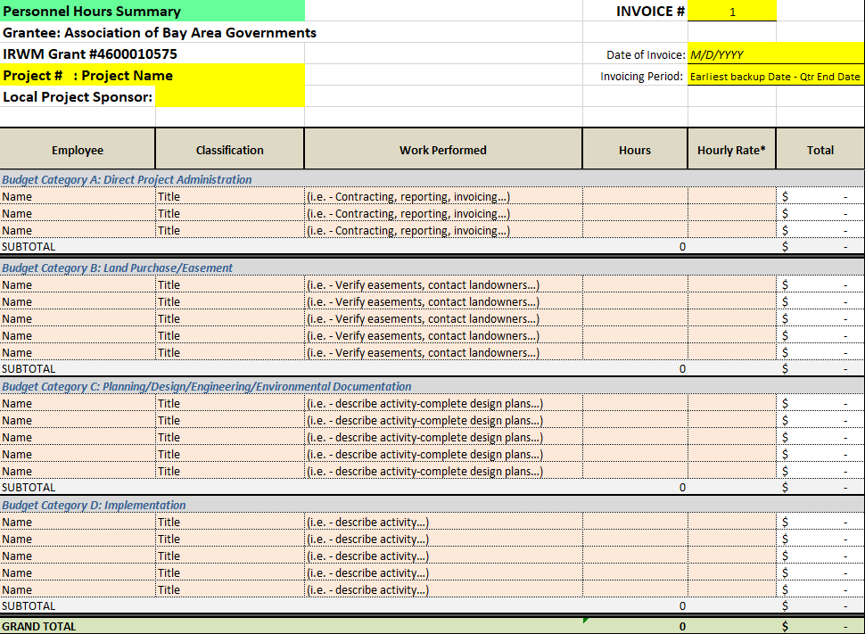
Invoice: Personnel Hours

Slide 26
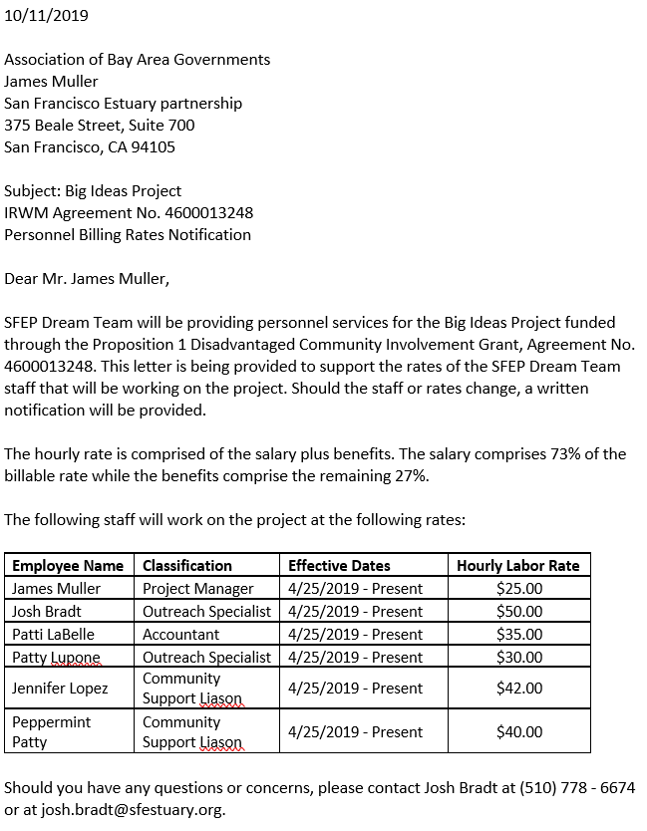
Billable Rates Letter
To be submitted with each invoice

Slide 27
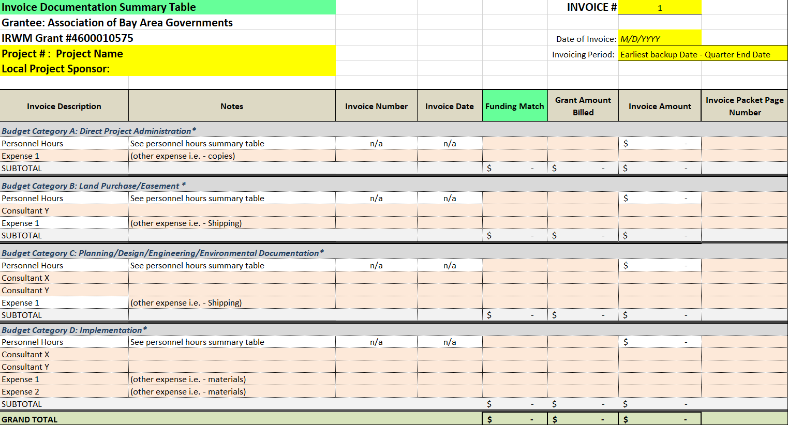
Invoice: Summary Table

Slide 28
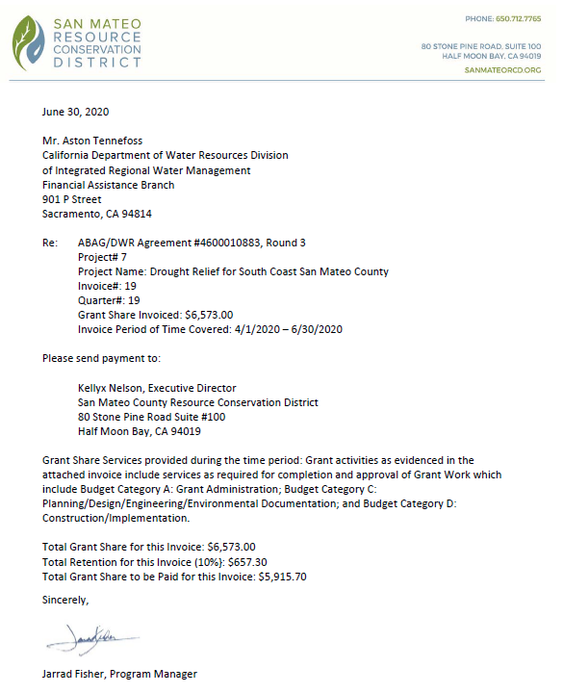
Invoice: Payment Request Letter

Slide 29
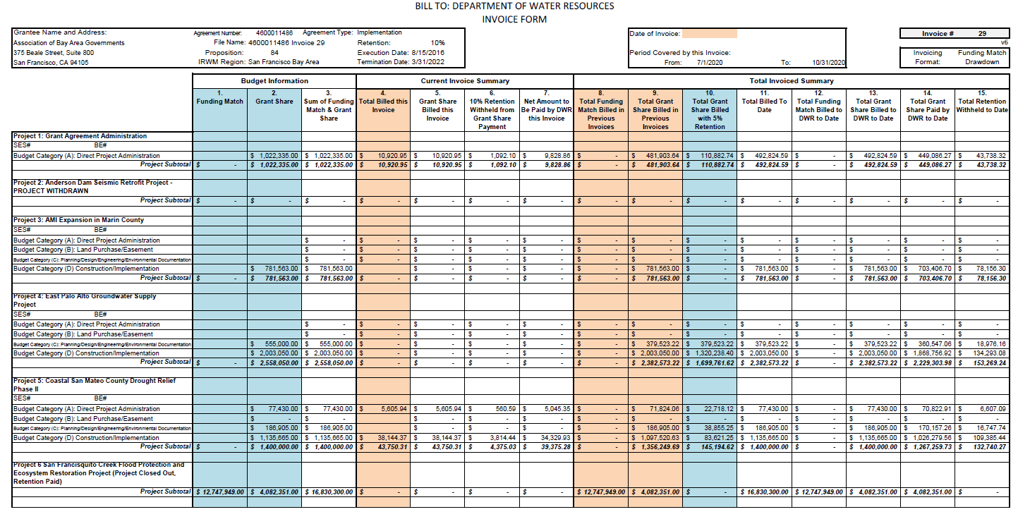
What does the end-product look like?

Slide 30
Progress Reports
Frequency and Due Dates
Quarterly progress reports will be submitted one month after the end of the quarter and are mandatory
Process
Two weeks before due SFEP will send a reminder
SFEP reviews progress reports and deliverables for submittal to DWR

Slide 31
Progress Reports Continued…
Information in the Report
Percent Complete for each task
Narrative on progress made that quarter for each task
Work anticipated next quarter and modifications anticipated
Table of deliverables
Deliverables
To be indicated on Table of Deliverables and to be included with your upload

Slide 32
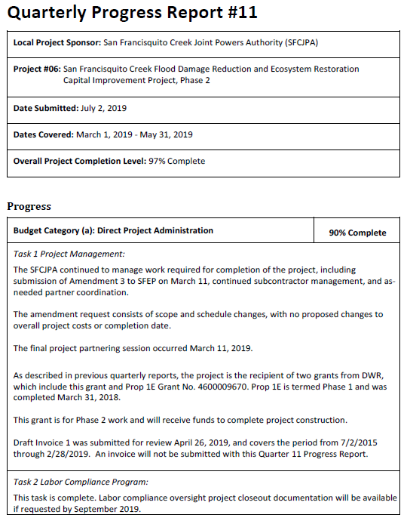
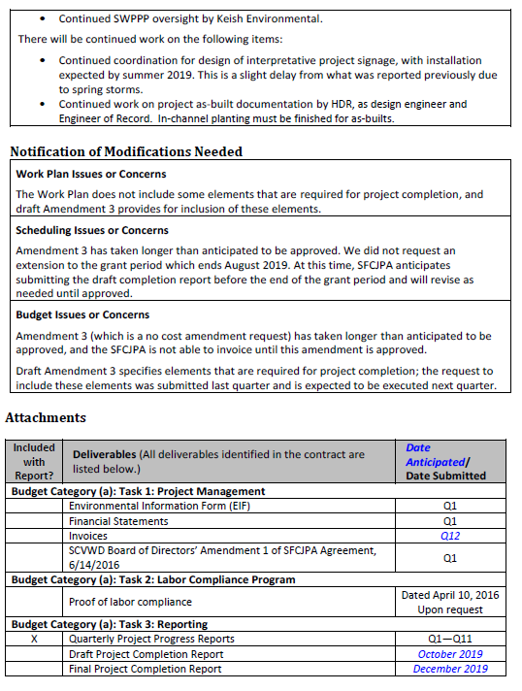

Slide 33
Submitting Materials
All materials can be submitted to your project’s unique upload folder on Microsoft OneDrive.
If you are not able to upload to the drive, contact/email Leslie to troubleshoot any issues.
More specific upload instructions will be sent out with the first email reminder.

Slide 34
Project Completion Reports
Guidance and templates will be developed to assist local project sponsors with this deliverable.

Slide 35
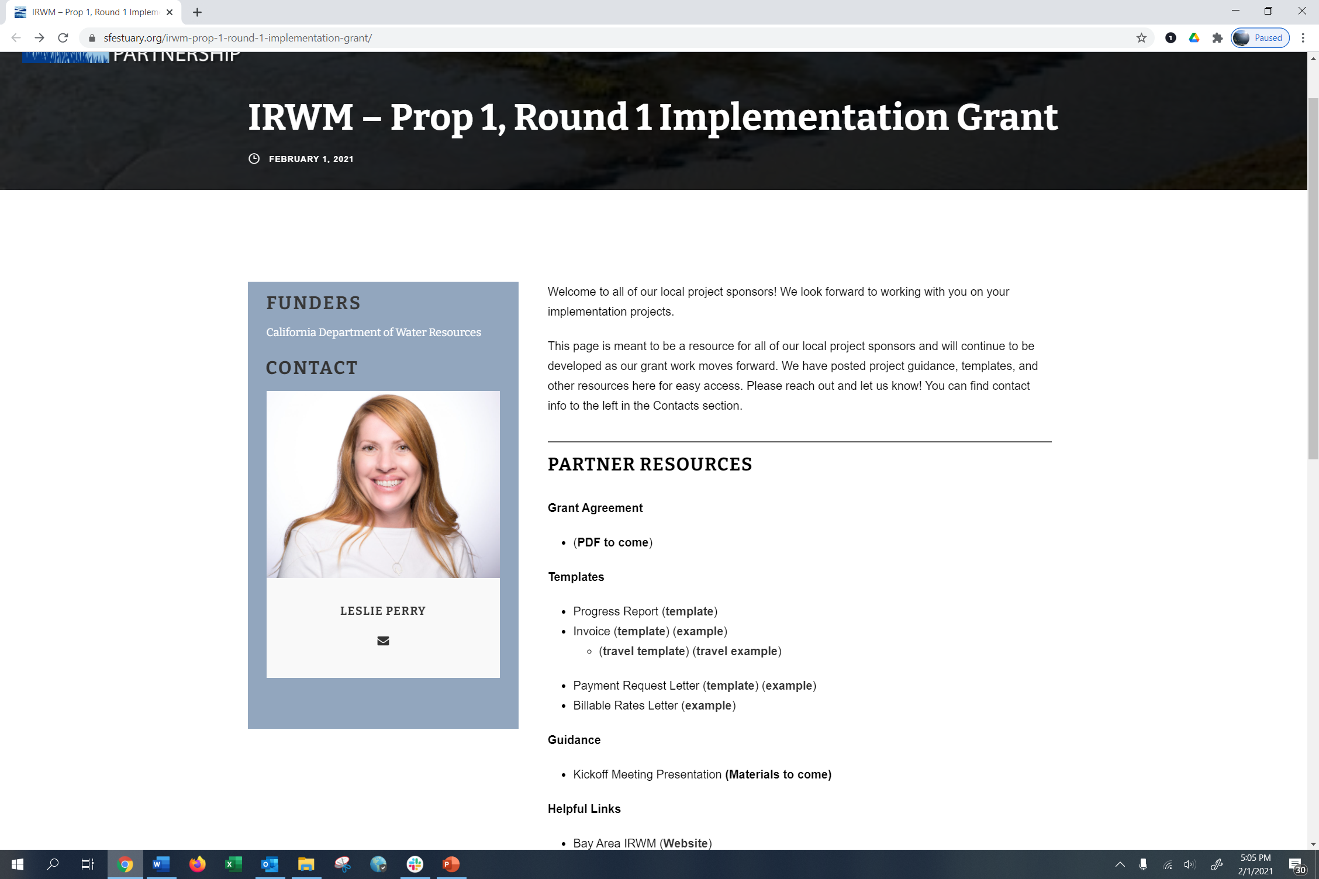
IRWM Prop 1 Website
http://www.sfestuary.org/P1R1
Notes:
A work in progress! This is our webpage which will have templates and other resources for you. Should have it live in the next few weeks.

Slide 36
Q & A
Leslie Perry
(415) 778 – 6675
Leslie.perry@sfestuary.org
James Muller
(415) 778 – 6674
James.muller@sfestuary.org

