Slide 1

DACTIP Kickoff Meeting
Josh Bradt
(510) 778 – 6671
Josh.bradt@sfestuary.org
James Muller
(510) 778 – 6674
James.muller@sfestuary.org

Slide 2


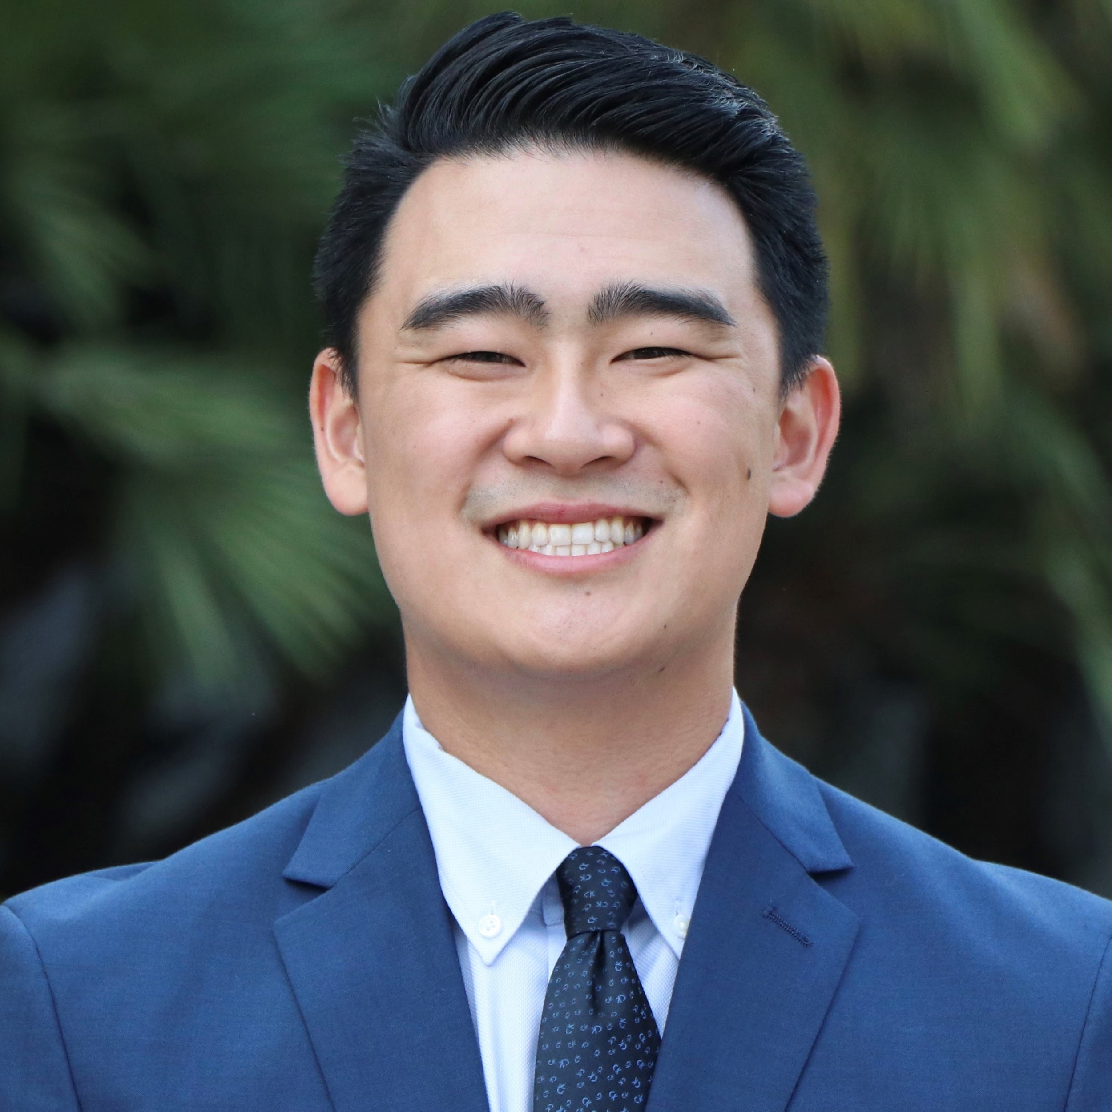


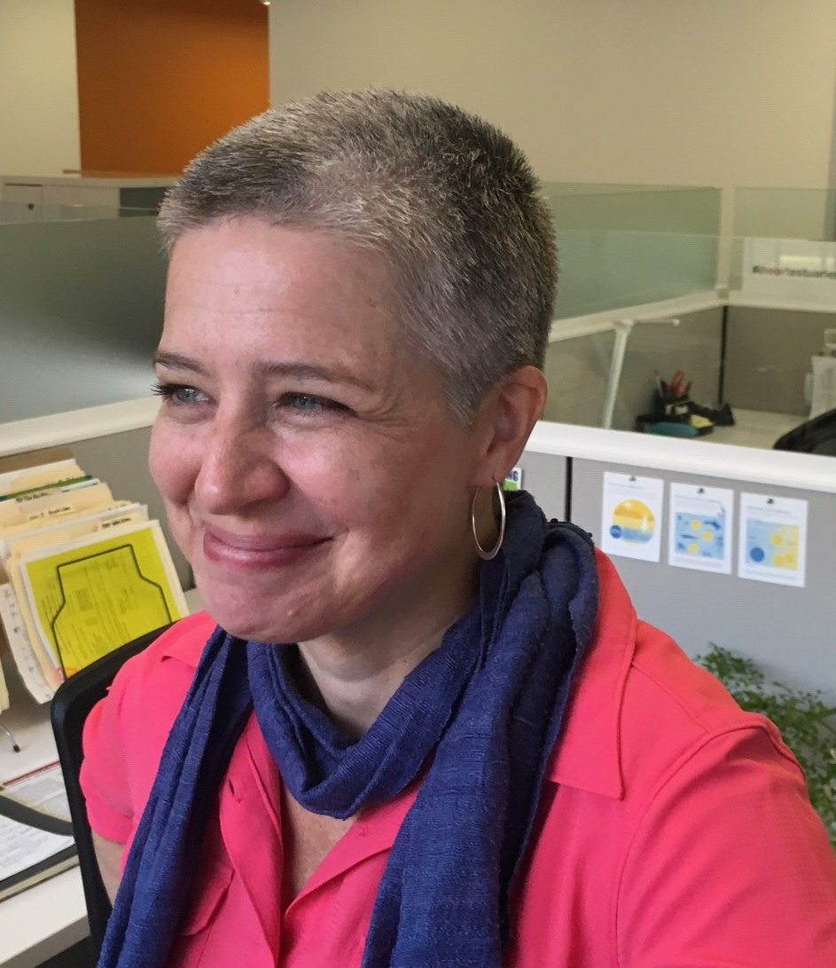

Programmatic and Administrative Support Team
Maddie Duda
Ryan Hirano
Darcie Luce, SFEP
Josh Bradt, SFEP
James Muller, SFEP
mduda@lotuswater.com
RHirano@woodardcurran.com
darcie.luce@sfestuary.org
josh.bradt@sfestuary.org
james.muller@sfestuary.org
Project Partner Needs Assessments (development & implementation support)
Regional Needs Assessment (strategy, tracking)
Capacity Building (coordination, tracking)
Project Development & Technical Assistance (ID needs, coordinate with TAC)
Technical Advisory Committee
Partner Needs Assessment (support)
Capacity Building (support)
Project Management (DWR liaison)
Contracts & Payments
Procurement of consultant support services
Regional Needs Assessment Report (strategy, development, & tracking)

Slide 3
Federal, State, Local Partnership
SFEP
ABAG/MTC
EPA
Regional Partner
Institutional (administrative, fiscal)
home of SFEP
Federal Partner
Clean Water Act – Sec 320
Legislative home of SFEP
Program approval, base funding
Notes:
SFEP is local, state, federal partnership. We are a national program under U.S. EPA
our fiscal and administrative home is ABAG. With the staff consolidation of MTC and ABAG, we are now MTC employees and work with consolidated staff from all departments of MTC/ABAG to connect the health of the Estuary to land use, resilience, and other regional planning efforts.
The SFEP is guided by a 38-member Implementation Committee, which includes representatives from local, state, and federal agencies, businesses, and environmental organizations, and works with me directly in determining Partnership priorities.

Slide 4
Overview and Status of the Program
Contracts Status
Phase I Program Overview
  Needs Assessment
  Regional Needs Assessment
  Capacity Building
  Coordinating Committee Integration
Technical Advisory Committee
Phase II

Slide 5
Table of contents
Grant agreement
Invoicing and Progress reports
Submitting documents
Completion Report
Resources website

Slide 6


The Grant Agreement
The high notes
  Eligible Project Costs
    Costs on/after April 25, 2019
  Standard Conditions
    D.4 – ADA
    D.5 – Audits
    D.16 – Drug-free workplace
    D.20 – Income restrictions
    D.27 – Nondiscrimination
    D.36 – Rights in Data
    D.45 – Travel (in and out of region)

Slide 7
Invoices and Progress Reports
Both are due at the same time each month
  Progress reports will document activities, milestones, and progress
  Invoices will document expenses and must include backup
  These two should work hand in hand
  Deliverables will be submitted with progress reports
Process
  Progress reports and invoices will be submitted at the end of each month (February’s report and invoice will be due March 31)
  SFEP will review and work with project partners to tie up any loose ends
  SFEP will submit to the state by the end of the following month

Slide 8
Process for submittals
Submit Reports, Invoices and Deliverables
  One month after work period
SFEP Review
  Work with project partners to finalize for DWR
Upload to State
  Two months after work period
Work Period
  November 1 - 30
Report, Invoice and Deliverables
  Due December 31
SFEP Review
  January 1 - 30
Upload to State
  January 31
$$$

Slide 9
Invoicing
A templet will be provided on the Website
Frequency and Due Dates
  Monthly invoices will be submitted by the end of the following month
    Example – February’s invoice will be due March 31
  Payments from MTC – upon invoice approval
Ineligible costs
  Costs incurred before April 25, 2019
  Food and beverage NOT related travel
  Purchase of equipment not an integral part of the Project
  Childcare costs or participation stipends
  Out of region travel – to be reimbursed for this, you must get approval before travel occurred
Required info
  Staff time – Complete Invoice (see template)
  Direct Costs – Complete Invoice (see template) and provide receipts

Slide 10
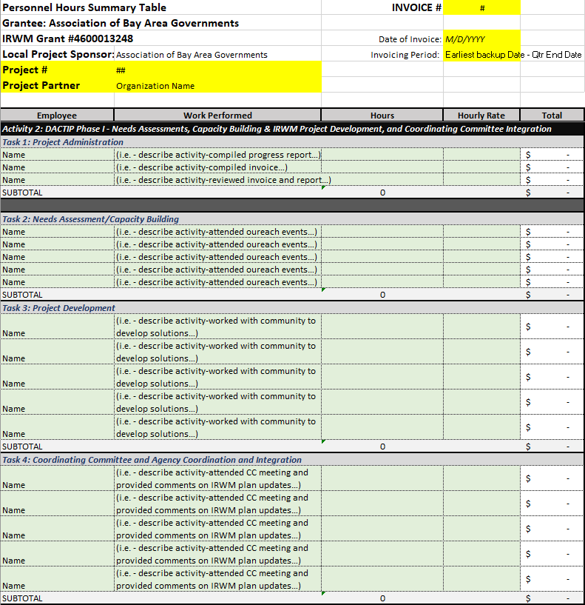
Invoice:
Personnel Hours

Slide 11
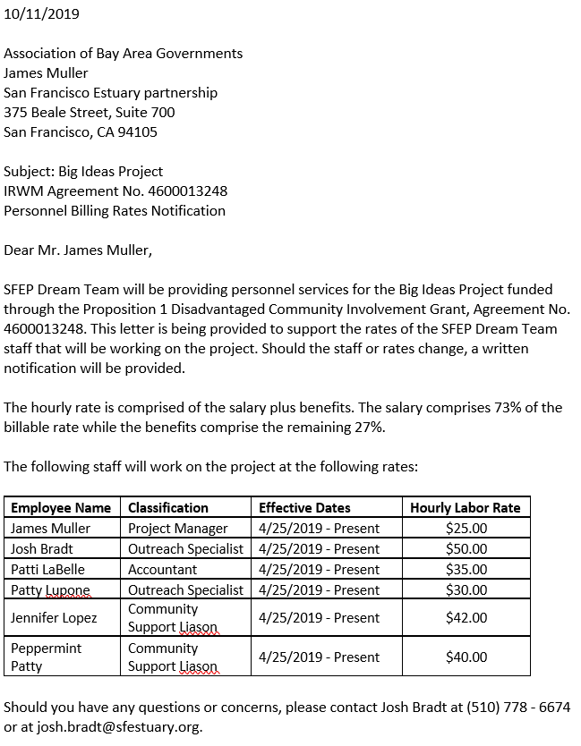
Billable Rates Letter
To be submitted once, with the first invoice

Slide 12
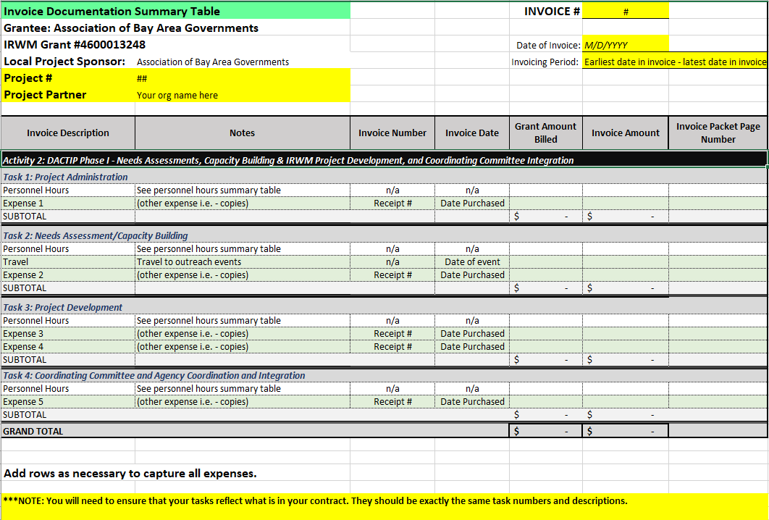
Invoice: Summary Table

Slide 13
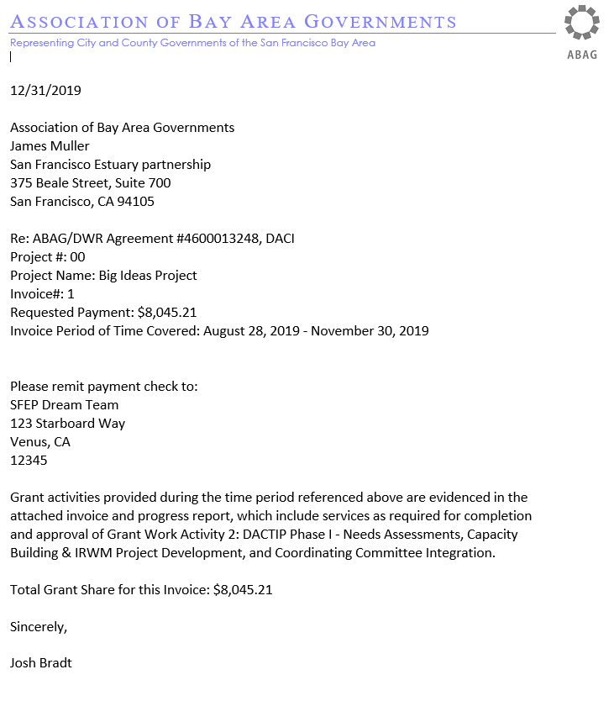
Invoice:
Payment Request Letter

Slide 14
An example invoice…
The following slides provide an example invoice in the order the various elements need to be organized in the packet you submit to SFEP.

Slide 15
1: Payment
Request Letter

Slide 16
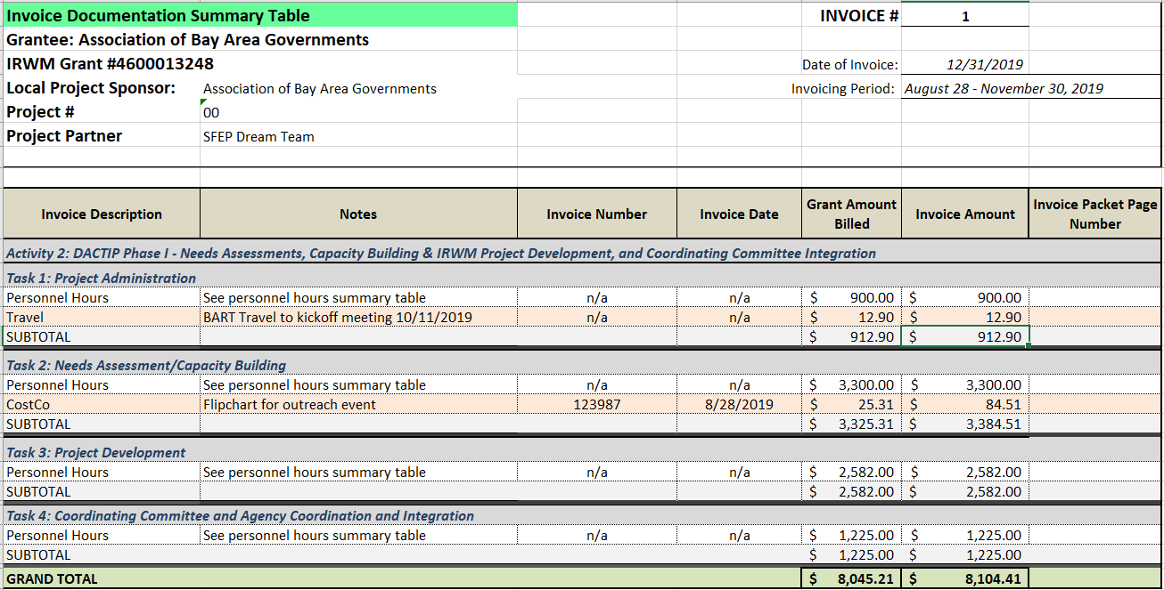
2: Invoice Documentation Summary
Notes:
Note here the different amounts in the “Grant Amount Billed” column and the “Invoice Amount” column. This is because, in this theoretical example, the trip to Costco included a number of items, some of which were not intended to be billed against the grant (groceries as mentioned in the presentation). The Invoice amount should include what the total is for the backup documentation (receipt total). The Grant Amount Billed is what is being requested to be reimbursed. This item

Slide 17
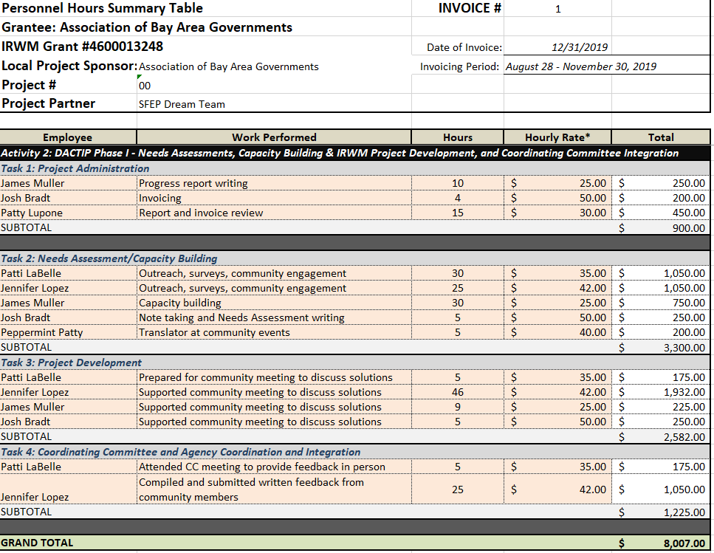
3: Personnel Hours Summary

Slide 18
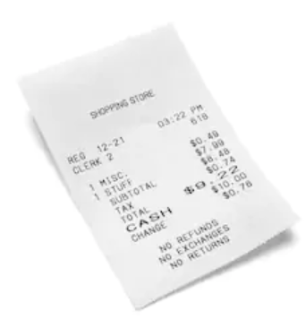
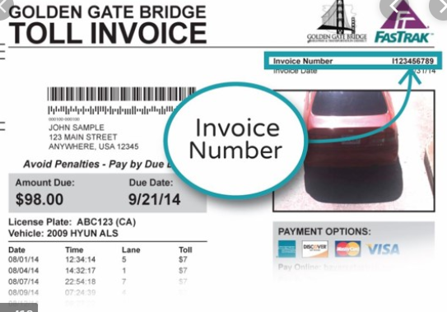
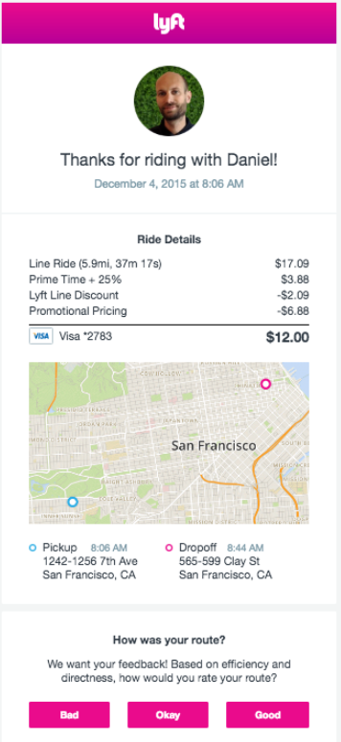

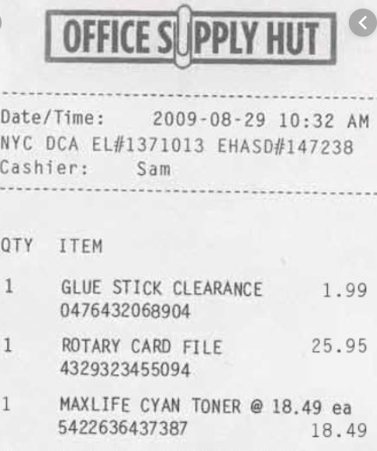
4: Direct Expenses and Travel Backup

Slide 19
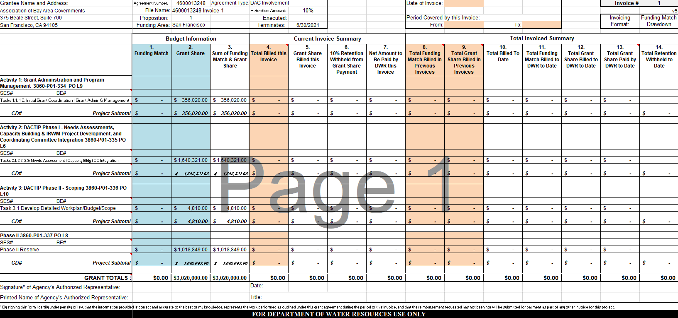
What does the end-product look like?
Notes:
This is not something any project partner will have to fill out under this grant. However, it is worth knowing how all the invoices get rolled up.

Slide 20
Progress Reports
Frequency and Due Dates
  Monthly progress reports will be submitted by the end of the following month
    Example – February’s invoice will be due March 31
Process
  Josh to solicit/collect/support – Josh to help inform this
Information in the Report
  Percent Complete for each task
  Narrative on progress made that month including any important meeting/outreach event dates
  Milestones or Deliverables completed/submitted
  Challenges to completion of task
Deliverables (when applicable)
  Agendas, meeting notes, attendee lists, outreach materials, presentations, maps, data summaries, list of capacity building needs, draft and final needs assessments

Slide 21
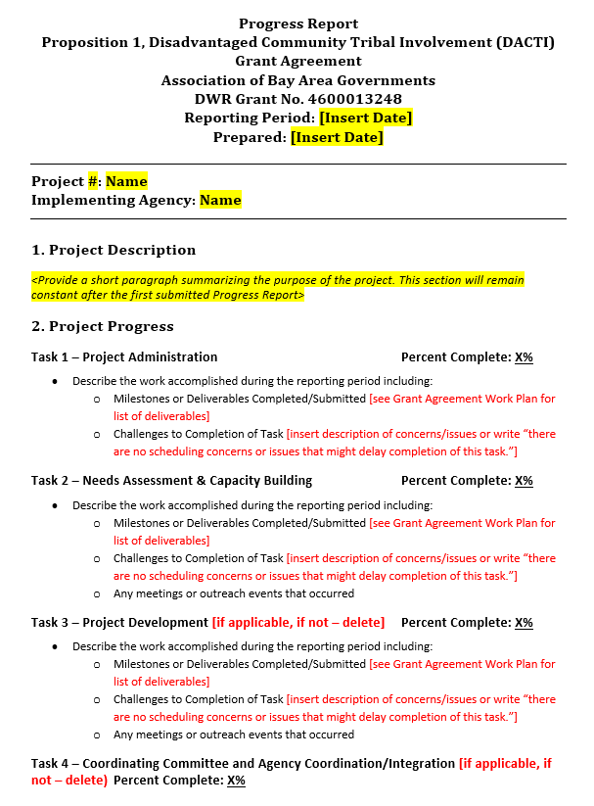
Progress Reports
Templet provided on the website
Progress report should go hand in hand with the invoice
  Example: Meetings that incurred travel expenses (in invoice) should be reflected in your progress report narratives

Slide 22

Submitting Materials
All materials should be submitted to your project’s unique upload folder on the Google Drive – you will not need a Google account to upload.
If you are not able to upload to the drive, email is acceptable as we work to troubleshoot any issues
A list of all upload folder locations are located on the DACTIP website

Slide 23
Project Completion Reports
Guidance and templates will be developed to assist project partners with this deliverable.

Slide 24
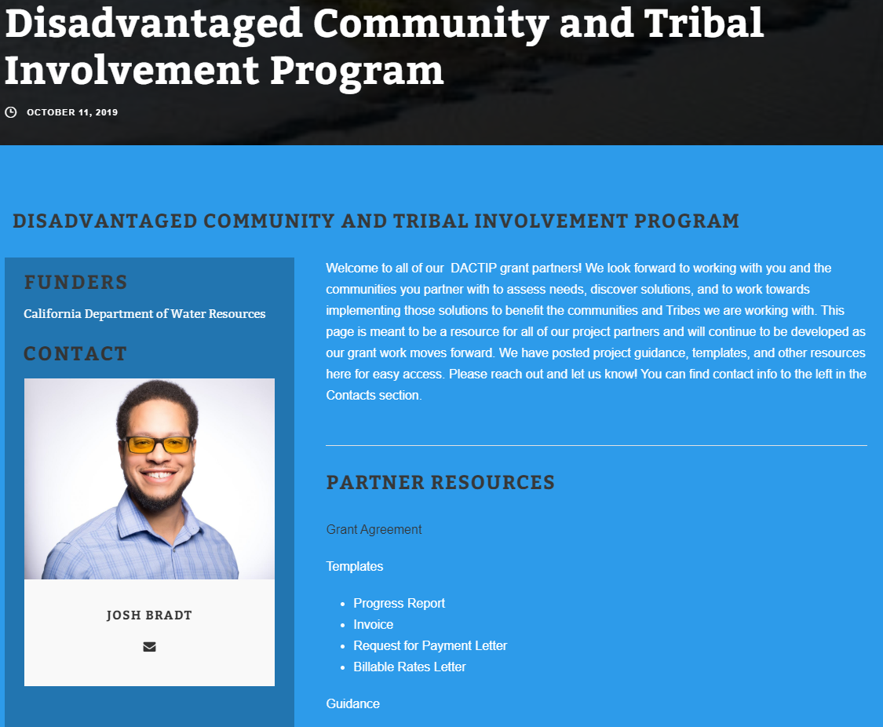
DACTIP
Website
http://www.sfestuary.org/DACTIP

Slide 25
Thank You!
Josh Bradt
(510) 778 – 6671
Josh.bradt@sfestuary.org
James Muller
(510) 778 – 6674
James.muller@sfestuary.org

