Slide 1
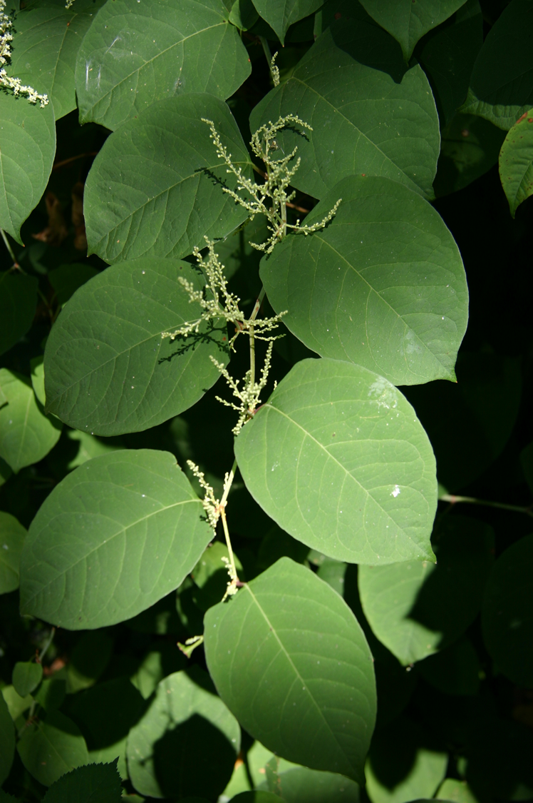
Japanese Knotweed Eradication Efforts in Marin County
MAY 3rd, 2019
Bay Area Watershed Network
Anna Dirkse, Japanese Knotweed Outreach Coordinator

Slide 2
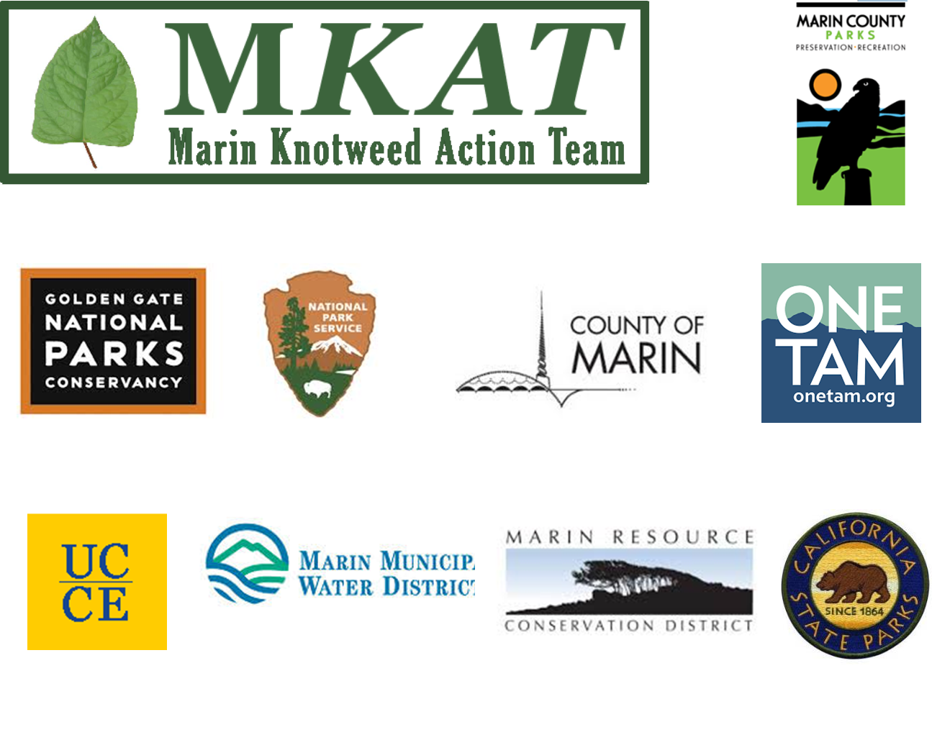
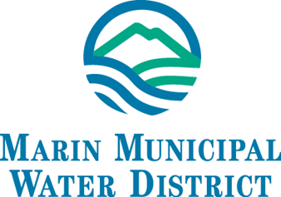

Slide 3
The Many NAMES of JAPANESE KNOTWEED…
Other Common Names:
Mexican bamboo
crimson beauty
Japanese fleece flower
Reynoutria fleece flower
Kontiki bamboo
Scientific Names:
Polygonum cuspidatum
Reynoutria japonica
Fallopia japonica

Slide 4
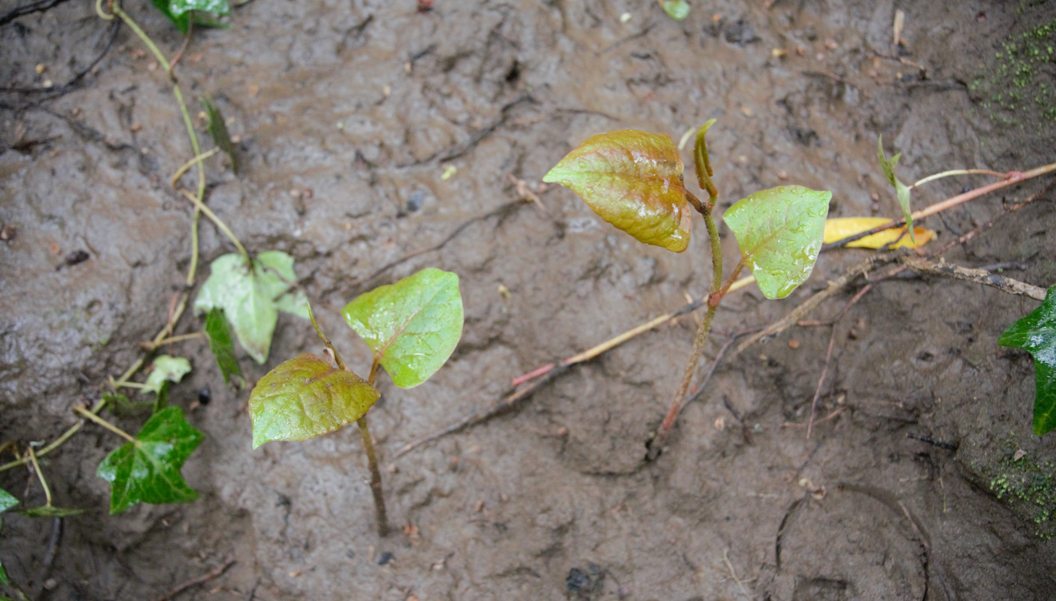
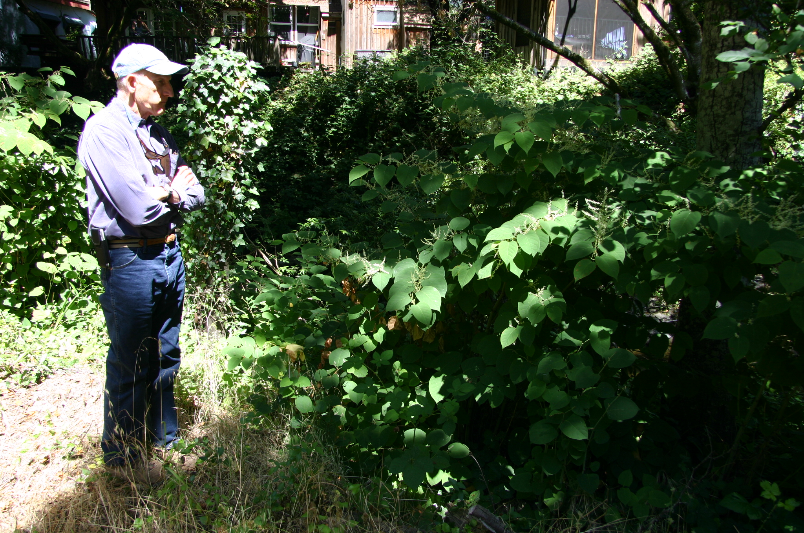
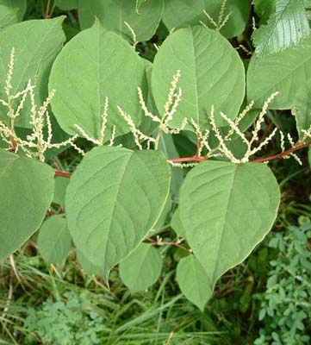
And its Many Faces
Spring: Looks like red or pink “asparagus”
Summer/Fall: Red speckled stems with nodes, shield shaped leaves with a flat base, zig-zag stems and white flowers; 2 to 3 meters tall
Winter: Brown stems that are hollow and still standing until spring

Slide 5
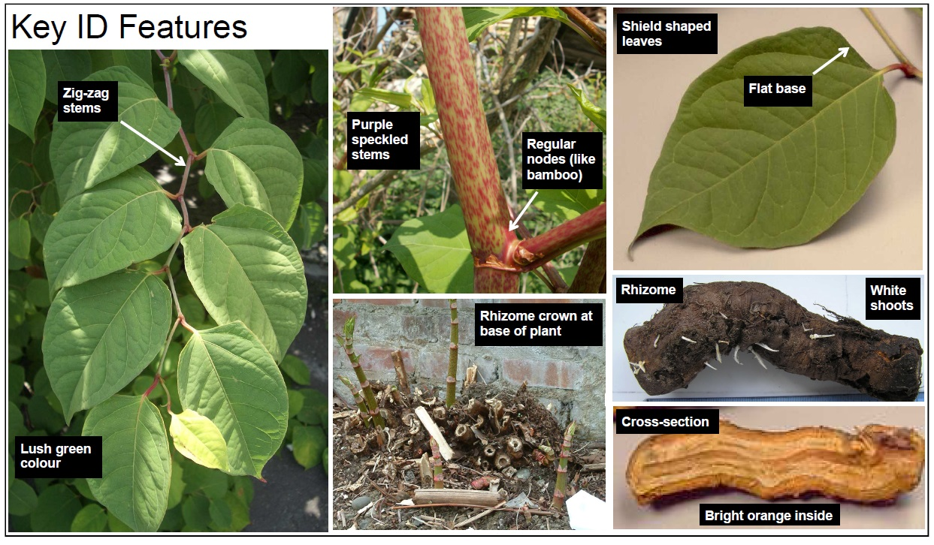
Image Credit: Phlorum Limited
Notes:
More id guides? Difference between pipevine and other plants

Slide 6
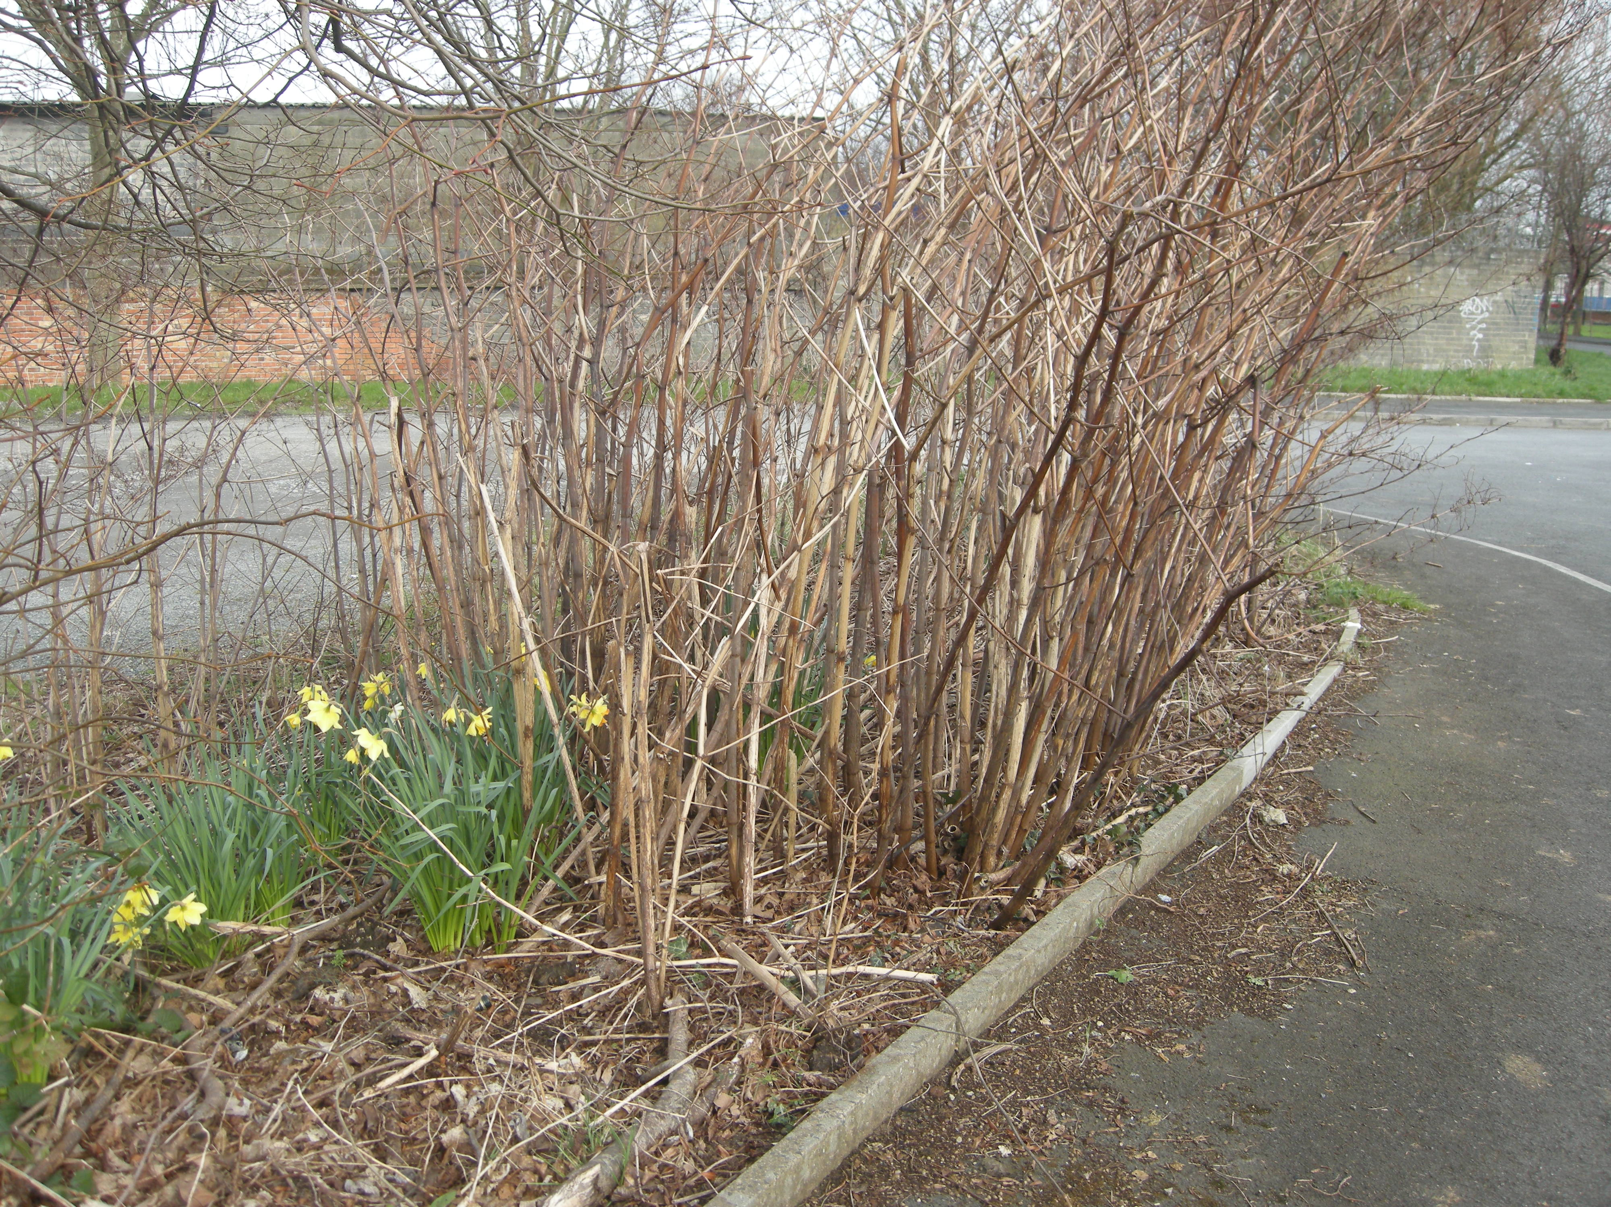
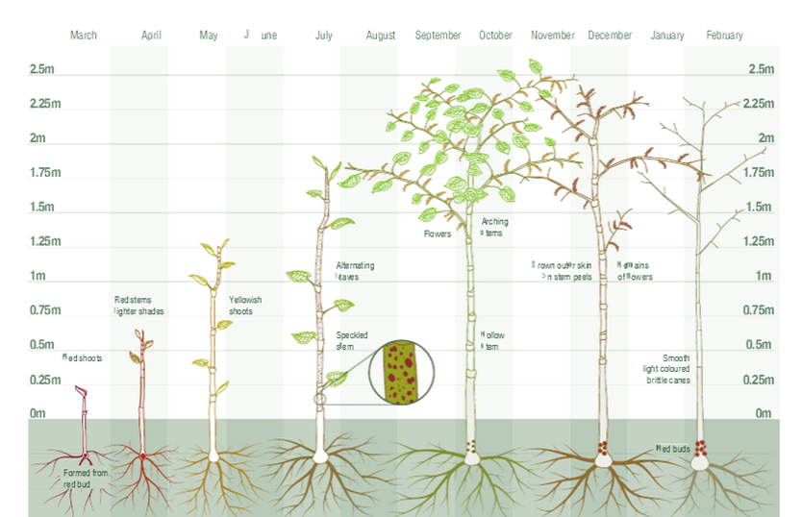
Photo credit: Invasive Species Ireland
Image credit: EnviraCulture

Slide 7
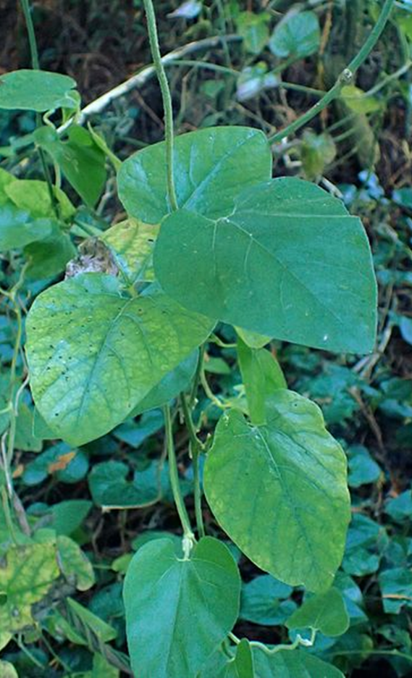
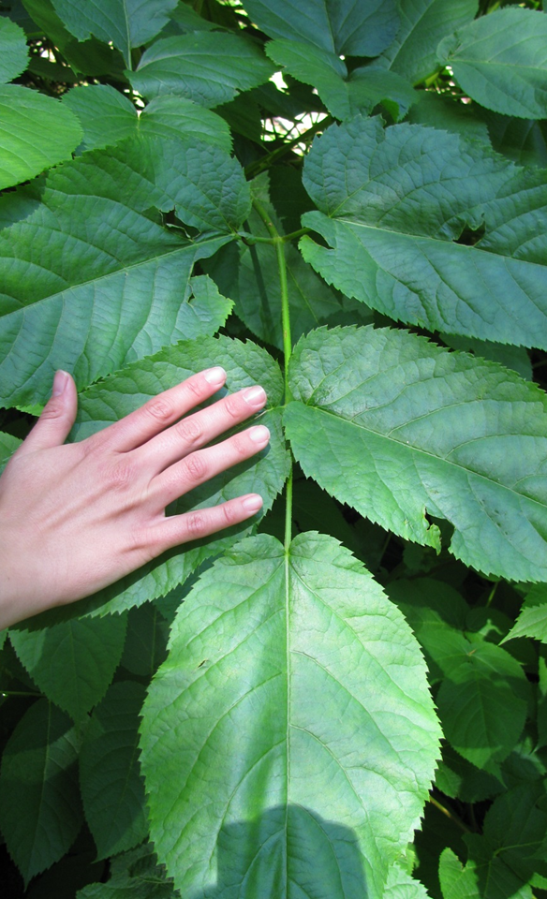
California pipevine (Aristolochia californica)
Smartweed
(Persicaria sp.)
California Spikenard/Elk clover
(Aralia californica)
Photos by Krzysztof Ziarnek and Andrea Williams

Slide 8
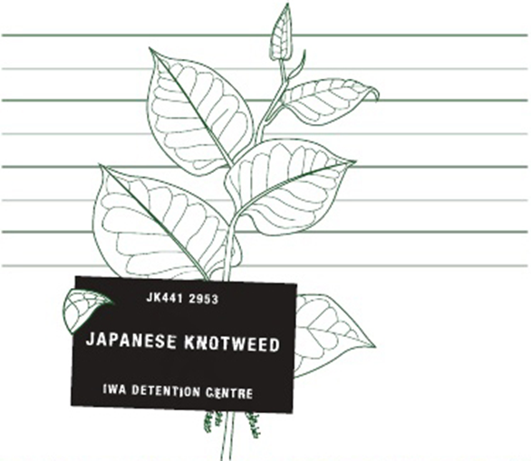
Why Eradication?
Aggressive colonizer that prevents tree seedlings from establishing because of its allelopathic properties
Early emergence and shoot height shades out other vegetation
Root system doesn’t hold soil in place, leading to soil erosion and increased sedimentation in streams
Reduces the food supply for juvenile salmon in the spring
Property damage; destroys roads, foundations and septic systems
WANTED FOR HABITAT DESTRUCTION
Image from Invasive Weeds Agency, Ltd.

Slide 9
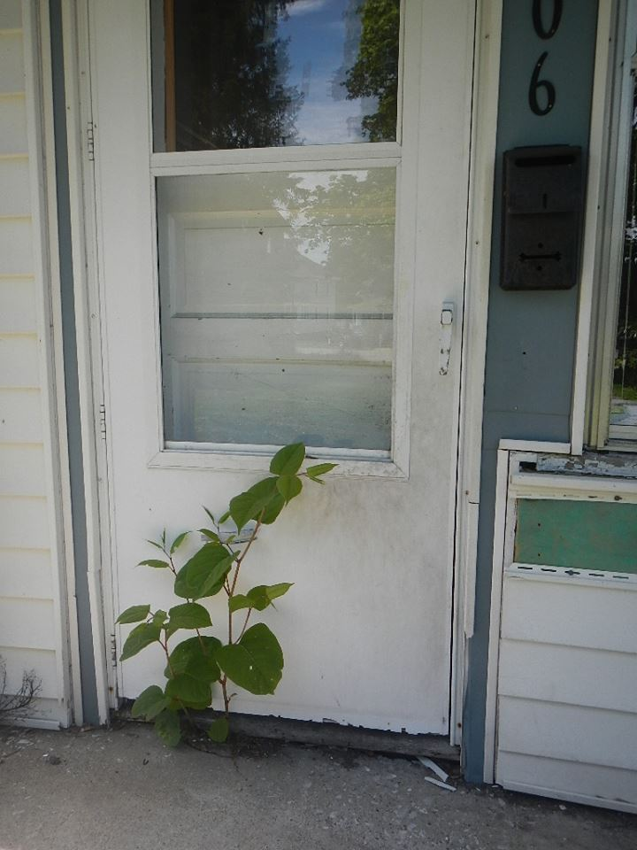
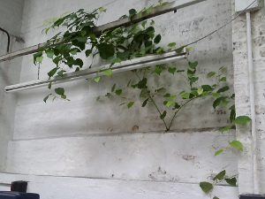
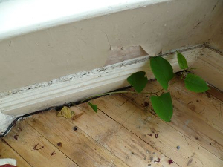
Don’t open
the door!
Photo Credit: Joseph Kerrer
Photo Credits: Japanese Knotweed Ltd.
Notes:
Pictures of Japanese knotweed growing through pavement and houses

Slide 10
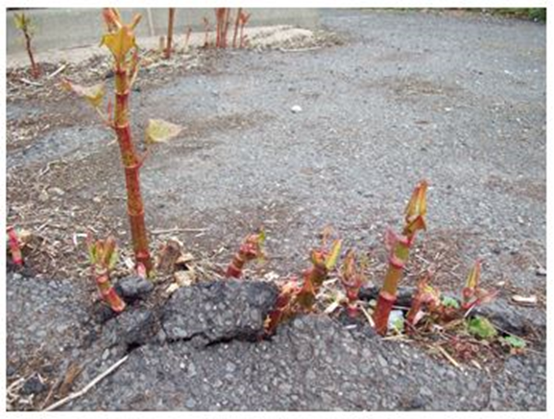
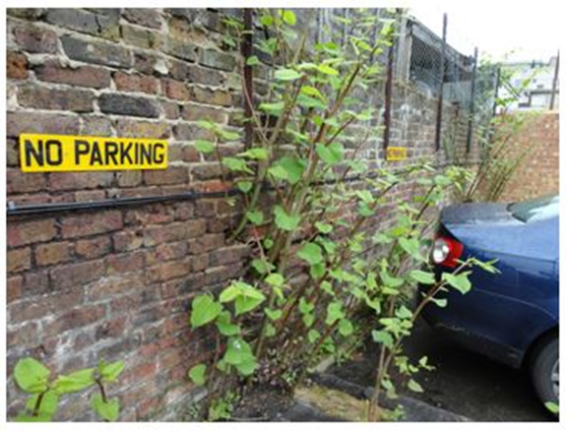
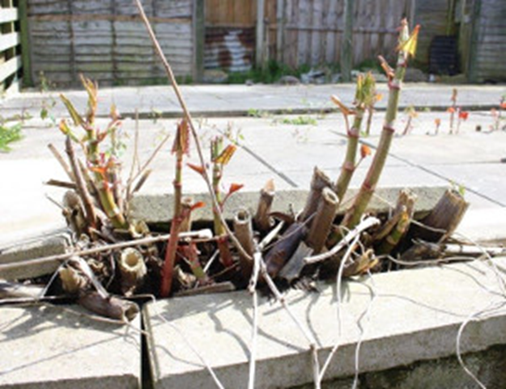
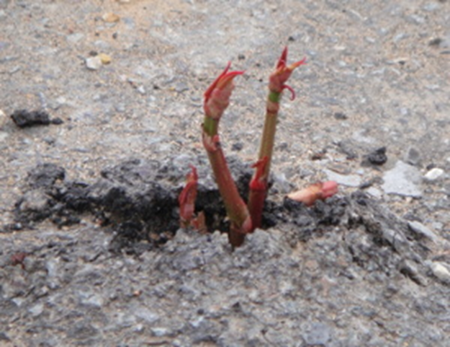
PUBLIC INFRASTRUCTURE DAMAGE
Photo Credits: Japanese Knotweed Ltd. and IVM and Treatment Ltd.

Slide 11
Where has Japanese knotweed Been Identified in MARIn County?
Lagunitas Creek watershed
San Geronimo Creek watershed

Slide 12
Ecology of Fallopia Japonica
How long have you had it?
How much do you have?
Not a lot, thankfully
But more than we want (which is none!)
NPS: 34 sites in 2017, 39 sites in 2018 (but a much lower stem count following treatment)
Private land owners: 26 sites were surveyed, 11 did not have knotweed, 15 did have knotweed, 11 of those 15 sites were treated in 2018
Infestation was first documented in the winter of 2011 along Lagunitas Creek
Since then, it has been confirmed on national, state and private lands along Lagunitas Creek and San Geronimo Creek
We don’t know how it got here and it is unlikely that we will ever find out

Slide 13
How does it reproduce?
How quickly might it spread?
Through its rhizomes; it has an extensive rhizome network can extend 23 feet horizontally and 10 feet deep
Occasionally produces seed, but rarely viable
Can also spread through stem fragments
Very quickly!
Aggressive nature, out-shades other vegetation
Easily spread through flooding
Takes as little as 0.7 grams of rhizome material or node material to start a new infestation

Slide 14
Photo Credit: Japanese Knotweed Solutions

Slide 15
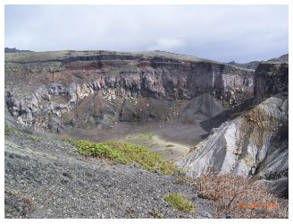
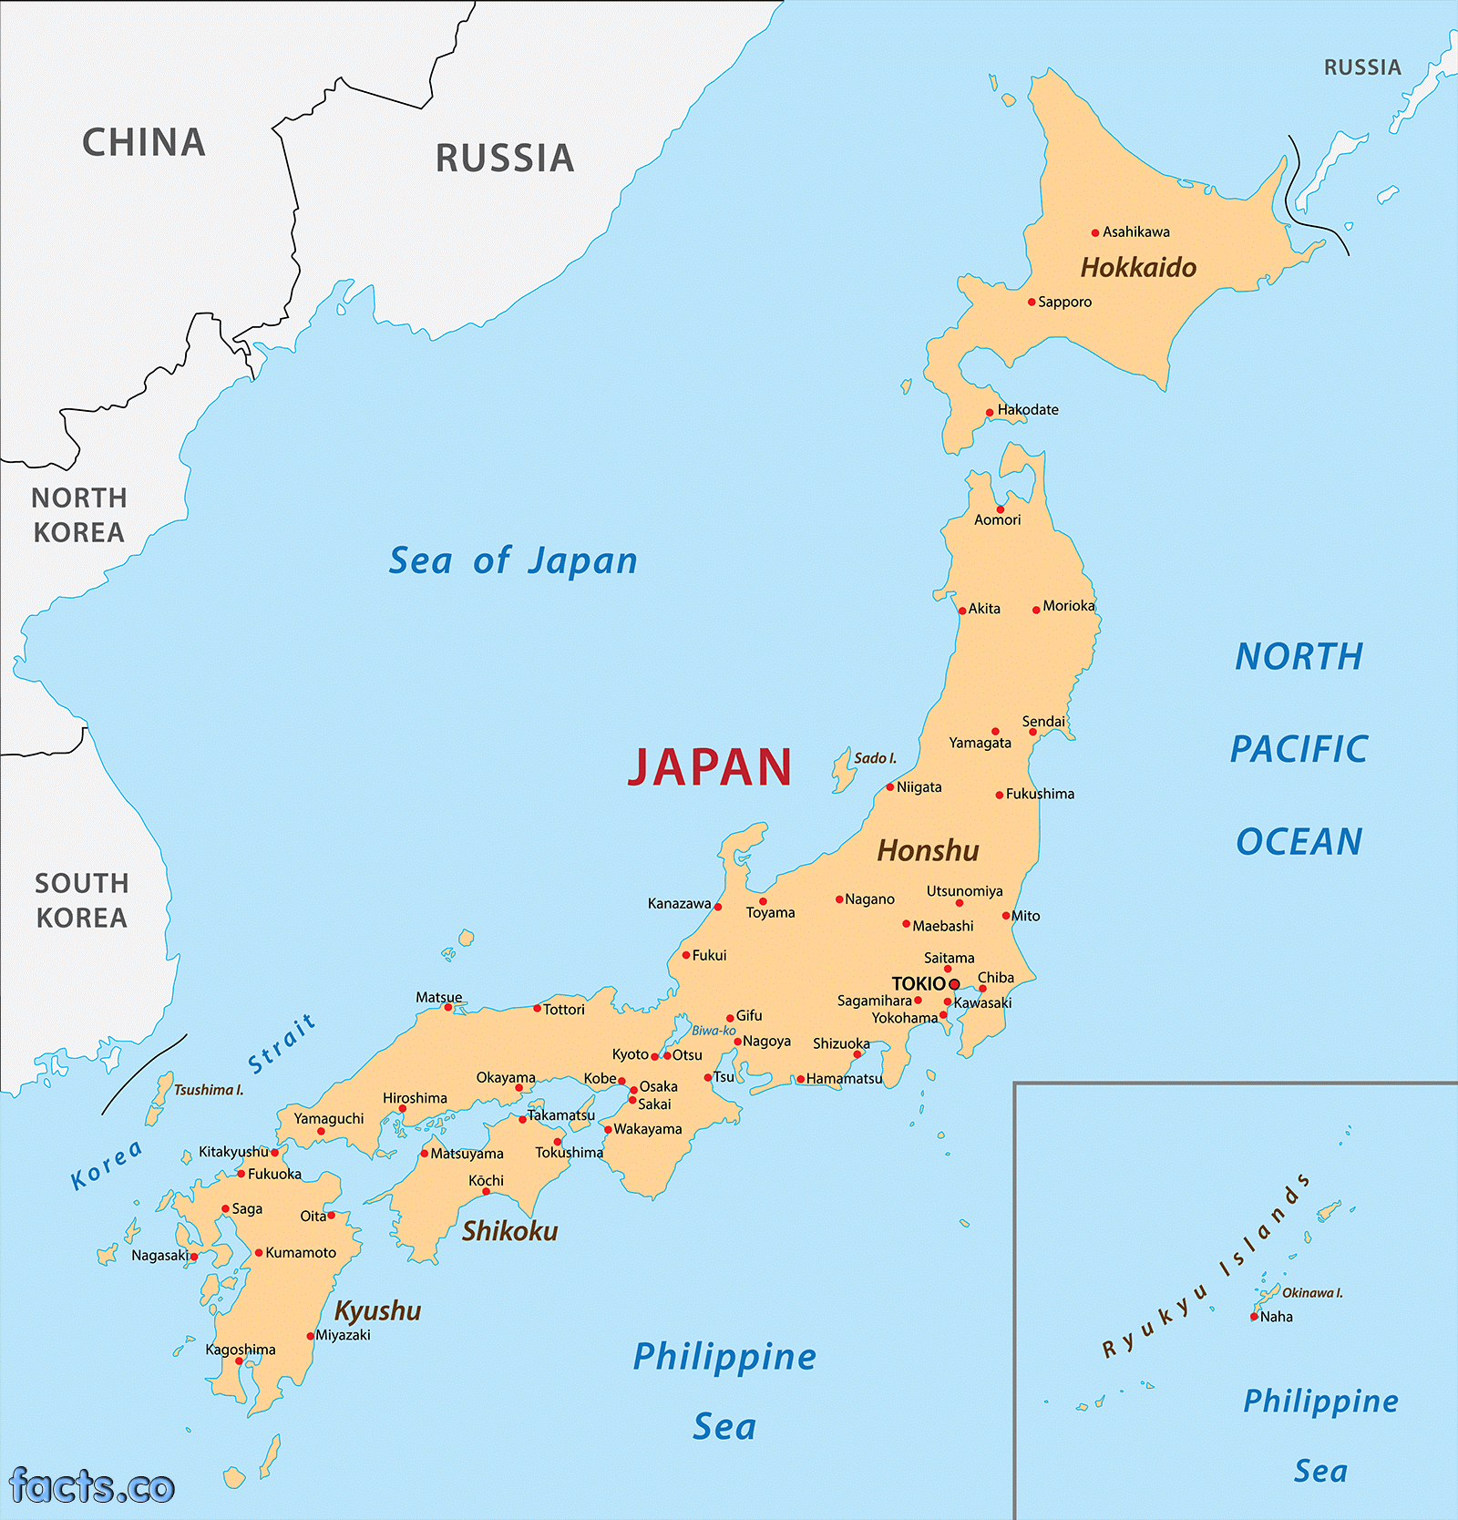
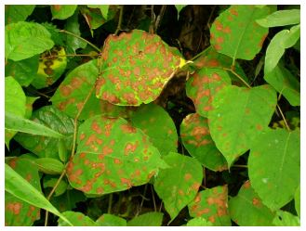
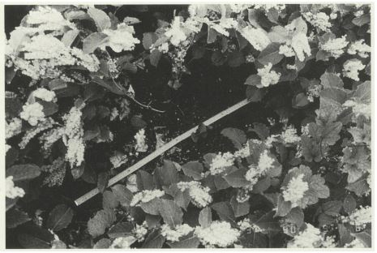
Japanese Knotweed in Japan
Aphalara itadori
Mycosphaerella leaf spot
Photo Credits: N. Adachi et al., D. Kurose et al. and Japanese Knotweed Removal UK
Notes:
However, in the volcanic environment knotweed plants are typically much smaller in size than in Britain due to poor soils, ‘central die back’ of the plant (similar to fairy rings common in Britain), and the repeated coverings of volcanic ash and landslides that serve to limit knotweed growth.
In its Japanese habitat, knotweed is further kept in check by a large native ecosystem of similarly vigorous giant herbs such as the grasses Miscanthus and Bamboo, and natural invertebrate pests such as the psyllid Aphalara itadori. A range of Japanese soil fungi and plant diseases also attack all parts of the knotweed plant.

Slide 16
When and how do you effectively treat it?
What has been tried and doesn’t work:
Mowing/cutting
Tarping
Hand digging/pulling
Burning
What is most effective:
Complete removal of soil and rhizomes (very expensive and not feasible on stream banks)
Herbicides: Aquatically approved herbicides applied by a qualified applicator
1.5% Imazapyr and 2% surfactant, 5% Glyphosate if homeowners request it
Need to target it in the late summer/fall when it is bringing resources to the rhizomes

Slide 17
Glyphosate (non-selective)
Control rates of around 80%-95% in first growing season
Works by disrupting the shikimic acid (metabolic) pathway
Available in both aquatic or non-aquatic formulations
Readily available and inexpensive
Slow acting (expect to need at least 2 weeks to see results)
No soil residual
The only herbicide used for injection applications
Information from Redwood Community Action Agency

Slide 18
Imazapyr (non-selective)
Control rates of around 90-95% in first growing season
Works by disrupting the shikimic acid (metabolic) pathway
Available in both aquatic or non-aquatic formulations
Expensive, but used at low rates
Can be mixed with glyphosate
Extremely slow acting (results may not be visible for a month, or possibly even the next growing season)
Has soil residual, may need to wait to replant

Slide 19
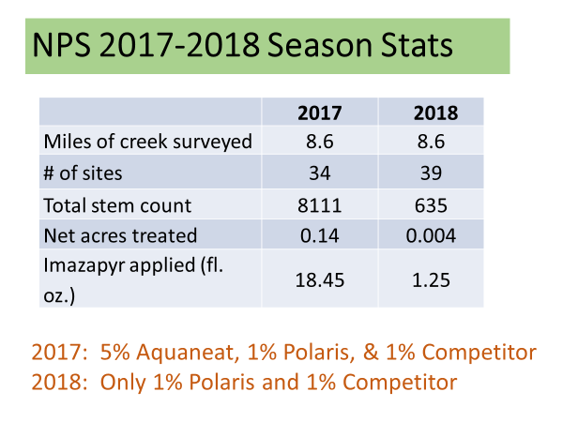
Image Credit: Bobbi Simpson, NPS

Slide 20
Community Messaging: Collaboration
If you think you have found Japanese knotweed, please do not attempt removal.
Mechanical removal stimulates growth and risks spread!
Take a picture of the plant and send it along to MKAT by emailing acdirkse@ucanr.edu
Make sure to include contact info and location info
Resources are available at https://ucanr.edu/sites/MarinKnotweedActionTeam/
Stay updated by “liking” our Facebook page, Marin Knotweed Action Team

