Slide 1
Grassroots Ecology
Restoration Lessons from the Field
Bay Area Watershed Network
May 3, 2019

Slide 2
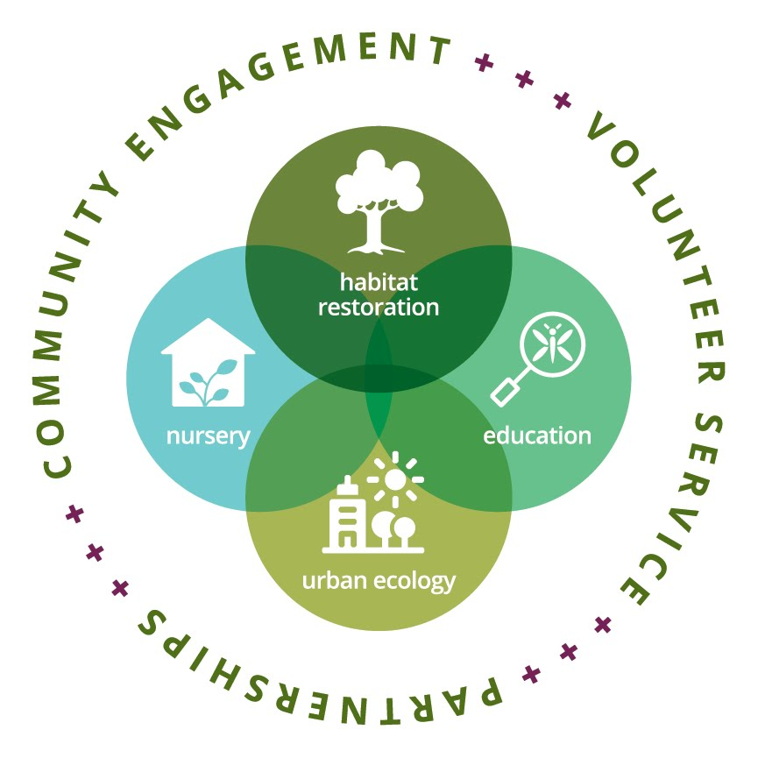
What We Do
Mission: To involve and educate the public to restore local ecosystems.

Slide 3
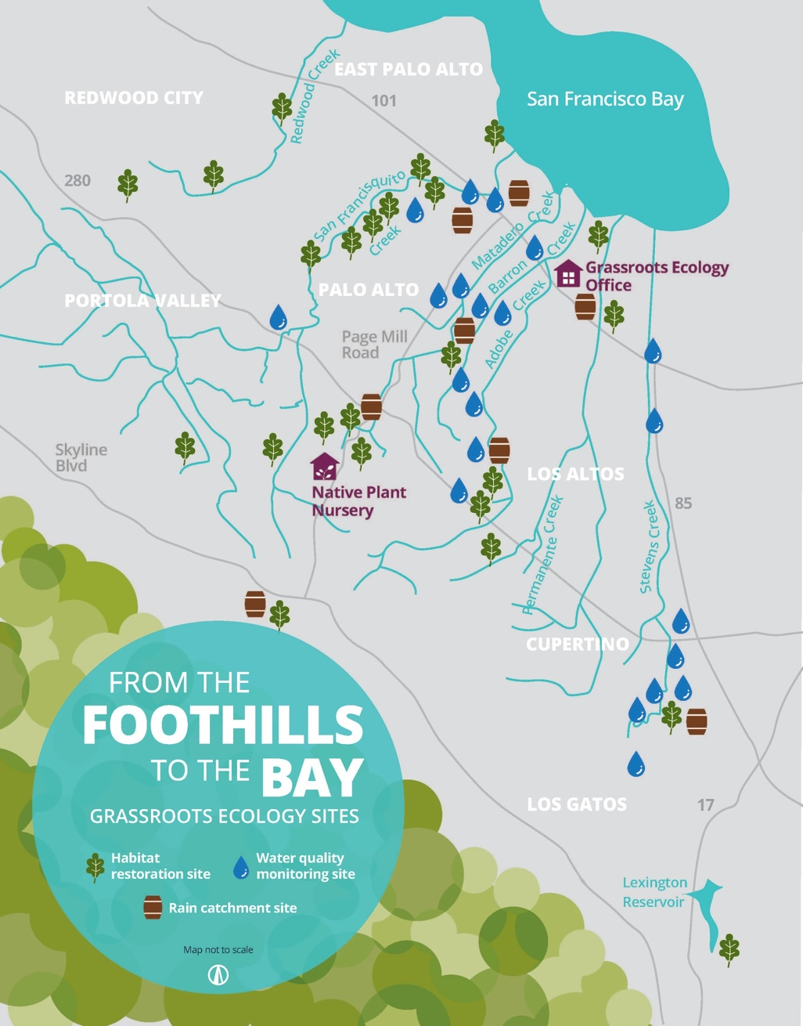
Where We Work
Habitat restoration
23 sites across 9 cities and 2 counties
2,600 acres of parks and open spaces
25,000 linear feet of creek across 9 watersheds
35,000 plants grown
Annual participation:
12,800 people engaged last year
80% youth and young adults
Commitment over many years!

Slide 4
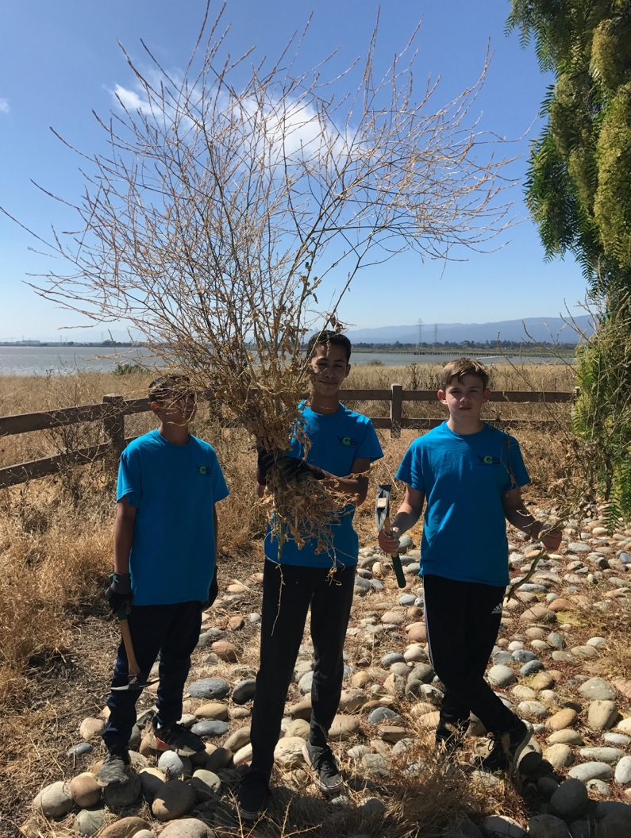
Habitat Restoration
Invasive plant removal, planting, sheet mulching, trash cleanups
Service groups, schools, corporate groups
Drop-in volunteer opportunities (2-3 hrs.) on weekends
Weekly programs on weekdays - Weed Warriors, Byrne Brigade, Ivy League

Slide 5
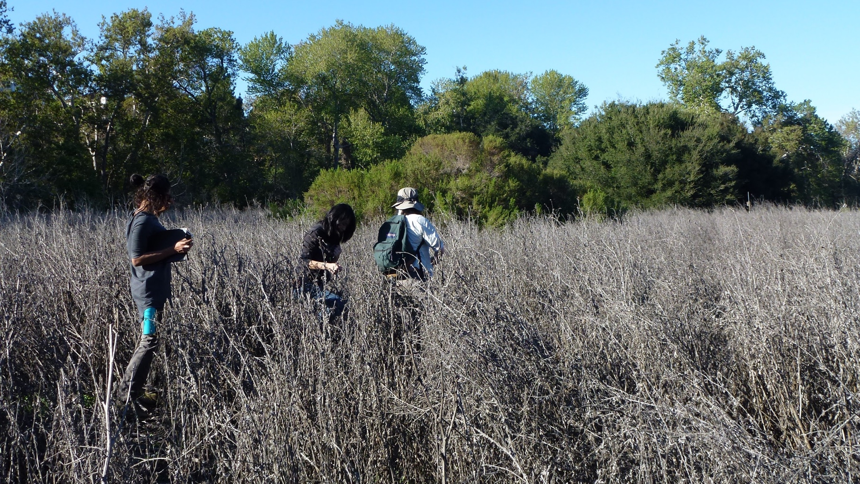
McClellan Ranch Preserve
Meadow Enhancement, Cupertino
Funded by City of Cupertino and Valley Water

Slide 6
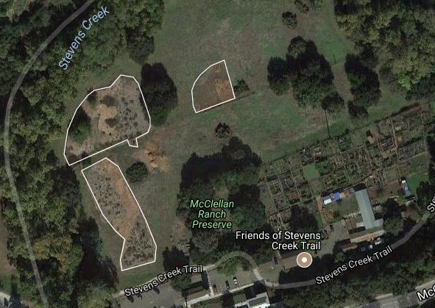
McClellan Ranch Preserve
5 years of sheet mulching, planting in islands, and mowing thistles around the islands. Over 4,000 volunteers!

Slide 7
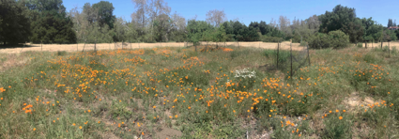
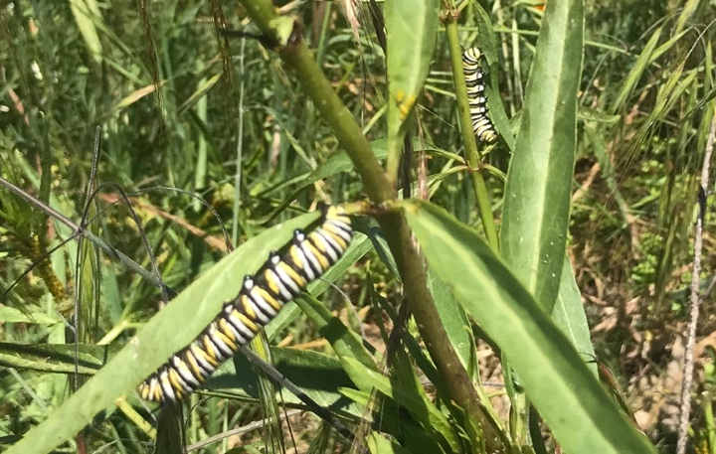
McClellan Ranch Preserve
Thistles are mostly gone, but annual grasses now move in, and gophers love the yarrow. Meadow restoration is an ongoing process.

Slide 8
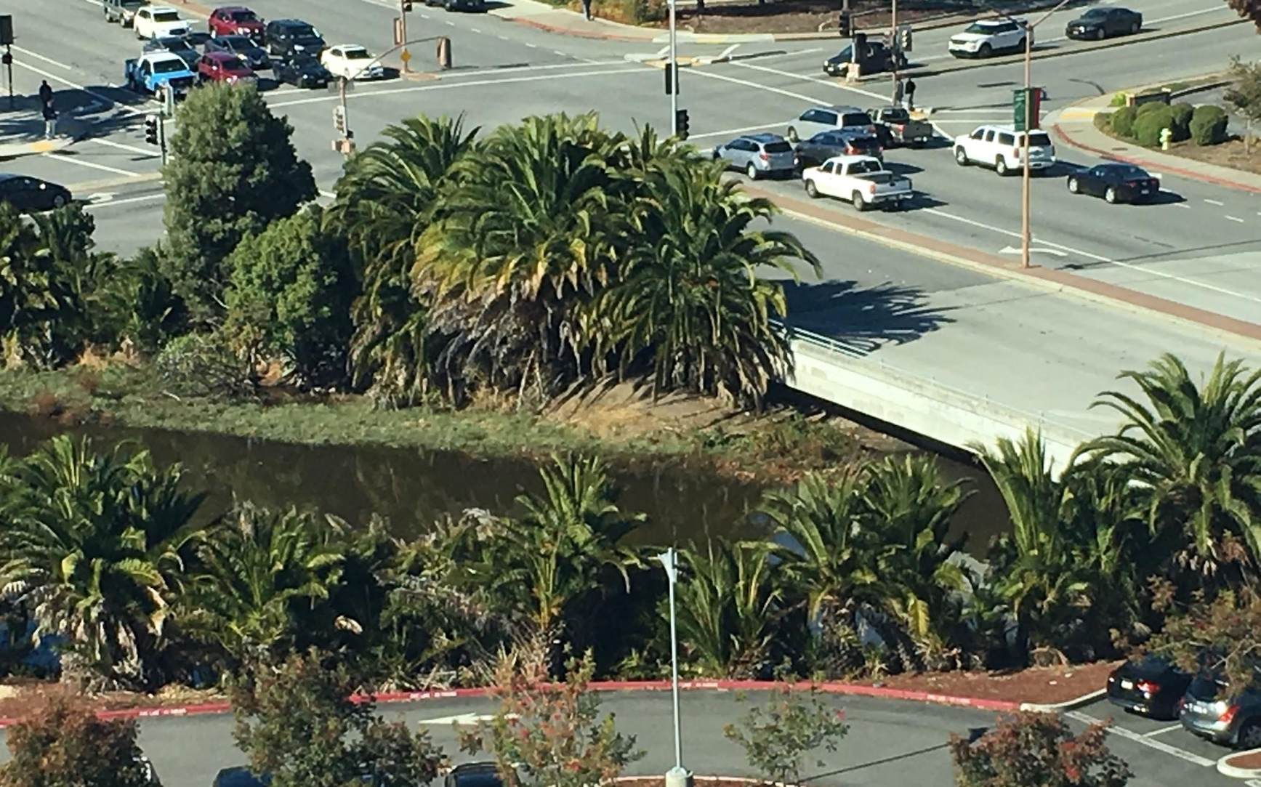
Redwood Creek
Funded by Coastal Conservancy Prop. 1 grant

Slide 9
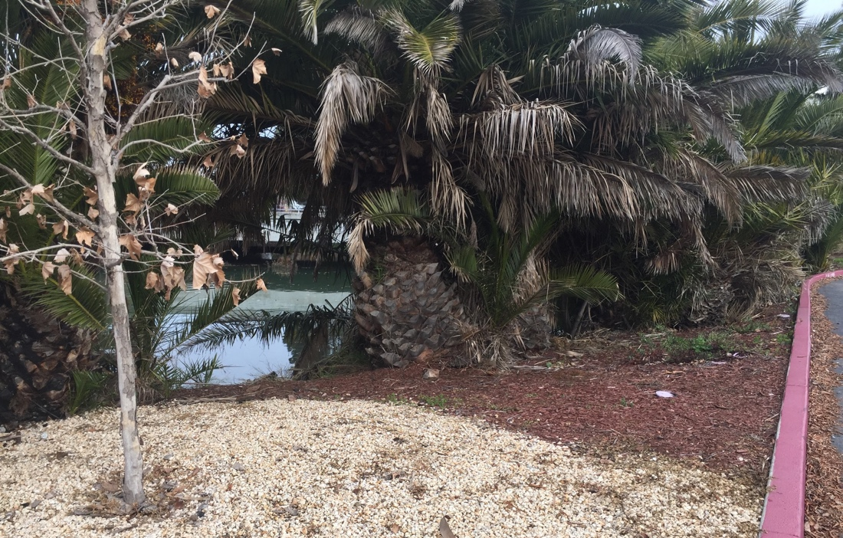
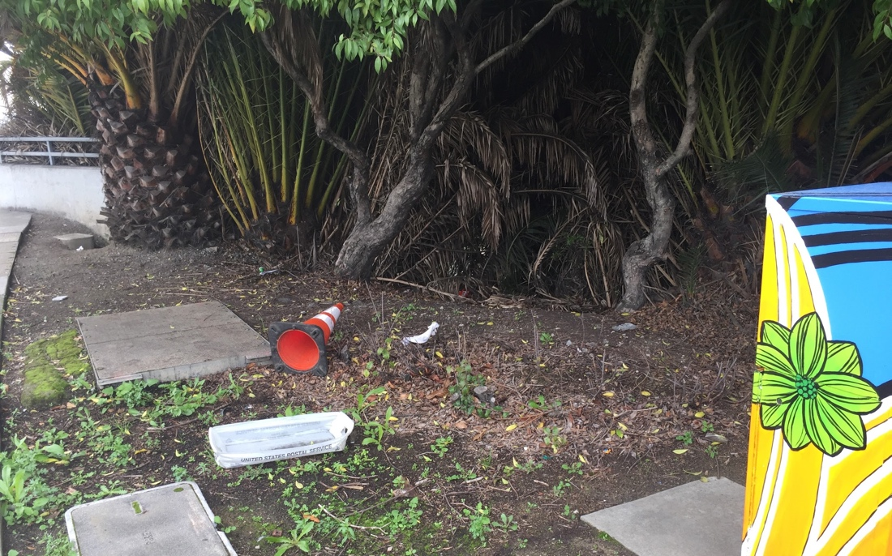
Redwood Creek
Flexibility in grant and community partners allowed for a flexible approach to move resident homeless couple into housing

Slide 10
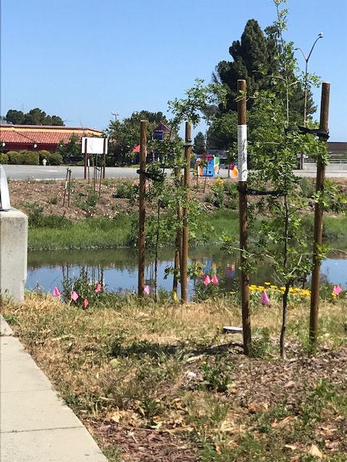
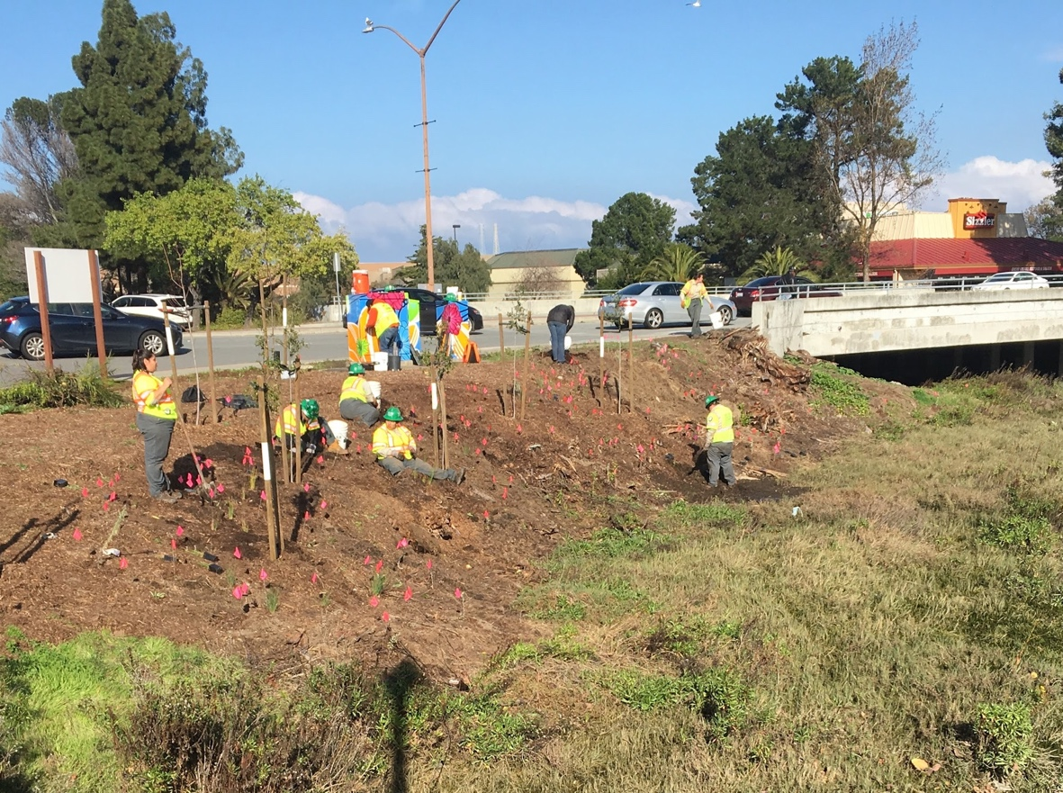
Redwood Creek
Replanting with a diversity of species
focusing on trees, shrubs, and “tough” perennials

Slide 11
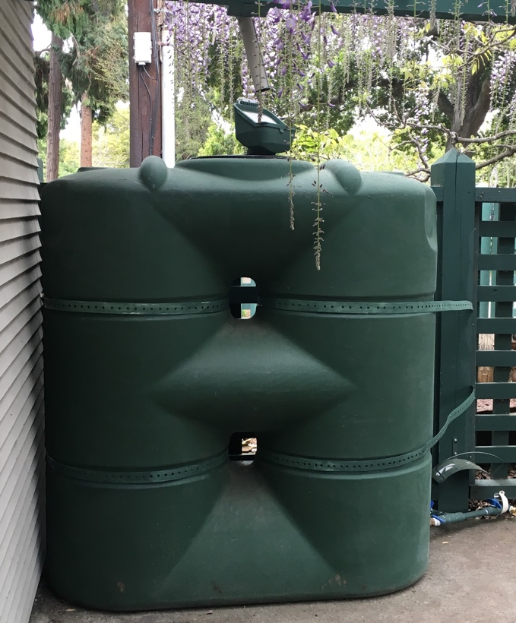
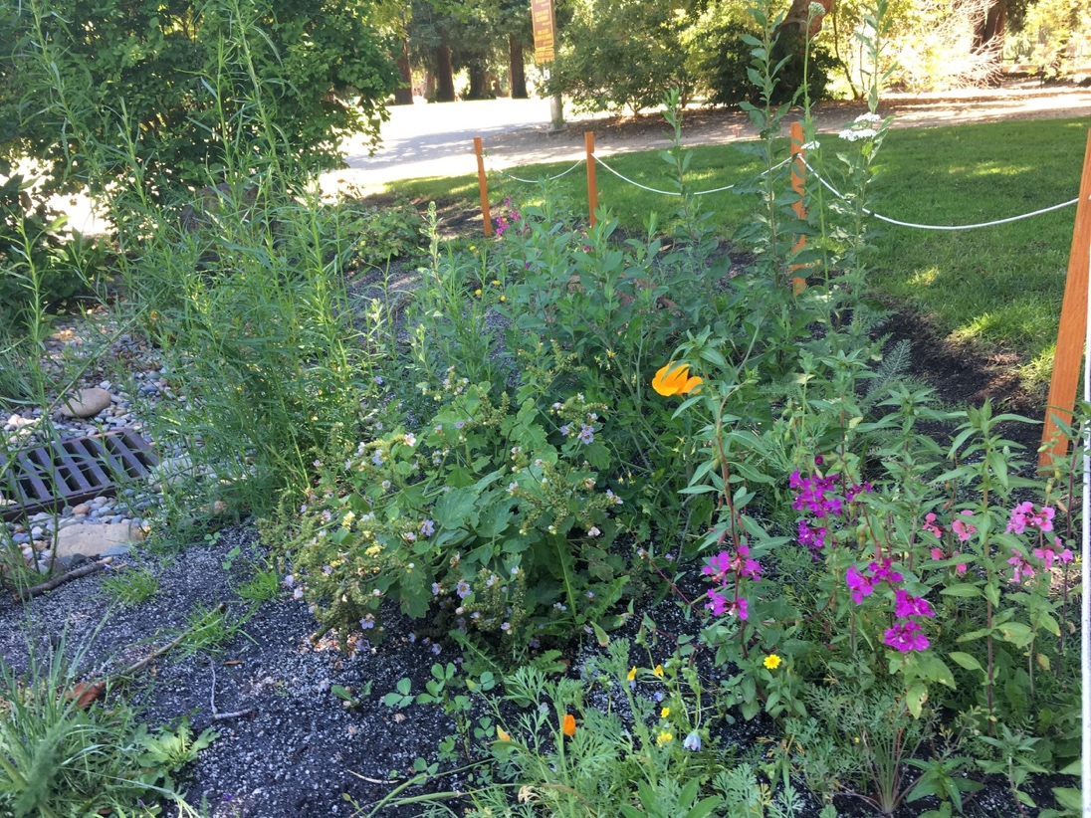
Urban Ecology
Hands on workshops to install rain gardens and rain barrel systems at TBD locations through a Valley Water grant with City of Palo Alto support

Slide 12
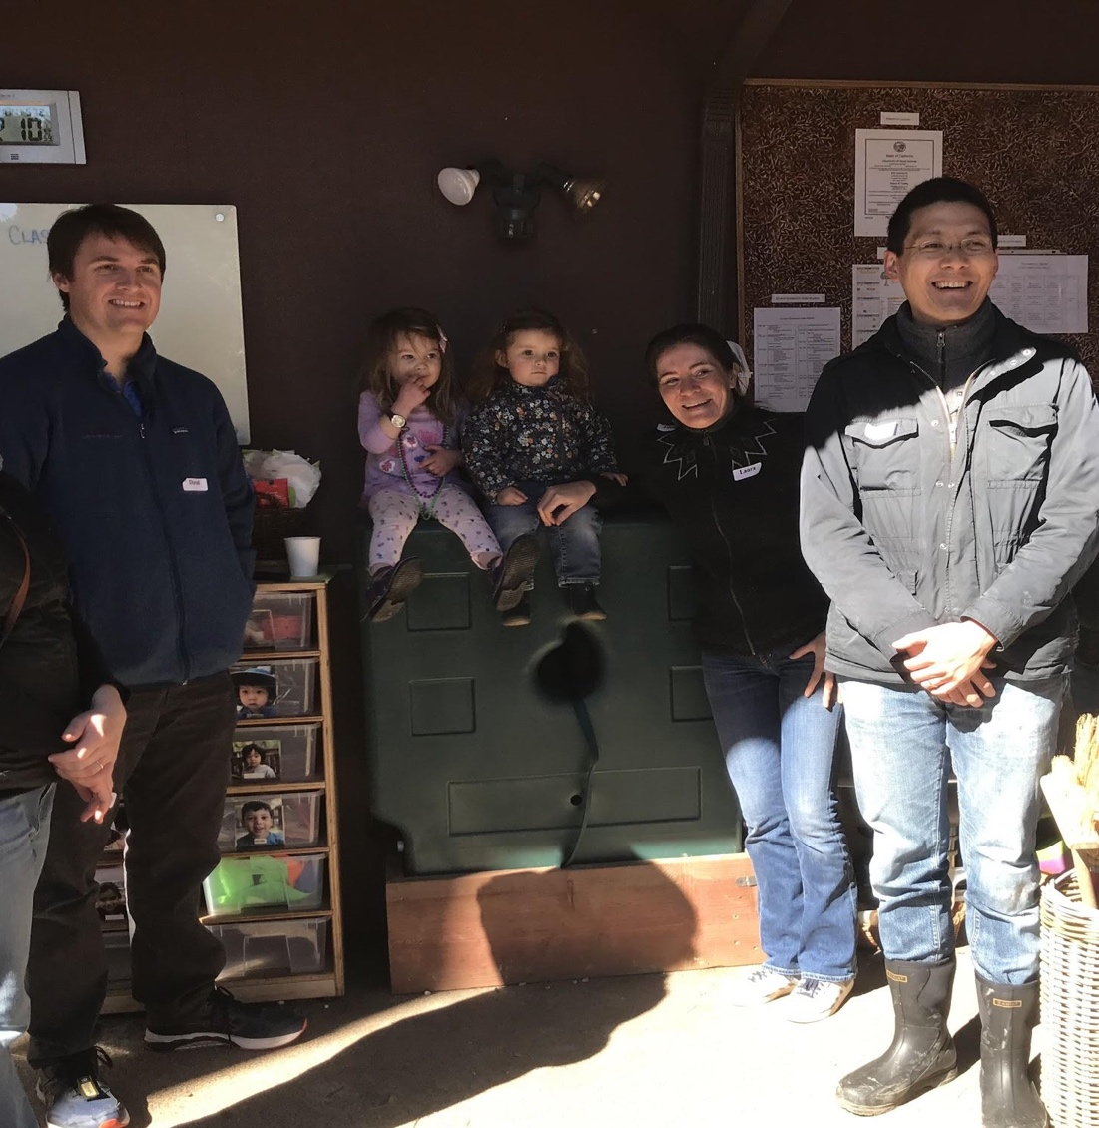
Urban Ecology
Challenges:
Staff turnover at City
Difficult for City staff due to maintenance concerns
Every site is slated for future construction!
Community sites, once we found them, were a better fit (e.g. church, preschool)

Slide 13
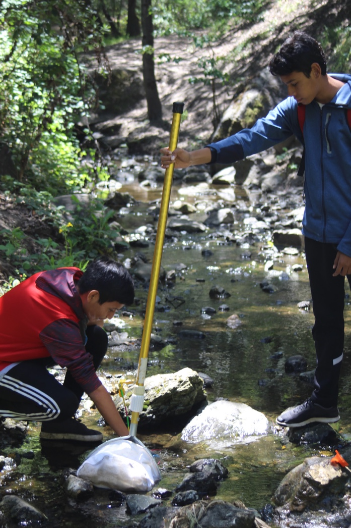
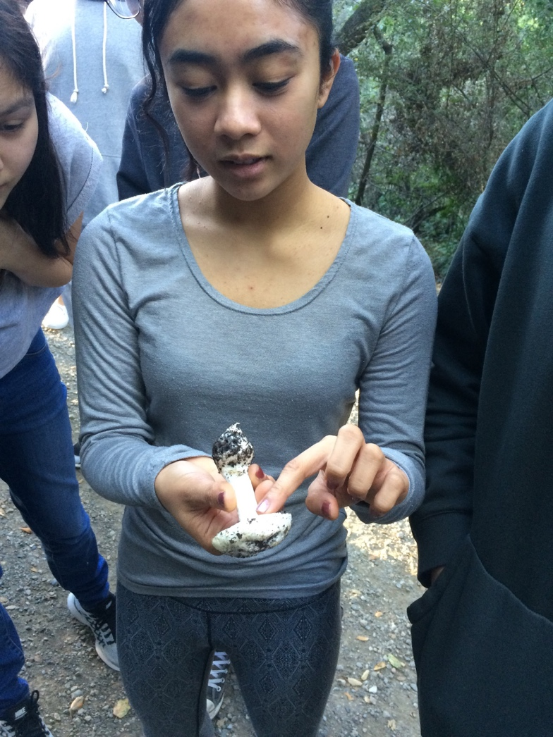
High School Stewards
Continuity over time is a key to success, but also the biggest funding challenge in underserved communities

Slide 14
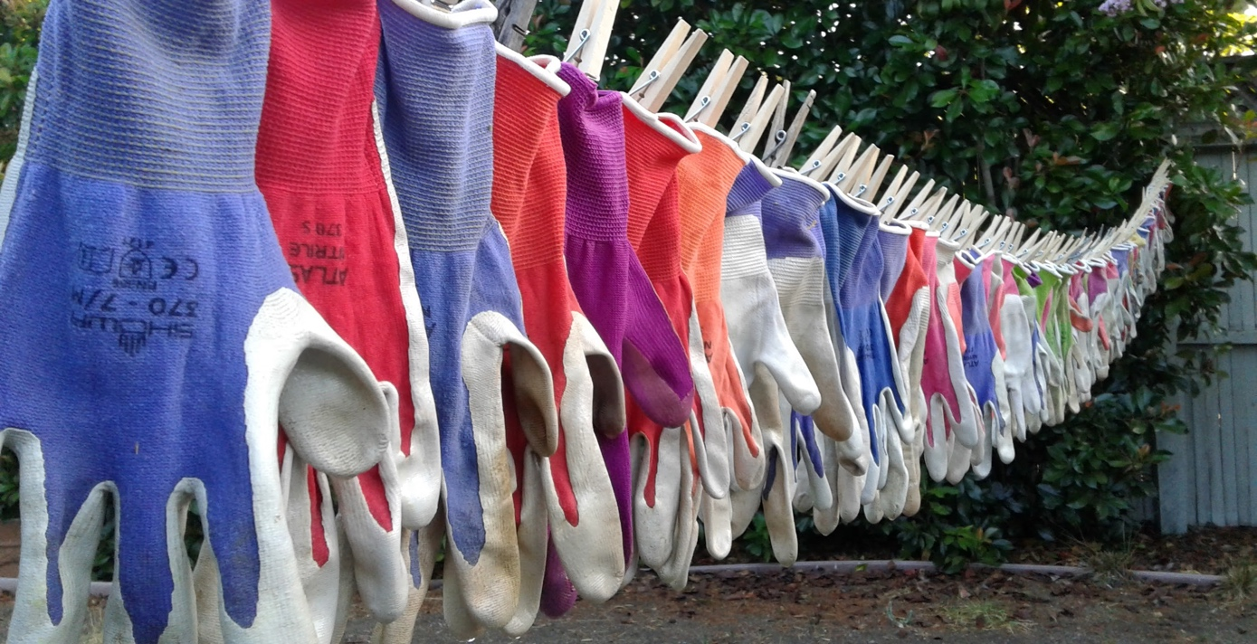
Stay in Touch
✓ Sign up for our e-newsletter at www.grassrootsecology.org
Questions? junko@grassrootsecology.org

