Slide 1


Slide 2

Zama Dlamini – Oakland Project Manager

Slide 3
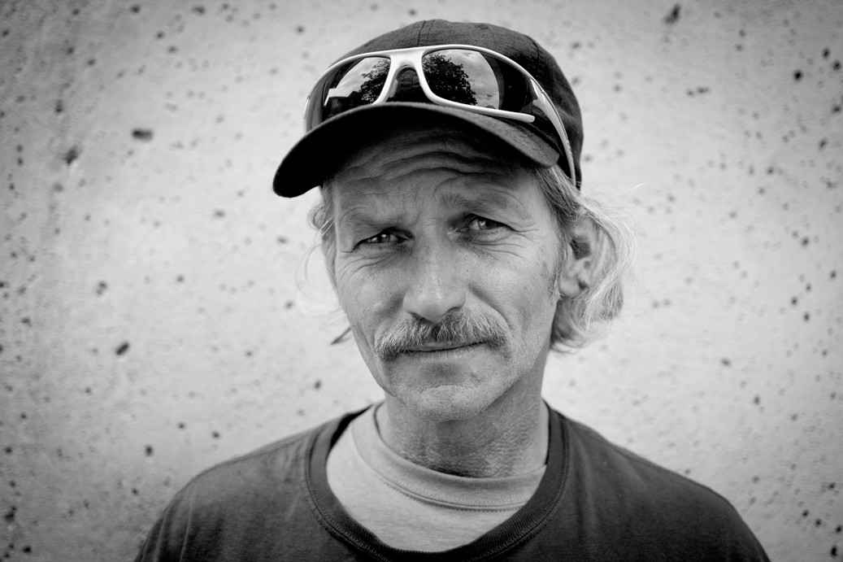
Roughly 28,200 people were homeless across the Bay Area, according to point-in- time counts in 2017. That was the third largest population in the country.
But the Bay Area has the
largest percentage of homeless people without shelter (67%) (indicating there’s a shortage of subsidized housing, short- term shelters and transitional housing).

Slide 4
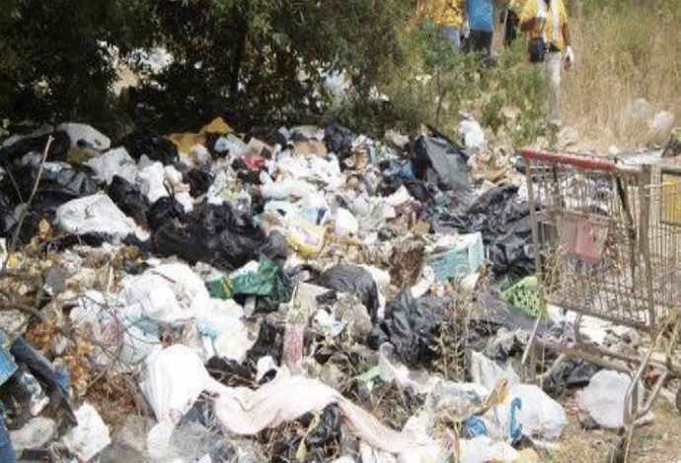
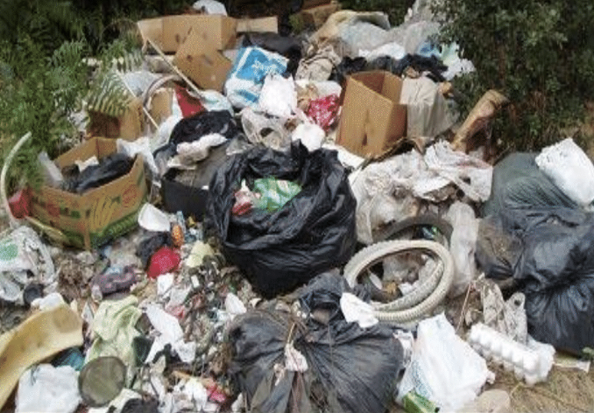
Lack of infrastructure for unhoused persons has led to upticks to debris, human waste, and blight
This human crisis has also lead to increased environmental impacts

Slide 5

Myth SMASHERS!
Homeless individuals flock to the Bay Area to take advantage of our homeless services.
True or False?
_{END}E_{I}ND_{G}IN_{H}G_{OM}HO_{EL}M_{ES}E_{S}L_{N}ES_{E}S_{S}N_{S}E_{T}S_{H}S_{R}T_{O}H_{U}R_{G}O_{H}UG_{T} H_{E}T_{D}H_{I}E_{G}D_{N}I_{I}G_{TY}NI_{O}T_{F}Y _{W}OF_{O}W_{RK}ORK

Slide 6


True or False?
Myth SMASHERS!
Homeless individuals flock to Bay Area to take advantage of our homeless services.
FALSE…
60% residents of their county for 10 years previous to homelessness. Typically over 80% were housed in the region in the year before entering homelessness.

Slide 7





Homelessness affects
everyone
Pol ice and CJ S.
Public Health and Hospitals
The Community, City Hall And Public Services
Environment
Taxpayer, Tourism And Small Business

Slide 8
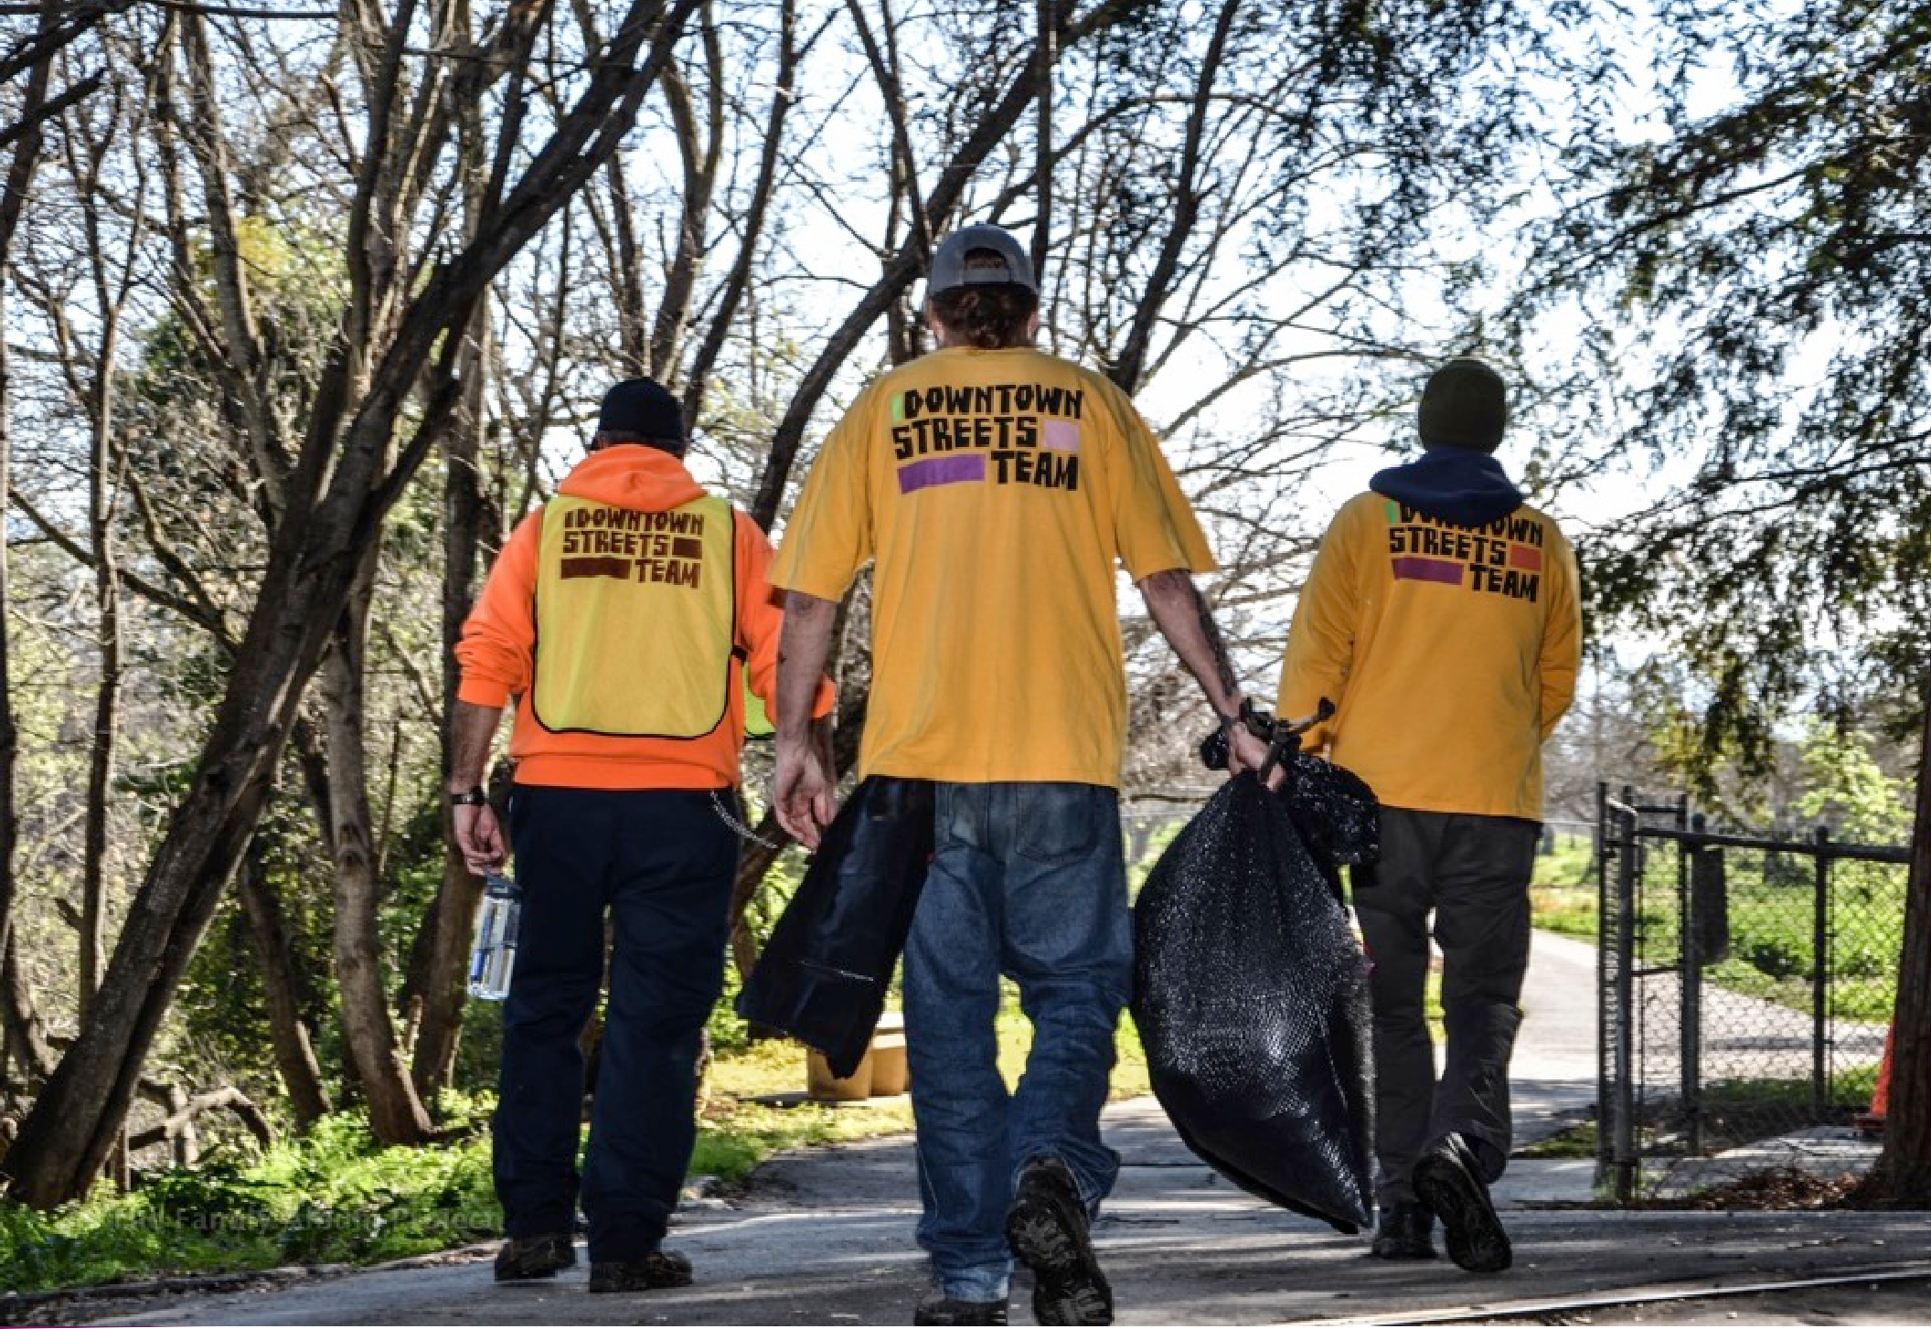
WE ARE helping homeless PEOPLE REBUILD THEIR LIVES through the
dignity of work.

Slide 9
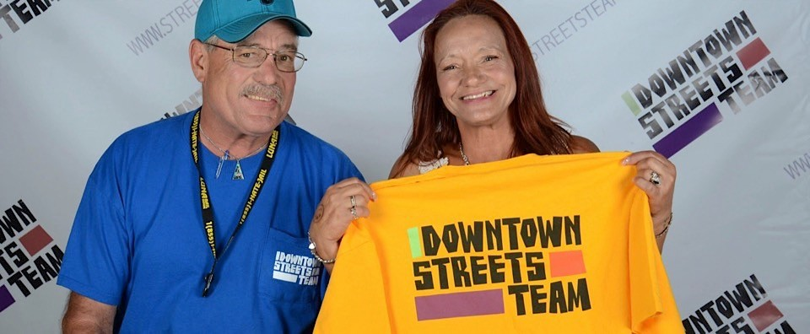
Our model in a nutshell
Homeless and Low-Income people volunteer with us and work collaboratively on beautification projects around the community.
In return, Team Members receive a basic needs stipend while receiving case management and employment services.

Slide 10


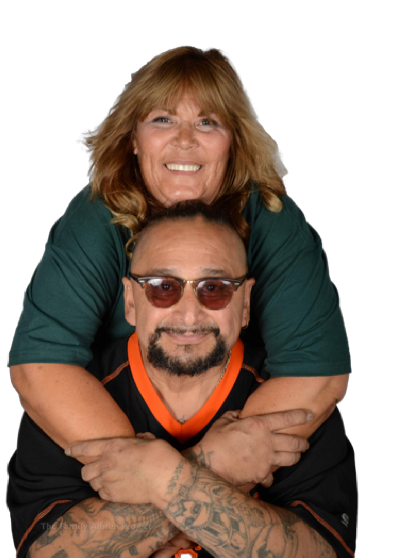




Stipend
Self Sufficiency
Non cash
  Food
  Storage
  Transportation
  Housing
  Communication
Stepping stone into employment
Job
Housing
Goal Setting Mode
Survival Mode

Slide 11
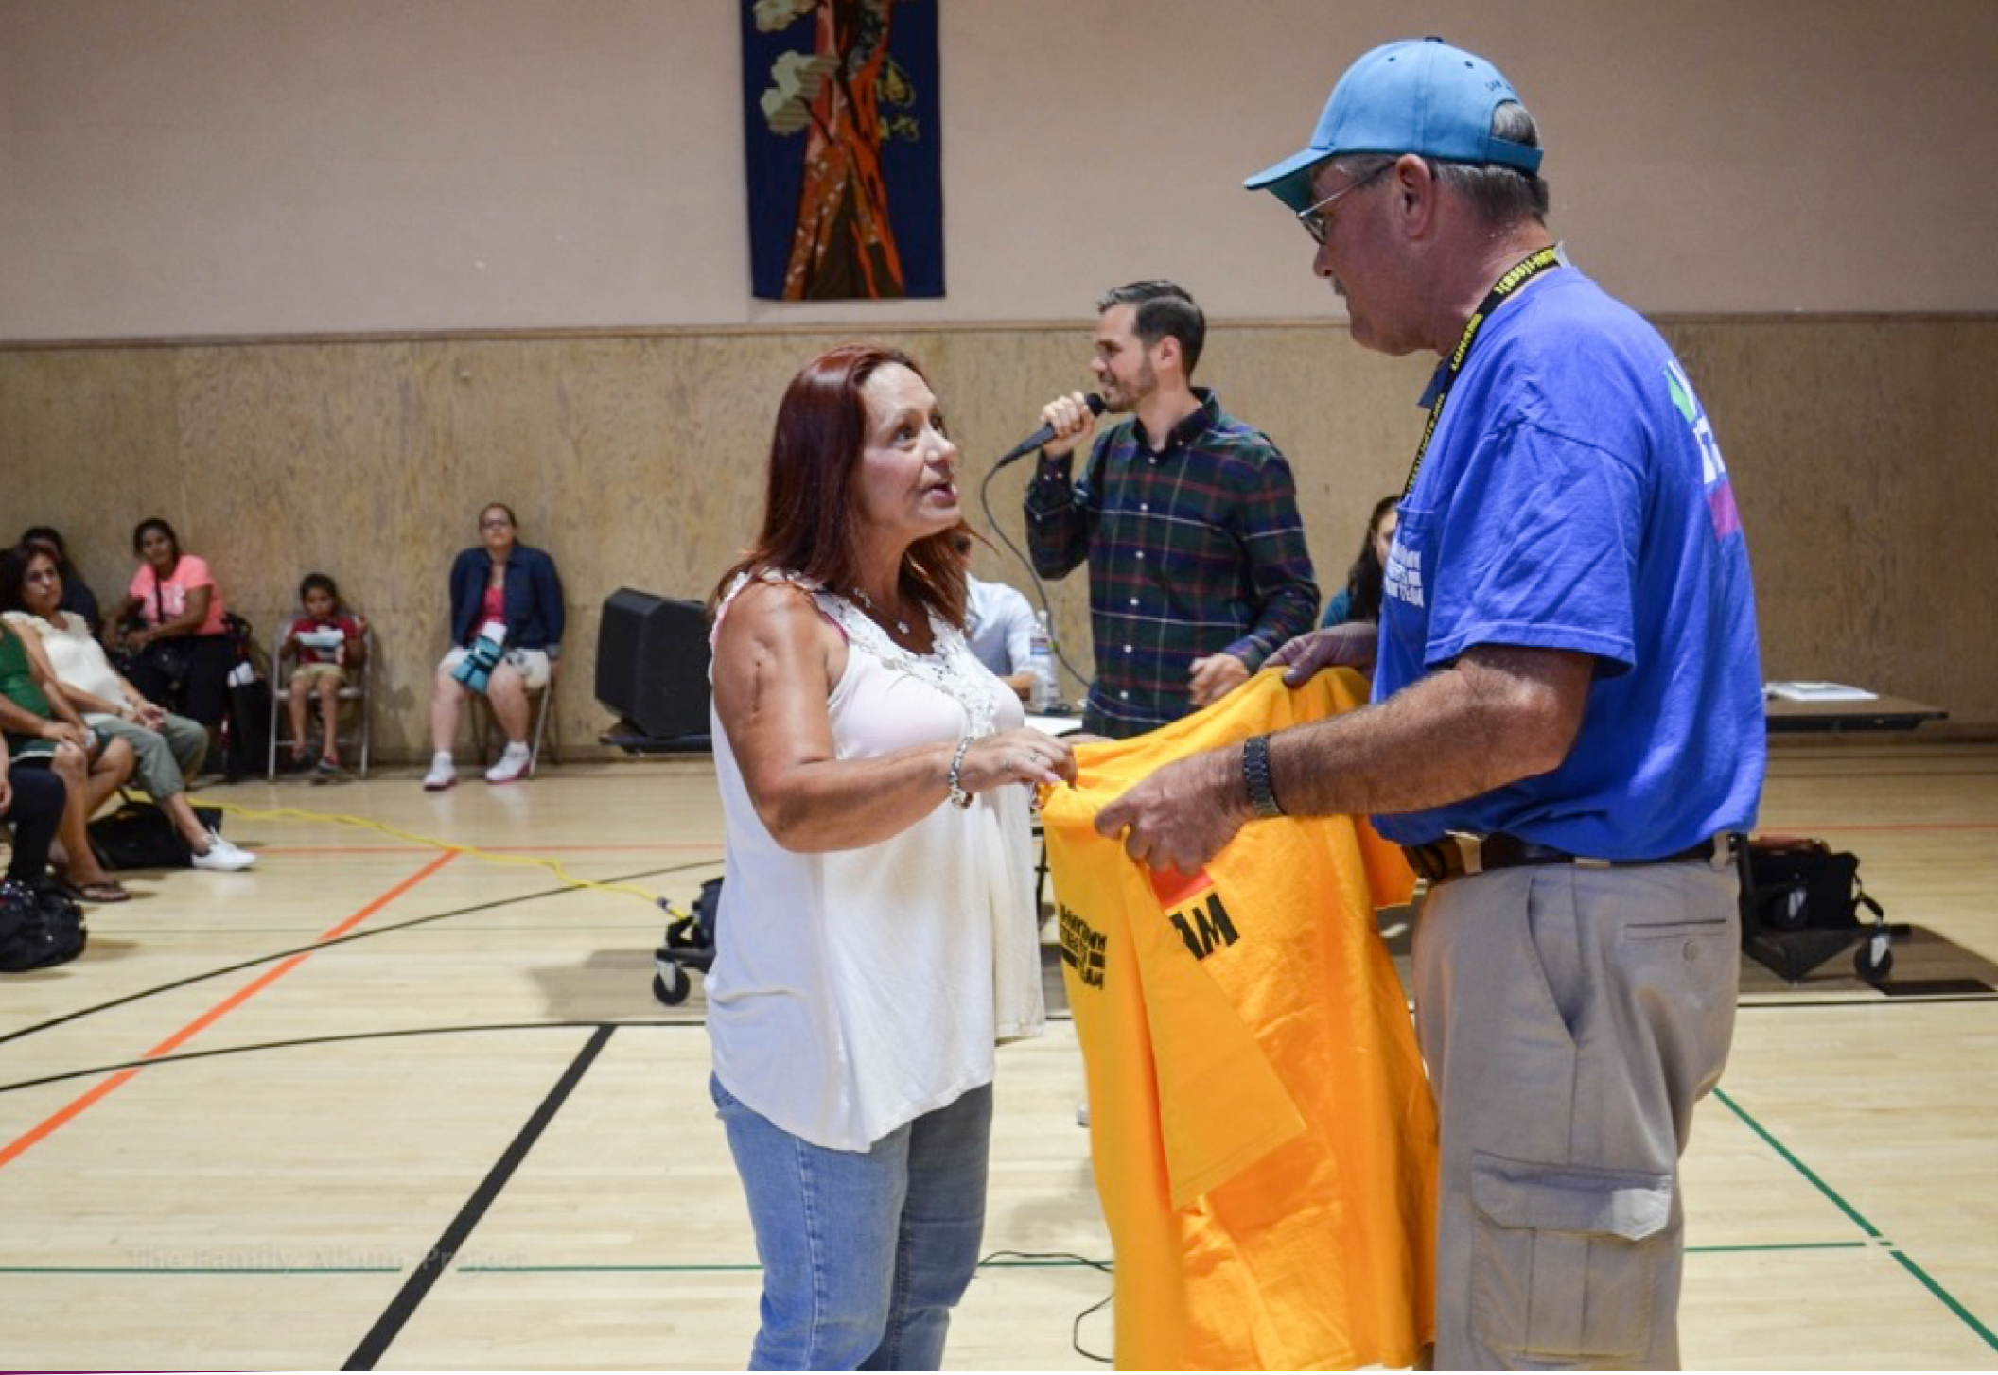

When a Team Member
This uniform is a symbol of them stepping into change!

Slide 12
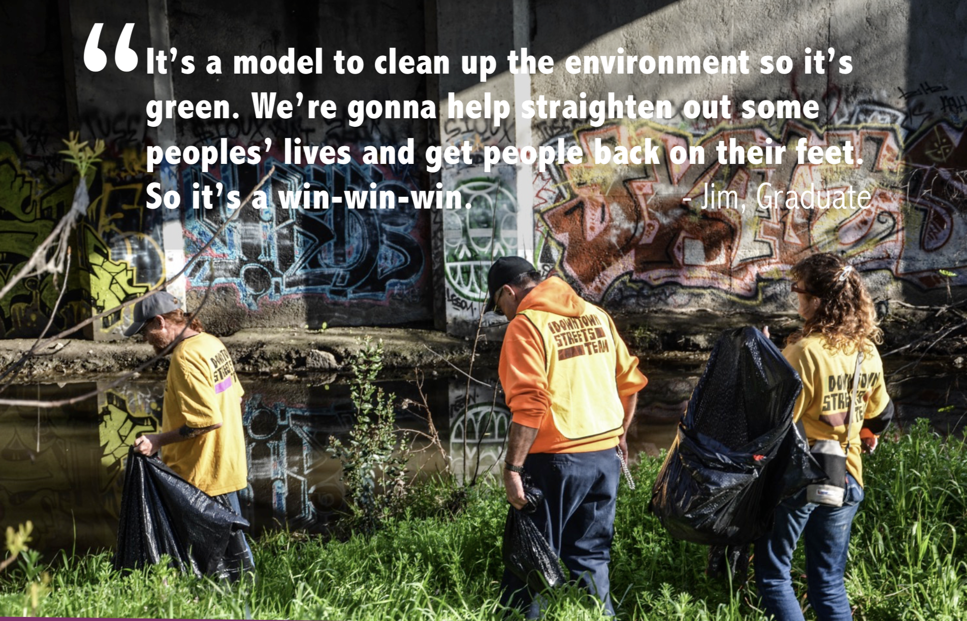
Team Members volunteer all over cities removing debris and helping the environment

Slide 13
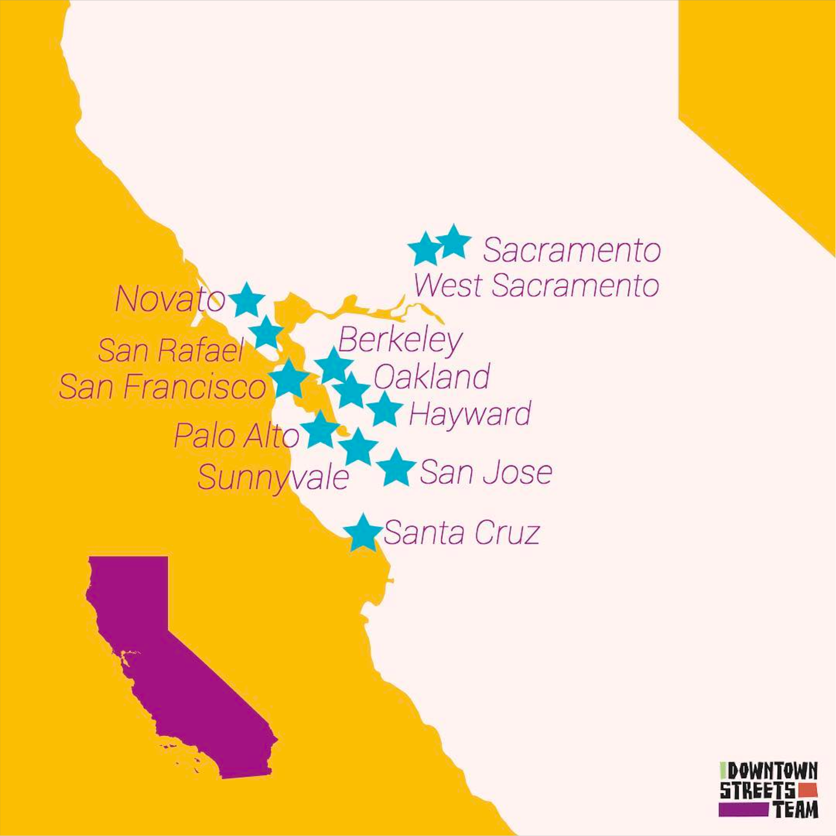

Slide 14
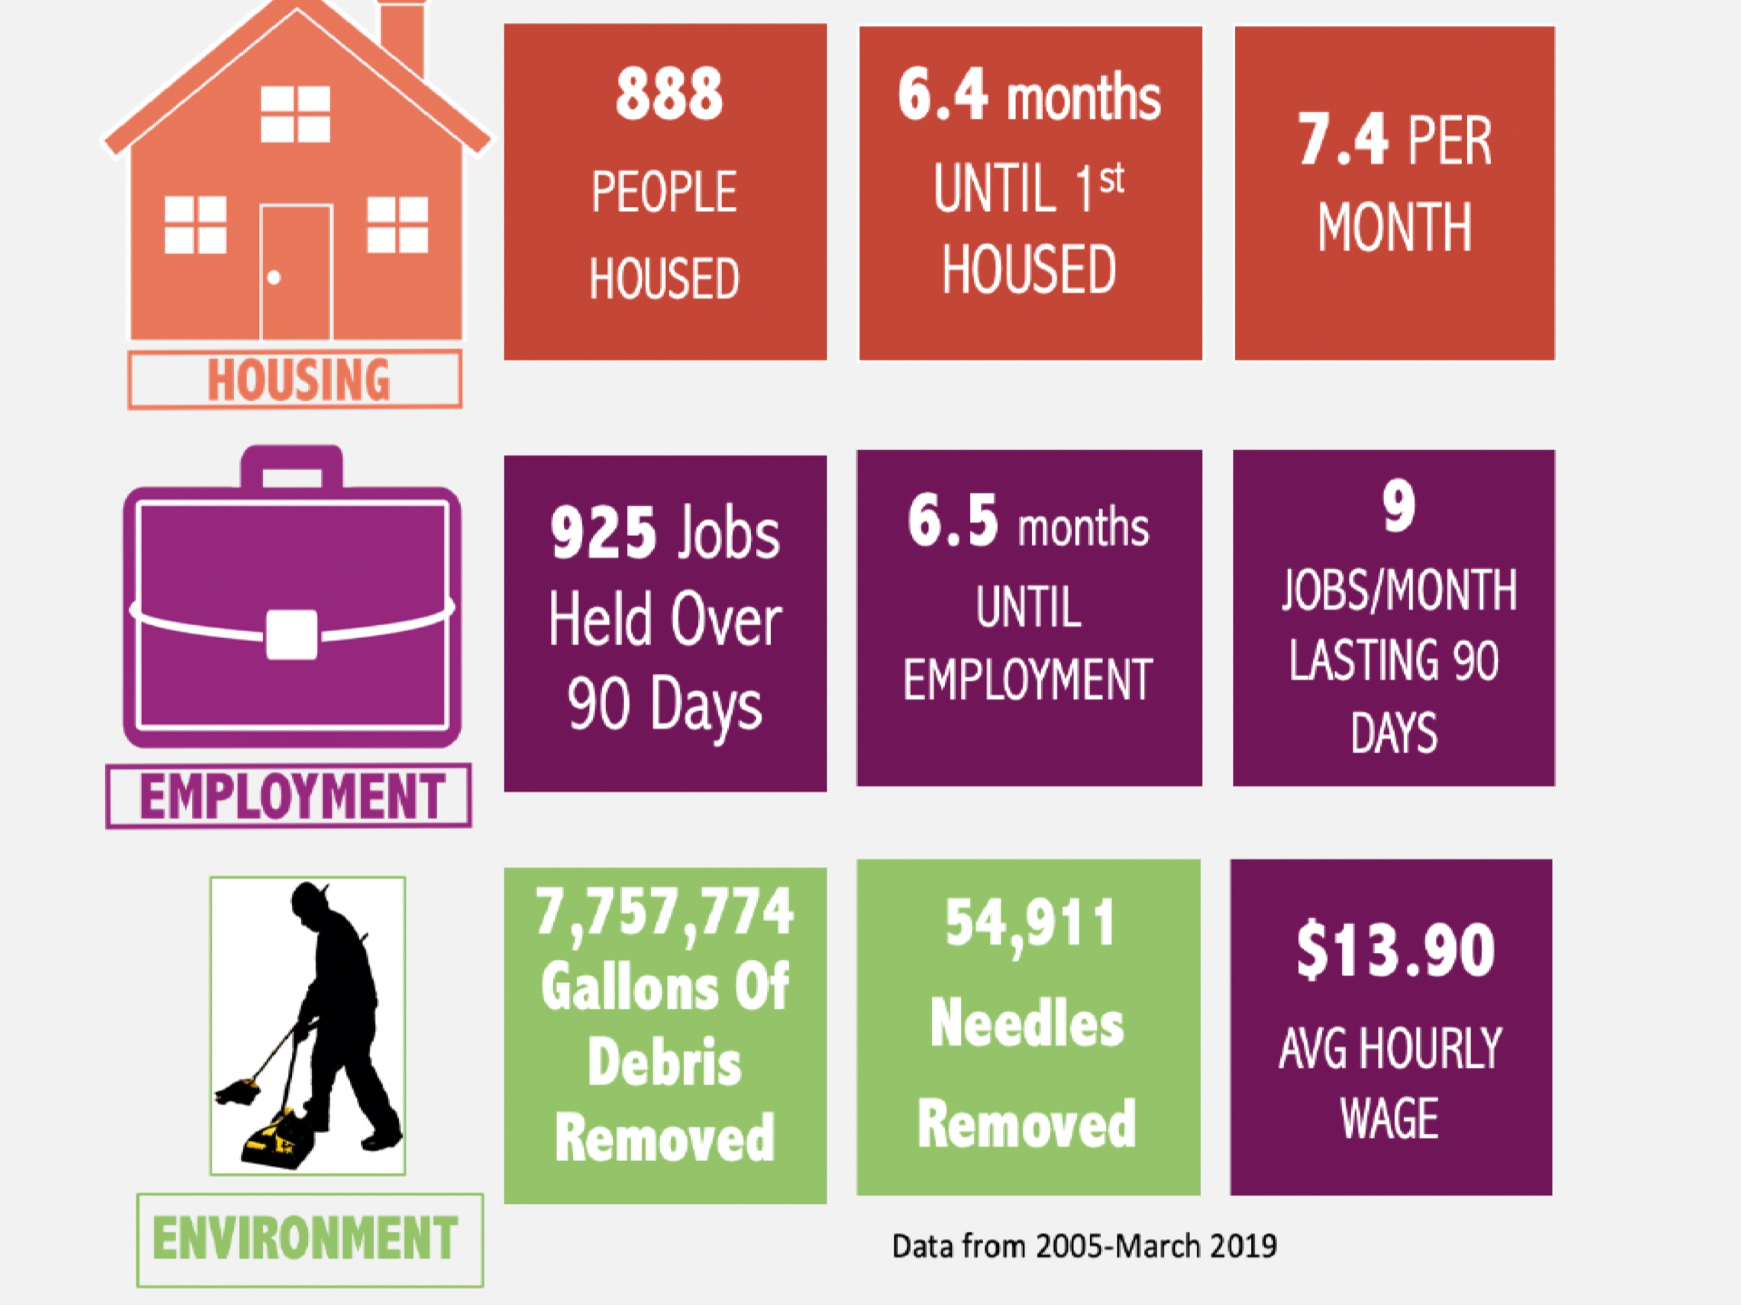





821 4.34 months _{10 PER}
_{PEOPLE} UNTIL 1st _{MONTH}
_{HOUSED} HOUSED
755 Jobs 6.51 months ⁸
84.9% _{Held Over UNTIL 90 DAY} JOBS/MONTH
Retention
^{Rate} _{90 Days} EMPLOYMENT ^{LASTING 90}
DAYS
5,265,225 1,895,491
Gallons Of CIGARETTE ^{$13.11}
ENVIRONMENT Debris BUTTS ^{AVG HOURLY}
Removed UPCYCLED ^{WAGE}
ENDING HOMELESSNESS THROUGH THE DIGNITY OF WORK

Slide 15
A case study
- San Jose, 2013 – Cleanups with the City
were super expensive.
The Jungle was the largest homeless encampment
some say in the U.S.
City was adversarial and didn’t have a path out
of homelessness for encampment residents.
City of San Jose sued by Bay Keepers.
City brought out Downtown Streets Team,
un-housed volunteers to help be part of the solution.

Slide 16
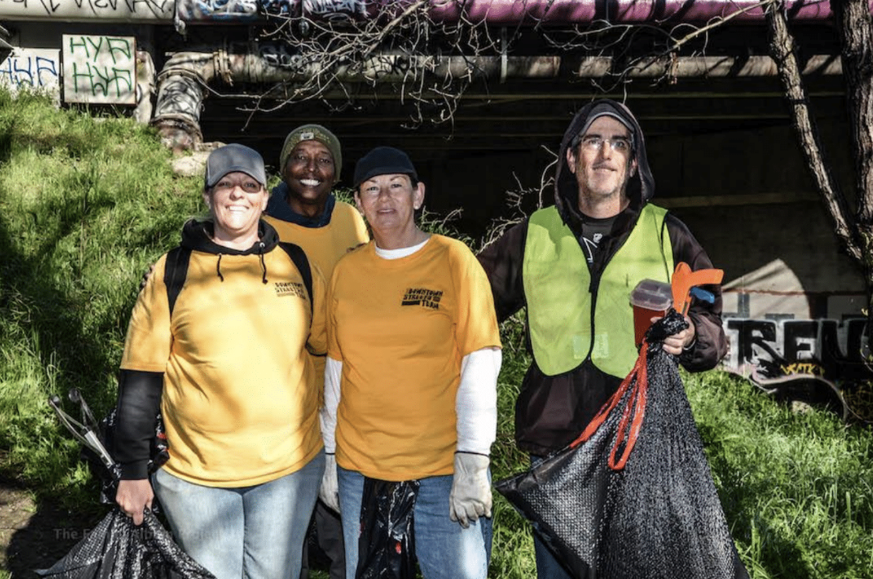
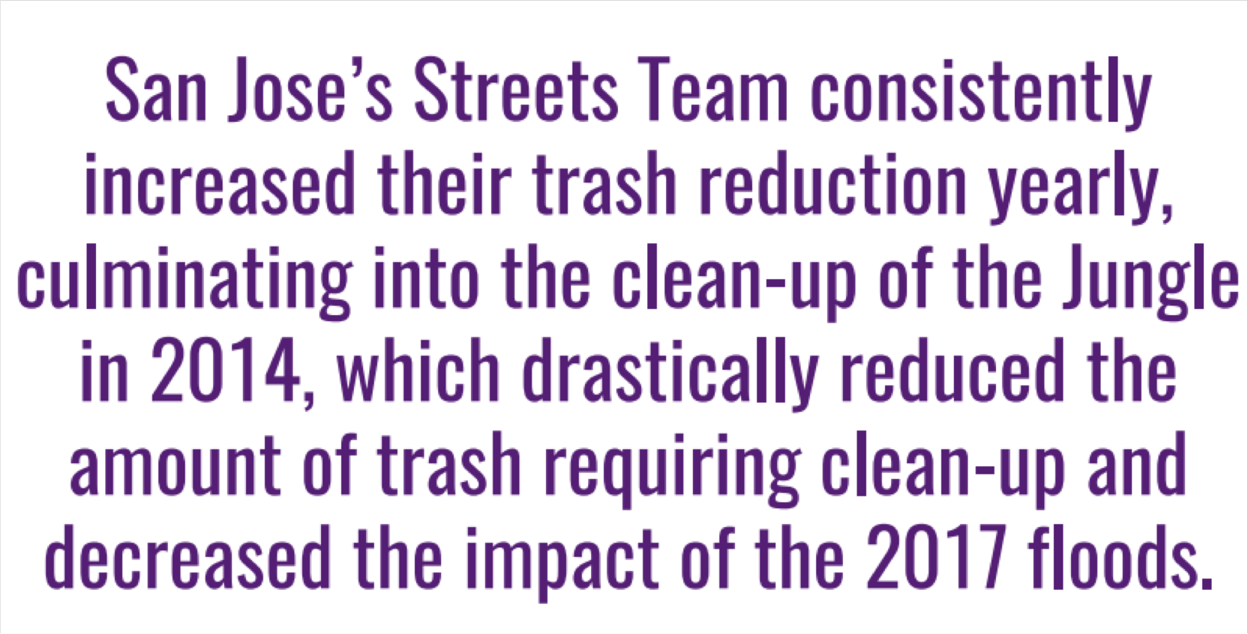

Slide 17
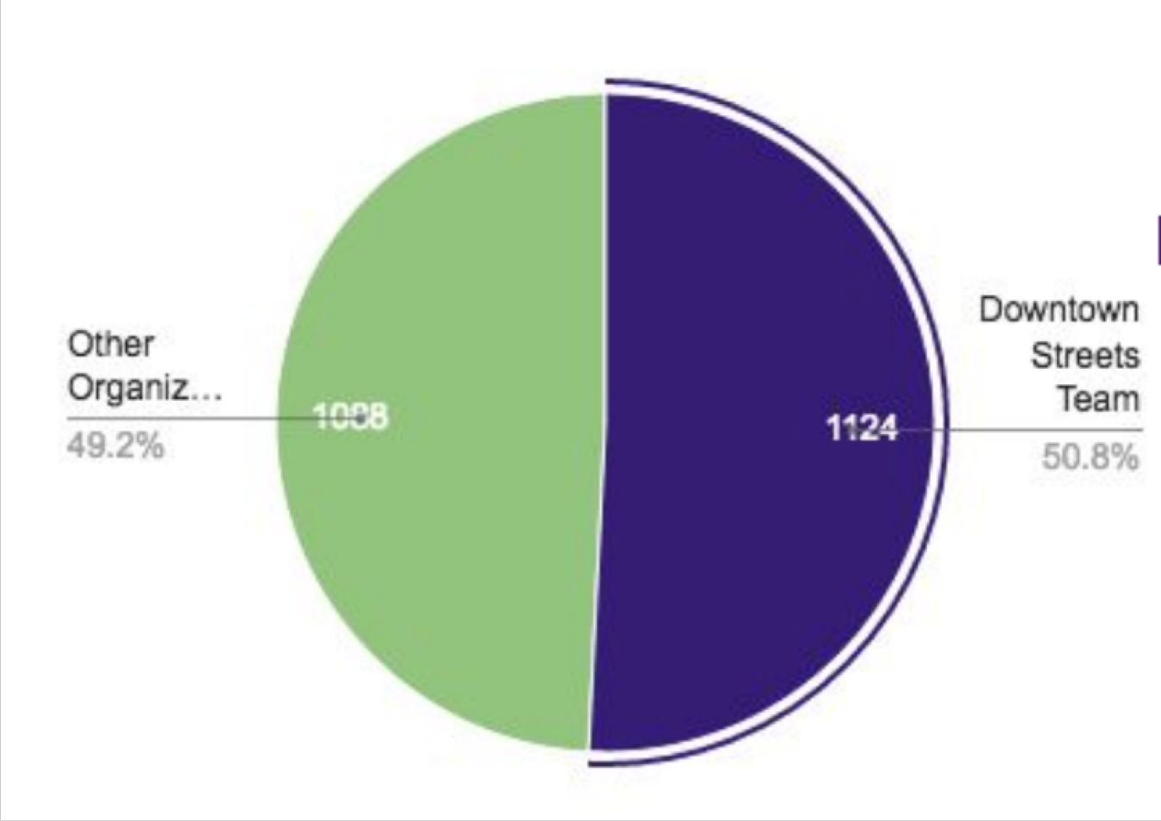
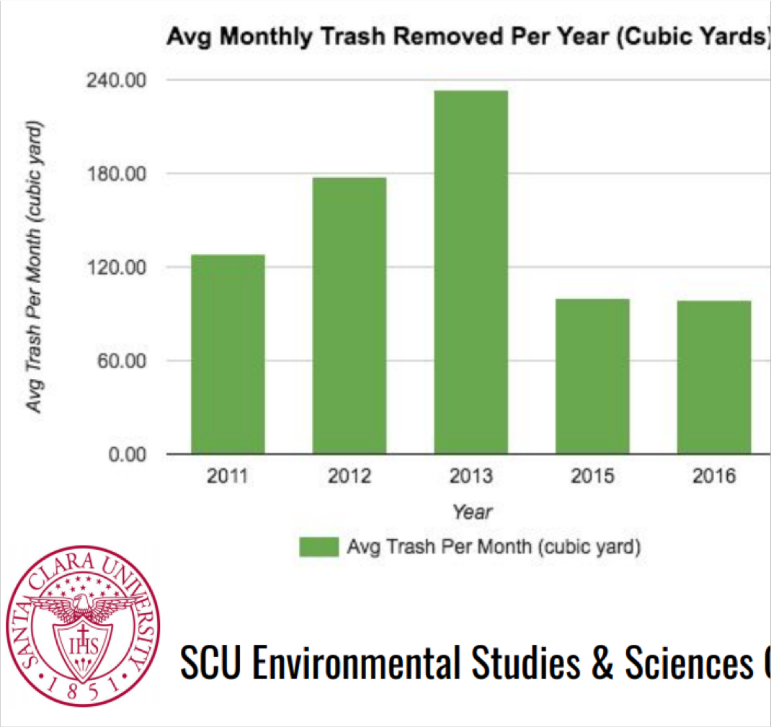
San Jose Environmental Success
as studied by Santa Clara University
SCU report (51% trash removed from waterways out of all volunteer groups city-wide)
4 hours/day 5 days/week

Slide 18

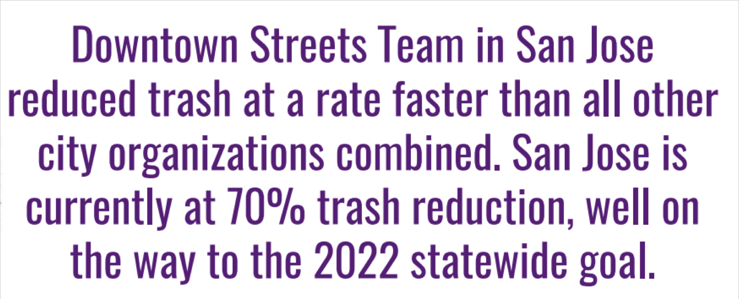

Slide 19
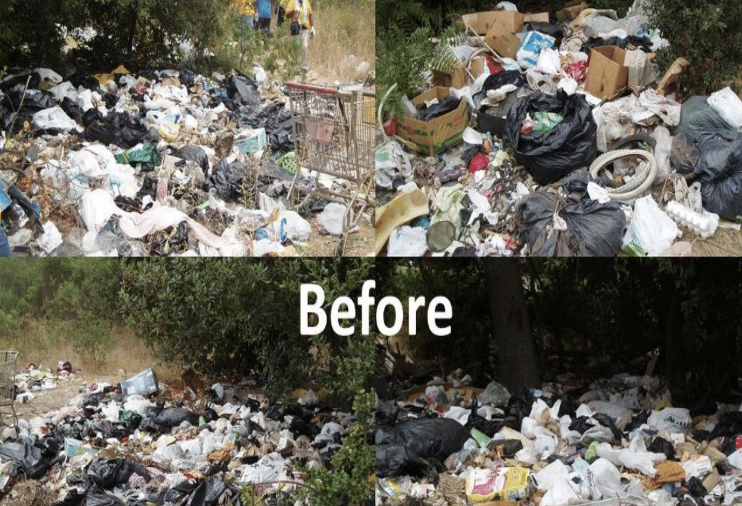

Slide 20
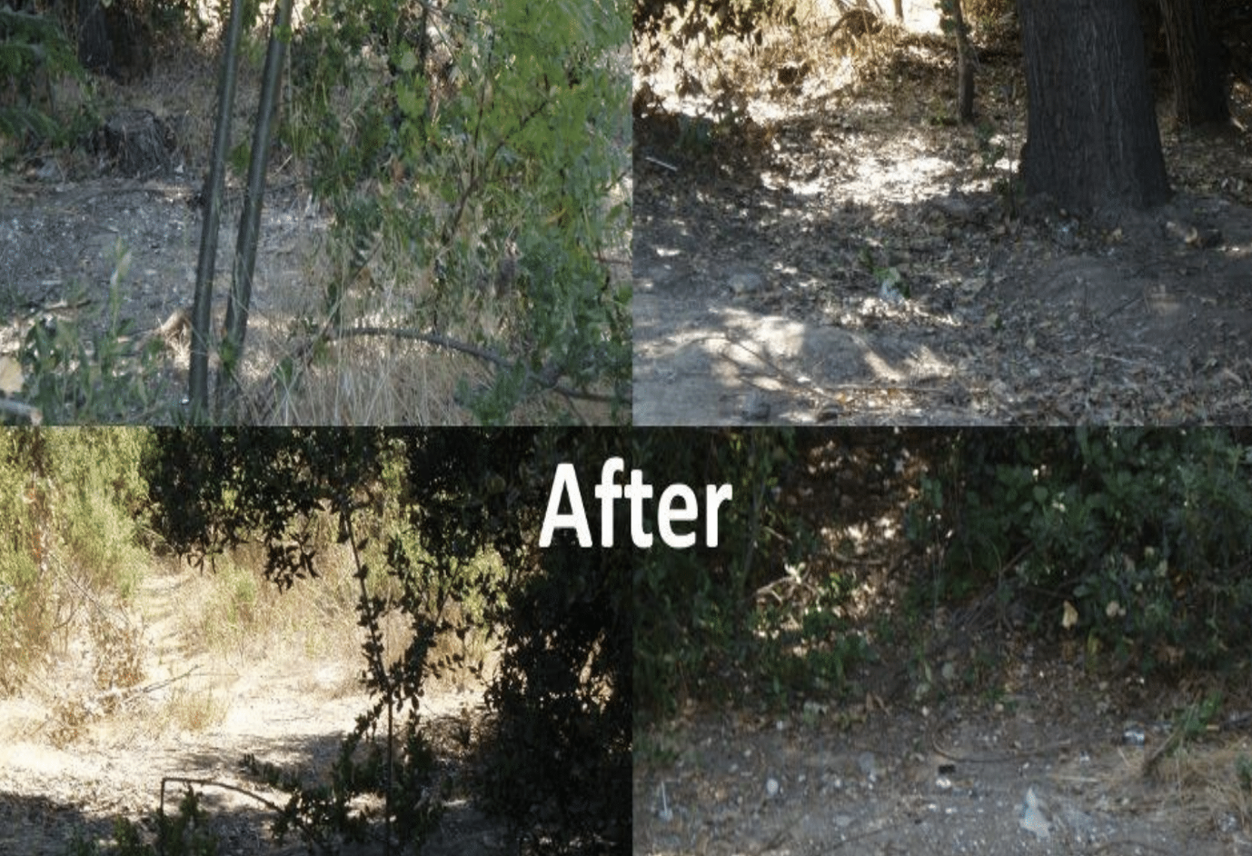

Slide 21
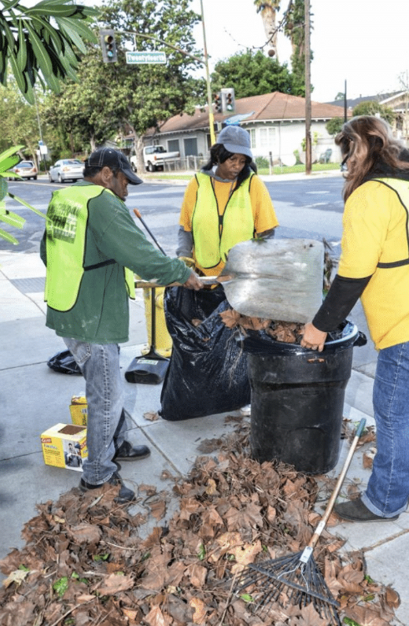
Other examples
Hayward part of 2022 zero waste initiative
Salinas - city recommends to
utilize Downtown Streets Team
for zero waste initiatives

Slide 22





Slide 23
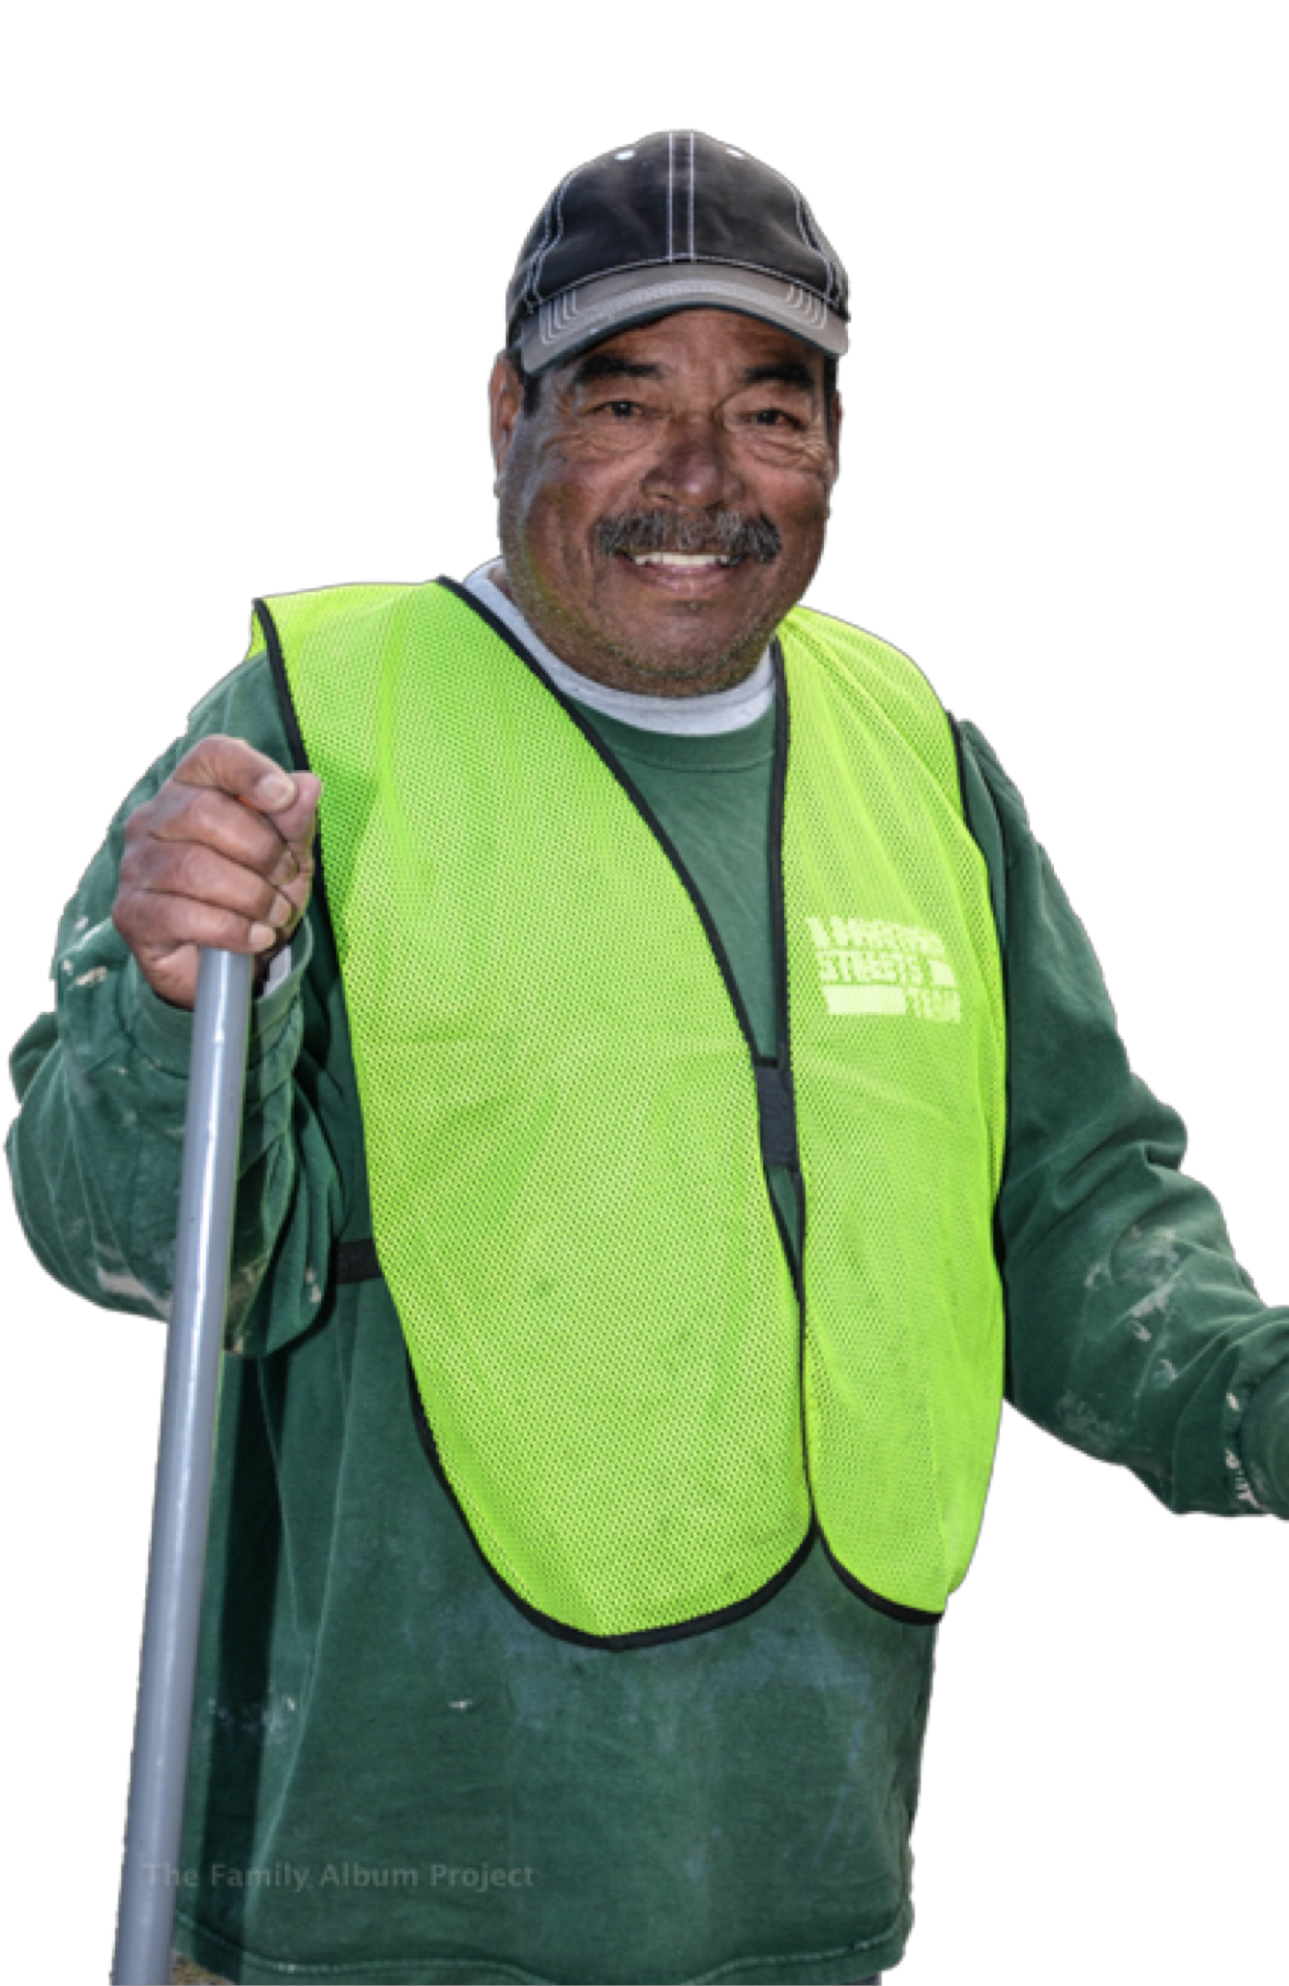
Community Benefits
Un-housed community reach higher self-sufficiency
Environmental impact
Cleaner Streets
Cost effective solution
Immediate results
Addresses behavioral issues
Highly Visible Action
  Attitude shift amongst residents
  Changes perception

Slide 24

Funding Sources
Environmental Agencies
  Water Districts
  Environmental Services Departments
  EPA
Corporations
  Gateways program
  Google
Foundations and grants
CDBG
– Economic Development
Public Works/Parks and Recreation
Business Improvement Districts/PBIDs
Healthcare Foundations
Events, donors, crowd funding
General funds

Slide 25

Join the DST Community and checkout a Team Meeting
www.streetsteam.org
Provide employment opportunities to Team Members.
Share this opportunity with a local un-housed person.

Slide 26

Connect
Zama Dlamini – Oakland Project Manager
zama@StreetsTeam.org

