Slide 1
Bay Area Watershed Network
May 3, 2019
Mitch Avalon

Slide 2
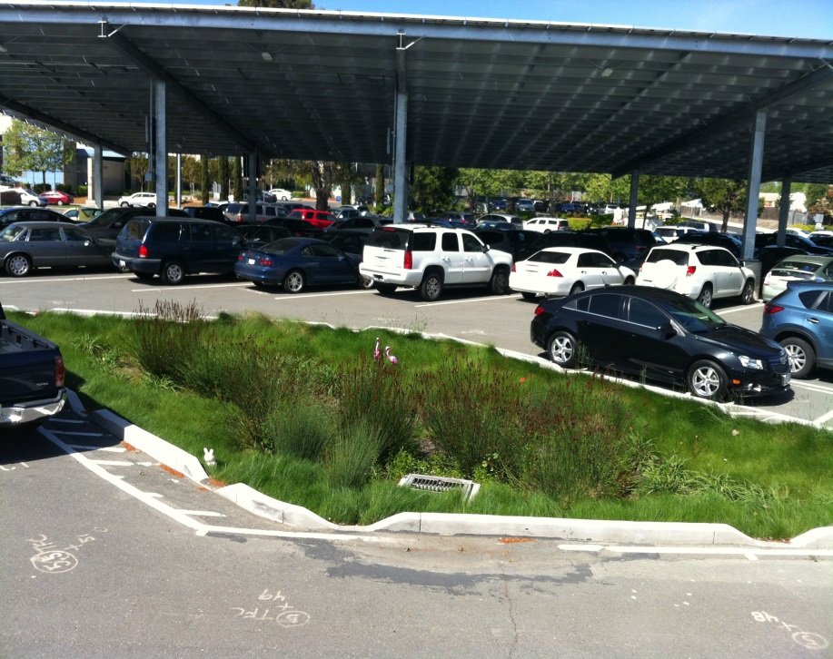
Stormwater Funding: Terminology
Stormwater is:
  Stormwater quality (pollutant reduction)
  Stormwater quantity (flood waters)
Resiliency relates to:
  Rising sea levels
  Increased storm surge
  More intense rainfall

Slide 3
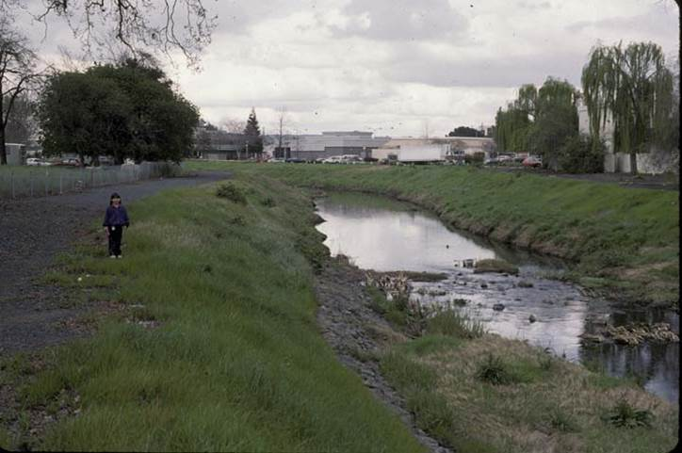
The Problem (by the numbers)
$1 billion in flood protection asset value
$2.4 billion in capital replacement costs
$5 million (this year) pollution reduction program costs
$1.2 million shortfall (this year)
Pollution reduction program costs increase each year

Slide 4
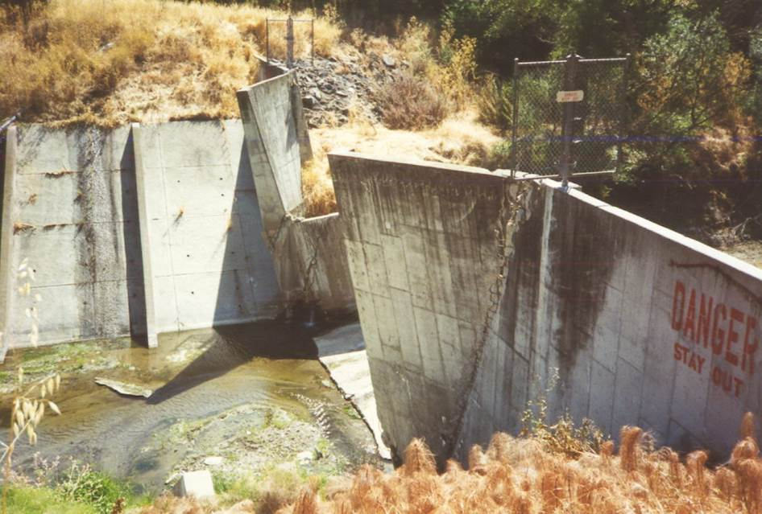
The Problem (stormwater perspective)
Rises to public conscious infrequently
Underfunded, underappreciated, undervalued
Not viewed as a benefit to upland dwellers
Out of sight, out of mind applies here
No customer/service relationship

Slide 5
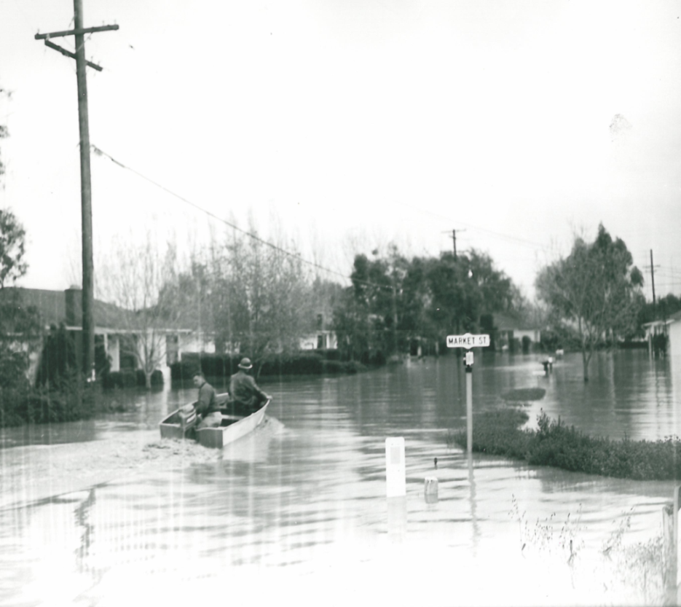
Overarching Problem
Storm drainage inventory not fully known
Stormwater infrastructure not considered until project stage
Understanding stormwater infrastructure needs is critical for resiliency

Slide 6
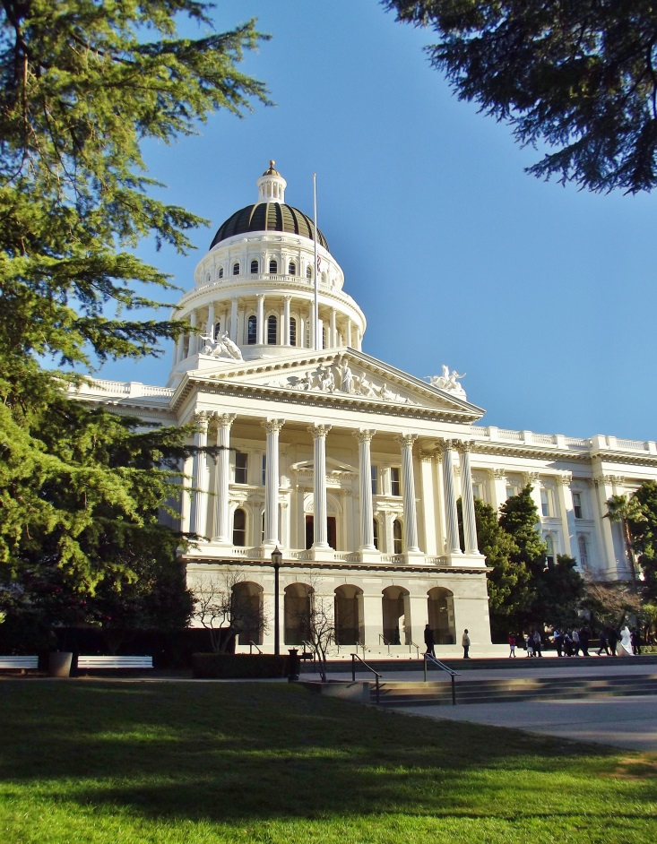
Legislative Proposal
Integrate stormwater infrastructure needs into the regional transportation planning process, along with land-use and housing needs.
  Stormwater infrastructure includes flood protection facilities and stormwater treatment facilities

Slide 7
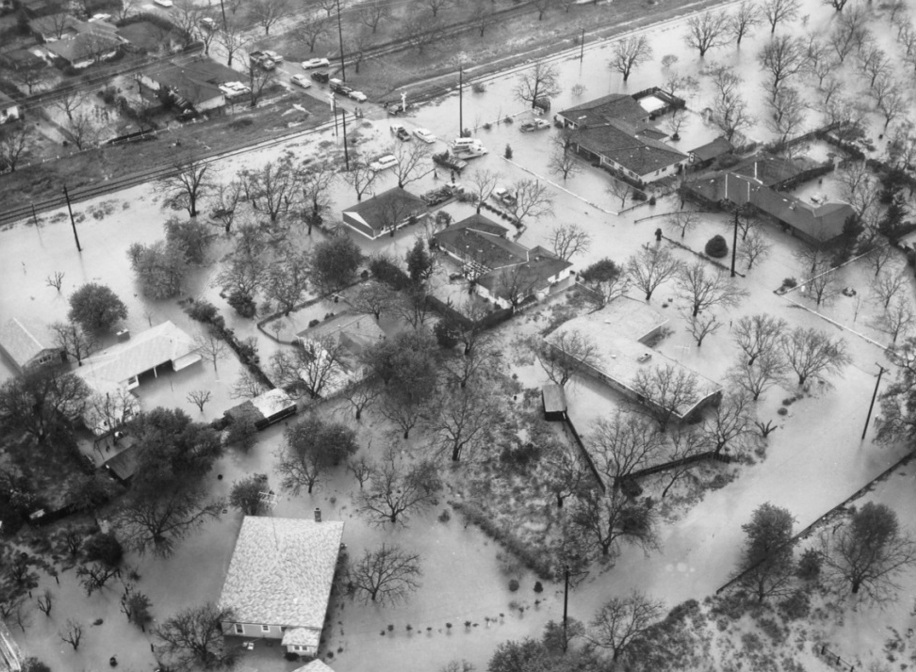
Stormwater Planning Activities
Green Infrastructure Plan
  Resiliency Planning
  Storm Water Resource Plan
  Flood Control District CIP
  Integrated Regional Water Management
  Pollutant Attainment Planning (TMDL)

Slide 8

Transportation Planning Activities
Regional Transportation Plan
  Sustainable Communities Strategy (Plan Bay Area)
  Integrates regional land-use and housing needs
  Updated every 4 to 5 years
  Stormwater infrastructure needs are not included
  Resiliency will be included in the next cycle

Slide 9
What does Integration Mean?
Gather stormwater quality and quantity information, data gaps, plan to fill gaps
Identify impacts on stormwater and identify mitigation measures
Determine future impact of floodwaters due to a changing climate
Not a grab of transportation dollars, but should help leverage stormwater funding

Slide 10
Benefits of Integration
More cost-effective mitigation for transportation projects
Development of robust Alternative Compliance program
Protecting transportation investment from climate change impacts
Potential groundwater recharge co-benefit
Development of better stormwater infrastructure inventory

Slide 11
Proposed Stormwater Legislation:
Next Steps
Work with MTC to develop implementation details
Go through the Plan Bay Area process
Include in the California State Association of Counties legislative program (next year)

Slide 12
Watershed Day at the Capitol
Sponsored by the California Watershed Network
Annual event to network and meet with legislators
Usually occurs in April
Morning session with speakers
Afternoon meetings with legislators
Opportunity to educate legislators and advocate for our collective needs

Slide 13
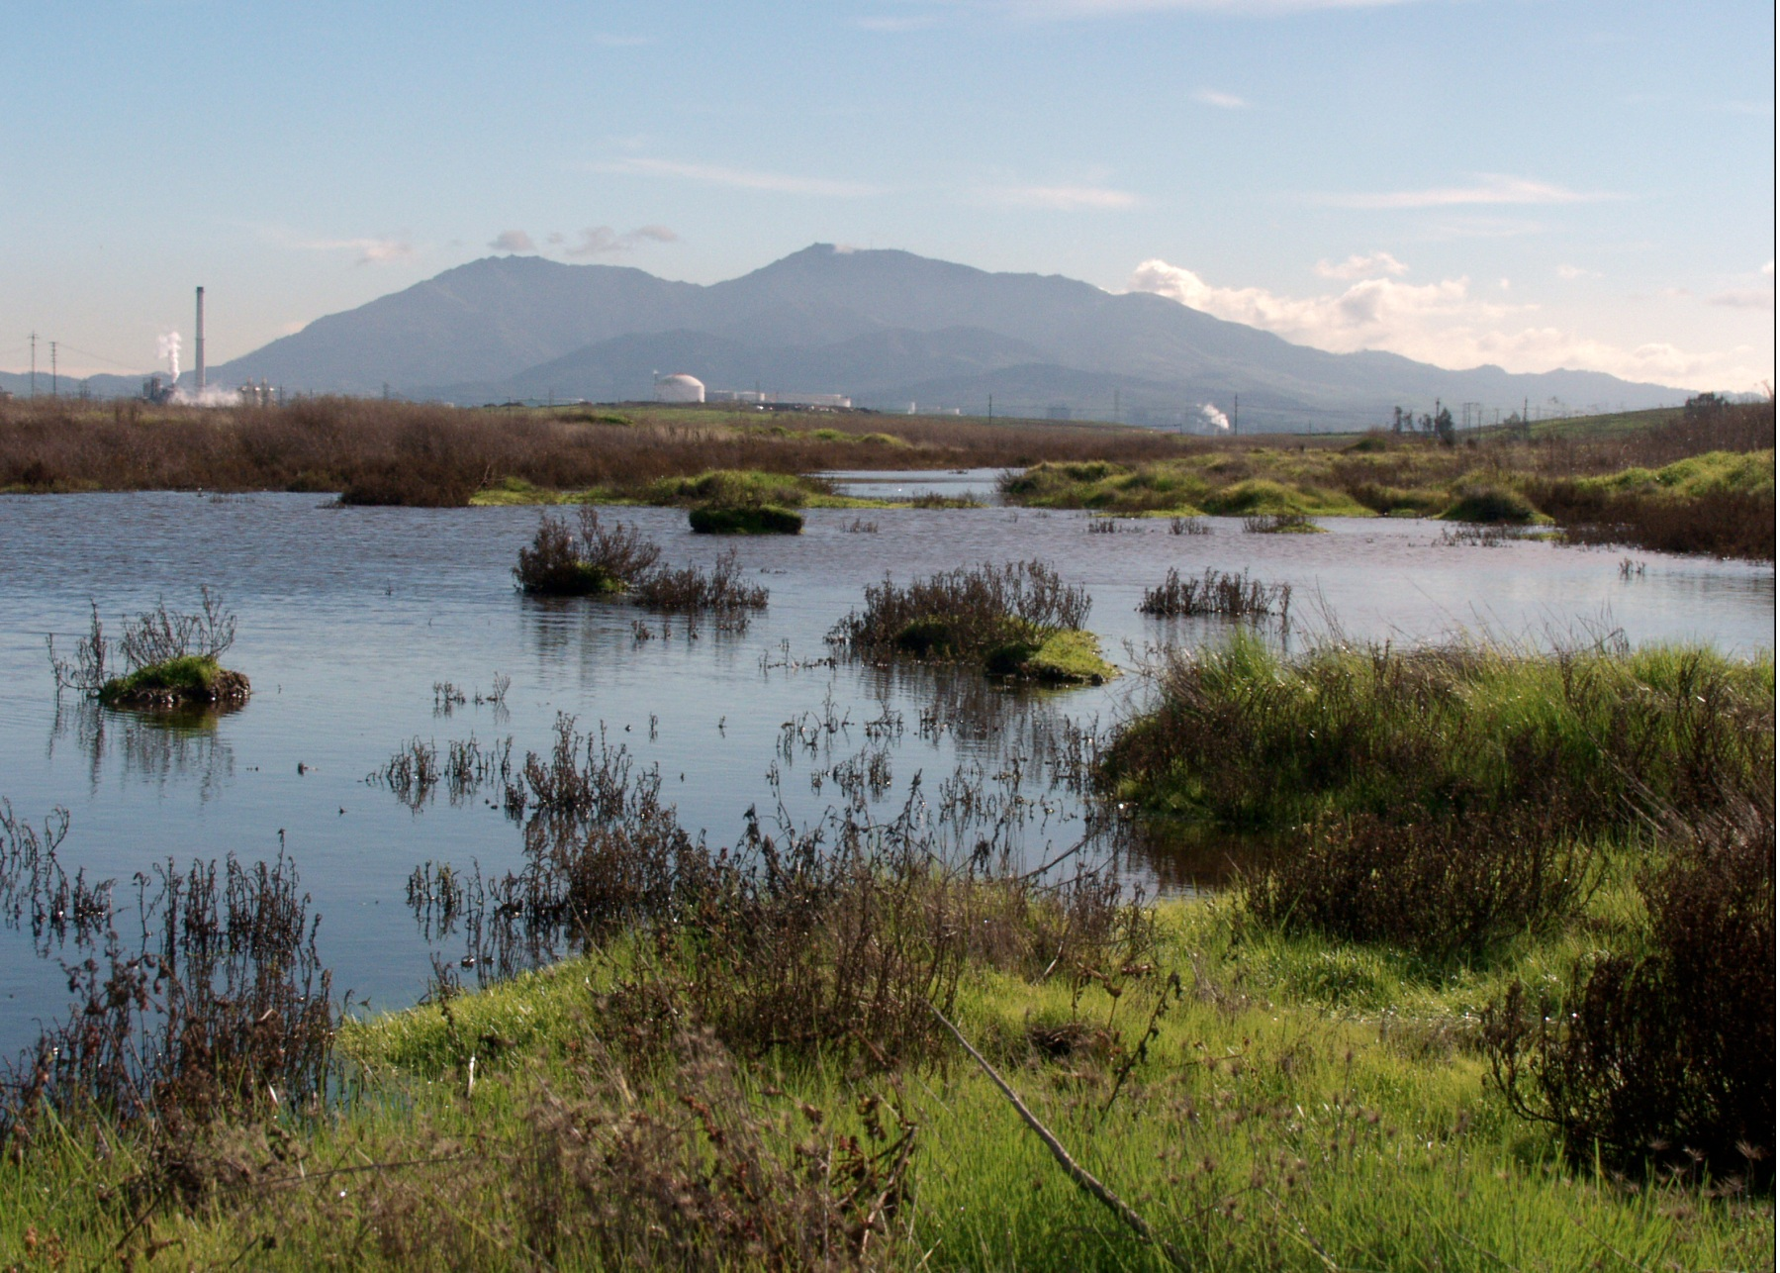

Questions?

