Slide 1
GreenPlan Bay Area
Kick Off Meeting
9/19/13, 2-4pm
Elihu Harris Building, Oakland, CA

Slide 2
Agenda
Welcomes 2pm
Introduction of Project 2:15
Roles for Cities 2:25
Discussion / Q & A 2:35
Overview of GreenPlan-It 3:00
Initial Thoughts on Data / Discussion 3:20
Next Steps 3:45

Slide 3
Welcome 2-2:15
Jennifer Krebs
Greetings from SFEP
Go around room
Sign-in sheet (needed for State Board)

Slide 4
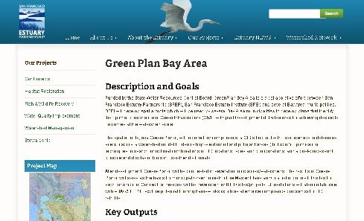
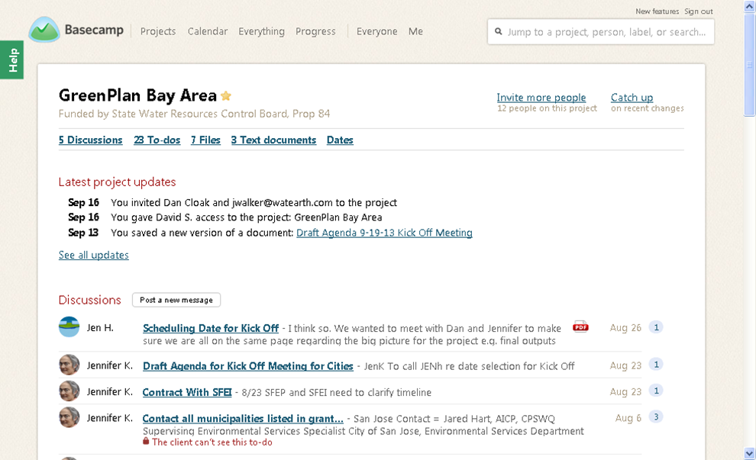
Introduction of Project 2:15-2:25
Jennifer Krebs
Project Team: SFEP, SFEI, Dan Cloak, Jennifer Walker
Web Page http://www.sfestuary.org/greenplanning
Basecamp
Project Schedule
Project Outcomes
Purpose of Meeting
Jesse Mills

Slide 5
Roles for Municipalities 2:25 – 2:35
Jennifer Krebs
TAC Members
“Master Planning” Agency
Interested Party

Slide 6
Discussion / Q&A 2:35 – 3:00
Jennifer Krebs
Municipalities current efforts that dovetail with Green Infrastructure Master Planning?
How do you think the Plans can benefit your municipality?
How do you think an alternative compliance program can benefit your municipality?
Questions?

Slide 7
Overview of Green Plan-It
Lester McKee SFEI
3:00-3:20
In a given watershed…
What quantitative water quality and hydrological improvements can be made with Low Impact Development?
What is the optimal plan?
With LID, can we improve upon the cost/benefit of grey infrastructure alone?

Slide 8
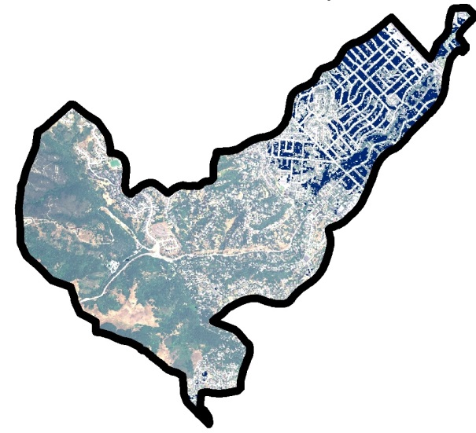
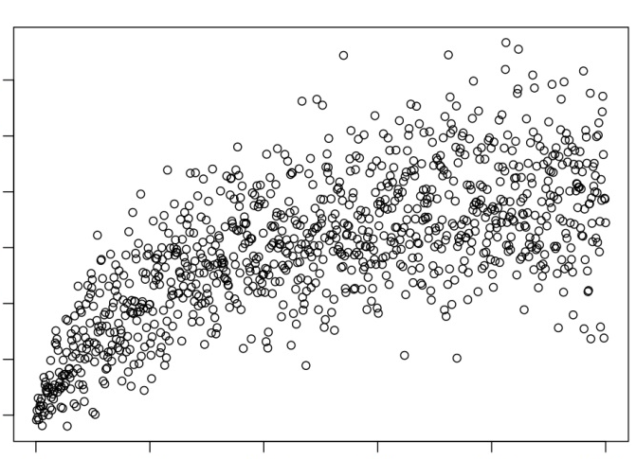
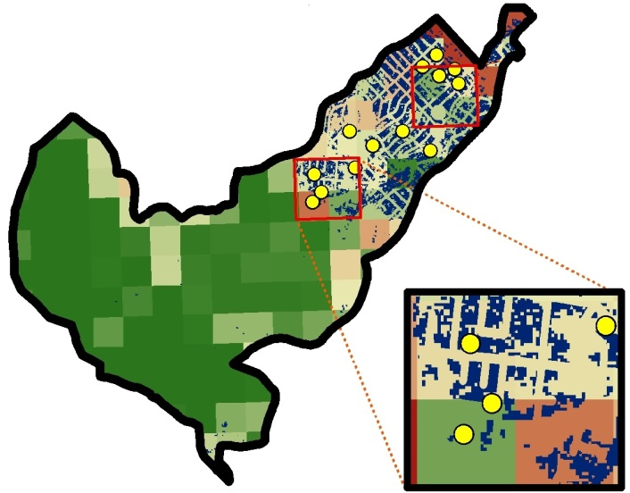
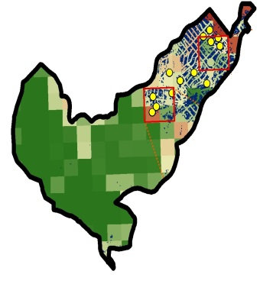
Critical Areas Tool
GreenPlan-it
toolbox
GIS Siting Tool
Improvement vs. Cost
Target
Improvement
LID (+ Grey)
Grey Infrastructure
Cost
Feasible & Effective
Optimization Tool
Maximize benefit
Minimize cost
Master Plan

Slide 9
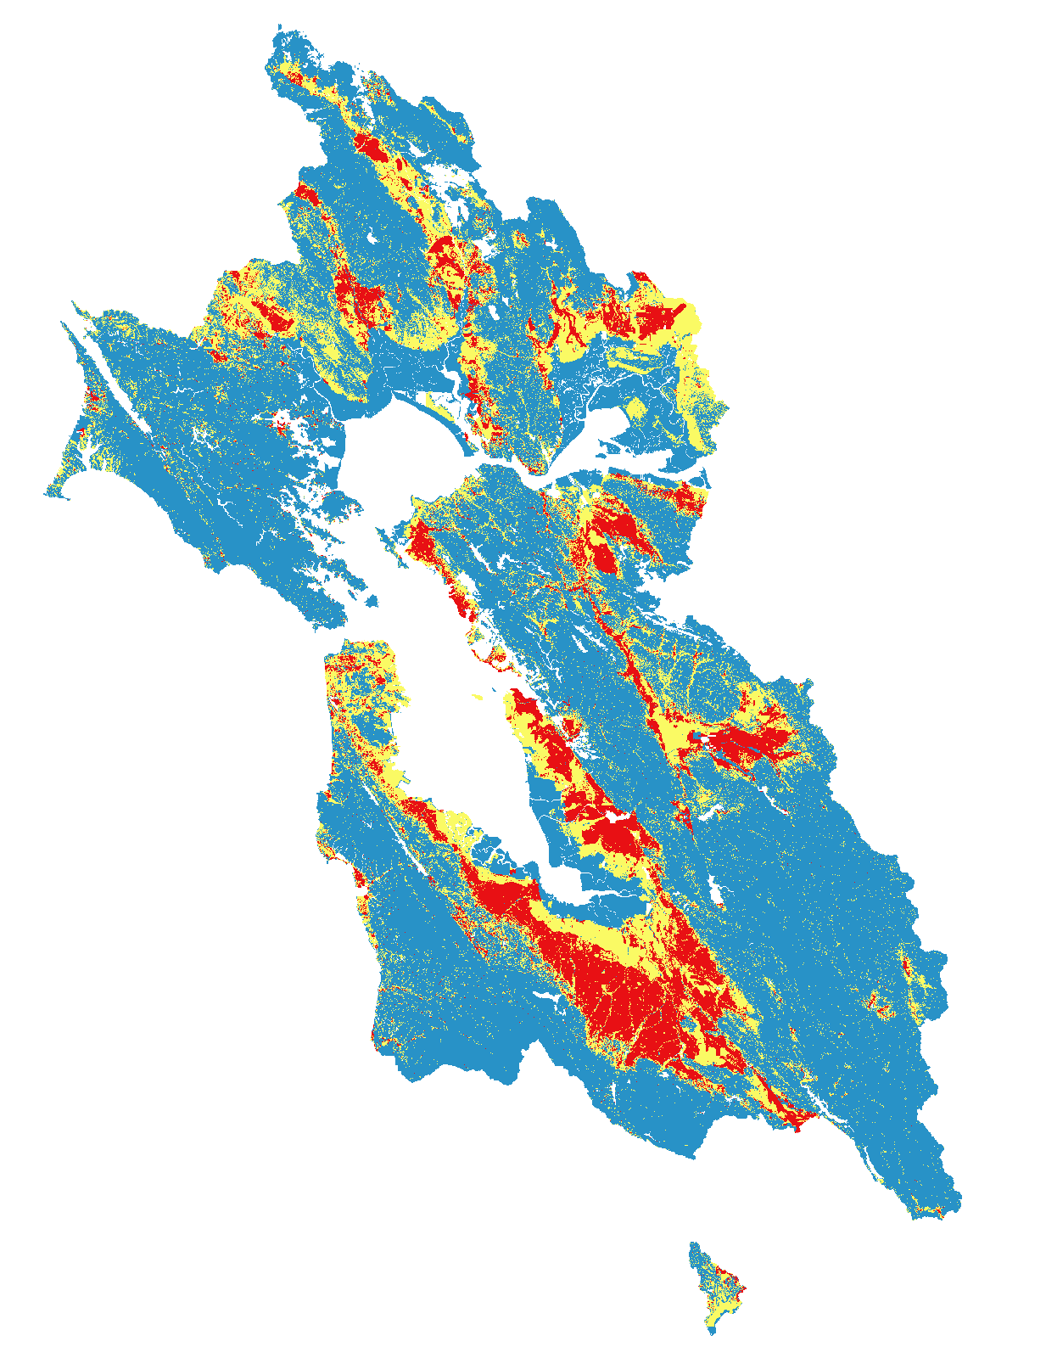
GIS Siting Tool
Regional LID Site Suitability Tool
SFEI (2012)
High
Use local + regional GIS layers to identify feasible sites
Infrastructure
Private vs. public land
Redevelopment plans
Capital improvement plans
Low

Slide 10
Critical Areas Tool
Simulate watershed processes
Identify critical sources areas
Flow
Contaminants
Overlay area-specific considerations
Areas of known flooding

Slide 11
GIS Siting Tool
Critical Areas Tool
Combination = Initial for optimization
e.g., 1000 possible locations
Field verification
Feasible & Effective

Slide 12
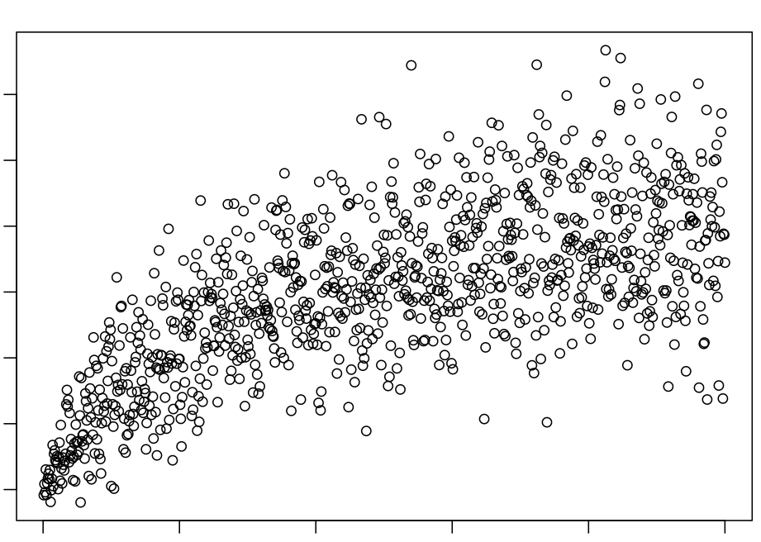
Target
e.g. Peak flow reduction
cost
Feasible & Effective
Optimization Tool
Maximize benefit
Minimize cost
Master Plan

Slide 13
Target
e.g. Peak flow reduction
Grey Infrastructure
cost
Feasible & Effective
Optimization Tool
Maximize benefit
Minimize cost
Master Plan

Slide 14
Multiple simulations
Quantify potential effectiveness
Balance benefit and cost
LID + Grey Infrastructure
Target
e.g. Peak flow reduction
LID (+ Grey)
Grey Infrastructure
cost
Feasible & Effective
Optimization Tool
Maximize benefit
Minimize cost
Master Plan

Slide 15
Multiple simulations
Quantify potential effectiveness
Balance benefit and cost
LID + Grey Infrastructure
Target
e.g. Peak flow reduction
LID (+ Grey)
Grey Infrastructure
cost
Feasible & Effective
Optimization Tool
Maximize benefit
Minimize cost
Master Plan

Slide 16
Critical Areas Tool
GreenPlan-it
toolbox
GIS Siting Tool
Improvement vs. Cost
Target
Improvement
LID (+ Grey)
Grey Infrastructure
Cost
Feasible & Effective
Optimization Tool
Maximize benefit
Minimize cost
Master Plan

Slide 17
Discussion Questions
What output would be most useful?
How could this project/toolkit best integrate with near-term and longer-term planning processes?

Slide 18
Local Data Needed for Toolkit
Topography – ~1ft vertical resoluton (LiDAR)
Land cover - ownership, parcels, roads
Hydrology - storm drainage network, depth to groundwater, flow
Water Quality Monitoring
Imagery – current (2010 or later) high resolution (<1 ft) aerial photography
Catchment Delineations - <HUC12
Additional data - any other partner-specific data themes or locations to be included in analysis of LID implementation, e.g., red curbs, right of ways, public parks, etc.
Meteorology – precipitation, temperature
Diversion - any water uses that divert water from the stream/watershed (locations and amounts)
Existing LID information - Location, type, remove efficiency, design capacity, any post-implementation monitoring data
Existing Stormwater Models
Local cost information on various types of LID - capital, operation and maintenance

Slide 19
Questions on Data 3:20-3:45 Kristen Cayce
Input:
What local data sets do cities have?
Who might we contact to acquire data?
Output:
What type of format of outputs that works best for cities? (map, list....)

Slide 20
Next Steps 3:45 – 3:55
Jennifer Krebs
Memo to Munis re data availability, interest in X role in project, reflections on this meeting (regarding project goals, etc.) – 9/25/13 – SFEP
Due date for response to memo – 10/15/13 - Municipalities
Selection of munis for various roles - 11/1/13 - SFEP
Memo to selected munis on data collection next steps (11/1/13), and follow up communications as needed on how to collect data (data due 12/13)

