Slide 1
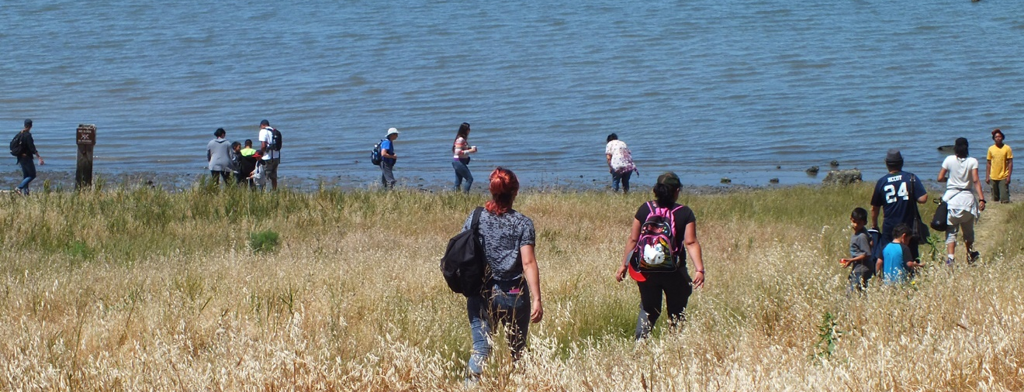
The North Richmond Shoreline
Community Visioning Results
The Watershed Project
Juliana Gonzalez and Jesse Brown
Notes:
Hello, I’m Jesse Brown and this is Juliana, we’re from the watershed project, and we’re going to pick up where we left off from the last presentation I did with this group
Back in June I talked about the beginning of this community visioning project
Since then we’ve been busy surveying out in North Richmond
And today we have more conclusive survey results that we will share with you

Slide 2
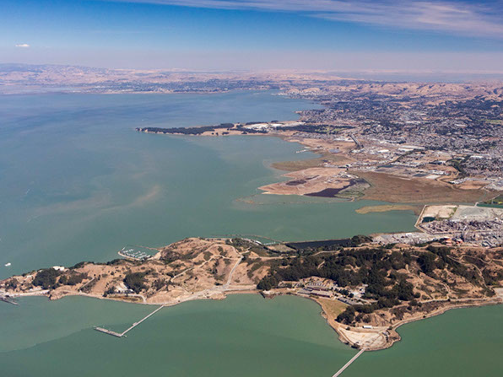
Overview
Review Project
Events
Findings
Recommendations
Notes:
So we’re going to first just review some of the project and survey basics
We’ll talk about where we’ve been with the survey
Then we’ll get into the findings and some recommendations

Slide 3
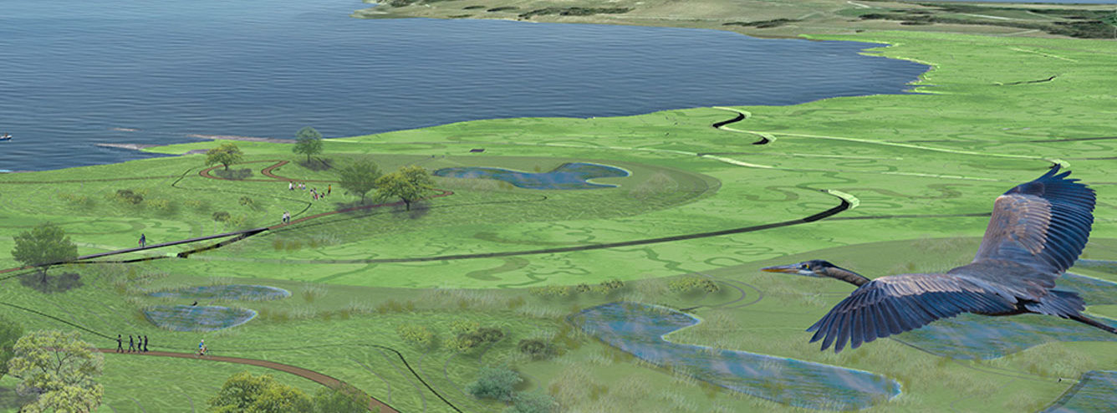
Visions of the Shoreline
Notes:
There have been visions of the shoreline
I’m sure you all even have your own
Here in this photo we have one of Dotson Family March
But for this project, we were interested in what the community, the people in the closest proximity the most effected by the shoreline – how they imagine this place should be

Slide 4
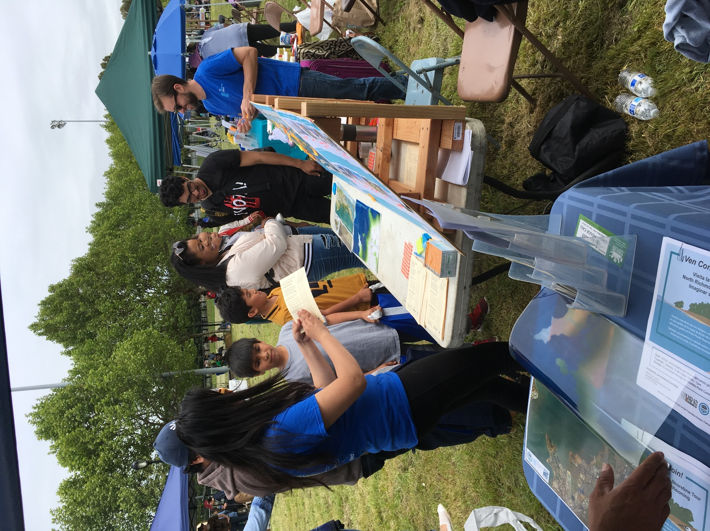
Goals
Gather North Richmond community input about the shoreline
On the shoreline…
What do people currently do?
Want do they want?
What are their concerns?
Notes:
And so, back in February we partnered with the San Francisco Estuary Partnership and SFEI to go out into the North Richmond Community and ask them about the shoreline
The best way we talk we should ask was
What do people currently the shoreline for
What do they want in the future
What are their concerns for on or near the shoreline

Slide 5
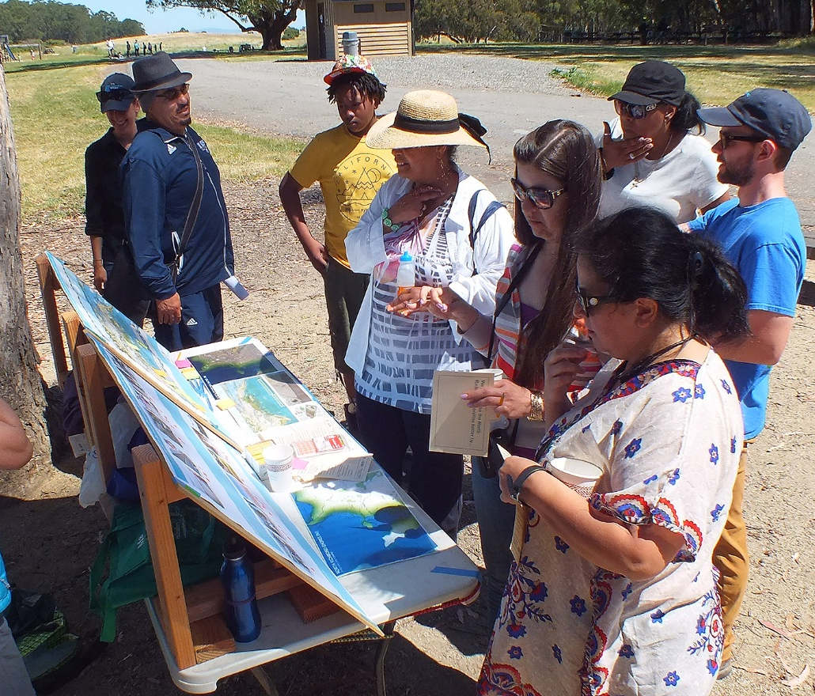
Notes:
Here we are out with our survey with a group of residents
And as a reminder – what your looking at here is two visual surveys, and we have a smaller written survey too

Slide 6
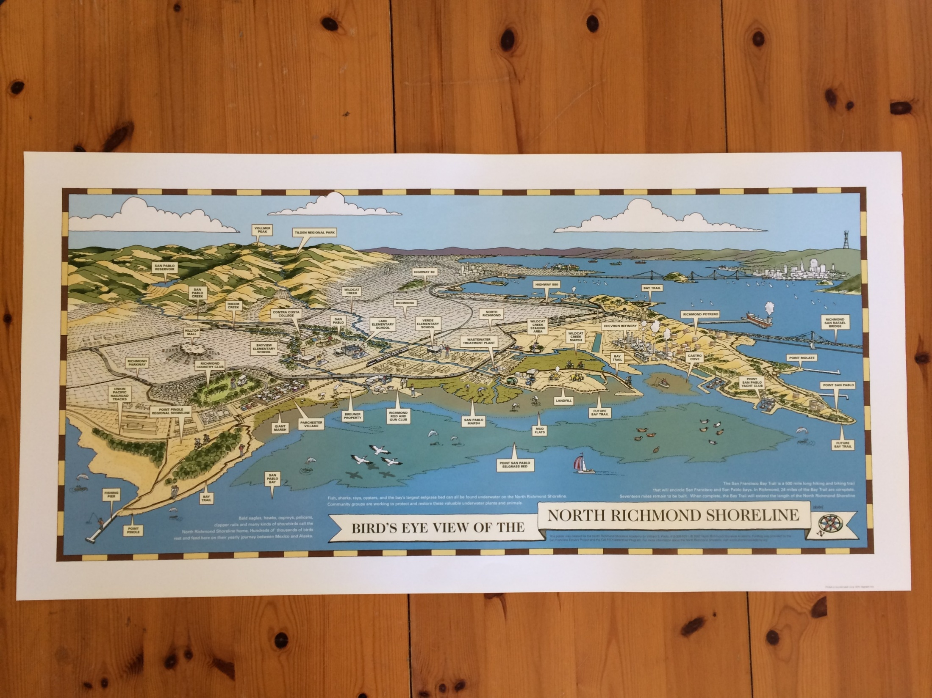
What do you do on the shoreline?
Notes:
One of the visual surveys – asking what do you do on the shoreline

Slide 7
What do you do on the shoreline?
Notes:
The What Do You Do Survey attempted to gather information on the current residential uses of the North Richmond Shoreline. Participants were asked to write on a sticky-note any activities that they personally perform on the shoreline and to attach the note in the general area where they did them.

Slide 8
What you want on the shoreline?
Notes:
The survey featured a photo for each category and an empty space underneath where survey participants place a small orange stickers “to vote”. Each participant received three stickers and could place these stickers under any three different categories to indicate their preference.

Slide 9
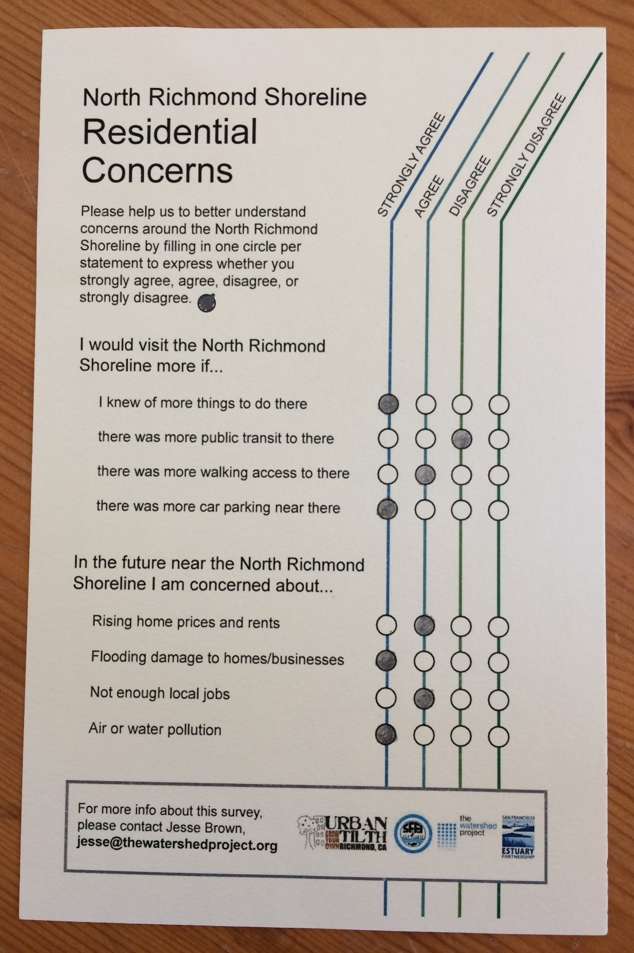
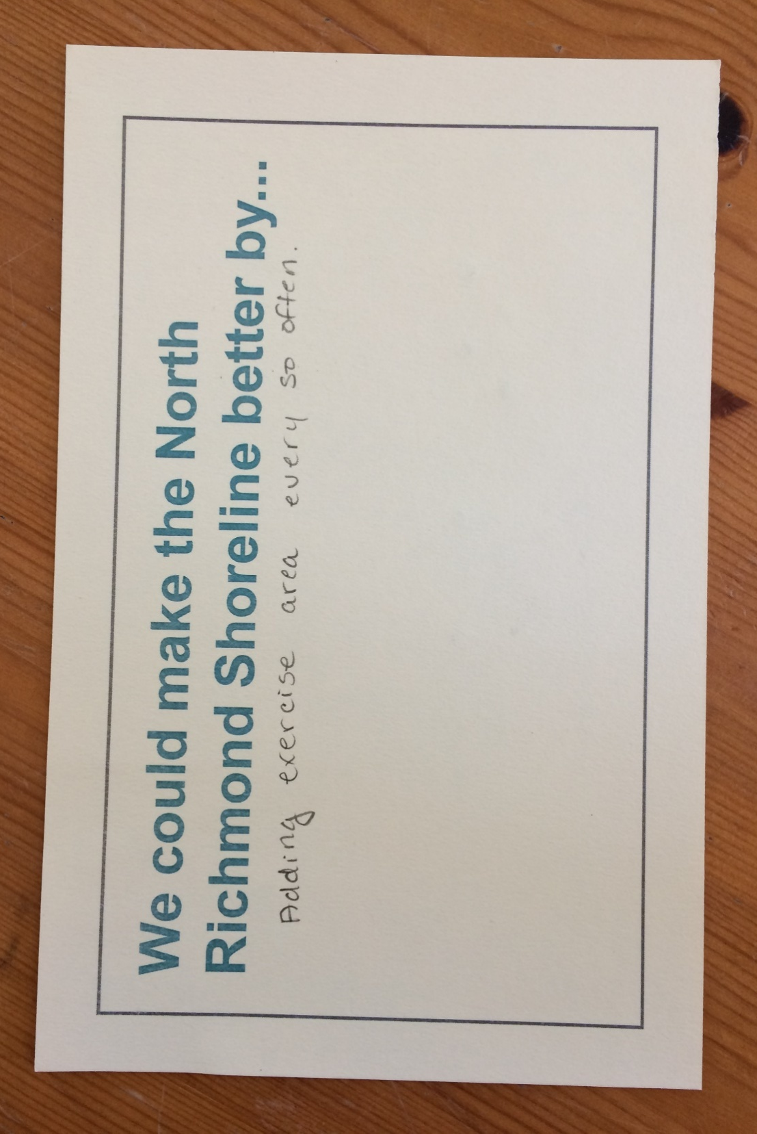
Notes:
The Concerns Survey included two short multiple choice sections. In both parts of the survey, participants were asked to indicated whether they strongly agree, agree, disagree, or strongly disagree to a list of statements. The first section provided statements concerning barriers to use of the shoreline. The goal of this section was to learn what may be preventing residents from currently using the shoreline. The second section included a brief set of statements related to either environmental justice or livability issues on or near the shoreline.

Slide 10
Events
Local Council Meetings
North Richmond Municipal Advisory Council
Parchester Village Neighborhood Council
Atchison Village Neighborhood Council
Community Events
North Richmond Green Festival
Dotson Marsh Opening
TWP Shoreline Tour
Hood Day
Urban Tilth Farm
Verde Elementary Parent Coffee Hour
Richmond High Environmental Club
Community Volunteer Events
Urban Tilth Creek Clean Up
Block Ambassadors
Surveyed 284 North Richmond Residents
Notes:
Where did we go?

Slide 11
What do you do on the shoreline?
Response Percentage
“Other” includes the following activities: volleyball, diving, ride horses, playground, gun range, dump trash, zumba, swim fishing

Slide 12
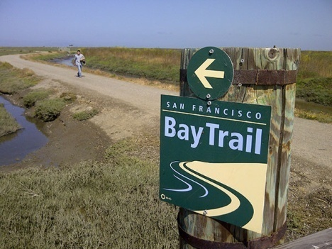
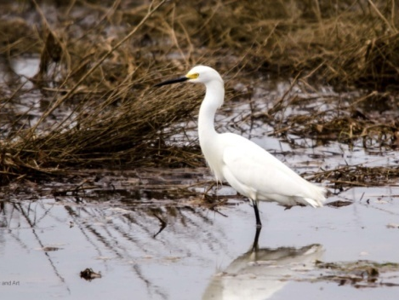
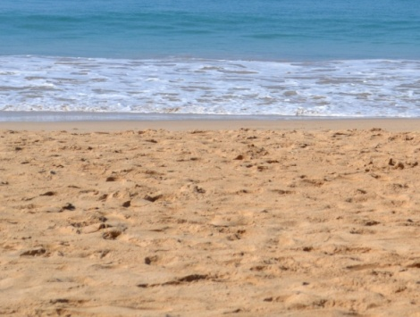
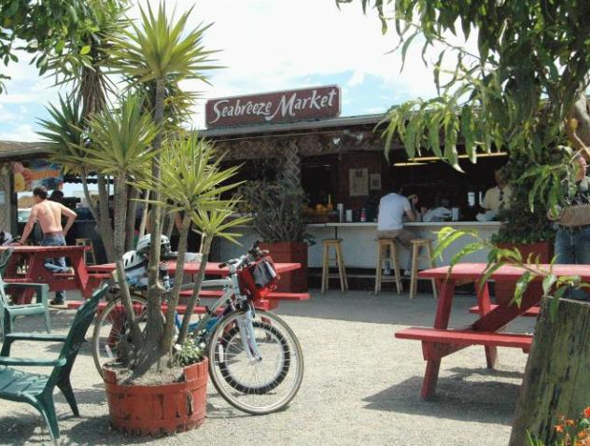
What you want on the shoreline?
Environmental Events
1. Hiking Trails (15%)
2. Wildlife (13%)
3. Sandy Beaches (11%)/ Environmental Ed (11%)
Community Events
1. Sandy Beaches (13%)
2. Children’s Play (11%)
3. Restaurants (10%)/ Fishing (10%)

Slide 13
What you want on the shoreline?
Totals
1. Sandy Beaches (13%)
2.Hiking Trails (11%)
3. Restaurants (10%)
4. Children’s Play (10%)
5. Wildlife (9%)

Slide 14
What are you concerns on shoreline?
I would visit the shoreline more if…
94% If I knew more things to do
90% Better walking access
66% Better public transportation access
66% More car parking
Notes:
First section on our survey – dealt visiting the shoreline
What are you concerns on or near the shoreline
Something we saw a little bit with our preliminary findings – but can be more confident here – is this figure 94%
Walking
And still a majority say better public trans and more car parking
What I think this shows -

Slide 15
What are you concerns on shoreline?
On the shoreline in the future I am concerned about…
90% Air or water pollution
85% Not enough local jobs
73% Flooding damage to homes/business
73% Rising home prices and rents
Notes:
Second part of survey – more about concerns and environmental justice issues
90% about pollution – I mentioned in my last presentation – these are our frontline communities and their adjacency to heavy industry could be influencing this response
And then also significant numbers for …

Slide 16
Solutions & Recommendations

Slide 17
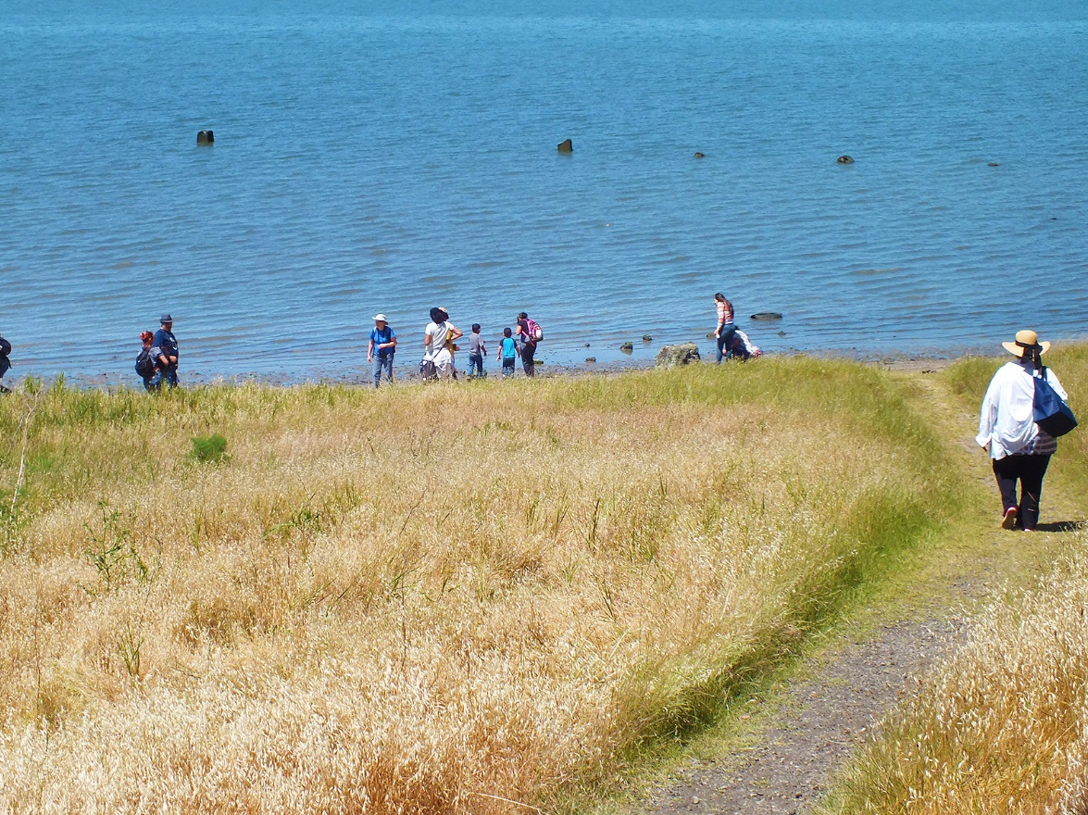
Thank you!
Juliana Gonzalez | juliana@thewatershedproject.org
Jesse Brown | jesse@thewatershedproject.org

